Slide 1
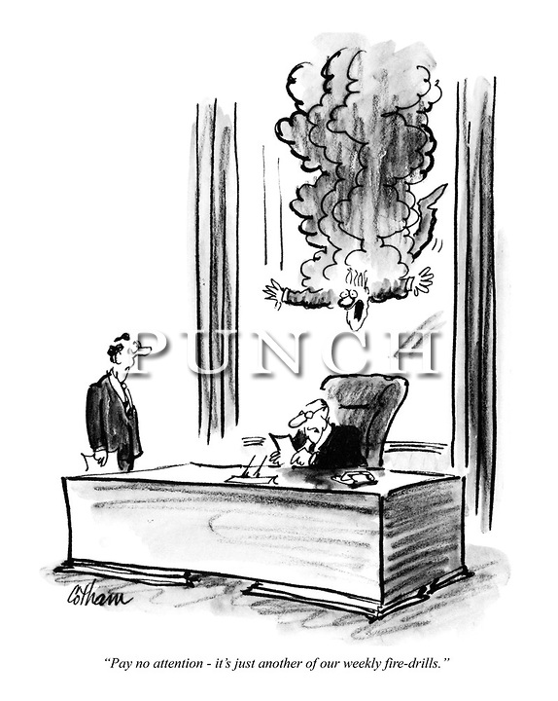
Fun Drill
Topic Selection Criteria
Generic and tied with common interests
Grassroots and Go-Viral
Extendible in the future
Attached to our career and life
Teamwork and Role Players
Organic and coordinated
Mash-ups
Virtual or Real/Physical

Slide 2
Drill One: How Big is iPhone5 Economy
iPhone5 teardown and BOM(bill-of-material) cost; technology inside you may want to know
SWOT based on TAIC-SIMO model or …
Put everything in one basket – defy market wiz or what!
From technology and design with innovation or just with performance up!
Which part of iPhone5 ecosystem get the bigger piece of economy?

Slide 3
Real or Virtual Teardown
Perform a physical teardown with your own cost or do it virtually with the following links:
http://www.youtube.com/watch?v=nlUQfXwvQLc&feature=related
http://www.youtube.com/watch?v=TulE1joZG-Q
http://www.ifixit.com/Teardown/iPhone-5-Teardown/10525/1
Open Q’s:
Why CEO of iFixit took such a hassle to launch iPhone5 teardown activities right after iPhone5 first launch? How on earth iFixit want to achieve here; surf http://www.ifixit .com to dig a bit more!
Other best cases of Guerrila and Viral Marketing
Can you perform a real teardown of your own gadgets: smart phone, PC etc.

Slide 4
BOM and Technology Inside
BOM and Cost
http://evertiq.com/news/22938
http://www.edn.com/electronics-blogs/now-hear-this/4396201/Estimate-put-iPhone-5-BOM-at--167-50
http://www.electronicsweekly.com/Articles/26/09/2012/54645/iphone-5-costs-8-to-manufacture.htm
http://blogs.marketwatch.com/thetell/2012/09/19/apple-iphone-5s-higher-production-costs-no-threat-to-profits/
http://www.valuewalk.com/2012/09/apples-gm-is-up-despite-increase-in-iphone-5-production-costs/
http://www.thinkdigit.com/Mobiles-PDAs/Teardown-analysis-reveals-Apples-iPhone-5costs_10824.html
http://www.eetasia.com/ART_8800675370_499489_TA_b0ed944c.HTM?click_from=8800098650,8626288021,2012-09-27,EEOL,ARTICLE_ALERT
http://www.electroiq.com/blogs/electroiq_blog/2012/09/inside-the-iphone-teardowns.html

Slide 5
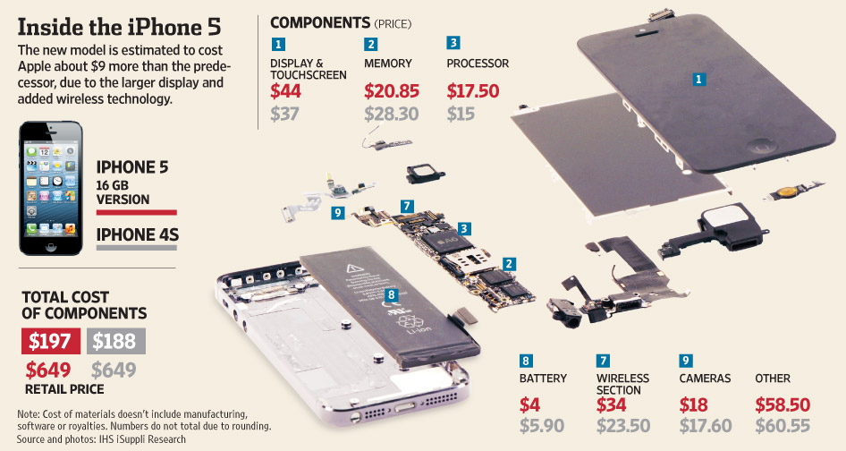
Hardware Inside Out

Slide 6
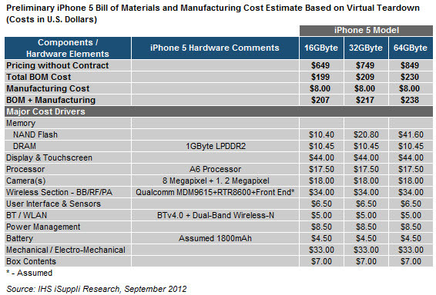
ASP(average selling price) and Profit Margin

Slide 7
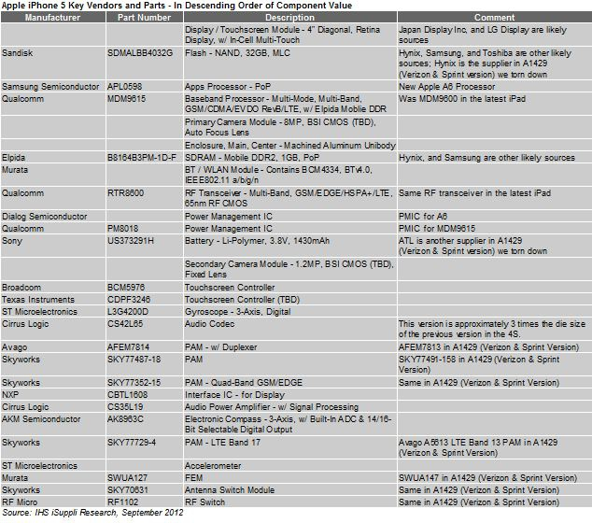

Slide 8
Hardware
Open Q’s:
Are you familiar with basic hardware technology nature of the major components in iPhone 5?
As a project manager in charge of iPhone 5 production delivery in Apple Inc., and your job is to construct a bill-of-materials (BOM) MS excel control file including cost, key part consigned decision, financial terms, delivery, inventory etc. for resource planning and supply chain management– how would you do this!
As CEO of Foxconn you challenge Apple for not warrant enough cost on the manufacturing -- how would you do this!
As CEO of Apple you face challenges of outsoucing too many manufacturing jobs outside U.S.– how would you respond this!

Slide 9
Software Inside Out
iOS6 http://www.apple.com/ios/what-is/
iTune Service http://www.apple.com/itunes/
Software and Services (3rd. Party Apps)
Patents
Open Q’s:
Are you familiar with basic software nature of iPhone 5 business?
As an iPhone heavy users, which software or service required more improvement or else.
As a markter how would you value the LTE service and what kind of Apps would be killer or most beneficial in the market!
What is your view on App Store and iTune: easy of use? How App ease your activities and interests?

Slide 10
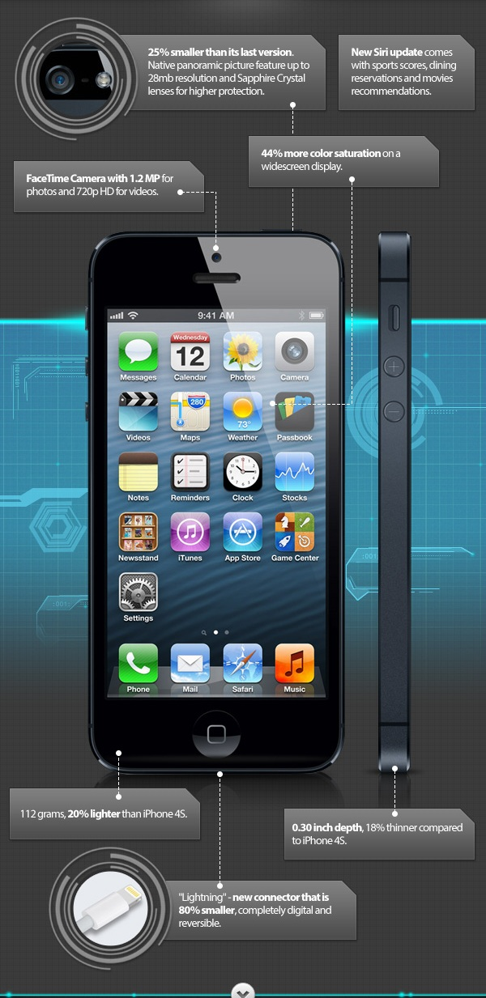
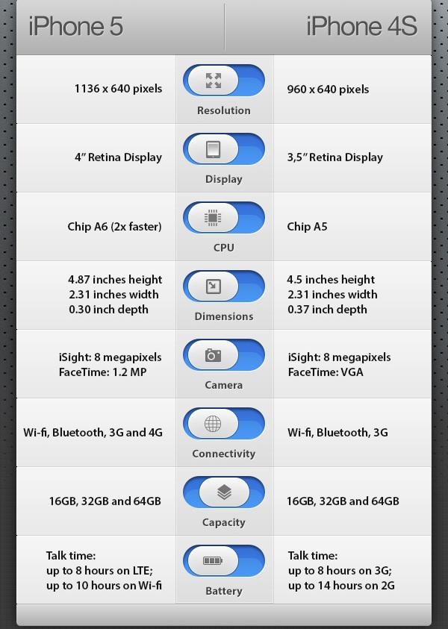

Slide 11
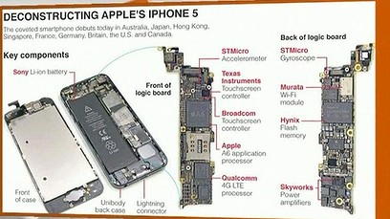

Slide 12
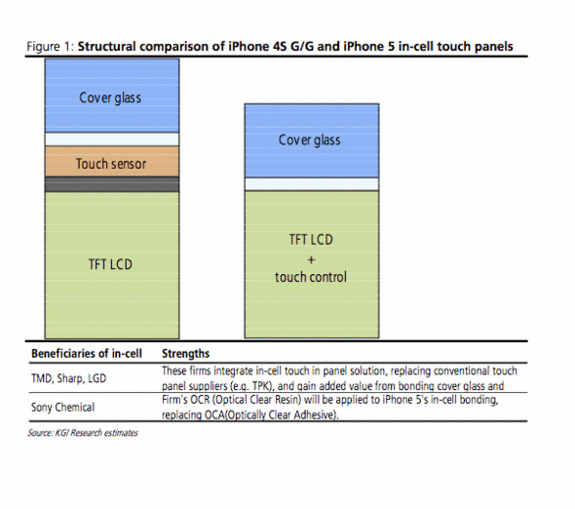
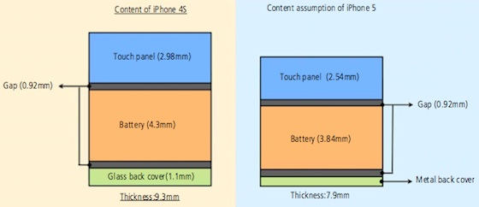
Shrinkage Technology: (battery, cover, and in-cell touch panel)

Slide 13
Visual Advantage of In-cell Technology
Non-in-cell
In-Cell

Slide 14
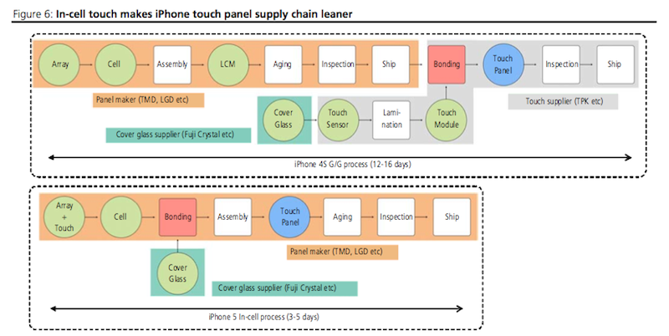

Slide 15
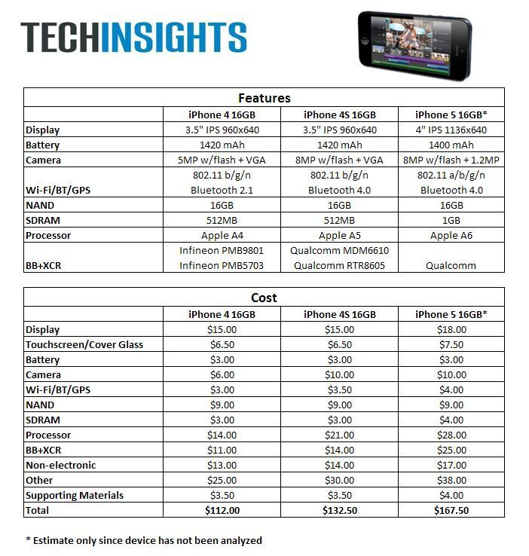

Slide 16
Technology Inside and Patents
http://www.chipworks.com/blog/recentteardowns/2012/09/20/2467/
http://www.businessinsider.com/apple-versus-samsung-2012-8?op=1
http://www.electroiq.com/blogs/insights_from_leading_edge/2012/09/iftle-116-a6-applications-processor-for-iphone-5-from-samsung-but.html

Slide 17
Non-Technology Inside Out (SWOT)
Spirit and Soul
Human Touch
iTune and Media Integration
Supply Chain Management
Value Chain Configuration
Apple Store and its authorized resales store
Other Intangible Factors

Slide 18
Non-Technology Inside Out (SWOT)
Open Q’s:
How Apple’s marketing approach differs or differed from others?
As a marketer, what is your view of Apple Store and its authorized resales stores!
Your view: What is or are the most important intangible(s) in Apple business!
What’s the watch-out needs to be concerned as a consultant of Apple business

Slide 19
SWOT
TAIC-SMIO Business Model
Matrix Integration in Supply/Value Chain http://itcandor.net/2010/03/05/matrix-integration/
Product Strategy
Apple Spirit and Leadership
Apple Economy and its Competitiveness http://itcandor.net/2012/08/16/itc-q212/ http://itcandor.net/2012/08/23/it-market-q212/

Slide 20
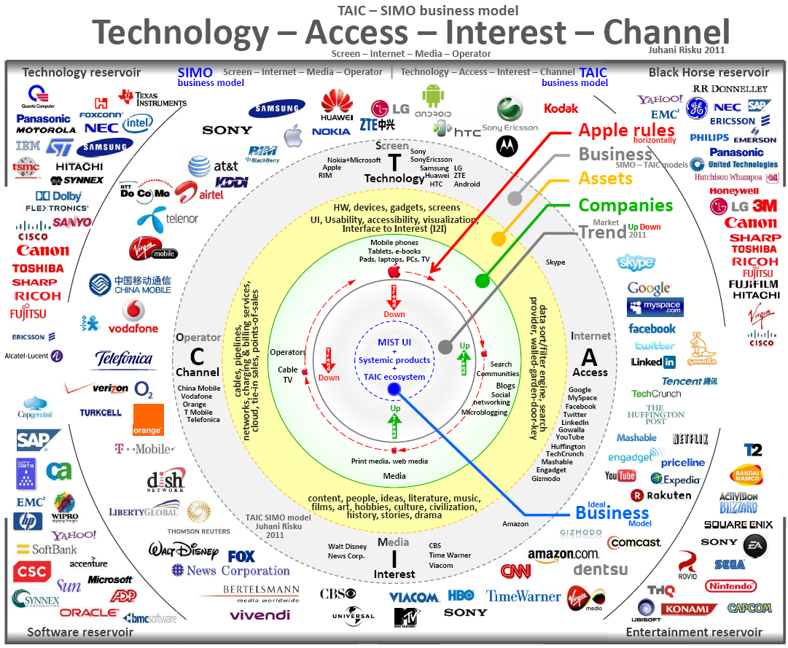

Slide 21
Or is Apple in control?

Slide 23
Did Steve Jobs envy this or what?

Slide 24
Spirit and Soul
Steve Jobs by Walter Isaacson
Inside Apple by Adam Lashinsky

Slide 25
iPhone5 Economy (transformed into $) (http://pcdandf.com/cms/marketnews/9080-apple-samsung-dominate-smartphone-space)
Apple alone
TAIC-SIMO ecosystem
Others:
Accessory
Authorized Retailed Stores
Media etc.
Financial: How Apple Sidesteps Billions in Taxes
http://www.nytimes.com/2012/04/29/business/apples-tax-strategy-aims-at-low-tax-states-and-nations.html?pagewanted=1&_r=1

Slide 26
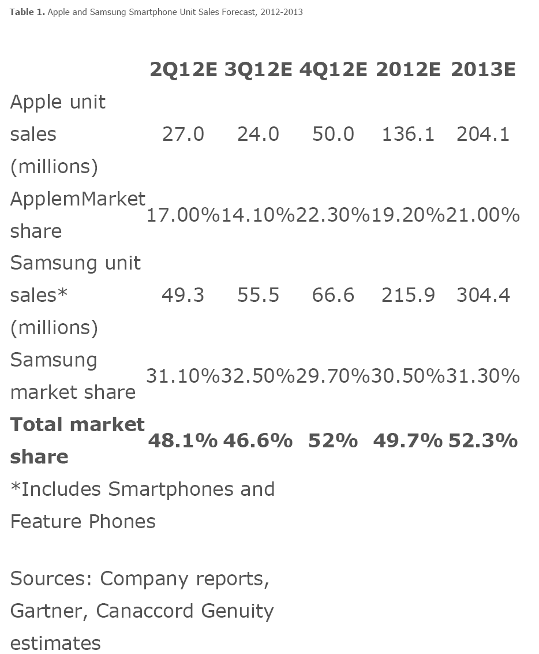

Slide 27
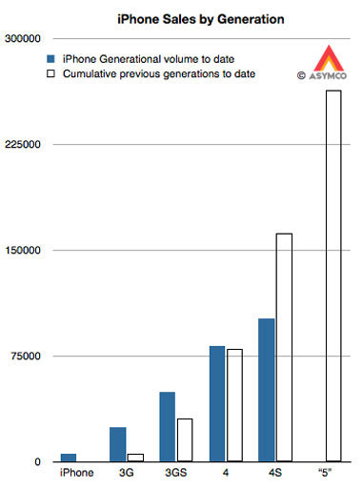
Apple expects to sell more than 263 million iPhone 5 units

Slide 28
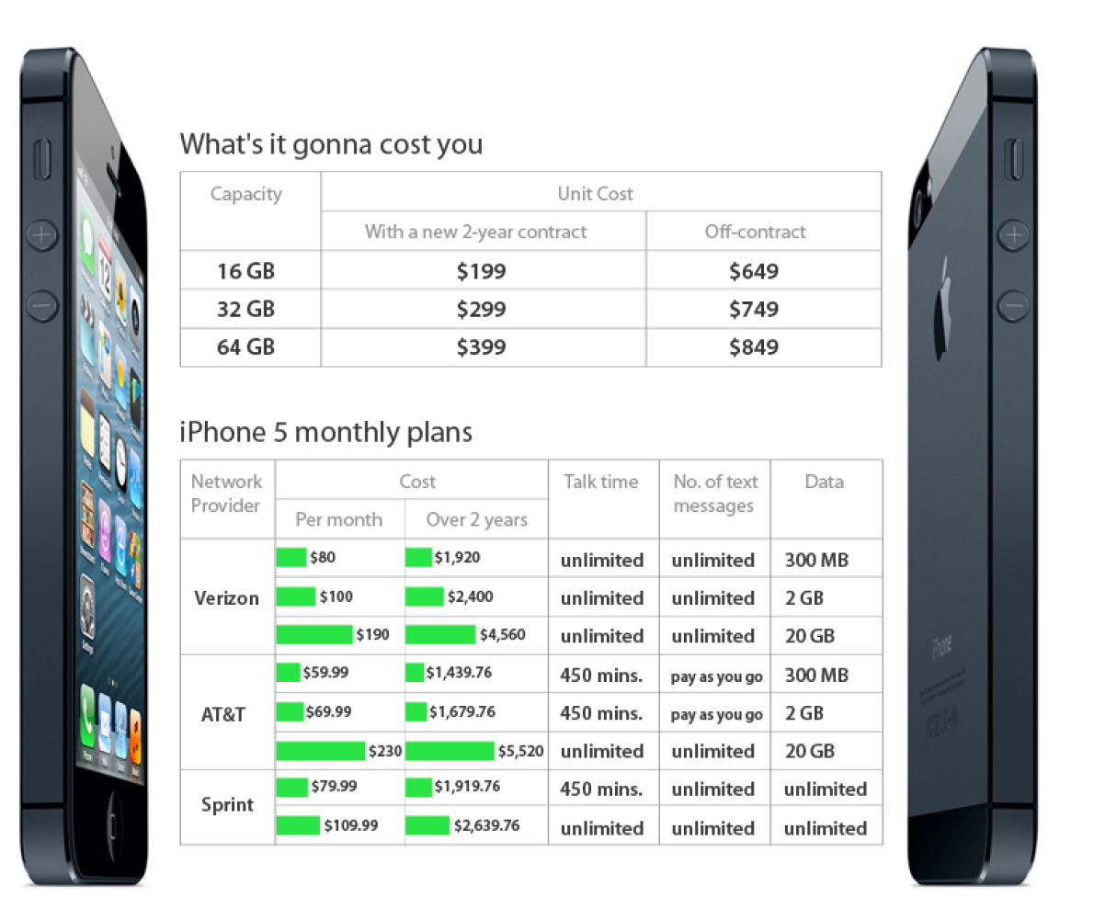
http://8.mshcdn.com/wp-content/uploads/2012/10/iphone5-true-cost.jpeg

Slide 29
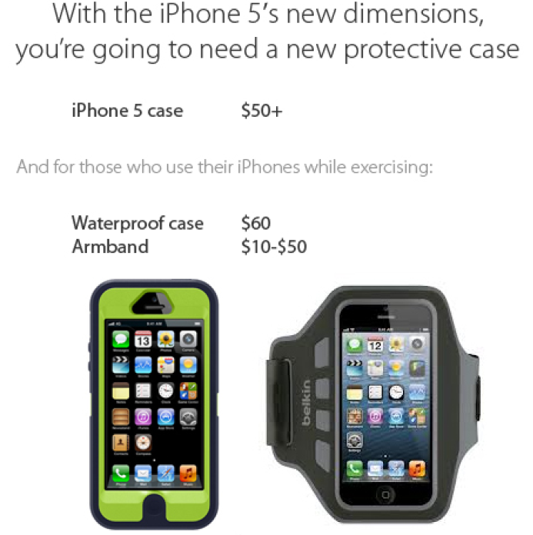
continue

Slide 30
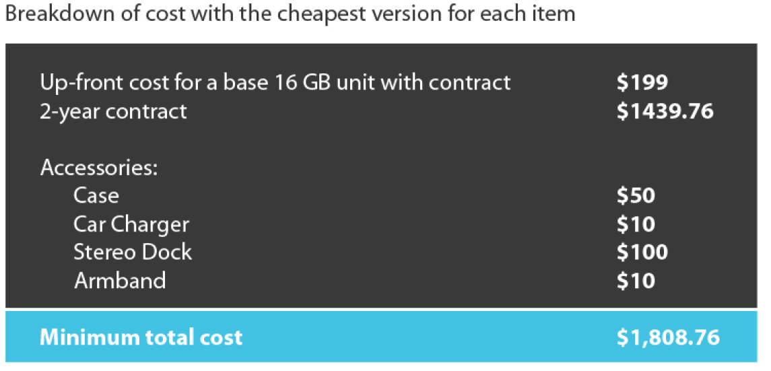
continue

Slide 31
continue

Slide 32
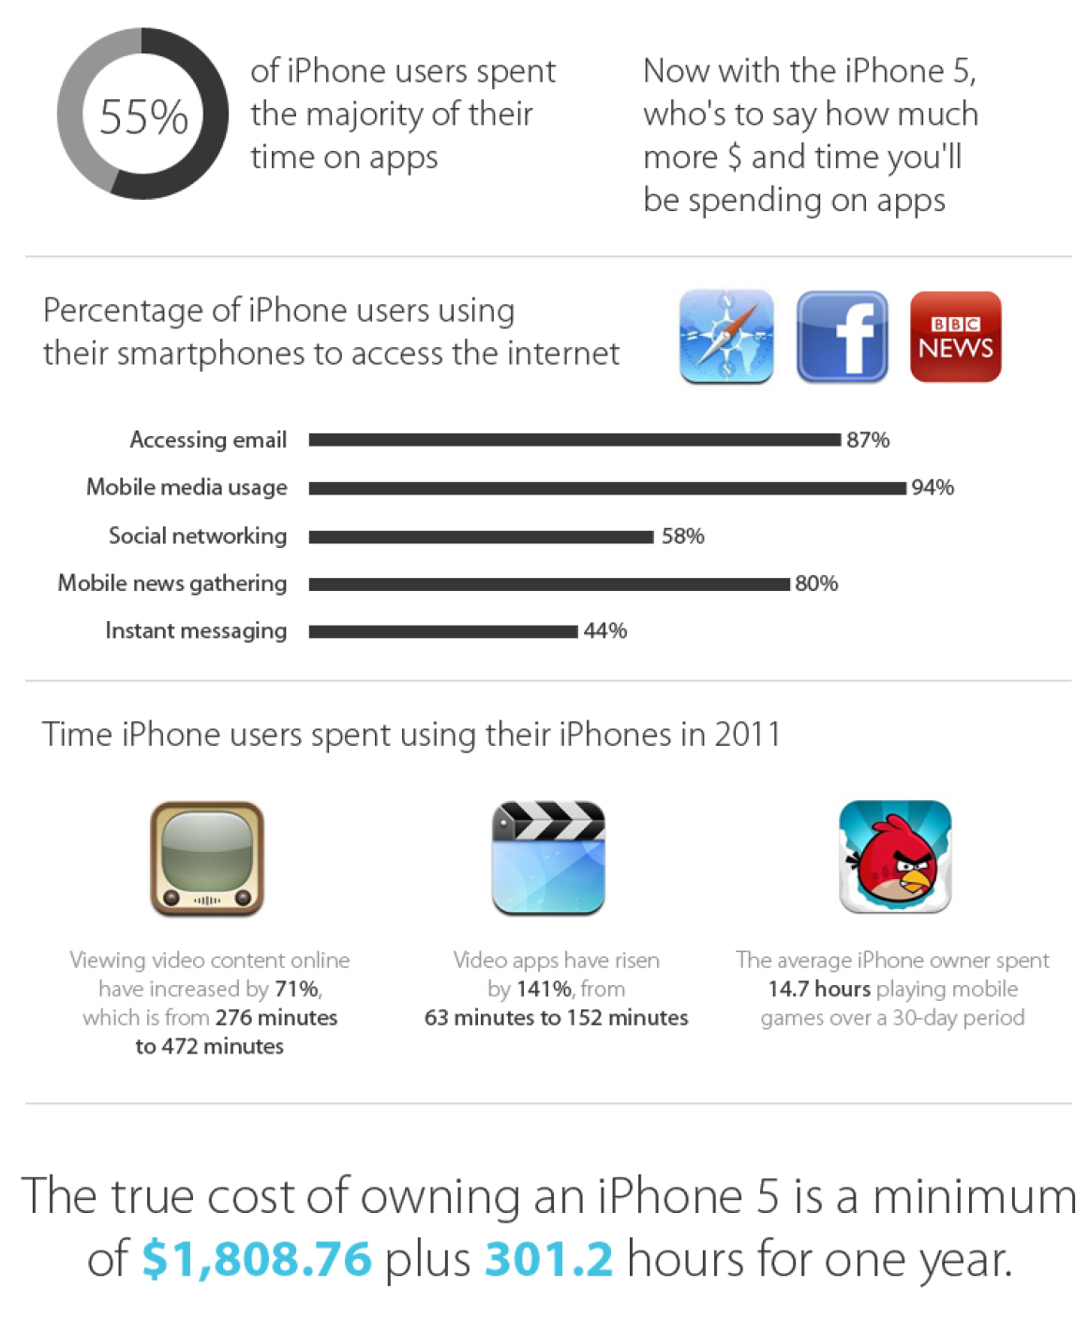
continue

Slide 34
iPhone 5(Apple) Economy: Analysis
Major Stakeholders in the iPhone5 Ecosystem
Manpower in the Value Chain
Technology Inside Out
Profit Distribution
Competition and Evolution?
Open Q’s:
How Apple can sustain its growth; iTV, iCloud, or iPC
Who/When/Why/What can beat or unleash Apple’s dominance (Antitrust, Samsung, Google, MS etc..)

Slide 35
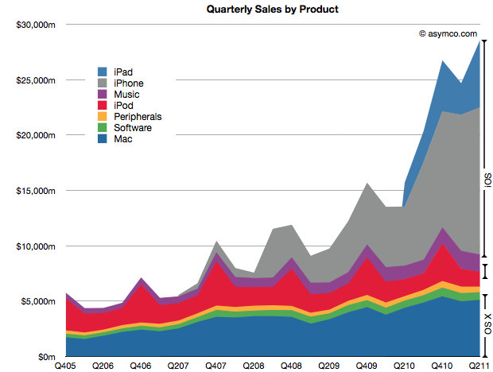
Apple QoQ Growth (pre-iPhone 5)

Slide 36
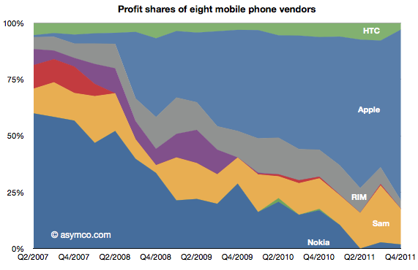
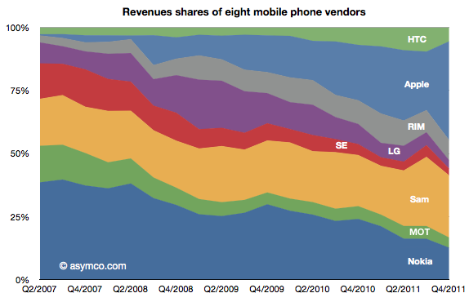
Apple Profit/Revenue Shares of Mobile Phone Market (pre-iPhone 5)

Slide 37
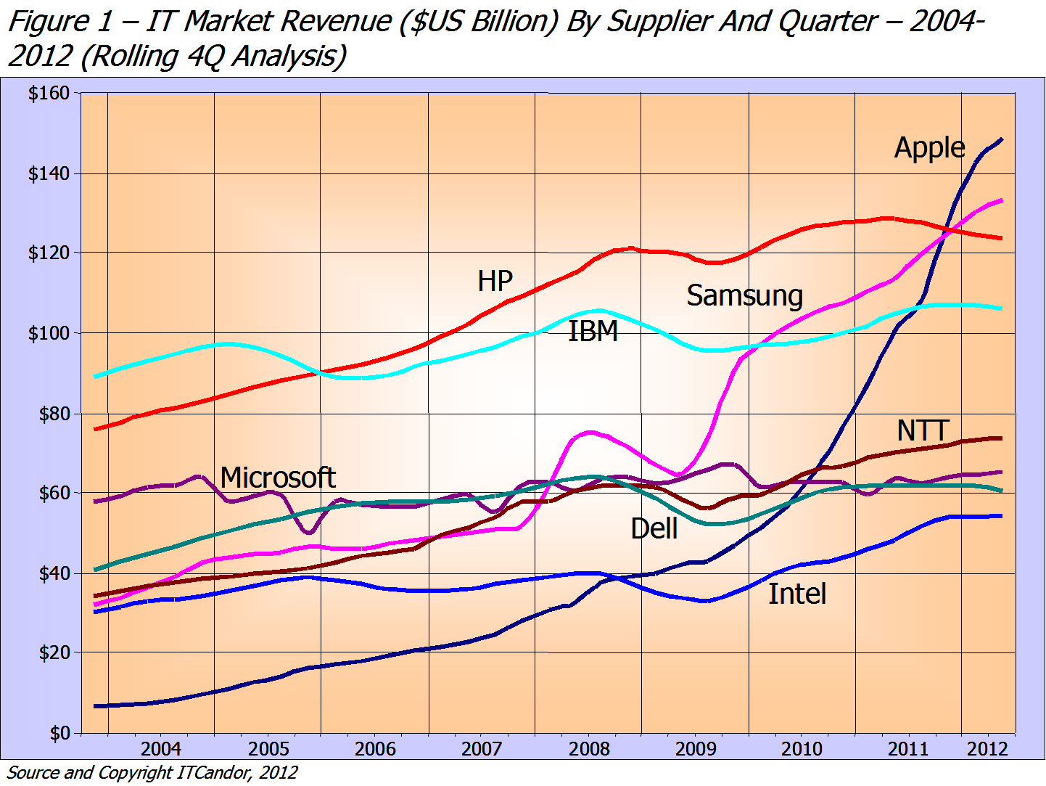
Apple Revenue in Overall IT Market
(pre-iPhone 5)

Slide 38
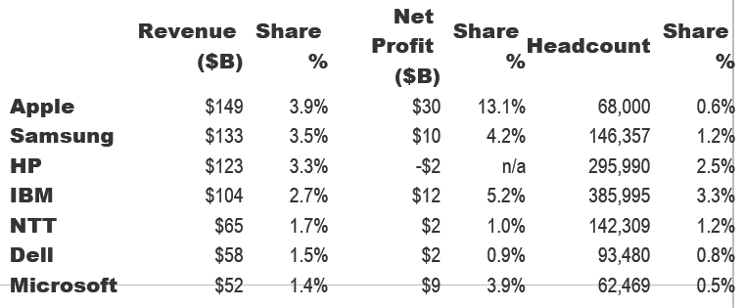
IT Market Share Revenue, Net Profit ($US Billion) and Headcount – Year To End of June 2012 (pre-iPhone 5)

Slide 39
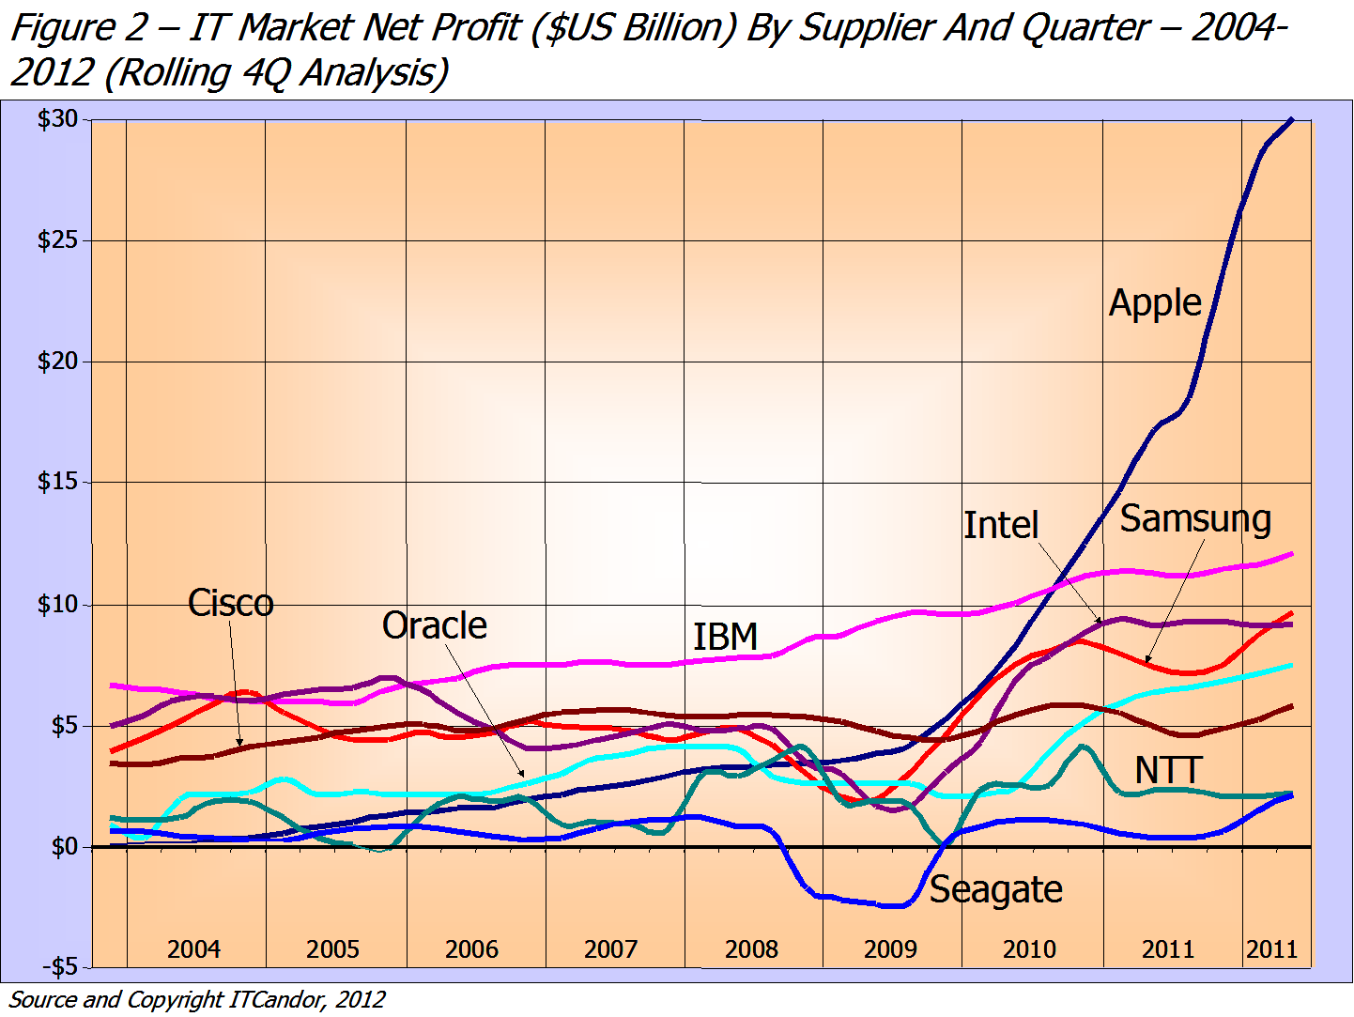
Apple Net Profit in Overall IT Market
(pre-iPhone 5)

Slide 40
Overall IT Market
(pre-iPhone 5)

Slide 41
Overall IT Market
(pre-iPhone 5)

Slide 42
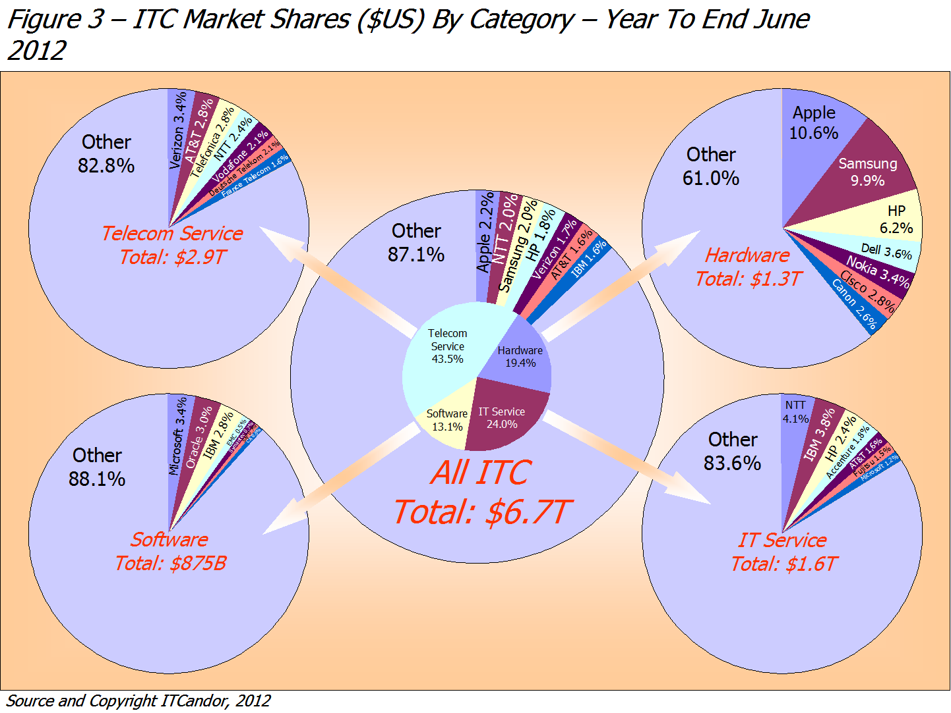
Overall IT Market
(pre-iPhone 5)

Slide 43
Competitors
Samsung S3 http://www.ifixit.com/Teardown/Samsung+Galaxy+S+III+Teardown/9391/1 http://www.techrepublic.com/blog/cracking-open/samsung-galaxy-s-iii-teardown-reveals-easy-open-case-difficult-to-fix-display/666

Slide 44
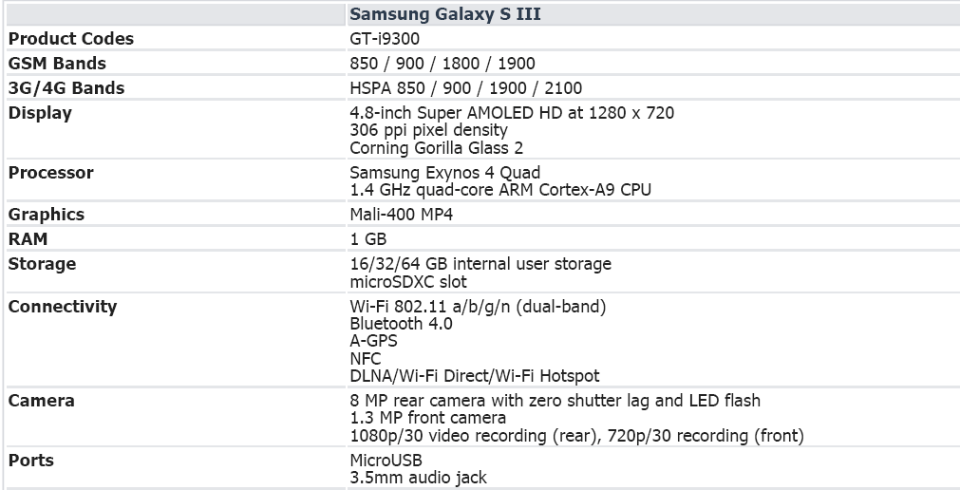

Slide 45
More Digging
Know What
Know How/When
Know Why
Assuming Role Players in the Business
What for: case study research paper, thesis, career planning, hobby etc.

Slide 46
iPhone 5 BOM (Bill of Materials)
Components/ Hardware Elements | iPhone 5 Hardware Comments |  | Leadtime | Inventory (OEM,EMS,Distributor,Component Supplier) | Component Consigned(OEM, EMS, Distributors) | Financial Terms(O/A, Net, T/T-in advance, LC, NET) | Note
ASP(average of selling price of iPhone 5) |  | $740
Total BOM Cost |  | $219.25
Manufacturing Cost |  | $8.00 |  |  |  | O/A 60 days
BOM + Manufacturing |  | $227.25
Malor Cost Drivers
Memory
NAND Flash | 32GB | $20.80 | 2-Month | 2-Month | OEM or Distributor | O/A 60 days | capacity;price up/down
DRAM | IGByte LPDDR2 | $10.45 | 2-Month | 2-Month | OEM or Distributor | O/A 60 days | capacity;price up/down
Display &Touchscreen | In-Cell Touch Display | $44.00 | 1-Month | 1-Month | OEM | O/A 60 days | yield
Processor | A6 Processor(ASIC) | $17.50 | 2-Month | 1-Month | OEM | O/A 60 days | single source
Camera(s) | 8 Megapixel(Back) + 1. 2 Megapixel(Front) | $18.00 | 1-Month | 1-Month | OEM | O/A 60 days | capacity
Wireless Section - BB/RF/PA | Qualcomm MDM9615 + RTR8600 + Front End | $34.00 | 2-Month | 2-Month | OEM | O/A 60 days
User Interface & Sensors | Light, 3D Gyro | $6.50 | 2-Month | 2-Month | OEM | O/A 60 days
BT/WLAN | BTv4.0 + Dual-Band Wireless-N | $5.00 | 2-Month | 2-Month | OEM | O/A 60 days
Power Management |  | $8.50 | 2-Month | 2-Month | OEM | O/A 60 days
Battery | Assumed 1800mAh | $4.50 | 1-Month | 1-Month | OEM or Distributor | O/A 60 days
Mechanical/Electro-Mechanical |  | $33.00 | 1-Month | 1-Month | OEM | O/A 60 days | single source
Passive Components |  | $10.00 | 1-Month | 1-Month | EMS or Distributor | O/A 60 days
Box Contents |  | $7.00 | 1-Month | 1-Month | OEM | O/A 60 days

Slide 47
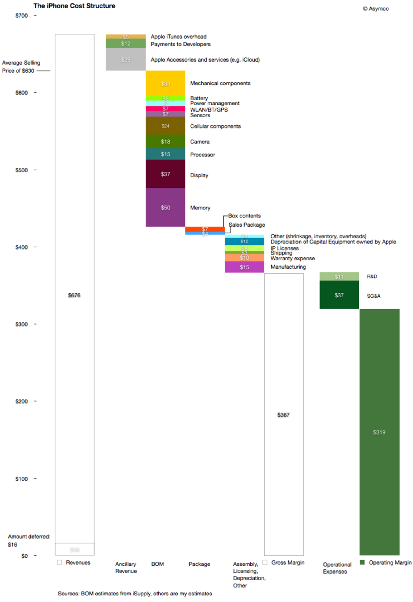

Slide 48
Twelve-month cash flow (unit: US$ million) |  |  |  |  |  | Apple Inc. (iPhone 5 project 10M/month) |  |  |  |  |  |  | Fiscal Year Begins: | Jan-13
 | Pre-Startup EST | Jan-13 | Feb-13 | Mar-13 | Apr-13 | May-13 | Jun-13 | Jul-13 | Aug-13 | Sep-13 | Oct-13 | Nov-13 | Dec-13 | Total Item EST
Cash on Hand (beginning of month) |  | $ - | $ 5,458 | $ 8,643 | $ 11,828 | $ 15,013 | $ 18,198 | $ 21,383 | $ 24,568 | $ 27,753 | $ 30,938 | $ 34,123 | $ 37,308
CASH RECEIPTS
Cash Sales |  | $ 7,400 | $ 7,400 | $ 7,400 | $ 7,400 | $ 7,400 | $ 7,400 | $ 7,400 | $ 7,400 | $ 7,400 | $ 7,400 | $ 7,400 | $ 7,400 | $ 88,800
TOTAL CASH RECEIPTS | $ - | $ 7,400 | $ 7,400 | $ 7,400 | $ 7,400 | $ 7,400 | $ 7,400 | $ 7,400 | $ 7,400 | $ 7,400 | $ 7,400 | $ 7,400 | $ 7,400 | $ 88,800
Total Cash Available (before cash out) | $ - | $ 7,400 | $ 12,858 | $ 16,043 | $ 19,228 | $ 22,413 | $ 25,598 | $ 28,783 | $ 31,968 | $ 35,153 | $ 38,338 | $ 41,523 | $ 44,708
CASH PAID OUT
Purchases (BOM+Manufacturing) | $ - | $ - | $ 2,273 | $ 2,273 | $ 2,273 | $ 2,273 | $ 2,273 | $ 2,273 | $ 2,273 | $ 2,273 | $ 2,273 | $ 2,273 | $ 2,273 | $ 24,998
Purchases (sales package) |  | $ 40 | $ 40 | $ 40 | $ 40 | $ 40 | $ 40 | $ 40 | $ 40 | $ 40 | $ 40 | $ 40 | $ 40 | $ 480
Purchases (specify)
Gross expense (SG&A+R&D) |  | $ 500 | $ 500 | $ 500 | $ 500 | $ 500 | $ 500 | $ 500 | $ 500 | $ 500 | $ 500 | $ 500 | $ 500 | $ 6,000
Payroll expenses (taxes, etc.) |  | $ 38 | $ 38 | $ 38 | $ 38 | $ 38 | $ 38 | $ 38 | $ 38 | $ 38 | $ 38 | $ 38 | $ 38 | $ 450
Outside services(payment to developers) |  | $ 120 | $ 120 | $ 120 | $ 120 | $ 120 | $ 120 | $ 120 | $ 120 | $ 120 | $ 120 | $ 120 | $ 120 | $ 1,440
Taxes (, etc.) |  | $ 555 | $ 555 | $ 555 | $ 555 | $ 555 | $ 555 | $ 555 | $ 555 | $ 555 | $ 555 | $ 555 | $ 555 | $ 6,660
Other expenses (IP licenses, warranty expense, shipping, inventory, overhead, depreciation ) |  | $ 350 | $ 350 | $ 350 | $ 350 | $ 350 | $ 350 | $ 350 | $ 350 | $ 350 | $ 350 | $ 350 | $ 350 | $ 4,200
Apple iTune overhead |  | $ 50 | $ 50 | $ 50 | $ 50 | $ 50 | $ 50 | $ 50 | $ 50 | $ 50 | $ 50 | $ 50 | $ 50 | $ 600
Apple accessory and service (e.g. iCloud) |  | $ 290 | $ 290 | $ 290 | $ 290 | $ 290 | $ 290 | $ 290 | $ 290 | $ 290 | $ 290 | $ 290 | $ 290 | $ 3,480
SUBTOTAL | $ - | $ 1,943 | $ 4,215 | $ 4,215 | $ 4,215 | $ 4,215 | $ 4,215 | $ 4,215 | $ 4,215 | $ 4,215 | $ 4,215 | $ 4,215 | $ 4,215 | $ 48,308
TOTAL CASH PAID OUT | $ - | $ 1,943 | $ 4,215 | $ 4,215 | $ 4,215 | $ 4,215 | $ 4,215 | $ 4,215 | $ 4,215 | $ 4,215 | $ 4,215 | $ 4,215 | $ 4,215 | $ 48,308
Cash Position (end of month) | $ - | $ 5,458 | $ 8,643 | $ 11,828 | $ 15,013 | $ 18,198 | $ 21,383 | $ 24,568 | $ 27,753 | $ 30,938 | $ 34,123 | $ 37,308 | $ 40,493

Slide 49
Challenge for Financial Manager of Apple Inc.
Zero budget to begin with?
No marketing and premarketing activities spending required?
What is the risk management of such amount of cash on hand?
What is the strategy plan to negotiate the terms with supply chain eco-system?
How iPhone 5 can be manufactured in U.S. and stayed cost competitve?

