Slide 1
World Is Flat or Spiky, or Something Else

Slide 2
Outline
“World is Flat”
“World is Spiky”
Unstable Planet: “World is Hot, Flat and Crowded”
Review of “World on Fire”

Slide 3
Flat World and Globalization

Slide 4
Links and Reading Materials
http://mitworld.mit.edu/video/519/
http://www.thomaslfriedman.com/media
http://macmillan.hosted.panopto.com/CourseCast/Viewer/Default.aspx?id=610215c3-a3c8-429c-9dcd-3f8b72ee8a99
http://deimos3.apple.com/WebObjects/Core.woa/Browse/uc.princeton.edu.1520400068
http://deimos3.apple.com/WebObjects/Core.woa/Browse/mit.edu.1472156963

Slide 5
What is a “Flat World?”
Phrase made popular by Thomas L. Friedman
  Author of “The World is Flat, A Brief History of the Twenty-First Century”
  Foreign affairs columnist for NY Times
The Flat World Defined
  Global, web-enabled platform
  Multiple forms of sharing knowledge and work
  Irrespective of time, distance, geography and increasingly, language
The global economic playing field is being leveled

Slide 6
Globalization and Flat World
Globalization is defined as the integration of economies throughout the world, enabled by innovation and technological progress

Slide 7
The Three Great Eras of Globalization
1492 – 1820 Globalization 1.0
  Exploration and colonization drive success
  Countries think globally to thrive
1820 – 2000 Globalization 2.0
  Collaboration between international companies
  Companies must think globally to survive
2000 – Present Globalization 3.0
  Individuals and small groups globalize
  Driven by diverse group comprised of all nationalities

Slide 8
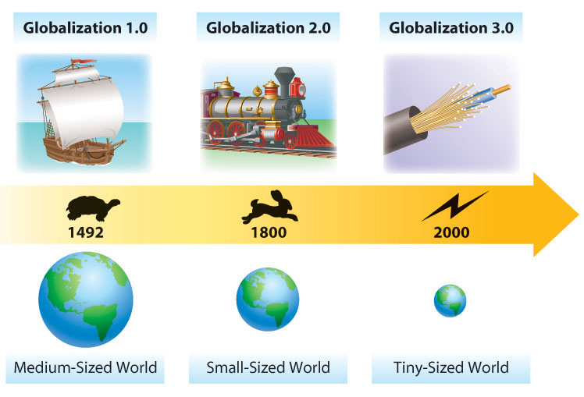
Globalization
Globalization created a new world characterized by:
  Worldwide communication
  Collaboration without barriers

Slide 9
Evolution of Globalization
Globalization 1.0
Mainly European countries are globalizing
Power is the primary driver
Industries changed
Slow pace of change

Slide 10
Evolution of Globalization
Globalization 2.0
Companies are globalizing
Reduction in transportation and telecom-munications costs
Mainly Europe and America involved

Slide 11
Evolution of Globalization
Globalization 3.0
Individuals and small groups are globalizing
Fast changes
Emergence of new industries
11

Slide 12
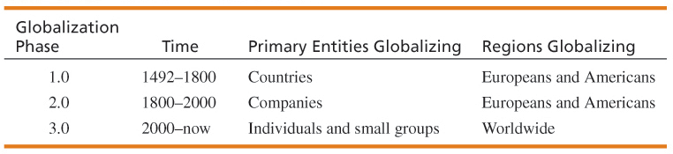
Evolution of Globalization: Summary
The World is Flat (Thomas Friedman)
“10 Flatteners”
  Key factors enabling globalization 3.0
12

Slide 13
Discussion Topics
How the world became flat
  Everyday examples
  The 10 World “Flatteners”
  The Triple Convergence
  The Quiet Crisis
What this means to us
  Impact on jobs
  Becoming an “untouchable”
  Taking advantage of the flat world

Slide 14
Everyday Examples
Jet Blue Reservation System
  Retirees and housewives take airplane reservations from their homes
McDonald’s Call Center
  Drive-thru customers across the country give their order to a worker in Colorado Springs
Indian Technicians and Engineers
  Read X-rays, write software, provide administrative support to US companies from Bangalore
Chinese Workers and Technicians
  Japanese speaking Chinese workers provide backroom support to American and Japanese companies

Slide 15
Friedman’s ten "flatteners"
    Friedman feels that his first three flatteners have become a “crude foundation of a whole new global platform for collaboration.”
  #1: Collapse of Berlin Wall-(11/09/1989) : The collapse of the Berlin wall which ended the cold war Friedman sees as the starting point for leveling the global playing field. Friedman believes that this event not only marked the end of the Cold war, it has allowed people from other side of the “wall” to join the economic mainstream.
  #2: Netscape - (8/9/1995): with their Web Browser broadened the audience for the Internet. Expanding the role from its roots as a communications medium used primarily by scientists.
  #3: Workflow software: The ability of machines to talk to other machines with no humans involved.
  #4: Open sourcing: Communities uploading and collaborating on online projects. Friedman’s examples include open source software, Blogs, and Wikipedia. Friedman considers Open sourcing "the most disruptive force of all“ to the old order.
  #5: Outsourcing: Friedman postulates that outsourcing has allowed companies to split service and manufacturing activities into components, where each component performed in most efficient, cost-effective way.

Slide 16
Friedman lists ten "flatteners" that have leveled the global playing field:
  #6: Offshoring: Offshoring, the manufacturing equivalent of outsourcing.
  #7: Supply chaining: Friedman compares the modern retail supply chain to a river, and uses Wal-Mart as the best example of a company using technology to streamline item sales, distribution, and shipping.
  #8: Insourcing: Friedman uses UPS as a prime example for insourcing, where the company's employees perform services--beyond shipping--on behalf of another company. For example, UPS itself repairs Toshiba computers on behalf of Toshiba. The work is done at the UPS hub, by UPS employees.
  #9: In-forming: Google and other search engines are the prime example. "Never before in the history of the planet have so many people-on their own-had the ability to find so much information about so many things and about so many other people", writes Friedman.
  #10: "The Steroids": Personal digital equipment like mobile phones, iPods, personal digital assistants, instant messaging, and voice over IP or VOIP

Slide 17
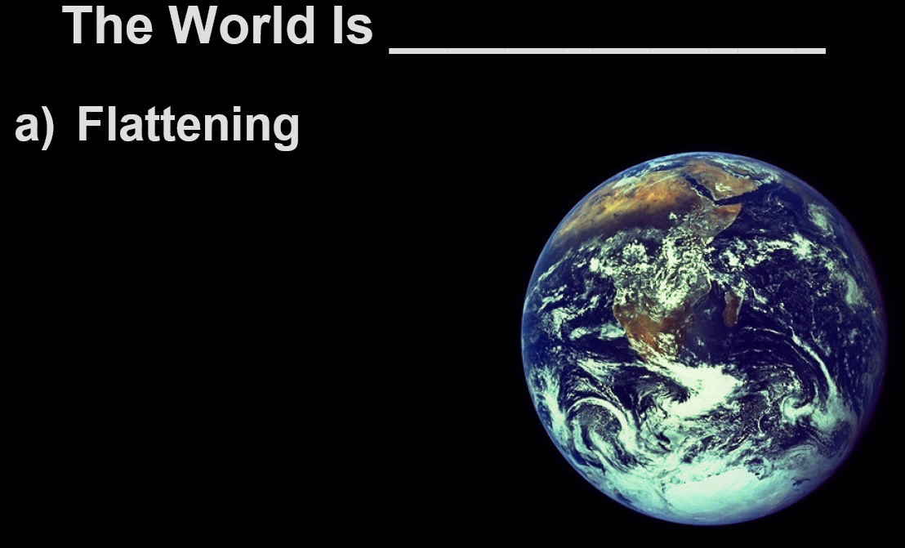

Slide 18
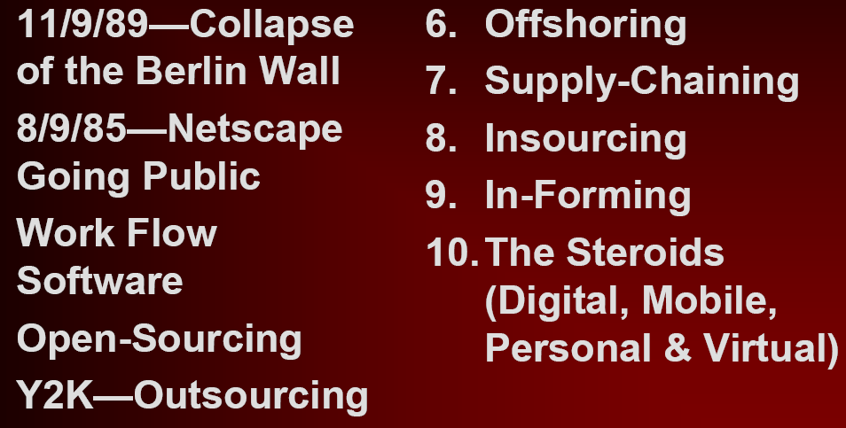
The Ten Forces* that
“Leveled the Playing Field”
1.
2.
95
3.
4.
5.

Slide 19
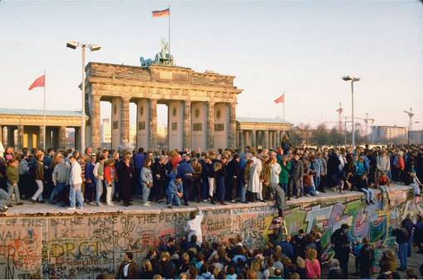
Flattener #1: The Fall of the Berlin Wall
11/9/1989: Berlin Wall came down
Each outbreak of freedom stimulated another outbreak
Tipped the balance of power toward democracy and free-market oriented governance
The wall was blocking our ability to think about the world as a single market. It allowed for the free movement of best practice
India brought down its own wall in 1991 by opening up its economy

Slide 20
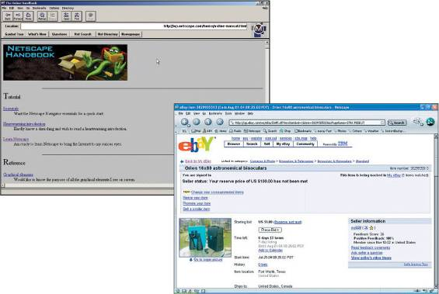
Flattener #2: Netscape Browser IPO
August 9, 1995, First mainstream browser, gave individuals access to the Internet
The coincidence of three events: Internet + World Wide Web + Netscape
What really popularized the Internet and the Web was the easy to use browser
Sparked the dot com boom and over-investment in fiber optic cable (connected the world)
Dot com bust made cost of using fiber optic cable virtually free
First commercial browser, invigorated internet use
Netscape brought the Internet alive and made it available to anyone with a computer
This led to massive investment in fiber-optic cable
This in turn made Bangalore a suburb of Boston
THEN
NOW
Uploading: The capacity to create, collaborate, develop then upload information, data, opinions, pictures and software onto the Web. can be done individually or part of self-forming communities – without going through traditional organizations or hierarchies. It is the shift from passive downloading to active uploading – everyone can now be a producer
Uploading is changing the way problems and issues can be raised, addressed and potential solved.

Slide 21
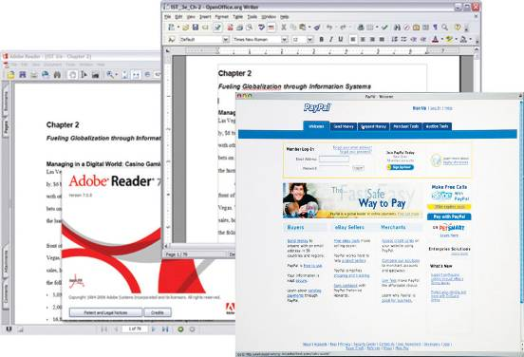
Flattener #3: Work Flow Software
Applications that allow people worldwide to communicate
XML allows applications to “talk” to each other
New possibilities for information sharing
Software and standards developed that allow people to work together
Created a global platform that enabled collaboration
Machines inter-acting with other machines without human intervention
Global platforms and standards allowed software applications to enhance collaboration, innovation and creativity.
More people were seamlessly connected and allowed to work on each other’s digital content allowing greater collaboration to build coalitions, projects and products - together

Slide 22
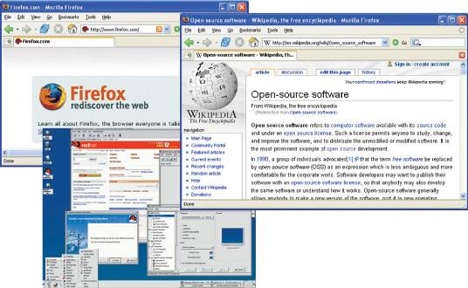
Flattener #4: Open Sourcing
Software and source code freely available to everyone
Self-organizing collaborative communities
Free code written by individuals and shared openly
Peer review provides rewarding gratification
Wikipedia a huge success

Slide 23
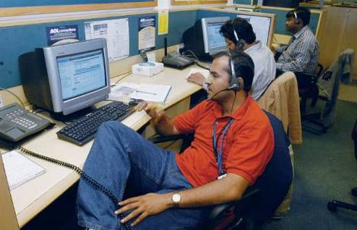
Flattener #5: Outsourcing
Bangalore becomes suburb
of North Dakota
Any service, call center, business support operation, or knowledge work that can be digitized can be sourced globally
Opportunity to seek cheapest, smartest, most efficient providers
Invigorated by Y2K computer date crisis (India)
Outsourcing companies profited from the drop in telecommunications costs
Companies can now use talented engineers from anywhere
Focuses primarily on the extensive opportunities in India to access highly qualified, English speaking engineers.
Services have rapidly expanded from low cost menial tasks to offering a range of software and consulting firms.
With growing pressure to reduce costs within North American organizations, whole new opportunities to outsource backroom operations have developed

Slide 24
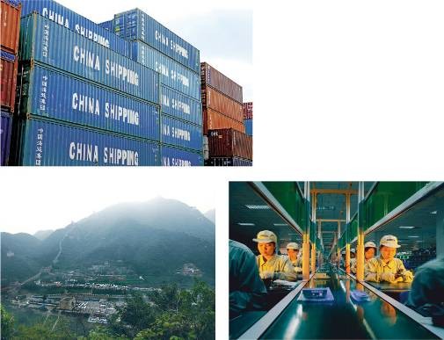
Flattener #6: Offshoring
Offshoring is taking an entire factory and moving it offshore
Whole new opportunities for offshoring developed when China entered the WTO
In addition, China is developing its own huge domestic market while at the same time racing to become the largest, strongest, and most dynamic economy in the world.
“If you are sitting in the U.S. and don’t figure out how to get into China in ten or fifteen years you will not be a global leader”
Companies move entire factory or operation offshore to foreign country
Same product produces in same way with cheaper labor, lower taxes, etc.
Invigorated by China joining the World Trade Organization (Dec 2001)
Companies set up entire factories in countries such as China
  Mass production
  Low Costs

Slide 25

Flattener #7: Supply Chaining
Integration of retailers, suppliers, and customers
RFID tags used
Wal-Mart became an early leader
Wal-Mart pioneered global supply chain efficiency
Wal-Mart trucks deliver products to stores, pick up goods from manufacturer on return to distribution center
An item is purchased in Wichita, KS and another one is instantly produced in Beijing
Prediction of hurricane causes specialized products to be shipped to affected stores (Pop Tarts, toys, beer)
Collaborating horizontally – among suppliers, retailers and consumers to create value
The more supply chains eliminate points of friction, the more efficiencies of one company get adopted by others, and the more they encourage global collaboration
Supply chaining is about working with manufacturers to reduce costs, ensuring supply chain efficiency and constantly improve your information systems

Slide 26

Flattener #8: In-Sourcing
Insourcing is the process where a company goes inside another organization and brings their skills and expertise while taking on the brand of that organization.
Its about an organization focusing on its core competencies.
The insourcing firm answers your phones, talks to your customers, inventories your products, and provides you with data on what sells and what does not.
This is much more than a customer-vendor relationship
Logistics giants take control of customer supply chains
UPS provides internal logistics support for other companies
Toshiba laptops sent directly to UPS where a UPS employee repairs it and return ships to customer
Delegation of company’s key operations to a subcontractor
  E.g.: UPS provides complete supply chain solutions to companies

Slide 27
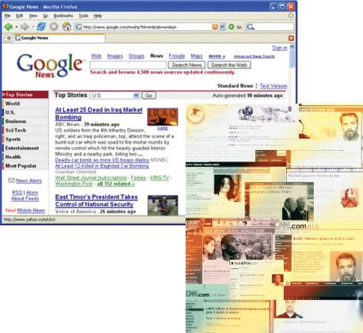
Flattener #9: In-Forming
Search engines (Google, Yahoo!, etc) provide universal access to information
Individuals empowered to find information
In-forming is the ability to build and deploy your own supply chain of information, knowledge and entertainment
It is the antithesis of being told or taught. It is about self-empowering; empowering individuals to do what they think best with the information they want.
The opportunity for people to have private, semiprivate, or public gatherings on the Internet regardless of geography and time
In-Forming is to individuals what outsourcing, offshoring, and in-sourcing is to companies
Individuals have access to massive amounts of information

Slide 28
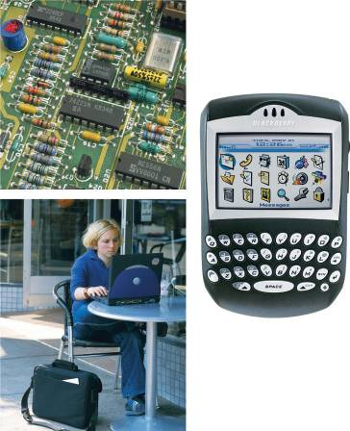
Flattener #10: The Steroids
Wireless, VoIP, file sharing that enhance the collaboration tools
Digital, mobile, virtual and personal technologies explode
The new technologies that are amplifying and turbo-charging all other flatteners.
  Computing speed and capacity
  Instant messaging
  VOIP
  Videoconferencing
  Computer graphics
  Wireless technologies and devices
Technologies that support different types of collaboration
  Greater mobility
  Convergence

Slide 29
The Triple Convergence
All of the ten flatteners coming together around the year 2000 creating a platform that is global, Web-enabled allowing for multiple forms of collaboration
Business and individuals adopting new habits, skills and processes to maximize the benefits of a flat world.
When all of this flattening was occurring, a whole new group of people in the billions from China, India and the former Soviet Union have entered the market and are leveraging the flat world

Slide 30
The Triple Convergence
Vertical (command and control) value-creation model
All 10 flatteners converged in 2000
and worked together to create the flat world
Horizontalization – Emergence of management
practicesand infrastructure to boost productivity
India, China, and former Soviet Empire
are joining the Flat world (300 million people)
Horizontal (connect and collaborate) value-creation model

Slide 31
The Quiet Crisis
Friedman argues that the US is in a “quiet crisis” caused by 3 issues
  The Numbers Gap
    US is no longer producing adequate number of educated workers and engineers
    India and China overshadow US demographically
  The Ambition Gap (“laziness”)
    Americans believe they are “entitled” to certain jobs
    Some companies believe productivity higher in other countries
  The Education Gap
    US education system is not preparing young people for new types of work
    Funding levels for education are inadequate

Slide 32
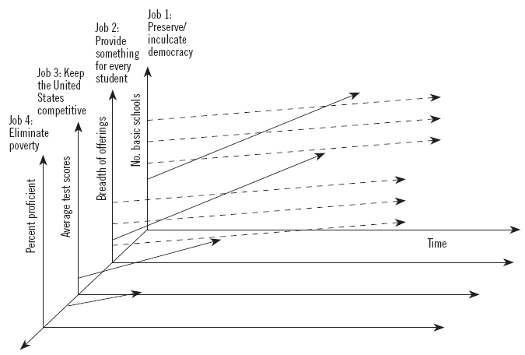
Traditional Education System in Democratic Regions
Continuous Sustaining Innovation
every student
Ref. Disrupting Class, Clayton M. Christensen

Slide 33
Traditional Education System in Democratic Regions
Continuous Sustaining Innovation
every student
Ref. Disrupting Class, Clayton M. Christensen

Slide 34
U.S. President
John Adams famously said:
I must study politics and war that my sons may have liberty to study mathematics and philosophy.
My sons ought to study mathematics and philosophy, geography, natural history, naval architecture, navigation, commerce, and agriculture in order to give their children a right to study painting, poetry, music, architecture, statuary, tapestry, and porcelain.
Prosperity can be an enemy to motivation to
study topics that are not taught in intrinsically motivating ways.

Slide 35
Intrinsic Motivation and
Extrinsic Motivation
Intrinsic motivation reflects the desire to do something because it is enjoyable. If we are intrinsically motivated, we would not be worried about external rewards such as praise or awards. If we are intrinsically motivated, the enjoyment we experience would be sufficient for us to want to perform the activity in the future.
Extrinsic motivation reflects the desire to do something because of external rewards such as awards, money, and praise. People who are extrinsically motivated may not enjoy certain activities. They may only wish to engage in certain activities because they wish to receive some external reward.

Slide 36
Examples of Extrinsic and Intrinsic
There are many possible extrinsic motivation examples. The writer who only writes poems to be submitted to poetry contests would be one example of extrinsic motivation. The person who dislikes sales but accepts a sales position because he or she desires to earn an above average salary is another example of extrinsic motivation. A third example of extrinsic motivation is selecting a major in college based on salary and prestige, rather than personal interest in the major.
Teachers may be very interested in fostering intrinsic motivation. If students are only interested in receiving grades or praise, and do not enjoy learning, then teaching may be very difficult. Students may not wish to think or apply their knowledge. They may only be concerned with what will be on the tests. In contrast, students who are intrinsically motivated may enjoy challenging work, and may think in greater depth about ideas. Teachers may be able to foster intrinsic motivation by having students work on projects that allow them to see how the information is relevant to their lives.

Slide 37
Malaise in Education
As a developing country develops an industrial-based economy, studying science, math, and engineering offer big rewards that ensure students an escape from poverty. When the same country achieves stability and prosperity, students have more freedom to study subjects that they find fun and intrinsically motivating.
This is a key reason why technological advantage shifted first from US/EU to Japan and is now shifting to China and India. Because of a variety of cultural, economic, and societal factors, the United States’ schools as a typical example start from a disadvantage compared to many of their international counterparts, where there is far more extrinsic motivation present in society
Schooling can and should be an intrinsically motivating experience. The questions are why this often has not been the case, and how to resolve these problems.

Slide 38
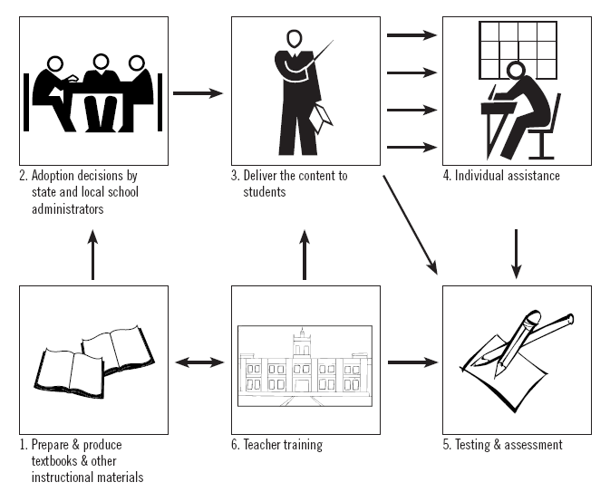
Public Education System:
Value-Chain Business and Monolithic

Slide 39
Education Commercial System
Step 1: Producing and Distributing Textbooks and Instructional Materials
Step 2: Marketing and Distribution
Subsequent Steps in the Monolithic Mode
Note how everything in the system (except step 4, the small amount of time teachers have available to offer individual help) is designed to treat all students the same

Slide 40
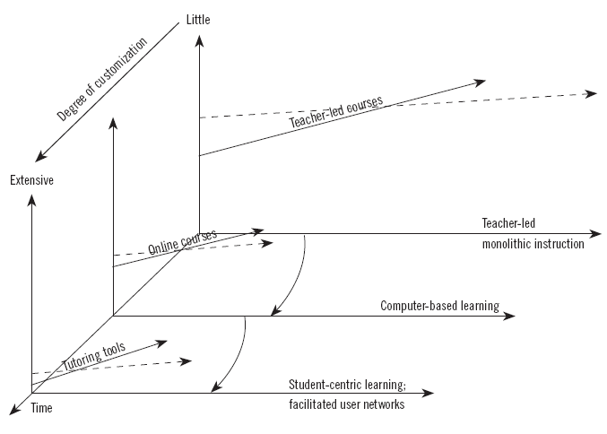
Asymmetric Competition:
Disruptive Class
Ref. Disrupting Class, Clayton M. Christensen

Slide 41
Disruptive Class
Teacher-led Monolithic instruction: Textbook development and production, school district adoption decisions, the systems of instruction, and assessment are al monolithic because customization is prohibitively expensive.
Online learning representing the first stage of instructional disruption called computer-based learning, takes root competing against nonconsumption. It is already underway and is being fueled primarily by the economics of the teacher-led model—by the inability of schools to offer the courses that students want or need to take. The courses in this stage look a lot like the courses in the back plane in that they tend to be designed by and taught to people with the dominant type of intelligence in the field. They constitute complete courses and tend to be made and marketed by companies with value-chain business models.
Student-centric learning depicts the second stage of disruption. The products in this wave will be user-developed online tools for tutoring. They will be distributed to students, teachers, and parents through a user network, not a value chain. Its products will be modular, which will make customization easy. In a manner analogous to the way that software developers can build their custom operating systems by inserting kernels of Linux exactly where they are needed, users will select these tutorial modules and then insert them, like “kernels,” to augment and customize the courses to the learning needs of each different type of learner. Ultimately, people will assemble them together into entire courses whose approach is truly student-centric—custom-configured to each different type of learner.
Ref. Disrupting Class, Clayton M. Christensen

Slide 42
Globalization: Impact on Jobs
Three types of jobs in current market
  Fungible Jobs
    Repetitive and skill-based work
    Easily digitized and not tied to a particular location
    Easily outsourced
  Anchored Jobs
    Must be performed in a particular location
  Value-add Jobs
    Require specialized skills and knowledge
    Knowledge must be across a number of disciplines and deep
The individual worker is responsible for managing
his or her own career, risks, and economic security

Slide 43
Becoming an “Untouchable”
Four types of workers in current market
  Special Workers
    Special people like sports stars, movie actors, etc.
  Specialized Workers
    Work cannot be outsourced
    Skills in high demand and not fungible
  Anchored Workers
    Tied to a specific location
  Really Adaptable Workers
    Constantly acquire new skills, knowledge, expertise
    Look for unique and creative components of job
Untouchables are people whose jobs cannot be
outsourced, digitized, or automated

Slide 44
Help Wanted Ads in a Flat World
Great Collaborators and Orchestrators
  Collaborating within and between companies
  Managers who can work in 24/7 supply chains
Great Synthesizers
  Putting disparate and unusual things together
  Example: Search engines require mathematicians and marketing experts
Great Explainers
  Ability to explain complex concepts with simplicity
Great Leveragers
  Optimizing the interface between people and machines

Slide 45
Help Wanted Ads in a Flat World
The Great Adapters
  Employees must be adaptable and versatile
    Specialists have deep skills and narrow scope
    Generalists have shallow skills and broad scope
    Versatilists apply depth of skill to widening scope through constant learning and growing
The Green People
  Industry of creating renewable energies and environmentally sustainable systems will grow
  Three-billion people in China, India, and former Soviet Empire are joining the flat-world – will create more demand for energy and products
The Great Localizers
  Local businesses will still drive majority of jobs
  Successful people will understand global infrastructure and adapt to local needs and demands

Slide 46
Taking Advantage of a Flat World
Utilize information resources
  AIAA Electronic Library, other internet sources
Utilize international network
  Colleagues at Universities, industry partners
  International members at AIAA conferences
  Look for opportunities to learn from and collaborate with others
Become Really Adaptable
  Never stop learning
    Participate in continuing education events
    Conduct research, write a paper for AIAA Journal or Conference
  Build a global network
    Participate in AIAA conferences, section meetings, etc.
    Become a member on an AIAA Technical Committee
    Find a mentor
  Take control of your own career

Slide 47
The Quiet Crisis
Dot Com misconception—Hard work not necessary
China and India took advantage of the flat economy
Steady erosion of US engineering, math and science
Must be innovative and creative

Slide 48
Dirty Little Secrets
NUMBERS GAP
NASA—40 percent of workers (18,146) are fifty years of age or older
AMBITION GAP
Jobs overseas save 75 percent of wages
EDUCATION GAP
Intel Science/Engineering Fair in China
65,000 American students
6 million Chinese students

Slide 49
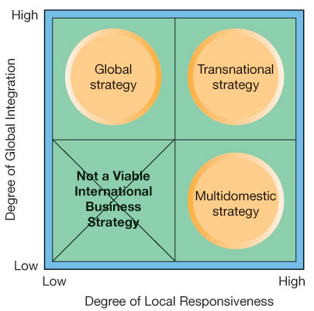
Going Global: International Business Strategy in the Digital World
Multidomestic Business Strategy
Global Business Strategy
Transnational Business Strategy

Slide 50
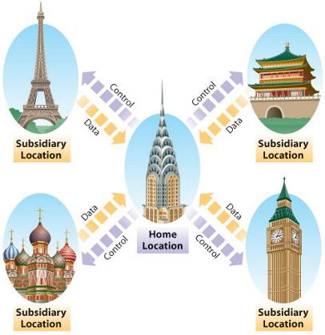
Multidomestic Business Strategy
Low degree of integration between subunits
Flexible and responsive to the needs and demands of local markets
E.g.: General Motors
  Opel in Germany
  Vauxhall in Great Britain

Slide 51
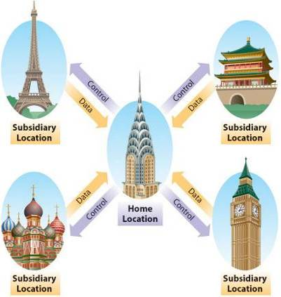
Global Business Strategy
Centralized
Used to achieve economies of scale
E.g.: Coca-Cola
  Same core product
  Some different tastes made for local markets

Slide 52
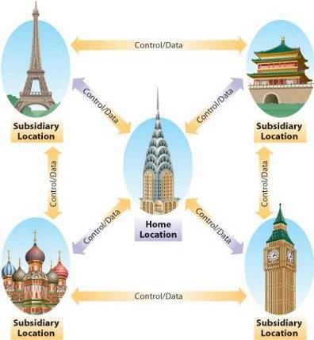
Transnational Business Strategy
Some operations centralized while others decentralized
  Flexibility
  Economies of scale
Difficult to manage
E.g.: Unilever, China!

Slide 53
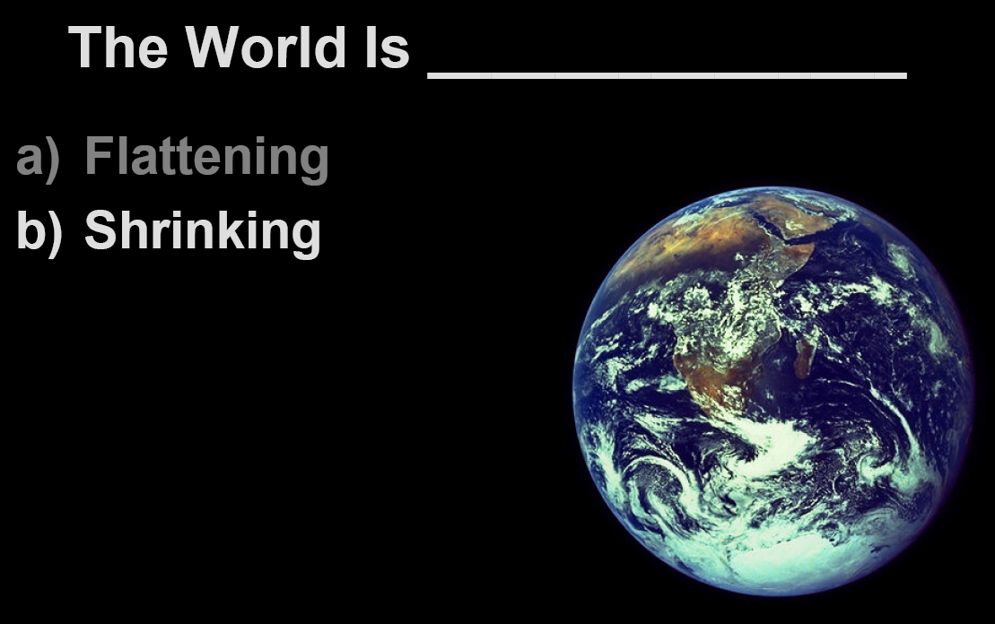
Courtesy of John. A White, U. of Arkansas 2006

Slide 54
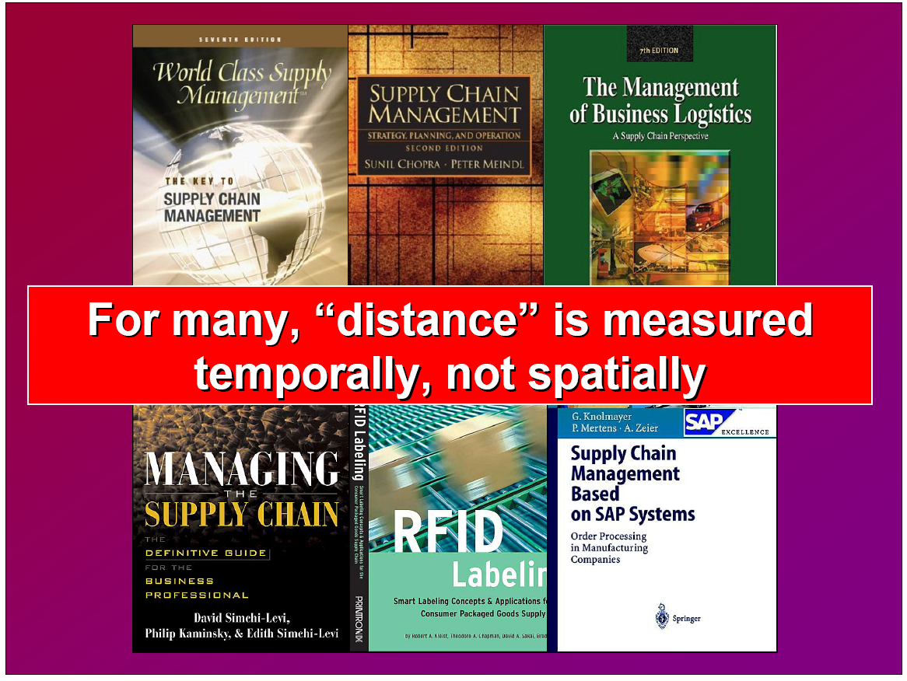
Courtesy of John. A White, U. of Arkansas 2006

Slide 55
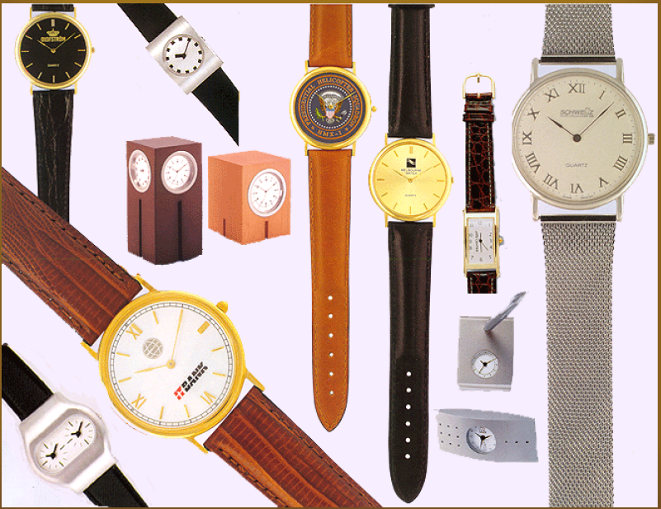
Distance Is Measured in Hours,
Minutes, and Seconds
Courtesy of John. A White, U. of Arkansas 2006

Slide 56
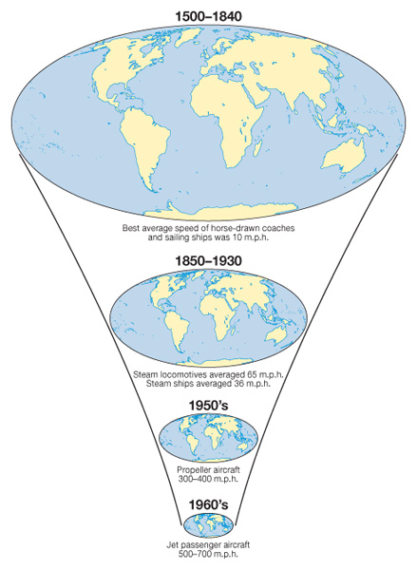
What does the following diagram show?

Slide 57
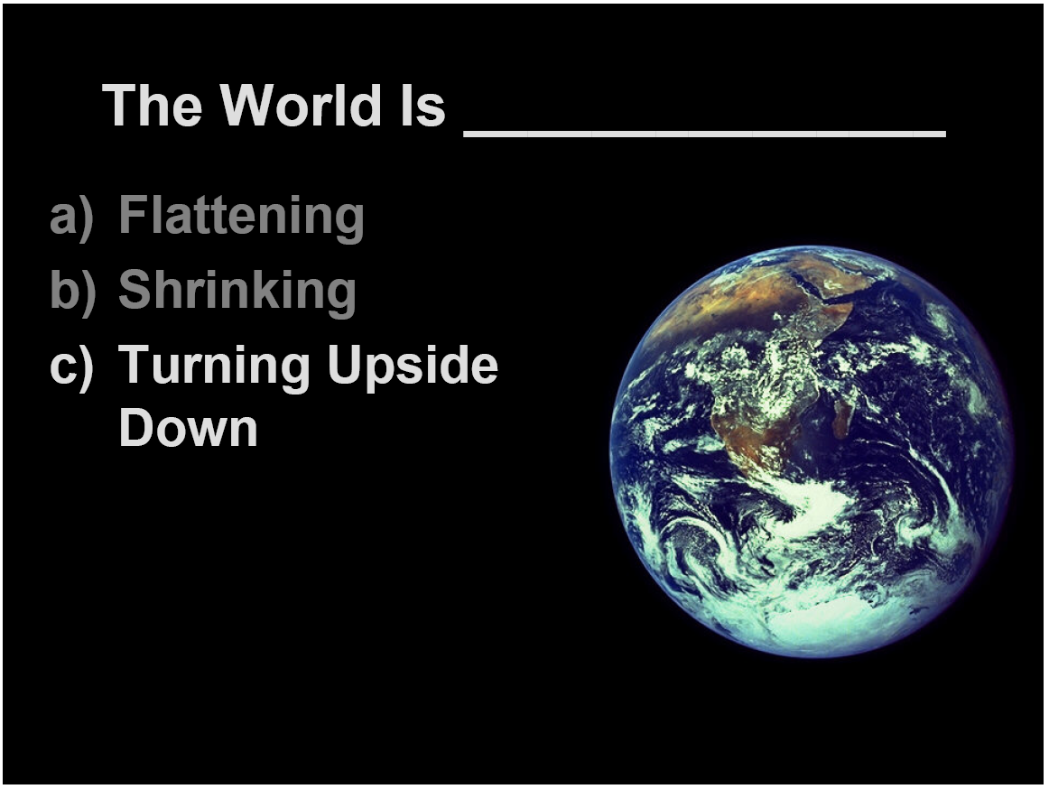
Courtesy of John. A White, U. of Arkansas 2006

Slide 58
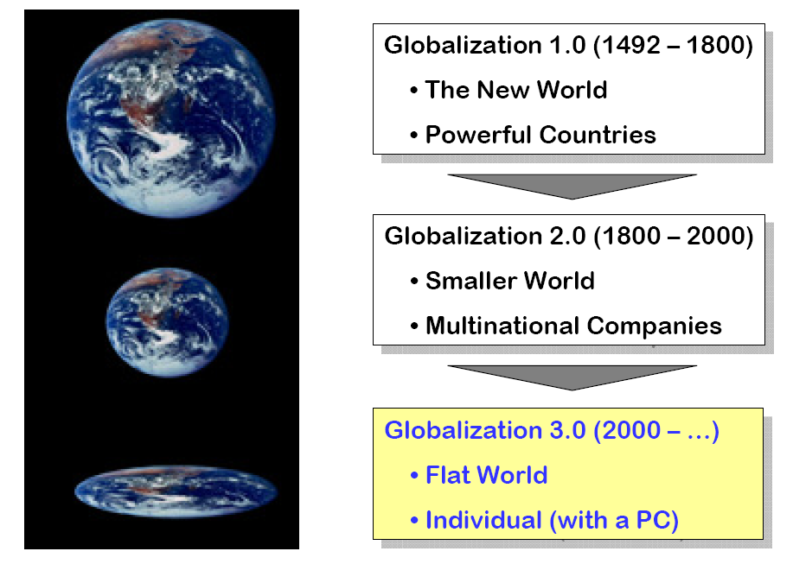
What Happens When the World is Flat?
Courtesy of Hermawan Kartajaya, 2007

Slide 59

What Happens When the World is Flat?
Courtesy of Hermawan Kartajaya, 2007

Slide 60
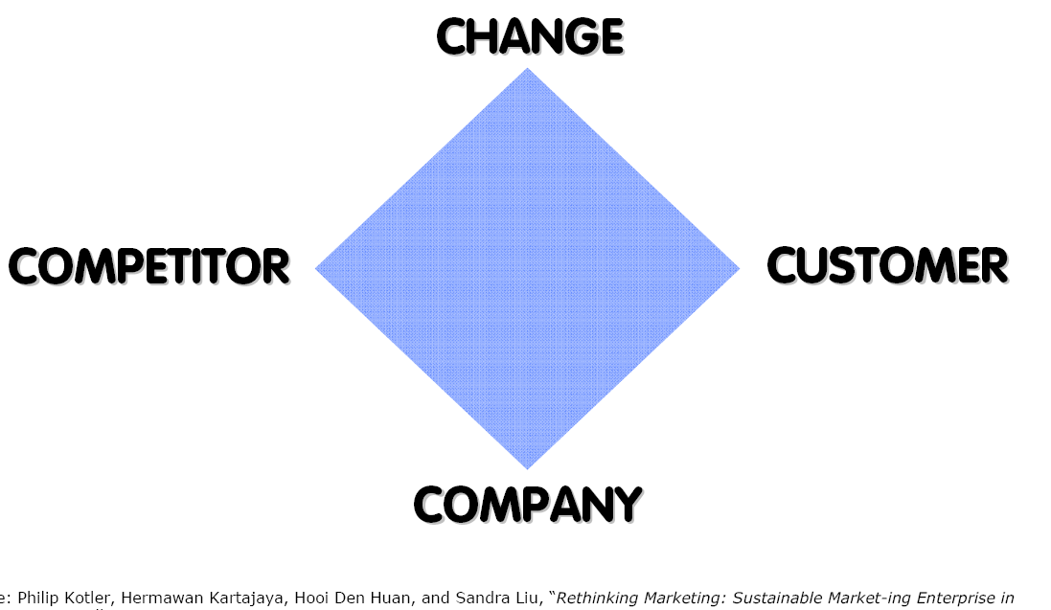
The Business Landscape Is Changing
Courtesy of Hermawan Kartajaya, 2007

Slide 61
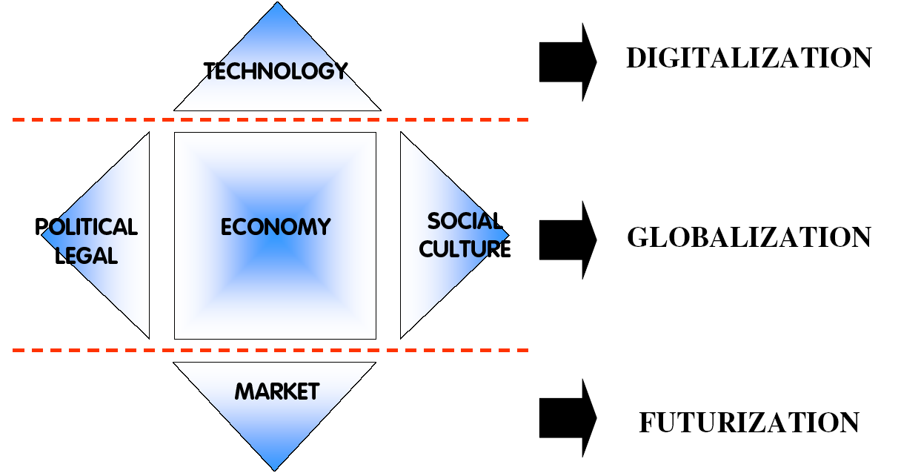
Three Factors Of Change That Is Re-Shaping The Business Landscape
Courtesy of Hermawan Kartajaya, 2007

Slide 62
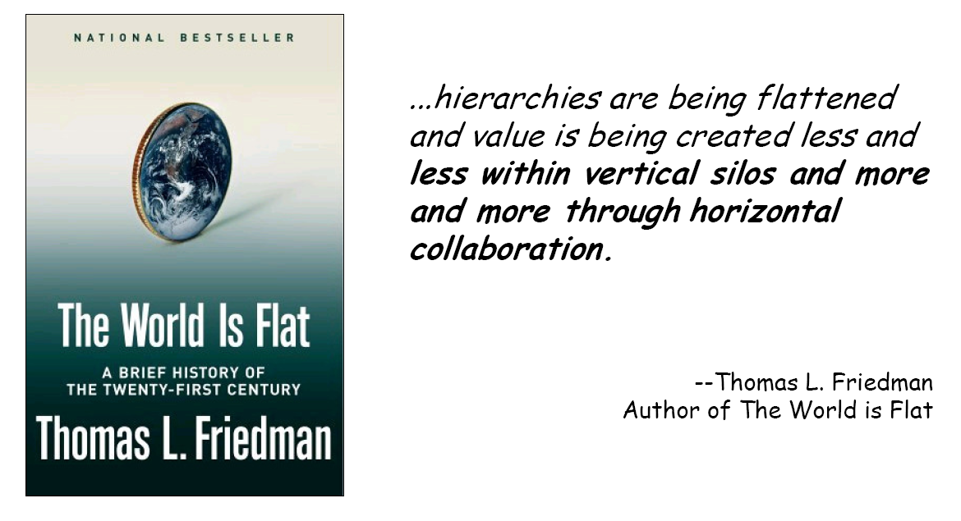
Digitization
Courtesy of Hermawan Kartajaya, 2007

Slide 63
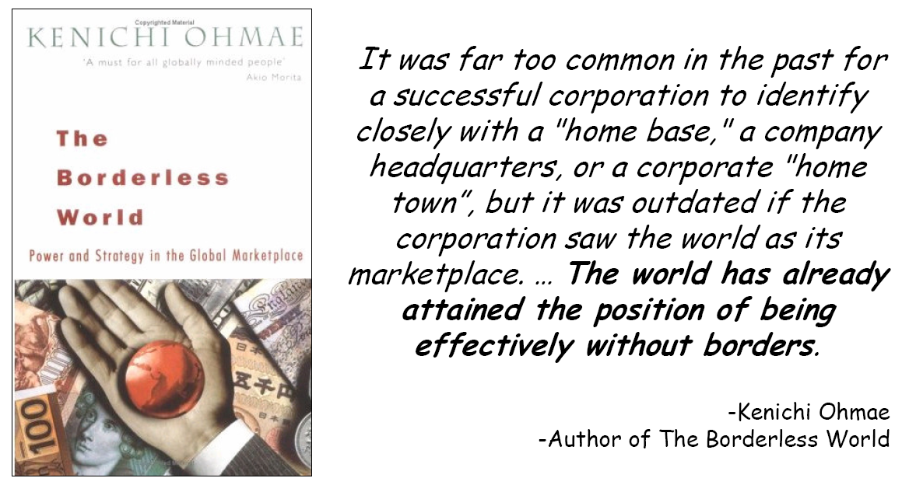
Globalization
Courtesy of Hermawan Kartajaya, 2007

Slide 64
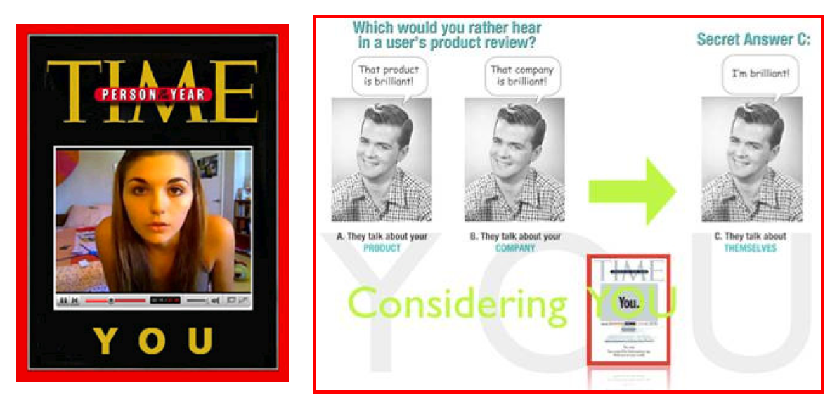
Futurization
Courtesy of Hermawan Kartajaya, 2007

Slide 65

Courtesy of Hermawan Kartajaya, 2007

Slide 66
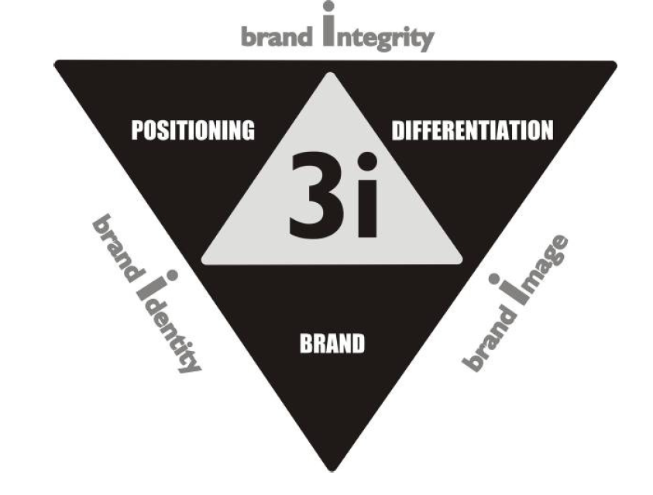
What Is “Marketing Yourself”
Courtesy of Hermawan Kartajaya, 2007

Slide 67
You don’t need to be the best, You don’t need to be better. You just need to be different.
It’s better to be a little bit different than to be a little bit better
Courtesy of Hermawan Kartajaya, 2007

Slide 68

Courtesy of Hermawan Kartajaya, 2007

Slide 69

Courtesy of Hermawan Kartajaya, 2007

Slide 70
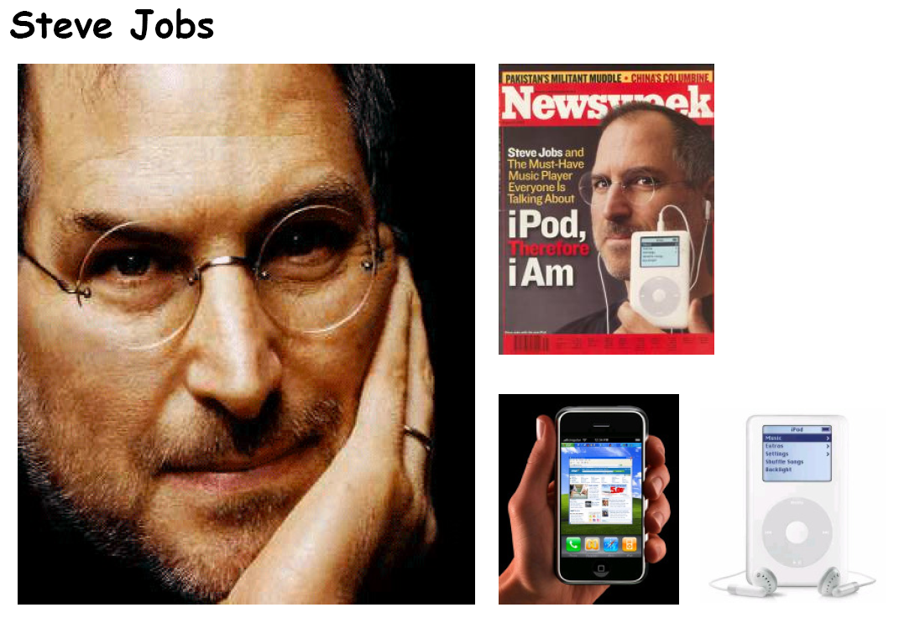
Courtesy of Hermawan Kartajaya, 2007

Slide 71

How To Market Yourself
Courtesy of Hermawan Kartajaya, 2007

Slide 72
World is Spiky

Slide 73
Society - Global digital divide
The global digital divide is a term used to describe:
  “great disparities in opportunity to access the Internet and the information and educational/business opportunities tied to this access … between developed and developing countries”
Lu, Ming-te (2001). Digital divide in developing countries. Journal of Global Information Technology Management (4:3), pp. 1-4.
Retrieved from: http://en.wikipedia.org/wiki/Global_digital_divide

Slide 74
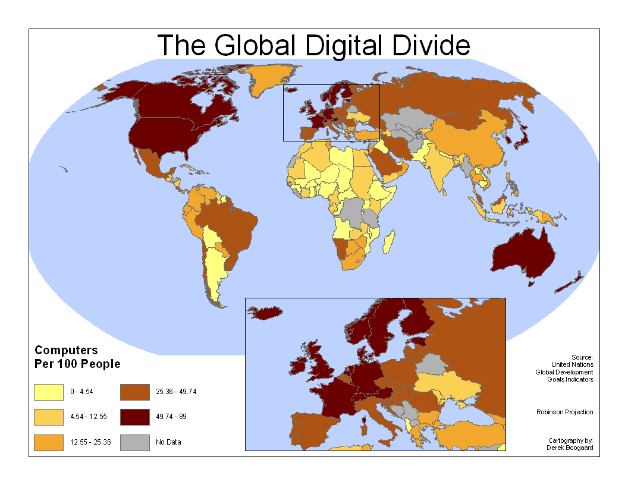

Slide 75
The World is Spiky – Is Freidman right? Just when we were getting used to the World becoming “Flat” now it is reported as “spiky” by another academic.
THE ATL ANTIC MONTHLY OCTOBER 2005 THE AGENDA THE ATL ANTIC MONTHLY
Richard Florida, the author of The Flight of the
Creative Class, is the Hirst Professor of Public Policy
at George Mason University.
Florida use indicators of which there is:
  SCIENTIFIC CITATIONS
  The world’s most prolific and influential
  scientific researchers overwhelmingly
  reside in U.S. and European cities.
  PATENTS
  Just a few places produce most of the world’s
  innovations. Innovation remains difficult without
  a critical mass of financiers, entrepreneurs,
  and scientists, often nourished by world-class
  universities and flexible corporations.
Florida believes that the world is not flat!

Slide 76
Florida's indicator 1: Population
The most obvious challenge to the flat-world hypothesis is the explosive growth of cities worldwide.
A shows the uneven distribution of the world’s population. Five megacities currently have more than 20 million inhabitants each. Twenty-four cities have more than 10 million inhabitants, sixty more than 5 million, and 150 more than 2.5 million. Population density is of course a crude indicator of human and economic activity.
Causing a divide between the urban and rural population of nations which is causing a friction in their societies

Slide 77
Population - Stronger Economic Production
“New York’s economy alone is about the size of Russia’s or Brazil’s, and Chicago’s is on a par with Sweden’s. Together New York, Los Angeles, Chicago, and Boston have a bigger economy than all of China.”

Slide 78
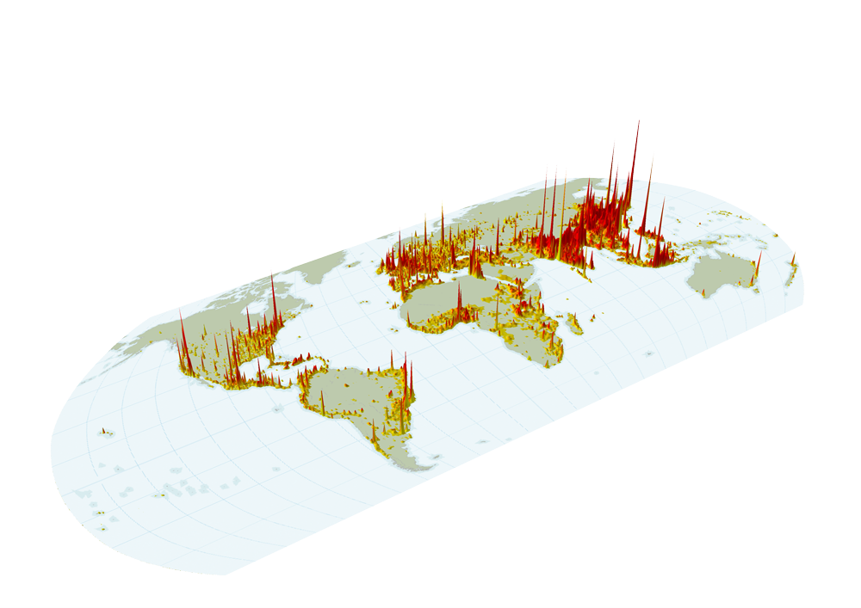
The World is Spiky: Population
Map by Tim Gulden, University of Maryland.
From Richard Florida, “The World is Spiky,”
The Atlantic Monthly, October 2005
Notes:
Innovation and wealth production is increasingly concentrated in cities, especially in advanced economies.
In 2007, more people will live in urban-regions for the first time in human history.
Greatest rural to urban migration in history is occurring today in China
China is building critical mass in research and sees the stem cell field as a competitive opportunity.
Today population is a crude indicator of economic activity. But what about in 2106?

Slide 79
Light Emission as indicator 2 Stronger Economic Production
“Unfortunately, no single, comprehensive information source exists for the economic production of all the world’s cities. A rough proxy is available, though is the widely circulated view of the world at night, with higher concentrations of light—indicating higher energy use and, presumably, stronger economic production—appearing in greater relief. U.S.”

Slide 80
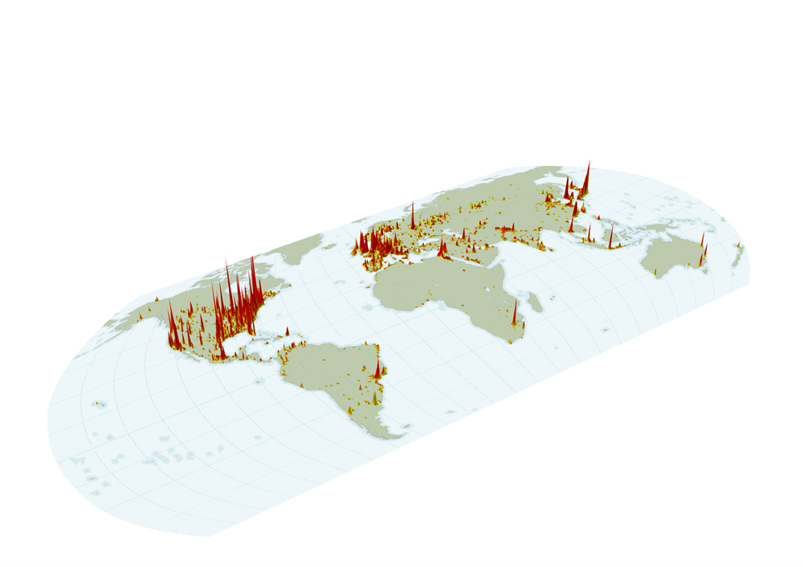
The World is Spiky: Light Emissions
Map by Tim Gulden, University of Maryland.
From Richard Florida, “The World is Spiky,”
The Atlantic Monthly, October 2005
Notes:
Light emissions from space based on a NASA study at night (“Earth at Night”).
A rough proxy for energy use and economic activity.

Slide 81
Indicator 3 – Innovation: the engine of economic growth (WIPO Patents)
“The World Intellectual Property Organization recorded about 300,000 patents from resident inventors in more than a hundred nations in 2002 (the most recent year for which statistics are available). Nearly two thirds of them went to American and Japanese inventors. Eighty-five percent went to the residents of just five countries (Japan, the United States, South Korea, Germany, and Russia).”

Slide 82
Innovation— the engine of economic growth(U.S. Patents)
“In 2003 India generated 341 U.S. patents and China 297. The University of California alone generated more than either country. IBM accounted for five times as many as the two combined.”
Nearly 90,000 of the 170,000 patents granted in the United States in 2002 went to Americans.
“The next ten most innovative countries including the usual suspects in Europe plus Taiwan, South Korea, Israel, and Canada produced roughly 25,000 more (patents).”

Slide 83
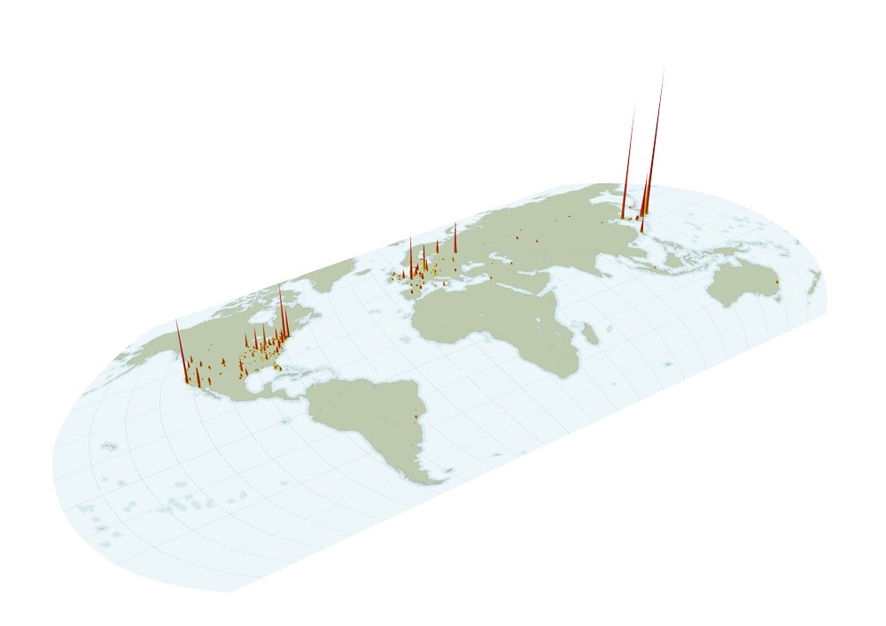
The World is Spiky: Patents
Map by Tim Gulden, University of Maryland.
From Richard Florida, “The World is Spiky,”
The Atlantic Monthly, October 2005
Notes:
Worldwide patent statistics -- can be misleading as indicator of innovation.
300,000 patents grant by more than 100 nations in 2002.
90,000 of the 170,000 U.S. patents granted to Americans, 35,000 to Japanese.

Slide 84
Indicator 4, Scientific advances: The residence of the
1,200 most heavily cited scientists
“Scientific advance is even more concentrated than patent production. Most occurs not just in a handful of countries but in a handful of cities —primarily in the United States and Europe. Chinese and Indian cities do not even register. As far as global innovation is concerned, perhaps a few dozen places worldwide really compete at the cutting edge.”

Slide 85
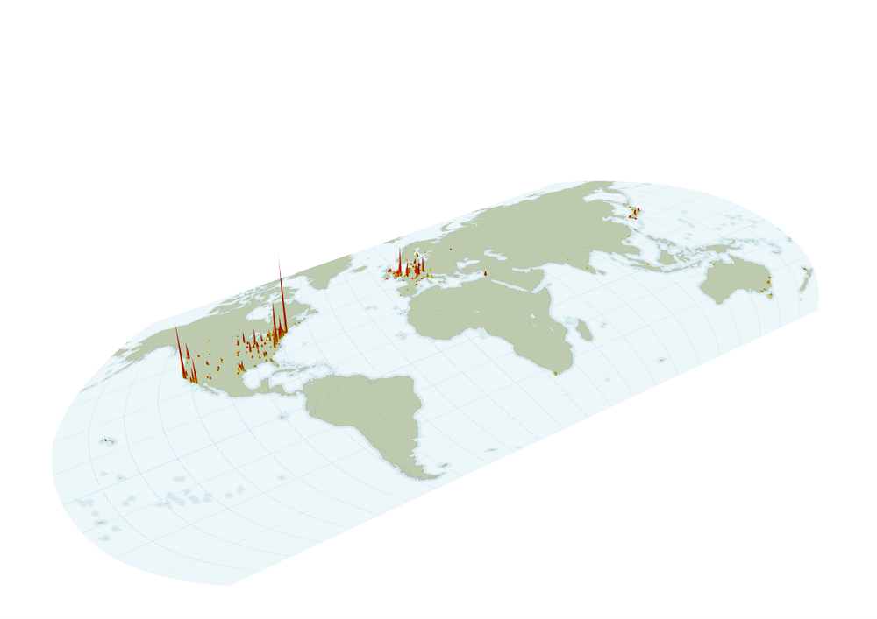
The World is Spiky: Scientific Citations
Map by Tim Gulden, University of Maryland.
From Richard Florida, “The World is Spiky,”
The Atlantic Monthly, October 2005
Notes:
Residence of 1,200 leading scientists by scientific citiation.
Highly concentrated in U.S. and Europe but beginning to change with the rise of the East.
Stem cell field is highly collaborative internationally.

Slide 86
Some of Florida's comments
“This is not to say that Indians and Chinese are not innovative. On the contrary, AnnaLee Saxenian, of the University of California at Berkeley, has shown that Indian and Chinese entrepreneurs founded or co-founded roughly 30 percent of all Silicon Valley startups in the late 1990s. But these fundamentally creative people had to travel to Silicon Valley and be absorbed into its innovative ecosystem before their ideas became economically viable. Such ecosystems matter, and there aren’t many of them.”
“Creative people cluster not simply because they like to be around one another or they prefer cosmopolitan centers with lots of amenities, though both those things count. They and their companies also cluster because of the powerful productivity advantages, economies of scale, and knowledge spillovers such density brings.”
“So although one might not have to emigrate to innovate, it certainly appears that innovation, economic growth, and prosperity occur in those places that attract a critical mass of top creative talent.”
On Friedman - “In his view (Friedman’s) , for example, the emerging economies of India and China combine cost advantages, high-tech skills, and entrepreneurial energy, enabling those countries to compete effectively for industries and jobs. The tensions set in motion as the playing field is leveled affect mainly the advanced countries, which see not only manufacturing work but also higher end jobs, in fields such as software development and financial services, increasingly threatened by offshoring.”

Slide 87
Conclusions
Ideas can have influence many years after their conception.
  Many new ideas need technological underpinnings that may not be available at the time of their conception.
There is a debate about the future world order and the distribution of wealth – is the world staying “spiky” or is it truly become “flat”.
  My view: The world is an evolving place. Look at Japan in 1945, South Korea in mid-1950s and now! I feel that Florida only gave us a snapshot of today. Friedman could be right in that we are evolving towards a flat world.
  Things that are impeding this flatting process are the friction between nations and war!

Slide 88
Qs and As
World is Flat or Spiky; your view on this?
Is future to be more flatter or more spiky?
Globalization and Inequality
Globalization and Poverty

