Slide 1
What’s Ahead
Daniel Hao Tien Lee
http://danieleewww.yolasite.com/

Slide 2
Outline
Age of Abundance
Generation Flux
Generation Global

Slide 3
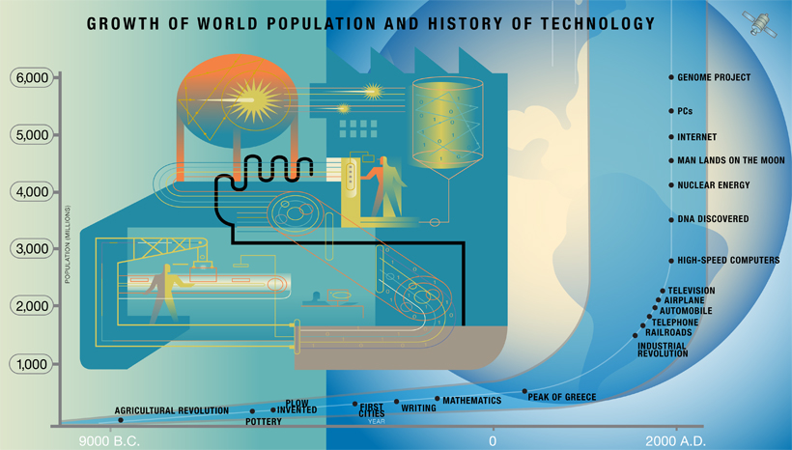
Courtesy of Peter H. Diamandis and Steven Kotler; illustrations by Hank Osuna; published in Discovery Magazine April 24, 2012
It is a blizzard of bad news out there: an ongoing economic crisis, a burgeoning education crisis, health-care turmoil, energy poverty, water scarcity--to name but a few of our fears. So pervasive is our sense of doom and gloom that anyone telling a different story can rarely be heard. But there is a very different story worth hearing. Currently, thanks to the exponential growth rate of technology combined with three powerful emerging trends, we are teetering on the edge of a much better tomorrow. Imagine a world where everyone has access to clean water, nutritious food, affordable housing, personalized education, top-tier medical care, nonpolluting and ubiquitous energy. Imagine a world of abundance.

Slide 4
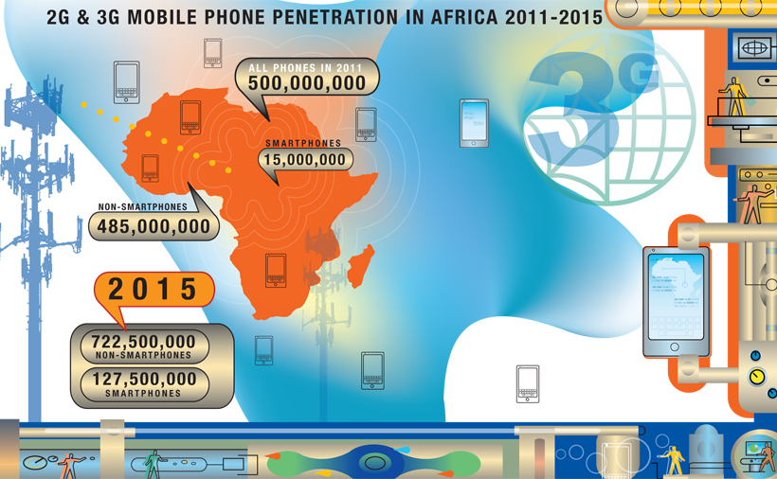
Courtesy of Peter H. Diamandis and Steven Kotler; illustrations by Hank Osuna; published in Discovery Magazine April 24, 2012
Sound too good to be true? According to some compelling trends and metrics, elements of this transformation are under way. Over the past 20 years, wireless technologies and the Internet have become ubiquitous, affordable, and available to almost everyone.
Africa has skipped a technological generation, bypassing the telephone landlines that stripe our American skies for the wireless way. Mobile phone penetration in Africa is growing exponentially, from 2 percent in 2000 to 28 percent in 2009 to an expected 70 percent in 2013. Folks with no education and little to eat have gained access to cellular connectivity unheard of just three decades ago. Soon the vast majority of humanity will be enmeshed in this same World Wide Web of instantaneous, low-cost communications and information. We are now living in a world of information and communication abundance.
Projections indicate that the number of smartphones in use will skyrocket. London economists found that adding 10 phones per 100 people boosts a developing country's GDP by 0.6 percent.

Slide 5
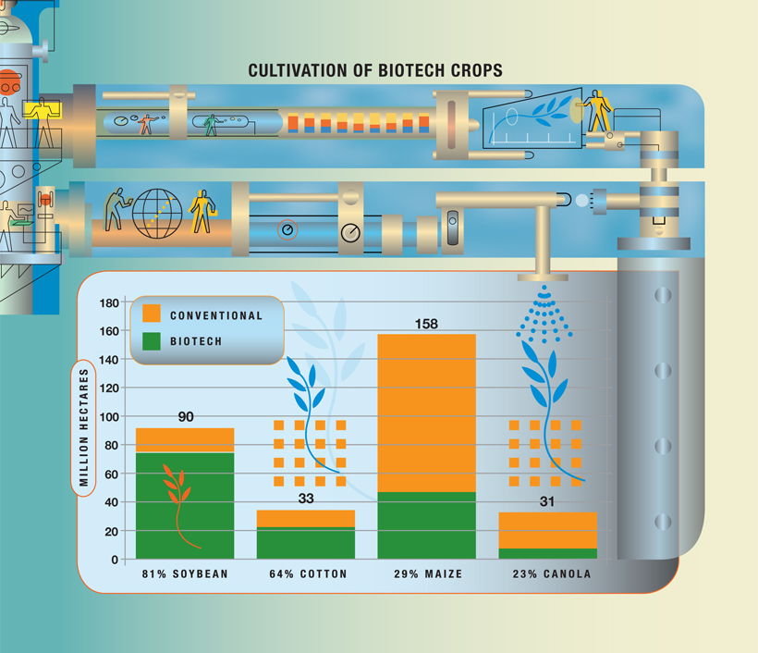
Courtesy of Peter H. Diamandis and Steven Kotler; illustrations by Hank Osuna; published in Discovery Magazine April 24, 2012
Smartphones aren't the only technology leaping forward: Computers, networks and sensors, artificial intelligence, robotics, biotechnology, 3D printing, nanotechnology, human-machine interfaces, and many other tools are also advancing exponentially. For instance, genetically engineered crops are the fastest-adopted new technology in the history of agriculture. By 2015 biotech rice could help feed 1 billion poor people in Asia alone.
In the near future, these technologies will enable most of the world to experience what only affluent societies have access to today. Even better, the new tools themselves are not the only agents of change in play.

Slide 6
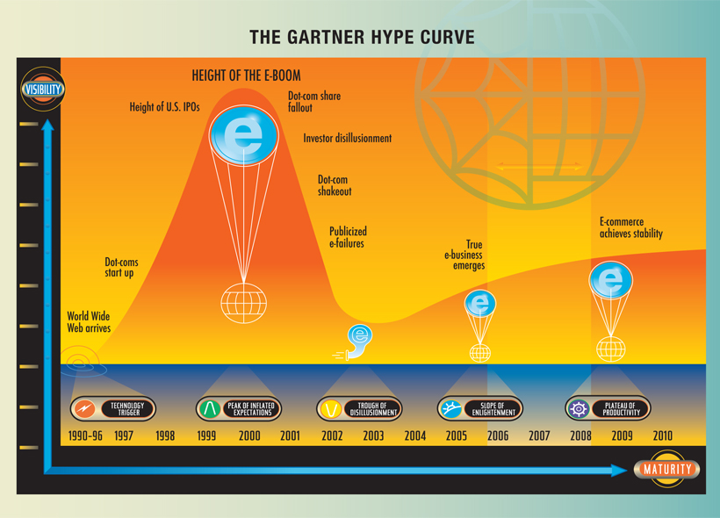
Courtesy of Peter H. Diamandis and Steven Kotler; illustrations by Hank Osuna; published in Discovery Magazine April 24, 2012
There are three additional forces at work, each with significant abundance-producing potential. The first of those is the newfound power of the do-it-yourself (DIY) innovator. DIYers have already proven themselves capable of launching a computer revolution, and now their reach extends considerably further. In the past decade, DIYers (working either in small teams or collectively, via crowdsourcing) have made major contributions to fields like genetics, robotics, proteomics, autonomous vehicles, even space exploration--fields that were once the sole province of large corporations, universities, and governments.
This graph tracks the life cycle of a new technology--here, the dot-com (or e-commerce) boom, which profited from significant contributions by DIYers. Overestimation of potential, the peak of inflated expectations, and disillusionment ultimately give way to true fulfillment and a plateau.
The same technologies that allowed the rise of the DIY innovator have also created wealth much faster than ever before. People like Jeff Skoll (the former president of eBay), Elon Musk (cofounder of PayPal), and Bill Gates (of Microsoft) became billionaires by reinventing industries before the age of 35. Maintaining their taste for the big and bold, they are now turning their attention and their considerable resources toward global betterment. This new breed of techno-philanthropist is a force for abundance as well.

Slide 7
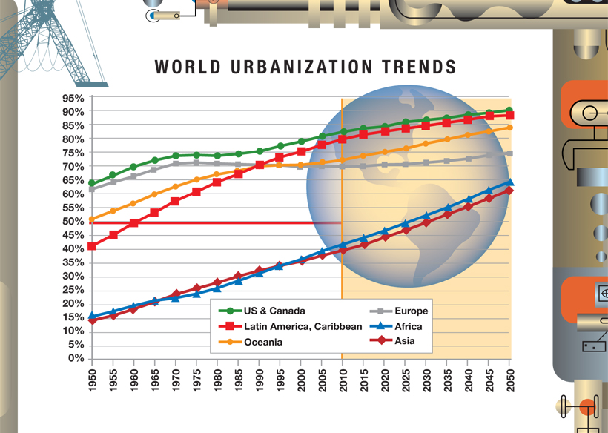
Courtesy of Peter H. Diamandis and Steven Kotler; illustrations by Hank Osuna; published in Discovery Magazine April 24, 2012
But the most significant change of the next decade should be the dramatic increase in worldwide connectivity via the Internet. The online community is projected to grow from 2 billion users in 2010 to 5 billion by 2020. Three billion new minds are about to join the global brain. What will they dream? What will they discover? What will they desire? These are minds that the rest of society has never had access to before. Their collective economic and creative boost should unleash the most powerful abundance force of all.
The worldwide move to the Internet goes hand in hand with a move to cities. By 2050, 70 percent of the world will live in cities. According to calculations by physicist Geoffrey West of the Santa Fe Institute, when a city doubles in size, the rate of innovation (as measured by new patents) increases by 15 percent.

Slide 8
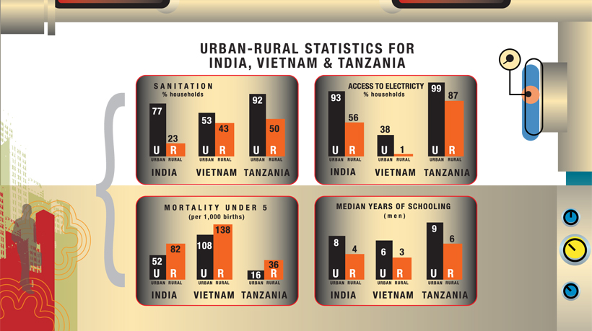
Courtesy of Peter H. Diamandis and Steven Kotler; illustrations by Hank Osuna; published in Discovery Magazine April 24, 2012
Urbanization is not only good for the environment, but also for the people. In most countries, city dwellers fare better than their rural counterparts. Urban residents in developed countries enjoy higher per capita income; in developing countries, they have greater access to health care and education.

Slide 9
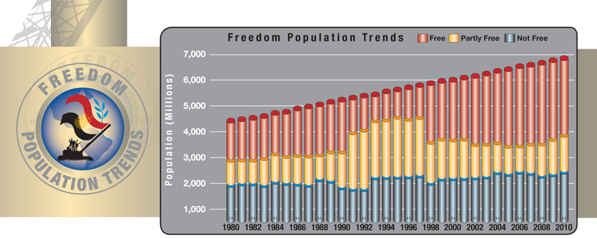
Courtesy of Peter H. Diamandis and Steven Kotler; illustrations by Hank Osuna; published in Discovery Magazine April 24, 2012
The 7 billion people on Earth had more freedom in 2010 than their counterparts in 1987, who numbered 5 billion, according to Washington, D.C.-based Freedom House.

Slide 10
Courtesy of Peter H. Diamandis and Steven Kotler; illustrations by Hank Osuna; published in Discovery Magazine April 24, 2012
Services once reserved for the wealthy are available to the masses essentially for free. Adjusted for inflation, nearly $1 million worth of features now come with any smartphone.

Slide 11
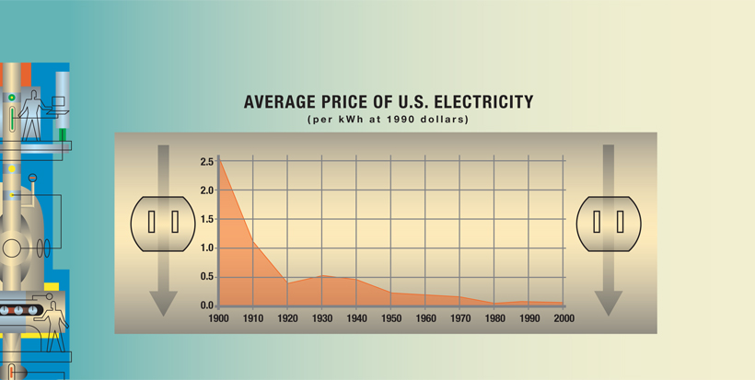
Courtesy of Peter H. Diamandis and Steven Kotler; illustrations by Hank Osuna; published in Discovery Magazine April 24, 2012
During the past hundred years, the cost of electricity (measured in constant dollars per kilowatt-hour) has decreased markedly, even as total world energy consumption has soared.

Slide 12
Future to be……
http://bigthink.com/
http://sydmead.com/v/11/
http://mkaku.org/
http://www.kurzweilai.net/
http://www.alvintoffler.net/

Slide 13
Generation Flux

Slide 14
Generation Trend
"It is not the strongest of the species that survives; nor the most intelligent that survives. It is the one that is most adaptable to change." - Charles Darwin
"The illiterate of the 21st century will not be those who cannot read and write, but those who cannot learn, unlearn, and relearn." - Alvin Toffler
“This century we're going to learn a lesson about what it means to be unable to forget anything.” - Charles Stross
“If you want to go quickly, go alone. If you want to go far, go together.” – African Proverb
Luke: "Are you all right? What's wrong?" Obi-Wan: "I felt a great disturbance in the Force... as if millions of voices suddenly cried out in terror and were suddenly silenced. I fear something terrible has happened. You'd better get on with your exercises."

Slide 15
Generation Flux
Modern business is pure chaos. Generation Flux is about the people who are adapting to disruption, and succeeding– Generation Fluxers
“What defines GenFlux is a mind-set that embraces instability, that tolerates–and even enjoys–recalibrating careers, business models, and assumptions.”
http://www.fastcompany.com/1802732/generation-flux-meet-pioneers-new-and-chaotic-frontier-business

Slide 16
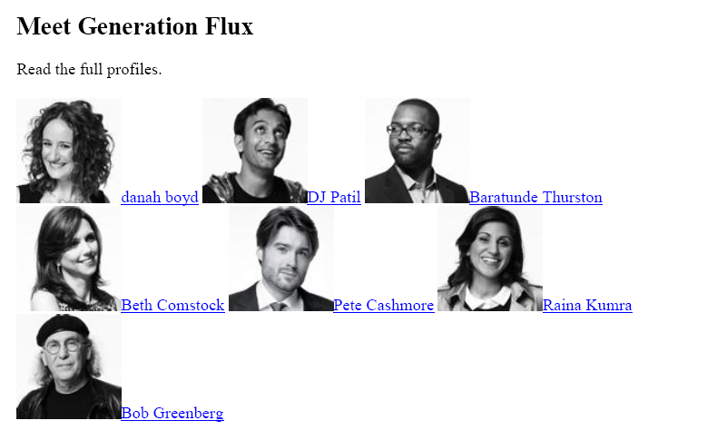
http://www.fastcompany.com/generation-flux
Generation Fluxers

Slide 17
Generation Flux: Skill to acquire new skills
“This is less a demographic designation than a psychographic one: What defines GenFlux is a mind-set that embraces instability, that tolerates--and even enjoys--recalibrating thinking, learning, and assumptions. Not everyone will join Generation Flux, but to be successful, schools, businesses, and individuals will have to work at it. This is no simple task. The vast bulk of our institutions--educational, corporate, political--are not built for flux.” Few traditional educational tactics train us for an era where the most important skill is the ability to acquire new skills.

Slide 18
Generation Global (GG)

Slide 19
GG
Survive through SCU070 and alikes
Initiate fun drill and resolve chaos into something simple (simplicity)

