Slide 1
Recall Last Week
Technology driven products and services facilitate our expression speed of emotion and logic mind--- How fast we can go? ---What the unsustainable problems can not be solved?
Lifestyle changing with advancing in technology
Addiction and Dependency: Mobile Phone and Coffee or the alikes

Slide 2
Food Industry and Related Technologies
Daniel Hao Tien Lee

Slide 3
Open-Ended Q’s
Your knowing about agriculture and food Industries?
Any farming or agriculture experience?
Aiming career in food or agriculture industries?

Slide 4
Open-Ended Questions and Problems
What’s your thinking about food ?
Food science and technology– make sense to you!
Your understanding on your preferred food!
Your choices of dream food!

Slide 5
Links
https://www.ift.org/

Slide 6
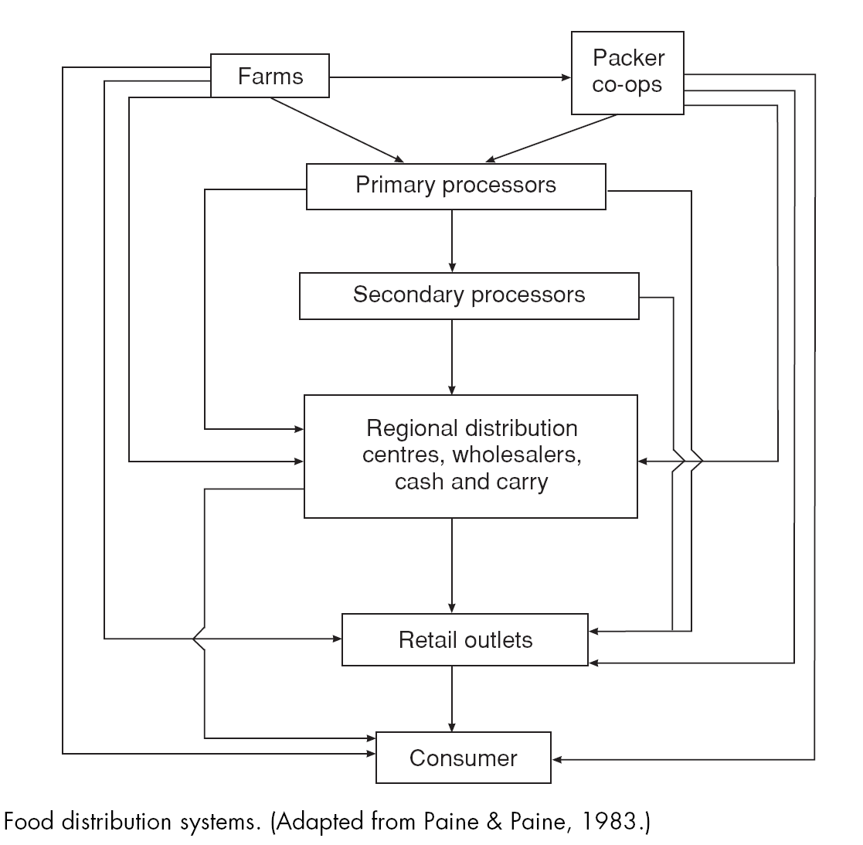

Slide 7
Food Industry and Technology
Growing
Making
Tracking
Functional Food
Future Food
Beverage Industry and Technology
Gastronomy and Technology

Slide 8
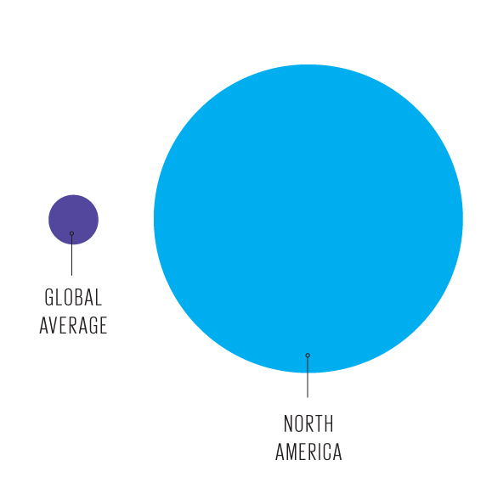
AG (Agriculture) Productivity
Illustration: Erik Vrielink
Farm output per worker averages US $2000 globally, $90 000 in North America, an edge due in part to higher capital investment, in part to greater efficiency
http://spectrum.ieee.org/static/the-age-of-plenty#food-part-2

Slide 9
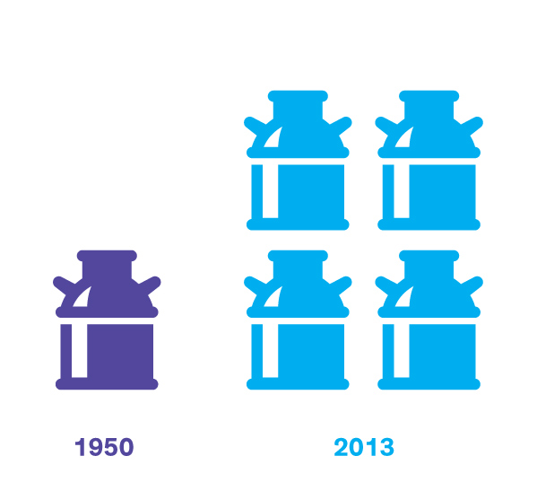
Illustration: Erik Vrielink
A cow’s yield has risen fourfold in the United States within living memory, the result of selective breeding and more sophisticated care and feeding.

Slide 10
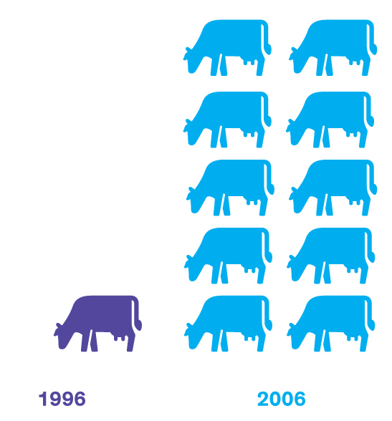
Illustration: Erik Vrielink
Brazil's beef exports rose tenfold in a single decade, one of the many changes that have made it the first tropical country to rank among the advanced agricultural powers.

Slide 11
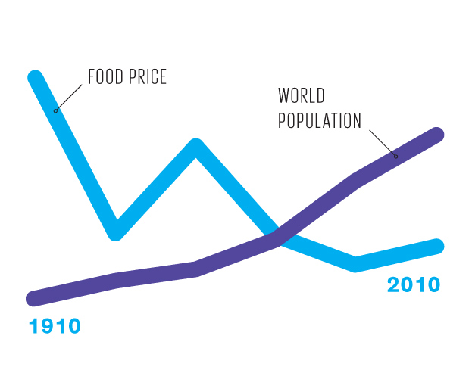
Illustration: Erik Vrielink
World population and food prices have moved in opposite directions, confirming that agricultural productivity can sustain and even improve the standard of living.

Slide 12
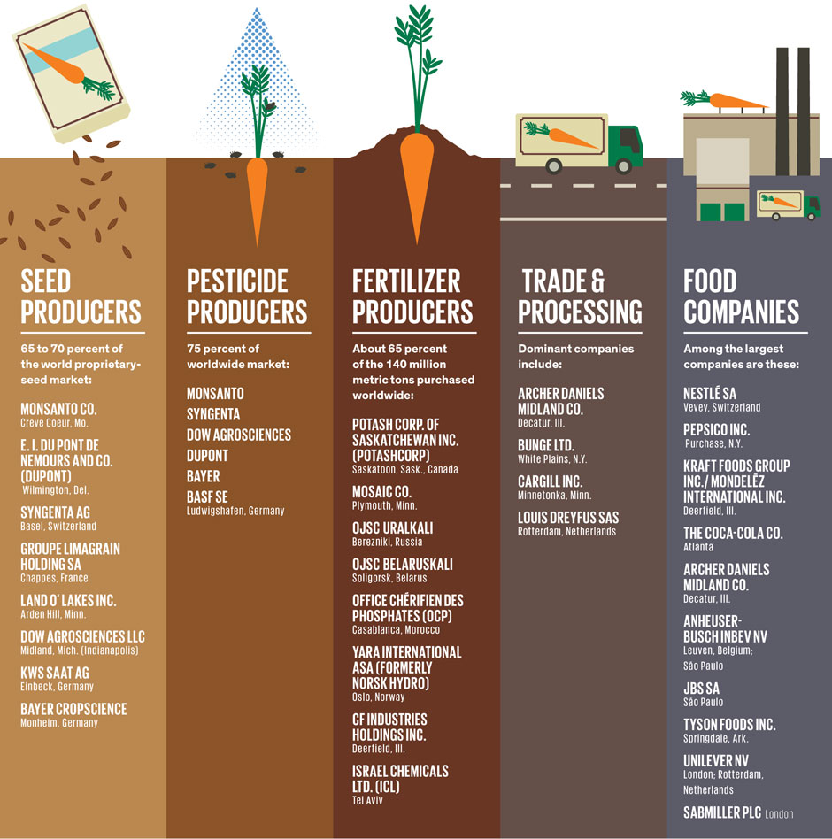
Everything you want know about big agriculture
Dozen of Oligopolies Control the Big Agriculture vs 50-100 million farmers worldwide

Slide 13
Oligopoly in Food Industries: Good or Bad?

Slide 14
Crossbread (Hybrid Seeds)

Slide 15
Hybrid Seeds: What are they?
Farmers and gardeners have been cultivating new plant varieties for thousands of years through selective breeding. They did this by cross-pollinating two different, but related plants over 6 to 10 plant generations, eventually creating a new plant variety.
The process required patience, but was rewarding. By selectively cross-pollinating related plants in this way, farmers could create varieties that were healthier and stood up to the farmer’s micro-climate — their soil, their weather patterns, their predatory insects.
Yet in the mid-nineteenth century, Darwin and Mendel discovered a method of controlled crossing that can create these desired traits within just one generation. This method produces what’s known as F1 hybrid seeds.

Slide 16
Hybrid Seeds: The Consequences
The biggest disadvantage of hybrid seeds is that they don’t “reproduce true” in the second generation. That means that if you save the seeds produced by F1 hybrid plants and plant them, the plant variety that will grow from those seeds (known as the second generation) may or may not share the desired traits you selected for when creating the first generation hybrid seed.
When the peasant farmers grew these new hybrids, they were indeed more productive, even though they required more fertilizer and water. But when they collected and saved the seed for replanting the next season—as they had done for generations and generations—none of it grew true to the parent crop, little food grew, and these poor farmers, having none of their open-pollenated traditional varieties left viable, had no choice but to go back to the big companies to purchase the hybrid seeds again for planting year after year.

Slide 17
Disruptive Business in Hybrid Seeds
U.S. companies like Cargill (acquired by Dow in 2000) intentionally disrupted the traditional cycle of open-pollinated seed saving and self-sufficiency to essentially force entire nations to purchase their seeds, and the agricultural chemicals required to grow them.

Slide 18
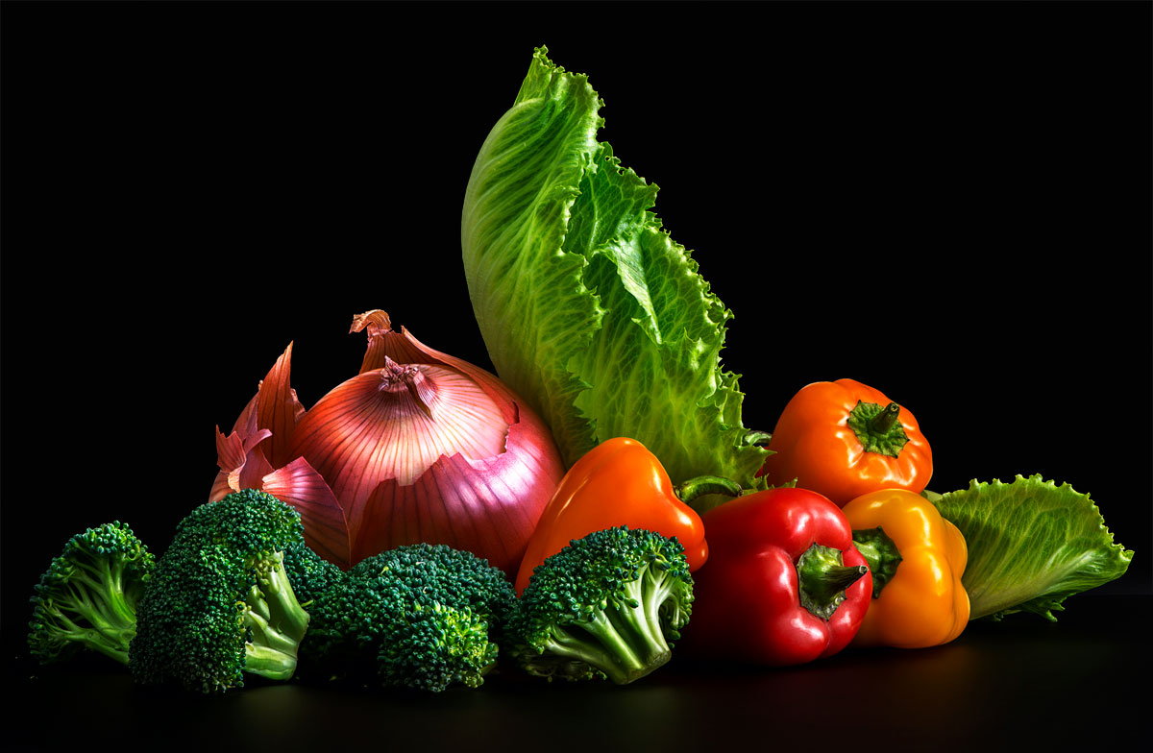
Monsanto Is Going Organic in a Quest for the Perfect Veggie
Monsanto’s new veggies are sweeter, crunchier, and more nutritious—with none of the “Frankenfoods” ick factor. Nicholas Cope
http://www.wired.com/wiredscience/2014/01/new-monsanto-vegetables/

Slide 19
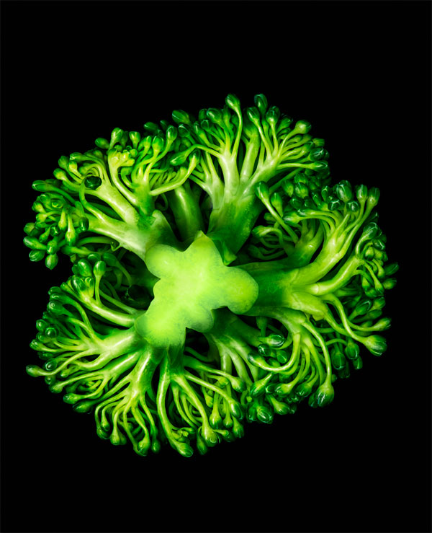
Beneforté (broccoli)
Launched Fall 2010
Availability Year-round
Trait Compared with standard broccoli, contains up to three times the amount of glucoraphanin, a compound that increases antioxidant levels
Method Crossbreeding commercial broccoli with a strain growing wild in southern Italy
Region Grown Arizona, California, Mexico
Price $2.50 per pound

Slide 20
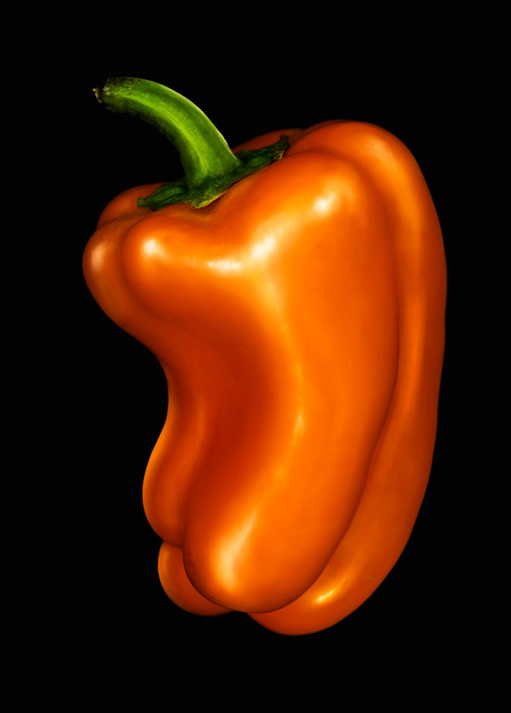
BellaFina (bell pepper)
Launched Fall 2011
Availability Year-round
Trait A third the size of regular bell peppers when ripe, mini- mizing waste and allowing for flexibility while cooking
Method Selectively breeding plants with smaller and smaller peppers
Region grown California, Florida, North Carolina
Price $1.50 per three-pepper bag

Slide 21
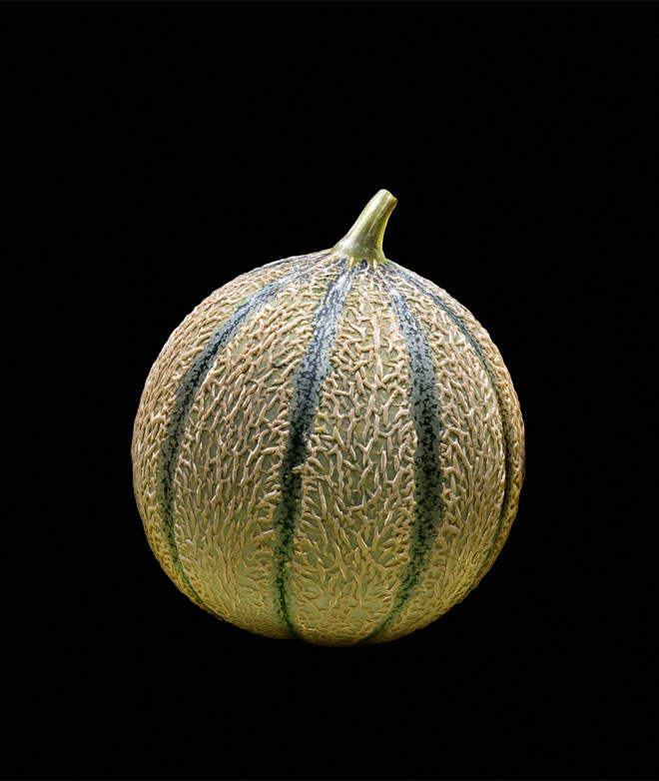
Melorange (melon)
Launched Winter 2011
Availability December through April
Trait Tastes up to 30 percent sweeter than cantaloupe grown in winter
Method Crossbreeding cantaloupe and European heritage melons with a gene for a fruity and floral aroma
Region Grown Arizona, Central America
Price $3 per melon

Slide 22
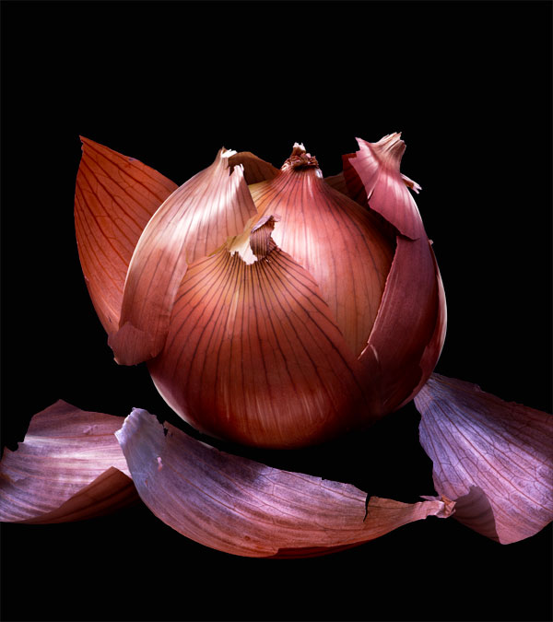
EverMild (onion)
Launched Fall 2010
Availability September through March
Trait Mild and sweet, less tear-inducing
Method Selecting for individual plants that have lower levels of pyruvate, which affects pungency, and lachrymatory factor
Region grown Pacific Northwest
Price $0.70 to $2 per pound

Slide 23
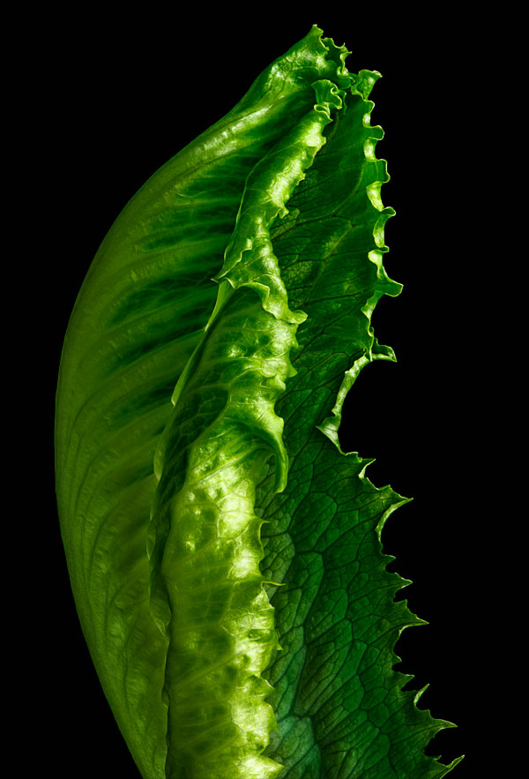
Frescada (lettuce)
Launched Spring 2012
Availability Year-round
Trait Crisp leaves with a longer shelf life, plus 146 percent more folate and 74 percent more vitamin C than ordinary iceberg lettuce
Method Crossing iceberg lettuce with romaine lettuce
Region grown Arizona, California
Price $2.25 to $2.50 per pound

Slide 24
I CAN’T BELIEVE IT’S NOT GMO:
Agriculture giant Monsanto may be best known for genetic modification—like creating corn that resists the effects of Monsanto’s weed killer Roundup. But when it comes to fruits and vegetables you buy in the store, genetic modification is off the menu. Monsanto thinks no one will buy Frankenfoods, so the company is tweaking its efforts—continuing to map the genetic basis of a plant’s desirable traits but using that data to breed new custom-designed strains the way agronomists have for millennia. Here’s how it works—and how the results differ from GMO crops. Thanks to this cross between high and low tech, a new era of super-produce may be upon us.

Slide 25
The New Monsanto Way
The Old Way Identify plants with recognizable, desirable traits. Crossbreed those plants together. Grow the offspring. Wait to see if the traits show up. Repeat as necessary.
The Genetic Modification Way Identify plants or other organisms with recognizable, desirable traits. Isolate the genes that manifest those traits. Use enzymes to clip out those genes and paste them into the genomes of other plants, or inject them using a “gene gun” (for real) or by piggybacking them on a bacteria or virus. Grow the plant with the inserted gene. If the gene has successfully incorporated into the plant, you’ll have a novel phenotype.
The New Monsanto Way Identify plants with recognizable, desirable traits. Crossbreed the plants. Sift through the offspring genome for known markers for desirable traits. Grow only the plants with those markers.

Slide 26
Sift(filter) through the offspring genome for known markers for desirable traits…..
Monsanto also has developed a seed chipper that sorts and shaves off varying samples of genetic material from soybean seeds. Researchers then can scan tiny genetic variations--down to a single nucleotide--to determine if it will result in plants with desirable traits. This is done without having to grow the seed into a plant. The computer model can predict inheritance patterns, allowing researchers to tell which desired traits will be passed to successive generations. This is breeding without the actual need to physically perform it. If actual breeding were done, the odds of combining 20 different characteristics into one plant are 1 in 2-trillion. This could take over one thousand years in nature, but only takes Monsanto several years.
What is amazing is that all this can be accomplished without any genetic engineering. No genes are inserted into any genomes. These technologies identify highly desirable traits and allow for enhanced products without any stigma of being GMO.

Slide 27
Seed Chipping Technology: Sequencing and Decoding the Genome
http://www.youtube.com/watch?v=gCb9TSpuxUU
http://www.youtube.com/watch?v=9MSH9ovXo1c
http://www.youtube.com/watch?v=zP8z0XokGDk

Slide 28
Generic Modification Engineering: GMO to Frankenfoods,

Slide 29
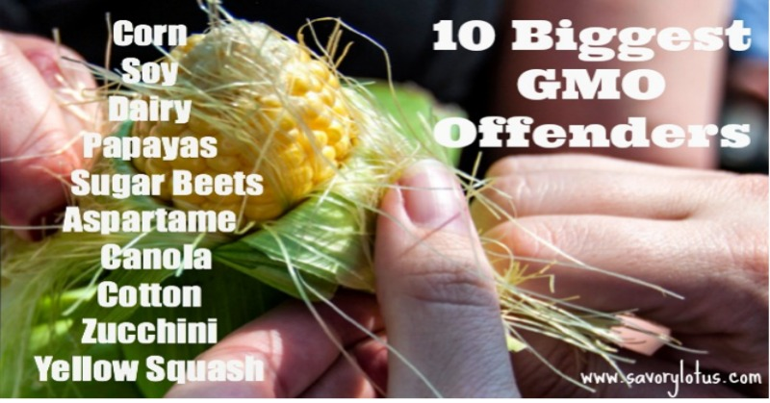
GMO
Big GMOs: Corn, Cotton, Soy, and Canola, Alifafa, and Sugar Beat etc.

Slide 30
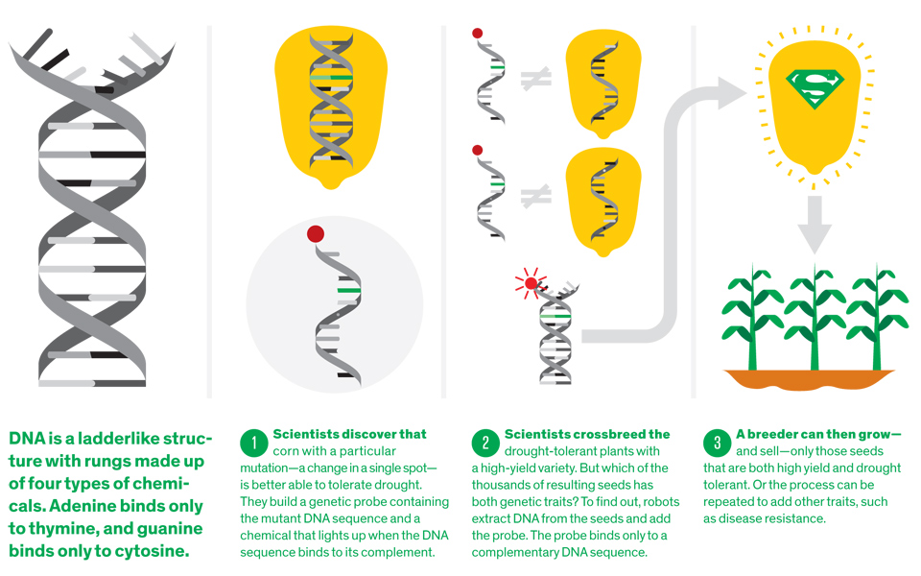
Illustration by James ProvostRobotic Breeding: Robot-assisted genetic analysis helps plant breeders combine several genetic traits into one plant breed.
http://www.youtube.com/watch?v=XFVU46mJCUE#at=12

Slide 31
GMO vs Crossbread
The difference is pretty large. In regular cross pollination, the species being crossed have to be related . . . basically respecting their common evolutionary origin. But with GMOs, you can take any gene from any species and splice it into a crop. So you get fish genes in tomatoes or the like. Read more: http://www.mnn.com/food/healthy-eating/stories/genetic-engineering-vs-selective-breeding#ixzz3Fu6MXA8M

Slide 32
GMO Introduction
Papaya’s http://www.youtube.com/watch?v=2G-yUuiqIZ0
Monsanto’s http://www.youtube.com/watch?v=jAP6ZtfP9ZQ
Non-Browning GMO Apple: Recent mapping of apple’s genome revealed that PPO is genetically encoded in a diverse, multi-gene family. Apples have at least eight PPO genes, in three main PPO gene families. To breed a truly nonbrowning apple, all of the active PPO genes must be silenced. Arctic® apples have been genetically engineered to produce little or no PPO enzyme, so cell disruption doesn’t lead to browning. https://sg.news.yahoo.com/video/time-lapse-conventional-apple-vs-175203750.html http://www.okspecialtyfruits.com/arctic-apples

Slide 33
How Technology to Feed the World of Nine Billions 2050

Slide 34
Thinking
Experts agree that increased production must be achieved by increasing yields while using fewer resources and minimizing or reversing environmental impacts. This “sustainable intensification” approach is fundamentally about making the current agricultural system more efficient through the use of new technologies or by improving current production systems

Slide 35
Agriculture Technology
No-till farming(Planting is done right through the residues of previous plantings)
Integrated soil fertility management (ISFM)
Precision agriculture (PA)
Organic agriculture (OA)
Nitrogen-use efficiency (NUE)
Water harvesting
Drip irrigation
Sprinkler irrigation
Improved varieties—drought-tolerant characters
Improved varieties—heat-tolerant characters
Crop protection
http://www.ifpri.org/publication/food-security-world-natural-resource-scarcity

Slide 36
Vertical Farming
http://www.youtube.com/watch?v=2nFQOkzEjxQ
http://www.youtube.com/watch?v=NnycizKw04s

Slide 37
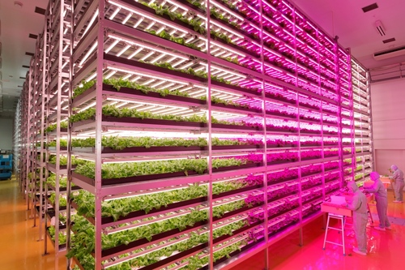
The farm uses 17,500 LED lights spread over 18 cultivation racks reaching 15 levels high.
The LED lights are a key part of the farm’s magic. They allow factory to control the night-and-day cycle and accelerate growth. “What we need to do is not just setting up more days and nights,” but “We want to achieve the best combination of photosynthesis during the day and breathing at night by controlling the lighting and the environment.”
The systems allows him to grow lettuce full of vitamins and minerals two-and-a-half times faster than an outdoor farm. He is also able to cut discarded produce from 50 percent to just 10 percent of the harvest, compared to a conventional farm. As a result, the farms productivity per square foot is up 100-fold, he says.
By controlling temperature, humidity and irrigation, the farm can also cut its water usage to just 1 percent of the amount needed by outdoor fields.

Slide 38
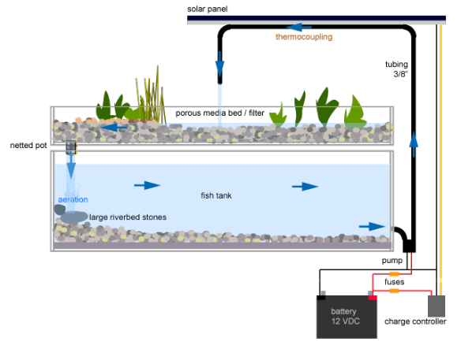
The Indoor Aquaponics Farm
Hydroponics is the art of soiless agriculture. Here the growing medium is a pH adjusted water solution. The required minerals are dissolved in the water and absorbed easily. In fact, research has proven that plant roots absorb minerals easier when in water than when in soil. Sometimes inert medium is used to hold the roots e.g. sand, gravel, vermiculite, rockwool, perlite, peatmoss. coir, coconut husks or sawdust.
http://youngagropreneur.wordpress.com/2011/09/29/hydroponics-aquaponics-and-aeroponics/

Slide 39
Sustainable Food Production for the Future
https://www.youtube.com/watch?v=NLad4f2Rt9E#t=34

Slide 40
Hacking Tomatoes at the World’s Greenest Greenhouse
http://www.youtube.com/watch?feature=player_embedded&v=X6DmmrglLSs#at=153
The Netherlands has nearly 11 thousand hectares of growing space under glass, or about 40 square miles. That’s almost twice the area of the island of Manhattan. In fact, no country has a greater proportion of its land area under glass.
But these greenhouses boast more than plants. They’re also a breeding ground for high-tech plant experiments and greener energy. Some of the country’s most advanced greenhouses are in Bleiswijk and operated by Wageningen University and Research Center. At the Wageningen greenhouses, researchers can grow as many as 150 pounds of tomatoes in a square yard of space. And by using specially calibrated LED lights, they have managed to produce exotic new tomatoes with a whopping 50 percent more vitamin C than ordinary ones.

Slide 41
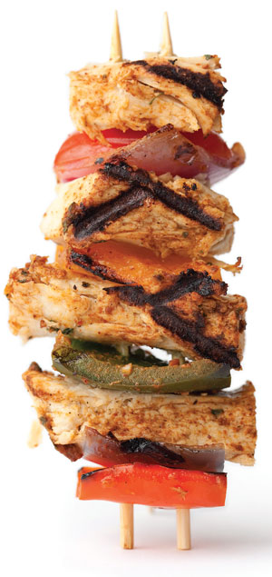
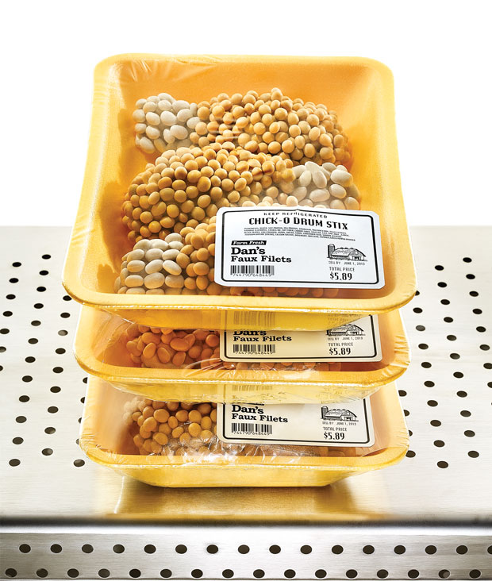
The Better Meat Substitute
All-Plant Kebab: State-of-the-art extrusion technology gives Beyond Meat the look and feel of chicken.

Slide 42
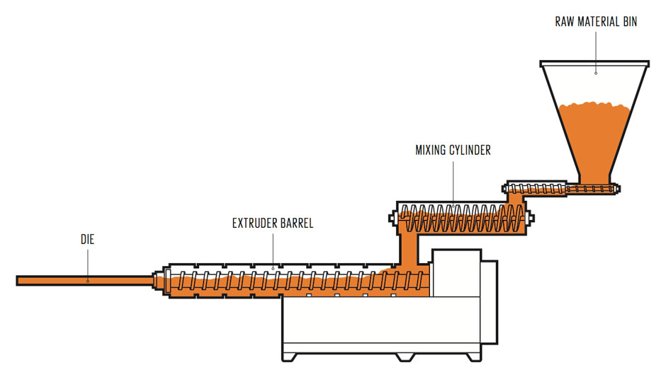
“Chicken” From an Extruder To make a high-moisture meat analogue, start by mixing plant protein powders with water and oil. Then knead the mix in an extruder barrel, and finally shear and cut in a die.

Slide 43
About a third of the food produced for human consumption never gets eaten. That’s a lot wasted—some 1.3 billion metric tons worldwide each year
It seems like a no-brainer. This is a problem that needs to be fixed. But where to start? In developing countries, inefficient harvesting, unrefrigerated storage, and frequent holdups in transportation and distribution leave food rotting in fields and warehouses and on the backs of trucks. In developed countries, efficient harvesting, processing, and distribution systems that include refrigerated warehouses and trucks mean that most food waste can’t be blamed on spoilage, although some farmers choose to leave crops in the field when they think market prices are too low. It’s when food gets into the store, restaurant, or kitchen that the real problems happen—leading to some 222 million metric tons’ worth of food being thrown out each year.
Solutions ?
http://www.leanpath.com/

Slide 44
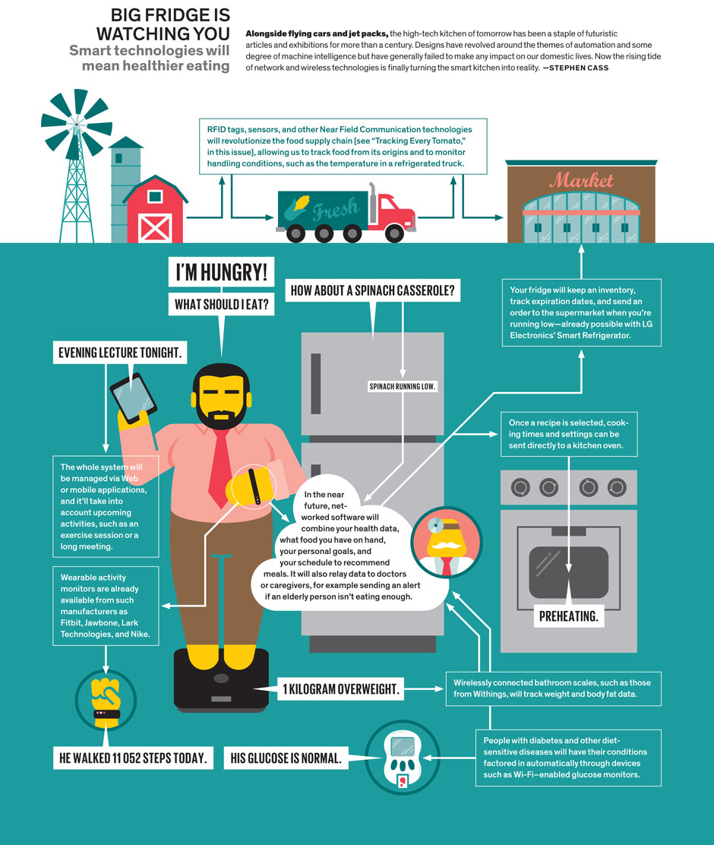
Smart Kitchen Reality!

Slide 45
Future Food: The Perfect Fake
http://www.thegatesnotes.com/features/future-of-food

Slide 46
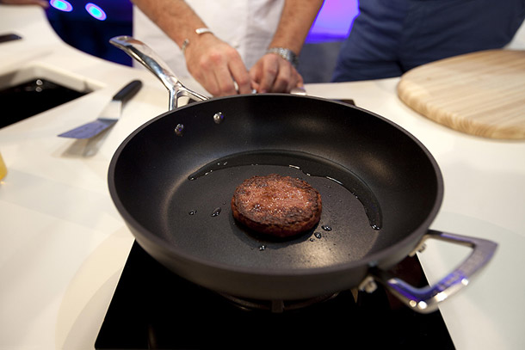
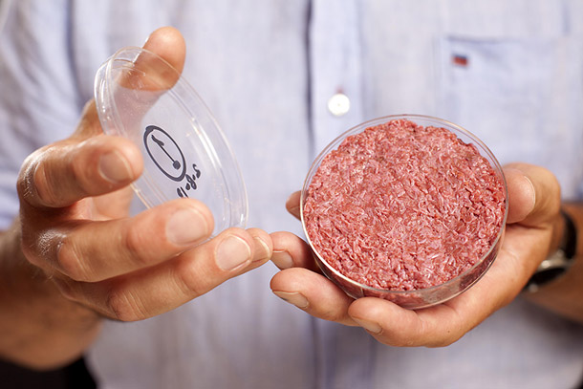
Future Food: In-Vitro Meat
(Cultured Meat, Guilt-Free Meat)
First lab-grown burger
http://www.maastrichtuniversity.nl/web/show/id=6866536/langid=42
http://www.maastrichtuniversity.nl/web/Main/Sitewide/Content/CulturedBeefPresentation5August2013Introduction.htm

Slide 47
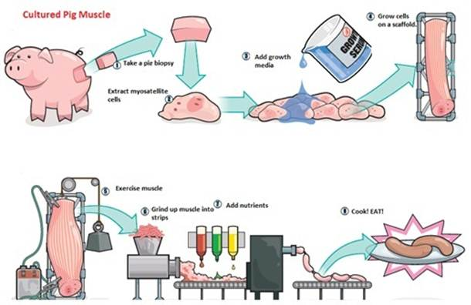
In Vitro Meat
http://www.experimentation-online.co.uk/article.php?id=1170

Slide 48
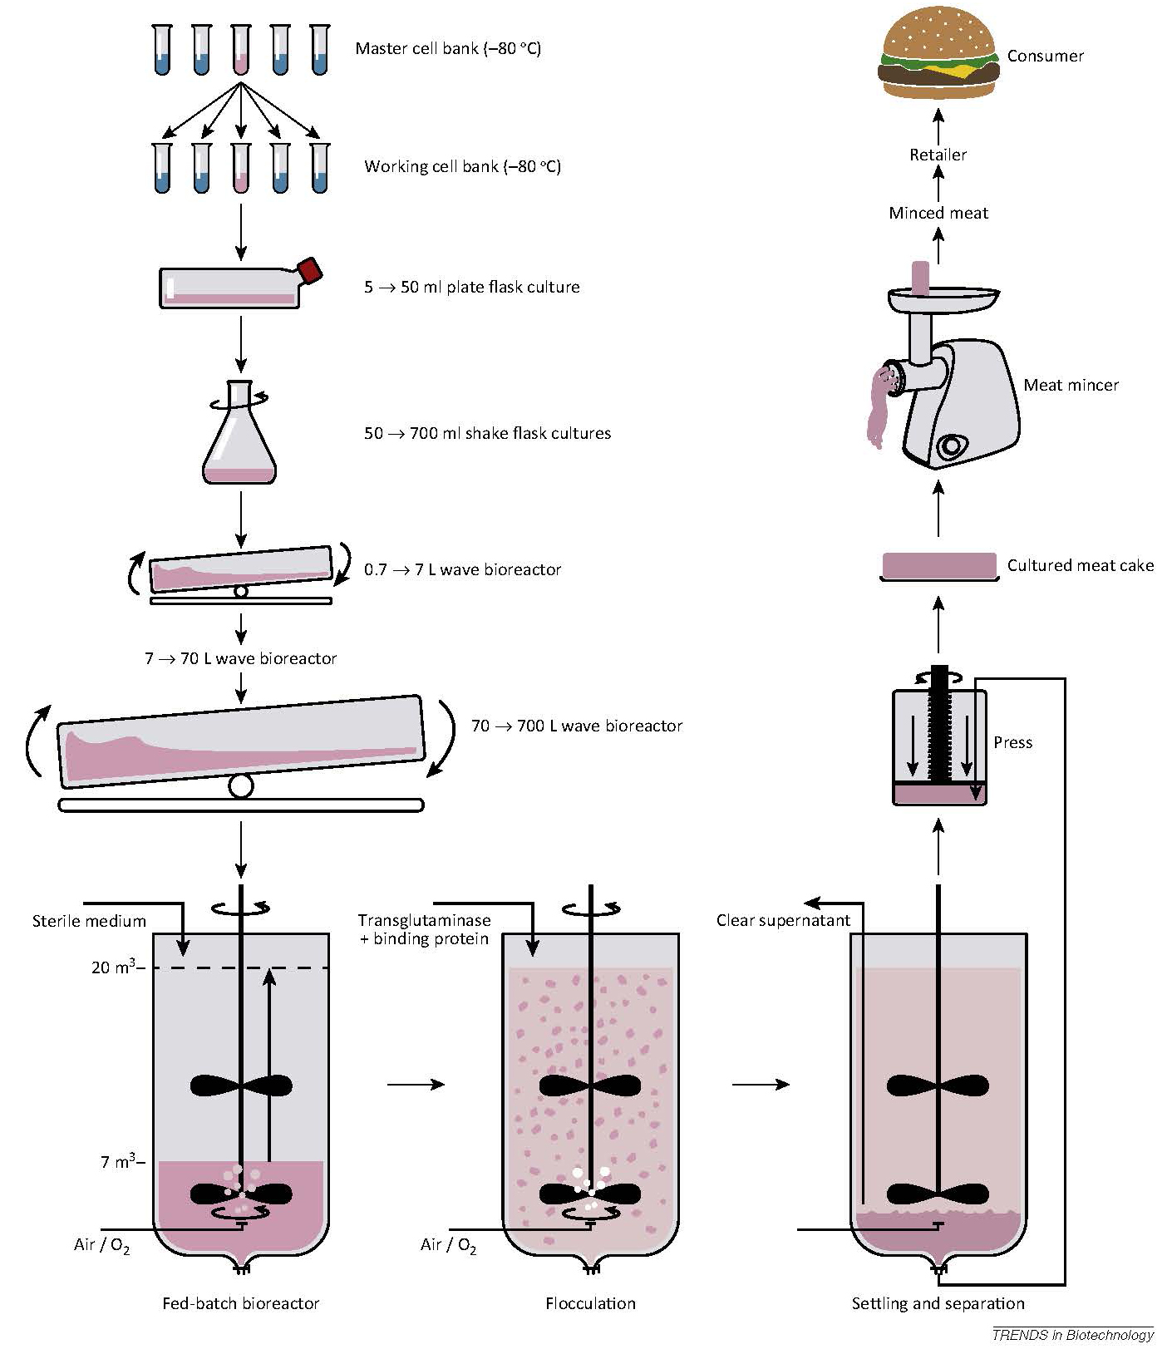

Slide 49
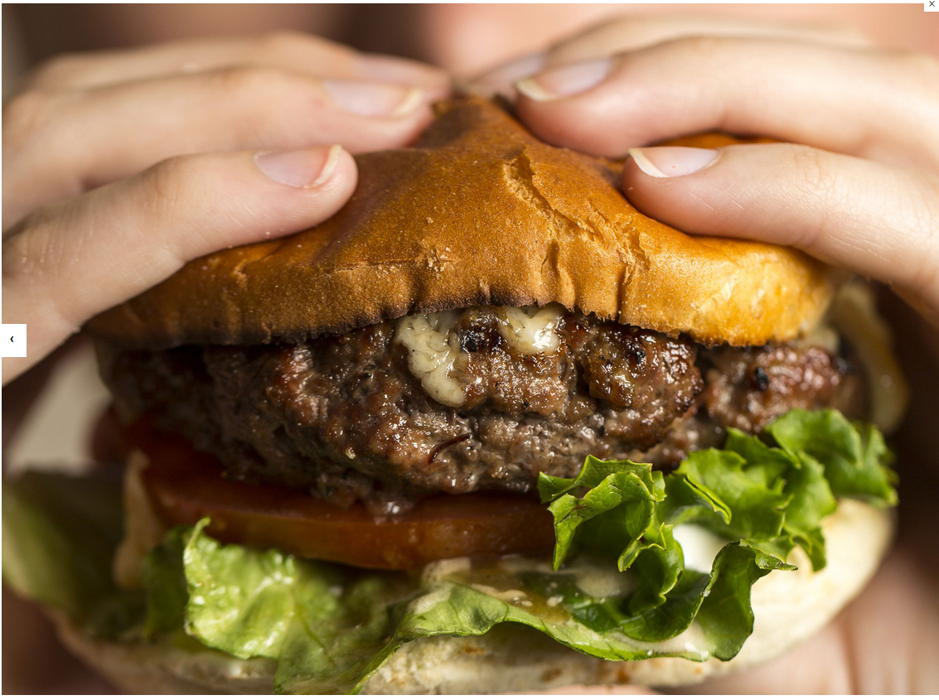
A 5-oz beef patty assembled from thousands of teeny-tiny meat strips, cultured from the stem cells of a single cow, is to be served in London. The price: £250,000, or about $385,000. (2013)

Slide 50
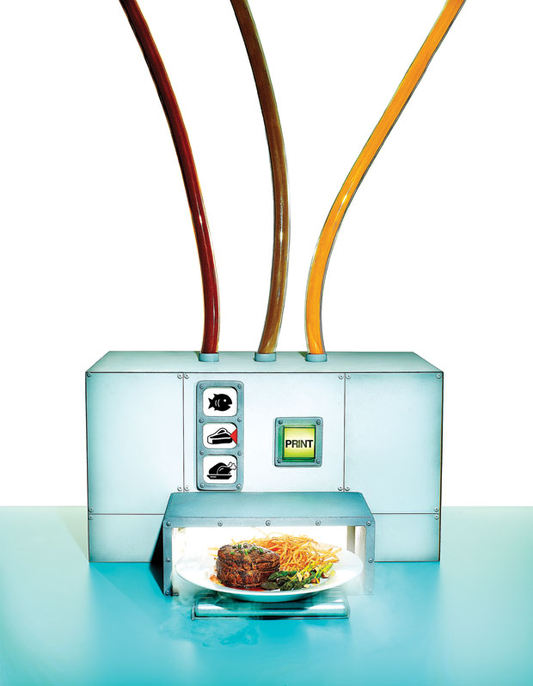
Chef in a Box Chef in a Box:
In the kitchen of the future, a food compositor could fabricate haute cuisine from scratch
How about 3D printing food!

Slide 51
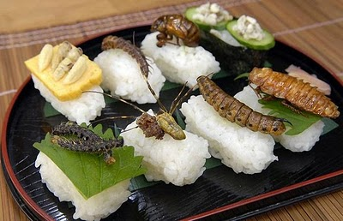
Sushi anyone?
http://northerngaijin.blogspot.tw/2011/06/gourmet-entomophagy.html
http://www.youtube.com/watch?v=Ea3j_-Xm6s8

Slide 52
Entomophagy of Future Food: Eating Bugs to Save the World!
http://www.youtube.com/watch?v=jlAl8EDDQRw
http://www.youtube.com/watch?v=dD6AG3HWwCk
http://www.youtube.com/watch?v=nN_zcp8644E#t=66
http://www.youtube.com/watch?v=GekDjhpnTU4 (10:00 mark)
Bug Eating Capital of the World?

Slide 53
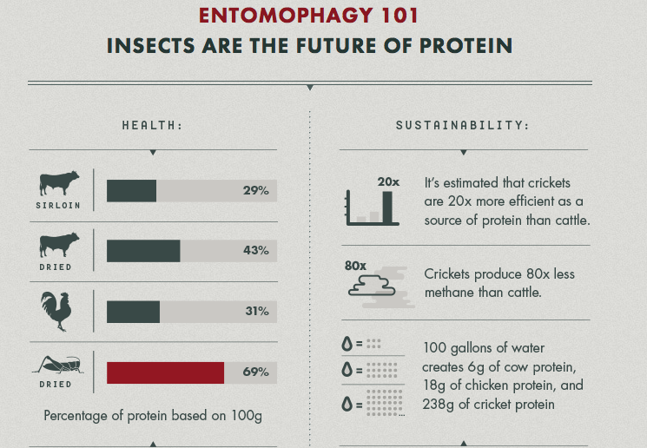
http://prezi.com/zio46exts34a/entomophagy/

Slide 54
5 Ways To Feed 9 Billion People Without Ruining The Planet
The world will need to produce 69% more calories by 2050, given a global population of 9.6 billion people.
REDUCE FOOD WASTE
CHANGE DIETS
LEAVE NO FARMER BEHIND
BETTER SEEDS
BETTER ANIMAL FEEDS
http://www.fastcoexist.com/3022983/5-ways-to-feed-9-billion-people-without-ruining-the-planet

Slide 55
How About BigData Analytics to Save the World!

Slide 56
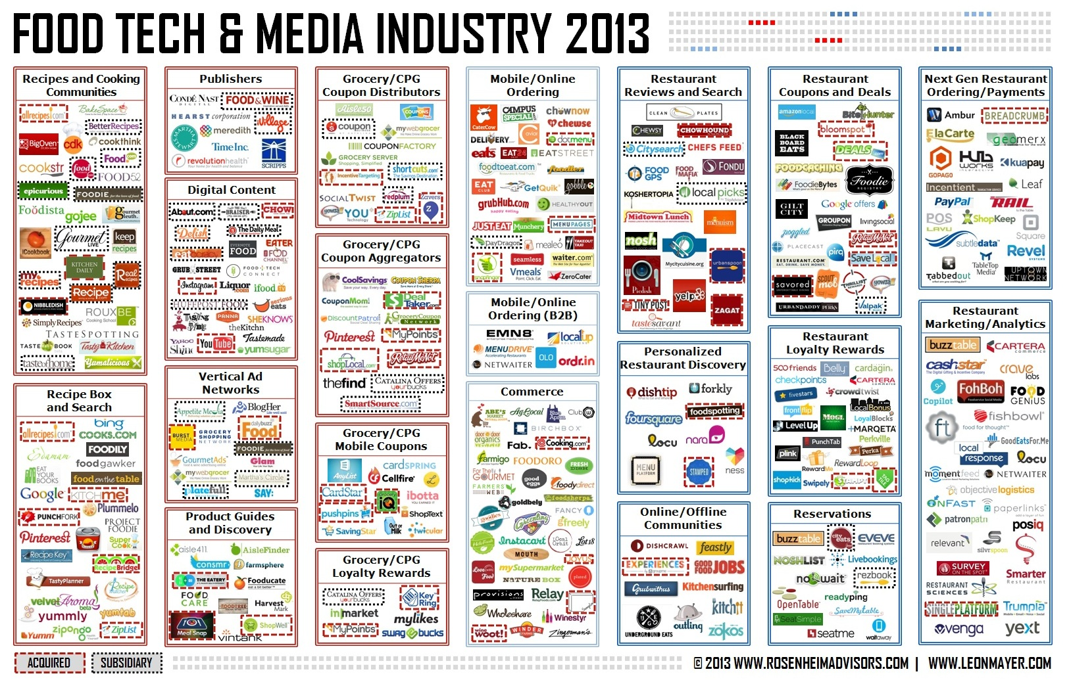
http://www.foodtechconnect.com/2013/07/17/food-tech-media-startup-funding-ma-and-partnerships-june-2013/

Slide 57
Smart Food Ecosystem
Analytics and agriculture
Sustenance and sustainability
Safety and the supply chain
http://www.youtube.com/watch?v=qVn9FOnRSHg
http://www.youtube.com/watch?v=3aUA4hDmkC4
http://www.ibm.com/smarterplanet/us/en/food_technology/ideas/

Slide 58
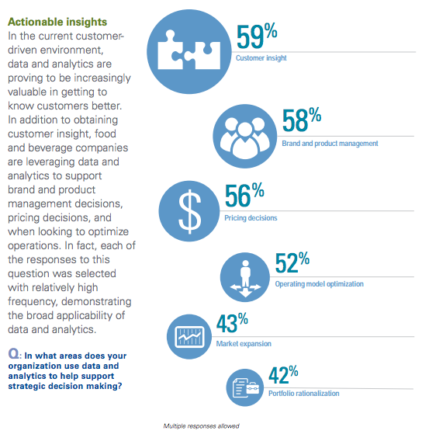
KPMG 2013 Food and Beverage Outlook Survey: Big Data Analytics

Slide 59
Beverage Industry and Technology
Coco-Cola Freestyle Fountain
Packaging
Marketing

Slide 60
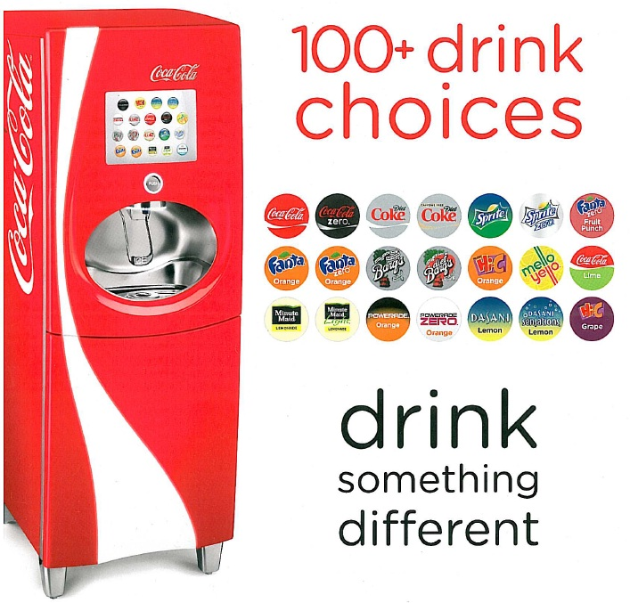
Coca-Cola Freestyle is a touch screen soda fountain introduced by The Coca-Cola Company in 2009. The machine features over 125 different Coca-Cola drink products, and custom flavors.The machine allows users to select from mixtures of flavors of Coca-Cola branded products which are then individually dispensed. The machines are currently located in major Coca-Cola partners and retail locations as a part of a gradual and ongoing deployment.
http://www.pininfarina.it/en/coca_cola_freestyle/

Slide 61
Coco-Cola Freestyle Fountain Machine
Designed by the Italian automotive design firm Pininfarina
Technologies involved include microdispensing technology and proprietary PurePour technology. Both technologies were originally developed to deliver precise doses of drugs.
One Freestyle unit with a similar footprint to a current vending machine can dispense 126 kinds of carbonated and non-carbonated beverages from one freestanding unit. Microdosing blends one or more concentrated ingredients in 46 US fl oz (1.36 L) packets with water and sweetener at the point where the beverage is dispensed,thus avoiding the use of traditional 5 US gal (18.9 L) boxes of syrup (also known as a bag-in-a-box).
Cartridges store concentrated ingredients in the dispenser cabinet and are RFID enabled. The machine uses RFID chips to detect its supplies and to radio resupplying needs to other units. The machines transmit supply and demand data to both Coca-Cola and the owner including brands sold, times of the day of sales, troubleshooting information, and service data.
The traditional ice cube dispenser remains. The maximum rate of output is 95 drinks per hour

Slide 62
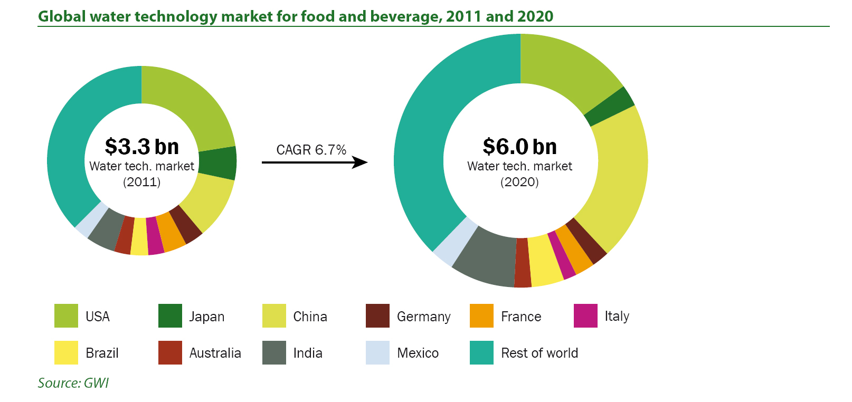

Slide 63
TOP 10 MOST INNOVATIVE COMPANIES IN FOOD (2013)
Beyond Meat
BrightFarms
Farmland LP
Chipotle
Fairlife
LiquiGlide
Hampton Creek Food
AgLocal
Blue Bottle Coffee
Kind Healthy Snacks

