Slide 1
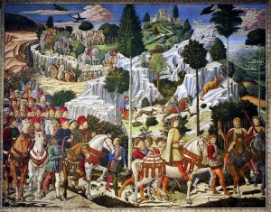
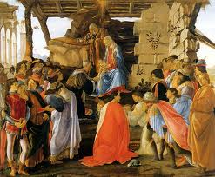
The Medici Effect
http://www.themedicieffect.com/index.html
http://www.youtube.com/watch?v=AsrRqsSM97U
http://www.youtube.com/watch?v=N_27L4XR_f4&feature=related
http://www.themedicigroup.com/videos

Slide 2
Medicis and Renaissance
The Medicis were a banking family in Florence who funded creators from a wide range of disciplines. Thanks to this family and a few others like it, sculptors, scientists, poets, philosophers, financiers, painters, and architects converged upon the city of Florence. There they found each other, learned from one another, and broke down barriers between disciplines and cultures. Beginning in the 14th century, The Medici used charm, skill and ruthlessness to garner unparalleled wealth and power. Standing at the helm of the Renaissance, they ruled Europe for more than 300 years and inspired the great artists, scientists and thinkers who gave birth to the modern world – escape from the ravages of Dark Ages.
Together they forged a new world based on new ideas—what became known as the Renaissance. As a result, the city became the epicenter of a creative explosion, one of the most innovative eras in history. The effects of the Medici family can be felt even to this day.

Slide 3
The MEDICI EFFECT
Frans Johansson
What Elephants and Epidemics can teach us
about Innovations
Introduction
Chapters 1-2
http://www.themedicieffect.com/index.html
"Crossroads" (1999), by István Orosz, is a limited-edition print pulled from a metal engraving. The work depicts crossing bridges that could not exist in the three-dimensional world. For example, there are reflections where there are no bridges to be reflected. For more, see:
http://im-possible.info/english/articles/vis_math_art/

Slide 4
What is the Medici Effect ?
Groundbreaking innovations can best be created in the Intersections where cultures, domains and disciplines stream together.
This kind of remarkable innovations are called the Medici Effect.

Slide 5
AND . . . The implications are …..
When society is at a crossroads

Slide 6
The Medici Family
The family was powerful and influential from the 13th to 17th century.
Estimates suggest that the Medici family was for a period of time the wealthiest family in Europe.
The Medici Bank was one of the most prosperous and most respected in Europe.
The family acquired political power initially in Florence, and later in wider Italy and Europe.
The family produced three popes (Leo X, Clement VII, and Leo XI), and Lorenzo il Magnifico, Ruler of Florence, patron of some of the most famous works of renaissance art.

Slide 7
The Medici Family
The accounting profession’s general ledger system was improved through the development of the double-entry bookkeeping system for tracking credits and debits.
This system was first used by accountants working for the Medici family in Florence.

Slide 8
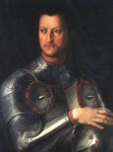
Significant accomplishments of the Medici were:
Agnolo di Cosimo 1(503-72)
Cosimo I de' Medici
undated; Oil on wood; Uffizi
The sponsorship of art and architecture, early and High Renaissance art and architecture.
Their money was significant because artists generally only made their works when they received commissions and advance payments.
The first patron of the arts in the family, ordered the reconstruction of the Church of San Lorenzo.
Cosimo I the Great erected the Uffizi Gallery in 1560 and founded the Academy of Design in 1562.

Slide 9
Put on your Thinking Cap
What is the Difference between the 13th Century and 2012 ?

Slide 10
The Difference between the 13th Century and 2012
We didn’t believe that life was fair
We didn’t believe that all people should be successful
We didn’t believe that everything and everyone should be equal
The king and queen may have been benevolent, but they certainly didn’t treat everyone the same
Risk was rewarded
And greatness was frequently achieved

Slide 11
The Medici Effect
“When you step into an intersection of fields, disciplines, or cultures, you can combine existing concepts into a large number of extraordinary ideas.”
“We have met teams and individuals who have searched for, and found, intersections between disciplines, cultures, concepts, and domains. Once there, they have the opportunity to innovate as never before, creating the Medici Effect.”
  Frans Johansson, The Medici Effect, Harvard Business School Press, 2006, page 186.
Doesn’t it sound like . . . .
Morphologically Forced Choices?

Slide 12

All new ideas are combinations of existing ideas

Slide 13
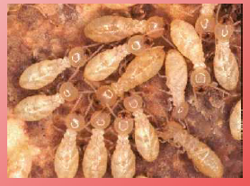
Modern Example:
Mick Pearce (architect)
Challenge:
  Build attractive, functioning, office building
  Use no air conditioning
  Location: Harare, Zimbabwe
Key to the solution:
Termites!

Slide 14
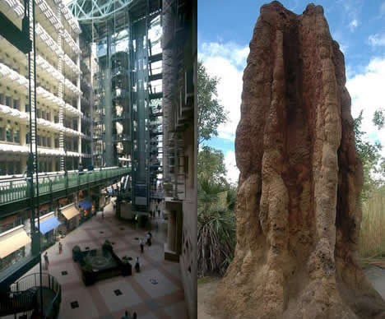
Biomimetic Building Uses Termite Mound As Model
The Eastgate Centre is a shopping centre and office block in central Harare, Zimbabwe.
The building was designed to be ventilated and cooled entirely by natural means.
Check out:
http://www.treehugger.com/files/2006/08/biomimetic_buil_1.php
http://www.inhabitat.com/2007/12/10/building-modelled-on-termites-eastgate-centre-in-zimbabwe/

Slide 15
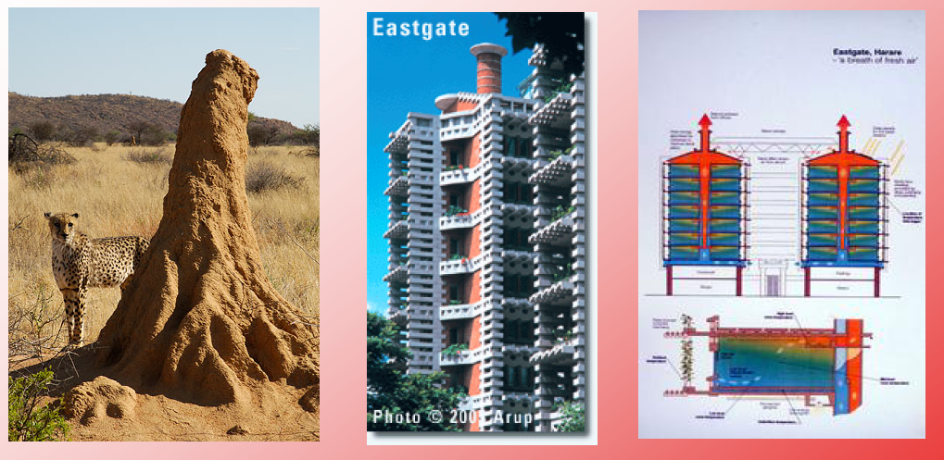
Connection between termites, office buildings, and air conditioning!
Combined architectural design, engineering, and processes in nature

Slide 16

George Soros
He was born in Budapest in 1930.
Survived the Nazi occupation and then fled communist Hungary for England, where he graduated from the London School of Economics.
Came to the U.S. in 1956, at age 26.
Accumulated a large fortune through the investment advisory firm he founded and managed. Chairman of Soros Fund Management, LLC
Founded organization network dedicated to promoting the values of democracy and an open society.
His foundation network spends about $400 million annually founder of The Open Society Institute.
http://www.georgesoros.com/
http://www.soros.org/about/bios/a_soros

Slide 17
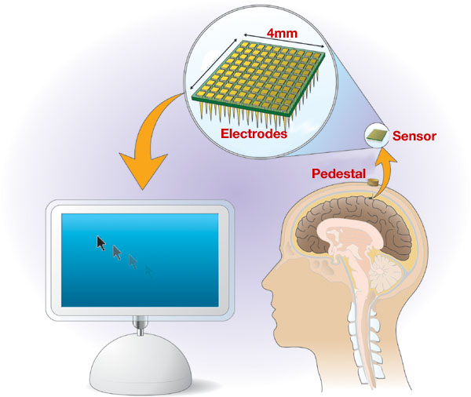
Chapter 1: The Intersection—Your Best Chance to Innovate
Monkeys and Mind Readers
a tiny array of electrodes that, when attached to a monkey’s brain, recorded, interpreted and reconstructed activity in the motor cortex, the area of the brain that controls hand movement
At first, the animals used their hands to play a simple game. Researchers turned off the hand control - Monkeys could still move the cursor.
Computer science, biology, medicine, psychology, physics, mathematics

Slide 18
Creative Ideas are . . . .
New to the user
Valuable
Realized – social evaluation
What could you put on wheels that isn't ?

Slide 19
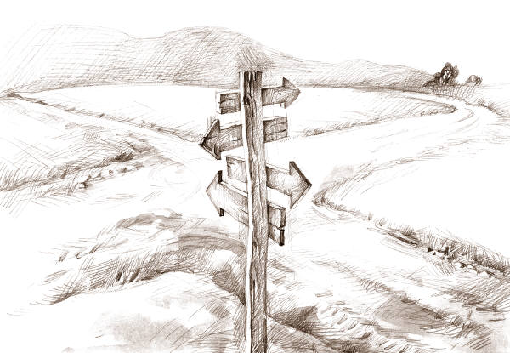
The Intersection
Where fields meet
Field = culture, domain, discipline
Fields consist of concepts (knowledge, practices)

Slide 20
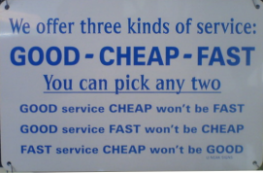
Ideas make you do a double take
Intersectional ideas compete for attention.

Slide 21
Intersectional ideas compete for attention.
They are surprising and fascinating.
They take leaps in new directions.
They open up entirely new fields.
They occupy a space for a person, team, or company to call its own.
They generate followers/ creators can become
leaders.
They provide a source of directional innovation for years to come.
They can affect the world in unprecedented ways.

Slide 22


Chapter 2: The Rise of Intersections—
The Sounds of Shakira and the Emotions of Shrek
3 Distinct Force Behind Intersectional Innovation
  The Movement of People
  The Convergence of Science
  The Leap in Computation

Slide 23
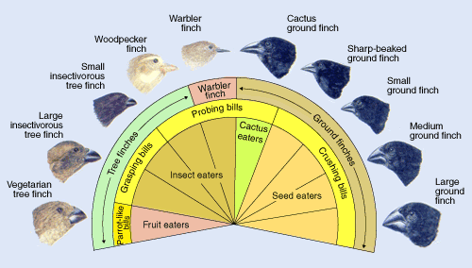
Chapter 3: Break Down Barriers Between Fields
Sea Urchin Lollipops and Darwin’s Finches
Unravel a chain of associations.
Low associative barriers lead to connections.
Driving down a city street by a chemical plant, the economist sees development; the environmental engineer sees pollution.

Slide 24
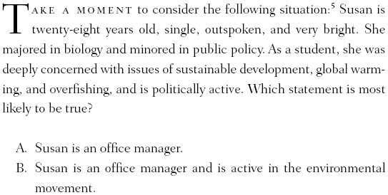

What Are Associative Barriers?
Which statement is more probable?

Slide 25
Chapter 4: How to Make the Barriers Fall
Heathrow Tunnel and Restaurants Without Food
People who succeed at breaking down associative barriers did one or more of the following things:
➣ Exposed themselves to a range of cultures
➣ Learned differently
➣ Reversed their assumptions
➣ Took on multiple perspectives

Slide 26
The whole idea behind a broad education, one that covers several fields, is that it can help us break out of the associative boundaries that expertise builds.
This fellow gives new meaning to the role of “bread man”
http://www.smh.com.au/ftimages/2005/09/04/1125772402835.html

Slide 27

Stan Lapidus founded Cytyc, invented ThinPrep® Pap Test® which increases cervical cancer detection 65%, and reduced the error rate (False Negative) by a factor of four; “He doesn’t have an M.D. or a Ph.D., but he has come up with an amazing way of analyzing stool samples for colon cancer pathology. Put it in a blender, mix, and you can spot cancer with hardly any false positives. It’s really an amazing invention. Now, why did he think of this? Because he’s not a doc.”

Slide 28

Chapter 5: Randomly Combine Concepts
Card Games and Sky Rises
Creativity comes from combining concepts in an unusual fashion. Pliers and a string, although separate at the outset of the experiment, become one—a pendulum.
It is difficult to trace the origin of an insight. The triggering factor appears random, lucky, or, as Richard Garfield said, “to come out of nowhere.” Creativity, in other words, is a combination of concepts and it is random.

Slide 29


Story

Slide 30
Cont. Lesson 1: It’s a Combination of Different Concepts
This story has a direction. You may even have started to smile as the implications of the mix-up between the man cleaning his balcony and the suspected lover became clear (directional idea). The story was then intersected by an unexpected concept—that the refrigerator was not filled with food, but with a man. The joke is a vivid example of what happens when people in one field unearth a new insight by combining their knowledge with unrelated ideas from a separate discipline.

Slide 31
Lesson 2: It’s Appearing Random
But somehow it may be more than that !
Luck does indeed critical
Hard work is always rule-of-thumb
It is important to be completely open at all times, to be surprised by some piece of information; “flash-in-the-sky serendipity”

Slide 32
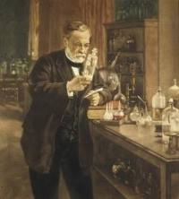
Prepared-mind Discoveries
The most famous one is perhaps Louis Pasteur’s discovery of vaccination in 1875. Pasteur had forgotten a culture of chicken cholera bacteria in his laboratory over the summer. When he came back and injected the old bacteria into the chickens, they didn’t die, as expected, but became only slightly ill, and then recovered. At first Pasteur thought there was something wrong with the bacteria, so he got a new culture. When he injected the new culture into the chickens, they still survived. Pasteur suddenly realized that the chickens had been immunized, or vaccinated, during their first injection—a completely unintended discovery! Had he not been prepared to understand the significance of the chicken surviving, however, the insight would have escaped him.

Slide 33

Chapter 6: How to Find the Combinations
Meteorite Crashes and Code Breakers
By diversifying occupations
By interacting with diverse groups of people
By going Intersection hunting

Slide 34
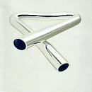
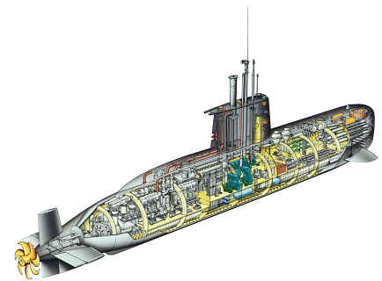
Chapter 7: Ignite an Explosion of Ideas
Submarines and Tubular Bells

Slide 35
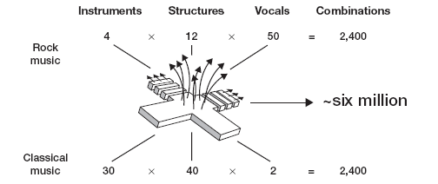
The Medici Effect: An Exponential Increase in Concept Combinations
By breaking down associative barriers and stepping into the intersection between fields, the number of available idea combinations increases beyond anything we can achieve in a single area.

Slide 36
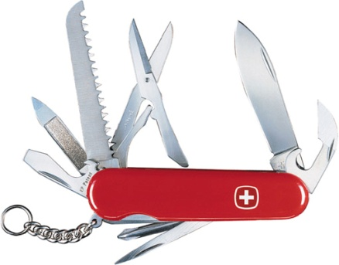
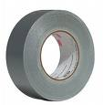
Chapter 8: How to Capture the Explosion
MacGyver and Boiling Potatoes
The fictional character MacGyver from the television series employs his resourcefulness and his knowledge of chemistry, physics, technology and outdoorsmanship to resolve what are often life or death crises.
He spontaneously creates inventions from simple items to solve these problems carried only a Swiss Army knife and duct tape

Slide 37
Chapter 9: Execute Past Your Failures—Violence and School Curricula
Get Ready for Failure
Directional ideas may be important but are extensions, improvements, or refinements of something already known.
Developing a linear plan works for Directional Innovation but poorly for Intersectional Innovation.
The major difference between a directional idea and an intersectional one is that we know where we are going with directional innovation.
Inters e ctional
Id
a
Directional
Innovation

Slide 38
Chapter 9: Execute Past Your Failures
An Intersectional Idea can go in any number of directions. We don’t know which will work until we try them out.
Successful execution of intersectional ideas does not come from planning for success, but planning for failure.
Intersection ideas and inventions are surprising and open up new fields, usually today taking advantage of opportunities offered by changes in population, science, and computation.

Slide 39
Chapter 10: How to Succeed in Failure
Palm Pilots and Counterproductive Carrots
Try ideas that fail in order to find those that won’t
Reserve/Budget resources for trial and error
Remain motivated

Slide 40
The Relationship Of Multiple Ideas To New Product Development Success
An estimated 40 percent of all new products simply fail in the marketplace *
It takes as many as 25 ideas to generate one success In the consumer products industry.**
In the biotech industry & pharmaceutical companies there are an increasing number of new drug candidates, and lower percentages are making it to later stages. Between 1998 and 2002, 48 percent of drugs in the pipeline were at the discovery stage.***
The ‘best’ organizations recognized one product success for every four new product ideas, while the ‘rest’ see just under 10 percent of new product ideas reaching fruition.
*Philip H. Francis, New Product Development — the Soul of the Enterprise, Mechanical Engineering, 3/14/03.
**Abbie Griffin, “PDMA Research on New Product Development Practices: Updating Trends and Benchmarking Best Practices,” Journal of Product Innovation Management (1997, 14): 429-458.
*** H.S. Ayoub, The Biotech Industry: 30 Years of Failure , Biotech Investor., 1/7/2007
**** Product Development and Management Association (PDMA) Foundation 2004 Comparative Assessment Study (CPAS)

Slide 41

How do you reward failure?
Robert Sutton “Inaction is far worse than failure in terms of assessing innovative effort.
Make sure people are aware that failure to execute ideas is the greatest failure, and that it will be punished.
Make sure everyone learns from past failures; do not reward the same mistakes over and over again.
If people show low failure rates, be suspicious. Maybe they are not taking enough risks; maybe they are hiding their mistakes, rather than allowing others in the organization to learn from them.
Hire people who have intelligent failures; let others know that’s one reason they were hired.

Slide 42
Reserve Resources for Many Trials
Be prepared to change your execution plans. You may have drawn them to convince others, motivate yourself, coordinate activities. They will need to be adjusted.
If realizing your ideas depends on money, spend it carefully.
Reserve enough $$$$ for one or two more attempts.
OR . . .find trusted backers who will provide money for several trials.
If realizing your idea depends on time, give yourself enough time for several trials and errors.
Proceed with extreme caution if your reputation, goodwill, or contacts are riding on a successful execution of your idea on the first try.

Slide 43
Chapter 11: Break Out of Your Network—
Ants and Truck Drivers
11
“ Swarm Intelligence”
The Network Paradox
The Reason We Build Networks
Why We Have to Break Away from Networks
“ Break Away Traditional Value Network”
e.g. Pixar have used computer-generated graphics to upend the traditional 2D animation market.

Slide 44
Chapter 12: Leave the Network Behind—
Penguins and Meditation
12
“Leave the comfort zone and prepare for a fight”

Slide 45
Chapter 13: Take Risks / Overcome Fear Airplanes and Serial Entrepreneurs
ICONOCLASTS Season 2: Isabella Rossellini + Dean Kamen
The secret is this: If you want to create something revolutionary, head toward the Intersection. The Intersection represents the best chance to innovate because of the explosion of unique concept combinations. It offers a great numerical advantage when looking for fresh ideas. In other words, the Intersection is a low-risk proposition for breaking new ground.

Slide 46
Chapter 14: Adopt a Balanced View of Risk—
Elephants and Epidemics
14
Prospect Theory: it is not so much that we hate uncertainty, but rather that we fear losing.
Our irrational reactions to possible loss can easily be observed outside
of a laboratory. The obvious example is the stock market. When a
stock has a run-up in value we are likely to sell in order to secure a gain.
But when the stock drops in value we are more likely to hold on, hoping
that the trend will reverse. This is not just true for amateur investors;
it also holds true for professionals. The problem here is that if
we take chances only when we have something to lose and play it safe
when we have something to gain, we will be losing in the long run.
Two important tools for overcoming fear: The first is acknowledging fear and the second is admitting that one can fail.

Slide 47
Acknowledge Fear and Risks
Mark Twain: “Courage is resistance to fear, mastery of fear, not absence of fear.”
The Courage to Move On !

Slide 48
Chapter 15: Step into the Intersection … — Create the Medici Effect
15
The Intersection is your best chance to innovate.
The place that drastically increases the chances for unusual combinations to occur
Expect the Unexpected, Because Intersections Are Everywhere

Slide 49
The Modern Day Medici: Steve Jobs
Steve Jobs, his real organizational power if ever made commonplace because he lived it and was one of the only leaders on record who had the ability to intersect different worlds where he saw no associated barriers existed, just like the epic work outlined. Art, calligraphy, Eastern and Western philosophies, hardware, software, movies, phones, all interchangeable but connected because he knew one important thing – all customer research and focus groups are worthless if you can create game changers on a regular basis.

Slide 50
Case Studies
Apple (What the secret behind!)
  Pursuit Mission of Great Product
  Optimized to create the value for customers not optimized for maximum of the profit
  Disrupt yourself within (i.e. iPad vs iMac)
  Apple would solve problems customers didn't know they had with products they didn't even realize they wanted.
  Modern day Medici Inc.

Slide 51
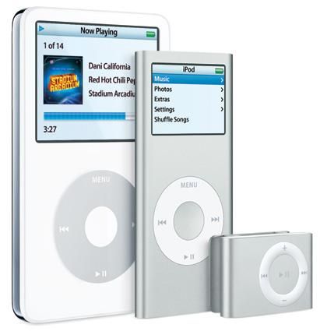
Apple iPod

Slide 52
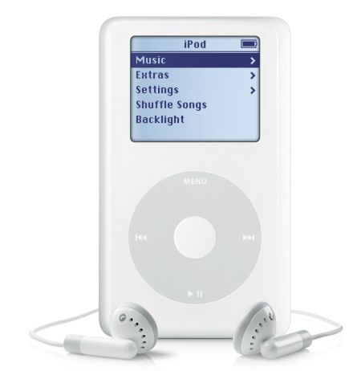
21st Century Innovation: the iPod;
iPhone and iPad follow through
The Apple iPod = 299$ of Chinese exports to US
Distribution of the value added
299 US$
  75$ profit to US (Apple)
  73$ wholesale/retail US (Apple)
  75$ to Japan (Toshiba)
  60$ 400 parts from Asia
  15$ 16 parts from the US
  2$ assembly by China
iTunes Music Store (2003)
  70% digital market share
  Big 5 recording companies
http://blogs.computerworld.com/node/5724
Notes:
Tapping into a global innovation network = 400+ components from over all over the world
Apple did very little R&D – rather most of its effort was spent on design, marketing and software development (iTunes Music Store) and the difficult negotiations of getting the “Big 5” music labels to agree to make their music available
These intangibles / intellectual assets were the key to the success of this product, allowing Apple to capture half of the sales price and 70% of the legal digital download market in just 7 years (25% of all).

Slide 53
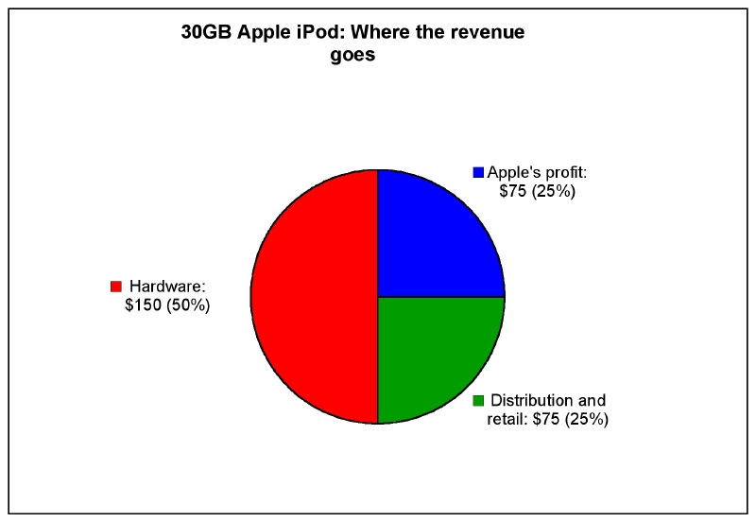
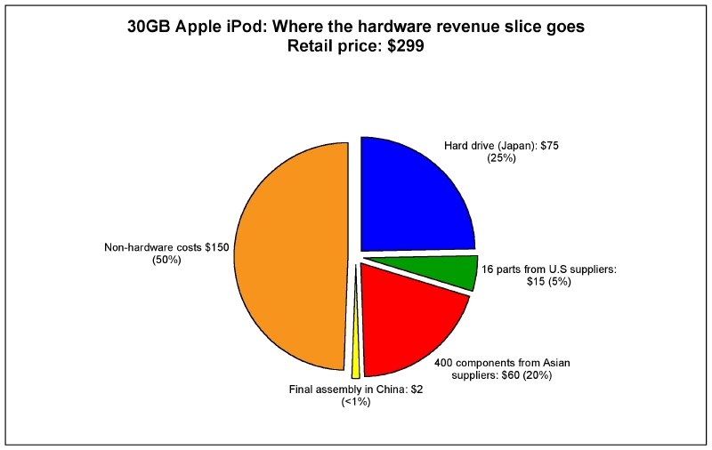
21st Century Innovation: the iPod;
iTune and iPhone iPad follow through
http://blogs.computerworld.com/node/5724
Notes:
Tapping into a global innovation network = 400+ components from over all over the world
Apple did very little R&D – rather most of its effort was spent on design, marketing and software development (iTunes Music Store) and the difficult negotiations of getting the “Big 5” music labels to agree to make their music available
These intangibles / intellectual assets were the key to the success of this product, allowing Apple to capture half of the sales price and 70% of the legal digital download market in just 7 years (25% of all).

Slide 54
Innovation and Organic Growth
Emphasis on:
  Top-line revenue
  Customer-centric, customer value
  Internal and external social interactions
  Cross-functional and cross-experiential teams
  Empathetic, high EI people
  Experimentation, learning
  Entrepreneurial culture, boldness, audacity
Value-creating strategy vs. Value-enhancing strategy

Slide 55
Value-creating vs. Value-enhancing Strategy
Profit
Plateau
Competition
Erodes
Profits
Profit
New Product
Introduction
Value-creating Innovation
Product₁
Product₂
Product₃
Product₄
time
Value-enhancing Innovation
Profit
Product₁
Product₂
Introduce
iPod
Windows
compatible
iPod
Photo
WiFi
iPod
Price
Cut
iPod
Video
iPod +
Nike Shoe
iPod
Mini
BMW
iPod
Adaptor
iPod
Wireless
Remote
iPod +
Timex Watch
Notes:
55

Slide 56
Apple’s iPod Innovation Network
Alliance Network and Innovation
10 parts create 85%
of the iPod’s cost
Samsung (Korea) – Mobile SDRAM memory
Toshiba (China) – Hard Drive
Toshiba-Matsushita (Japan)- Display Module
Nike
Disney
Timex
Broadcom (Singapore)-Multimedia Processor
PortalPlayer (US) Portal Player CPU
Apple
iPod
Inventec (Taiwan)-Assembly, Testing
Renesas (Japan) Display Driver
Digital
Music
Group
GM
Ford
Delta
Airlines
Unknown Battery Pack
Unknown Mainboard PCB
Unknown Back Enclosure
400 additional inputs with values from $2 to fractions of a penny, with an average value of $.05
Source: Portelligent, Inc. and
Linden, Kraemer & Dedrick, 2007.
Notes:
56

Slide 57
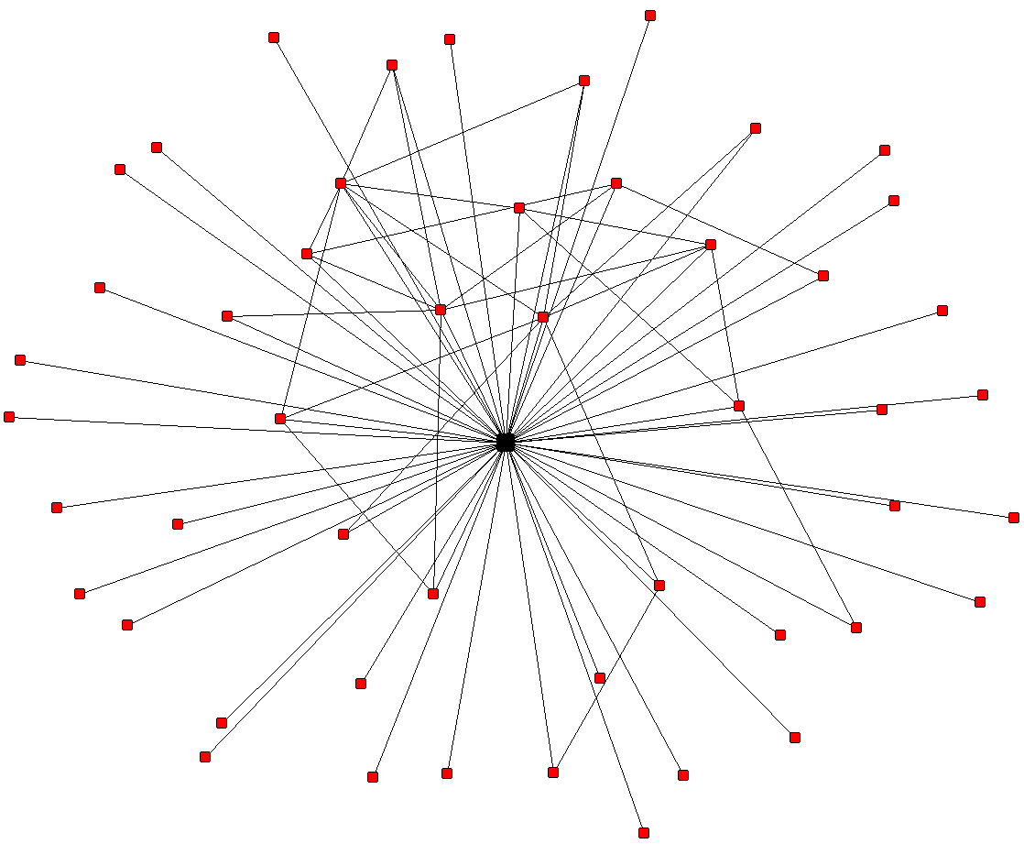
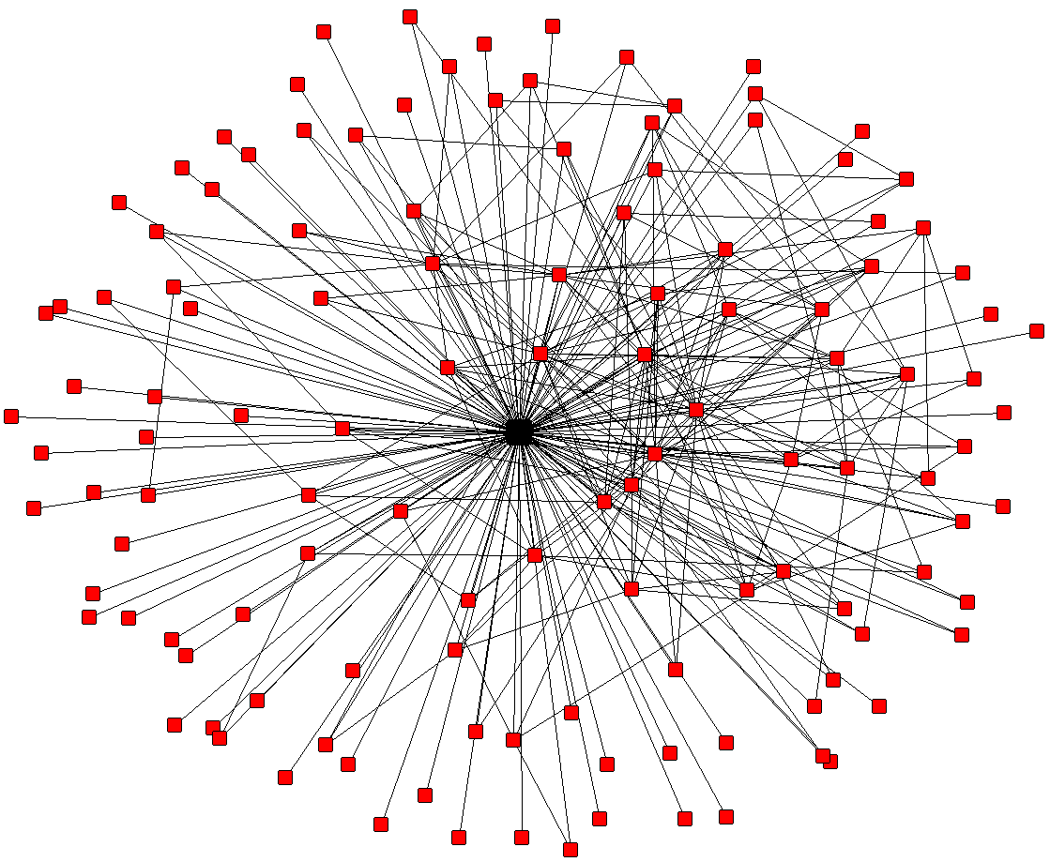
Alliance Network and Innovation
Apple Computuer
High Level of VC + VE
Apple – alliance network in 1995
Apple – alliance network from 1995-1997
Notes:
57

Slide 58
Apple (Close System) vs
Microsoft (Open EcoSystem)
Apple
  Key Ingredients of Apple Products
    Very Efficient Integration of Hardware, Software, User Interface, and Service
    Simplicity and Aesthetics, More Consumer Centric Products
    Plus Steve Jobs to Break Rules and Apple Brand
  Solid Continuity and Right Timing Launch of various Products
    iMac, the MacBook line, iPod, iTunes, iPhone, iPad, iWork, and iCloud
Microsoft
  Complicated Ecosystem
  More Business Centric Products

Slide 59
Google vs. Apple
Apple
Launch iPhone
Improvement
Improvement
Improvement
Launch iPad
Google
Android operating system
Improvement
Launch Nexus One
Pull back Nexus One

Slide 60



Apple: 8 Easy Steps to Beat
Microsoft (and Google)
Paris, July 2010
Courtesy of FaberNovel, 2010

Slide 61

Table of contents
Introduction
Step #1: Believe in the simple
Step #2: Design a full experience
Step #3: Lock customers in
Step #4: Sell at a premium
Step #5: Cross-sell your product line
Step #6: Balance control vs. freedom
Step #7: Think different
Step #8: Assess risks and competition
Conclusion: happily ever after Apple?
Appendixes: Glossary
..…….
July 2010 • Apple Study
3

Slide 62
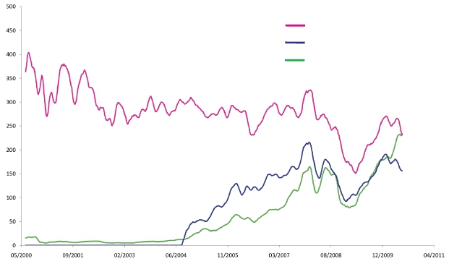
Why and how did Apple beat
Google & Microsoft?
Microsoft
Google
Apple
In 6 years, Apple’s market cap outweighed
both the new and old tech champions
..…….
Source: Bloomberg
July 2010 • Apple Study
4

Slide 63

Step #1: Believe in the simple
Apple: the arrogance of simplicity
..…….
June 2010 • Apple Study v1.0
5

Slide 64

What is Apple’s design process?
“When you first start off trying to solve a problem, the first solutions you come up with
are very complex, and most people stop there. But if you keep going, […] you can often
times arrive at some very elegant and simple solutions.” Steve Jobs1
Apple identifies needs and use cases to make
decisions about function and technologies.
Drops 20 % of non-required functionalities to
perfectly design 80 % of key user needs.
Attention to details leads to excellence in user
experience.
Vision
Focus
Global
..…….
1
Q&A: Jobs on iPod's Cultural Impact, Newsweek, 10/16/2010
July 2010 • Apple Study
6

Slide 65
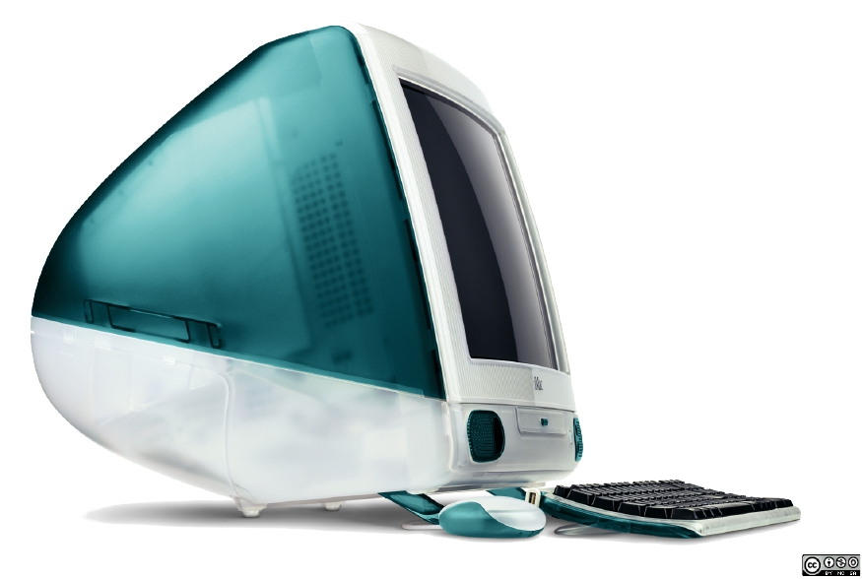
Case study: iMac (1998)
Simplicity & choices
Simplicity
All-in-one computer
Setup & go
Choices
No floppy disk
No extension stack
..…….
July 2010 • Apple Study
7

Slide 66



Case study: why does making choices
implies constraint?
“It became an intense and almost religious argument about the purity of the system's
design versus the user's freedom to configure the system he liked.”
Christopher Espinosa (Apple employee #8) speaking about the Macintosh project, 1984
No sign of upcoming blu-ray
support on Apple computers.
Music can only be managed
through iTunes.
App Store approval process
as a quality insurance.
“YouTube now supports HD video.” Steve Jobs1
“Other companies tried to do everything on the
device itself and made it so complicated that it
was useless.” Steve Jobs2
“We created an approval process [to] avoid
applications that degrade the core experience of
the iPhone.” Apple Answers the FCC’s Questions
..…….
1Email on 04/14/2010
2Q&A: Jobs on iPod's Cultural Impact, Newsweek, 10/16/2010
July 2010 • Apple Study
8

Slide 67

Step #2: Design a full experience
Apple adopts a comprehensive
approach
..…….
UX: User experience
July 2010 • Apple Study
9

Slide 68
Apple re-legitimize vertical integration
Customer-centric
Apple goes against
the outsourcing
trend.
Contrary to industrial
vertical integration,
Apple uses it to
control the global
experience of its
customers.
App Store contributed to only
1 % in profit!1
“Pure” financial management
would have required it to be
outsourced as soon as possible.
Business design
Apple adopts a
holistic approach to
its business.
Products
UX
Financial
Marketing
Apple advertisement are
designed internally.
Mobile carriers are only allowed
to show their logo at the end.
Focus
Apple focuses on a
very lean product
line.
Risk management on
technological choices
and consistency at all
layers
“We’ve reviewed the road map of
new products and axed more
than 70 percent of them, keeping
the 30 percent that were gems.”
Steve Jobs upon his returning to
Apple in 1997
..…….
1Source:
Piper Jaffray
July 2010 • Apple Study
10

Slide 69
Apple’s vertical integration offers three
competitive advantages
“Our competitors, Dell and Compaq, are distribution companies […].
They don’t create anything.”
Steve Jobs, Time, Oct 1999
Simplicity
Apple acts as an
abstraction layer.
Technical complexity
hidden behind slick
and intuitive UI:
seamless experience.
Quality
Thanks to hardware
and software tight
integration, Apple’s
products offers great
quality.
Innovation
Apple does not
depend on its
suppliers’ technical
breakthroughs.
It can innovate on
hardware and
software at its own
pace.
July 2010 • Apple Study
..…….
11

Slide 70
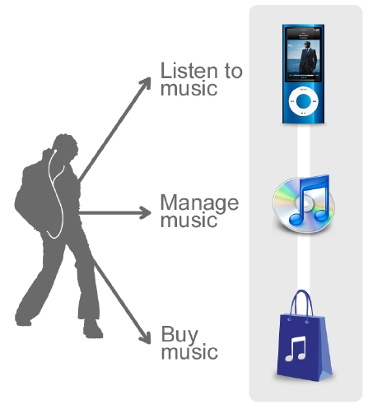
Case study: the digital music revolution
(2001-2004)
• Chose high-speed FireWire
instead of USB1
• Game-changing click wheel
• Apple’s design guidelines applied
• iTunes software
• Available on Mac & PC
• Simple and reliable software
• Agreements with the music industry
• Distribution
• DRM1
Apple provides a comprehensive music experience
..…….
1Digital
Rights Management (DRM): technologies used by content owners to control usage of music, movies…
July 2010 • Apple Study
12

Slide 71
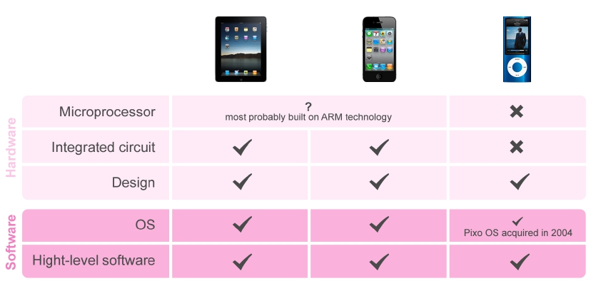
Case study: Apple’s vertical integration
in hardware for consumer electronics
Apple controls every step: it ensures that almost every hardware and
software parts are customized to perfectly fit its needs.
July 2010 • Apple Study
..…….
13

Slide 72

Step #3: Lock customers in
iTunes’ goal is to lock the consumer in
..…….
July 2010 • Apple Study
14

Slide 73

iTunes revenues are insignificant
$6.6 bn
Hardware
Software
37%
iTunes Store
Other software
82%
18%
63%
$4.1 bn
$30 bn
Revenue Distribution in 2009
The iTunes Store represented only 11 % of Apple’s revenues in 2009.
..…….
Source: Apple annual reports
July 2010 • Apple Study
15

Slide 74




Case study: App Store revenues
are a drop in the bucket
$6.8 bn
$400 m
Revenues generated by iPhone (hardware) sales in 2009
(22 % of Apple’s revenues)
Revenues generated by App Store sales since its creation
<
1%
App Store contribution to gross profit since its creation
Apple authorizes and sometimes promotes apps competitors
to its iTunes Store during keynotes.
..…….
Source: Keynote WWDC 2010, Piper Jaffray
July 2010 • Apple Study
16

Slide 75







Yet iTunes’ goal
is to lock the consumer in
iTunes-devices relationship is locked
One-way sync
(Palm controversy)
FairPlay
DRM software invented by Apple,
protecting videos, eBooks, apps2
Consumers lock themselves in
$100
spent per device on av.1
125 m
iTunes accounts linked with credit
card (painless buying experience)
Great customer loyalty (user retention/walled garden)
..…….
1
2There are no DRM on iTunes Music since 2009.
Deutsche Bank.
July 2010 • Apple Study
17

Slide 76

Step #4: Sell at a premium
Apple’s revenues come from high
margin hardware products
..…….
July 2010 • Apple Study
18

Slide 77
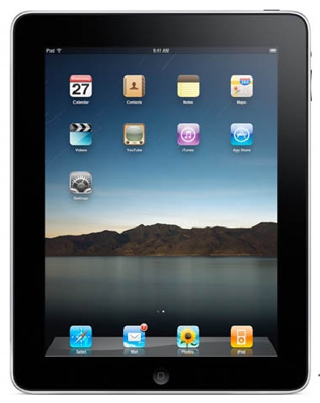
Case study: Apple’s profit comes from
margins in hardware (iPad)
$499
$110
+ Apple margin
Margin:
40 %
$90
$70
$230
Average industry margin
(approx. 30 %)
Cost of sales
(approx. 30 %)
Cost of materials and
manufacturing1
..…….
1Source:
iSuppli
July 2010 • Apple Study
19

Slide 78
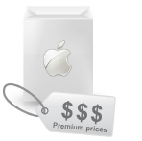
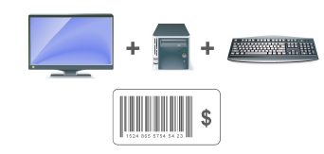
Big picture: hardware drives
Apple’s gross margin
vs.
iPod
iPhone
iPhone 3G
iPad
Biggest gross margin growth in the industry
..…….
Source: Apple annual reports
June 2010 • Apple Study v1.0
20

Slide 79

Step #5: Cross-sell your product line
Apple brand appeal drives its product
line
..…….
July 2010 • Apple Study
21

Slide 80
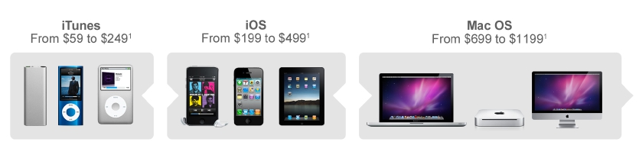
Who is the iCustomer?
Product line covers all markets, all price ranges, all needs with an accurate segmentation.
Market leader
100m iPhones sold by 2011 (est.)
8 % market share
+ Product lifecycle: each new product implements appealing new features, strongly inducing the
loyal iCustomer to buy new products (iPhone 3GS to iPhone 4)
The iCustomer needs all Apple products to maximize his user experience.
..…….
1Prices for entry-level models.
Source: Apple, Morgan Stanley, Gartner.
July 2010 • Apple Study
22

Slide 81
Who is the iCustomer?
Product line covers all markets, all price ranges, all needs with an accurate segmentation.
Market leader
100m iPhones sold by 2011 (est.)
8 % market share
+ Product lifecycle: each new product implements appealing new features, strongly inducing the
loyal iCustomer to buy new products (iPhone 3GS to iPhone 4)
The iCustomer needs all Apple products to maximize his user experience.
..…….
1Prices for entry-level models.
Source: Apple, Morgan Stanley, Gartner.
July 2010 • Apple Study
22

Slide 82
Case study: iPod and iPhone
drives Mac sales
Mac
sales, m
Mac(leftaxis)
iPod(rightaxis)
iPod and
iPhone
sales, m
Halo effect1+ seamless experience with mobile devices requires a Mac
40 % of Apple revenues comes from Mac sales (desktop and laptop).
..…….
1Halo effect: e.g. a product (the iPod) has positive effects on our perception of something else (the Apple brand)
Source: Apple annual reports, Oppenheimer
July 2010 • Apple Study
23

Slide 83
Integration reinforced by retail strategy
“We want to make the best buying experience in the world […]. It’s impossible to get
knowledge at the point of sale. We can’t thrive in that environment.” Steve Jobs, D2
% revenue from Apple’s retail stores
Number of Apple stores
Contribution to revenue starting to plateau (but profitability sacrificed to enhance buying
experience) but still Apple Stores are a place where the company can:
• showcase a 100 % Apple environment (to appeal the iCustomer)
• have a trained sales force selling its products.
Apple Stores fosters the brand appeal and consequently, the halo effect.
..…….
Source: Apple annual reports
July 2010 • Apple Study
24

Slide 84
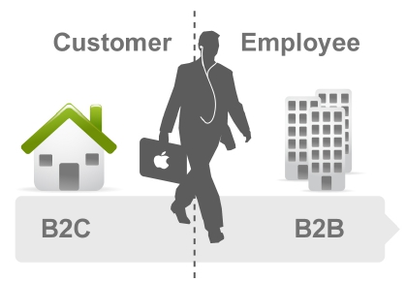
iCustomers will drive Apple’s sales
Apple’s main focus is the consumer market where “every person votes for themselves”
Steve Jobs, D8
However, thanks to its thriving success in B2C, Apple will be able to raise its
market share in B2B
..…….
July 2010 • Apple Study
25

Slide 85
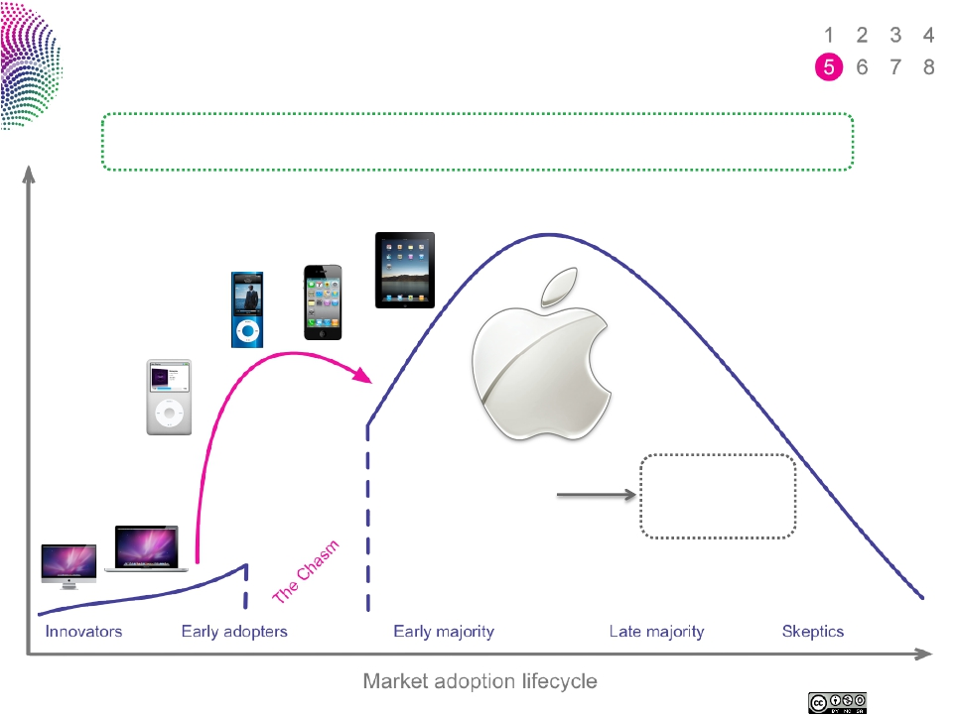
How did Apple cross the chasm?
iPhone and iPod sales have enabled the Apple brand to cross the chasm.
Example: Amazon Kindle sold 3 m units in its first year. Apple’s iPad did the same in 80 days.
Killer products
+
Brand leverage
Immediate
mainstream
adoption
..…….
Source: Apple, Electronista
July 2010 • Apple Study
26

Slide 86

Step #6: Balance control vs. freedom
Apple needs an ecosystem
..…….
July 2010 • Apple Study
27

Slide 87

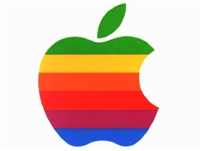
Case study: how Apple failed in the 80’s
“We weren’t so good at partnering with people […]. If Apple could have a little more of
that in its DNA, it would have served it extremely well.” Steve Jobs, D5, 2007
1982: Steve Jobs forces Bill Gates to develop productivity software only for the
Mac
1985: Apple allows Microsoft to use Mac technologies in Windows in exchange of
a Word and Excel upgrade for Macintosh
1988-1995: 7-year legal battle lost by Apple
1995: Launch of Windows 95 has definitively dwarfed Apple’s share in the PC
market
..…….
July 2010 • Apple Study
28

Slide 88





Lessons learned!
Copyright owners
Apple:
• understood their market
structure
• gave them what they wanted
most (DRM for music,
price control for publishers)
Developers
Contrary to the Mac, Apple has attracted
developers on iOS
• Ground breaking
revenue sharing
• 56 % of US mobile dev
on iPhone
(90 % are single-platform)1
Carriers
Crucial to iPhone’s success:
• AT&T first allowed Apple,
which had no experience
in this market, to make the phone
they wanted
• Set a standard for others
Google
Apple’s keeps partnering with its #1
competitor because it’s the best at
certain services (native apps on iOS):
• Search
• Maps
• YouTube
Apple understood it needed to partner with other players.
..…….
1Source:
Millenial Media
July 2010 • Apple Study
29

Slide 89
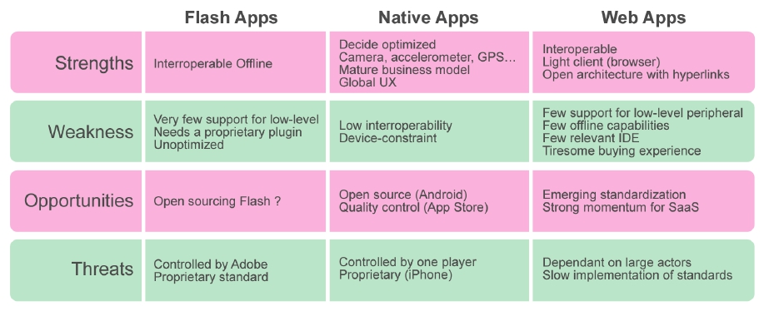
Mobile application paradigms:
Native Apps vs. Web Apps
Apple’s model put the emphasis on native apps (iPhone SDK), but also
promotes HTML5 (iAd, WebKit). Flash represents “the past”.
..…….
SaaS: Software as a service (see Wikipedia)
June 2010 • Apple Study v1.0
30

Slide 90
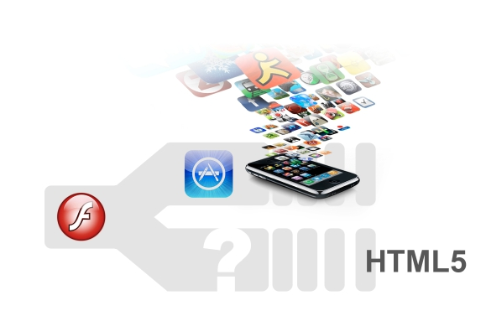
Case study: What is Apple’s vision about
mobile applications?
To Apple HTML5 is a complement to the curated App Store model, providing
developers with liberty and an open architecture.
Near future
Long-term vision: promoting open standards will prevent other players from
excluding Apple, as Microsoft did with its Office proprietary formats.
..…….
July 2010 • Apple Study
31

Slide 91

Step #7: Think different
Apple uses the cloud to foster a
new computing paradigm.
..…….
From Wikipedia: “Cloud computing is Internet-based computing, whereby shared resources, software, and information
are provided to computers and other devices on demand, like the electricity grid.”
June 2010 • Apple Study v1.0
32

Slide 92
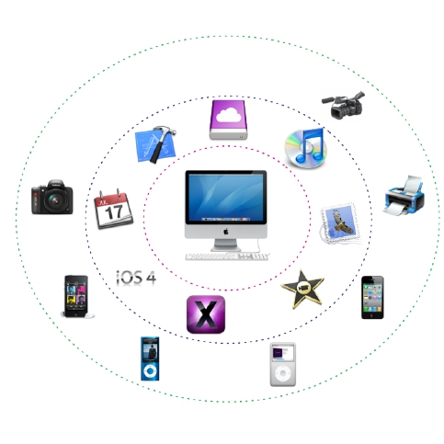
What was Apple’s vision of computing ?
Personal computer
= only digital hub
Applications and UX
= glue
Devices = media
consumption/creation
..…….
July 2010 • Apple Study
33

Slide 93
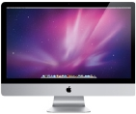



iPad embodies the transition
to post-PC era
“We are scratching the surface on the kind of apps we can build for it. […] One can
create a lot of content on a tablet.” Steve Jobs, D8
New input
technologies
+
Progress in
UI
People will turn to a more intimate and
direct relationship with content
Personal computers
are trucks: most
people do not need
such an extensive
interface.
Other devices,
including tablets, will
be mainstream, just
as cars are great for
everyday life.
..…….
July 2010 • Apple Study
34

Slide 94
To make it happen Apple is investing
in cloud
Differentiation
Without cloud computing, Apple
would lose ground before its
competitors.
• Mobile resources are
constraints (end of Moore’s
law1, battery life), while cloud
computing enables speech
recognition, unlimited storage…
• Competitors are already
differentiating: Google Voice,
Independence
Without cloud computing, Apple
would fail to secure reliable
infrastructure.
• It would be dependent on
competitors (notably Google
and Amazon)
• Entry barriers are increasing
(experience maintaining
security and scalability)
Microsoft Office Online…
..…….
1Moore’s
Law: see Wikipedia.
July 2010 • Apple Study
35

Slide 95


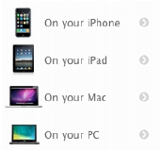
Three upcoming features
to build an Apple cloud
“We’re working on it”, Steve Jobs, D8, June 2010
MobileMe
Apple makes MobileMe
free for all Apple users
Devices will be synced
wirelessly
Streaming
Streaming as a new
paradigm for media
consumption
• Streamlined UX: no
more downloading/buying
• Media & entertainment
as a service
• Monetisation: via
Quattro Wireless1
New glue
The cloud is the new
glue that links all Apple
devices
• Unified storage (iDisk)
• Streaming vs.
downloading
• Would greatly improve
the iPad
Apple bought Lala (an online
music store) in 2009,
presumably to build up a
cloud-based iTunes.com
..…….
1
Quattro Wireless is a mobile advertising agency bought by Apple in January 2010.
July 2010 • Apple Study
36

Slide 96
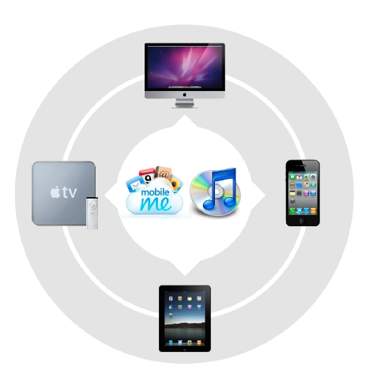
Fostering a new Apple environment
Decentralisation
Glue = iTunes.com
and MobileMe
Variety of devices
..…….
July 2010 • Apple Study
37

Slide 97

Step #8: Assess risks and competition
Apple’s notion of control is the
company’s greatest risk
..…….
June 2010 • Apple Study v1.0
38

Slide 98
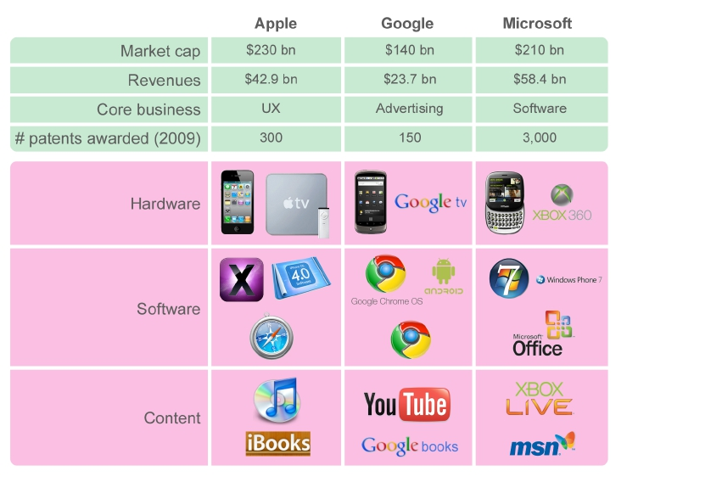
Overview of Apple, Microsoft and Google
..…….
Source: Google Finance, IPO
June 2010 • Apple Study v1.0
39

Slide 99
Will iOS vs Android be the revival of
Macintosh vs. Windows?
Apple: control and decide
Tight control on all
aspects of UX
The firm cannot support
all development cost and
must focus on a few
products.
Microsoft Office (at the beginning only available
for the Macintosh platform) was instrumental in
fostering its sales.
Microsoft & Google: dominate and divide
Focus on one strategic
layer
(Windows, Search)
They create competition
to let others innovate in
all remaining layers
(hardware, web…)
1985: Bill Gates begs Apple to consider licensing
the Macintosh: “Apple must make Macintosh a
standard”.
1996: “If we had licensed earlier, we would be
the Microsoft of today” (Apple executive VP Ian
W. Diery)
The same year, Apple reports $740 m loss.
..…….
July 2010 • Apple Study
40

Slide 100


Differences in business models
explain why Google and Apple compete
Apple
Car dealer
Google
Road Toll
Apple sells “great products”.
Differentiation: strives on selecting
the best technologies available
(Google’s when they’re the best).
“I’ve always wanted to own the […]
technology in everything I do”
Steve Jobs1
Attacks
Monetises web streams via ads.
Volume: an Internet that is more
open increases the traffic, which
increases Google’s revenues.
“[We don’t want] a future with one
man, one company, one carrier”
Vic Gundotra, Google VP, Engineering2
Freely adapted from a comment by Dominique de Vito on affordance.info
..…….
1BusinessWeek Online, Oct. 12, 2004
2Google I/O 2010
July 2010 • Apple Study
41

Slide 101
Worst-case scenario:
How could Android kill iOS?
Technological value
Android benefits from
open innovation.
Apple’s walled
garden prevents
others from innovating
in input method,
hardware…
Swype, an alternative input
method replacing the Android
User base
Android supports a
variety of devices.
Only Apple products
can use iOS.
Ford, GM announced a line of
“Android cars”
Complementary goods
Android Market
fosters developers’
freedom.
App Store approval
process is not
flexible.
Developers’ opinion: Android best
in the long term1
keyboard
Apple’s vertical integration prevents partnerships: why would Apple let
others compete with one of its layer?
..…….
1Appcelerator
study
July 2010 • Apple Study
42

Slide 102

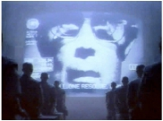
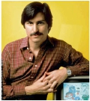
What are Apple’s main short-term risks?
Product
Apple’s strategy is a
limited number of high
quality products.
If a products had to be
recalled, it would
dramatically impact the
brand.
Heating issue in Apple III released in
1980, due to Steve Jobs’ insistence that
the computer should have no fans.
iPhone 4 antenna controversy
Brand image
Apple’s strategy of strict
product control can come
across as evil.
Developer lock-in: Xcode
(only IDE3), Objective-C
(only language)
“We have created for the first time in all
history, a garden of pure ideology, where
each worker may bloom secure from the
pests of contradictory and confusing
truths.”
Steve Jobs speaking about the App
Store?
Steve Jobs
Apple’s nightmare began
with Jobs’ departure and
ended with his return.
Its capacity to focus may
be significantly impeded
without him
“Apple desperately needs a great day-to-
day manager, visionary, leader and
politician. The only person who’s
qualified to run this company was
crucified 2,000 years ago.”
Michael Murphy, San Francisco
Chronicle, September 11, 1997
No. Dictator representing IBM in Apple’s
famous “1984” ads. 2
..…….
43
1BusinessWeek
2Apple’s Mistake by Paul Graham 3Integrated Development Environment
July 2010 • Apple Study

Slide 103
Conclusion: happily ever after Apple?
Step #9: you can’t afford to make the
slightest mistake?
..…….
July 2010 • Apple Study
44

Slide 104
Coevolution of Business and Technology

Slide 105
About the Future
The future is already here, it’s just not very well distributed.
The best way to predict the future is to invent it.
History is the greatest resource for planning the future.
Sometimes it is hard to recognize the future, even when it is staring you right in the face.

Slide 106
Definition of Coevolution
Two or more systems evolve in concert to the point they cannot survive separately
Businesses advances depend on technology (e.g., reputation system for e-Bay)
Technology advances depend on business drivers (e.g., Moore’s law needs investment)

Slide 107
Amusing things all happened once in a lifetime we may experience
Analog to Digital
Real Surfer to Web Surfer
Wired to Wireless
B&W to Color
Bicycle to Car, and Airplane
Seemingly unlimited food supply and continuously grow on wealth
Conservation to Consuming
….. and more
But in the past two years, wake-up calls from:
Bubble vs Reality
Inflation vs Deflation
Leverage vs Deleveraging
Collateral Damage vs Simple Knock-out Punch
Capitalism vs Socialism
Investment Banks vs Traditional Banks
Structured Product vs Single Product
Prosperity vs Recession and Depression
Oil → Nuclear Energy and other Green Energy → Oil ????
Job vs Jobless
…. and more

Slide 108
10 most disruptive technology combinations over last 25 years (1)
Disruption: The whatever/wherever/whenever model of media consumption is turning both Hollywood and the consumer electronics industry on their heads, and forcing advertisers to rethink ways to capture our attention.
  10. VOD and TV on demand + broadband service (TiVo, iTune, Slingbox, iPad etc.)
Disruption: Digital video has made mini-Hitchcocks of everyone. YouTube and its many cousins give the masses a place to put their masterworks. Journalism, politics, and entertainment will never be the same.
  9. YouTube + Cheap Digital Cameras and Camcorders (Flickr, Pinterest, etc.)
Disruption: The Net is seeing a new boom in Web 2.0 companies that are more stable and more interesting than their dot-com-era predecessors. And with phones using Google's Linux-based Android operating system slated to appear this year, open source could disrupt the wireless market as well.
  8. Open Source + Web Tools (Android, Linux, OpenOffice etc.)
Disruption: The idea that media should be portable is disruptive. The notion that it should be free--and that some artists can survive, or even thrive, despite a lack of sales revenue--is even more so.
  7. MP3 + Napster (iPod, Pandora, Fm etc.)
Disruption: Blogs give everyone a public voice, while Google gives bloggers a way to fund and market themselves--and the economy of the 21st century is born.
  6. Blogs + Google Ads
Source: Dan Tynan, PC World 2008.03

Slide 109
10 most disruptive technology combinations over last 25 years (2)
Disruption: Where would we be today without cheap, capacious, portable storage? No iPods. No YouTube. No Gmail. No cloud computing.
  5. Cheap Storage + Portable Memory
Disruption: For enterprises, cloud computing provides the benefits of a data center without the cost and hassle of maintaining one. For consumers, it offers the promise of cheaper, simpler devices that let them access their data and their applications from anywhere.
  4. Cloud Computing + Always-On Devices (i-Cloud, Dropbox, etc.)
Disruption: Broadband has created an explosion of video and music Web sites and VoIP services, while Wi-Fi is bringing the Net to everyday household appliances such as stereos, TVs, and home control systems. Together, they're making the connected home a reality.
  3. Broadband + Wireless Networks
Disruption: Media firms, publishing companies, and advertisers now think Web first, and broadcast or print second.
  2. The Web + The Graphical Browser
Disruption: The ability to be reachable 24/7 is morphing into the ability to surf the Net from any location. And it's forcing monopolistic wireless companies to open up their networks to new devices and services.
  1. Cell Phones + Wireless Internet Access
Source: Dan Tynan, PC World 2008.03

Slide 110





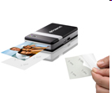
Disruption in business models has been the dominant historical mechanism for making things more affordable and accessible.
Yesterday
Ford
Dept. Stores
Digital Eqpt.
Delta
JP Morgan
Xerox
IBM
Cullinet
AT&T
Dillon, Read
Japan
Sony DiskMan
Today
Toyota
Wal-Mart
Dell
Southwest Airlines
Fidelity
Canon
Microsoft
Oracle
Cingular
Merrill Lynch
Korea, Taiwan
Cellular Phones, iPod
Tomorrow:
Chery
Internet retail
RIMBlackberry
Skywest, Air taxis
ETFs (exchange trade fund)
Zink, Micropojector
Linux, Android, iOS
Salesforce.com
Skype
E-Trade
China, India, Turkish, Brazil
Smart Phones, iPad, ebook
Courtesy of Clayton Christensen, Harvard U. 2008

Slide 111
The Historical S, T & A Co-evolution Process Perspective
NBIC: Nanotechnology, Biotechnology, Information Technology, Cognitive Science
More stories here!
Courtesy of Byeongwon Park 2007

Slide 112
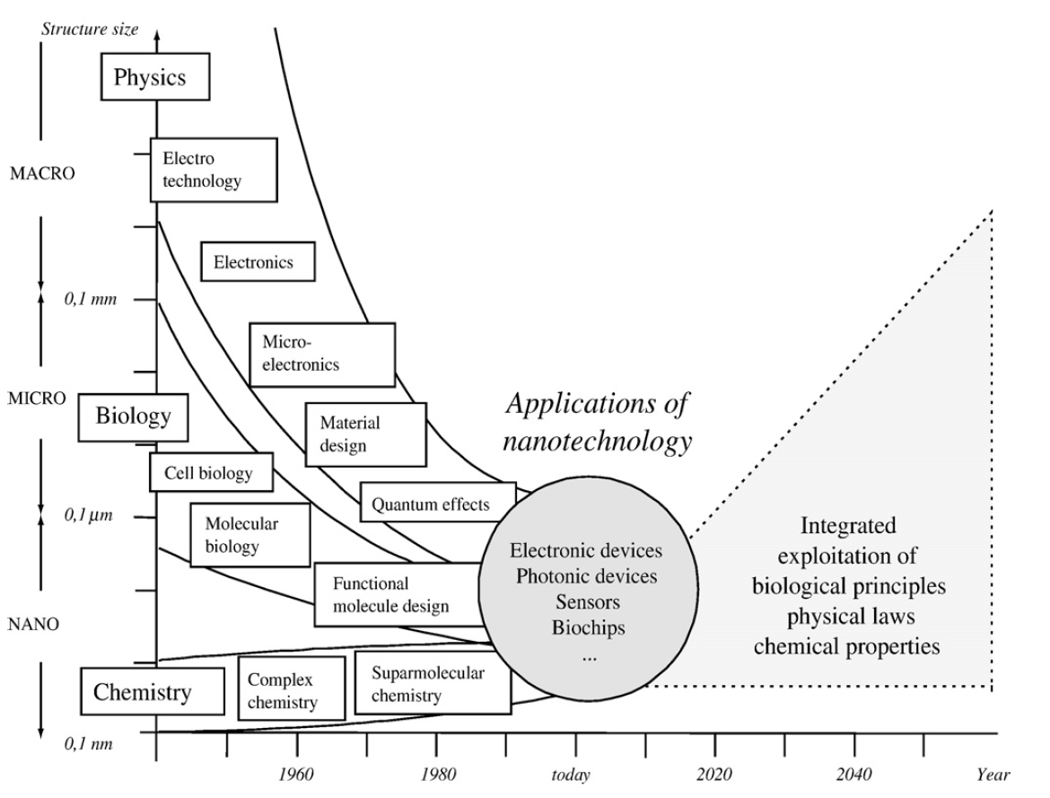
Trajectories of Underlying
Scientific Disciplines
Courtesy of F. Hacklin et al. / Technological Forecasting & Social Change 76 (2009)

Slide 113
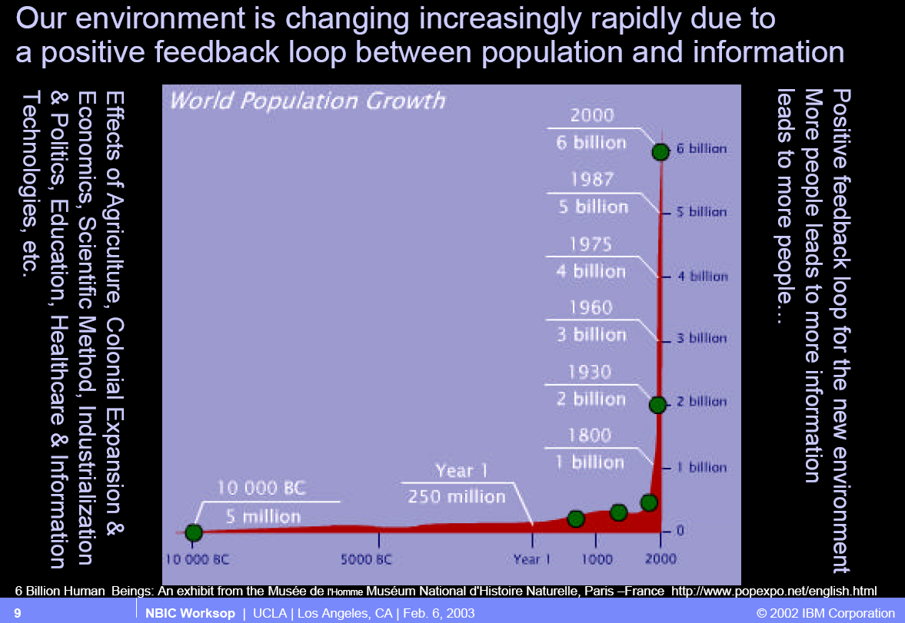

Slide 114
Information-Power Economy
Business architectures co-evolve with technology
Information technology has radically changed the structure of firms
Information about goods becomes a good (or a service?)
Business models are shifting from forecast/schedule-driven to demand/event-driven
Business relationships/architectures shifting from tightly to loosely coupled
Business models are shifting from proprietary to standard models with reusable components

Slide 115
Co-evolution of Business Models and
Enabling Technologies
Business patterns are continuously evolving, mostly as a result of changes in information and communications technology
Businesses don't just select a pattern and follow it; they may have to adapt a pattern or change to a different pattern to succeed
New technologies pose predictable problems for the business models of incumbents (as opposed to new firms) in an industry

Slide 116
"The Nature of the Firm" – Coase (1937)
Why do firms exist at all? Why does an entrepreneur hire people instead of "renting" them in the marketplace?
A transaction costs analysis says that firms are created when hierarchical coordination of internal processes is more efficient than carrying out the same processes externally "in the market"
The marketplace sets prices and coordinates the actions of self-interested buyers and sellers through the "invisible hand" (Adam Smith), but it also imposes "transaction costs"
When transactions are brought inside, the administrative coordination with the "visible hand" of management and authority can reduce transaction costs

Slide 117
"Transaction Costs"
SEARCH – Discovery of potential business partners
INFORMATION ANALYSIS – Determining what products and services are offered and whether the partner is appropriate on other dimensions
BARGAINING – Proposing the terms of a business relationship
DECISIONMAKING – Agreeing on the terms and ensuring their fit with other business processes
MONITORING – Ensuring that the terms and conditions are being met
ENFORCEMENT – Taking corrective action if they are not

Slide 118
"The New Industrial State"
The size of General Motors is in the service not of monopoly or the economies of scale but planning…and (thanks to) this planning—control of supply, control of demands, provision of capital, minimization of risk—there is no clear limit to the desirable size (of the company.)
Size is the general servant of technology, not the special servant of profits. Small businesses have no need for technological innovations and can hardly afford to keep up with new technologies (as big businesses do) and therefore struggle to survive in the economical whirlwind of production and profit. The enemy is advanced technology, the specialization and organization of men and process that this requires and the resulting commitment of time and capital.
John Kenneth Galbraith (1957)

Slide 119
The Hierarchical Firm
The traditional industrial corporation of the mid-to-late 20th century was large, vertically integrated, and hierarchically organized to produce standardized products for mass markets
In 1960 all but two of the world’s largest companies based in US
General Motors earned as much in profits as 10 biggest firms from France, UK, Germany combined (30 total)
US firms produced 50% of world output; this amounted to more than the next 9 industrial nations combined

Slide 120
Example: Ford's River Rouge Plant
The ultimate in vertical integration - with docks on the Rouge River, 100 miles of interior railroad track, its own electricity plant, and ore processing, raw materials were turned into running vehicles within this single complex
1.5 miles (2.4 km) wide by 1 mile (1.6 km) long, including 93 buildings with nearly 16 million square feet (1.5 km²) of factory floor space
Over 100,000 workers worked in this single complex in the mid 1900's

Slide 121
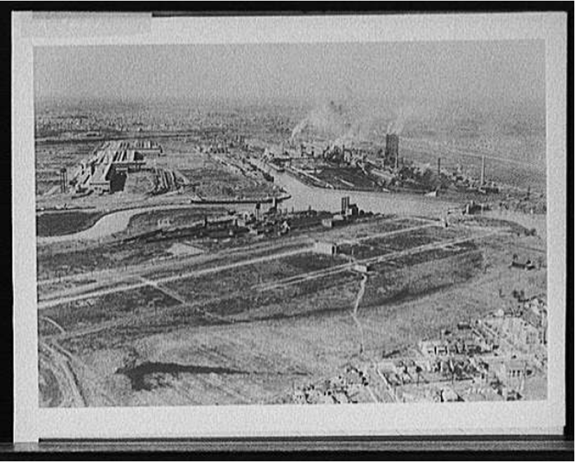
River Rouge -- 1940s Aerial View

Slide 122
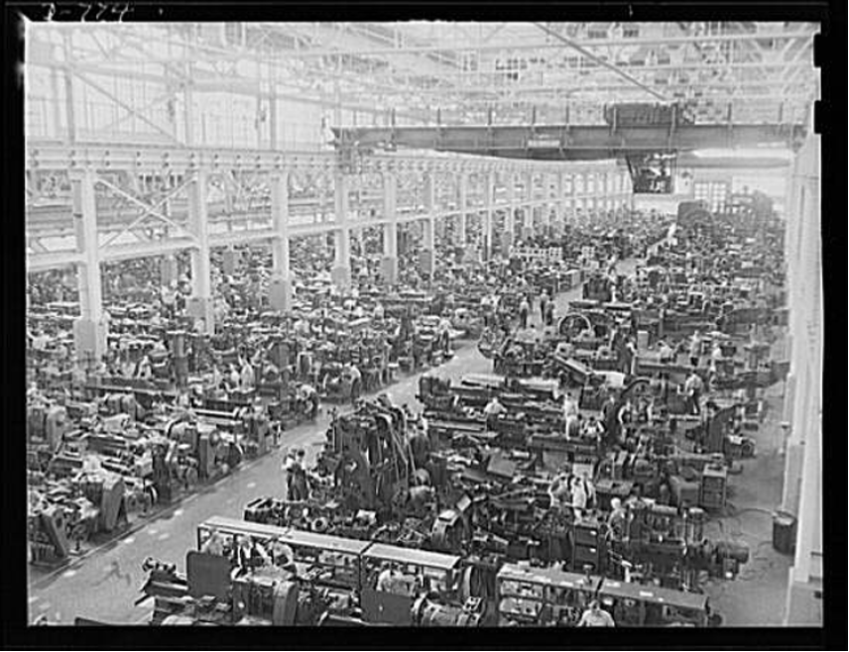
River Rouge -- 1940s Tool and Die Works

Slide 123
Transaction Costs and New Technologies
New technologies (e.g. telephone, mainframe computer) reduce coordination costs so firms can get bigger...
But what if new technologies reduce the external costs proportionally more than internal costs?
As communication, coordination, and monitoring costs decline because of new technology and more organizational autonomy it becomes possible to outsource non-essential functions
And makes it cheaper to work with new business partners on shorter term, more ad hoc relationships
Technical standards for product description and document exchange can also be seen as technology that reduces transaction costs

Slide 124
From Hierarchy to Network
Today, the large vertical integrated firm of the mid- to late- 900s has been transformed into a more "network" form, no longer driven by command-and-control
IBM, Cisco and other large firms are repositioning themselves as comprehensive "service networks" whose business units are both more autonomous and collaborative
Competition is increasingly between entire supply chains or ecosystems, not just between firms
This requires large amounts of formal and informal information exchange

Slide 125

Information About Goods Becomes a Good
Information about the supply chain is taking on independent value
Information about where products are, who uses them, and when and how they are used can be worth more than the products themselves

Slide 126
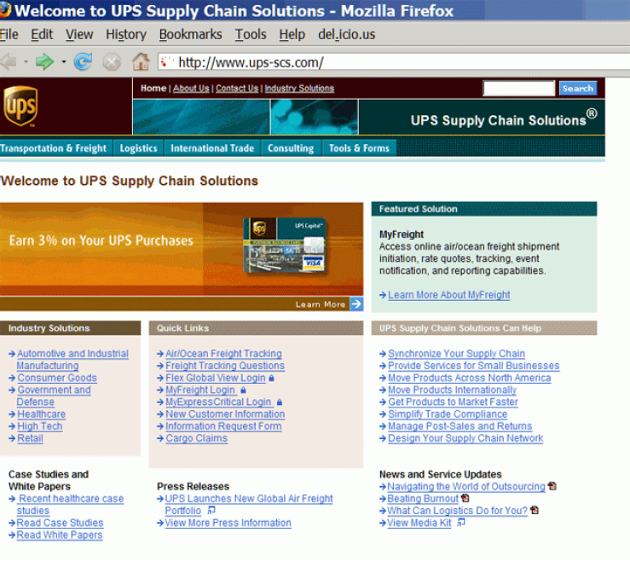
Example: UPS Supply Chain Solutions

Slide 127
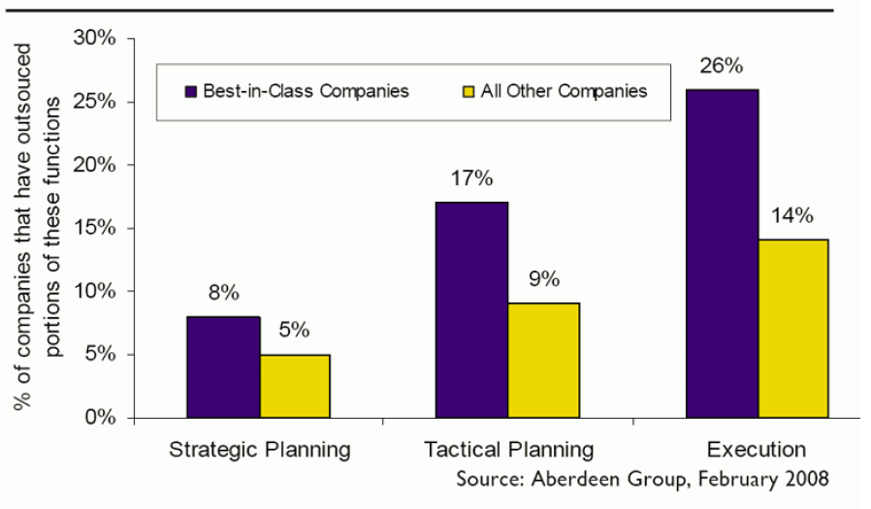
Smart Firms Outsource Their Logistics

Slide 128
Toward On Demand/Event-Driven Business Models
No forecast can ever be as accurate as actual sales and demand information
The key to supply chain optimization isn't moving things faster according to plans, it is moving things smarter according to actual demand
"Information-driven decisions" can be make more reliably and with less latency when sensor networks collect information

Slide 129

Example: GPS & Sensor-Driven "Precision Agriculture"

Slide 130

Example: GPS & Sensor-Driven "Precision Agriculture"

Slide 131

Example: Mobile Telemedicine for Home Care and Patient Monitoring

Slide 132

Example: Mobile Telemedicine – Patient Monitor

Slide 133

EDF+ Data Format

Slide 134
Tight Coupling
"Tight coupling" between two businesses, applications or services means that their interactions and information exchanges are completely automated and optimized in performance
...... by taking advantage of knowledge of their internal processes, information structures, technologies or other private characteristics that are not revealed in their public interfaces
... and usually implemented with a custom program that fit only between the two of them
Tight coupling is most often used, and usually limited to, situations in which the same party controls both ends of the information exchange

Slide 135

Co-Evolution of Business and Technology Architecture

Slide 136
Document- or Service-Oriented Integration
Internet protocols and XML are enabling "loosely coupled" architectures and "coarse-grained" information exchanges that make far fewer (or no) assumptions about the implementation on the "other side"
When integration is done with loose coupling, the two sides can make (some) changes to their implementations without affecting the other
This is even more true when they communicate through an "integration hub" which can further abstract their implementation by doing transport protocol/envelope/syntax translation for them
The particular integration technology for loose coupling is less important than the philosophy or business model that requires it – treating different organizations, applications, and devices as loosely-coupled cooperating entities regardless of where they fit within or across enterprise boundaries

Slide 137
Co-evolution of Business and Information Technology (IT)
On demand business (information as a service). Others call it the adaptive enterprise, the agile enterprise, the real time enterprise or the zero latency enterprise. These are all simply labels for something being sensed by the information technology (IT) industry – a sense that we are entering a fundamentally new phase in the constant co-evolution of IT and business. Evolving IT enables new business models and new scale to existing models; evolving business requirements thrust new requirements on the IT industry.

Slide 138

On Demand Real-time Enterprise – an example

Slide 139
On demand Real-time Enterprise
Standardize business processes
Enable information as a service (SOA)
Information integration
Connect participants to business processes . . . in real-time
Provide real-time analysis and insight (Business Intelligence BI)

Slide 140

On Demand Business Processes

Slide 141

Information Enabling Existing Applications

Slide 142

Ecosystem of Services

Slide 143

Virtualization ←→ Cloud

Slide 144

Real-time Enterprise: Retail example

Slide 145

Retail Layered Architecture
What are the sales in this region?
How do my stores compare in performance?
Who are my top customers?

Slide 146
New Business Model of Cloud Service
Consumer
Distributor
Developer
Product Design
Enterprise

Slide 147


Cloud Computing(1)
Microsoft(Online Services), Salesforce(CRM), IBM(LotusLive)

Slide 148



Cloud Computing(2)
Microsoft(Azure), Salesforce, Google(App Engine)
Amazon(Web Services), RackSpaceCloud, GoGrid

Slide 149
Technology Innovation: Future Trends
http://www.globalchange.com/Future-of-Technology-IT-Computing-Nanotech/
http://www.jimcarroll.com/category/trends/media-tech/
http://www.rolandberger.com/gallery/trend-compendium/tc2030_c-t5/

