Slide 1
Technology Revolution with Contemporary Industry/Business Evolution II
Daniel Hao Tien Lee
http://danieleewww.yolasite.com/

Slide 2
Outline
Kondratiev Wave
Big Pictures of Carlota Perez’s: : The Dynamics of Bubbles and Golden Ages
Video Course: Prof Carlota Perez
  https://www.youtube.com/watch?v=X43shMedAy8
  http://www.youtube.com/watch?v=k8S0OSxWmuo&list=UUX6QveqMpgeaEIPJvndQ90Q&index=1&feature=plcp

Slide 3
Kondratiev Wave
The Kondratieff Wave is an economic theory that states that Western capitalist economies are susceptible to extreme performance volatility as they expand and contract over the years. Unlike what is referred to as the business cycle, the Kondratieff Wave holds that these fluctuations are in fact part of a much longer cycle periods known as “super cycles” that last between 50-60 years or longer depending upon factors such as technology, life expectancy, etc

Slide 4
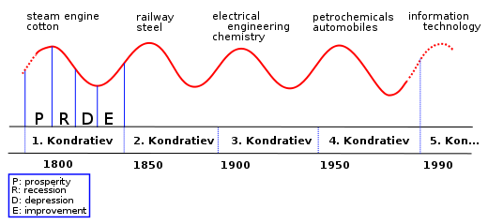
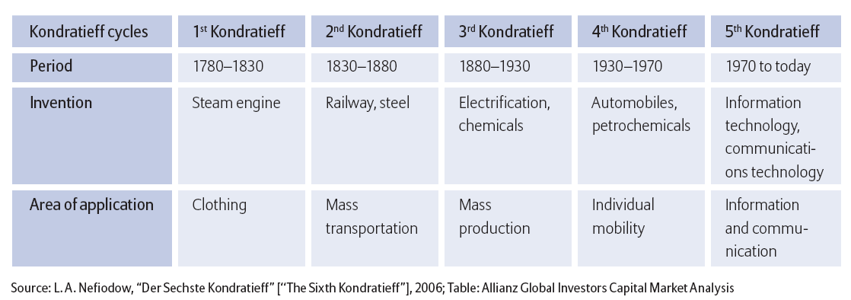
  Kondratiev Wave

Slide 5
  Kondratiev Wave
Period | Date (Prosperity to prosperity) | Innovation | Saturation point
First Industrial Revolution (Mechanical Age) | Circa 1787–1843 | Cotton-based technology: spinning weaving; atmospheric stationary steam engines replaced by high pressure engines, wrought iron, iron displaces wood in machinery, canals, turnpikes. Development of machine tools | Cotton textiles: British market saturated ca. 1800. By 1840, 71% of British cotton textiles were exported
Railroad and Steam Engine Era | Circa 1842–1897 | Age of steam railways, steam shipping and machinery. First inexpensive steel, telegraph, animal powered combine harvesters, etc. Final development of and diffusion of machine tools and interchangeable parts. Emergence of petroleum and chemical industries and heavy industries after 1870. Beginning of public water and sewer systems. | Canals: Late 1840s1870: Steam exceeds water power and animal power. 1890s: Railroads. Track mileage continued to grow but much is later abandoned.
Age of steel, electricity and internal combustion | 1897–1939 | Steel, electric motors, electrification of factories and households, electric utilities, aluminum, chemicals and petrochemicals, internal combustion engine, automobiles, highway system, Fordist mass production, telephony, beginning of motorized agricultural mechanization, radio. Electric street railways help create streetcar suburbs. Build out of urban public water supply and sewage systems. | 1917: Railroads nationalized. Post World War I short depression. Railroads and electric street railways decline after 1920. Horses, mules and agricultural commodities: 1919. After 1923 industrial output rises as workforce slowly declines. Depression of 1930s: Overcapacity in manufacturing, real estate. Work week reduced from 50 to 40 hours in mid-1930s. Total debt reaches 260% of GDP during early 1930s.

Slide 6
  Kondratiev Wave
Period | Date (Prosperity to prosperity) | Innovation | Saturation point
War and Post-war Boom: Suburbia | 1939–1982? | Oil displaces coal. Suburban growth and infrastructure. Greatest period of agricultural productivity growth 1940s-1970s. Consumer goods, semiconductors, business computers, plastics, synthetic fibers, fertilizers, television and electronics, green revolution, military-industrial complex, diffusion of commercial aviation and air conditioning, beginning nuclear utilities. | 1940s-50s: Diesel locomotives replace steam.1971: Peak U.S. oil production 1973: Peak steel consumption in U.S. Pennsylvania steel cities and industrial midwest turn into "rust belt". 1973: Slow economic and productivity growth noted. 1980s: Highway system near saturation
Post Industrial Era: Information Technology and care of elderly | 1982? – ?? | Fiber optics and Internet, personal computers, wireless technology, on line commerce, biotechnology, Reagan's "Star Wars" military projects. Energy conservation. Beginning of industrial robots. In the U.S. health care becomes a major sector of the economy (16%) and financial sector increases to 7.5% of economy. | 1984: Peak U.S. employment in computer manufacturing. Long term decline in U.S. capacity utilization 1990s: Automobiles, land line telephones, chemicals, plastics, appliances, paper, other basic materials, commercial aviation. 2001:Computers, fiber optics 2000s: Crop yields approach limits of photosynthesis. 2008: Developed world on verge of depression. Widespread overcapacity except some nonferrous metals and oil. Large housing and commercial real estate surplus. GDP no longer responds to increases in debt. Total debt exceeds 360% of GDP by late 2009.

Slide 7
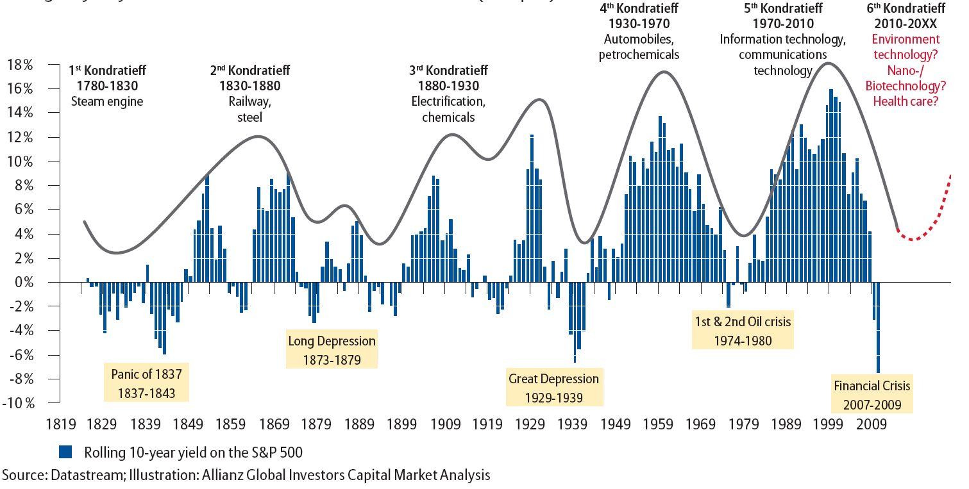
Kondratieff cycles – long waves of prosperity.
Rolling 10-year yield on the S&P 500 since 1814 till March 2009 (in %, p. a.)

Slide 8
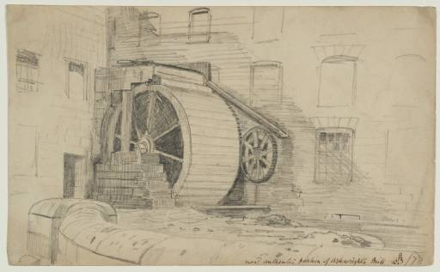
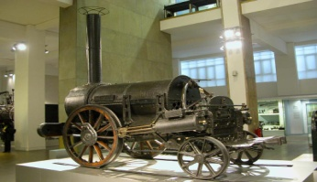
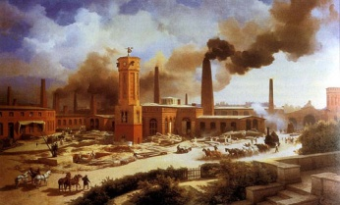
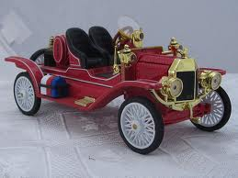
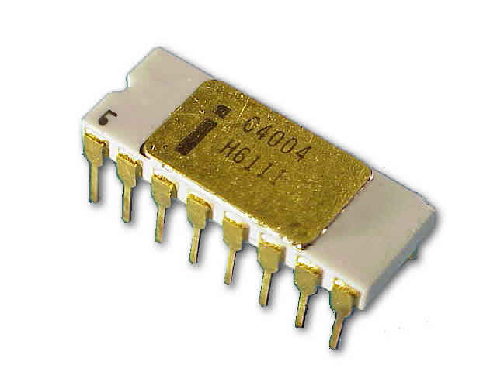
Five Successive Technological Revolutions, 1770s to 2000s
Technological revolution | Popular name for the period | Core country or countries | Big-bang initiating the revolution | Year
FIRST | The ‘Industrial Revolution’ | Britain | Arkwright’s mill opens in Cromford | 1771
SECOND | Age of Steam and Railways | Britain (spreading to Continent and USA) | Test of the ‘Rocket’ steam engine for the Liverpool-Manchester railway | 1829
THIRD | Age of Steel, Electricity and Heavy Engineering | USA and Germany forging ahead and overtaking Britain | The Carnegie Bessemer steel plant opens in Pittsburgh, Pennsylvania | 1875
FOURTH | Age of Oil, the Automobile and Mass Production | USA (with Germany at first vying for world leadership), later spreading to Europe | First Model-T comes out of the Ford plant in Detroit, Michigan | 1908
FIFTH | Age of Information, Computing, and Telecommunications | USA (spreading to Europe and Asia) | The Intel microprocessor is announced in Santa Clara, California | 1971
Source: Carlota Perez 2002

Slide 9
Big-Bang
For society to veer strongly in the direction of a new set of technologies, a highly visible ‘attractor’ needs to appear, symbolizing the whole new potential and capable of sparking the technological and business imagination of a cluster of pioneers.
This attractor is not only a technical breakthrough. What makes it so powerful is that it is also cheap or that is makes it clear that business based on the associated innovations will be cost-competitive. That event is defined here as the big-bang of the revolution.

Slide 10
Big-Bang of Each Revolution
(initiated by a narrow community of entrepreneurs and technical people)
Arkwright’s Cromford mill opened in 1771: the future paths to cost reducing mechanization of the cotton textile and other industries were powerfully visible
Stephenson’s ‘Rocket’ steam locomotive announced and triumphed in 1829: the world of railways and steam power were non-stoppable
Carnegie’s highly efficient Bessemer steel plant opened in 1875: inaugurating the Age of Steel
Ford’s the first Model-T prototype in 1908: layout of the future of production patterns for standardized, identical products, and choice of Age of Oil
Intel’s first microprocessor in 1971: the original and simplest ‘computer on a chip’ seen as the birth of the Information Age, based on the amazing power of low-cost microelectronics

Slide 11
Double Nature of Technological Revolutions
A CLUSTER OF NEW DYNAMIC
PRODUCTS, TECHNOLOGIES
INDUSTRIES AND INFRASTRUCTURES
generating explosive growth
and structural change
NEW INTERRELATED
GENERIC TECHNOLOGIES
AND ORGANIZATIONAL PRINCIPLES
capable of rejuvenating and
upgrading mature industries
A CHANGE OF TECHNO-ECONOMIC PARADIGM
New engines of growth
for a long-term upsurge
of development
A higher level
of potential productivity
for the whole
productive system
Source: Carlota Perez 1998

Slide 12
Big-Bang as Creative Destruction
http://www.e-elgar.co.uk/g_emag.lasso?ebook13isbn=9781781005323&title=Technological%20Revolutions%20And%20Financial%20Capital

Slide 13
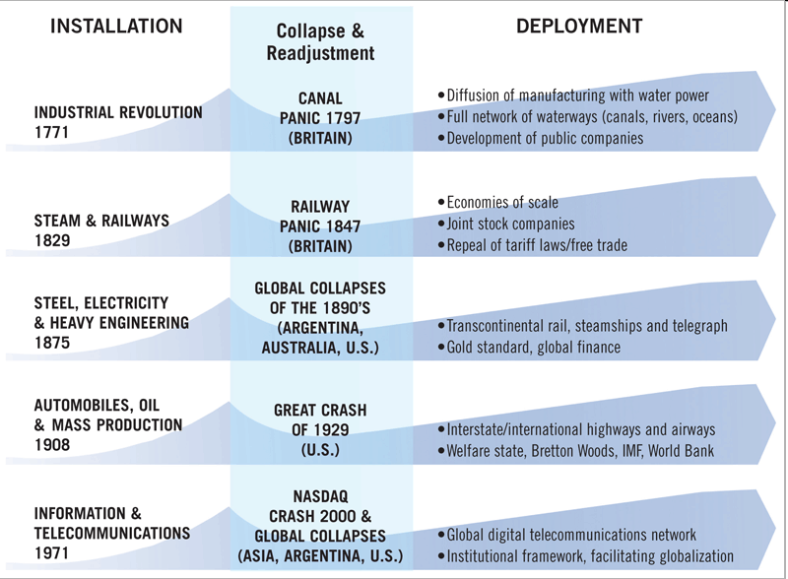
Five Great Surges of Development in 240 Years
(driven by successive technological revolutions with collapse and readjustment)
Courtesy of Source: Based on Technological Revolutions and Financial Capital: The Dynamics of Bubbles and Golden Ages, Carlota Perez; IBM 2004 Annual Report

Slide 14
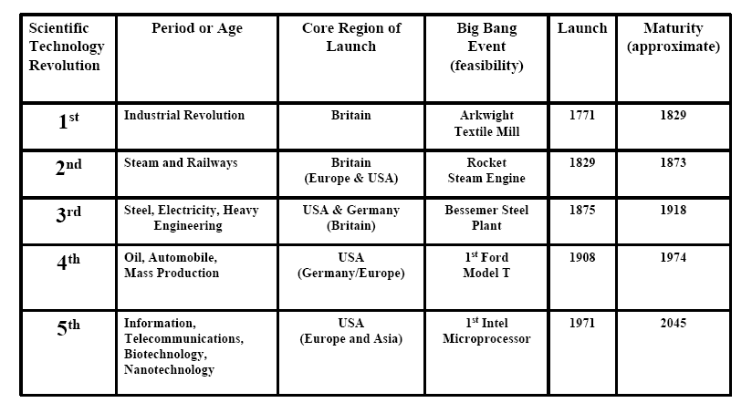
Scientific Technology Revolution Cycles
(Nominal Time 50-60 Years: Perez 2002, Hirooka, 2003)
Is modern technology revolution driven by model or luck, or
spirit ?
Courtesy of John. P. Dismukes, U. Toledo 2005

Slide 15
Life Cycle of a Technological Revolution
Phase One
Phase Two
Phase Three
Phase Four
Last new products
and industries.
Earlier ones approaching
maturity and market
saturation
Full constellation
(new industries,
technology systems
And infrastructures)
Full expansion of
innovation and
market potential
Early new
products and
industries.
Explosive growth
and fast innovation
Gestation
period
Paradigm
configuration
Introduction of successive new products, industries and technology systems, plus modernization of existing ones
Constriction of potential
Big-bang
Around half a century
Courtesy of Carlota Perez 2002

Slide 16
Two Different Periods in Each Great Surge
-- INSTALLATION PERIOD→
Turning
point
-- DEPLOYMENT PERIOD→
Big-bang
Next Big-bang
Courtesy of Carlota Perez 2002

Slide 17
Recurring Phases of Each Great Surge in the Core Countries
Turning
point
--------INSTALLATION PERIOD→
-- DEPLOYMENT PERIOD→
MATURITY
Socio-political split
Last products and industries
Market saturation and
technological maturities
of main industries
Disappointment vs. complacency
Previous Great surge
SYNERGY
Golden Age
Coherent growth with
Increasing externities
Production and employment
FRENZY
Financial bubble time
Intensive investment in the revolution
Decoupling of the whole system
Polarization of rich and poor
Gilded Age
IRRUPTION
Techno-economic split
Irruption of the technological
revolution
Decline of old industries
Unemployment
Institutional
recomposition
Big-bang
Crash
Next Big-bang
Courtesy of Carlota Perez 2002

Slide 18
The Irruption Phase:
A Time for Technology
It begins with the big-bang of the technological revolution amidst a world threatened with stagnation, as in Britain in the 1830s and 1870s or the USA in the 1970s.
This period is marked by increasing unemployment stemming from various sources, ranging from economic stagnation, through rationalization efforts, to technological replacement. – The world seems to be falling apart and the old behaviors and polices are impotent to save it.
Meanwhile, the new entrepreneurs are gradually articulating the new ideas and successful behaviors into a new best-practice frontier that serves as the guiding model or techno-economic paradigm.

Slide 19
The Frenzy Phase:
A Time for Finance
A phase characterized by very strong centrifugal trends in society at large – a small but growing portion at the top is rich and getting richer while there is deterioration and growing outright poverty at the bottom
A time of speculation, corruption and unashamed love of wealth – ‘The Gilded Age’ which appears of shinning prosperity and its socially insensitive inside of base metal
Frenzy phase is also one of intense exploration of all the possibilities opened up by the technological revolution – though bold and diversified trial and error investment
A phase of fierce ‘free’ free competition with tremendous excess money poured into the infrastructure (e.g. canal mania, railway mania, Internet mania), often leading to overinvestment that might not fulfill expectations – a sort of gambling economy with asset inflation in the stock market, looking like a miraculous multiplication of wealth → so late Frenzy phase becomes “Financial Bubble time” → Recession time

Slide 20
The Turning Point:
Rethinking and Rerouting Development
A process of contextual change to move the economy from a Frenzy mode, shaped by financial criteria, to a Synergy mode, solidly based on growing production capabilities
  e.g. Bretton Woods meetings, enabling the orderly international Deployment of the fourth surge
  e.g. The repeal of the Corn Laws in Britain, facilitating the Synergy of the second
The turning point has to do with the balance between individual and social interests within capitalism – it is the swing of the pendulum from the extreme individualism of Frenzy to giving greater attention to collective well being, usually through the regulatory intervention of the state and civil societies
The unsustainable structural tensions that build up the economy and society, especially during Frenzy, must be overcome by a recomposition of the conditions for growth and development

Slide 21
The Synergy Phase:
A Time for Production
Synergy is the early half of the deployment period. This phase can be the true ‘Golden Age’
  e.g. Victorian England after the Great exhibition
  e.g. America after the Second World War
A mode of growth based on social cohesiveness, moral principles are in force, ideas of confidence flourish and business is satisfied about its positive social role – it’s a time of advance in labor laws and other measures for social protection of the weak, a time for income redistribution in one form or another, leading to enlarged consumption markets. It’s above all the reign of the ‘middle class’. Fast and easy millionaires are rare, though investment and work lead to persistent accumulation of wealth. “ Production is the key word in this phase”

Slide 22
The Maturity Phase:
A Time for Questioning Complacency
All the signs of prosperity and success are still around. Those who reaped the full benefits of the ‘golden age’ continue to hold on to their belief in the virtues of the system and to proclaim eternal and unstoppable progress, in a complacent blindness, which could be called the ‘Great Society Syndrome’
Markets are saturating and technologies maturing, therefore profits begin to feel the productivity constriction, leads to concentration through mergers or acquisitions, as well as export drives and migration of activities to less-saturated markets abroad

Slide 23
Approximate Timeline of Each Great Surge of Development
(1770s and
early 1980s)
(late 1780s and early 1790)
(1798-1812)
(1813-1829)
1793-97
(1840s)
(1850-1857)
(1857-1873)
(1830s)
1848-50
(1895-1907)
(1875-1884)
(1908-1918)
1893-95
(1884-1893)
(1920-1929)
Europe
1929-33
USA
1929-43
(1943-1959)
(1908-1920)
(1960-1974)
(1971-1987)
(1987-2001)
2001-?

Slide 24
Geographic Outspreading of Technologies as They Mature (USA case)
Net
exporter
Time
New products
Mature products
Net
importer
LDC: less developed country
Phase I | Phase II | Phase III | Phase IV | Phase V
All production in USA | Production started in Europe | Europe exports to LDCs | Europe exports to USA | LDCs exports to USA
US Exports to many countries | US Exports mostly to LDCs | US Exports to LDCs displaced

Slide 25
Mass-Production Paradigm and Information Revolution
1950s was a period of expansion in the USA, which served to pull the front-running European countries
By the 1960s the main dynamism moved towards Europe and Asia, producing the so-called ‘miracles’ in Germany, Italy and Japan
In the 1970s, it was Brazil, Taiwan and Korea that had taken over the baton
After the mid-1970s, some of the oil countries were able to attempt growth using the mature energy-intensive technologies in aluminum, petrochemicals and so on. But by then, the information revolution was already taking force in the USA and other core countries and the organizational revolution was catapulting Japan to the front ranks while the stagflation of the irruption phase was entering he scene of the old advanced countries.

Slide 26
Definition of Financial Capital and Production Capital
Financial capital (paper wealth/economy)
  Represents criteria and behavior of possessing wealth in the form of money or other paper assets – to use money to make more money by receiving interest, dividends or capital gains
  Tools: deposits, stocks, bonds, oil futures, derivatives, diamonds or whatever
  Services: banks, brokers and other intermediaries who provide information to make paper wealth growth
  Mobile and footloose in nature
  Flee from danger but enable the rise of the new entrepreneurs
Production capital (real wealth/economy)
  Generate new wealth by producing goods or performing services (including transport, trade and other enabling activities)
  Typical with borrowed money from financial capital or use their own money
  Purpose of production capital is to produce in order to be able to produce more – objective is to accumulate greater and greater profit-making capacity
  Tied to concrete products, and knowledge about product, process and markets is the very foundation to potential success
  Roots in an area of competence and even in a geographic region
  Has to face every storm by holding fast, ducking down or innovating its way forward or sideways – but when it comes to radical changes, incumbent production capital can become conservative

Slide 27
Recurring sequence in the relationship between financial capital (FK) and production capital (PK)
Turning
point
--------INSTALLATION PERIOD→
-- DEPLOYMENT PERIOD→
MATURITY
Signs of Separation
Financial capital
searching on its own
Decreasing investment opportunities
Idle money moving to new area,
sectors and regions
Previous Great surge
SYNERGY
Recoupling FK-PK
Production capital at the helm
Recoupling of real and paper wealth
Coherent growth
FRENZY
Decoupling FK-PK
Bubble economy
Divorce between paper and real value
Asset inflation
IRRUPTION
Love affair of FK
with revolution
Financial Revolution
Intense funding of the new technologies
Disdain of old assets
Next Great Surge
Institutional
recomposition
Big-bang
Crash
Next Big-bang
Courtesy of Carlota Perez 2002

Slide 28
Five successive surges, recurrent parallel periods and major financial crises
?

Slide 29
Financial and Social Impact by Technology Revolution
National market in the Victorian boom, from the mid-nineteenth century after the 2nd. technology revolution: That prosperity was brought about on the basis of a whole set of new institutions that ordered national markets and regulated the national banking and financial worlds, which facilitated the continued expansion of the railway system and the network of steam-powered factories in the growing industrial cities.
International markets arisen, two decades after the big-bang of Age of Steel, required worldwide regulation (from the general acceptance of the London-based Gold Standard to universal agreements on measurement, patents, insurance, transport, communications and shipping practices), which the structural changes in production, including the growth of important science-related industries had to be facilitated by deep educational reforms and social legislation.
Mass production and massive consumption, based on the mass-production technologies of the fourth paradigm had been diffusing since the 1910s and 1920s demanded institutions facilitating massive consumption, by the people or by the governments. Only is such a context could full flourishing be achieved.
Cohesive growth based on the information revolution, would seem to require a global network of institutions, involving the supranational, national and local regulatory levels --- Globalization

Slide 30
Impact of War Expenditure
War served to spread technology among the adversaries and thus create future peace-time competitors.
  The massive war expenditures of the First and Second World War came to rescue of investment opportunities and profits in the maturity phase of the third and fourth surge ,respectively, in the main advanced countries.
  Vietnam war plus the intensification of the Cold War and the Space Race, had a similar effect for the US economy during Maturity in the fourth surge.

Slide 31
Attributes of Past Revolutions
Each begins in a core country and later becomes dominant both in economy and politics worldwide.
Each defines new/or redefines industries and infrastructures.
Each generates new techno-economic paradigm
  New “common sense” innovation principles which define best competitive practices.
Each takes 40-60 years going through Carlota Perez’s 3-stage model to spread across world:
  Installation period (Irruption and Frenzy Bubble)
    Each generates technology bubble (massive over-investment) and later spearheads into financial panic and collapse.
  Turning point
    Each turning point required collective vision.
  Deployment period (Golden Age (Synergy) and Maturity)
    Each Golden Age has been facilitated by enabling regulation and policies for shaping and widening markets.

Slide 32
Attributes of Past Revolutions
Resistance from established firms/institutions
Functional separation between financial capital and production capital
Paradigm shift led by financial capital, which forms bubble, which bursts, leading to hyper-adaptation (common-sense)
Production capital then controls propagation
Huge surge is divided into two extremely different periods. Installation period vs. Deployment period

