Slide 1
Technology Revolution with Contemporary Industry/Business Evolution I
Daniel Hao Tien Lee
http://danieleewww.yolasite.com/

Slide 2
Outline
Five Consecutive Technology Revolutions in the past 250 Years
The Industries, Infrastructures and Paradigms of Each Technological Revolution
The ‘Industrial Revolution’
Age of Steam and Railways
Age of Steel, Electricity and Heavy Engineering
Age of Oil, the Automobile and Mass Production
Age of Information, Computing and Telecommunication (ICT)
High-Tech Competition and Evolution

Slide 3
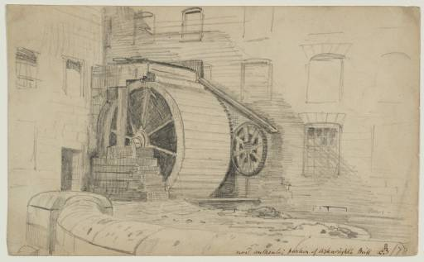
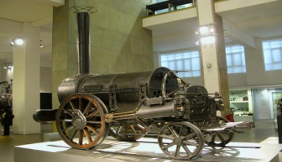
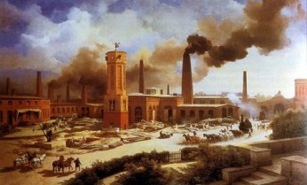
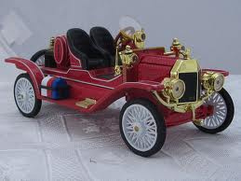
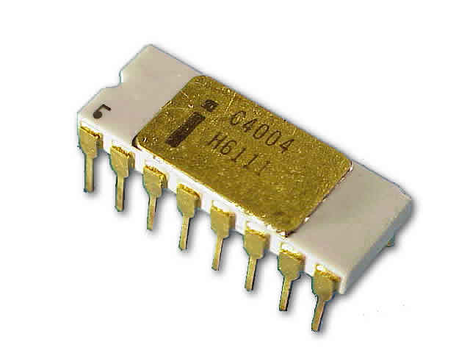
Five Successive Technological Revolutions, 1770s to 2000s
Technological revolution | Popular name for the period | Core country or countries | Big-bang initiating the revolution | Year
FIRST | The ‘Industrial Revolution’ | Britain | Arkwright’s mill opens in Cromford | 1771
SECOND | Age of Steam and Railways | Britain (spreading to Continent and USA) | Test of the ‘Rocket’ steam engine for the Liverpool-Manchester railway | 1829
THIRD | Age of Steel, Electricity and Heavy Engineering | USA and Germany forging ahead and overtaking Britain | The Carnegie Bessemer steel plant opens in Pittsburgh, Pennsylvania | 1875
FOURTH | Age of Oil, the Automobile and Mass Production | USA (with Germany at first vying for world leadership), later spreading to Europe | First Model-T comes out of the Ford plant in Detroit, Michigan | 1908
FIFTH | Age of Information, Computing, and Telecommunications | USA (spreading to Europe and Asia) | The Intel microprocessor is announced in Santa Clara, California | 1971
Source: Carlota Perez 2002

Slide 4
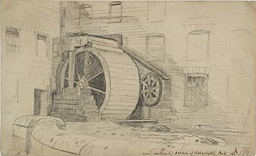
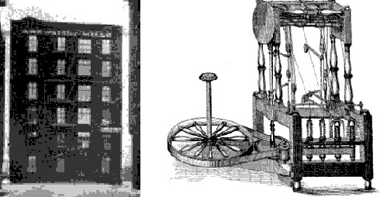
The Industrial Revolution (1771)
https://www.youtube.com/watch?v=JhF_zVrZ3RQ
Cromford Mill was Sir Richard Arkwright's first and most important cotton mill, at which he pioneered the development of his water frame spinning machine and revolutionised the manufacture of cloth, thereby laying one of the cornerstones of the Industrial Revolution.

Slide 5
The Industries, Infrastructures and Paradigms of 1st. Technological Revolution
Source: Technological revolutions and techno-economic paradigms, Carlota Perez 2009
http://www.e-elgar.co.uk/g_emag.lasso?ebook13isbn=9781781005323&title=Technological%20Revolutions%20And%20Financial%20Capital

Slide 6
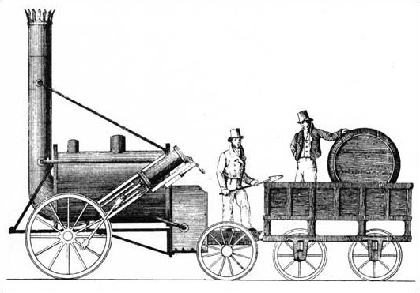
Age of Steam and Railway (1829)
https://www.youtube.com/watch?v=KdjnVXdNUUo
https://www.youtube.com/watch?v=QXBwzC4JYC0&list=TLdEo9oIicE8Nh6tasTfQMD_lH1rnBQR_-
Stephenson's Rocket was an early steam locomotive of 0-2-2 wheel arrangement, built in 1829 at the Forth Street Works of Robert Stephenson and Company in Newcastle Upon Tyne.
It was built for, and won, the Rainhill Trials held by the Liverpool & Manchester Railway in 1829 to choose the best design to power the railway.
Though the Rocket was not the first steam locomotive, it was the first to bring together several innovations to produce the most advanced locomotive of its day.

Slide 7
The Industries, Infrastructures and Paradigms of 2nd. Technological Revolution
Source: Technological revolutions and techno-economic paradigms, Carlota Perez 2009
http://www.e-elgar.co.uk/g_emag.lasso?ebook13isbn=9781781005323&title=Technological%20Revolutions%20And%20Financial%20Capital

Slide 8
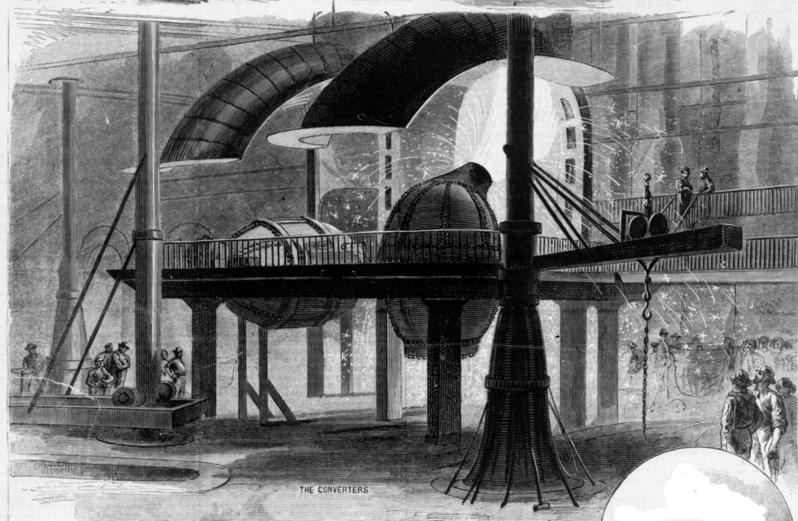
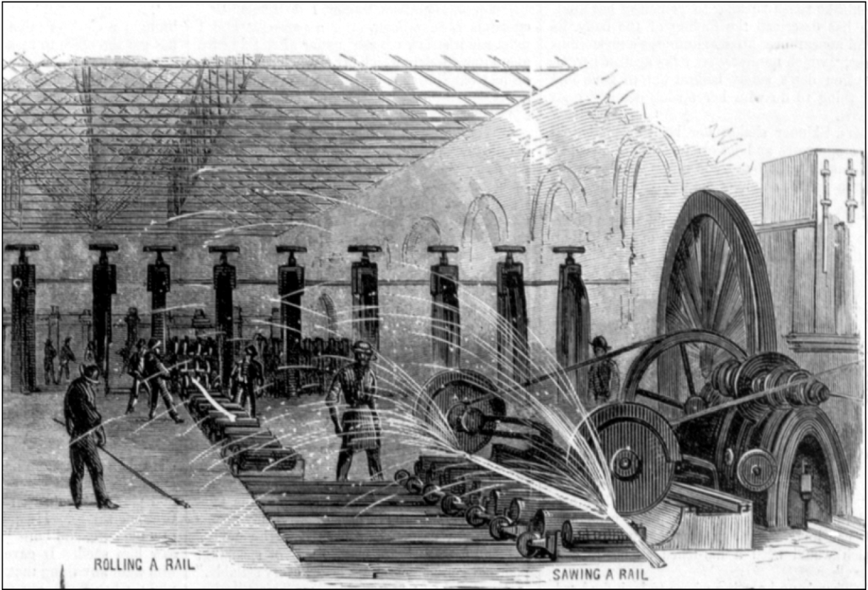
Age of Steel (1875)
Carnegie learned about a new process of mass-producing steel that was invented in England. It was called the Bessemer Converter, or blast furnace (right). It produced steel by blowing air under high pressure through a mix of molten iron limestone, and other materials.
Carnegie's first steel mill opened in 1875 just outside Pittsburgh, Pennsylvania. His company was called the Carnegie Steel Company.
Carnegie succeeded because he understood that steel making had to be done on a very large scale. The rolling equipment shown below is used to force red-hot steel through rollers, again and again, to make rails for railroad tracks. Large scale production made it possible to produce better steel at lower prices.
https://www.youtube.com/watch?v=C9Clp0Hz9WY

Slide 9
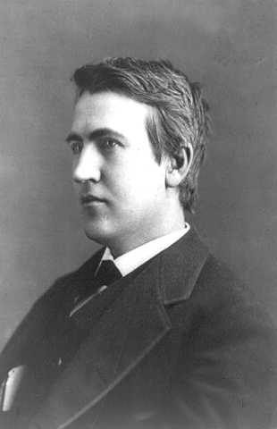
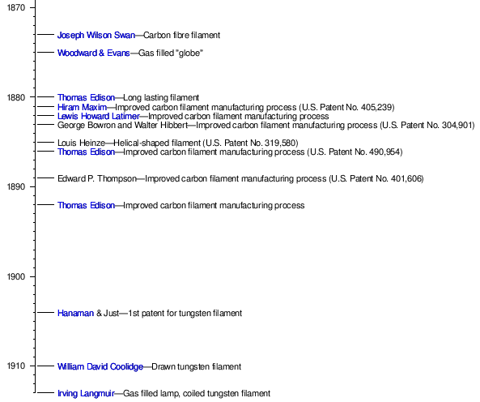
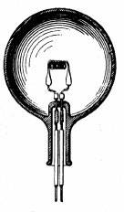
Age of Electricity (1879)
https://www.youtube.com/watch?v=VVL8ptff7yI
Thomas Edison built a laboratory in Menlo Park, New Jersey in 1876 . It was here with his employees he made many of his inventions. He would work night after night, and sometimes he would fall asleep at his workbench. His wife wouldn't see him for days at a time.
He and his team worked to make a light bulb which would burn for a long time without burning out. They tried 1,500 materials and nothing worked well. Finally he tried a new material in the filament * that burned nearly 200 hours.

Slide 10
The Industries, Infrastructures and Paradigms of 3rd. Technological Revolution
Source: Technological revolutions and techno-economic paradigms, Carlota Perez 2009
http://www.e-elgar.co.uk/g_emag.lasso?ebook13isbn=9781781005323&title=Technological%20Revolutions%20And%20Financial%20Capital

Slide 11
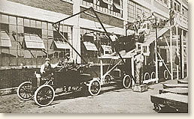
Age of Automobiles and Mass Production: Henry Ford Changes the World (1908)
https://www.youtube.com/watch?v=S4KrIMZpwCY
The 1908 Model T. Two forward gears, a 20 horsepower engine and no driver doors. They sold like hot cakes
1908: Birth of the Assembly Line @ Ford (Mass Production)

Slide 12
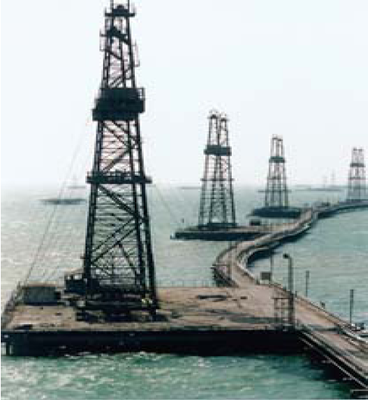
Oil Age: Technological Innovations
1896: First off-shore wells
1900: ‘Mudding’
1947: First off-shore well built ‘out of sight’ of coast

Slide 13
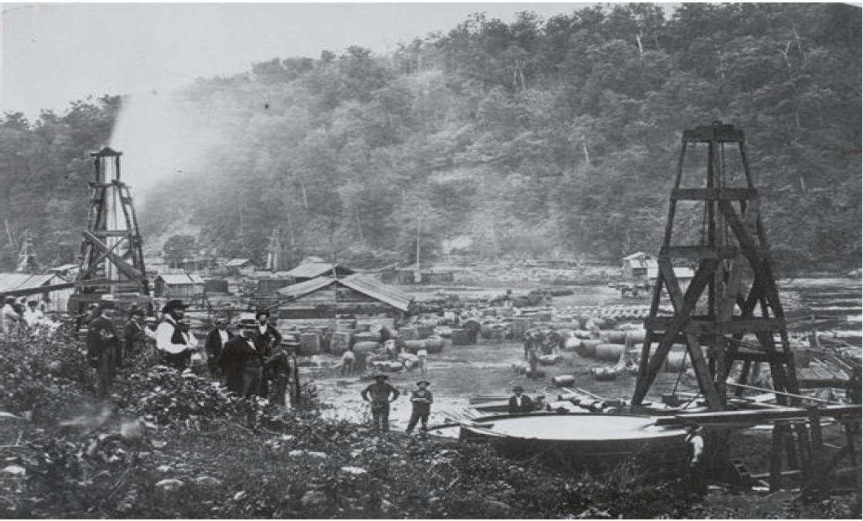
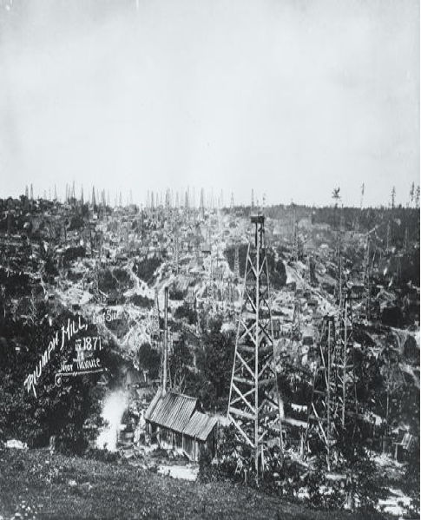
Age of Oil
In 1859 Drake’s find leads to Pennsylvania ‘oilrush’
Pennsylvania becomes responsible for half of world’s oil production until 1901 finds in Texas, Birth place of oil giants Gulf Oil, Amoco, and Humble Oil Company
U.S. remained the world’s foremost producer until 1950s

Slide 14
The Industries, Infrastructures and Paradigms of 4th. Technological Revolution
Source: Technological revolutions and techno-economic paradigms, Carlota Perez 2009
http://www.e-elgar.co.uk/g_emag.lasso?ebook13isbn=9781781005323&title=Technological%20Revolutions%20And%20Financial%20Capital

Slide 15
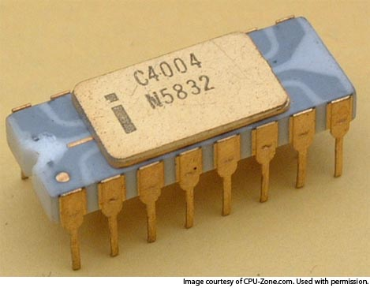
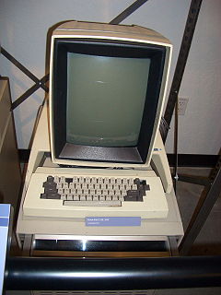
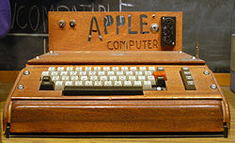
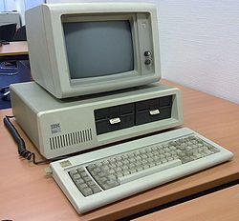
Age of ICT Revolution
https://www.youtube.com/watch?v=FSIIJkW8Dqg
1965: Uncanny Moor’s Law “The number of transistors that can be fit on a computer chip will double every 1-2 years” published
1971: 1st. CPU announced by Intel
1972: 1st. PC Xerox Alto
1976: Apple I (The Apple I was Apple's first product, and to finance its creation, Jobs sold his only means of transportation, a VW van and Wozniak sold his HP-65 calculator for $500)
1981: 1st. IBM PC Launched
1981: MS-DOS 1.0. This was Microsoft's first operating system, and it also became the first widely used operating system for the IBM PC and its clones.

Slide 16
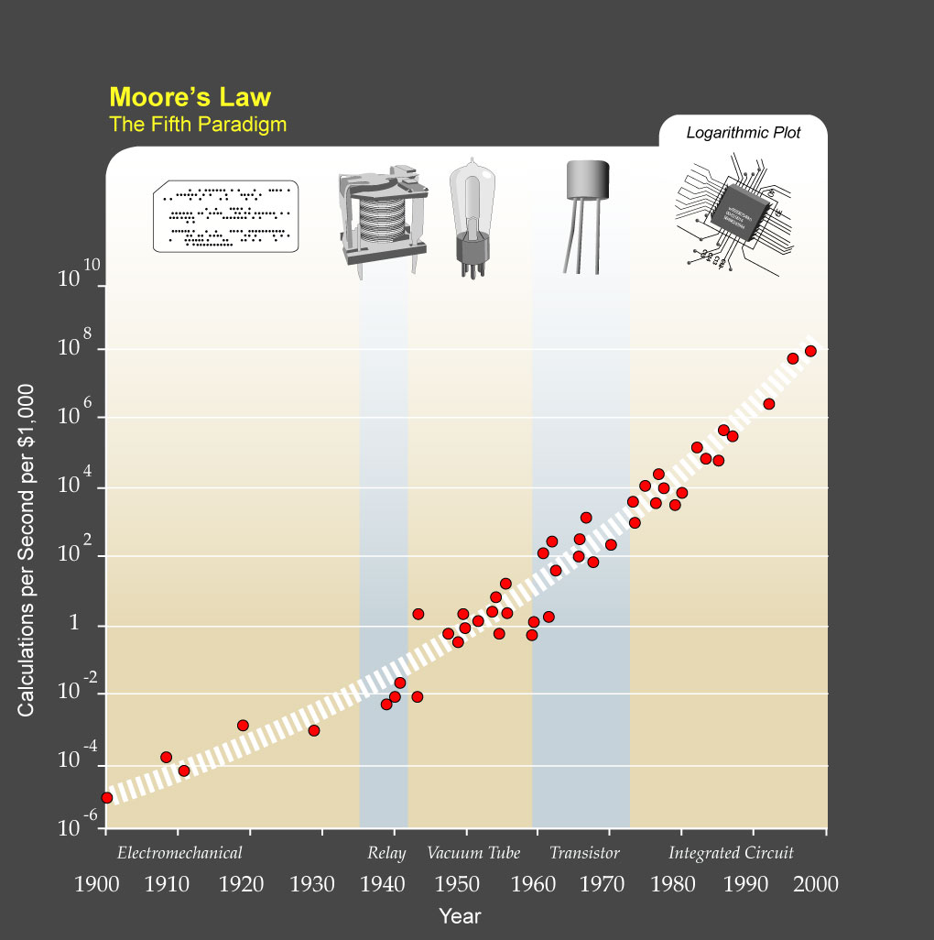
Age of ICT Revolution

Slide 17
New technologies and new or redefined industries of 5th. Revolution (ICT 1971)
Cheap microelectronics
Computers and Software
Telecommunications
Control instruments
Computer-aided biotechnology and new materials
New or redefined infrastructures

Slide 18
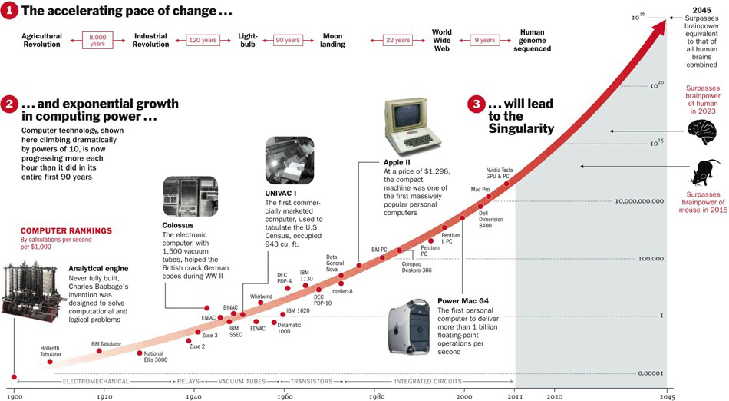
Acceleration of Change

Slide 19
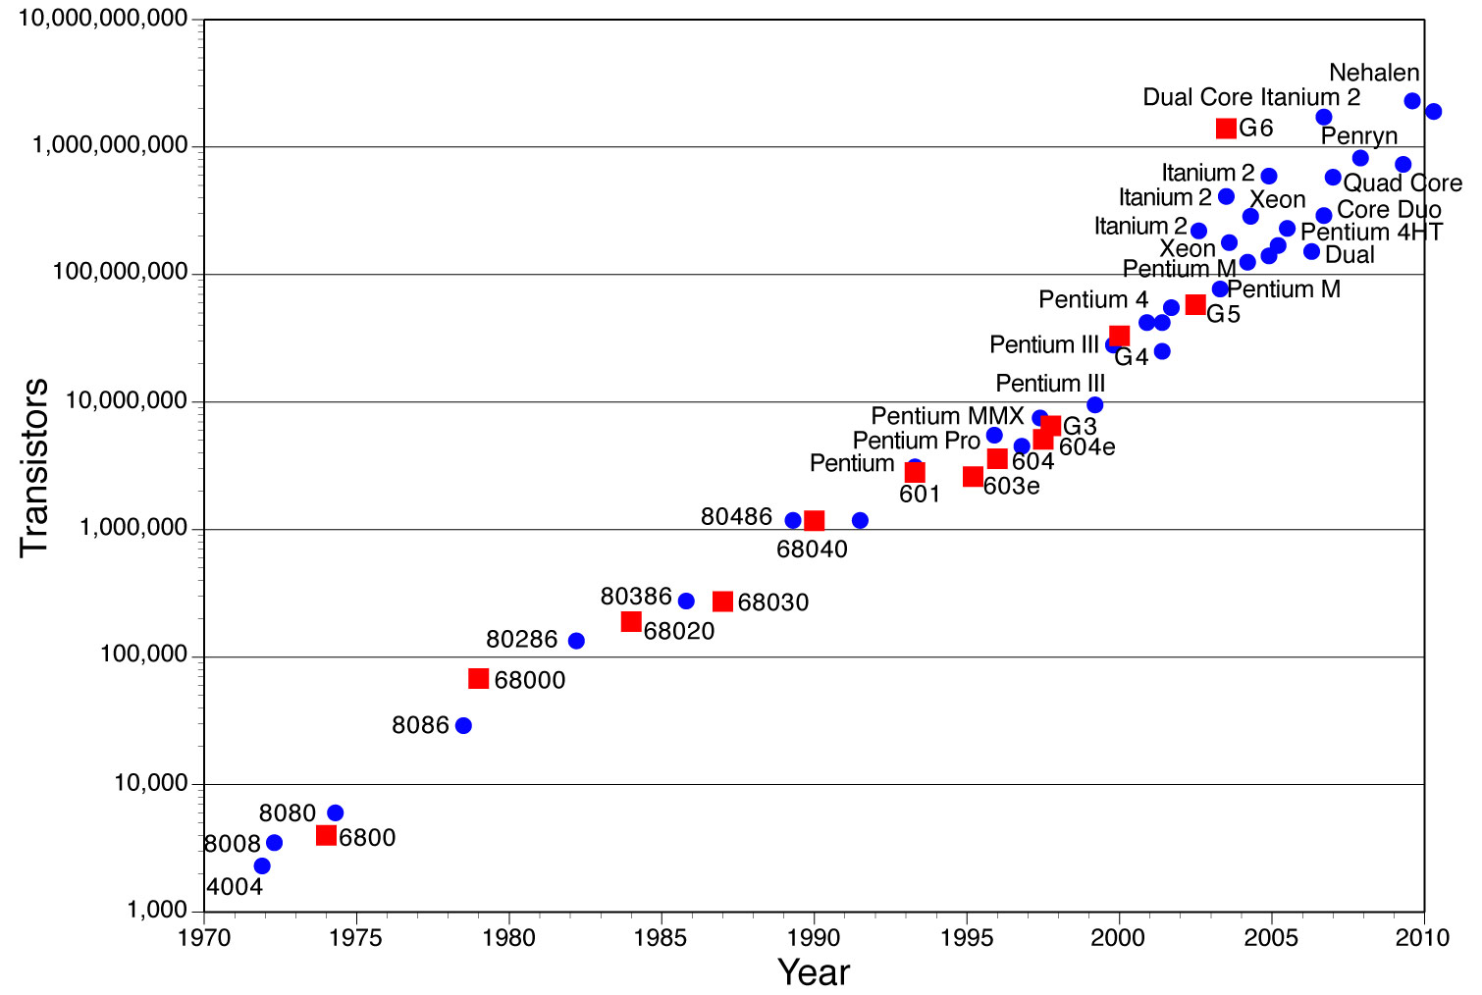
Moor’s Law and CPU Transistor Counts

Slide 20
New or Redefined Infrastructures of 5th. Revolution (ICT)
World digital telecommunications (cable, fiber optics, radio and satellite)
Internet/Electronic mail and other e-services
Multiple source, flexible use, electricity networks
High-speed physical transport links (by land, air and water)
Social-networking

Slide 21
Techno-Economic Paradigm of 5th. Revolution (ICT)
Information-intensity (microelectronics-based ICT)
Decentralized integration/network structures
Knowledge as capital/intangible value added
Heterogeneity, diversity, and adaptability
Segmentation of markets/proliferation of niches
Economies of scope and specialization combined with scale
Globalization/integration between the global and the local
Inward and outward cooperation/clusters
Instant contact and action/instant global communications
http://www.e-elgar.co.uk/g_emag.lasso?ebook13isbn=9781781005323&title=Technological%20Revolutions%20And%20Financial%20Capital

Slide 22
The Industries, Infrastructures and Paradigms of 5th. Technological Revolution
Source: Technological revolutions and techno-economic paradigms, Carlota Perez 2009
http://www.e-elgar.co.uk/g_emag.lasso?ebook13isbn=9781781005323&title=Technological%20Revolutions%20And%20Financial%20Capital

Slide 23
High-Tech Competition and Evolution: The alikes of Darwin’s Evolution?

Slide 24
 | Components | Device | Network | Software | Applications
1980s & before | Semiconductors Memory Storage | Computers | TCP/IP
1990s | Semiconductor Foundry Service | Cellular Phones Personal Computers | Private Networks / LAN Telecoms / PSTN | Operating systems / GUI
Early 2000s | Fabless | Mobile computing / Laptops Mobile phones Consumer electronics | Public Networks / Internet Cellular | Browsers Enterprise software Open-source / GPL(general public license) | BPO(business process outsourcing) Internet Search E-commerce
Late 2000s | SOC(system-on -chip) | SmartPhones 3D | Mobile Internet 3G Wi-Fi | SaaS(software as a service) Cloud Computing | Web 2.0 / Social media Virtual Reality
Notes:
24

Slide 25
 | Components | Device | Network | Software | Applications
1980s & before | Semiconductors Memory Storage | Computers | TCP/IP
1990s | Semiconductor Foundry Service | Cellular Phones Personal Computers | Private Networks / LAN Telecoms / PSTN | Operating systems / GUI
Early 2000s | Fabless | Mobile computing / Laptops Mobile phones Consumer electronics | Public Networks / Internet Cellular | Browsers Enterprise software Open-source / GPL(general public license) | BPO(business process outsourcing) Internet Search E-commerce
Late 2000s | SOC(system-on-chip) | SmartPhones 3D | Mobile Internet 3G Wi-Fi | SaaS(software as a service) Cloud Computing | Web 2.0 / Social media Virtual Reality
Competing against better and cheaper: Samsung Electronics
IBM
Evolution of Microsoft’s Business Model
TSMC, UMC, Chartered, etc.
Competitive Advantage of a Firm within a Country: Finland and Nokia
Outsourcing for the World:
Taiwan, China and India
Mapping out the Global PC Value Chain
WINTEL
Competitive Advantage of High-tech Nations: Taiwan, S. Korea, Singapore and Israel
Rise of Global Internet Giants: Google and Tencent, Alibaba
Consumer Electronics: Then and Now
Sony, Samsung and Apple
GlobalFoundries, Samsung
Web20 Development of Free, No Business Model Service: Skype, Youtube, Facebook Wikipedia, Twitter, Flickr, LinkedIn etc.
Development of the IaaS, PaaS, SaaS Industries
Notes:
25
25

Slide 26
 | Components | Device | Network | AI Robot | Software | Applications
Emerging @ 2010 & before | Memrister, SCM (storage class memory; RRAM, PCM etc.), | Tablet Computing Device, Soft Display, Light Field Camera(handheld) | IPV6 and 4G |  | Cloud Computing , Cloud Service
2010s | 3DIC, Biochip, LoC | iPad, Kindle, Smart Phone, 3D-TV glasses-less, 3D Printer | Ubiquitous 4G and IPV6 Devices, IoT | Siri-iPhone and alikes | Augmented Reality | iCloud, Amazon, Blue Cloud,
2020s | TeraHertz Components, Organic Components, | Quantum Computing, Analog Computing, Optical Computing | Sensor Networking, | Avatar(web) | Contextual Search, Analytic Search Engine, Virtual Reality | Semantic Web, Real-time Predictive Analytics,
2030s | Nanomachine | BioComputing, |  | Avatar(physical)
IBM
2nd. Life
Notes:
26

