Slide 1
Bitcoin
Daniel Lee

Slide 2
Why Create a Currency in Digital Form!

Slide 3
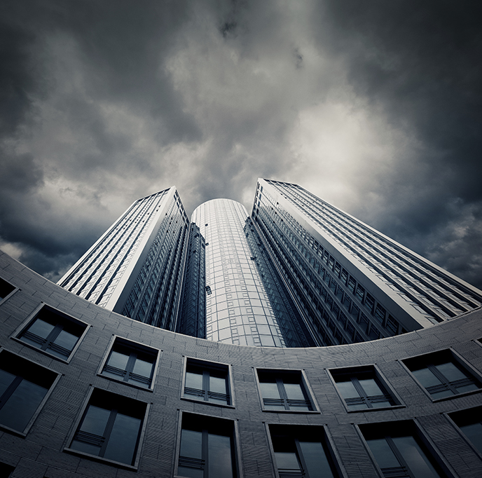
Creating a currency from scratch
Motivation
  Distrust of financial institutions
  Transaction costs
Primary concerns
  Transaction security
  Double spends

Slide 4
Distrust of financial institutions
Any noncash transaction requires a trusted third-party administrator—commonly a bank or financial service provider.
The system forces participants to trust financial institutions that are not always trustworthy.

Slide 5
Transaction costs
Traditional payments are revocable, even on irrevocable services.
Financial institutions act as an arbitrator between counterparties in disputed claims.
Arbitration costs are passed on to consumers.

Slide 6
Transaction security
Two levels of verification
  Source is legitimate
  Coins are legitimate
Public/private key verification ensures the legitimacy

Slide 7
Double-Spend Problem in the digital currencies
Up until Bitcoin and its distributed ledger was invented, digital currencies were seen as unfeasible due to the relative ease of which digital information can be copied. This is know as the “double-spend” problem where each transaction carries a risk of the holder sending a copy of the digital coin to the merchant while retaining the original. The traditional way of mitigating this risk has been to have a trusted third party, such as a bank, to act as a centralized authority keeping track of all transactions.
Bitcoin has shifted this responsibility to a whole network. To exchange ownership of a digital coin, a centralized database is no longer required. Instead, a distributed ledger keeps a history of all transactions, and requires validation from its users to verify each change of ownership.

Slide 8
Double spends
If the money is just digital codes, why not copy and paste to make more money?
  Timestamps
  Hashes
  Block chain

Slide 9
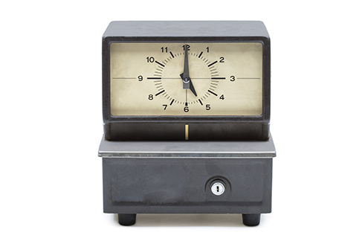
Double spends
Timestamp
  Each transaction is packaged and publically recorded in the order it was carried out.
Hash
  The time-stamped group of transactions are given a unique algorithmically derived number

Slide 10
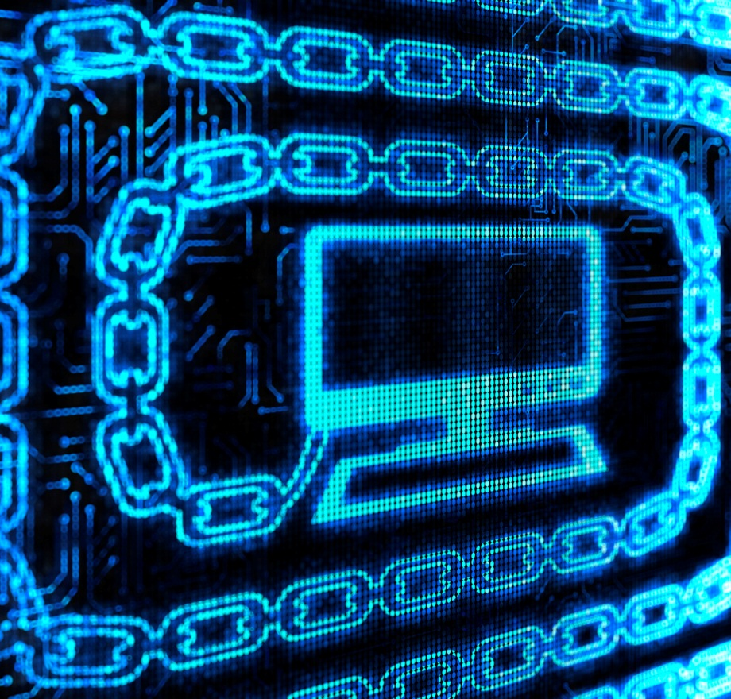
Double spends
Block chain
  Transactions are recorded in a community-built record of all transactions that acts as a proof-of-work.
  Computers connected to the network accept the longest chain as accurate.

Slide 11
Where do bitcoins come from?
They’re mined, silly.
High-powered computers solve complicated math problems.
Each time a problem is solved, the finder is paid a bounty.

Slide 12
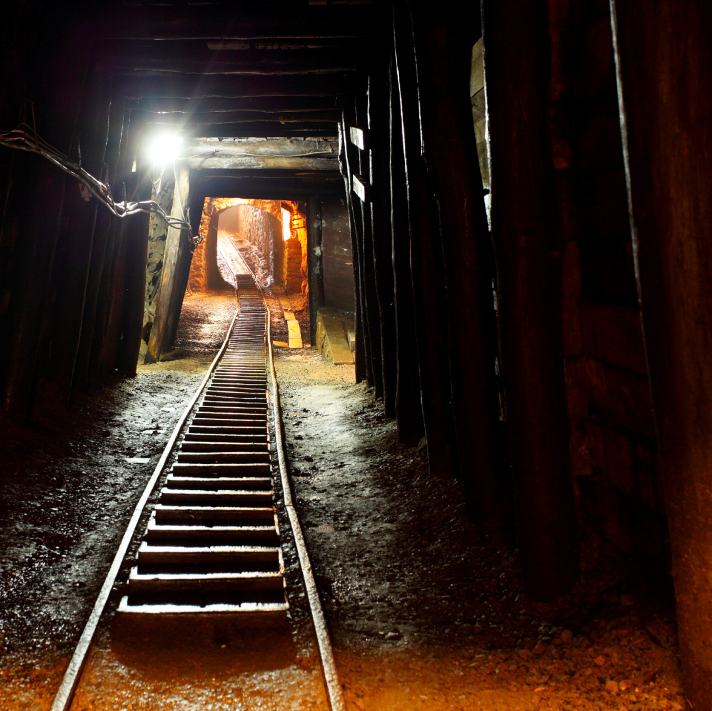
Mining bitcoins
Miners solve complicated algorithms to find a solution called a hash.
Finding a hash creates a block that is used to process transactions.
Each new block is added to the block chain.

Slide 13
Mining bitcoins
Until there are 21 million bitcoins, miners are paid for finding a hash in new coin.
After 21 million, miners will charge transaction fees for creating a new block.
The amount paid per hash goes down by half about every 4 years.

Slide 14
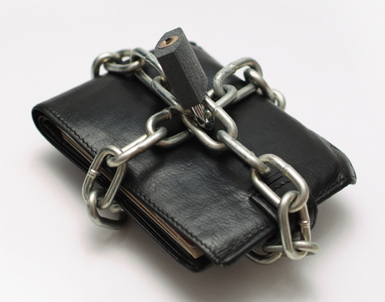
Owning bitcoins
Users create accounts called wallets.
Wallets are secured using passwords and contain the private keys used for transferring bitcoins.

Slide 15
Spending bitcoins
Seller provides an address to the buyer
Buyer enters the seller’s address and the amount of the payment to a transaction message
Buyer signs the transaction with a private key and announces the public key for verification
Buyer broadcasts the transaction to all the Bitcoin network

Slide 16
Bitcoin security
Computers accept the longest block chain, which inhibits hacking.
  Hackers would have to create a longer chain of fraudulent information faster than the combined effort of all other computers.
Public/private cryptography means individual bitcoins are secured when not being transacted.

Slide 17
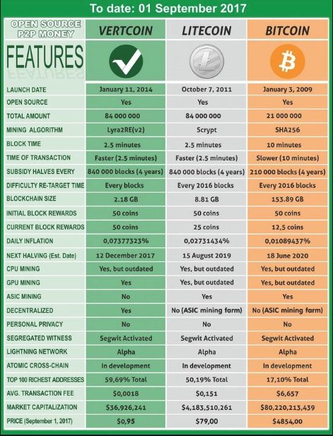
What’s the most expensive commodity/cryptocurrency?
Hype:
  Gold → “Bitcoin’s BTC”
  Silver → “Litecoin”
  Diamond → “Ripple’s XRP”
Or something else!
  Asset? But no future cash flow!
  Commodity? Not production material !
  Currency ? Who publish it!
  Collectable? Not sculpture or painting !

Slide 18
BITCOIN
Bitcoin: What is it?
Bitcoin: Overview
Bitcoin: Intuition
Bitcoin: Sustainable?
Daniel Lee, MGB070, Soochow University
2018/09/20

Slide 19
What it is!--- Satoshi Nakamoto’s!
“A purely peer-to-peer version of electronic cash would allow online payments to be sent directly from one party to another without going through a financial institution ...
We propose a solution to the double-spending problem using a peer-to-peer network. The network timestamps transactions ... forming a record that cannot be changed without redoing the proof-of-work” Nakamoto (2009)
The blockchain records all Bitcoin transactions in a public ledger that is distributed worldwide, with no single authority.

Slide 20
Timeline of Bitcoin events
Year | Main Events
2009 | The Bitcoin Whitepaper by Satoshi Nakamoto and the Genesis Block
2010 | The first real-world transaction took place to purchase a pizza. 10,000 BTC sent from the USA to a person in the U.K. in return for two pizzas from Papa John’s
 | First mining poll & BTC market cap of $1 Million
2011 | Silk Road started (Black-market Darknet outlet). Parity of Bitcoin & the US Dollar (Feb 2011)
2012 | Coinbase Exchange started (Also started to deal in Ethereum & Litecoin)
2013 | Oct Silk road closed. Bitcoin reaches $1000 during Q4 2013
2014 | Collapse of Mt Gor exchange (At one time >70% of Bitcoin transactions) 850,000 coins ($850 Million) hacked. 200,000 recovered. Today worth $2 Billion. Creditors will receive $100% back . Owner of Mt Gor could receive the surplus value approx $1.2 Billion
2015 | Bitcoin price falls to $229 from a peak of over $500 in 2014
2016 | Bitcoin price rises to $1000. Mining reward halves, doubling production costs rise of 100s of altcoins
2017 | 2 Bitcoin forks (Free bitcoin Gold & Bitcoin Cash). Price rises to exceed $10,000 & predictions by some on wall street for a $40,000 + price

Slide 21
Legal Elements

Slide 22
What it is!--- non-technical
https://www.youtube.com/watch?v=t5JGQXCTe3c
https://www.youtube.com/watch?v=NBVDqAHQ4-M
https://www.youtube.com/watch?v=LtITDtZPYEw

Slide 23
What it is! --- Technical
https://www.youtube.com/watch?v=l9jOJk30eQs
https://www.youtube.com/watch?v=Lx9zgZCMqXE
https://www.youtube.com/watch?v=bBC-nXj3Ng4

Slide 24
Overview:
https://www.youtube.com/watch?v=l1si5ZWLgy0
https://www.youtube.com/watch?v=bBC-nXj3Ng4

Slide 25
What is Bitcoin: Terminology
Bitcoin was born during the financial crisis of 2008 and sought to answer a need for a currency that didn’t require a bank. The network became the bank, with each node (computer server) holding the full ledger of Bitcoin transactions. By decentralizing, no bank is required for sending money.

Slide 26
What is Bitcoin: Intuition
Bitcoin was born during the financial crisis of 2008 and sought to answer a need for a currency that didn’t require a bank. The network became the bank, with each node (computer server) holding the full ledger of Bitcoin transactions. By decentralizing, no bank is required for sending money.
Bitcoin’s BTC as “Digital Gold?” requires mining (solving puzzle) with hardworking and lucks---A reward driven system for achieving consensus (mining) based on “Proofs of Work” for helping to secure the network
Decentralized/Distributed peer-to-peer electronic cash system without government, bank, and other 3rd. party involvement---A protocol (digital wallet) that supports a decentralized, pseudo-anonymous, peer-to-peer digital currency
Double-spending problem is overcoming by unchangeable, irreversible transaction record---A publicly disclosed linked ledger of transactions stored in a blockchain. https://medium.com/coinmonks/how-a-miner-adds-transactions-to-the-blockchain-in-seven-steps-856053271476 https://medium.com/coinmonks/what-is-a-51-attack-or-double-spend-attack-aa108db63474
Value coming from Transaction and Validation--- ” The worth of a thing is the price it will bring.“
“No-brainer Trust” to its egosystem

Slide 27
Bitcoin: Security Sustainable?
How secure blockchain and Bitcoin is: theoretically tamperproof good enough? https://www.technologyreview.com/s/610836/how-secure-is-blockchain-really/ https://www.technologyreview.com/s/611591/bitcoins-inherent-economics-could-keep-it-from-ever-being-very-important/ http://faculty.chicagobooth.edu/eric.budish/research/Economic-Limits-Bitcoin-Blockchain.pdf http://faculty.chicagobooth.edu/eric.budish/research/Slides-Economic-Limits-Bitcoin-Blockchain.pdf
  Hackers/Heists/Thief can break into “Wallets” either online/offline
  New creative way to cheat if …..!
Is 10,000 connected nodes with over 1 millions PC’s for Bitcoin network good enough?
Mining centralization in China: Having so much mining power centralized in any single country exposes the Bitcoin network to a worrying degree of political risk. Should the Chinese government decide to crack down on Bitcoin, perhaps seeing it as a threat to their economy or a competitor to their own planned digital currency, they could wreak untold havoc in the Bitcoin ecosystem. https://www.blockchain.com/pools?timespan=4days

Slide 28
Bitcoin: Power Sustainable?
Electricity Power Consumption
  Bitcoin network consumes at least 2.55 GW of electricity currently, and that it could reach a consumption of 7.67 GW in the future, making it comparable with countries such as Ireland (3.1 GW) and Austria (8.2 GW). With the Bitcoin network processing just 200,000 transactions per day, this means that the average electricity consumed per transaction equals at least 300 kWh, and could exceed 900 kWh per transaction by the end of 2018. https://www.cell.com/joule/fulltext/S2542-4351(18)30177-6
  Chinese mining pools control more than 70% of the Bitcoin network’s collective hashrate.
  Four key ingredients for cryptocurrency mining – low cost electricity, cold weather, reliable internet and low population density http://uk.businessinsider.com/why-china-mines-more-bitcoin-than-any-other-country-2017-12

Slide 29
Bitcoin: Uncertainty
Government Regulation? Comic stories spreaded all over the world so far!
Initial Coin Offering (ICO) or Cybercurrency (stateless currency and its “Wild West Industry”) a security likes bonds or stocks, if not, what it is ???
SEC of U.S. said ICO was a scam! SEC Chairman Jay Clayton, said Bitcoin (BTC) is not a security since it acts as a replacement for sovereign currencies.
  “Replace the dollar, the yen, the euro with Bitcoin. That type of currency is not a security.”
  While Clayton did not comment on specific assets besides Bitcoin about their status as securities, he went on to explain that what he considers to be securities are tokens that act as digital assets: “Where I give you my money and you go off and make a venture […] and in return for me giving you my money, you say, ‘You know what, I’m going to give you a return.’ That is a security, and we regulate that. We regulate the offering of that security, and we regulate the trading of that security.” Clayton had noted that every ICO that the SEC had seen so far would be considered a security. But Ethereum emphatically denying that ETH was ever a security, and Ripple similarly rejecting a security classification.
Is Regtech (Regulatory Technology) coming to rescue this uncertainty!

Slide 30
Bitcoin and Blockchain

Slide 31
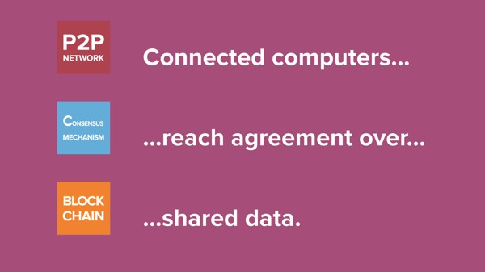
What is Blockchain?
A blockchain is a continuously growing list of records
called blocks, which are linked and secured
using cryptography.
It is an open, distributed ledger that can record transactions between two parties efficiently and in a verifiable and permanent way.
https://coincenter.org/entry/what-is-blockchain-anyway

Slide 32
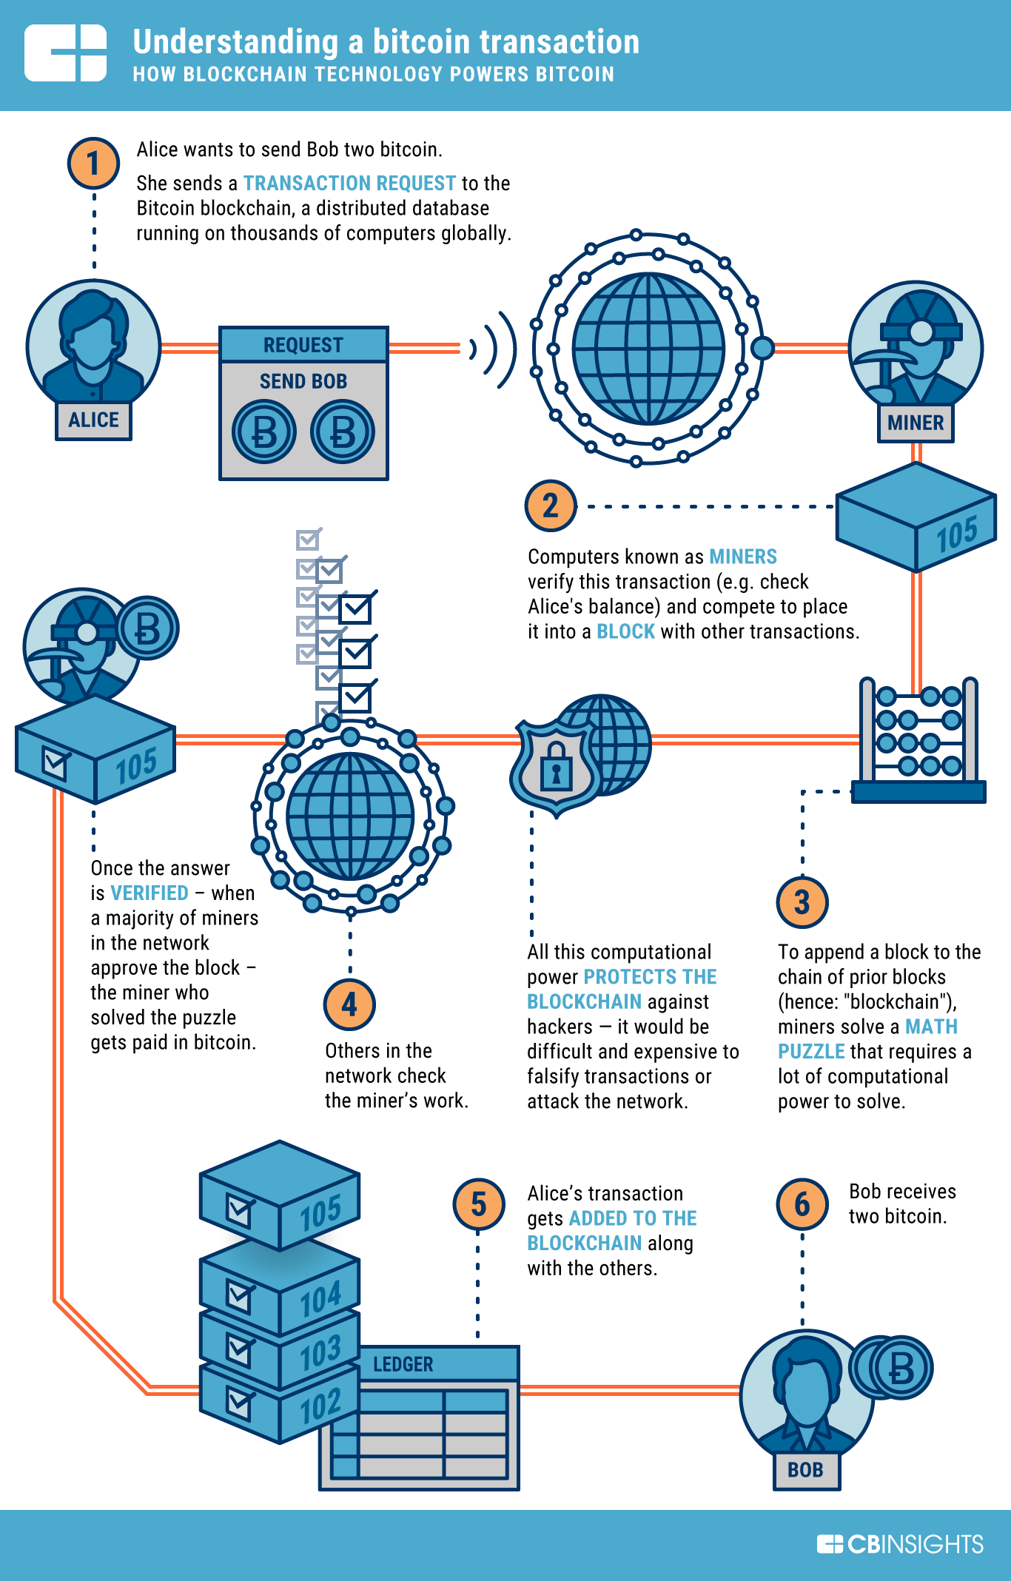

What is Blockchain?
Blockchains can be used in application requiring:
Contracts
Certificate of Ownership
Statement of authenticity
Proof of a bank's financial transaction
https://www.cbinsights.com/research/what-is-blockchain-technology/

Slide 33
Key aspects of Blockchain
Digital Ledgers
Blocks
Decentralized
Consensus Mechanism
Proof-of-work
Cryptography

Slide 34
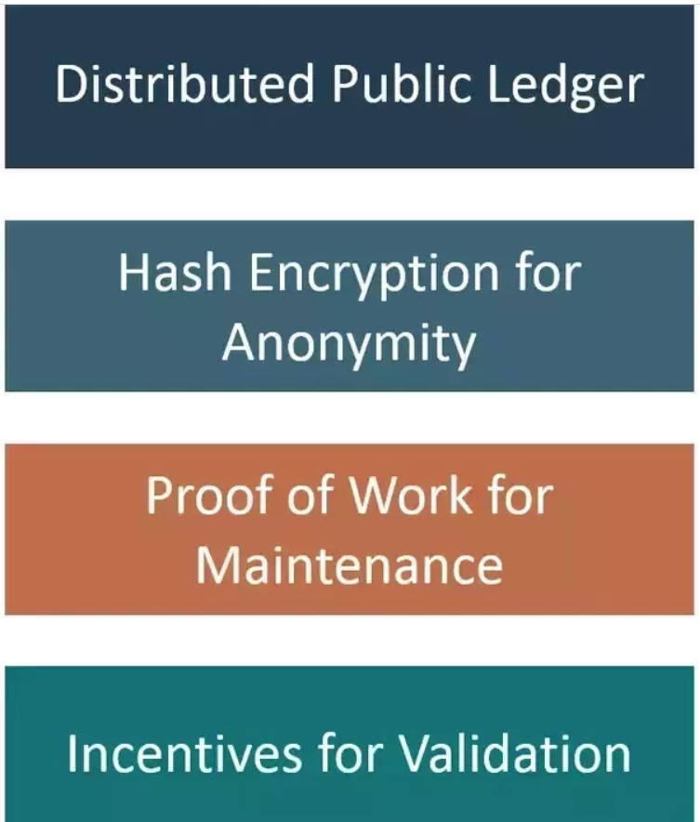
Blockchain Bitcoin Features

Slide 35
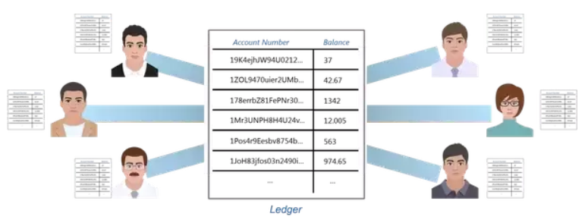
Anonymous Distributed Public Ledger
Every single person on the network has a copy of the ledger. There is no single centralized original copy. Ledger here means the copy of all the transactions that ever happened. Blockchain is a distributed database that stores all the transactions that have ever happened in the history of specific application, i.e. Bitcoin. This ensures that no one person can make changes to the ledger because everyone else will immediately flag it as corrupt.

Slide 36
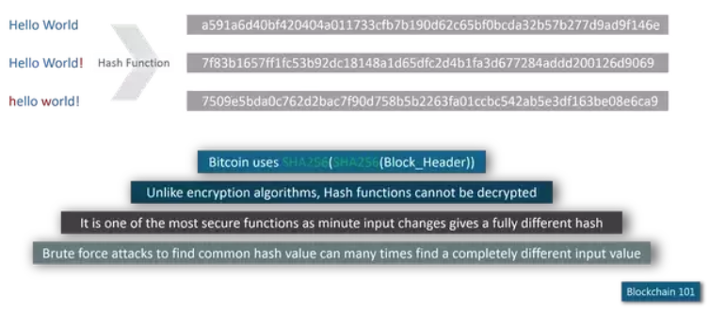
Hash Encryption
Everything stored on the Blockchain is encrypted. This way, everyone is able to see all the transactions but at the same time no one will know which of those accounts belongs to you. Isn’t this exactly what we expect a banking system to be?

Slide 37
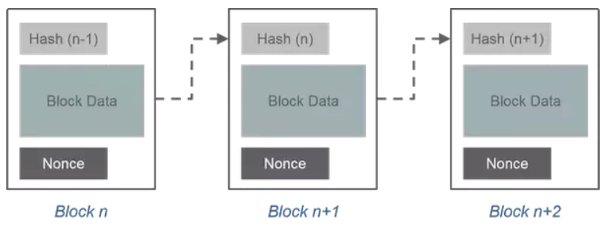
Proof of Work
Proof of Work is a concept invented in Bitcoin Blockchain where in the miners (special users of Bitcoin) will validate transactions by solving a complex mathematical puzzle called Proof of Work. Technically, there is a hash target value designated to every block before time.
Miners club together a set of unverified Bitcoin transactions (around 250) into one block, compute its hash and then begin a race to find a specific set of characters called Nonce.
The total hash obtained from the hash of the previous block, transaction data and the nonce has to match the final pre-assigned target hash value. It is this Nonce which is computationally extensive. Only people with huge computational computing power and electricity are able to solve it in 10 minutes on average.

Slide 38
Incentive Validation
The most interesting part of Bitcoin is Bitcoin Mining. It is the concept in which certain users do a piece of work and are rewarded 12.5 BTC per block. Each block takes on average about 10 minutes to mine. Thus a successful miner earns US$ 34,380. You could in theory buy an Audi A4 every 10 minutes given you can successfully mine the block. It takes on average about 12 billion laptops working in parallel to achieve this feat.

Slide 39
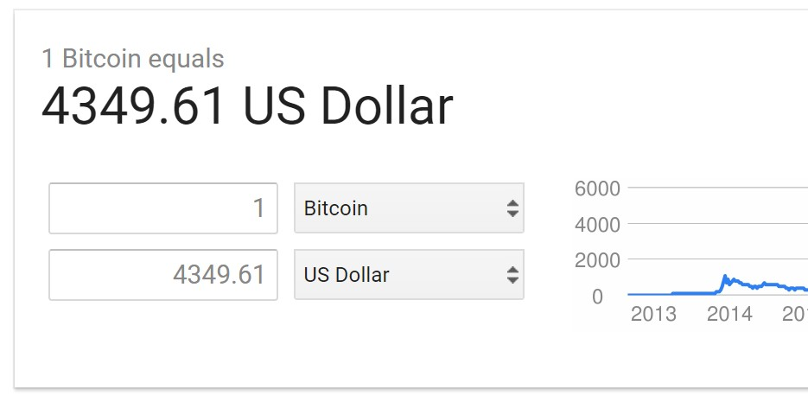

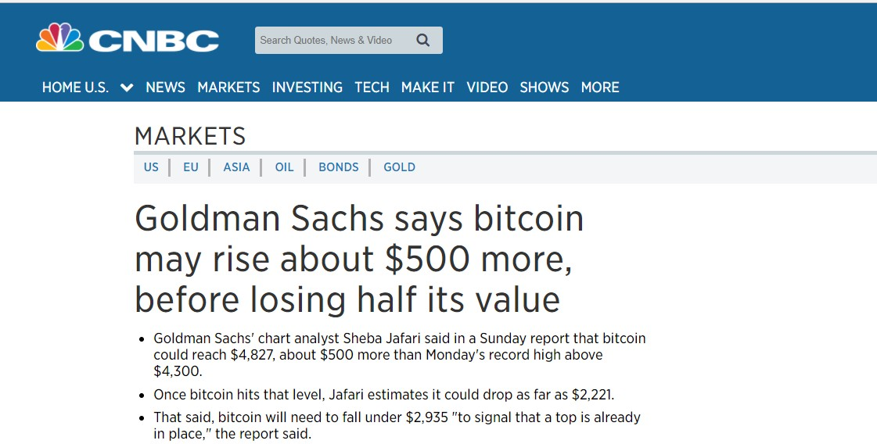

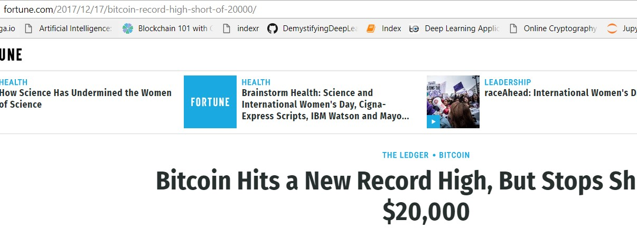

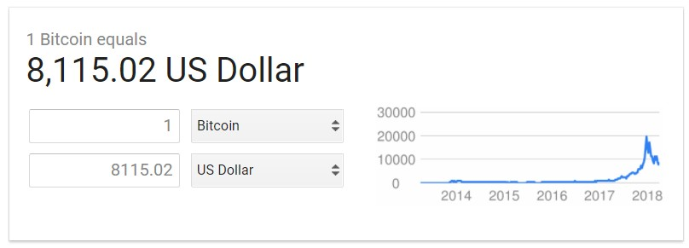

Bitcoin is not equal to Blockchain! Blockchain is technology behind Bitcoin.

