Slide 1
Technology and Industry/Business
Daniel Hao Tien Lee
http://danieleewww.yolasite.com/2018-mgb070.php
danieleewww@gmail.com

Slide 2
Technology
The Merriam-Webster Dictionary offers a definition of the term: "the practical application of knowledge especially in a particular area" and "a capability given by the practical application of knowledge".
Technology can be most broadly defined as the entities, both material and immaterial, created by the application of mental and physical effort in order to achieve some value.

Slide 3
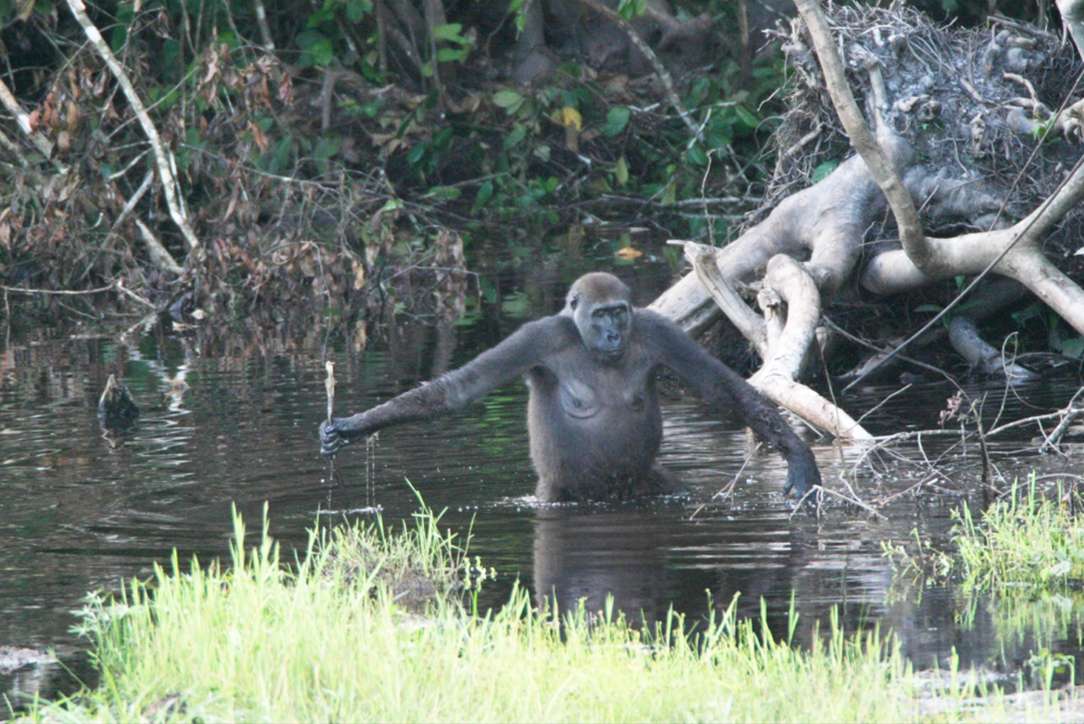
Wild Gorillas Handy with a Stick. PLoS Biology Vol. 3/11/2005, e385 doi:10.1371/journal.pbio.0030385

Slide 4
Technology and Industry/Business
Why this!
Interests….
Philosophy
Romantic understanding
Classic understanding

Slide 5
Romantic Understanding

Slide 6
Classical Understanding

Slide 7
Romantic + Classical Understandings

Slide 8
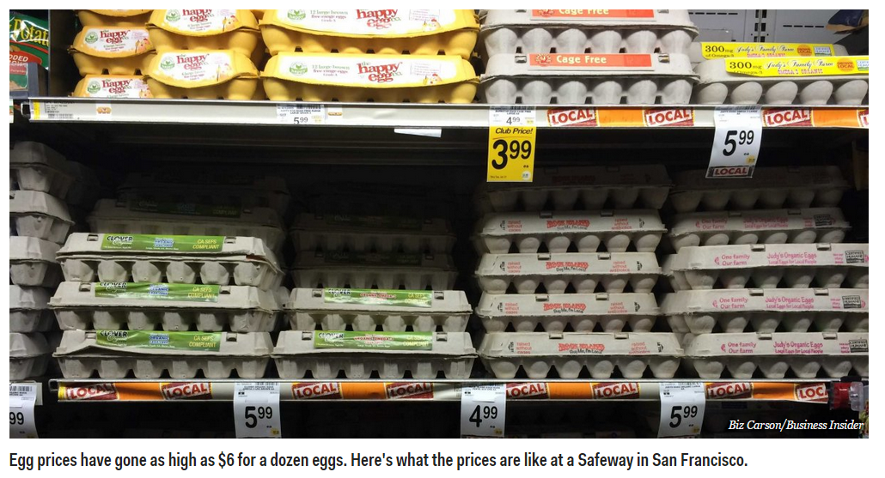
Project example: “Egg Replacement” mission is making the egg without dependency on animals.

Slide 9
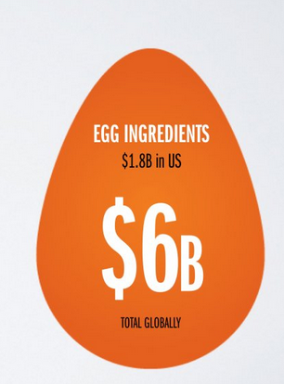
---cont. “What’s your takes on this”
Romantic
Classical
Massive Opportunity
google “Just Mayo, Just Cookies, Just Cookie Dough”
of Hampton Creek Inc. for reference

Slide 10
Three Breakthroughs That Will Disrupt The Tech World In 2019
Blockchain-Based Identity And Privacy
https://www.youtube.com/watch?v=NTNQMKB0A3A
https://www.youtube.com/watch?v=x-dyo4RkJYc
https://www.youtube.com/watch?v=zGa0vpRYUBk
‘Dueling AI’ : Generative Adversarial Networks (eCommerceGAN)
https://www.youtube.com/watch?v=deyOX6Mt_As
https://www.youtube.com/watch?v=RvgYvHyT15E
3D Metal Printing
https://www.youtube.com/watch?v=tgo3DMrJLh4
https://www.3dhubs.com/knowledge-base/introduction-metal-3d-printing
https://www.forbes.com/sites/forbestechcouncil/2018/07/18/three-breakthroughs-that-will-disrupt-the-tech-world-in-2019/#3a679d5e1f87

Slide 11
Five Years Ago
Social media struggling to integrate with consumerism
Mobile phones primarily being used for “casual” pursuits by the general public rather than “business,” “work” or “commerce” applications
The relative non-existence of cloud-based solutions for small to mid-sized businesses
The birth of the App Generation (again, primarily concerned with games and trivialities like “poking”)
The bumbling incompetence of early attempts at omni-channel marketing

Slide 12
Looking into the future?
Forecast
– How we think the future will be
Vision
– How we want the future to be
Scenarios
– What the future can be
–“Alternative memories” from the future
? ?
? ?
ref. https://www.slideshare.net/eteigland

Slide 13
ref. https://www.slideshare.net/eteigland

Slide 14
Thx to R. Wieselfors, Ericsson for photos
ref. https://www.slideshare.net/eteigland

Slide 15
Smart Robots
2015
ref. https://www.slideshare.net/eteigland

Slide 16
H.I.S. Co. has Hotels run
2017
“entirely” by robots and plans to open 100 hotels.
Food
deliveries
Check-in
Other Automated Tasks
Concierge Porters Cleaning Lawnmowing Room Service Robot Trashcan Robot fish
ref. https://www.slideshare.net/eteigland

Slide 17
Technology is Changing Business
Citizen AI (responsibility)
Extended Reality (the end of distance)
Data Veracity (the importance of trust)
Frictionless Business (digital technology-based partnerships)
Internet of Thinking (intelligence everywhere)
FINTECH (technology centric financial service)
https://www.accenture.com/t20180227T215953Z__w__/us-en/_acnmedia/Accenture/next-gen-7/tech-vision-2018/pdf/Accenture-TechVision-2018-Tech-Trends-Report.pdf#zoom=50
https://www.forbes.com/sites/steveolenski/2018/03/12/the-5-technology-trends-that-may-disrupt-business-over-the-next-3-years/#a2594c4b18cf

Slide 18
Citizen AI
https://www.youtube.com/watch?v=78-1MlkxyqI
https://www.youtube.com/watch?v=kWlL4KjIP4M
https://www.youtube.com/watch?v=xmt6OCBeS94

Slide 19
Extended Reality (XR)
https://www.youtube.com/watch?v=kDFNHWb7Ln8

Slide 20
FINTECH Evolution (Financial Technology)
Cryptocurrency
Bitcoin
Blockchain
Ethereum
Regetech
Insurtech
Initial Coin Offering (ICO)
Open Banking
Robo-advisor
Unbanked/Underbanked
Financial Inclusion
Smart Contracts
Accelerators
https://www.cnbc.com/2017/10/02/fintech-everything-youve-always-wanted-to-know-about-financial-technology.html

Slide 21
Seamless Interactive Society
Human-to-Human
Twitter
Facebook
Human-to-Machine
Apple Siri
Google Now
Amazon Alexa
Machine-to-Human
Robot@Home/Service
Machine-to-Machine
Driverless Vehicle
Automated Factory
Payment

Slide 22
Convergence for a “true” Collaborative Economy?
AI/ML
IoT/Sensors
Blockchains/Tokens
P2P/M2M payments
3D printing
Renewables
VR/AR
Sharing/ Collaborative Economy
ref. https://www.slideshare.net/eteigland

Slide 23
Class Activity
Weekly Special Topic Presentation: team effort
Fun Project: team effort or individual (optional)
Ideas for startup, product, and business etc…
Hand-on projects on analytics by using machine learning or deep learning tools, or blockchains ! (no programming experience needed)
https://www.kaggle.com/learn/overview
https://www.kaggle.com/learn/python
https://www.kaggle.com/learn/machine-learning
https://www.kaggle.com/learn/deep-learning
https://www.kaggle.com/kmader/build-your-own-blockchain

Slide 24
Course Topics
Course Introduction
Emerging Technology Trend
Blockchain and Distributed Ledger Technology (DLT)
FINTECH (Financial Technology)
Social Physics for Human Clowds
Future Jobs and Skills
Digital Enterprise and Industry 4.0: Enterprise Virtualization
Behavioral Science and Persuasive Technology
Machine Learning (ML) and Deep Learning (DL) : Learning Data Science for Sustainable Career
Data Driven Decision Making (DDDM) Processes
Culinary Technology and Reinvention of Food Recipes; Case Study and Discussion: "Digitized Your Favorite Recipe”
Hand-On Project: Machine Learning (ML) and Deep Learning (DL), or Blockchain Hand-On Project, or Research Project Report

Slide 25
Assignment for next week (9/20)
Case Study and Discussion: "Which Technology Pioneer Companies (chose one or two) will be your Favorite and Why!“ → prepare for 25min. presentation and 5min. Q&A
Company Review Assignment:
Group 1: http://widgets.weforum.org/techpioneers-2018/ Digital & Entertainment (19)
Group 2: http://widgets.weforum.org/techpioneers-2018/ Cyber Security & Digital Identity (8) and Mobility (7)
Group 3: http://widgets.weforum.org/techpioneers-2018/ Energy & Environment (7) and Production (6)
Group 4: http://widgets.weforum.org/techpioneers-2018/ Financial System (6) Health (4), and Food Security & Agriculture (4)
References:
Technology Pioneer Company: https://www.weforum.org/communities/technology-pioneer.
Handout: Emerging Technology Trend http://danieleewww.yolasite.com/2018-mgb070.php
Recommend using Prezi style of presentation https://prezi.com/signup/public/

Slide 26
Presentation and Q&A Guideline
Review the selection criteria here https://www.weforum.org/about/technology-pioneers-programme-faq and identify the selection criteria and takeaways.
Review the website of your favorite company including its technology advancing and business progress.
Google the company information see any information on its technology/business competitor or positive/negative business reviews
Review the handout material : Emerging Technology Trend http://danieleewww.yolasite.com/2018-mgb070.php to get familiar with the information about the tipping point and predict if your favorite company could squeeze into the “Chasm” stage.
Prepare questionnaires in advance for Q&A session
Presentation Arrangement (recommended): arrange a group leader to moderate the presentation and Q & A session, and each team member should carry certain part of presentation, if possible.

