Slide 1
What is Social Physics
Social physics or sociophysics is a field of science which uses mathematical tools inspired by physics to understand the behavior of human crowds. In a modern commercial use, it can also refer to the analysis of social phenomena with big data.
Social physics is closely related to econophysics which uses physics methods to describe economics.
https://en.wikipedia.org/wiki/Social_physics

Slide 2
What is Social Physics
https://www.youtube.com/watch?v=StIs_gIzbhs
https://www.youtube.com/watch?v=HMBl0ttu-Ow

Slide 3
Purpose
How can we create organizations and governments that are cooperative, productive, and creative? These are the questions of social physics, and they are especially important right now, because of global competition, environmental challenges, and government failure. The engine that drives social physics is big data: the newly ubiquitous digital data that is becoming available about all aspects of human life. By using these data to build a predictive, computational theory of human behavior we can hope to engineer better social systems.

Slide 4
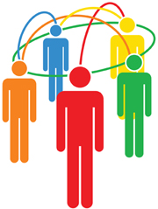
BiG DATA:
UnDERSTANDING PEOPLE
Prof. Alex `Sandy’ Pentland
MIT
Human Dynamics Lab
http://hd.media.mit.edu

Slide 5
Complexity is simple
look at the generating process, not the leaves
Big Data, Small Problems
use big data to discover parameters and boundaries
Stone Soup & Big Data
pooling data with users to benefit everyone

Slide 6
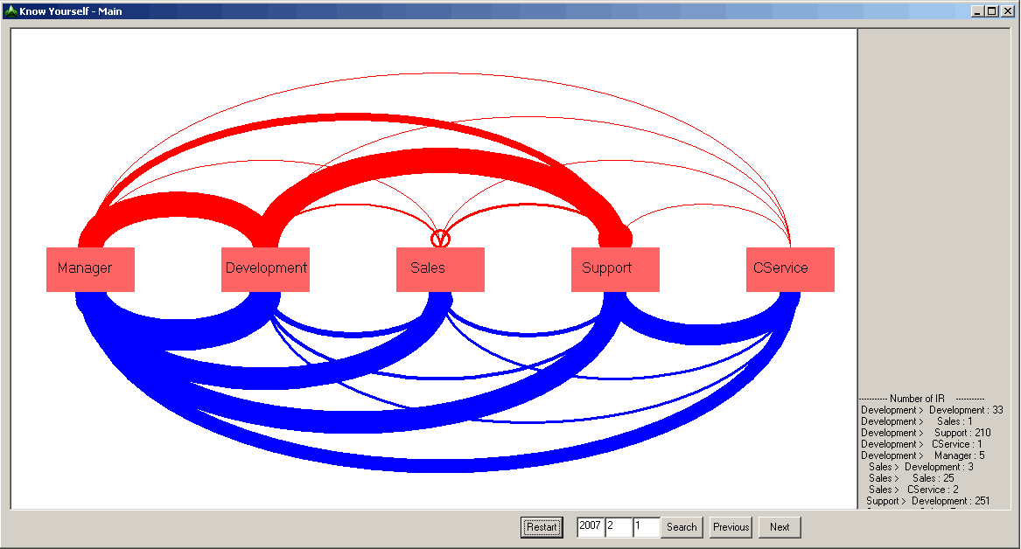
Corporate Information Flow
Complex!

Slide 7
Nature 1/09
Big Data Says that Humans are Really Pretty Simple
`People have been studying this for a long time, but Alex is raising it up to another level.’
Nature, 1/09

Slide 8
Two Minds
Nobel Prize winners Kahneman and Simon: Humans have two minds
Habitual
(System 1)
Attentive
(system 2)
Process
Fast
Parallel
Automatic
Associative
Slow
Serial
Controlled
Rule-based
Content
Conceptual Representations
Past, Present, Future
Can be evoked by language

Slide 9
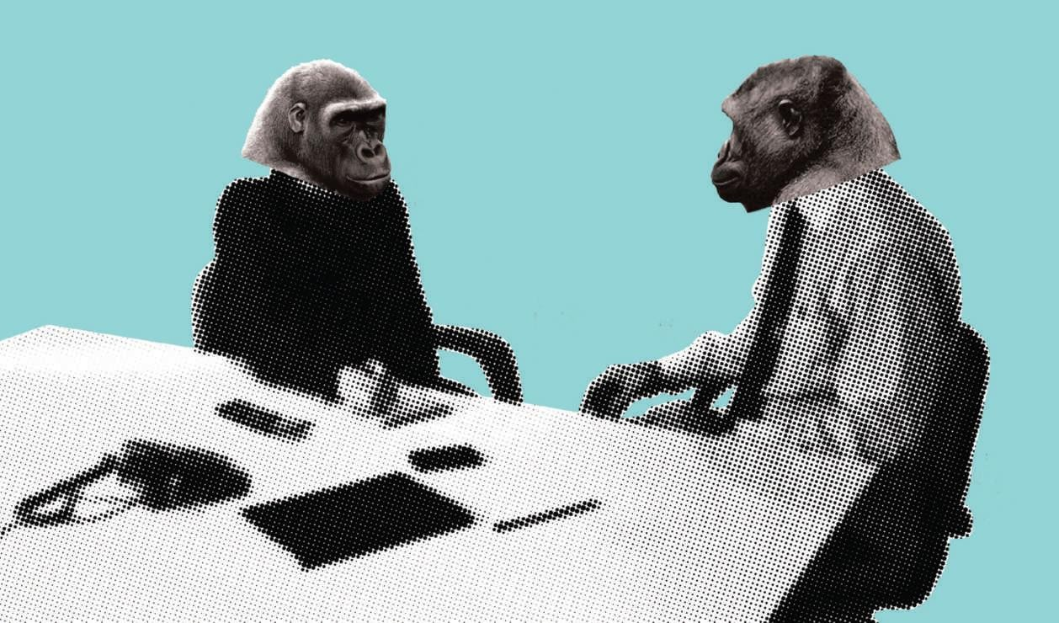
People Mostly Learn by Examples, not Arguments or Reasoning
90% - 10% balance
Rendell et al, Social Learning, Science 4/10

Slide 10

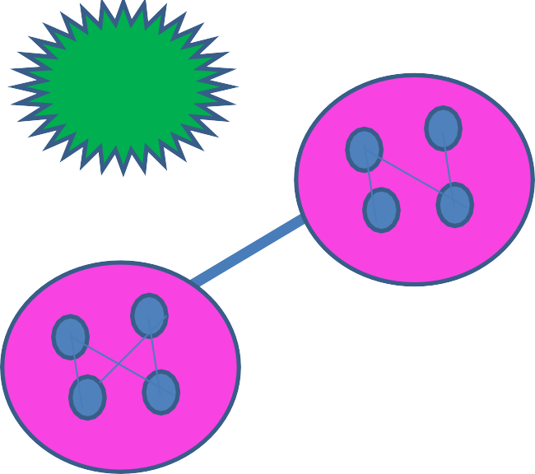


Influence Model & Idea Flow
Private
Observation
Internal State s₂
Internal State s₂
Internal State s₁
 | s₁ | s₂
s₁ | 0.8 | 0.2
s₂ | 0.2 | 0.8
6

Slide 11
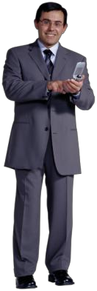
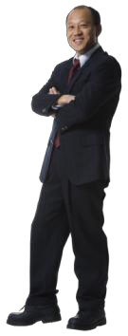
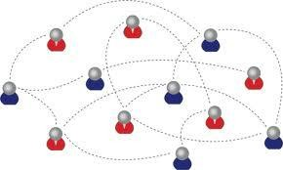


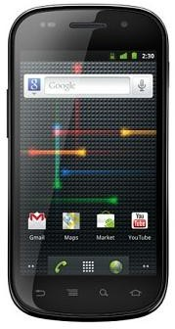



Social Exposure Predicts Behavior
65 young families, 12 months data
No content involved!
Proximity Network
Call Network
Friendship Network
45% accuracy predicting app downloads. Gompertz function describes influence
Using sensors in smart phones to obtain different type of social networks.
Co-location Network
7

Slide 12
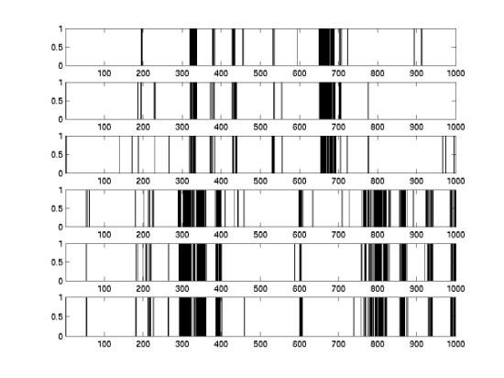
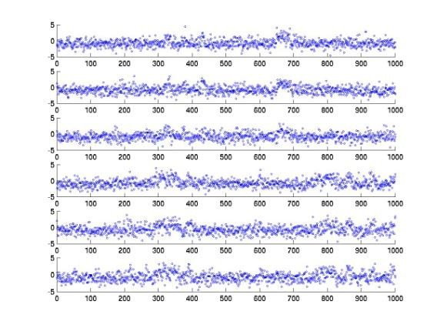
Inverse Problem: Discovery of Influence, Node State
Raw Observations From Nodes
clean state estimate for nodes
(c)
1
2
influence structure connecting nodes
process id
3
4
5
6
1 2 3 4 5 6
process id
8

Slide 13
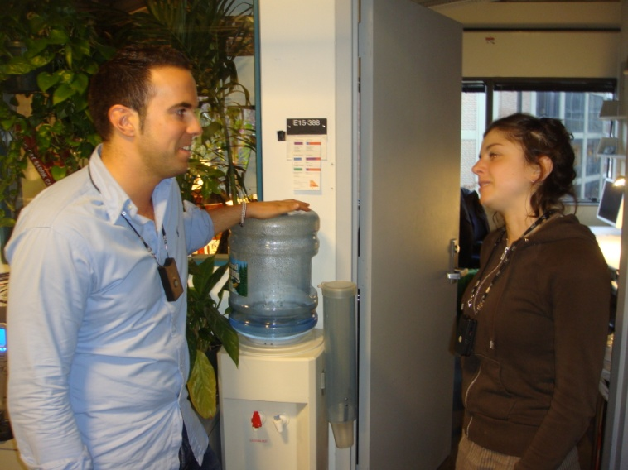

The Sociometric Badge captures interactions with others
Proximity
Location
Face-to-face interactions
Social signals
NOT words
Sociometric Solutions
Organizations for Humans
Technology Review Top 10 Emerging Technologies

Slide 14
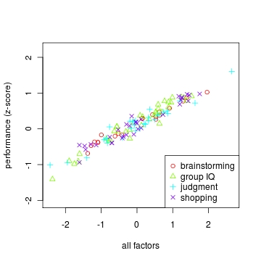
Group Performance
Governed by
Ancient Patterns
204 groups, size 2 – 5 participants
Three Factors:
1. Total Number of contributions
2. Equality of contribution rate
3. Amount of (backchannel) signaling
Science, 9/2010

Slide 15
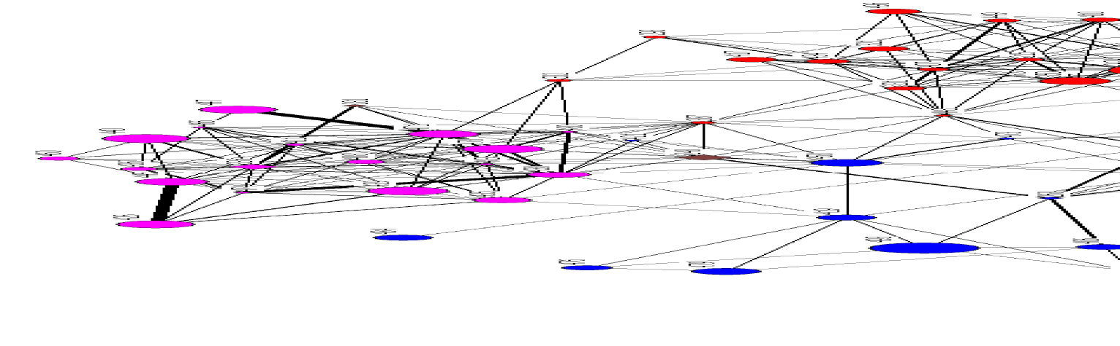
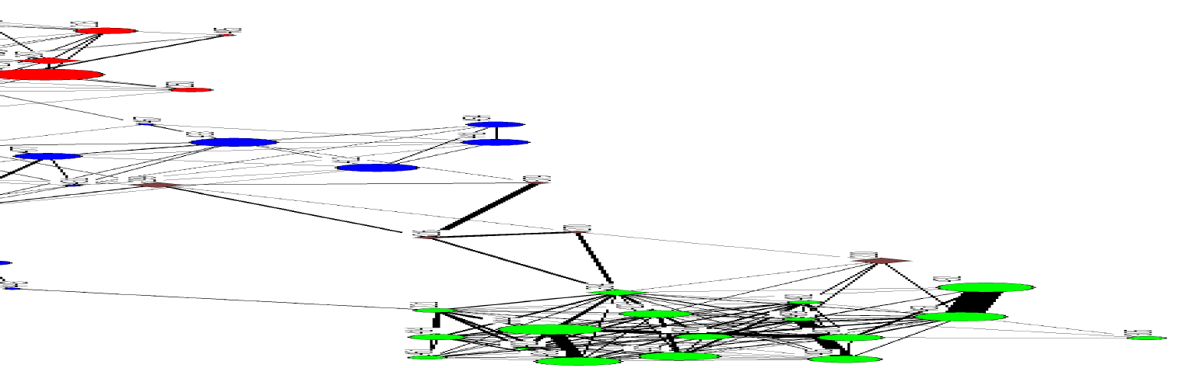
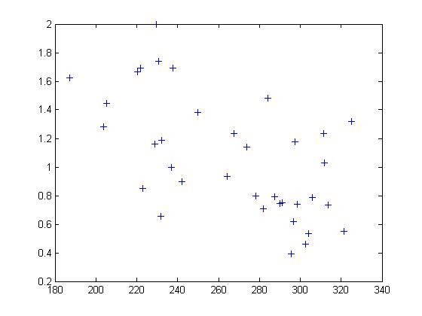
BAC Call Center
Productivity from
to simple patterns
Cohesion of Face-to-Face Network
$15M / year savings…..
Just by changing
coffee breaks
Average Call Handle Time
Waber, Olguin, Pentland

Slide 16
Creativity: discovery and integration
Creative groups change between star-shaped network (exploration) and cohesive network (integration)
…like bees
89% accurate identification of `top creative days’ by socialization and activity measurements (sociometric badge)
Tripathi, Burleson, Gloor, Pentland

Slide 17

Simple Patterns Account for
40% to 60% of Performance
Harvard Business Review:
Breakthrough Idea of the Year
Olguin, Waber, Kim, Gloor, Pentland

Slide 18
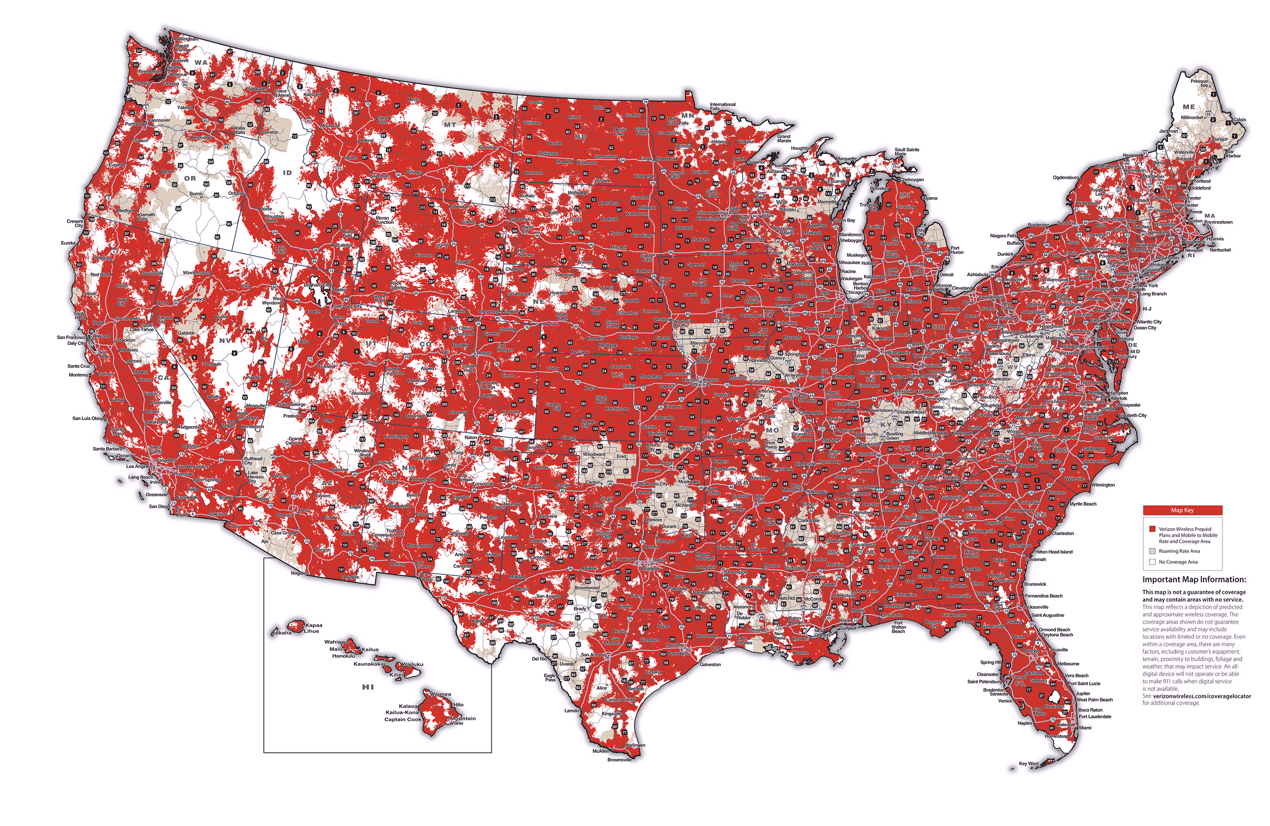
Out In The Wild
Complex!

Slide 19
Big Data Says that Humans
Are Really Pretty Simple
Decisions made by Exposure
not friends, information, or arguments
Accounts for 75% – 85% of variance

Slide 20

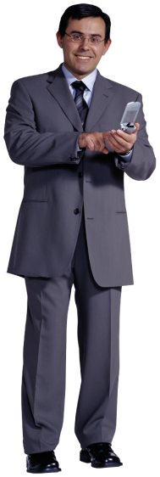

Social Influence:
Like Immune System
100% Republican
Individual 3
100% Democratic
Individual 2
Democrat, but 0.50 to switch to Republican
Me (Individual 1)
Pan, Altshuler, Pentland
Notes:
20

Slide 21
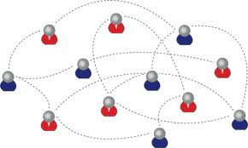

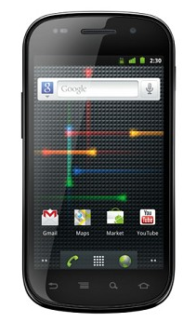







FunF Open Source Sensing
http://funf.media.mit.edu
Proximity Network
Call Network
Friendship Network
Using sensors in smart phones to
obtain different type of social networks.
Co-location Network
Copyright alex pentland 2011, all rights reserved
Aharony, Pan, Pentland
Notes:
21

Slide 22
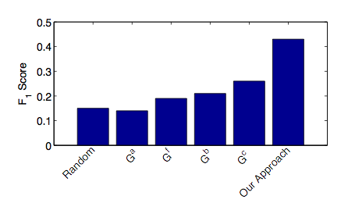
Predicting What You Will Buy
Many networks influence conscious decisions
Copyright alex pentland, 2011
Pan, Aharony, Pentland

Slide 23
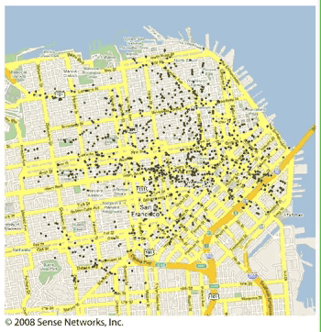
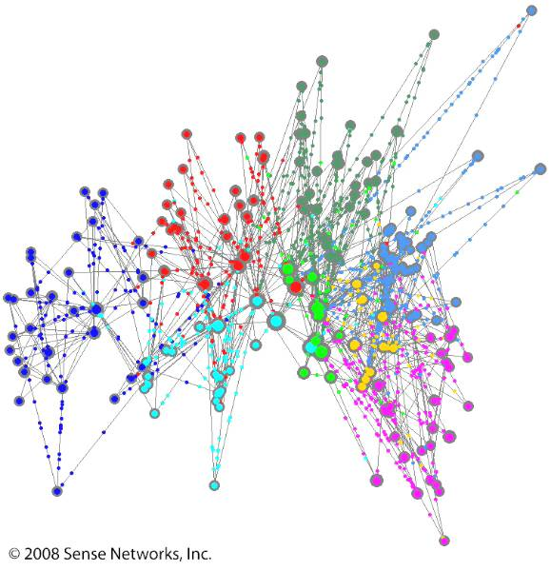
Big Data and Tribes
The Next Google
…cover Newsweek

Slide 24

Patterns of Buying
The Next Google … cover Newsweek
blackberry
iPhone

Slide 25
Patterns of Health
The Next Google … cover Newsweek
diabetes
HIV

Slide 26
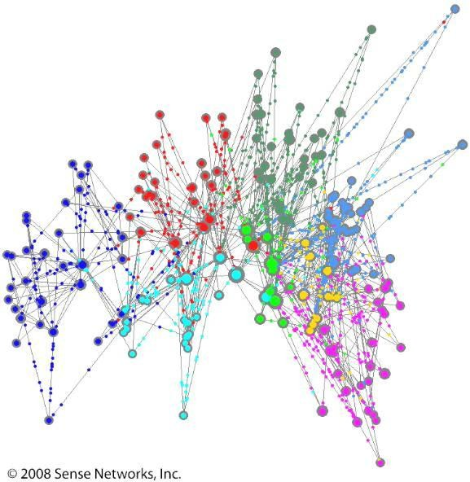
Patterns of Finance
Success Scoring of Unbanked
Unlikely to succeed
Likely to
succeed
Including life coaching

Slide 27
Shaping Behavior:
Social Influence
100% Republican
Individual 3
100% Democratic
Individual 2
Democrat, but 0.50 to switch to Republican
Me (Individual 1)
Gompertz function, like immune system
Pan, Altshuler, Pentland
Notes:
27

Slide 28
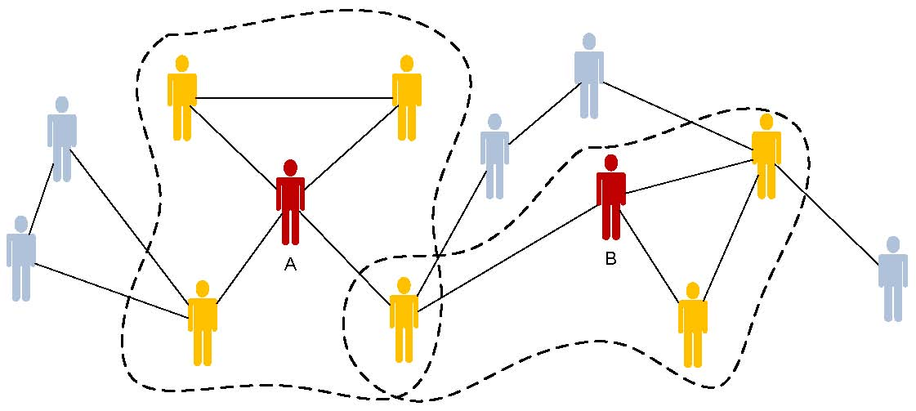
Leveraging Social Influence
Twice as efficient as standard incentive mechanisms
Mani, Rahwan, Pentland

Slide 29
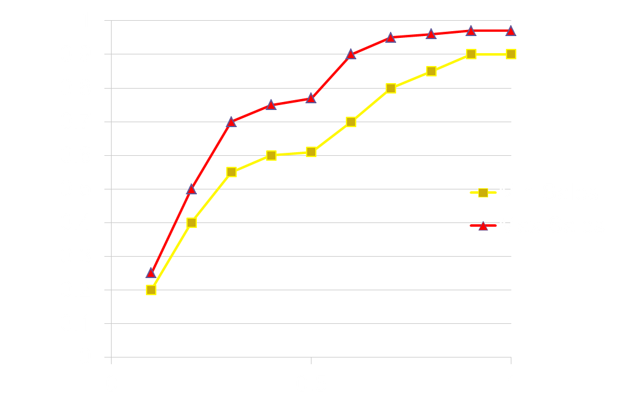
Quantitative Shaping
validated on stock purchases, app downloads
Predicted
Proportion
Of Population
Changing
Behavior
Treatment Cost
Altshuler, Pan, Pentland

Slide 30
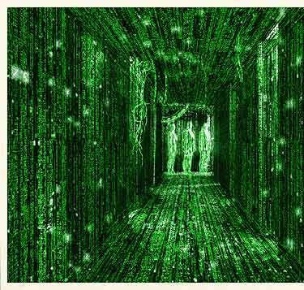
Personal Data & Privacy
“Personal data is the new oil of the internet and the new currency
of the digital world.”
—Meglena Kuneva
European Consumer Commissioner

Slide 31

Stone Soup & Big Data
The Evolution of A New Consensus
FTC, Commerce, White House, EU,…
Microsoft, Google, Cisco, Qualcomm…
Verizon, ATT, FT, BT, Bharti……
Mastercharge, Equifax, …
ACLU, OpenID,Infocard,….
Harvard Law, MIT Media Lab, …

Slide 32
Personal Data Stores
Bank Data
Bank Data
Legal
Data
Mobility and
Call Data
Bank Data
Bank Data
Medical
Data
My Data
Financial
Data

Slide 33
Privacy Market
Personal
Data
Store
Personal
Data
Store
Trust
Personal
Data
Store
Personal
Data
Store
Securely make offers
to individuals
Personal
Data
Store
Personal
Data
Store
Trust
Trust
OIX, NSTIC, EU
UK: mydata
Vets: blue button
Copyright alex pentland 2011

Slide 34
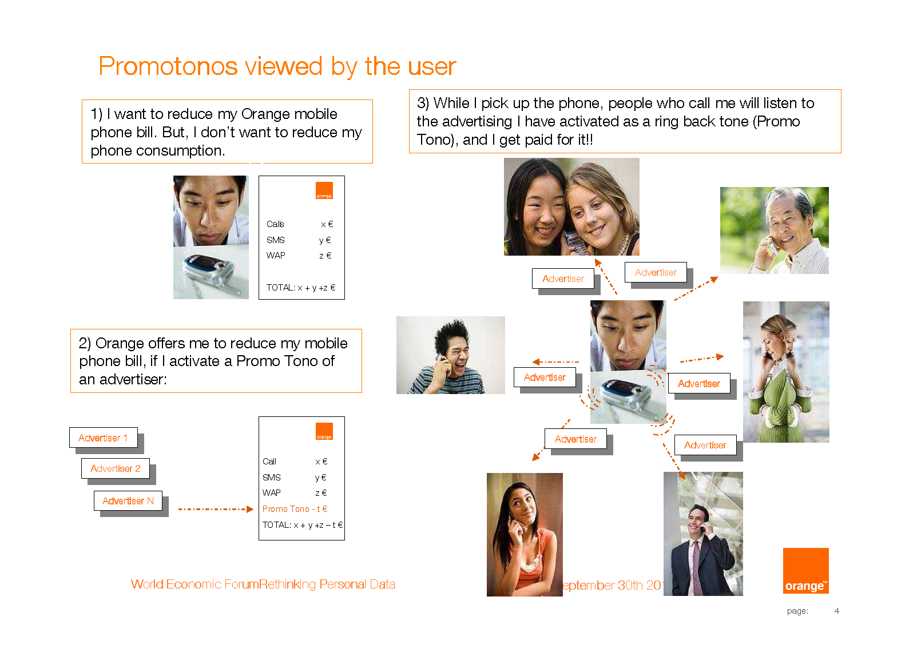
USE CASE 1

Slide 35
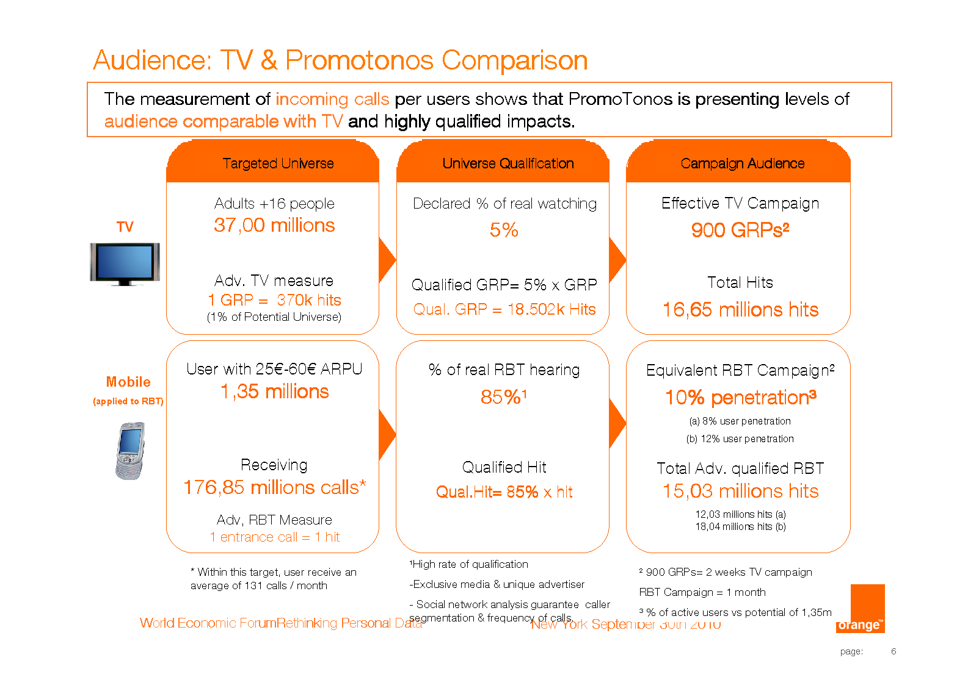
USE CASE 1 CONTINUED

Slide 36
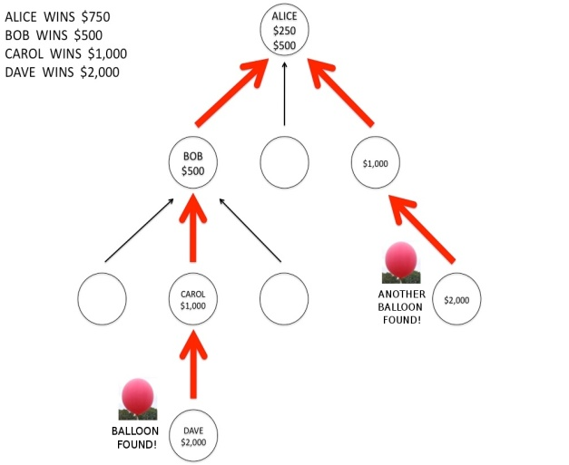
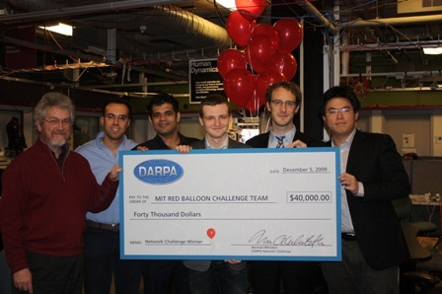
USE CASE 2
40th Anniversary of the Internet Grand Challenge
`Optimal’ Anonymous Market Discovery:
AKA Instant Groupon
Pickard, Pan, Rahwan,Cebrian,Madan,Crane,Pentland

Slide 37
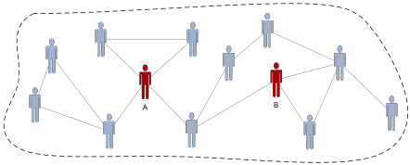
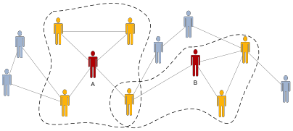
Shaping by Social Incentives
incentives that leverage social influence
Global externality:
tragedy of the commons
Localized externality:
The peers of individuals A and B receive rewards for behavior of A, B.
Copyright alex pentland 2012 all rights reserved
Mani, Rahwan, Pentland

Slide 38



Behavior Shaping By Social Influence
Reward individuals for their peers' behavior
personal
utility
externality
cost
peer
pressure
peer
cost
Incentive
The total reward distributed to the peers of actor j is less than the Pigouvian subsidies to j if
Mani, Rahwan, Pentland

Slide 39


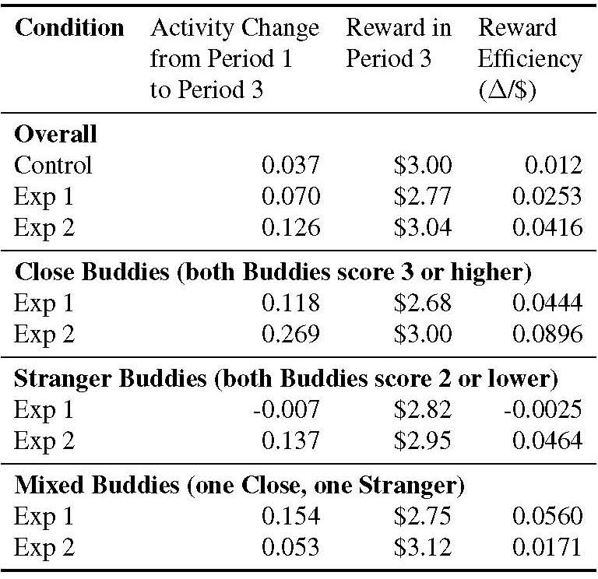

Social Influence incentive mechanism is 3.5 times as efficient as standard incentive mechanism
Standard
Incentive
Social media
Incentive
Peer reward
incentive
65 young families, 3 months data
Aharony, Pan, Pentland

Slide 40
The Bottom Line
Big Data and Simple Behavior Models
can make the complex simple
We are moving to a data-driven world,
make sure you secure the data you need!

