Slide 1
FINTECH-Payments
Daniel Hao Tien Lee
http://danieleewww.yolasite.com/2018-mgb070.php
danieleewww@gmail.com

Slide 2
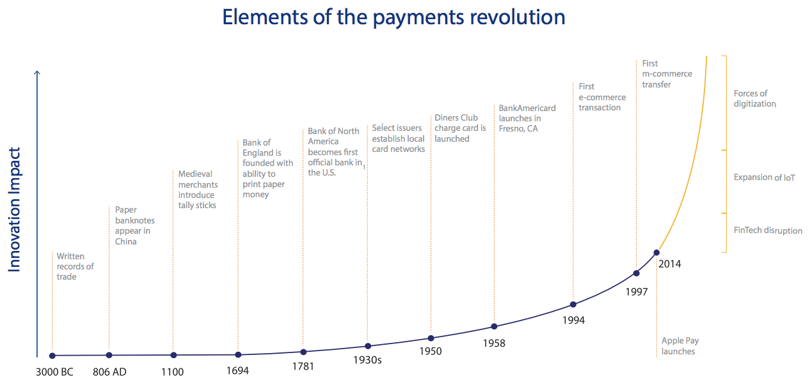

Slide 3
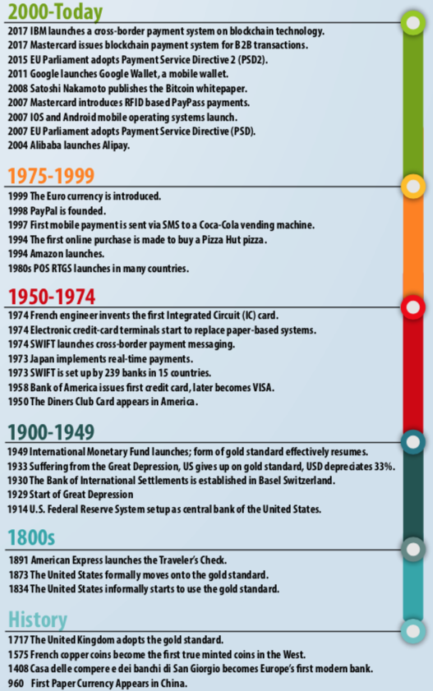

Slide 4
FinTech and Payment Trends
Fintegration: cooperation with banks and fintechs
Instant payments: Payment at the speed of Internet
PSD2: Reinforcing security and clarifying the role of payment players
Invisible payment or frictionless client experience
Subscription economy: an opportunity for the payment players

Slide 5
Fintegration
Commonly referred to as fintegration, the integration of fintech players into the existing banking and financial system is driven by strong government decisions relating to payment regulation, making exchanges between the two parties necessary.
The most concrete example of this collaboration can be summarised by three letters: API – or Application Programming Interface, a technological protocol enabling communication between different information systems, in our case those of banks and fintech, allowing the first to offer their customers the services offered by the latter.

Slide 6
Instant payments
Sometimes referred to as ‘immediate’ or ‘real-time’ payments, instant payments are cleared immediately or close to immediately, irrelevant of the payment instrument used and the clearing and settlement arrangements.

Slide 7
PSD2
With Europe’s second Payment Services Directive (PSD2) coming into force January 13, 2018, FinTechs and other Third-Party Players (TPPs) are expected to leverage open Application Programming Interfaces (APIs) to examine available opportunities
Key PSD2 provisions include: – Access to Accounts:The regulation introduces Account Information Service Providers (AISPs) as value-chain stakeholders that leverage APIs to collect information from customer accounts and then develop new customized offerings
– Retailer-Consumer Interaction: EU retailers will now be able to ask customers for permission to use their bank information to initiate payments and will, therefore, assume the role of Payment Initiation Service Providers (PISPs) much in the way as online service providers Amazon and Apple
By thinking beyond mere PSD2 compliance, banks can tap into monetization avenues and reach customers faster using the open API platform

Slide 8
Invisible payment or frictionless client experience
Why does ordering an Uber seem so effortless and painless? Not simply for the ride quality. Rather, it’s because at no point during the journey does the customer actually have to pay. No money changes hands, no card is swiped, no change is given.
Amazon recently created a buzz by announcing Amazon Go, a store where shoppers do not pay. Or to be more precise, the customer does not consciously pay. There are no registers, customers simply pick up what they want and “Just Walk Out”. Just like Uber: no wait, no credit card code error or counting change; all to promote the customer experience lived in the store. And if this practice was extended to all forms of commerce?

Slide 9
Subscription economy: an opportunity for the payment players
Today, 68 million people in the world pay for a subscription to a music platform, which is much more preferred to making punctual purchases for each album. The entire ecosystem of subscription and pay as you go models is based on the principle of an improved customer experience and preferred to possession.
In this context, the choice of method of payment is key since it must compliment and support this business model based on a long term, frictionless and recurring basis.
Bearing in mind that, according to McKinsey, payment represents 43% of fintech startups, the development of the subscription economy should play an important role for the whole sector.

Slide 10
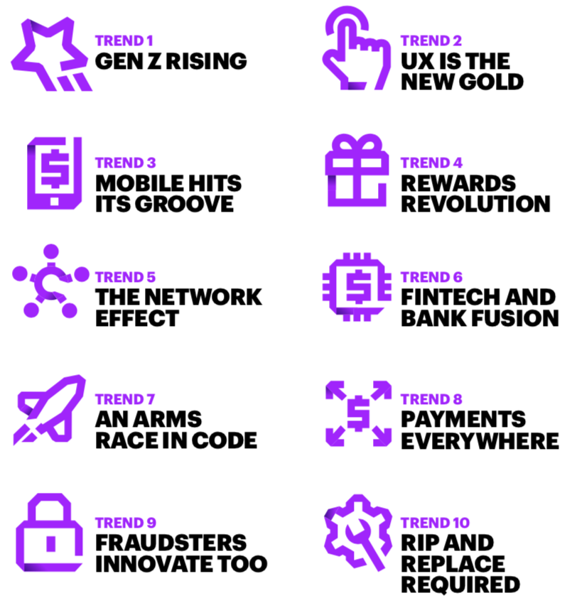
Future Payment Trends
Ref. DRIVING THE FUTURE OF PAYMENTS 10 MEGA TRENDS
Accenture 2017

Slide 11
Future Trend in Payments
GenZ Rises: One-third of Gen Z consumers want to share their payments on social media while only three percent of Baby Boomers would. 68% of Gen Z consumers are interested in instant person-to- person payments— more than any other age group.
UX(user experience design) is the new Gold: The ties that bind customers to traditional payments players are fragile at best. 61% of consumers welcome open access to their finances so they can see checking account or credit card balances when paying with any mobile app.
Mobile hits its Groove: 23 percent of consumers would give up their mobile banking app for a digital wallet with allthing in one place. 64% of consumers plan to use a mobile wallet in 2020, up from 46 percent today—a 39 percent rise in the user base.
Rewards Revolution: Consumers want more and more—and still more—in rewards and are willing to switch cards to get it. 48% of consumers would switch their primary rewards card to get more value for their purchases, and 42 percent would switch for a large up-front sign-up bonus.

Slide 12
Future Trend in Payments
The Network effect: The power of the network is essential to win the future of payments.
Fintech and Bank Fusion: Payments innovation could lose its brilliance without Fintechs and banks partnering.
An Arms Race in Code: The way consumers think about their credit card accounts is about to undergo the most radical shift in 100 years.
Payments Everywhere: Everyone can be a merchant—and every device can be an acceptance device.
Fraudsters innovate too: Criminals are making it their full-time job to out innovate the payments industry.
Rip and Replace required: Traditional payments players cannot survive without a complete overhaul of existing systems.

Slide 13
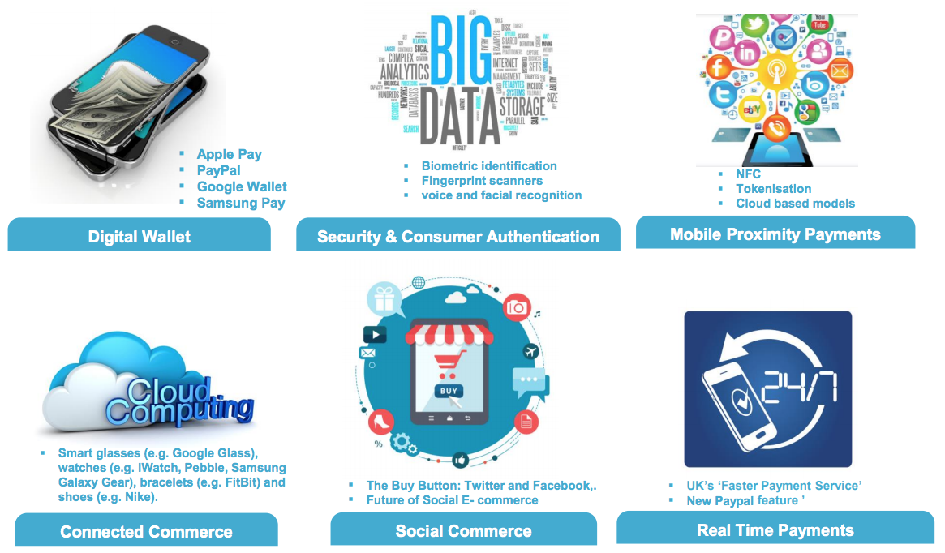
Payment Revolution – New Technologies
https://www.iia.org.uk/media/1560303/digitalisation-of-payments-presentation.pdf

Slide 14
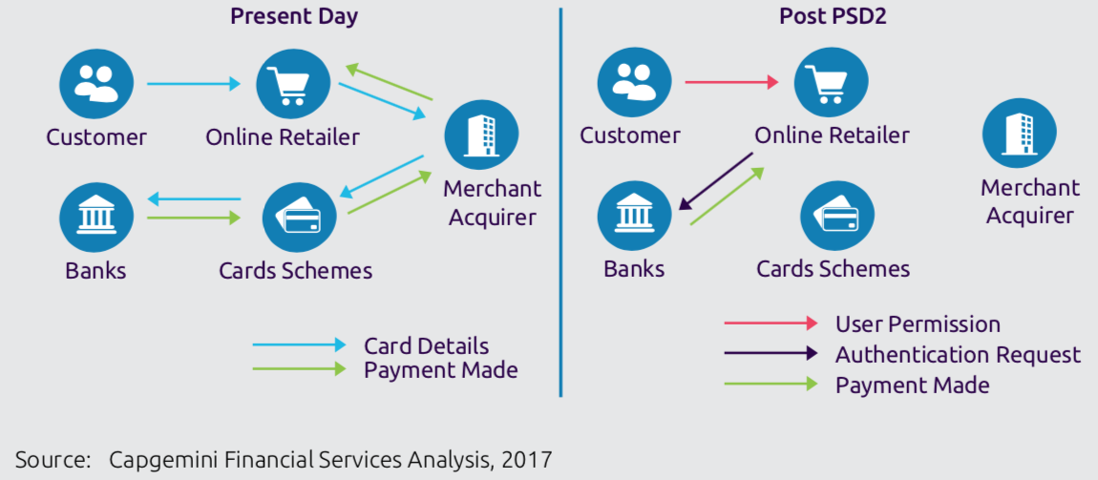
Payment Initiation Process Pre and Post PSD2

Slide 15
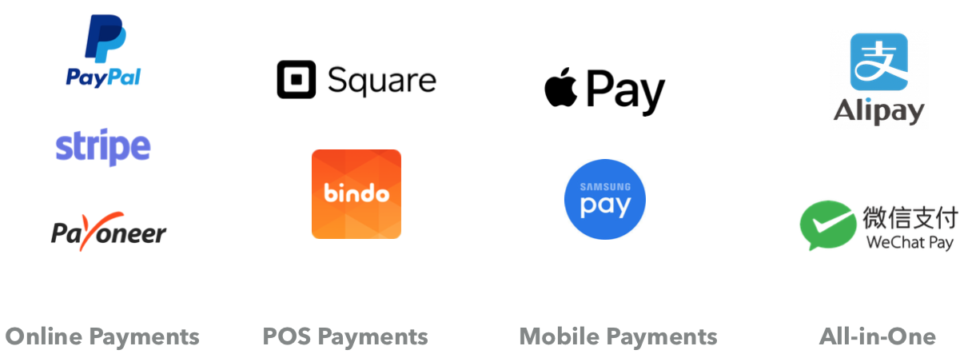
Payments

Slide 16
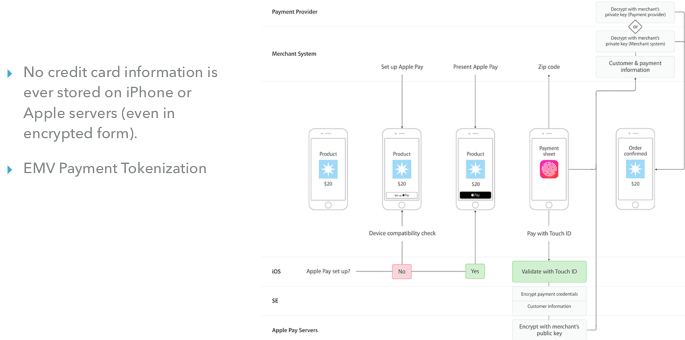
How Does Apple Pay Work?

Slide 17
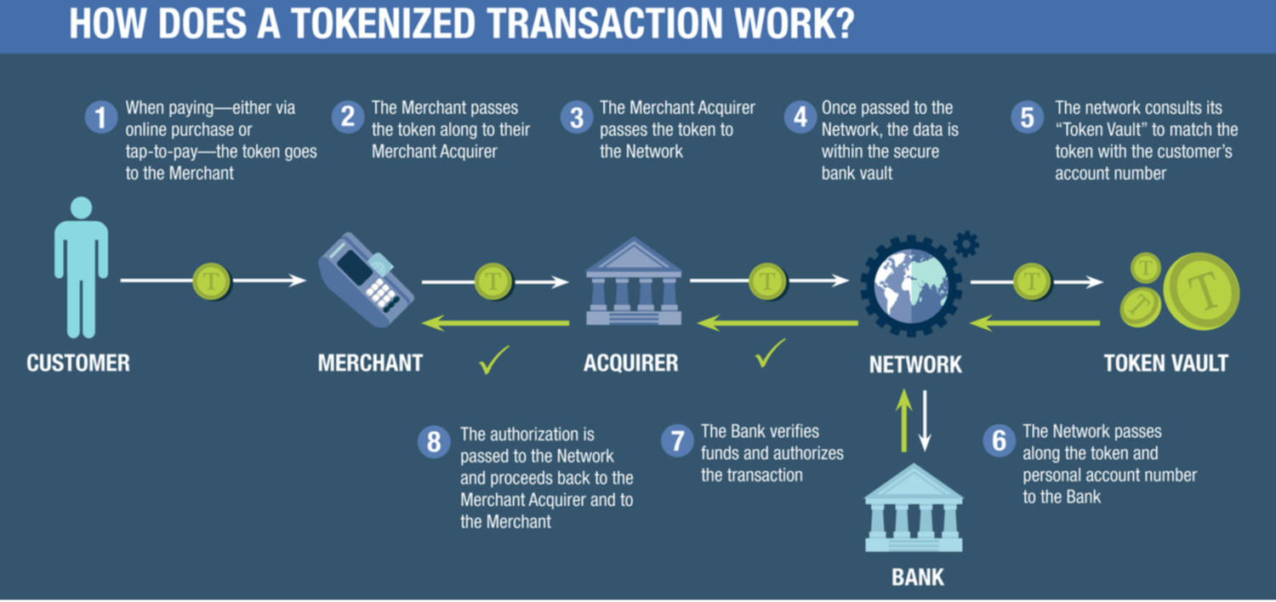
Tokenization

Slide 18
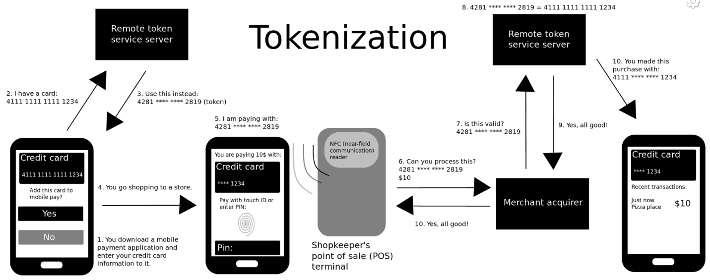
Tokenization: how it works
This is a simplified example of how mobile payment tokenization commonly works via a mobile phone application with a credit card. Methods other than fingerprint scanning or PIN-numbers can be used at a payment terminal. Tokenization, when applied to data security, is the process of substituting a sensitive data element with a non-sensitive equivalent, referred to as a token, that has no extrinsic or exploitable meaning or value. The token is a reference (i.e. identifier) that maps back to the sensitive data through a tokenization system.

