Slide 1
Emerging Technology Trend
Daniel Hao Tien Lee
http://danieleewww.yolasite.com/2018-mgb070.php
danieleewww@gmail.com

Slide 2
Megatrend
https://vimeo.com/247340863

Slide 3
Three Breakthroughs That Will Disrupt The Tech World In 2019
Blockchain-Based Identity And Privacy
https://www.youtube.com/watch?v=x-dyo4RkJYc
https://www.youtube.com/watch?v=zGa0vpRYUBk
‘Dueling AI’ : Generative Adversarial Networks (eCommerceGAN)
https://www.youtube.com/watch?v=deyOX6Mt_As
https://www.youtube.com/watch?v=RvgYvHyT15E
3D Metal Printing
https://www.youtube.com/watch?v=tgo3DMrJLh4
https://www.3dhubs.com/knowledge-base/introduction-metal-3d-printing
https://www.forbes.com/sites/forbestechcouncil/2018/07/18/three-breakthroughs-that-will-disrupt-the-tech-world-in-2019/#3a679d5e1f87

Slide 4
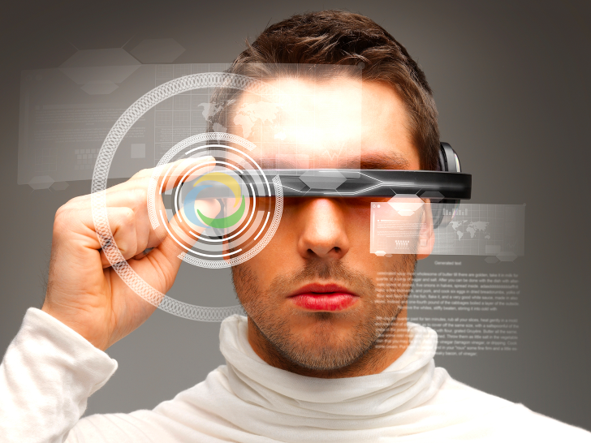
The Top Emerging Technologies
Joe Vandeville
4 May 2017
Slides courtesy of : https://www.incose.org/docs/default-source/space-coast/top-emerging-technologies-(2017-0504).pptx?sfvrsn=f51f8bc6_2

Slide 5
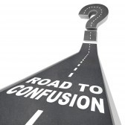
Purpose
The purpose of this presentation is explore some of the emerging technologies that have been recently described
Will they affect you?
(When?)
Where do you find about these things?

Slide 6
Where to Find Out . . .
You are a scientist – and you create them
You are a scholar – and you research them
You are curious – and you seek them
You are lazy – and sometimes they drift by
You are indifferent – and ignore them
These are not mutually exclusive
You can move among them
Notes:
Laziness is the Mother of Invention - Rear Admiral Grace Murray Hopper '28 is best known for the invention of the compiler, "the intermediate program that translates English language instructions into the language of the target computer. She did this, she said, because she was lazy and hoped that 'the programmer may return to being a mathematician.'
Laziness is the Father of Innovation - Professor John Atanasoff, along with graduate student Clifford Berry, built the world’s first electronic-digital computer back in the late 1930’s. Why did he do this? He said, “I was too lazy to calculate and so I invented the computer.”
A number of years back while working for a computer manufacturer, the department head dubbed me the “Chief Laziness Officer.” He meant that as a compliment. I was constantly finding ways to reduce my workload. I got so good at it that in my spare time I helped others do the same.

Slide 7
Lazy?
(He can’t be talking about me . . . )
Laziness is the Mother of Invention
- Rear Admiral Grace Murray Hopper '28 is best known for the invention of the compiler, the intermediate program that translates English language instructions into the language of the target computer. She did this, she said, because she was lazy and hoped that 'the programmer may return to being a mathematician.'
Laziness is the Father of Innovation
- Professor John Atanasoff, along with graduate student Clifford Berry, built the world’s first electronic-digital computer back in the late 1930’s. Why did he do this? He said, “I was too lazy to calculate and so I invented the computer.”

Slide 8
Where to Find Out . . .
This presentation is for the
curious and lazy
The scholarly stuff is often very narrowly focused and dry. It may not peak your interest unless you are in that field.
BUT – it is incredibly important to work that follows.

Slide 9
Where to Find Out . . .
Caution
The curious & lazy stuff
may not be peer reviewed
may not be accurate
may be an outright lie
or alternative facts
Note: the same may be said for fine literature (like science fiction) but it is still fun and may make your creative juices flow.

Slide 10
Where to Find Out . . .
World Economic Forum
www.weforum.org
Gartner Group
www.gartner.com
Google (search engine)
MIT Technology Review
www.technologyreview.com
Scientific American
www.scientificamerican.com
Tech News World
www.technewsworld.com
New Atlas (was Gizmag)
newatlas.com/
Harvard Business Review
hbr.org
Forbes
http://www.forbes.com/

Slide 11
World Economic Forum
https://www.weforum.org/agenda/2016/06/top-10-emerging-technologies-2016/ http://www3.weforum.org/docs/WEF_Top_10_Emerging_Technologies_report_2017.pdf
https://www.weforum.org/agenda/archive/emerging-technologies/
The Report is an 18 page pdf.
Notes:
The World Economic Forum, committed to improving the state of the world, is the International Organization for Public-Private Cooperation.
The Forum engages the foremost political, business and other leaders of society to shape global, regional and industry agendas.
It was established in 1971 as a not-for-profit foundation and is headquartered in Geneva, Switzerland. It is independent, impartial and not tied to any special interests. The Forum strives in all its efforts to demonstrate entrepreneurship in the global public interest while upholding the highest standards of governance. Moral and intellectual integrity is at the heart of everything it does.
Our activities are shaped by a unique institutional culture founded on the stakeholder theory, which asserts that an organization is accountable to all parts of society. The institution carefully blends and balances the best of many kinds of organizations, from both the public and private sectors, international organizations and academic institutions.
We believe that progress happens by bringing together people from all walks of life who have the drive and the influence to make positive change.

Slide 12
World Economic Forum
https://www.weforum.org/agenda/2016/06/top-10-emerging-technologies-2016
1. Nanosensors and the Internet of Nanothings
2. Next Generation Batteries
3. The Blockchain
4. 2D Materials
5. Autonomous Vehicles
6. Organs-on-chips
7. Perovskite Solar Cells
8. Open AI Ecosystem
9. Optogenetics
10. Systems Metabolic Engineering

Slide 13
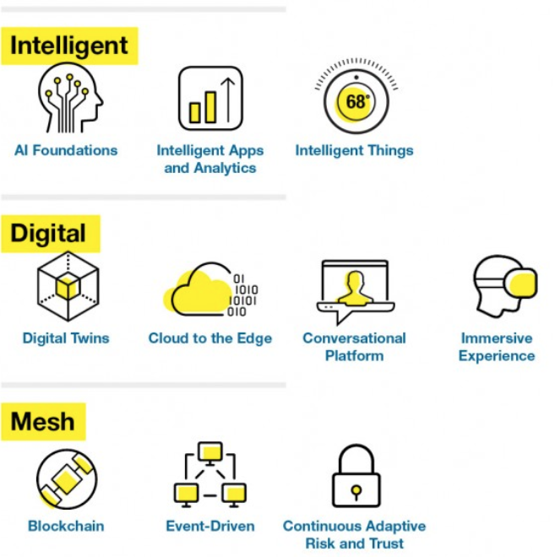
Gartner
The top 10 strategic technology trends for 2018 are:
https://www.gartner.com/smarterwithgartner/gartner-top-10-strategic-technology-trends-for-2018/

Slide 14
Lists are good, but . . .
. . . what technologies are likely to really take off?
July 2016 - Flirtey (drone maker) and 7-Eleven made history when one 7-Eleven customer’s order of a chicken sandwich, donuts, candy, Slurpees and hot coffee was completed via drone. The companies claim it was the first time a drone delivered a package to a U.S. resident who placed an order with a retailer.
Notes:
July 2016 - Flirtey (drone maker) and 7-Eleven made history when one 7-Eleven customer’s order of a chicken sandwich, donuts, candy, Slurpees and hot coffee was completed via drone. The companies claim it was the first time a drone delivered a package to a U.S. resident who placed an order with a retailer.

Slide 15
Tipping Points
(a short interlude)

Slide 16
You May Have Heard of This
The Tipping Point: How Little Things Can Make a Big Difference
by Malcolm Gladwell (first published by Little Brown in 2000)
Gladwell defines a tipping point as "the moment of critical mass, the threshold, the boiling point".
Notes:
Malcolm Gladwell has been a staff writer at The New Yorker since 1996. He is the author of The Tipping Point, Blink, Outliers, and What the Dog Saw. Prior to joining The New Yorker, he was a reporter at the Washington Post. Gladwell was born in England and grew up in rural Ontario. He now lives in New York.

Slide 17
Tipping Point
Literally: the point at which a thing would begin to tip over
The point at which a series of small changes or incidents becomes significant enough to cause a larger, more important change.
Some examples:
Epidemiology: when an infectious disease reaches a point beyond any local ability to control it from spreading more widely. A tipping point is often considered to be a turning point.
“White Flight” (1950’s): Point at which a majority withdraws from a neighborhood when a minority moves in (10 – 15%)
Business marketing . . .
Notes:
Thomas Schelling - He was awarded the 2005 Nobel Memorial Prize in Economic Sciences (shared with Robert Aumann) for "having enhanced our understanding of conflict and cooperation through game-theory analysis". Described tipping points 30 years before Gladwell. Used tipping points to describe how neighborhoods form.

Slide 18
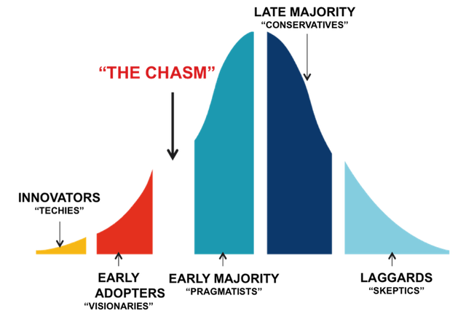
The “Chasm”
Crossing the Chasm, Marketing and Selling High-Tech Products to Mainstream Customer (revised edition),
- Geoffrey A. Moore, HarperCollins Publishers, New York, 1999
The chasm is a gap between visionary early adopters and the pragmatic majority. Crossing the chasm requires securing a specific niche as a beachhead first. Position yourself as a market leader in your niche by making a strong claim

Slide 19
Technology Tipping Points
http://www3.weforum.org/docs/WEF_GAC15_Technological_Tipping_Points_report_2015.pdf

Slide 20
Tipping Point Survey
“Now comes the second machine age. Computers and other digital advances are doing for mental power – the ability to use our brains to understand and shape our environments – what the steam engine and its descendants did for muscle power.”
-- Erik Brynjolfsson, Council Vice-Chair; Director, MIT Initiative on the Digital Economy
Early 2015, the World Economic Forum’s Global Agenda Council on the Future of Software and Society set out to help people prepare for changes enabled by software.
21 examples of these potential changes will have far reaching impacts on human health, the environment, global commerce and international relations.

Slide 21
Tipping Point Survey
In March 2015, the Technological Tipping Points survey was launched.
Based on the council’s discussions over previous months, the survey asked respondents for their views on 21 “tipping points” – moments when specific technological shifts hit mainstream society.
Survey of over 800 executives and experts from the information and communications technology sector.
The survey asked respondents for their perception of when these tipping points would occur, offering date ranges from “it has already happened” to “20+ years”. The option of “never” was also available.

Slide 22
Tipping Point Survey
http://www3.weforum.org/docs/WEF_GAC15_Technological_Tipping_Points_report_2015.pdf

Slide 23
Contextual View of 2015 Tipping Point Report
https://www.businessinsider.com/technology-tipping-points-we-will-reach-by-2030-2016-11

Slide 24
TPs Expected to Occur by 2025
percentage of the respondents that expect the tipping point to have occurred by 2025

Slide 25
TPs Expected to Occur by 2025
percentage of the respondents that expect the tipping point to have occurred by 2025

Slide 26
Implantable Technologies
2023: The first implantable mobile phone available commercially
People are becoming more and more connected to devices
Devices are increasingly becoming connected to our bodies
Devices are not just being worn, but also being implanted into bodies
Providing communications, location and behavior monitoring, and health functions.
Pacemakers and cochlear implants were just the beginning
New devices will be able to sense the parameters of diseases, enable individuals to take action, send data to monitoring centers, or potentially release healing medicines automatically
Smart tattoos and other unique chips could help with identification and location. Implanted devices will likely also help to communicate thoughts normally expressed verbally through a “built-in” smartphone by reading brainwaves and other signals.

Slide 27
Vision as the New Interface
2023: 10% of reading glasses connected to the internet
Glasses, headsets and eye-tracking devices can become “intelligent” with eyes and vision being connected to the internet and other devices
Direct access to internet applications and data through vision, can enhance, mediate or completely augment an individual’s experiences to provide immersive reality
With emerging eye-tracking technologies, devices can feed information through visual interfaces, and eyes can be the source for interacting with and responding to the information.
Enabling vision as an immediate, direct interface – by providing instruction, visualization and interaction – can change the way that learning, navigation, instruction and feedback for producing goods and services, experiencing entertainment and enabling the disabled are helping people to engage more fully with the world.

Slide 28
Wearable Internet
2022: 10% of people will be wearing clothes connected to the internet
Technology is becoming increasingly personal. Computers were first located in large rooms, then on desks and, following that, on people’s laps.
While technology can now be found in people’s mobile phones in their pockets, it will soon be integrated directly into clothing and accessories.
Released in 2015, Apple Watch is connected to the internet and contains many of the same functional capabilities as a smartphone.
Increasingly, clothing and other equipment worn by people will have embedded chips that connect the article and person wearing it to the internet.

Slide 29
Supercomputer in Your Pocket
2023: 90% of the population using smartphones
Google published in 2012 that, “It takes about the same amount of computing to answer one Google Search query as all the computing done – in flight and on the ground – for the entire Apollo programme!”
Current smartphones and tablets contain more computing power than many of the formerly known supercomputers, which used to fill an entire room.
Global smartphone subscribers are anticipated to total 3.5 billion by 2019; that will equate to 59% smartphone penetration by population
In Kenya, Safaricom, the leading mobile service operator, reported that 67% of handset sales were smartphones in 2014, and the GSMA forecasts that Africa will have over half a billion smartphone users by 2020
. . .
Notes:
Manber, U. and P. Norvig, “The power of the Apollo missions in a single Google search”, Google Inside Search, 28 August 2012, http://insidesearch.blogspot.com/2012/08/the-power-of-apollo-missions-in-single.html.
The GSM Association is a trade body that represents the interests of mobile operators worldwide. Approximately 800 mobile operators are full GSMA members and a further 300 companies in the broader mobile ecosystem are associate members

Slide 30
Supercomputer in Your Pocket
2023: 90% of the population using smartphones
The shift in devices has already occurred in many countries across different continents (with Asia leading the trend today), as more people are using their smartphones rather than traditional PCs.
Society is headed towards adopting even faster machines that will allow users to perform complicated tasks on the go.
Most likely, the number of devices that each person uses will grow strongly, not only with new functions performed but also with specialization of tasks.
Notes:
Manber, U. and P. Norvig, “The power of the Apollo missions in a single Google search”, Google Inside Search, 28 August 2012, http://insidesearch.blogspot.com/2012/08/the-power-of-apollo-missions-in-single.html.

Slide 31
Smartphones vs. PCs

Slide 32
~ 90% Smartphone Usage
Countries such as Singapore, South Korea and the United Arab Emirates (UAE) are the closest to reaching the tipping point of 90% of the adult population using smartphones

Slide 33
The Connected Home
2024: Over 50% of internet traffic delivered to homes for appliances and devices (not for entertainment or communication)
In the 20th century, most of the energy going into a home was for direct personal consumption (lighting).
But over time, the amount of energy used for this and other needs was eclipsed by much more complex devices, from toasters and
dishwashers to televisions and air conditioners.
The internet is going the same way: most internet traffic to homes is currently for personal consumption, in communication or entertainment.
. . .

Slide 34
The Connected Home
2024: Over 50% of internet traffic delivered to homes for appliances and devices (not for entertainment or communication)
Very fast changes are already occurring in home automation, enabling people to control lights, shades, ventilation, air conditioning, audio and video, security systems and home appliances.
Additional support is provided by connected robots for all kinds of services – as, for example, vacuum cleaning.
Nest, makers of the Internet-connected thermostat and smoke detector … announced [in 2014] the ‘Works with Nest’ developer program, which makes sure products from different companies work with its software. For example, a partnership with Mercedes Benz means your car can tell Nest to turn up the heat at home so it’s warm when you arrive

Slide 35
Smart Cities
2026: The first city with more than 50,000 inhabitants and no traffic lights
Many cities will connect services, utilities and roads to the internet.
These smart cities will manage their energy, material flows, logistics and traffic.
Progressive cities, such as Singapore and Barcelona, are already implementing many new data-driven services, including intelligent parking solutions, smart trash collection and intelligent lighting.
Smart cities are continuously extending their network of sensor technology and working on their data platforms, which will be the core for connecting the different technology projects and adding future services based on data analytics and predictive modelling.
Notes:
says Yusuf. "Parking is generally the second or third largest source of revenue for a city.” "This is a piece of real estate that isn't priced appropriately, that isn’t allocated appropriately,“ - Zia Yusuf, CEO at Streetline, a company that specializes in implementing what are being called intelligent parking systems.

Slide 36
AI and Decision-Making
2026: The first Artificial Intelligence (AI) machine on a corporate board of directors
Beyond driving cars, AI can learn from previous situations to provide input and automate complex future decision processes, making it easier and faster to arrive at concrete conclusions based on data and past experiences.
[IT News Africa wrote]: An artificial intelligent system using natural language processing, ontologies and reasoning can be effective in gathering and extracting information from large data sources and has the ability to identify the cause and effect within data. These knowledge processing systems, through the process of learning, identify relationships and connections between databases, help fulfil the role of marketing companies through effectively aiding in market segmentation and measurement of performance while reducing costs and improving accuracy.

Slide 37
3D Printing and Human Health
2024: The first transplant of a 3D-printed liver
One day, 3D printers may create not only things, but also human organs – a process called “bioprinting”. In much the same process as for printed objects, an organ is printed layer by layer from a digital 3D model.
The material used to print an organ would obviously be different from what is used to print a bike, and experimenting can be done with the kinds of materials that will work, such as titanium powder for making bones. 3D printing has great potential to service custom design needs; and, there is nothing more custom than a human body.
The first use of a 3D-printed spine implant was reported by Popular Science: [In 2014], doctors at Peking University Third Hospital successfully implanted the first ever 3-D-printed section of vertebra into a young patient to replace a cancerous vertebra in his neck. The replacement vertebra was modelled from the boy’s existing vertebra, which made it easier for them to integrate.

Slide 38
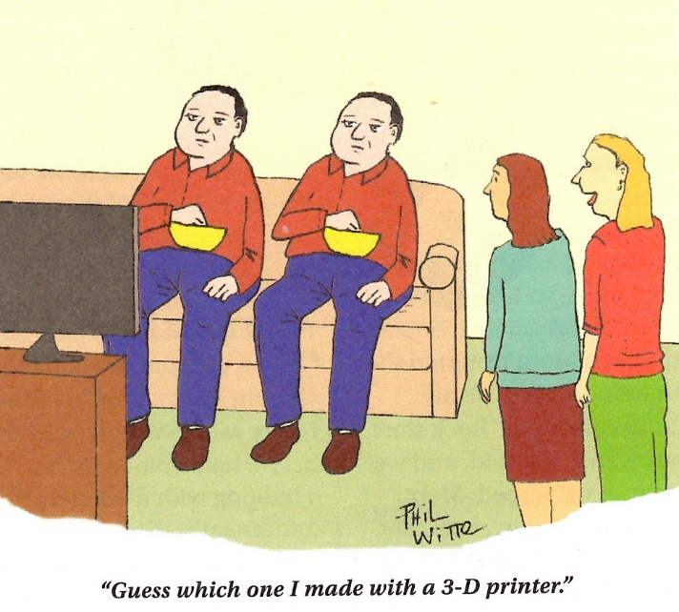

Slide 39
Technology Trend 2030
Daniel Hao Tien Lee
http://danieleewww.yolasite.com/2017-mgb070.php
danieleewww@gmail.com

Slide 40
Outlines
Consumers in 2030
http://www.forumforthefuture.org/sites/default/files/project/downloads/future2030-finalreport.pdf
http://www.mckinsey.com/industries/consumer-packaged-goods/our-insights/the-consumer-sector-in-2030-trends-and-questions-to-consider
Technology Trend for 2030
http://www.businessinsider.com/technology-tipping-points-we-will-reach-by-2030-2016-11/#a-government-will-collect-taxes-for-the-first-time-via-blockchain-2023-10
http://www.businessinsider.com/technologies-future-2030-world-economic-forum-tech-video-2017-2
http://www.futuretimeline.net/21stcentury/2030.htm#.WSgc-BOGO_E
http://www.quantumrun.com/future-timeline/2030/future-timeline-subpost-technology#article0
https://www.forbes.com/sites/gregsatell/2016/08/12/5-technologies-for-2031/#89d05a5334f0
http://unctad.org/meetings/en/Presentation/ecn162016p02_McBean_en.pdf

Slide 41
Key Technology in 2030
Ambient Computing
https://shanewallcto.com/2016/11/07/challenges-and-opportunities-of-ambient-computing/
Smart(er) Devices
http://smarter2030.gesi.org/
Cybersecurity and Ethics
Robot and Ethics
AI and Risk Management
Information and Analytics
www.mckinsey.com/~/media/mckinsey/.../mgi-the-age-of-analytics-full-report.ashx
http://www.gartner.com/smarterwithgartner/technology-and-business-in-2030/

Slide 42
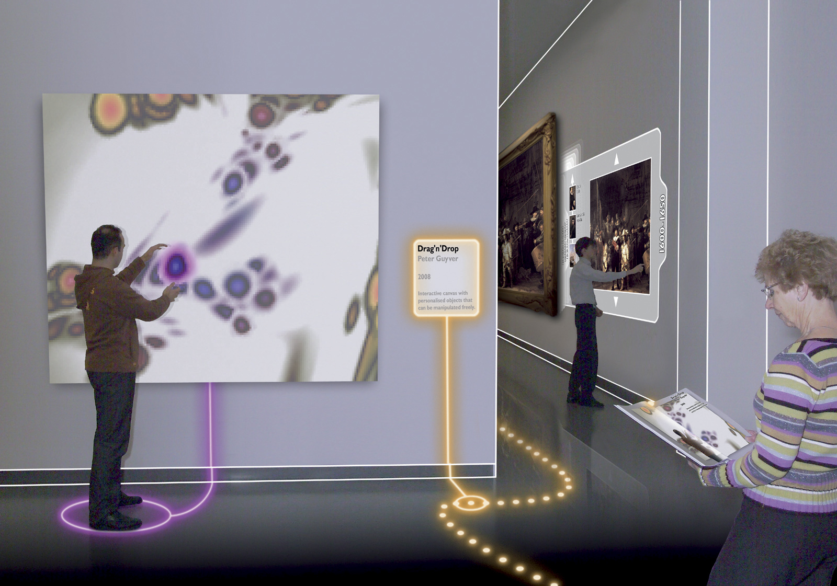
Ambient Intelligence
Dr. Mazlan Abbas

Slide 43
Ambient Intelligence (AmI)
Ambient Intelligence builds on three recent key technologies:
Ubiquitous Computing, Ubiquitous Communication and Intelligent User Interfaces
Ubiquitous Computing means integration of microprocessors into everyday objects like furniture, clothing, white goods, toys, even paint.
Ubiquitous Communication enables these objects to communicate with each other and the user by means of ad-hoc and wireless networking.
An Intelligent User Interface enables the inhabitants of the AmI environment to control and interact with the environment in a natural (voice, gestures) and personalized way (preferences, context).

Slide 44
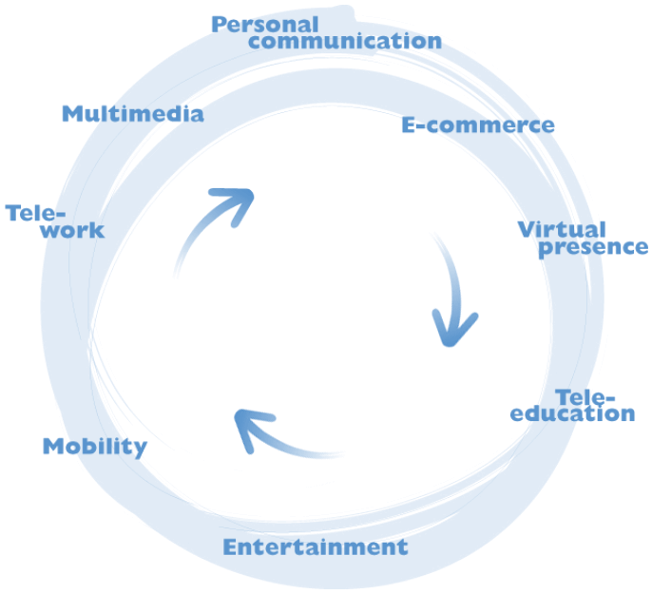
Photonics enabling Ambient Intelligence
AmI puts PEOPLE in the CENTER
Making technology invisible, embedded in natural surroundings, present whenever we need it and making interaction with technology simple effortless
PEOPLE
Notes:
In the future environment people will be surrounded and supported by a network structure which will support all their communication needs. This structure can be considered as offering an Ambient Intelligence linking people and services. Ambient intelligence requires the embedding of technology in natural surroundings such as buildings etc providing constant access to a variety of services, such as entertainment, personal communications, tele-education etc
Realisation of an ambient intelligence requires a fixed network providing large capacity links, which can only be supplied at low cost through the use of photonic networks, subsystems and components.

Slide 45
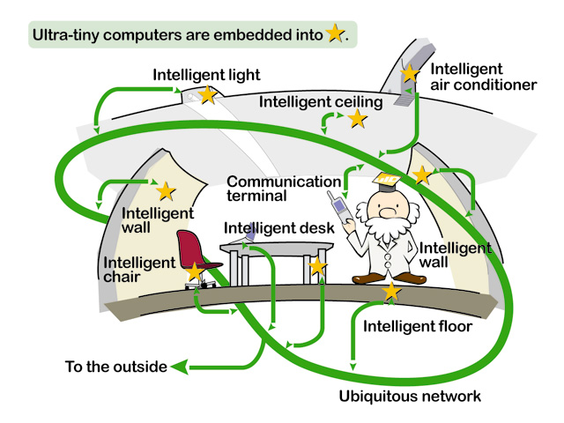
Imagine in the future…. Intelligence Are Embedded
Providing:-
Information
Communications
Entertainment
[Source: http://www.uidcenter.org ]

Slide 46
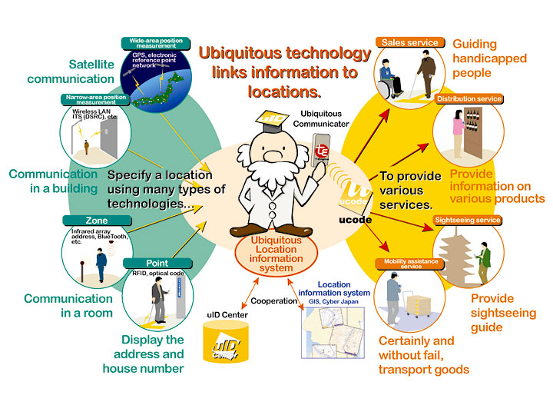
Information can be Access Anywhere & Anytime…
[Source: http://www.uidcenter.org ]

Slide 47
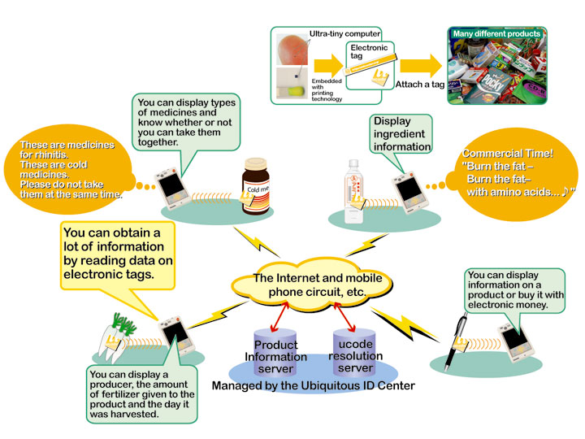
Links Devices with Different Networks...
[Source: http://www.uidcenter.org ]

Slide 48
Characteristics of Ambient Intelligence
Distribution
Non-central systems control and computation
Ubiquity
Surrounded by a multitude of interconnected embedded systems
Intelligence
Recognize the people that live in it, adapt themselves to them, learn from their behavior, and possibly show emotion.
Ambient
Intelligence

Slide 49
Ambient Intelligence
Significant work in the areas of:-
Device
Network
Software
R&D in preliminary stage
Would take at least another decade to see the light of commercialization
Critical factors
Interoperability
Security
Reliability
Predictablity
Devices need to become more autonomous in nature
Reduce arduous task of system management and administration
Biggest adopters
Healthcare
Home automation
Key enabling technologies
Wireless communications
Multi-disciplinary Research
Technologists
Designers
Human behavior sceintists
Adaptive
Ambient
Intelligence
Anticipatory
Personalized

Slide 50
Convergence of 3 Areas
Ubiquitous
Communications
Ambient
Intelligence
Ubiquitous
Computing
Ubiquitous
Interfaces
“The vision is to embed intelligence into different devices, to make them smart and capable to attend to the user’s need and lifestyle”

Slide 51
Requirements of Ambience Intelligence
Unobtrusive hardware
Nano-electronics & Nano-devices
Dependability and security
One global network of devices
Safe to use
Ambient
Intelligence
Seamless communications infrastructure
Heterogeneous networks
Convergence networks
Advanced human interface
Universal access to existing devices
Unified interface
Dynamic and distributed device network
Portable
Plug-and-play

Slide 52
Architecture
Daily
Lifestyle
Solutions
Applications
Convergence
Ambient Intelligence
Technologies
Ubiquitous
Computing
Ubiquitous
Communications
Ubiquitous
Interfaces

Slide 53
Six Forces Shaping Business and Technology in 2030
Global to personal
Hierarchies to meshes
Fixed to interchangeable assets
Devices to connected humans and things
Big data to algorithmic business
Resources to smart materials
https://pages.upwork.com/gartner-report-six-forces-that-will-shape-business-and-technology-in-2030.html

Slide 54
References
Consumers in 2030
http://www.forumforthefuture.org/sites/default/files/project/downloads/future2030-finalreport.pdf
http://www.mckinsey.com/industries/consumer-packaged-goods/our-insights/the-consumer-sector-in-2030-trends-and-questions-to-consider
Technology Trend for 2030
http://www.businessinsider.com/technology-tipping-points-we-will-reach-by-2030-2016-11/#a-government-will-collect-taxes-for-the-first-time-via-blockchain-2023-10
http://www.businessinsider.com/technologies-future-2030-world-economic-forum-tech-video-2017-2
http://www.futuretimeline.net/21stcentury/2030.htm#.WSgc-BOGO_E
http://www.quantumrun.com/future-timeline/2030/future-timeline-subpost-technology#article0
https://www.forbes.com/sites/gregsatell/2016/08/12/5-technologies-for-2031/#89d05a5334f0
http://unctad.org/meetings/en/Presentation/ecn162016p02_McBean_en.pdf

Slide 55
Key Technology in 2030
Ambient Computing
https://shanewallcto.com/2016/11/07/challenges-and-opportunities-of-ambient-computing/
Smart(er) Devices
http://smarter2030.gesi.org/
Cybersecurity and Ethics
Robot and Ethics
AI and Risk Management
Information and Analytics
www.mckinsey.com/~/media/mckinsey/.../mgi-the-age-of-analytics-full-report.ashx
http://www.gartner.com/smarterwithgartner/technology-and-business-in-2030/

Slide 56
Ambient Intelligence
Dr. Mazlan Abbas

Slide 57
Ambient Intelligence (AmI)
Ambient Intelligence builds on three recent key technologies:
Ubiquitous Computing, Ubiquitous Communication and Intelligent User Interfaces
Ubiquitous Computing means integration of microprocessors into everyday objects like furniture, clothing, white goods, toys, even paint.
Ubiquitous Communication enables these objects to communicate with each other and the user by means of ad-hoc and wireless networking.
An Intelligent User Interface enables the inhabitants of the AmI environment to control and interact with the environment in a natural (voice, gestures) and personalized way (preferences, context).

Slide 58
Photonics enabling Ambient Intelligence
AmI puts PEOPLE in the CENTER
Making technology invisible, embedded in natural surroundings, present whenever we need it and making interaction with technology simple effortless
PEOPLE
Notes:
In the future environment people will be surrounded and supported by a network structure which will support all their communication needs. This structure can be considered as offering an Ambient Intelligence linking people and services. Ambient intelligence requires the embedding of technology in natural surroundings such as buildings etc providing constant access to a variety of services, such as entertainment, personal communications, tele-education etc
Realisation of an ambient intelligence requires a fixed network providing large capacity links, which can only be supplied at low cost through the use of photonic networks, subsystems and components.

Slide 59
Imagine in the future…. Intelligence Are Embedded
Providing:-
Information
Communications
Entertainment
[Source: http://www.uidcenter.org ]

Slide 60
Information can be Access Anywhere & Anytime…
[Source: http://www.uidcenter.org ]

Slide 61
Links Devices with Different Networks...
[Source: http://www.uidcenter.org ]

Slide 62
Characteristics of Ambient Intelligence
Distribution
Non-central systems control and computation
Ubiquity
Surrounded by a multitude of interconnected embedded systems
Intelligence
Recognize the people that live in it, adapt themselves to them, learn from their behavior, and possibly show emotion.
Ambient
Intelligence

Slide 63
Ambient Intelligence
Significant work in the areas of:-
Device
Network
Software
R&D in preliminary stage
Would take at least another decade to see the light of commercialization
Critical factors
Interoperability
Security
Reliability
Predictablity
Devices need to become more autonomous in nature
Reduce arduous task of system management and administration
Biggest adopters
Healthcare
Home automation
Key enabling technologies
Wireless communications
Multi-disciplinary Research
Technologists
Designers
Human behavior sceintists
Adaptive
Ambient
Intelligence
Anticipatory
Personalized

Slide 64
Convergence of 3 Areas
Ubiquitous
Communications
Ambient
Intelligence
Ubiquitous
Computing
Ubiquitous
Interfaces
“The vision is to embed intelligence into different devices, to make them smart and capable to attend to the user’s need and lifestyle”

Slide 65
Requirements of Ambience Intelligence
Unobtrusive hardware
Nano-electronics & Nano-devices
Dependability and security
One global network of devices
Safe to use
Ambient
Intelligence
Seamless communications infrastructure
Heterogeneous networks
Convergence networks
Advanced human interface
Universal access to existing devices
Unified interface
Dynamic and distributed device network
Portable
Plug-and-play

Slide 66
Architecture
Daily
Lifestyle
Solutions
Applications
Convergence
Ambient Intelligence
Technologies
Ubiquitous
Computing
Ubiquitous
Communications
Ubiquitous
Interfaces

Slide 67
Six Forces Shaping Business and Technology in 2030
Global to personal
Hierarchies to meshes
Fixed to interchangeable assets
Devices to connected humans and things
Big data to algorithmic business
Resources to smart materials
https://pages.upwork.com/gartner-report-six-forces-that-will-shape-business-and-technology-in-2030.html

