Slide 1
Data Science: Machine Learning (ML) and Deep Learning (DL)
Future of J
Daniel Lee. MGB070 2018
Notes:
1

Slide 2
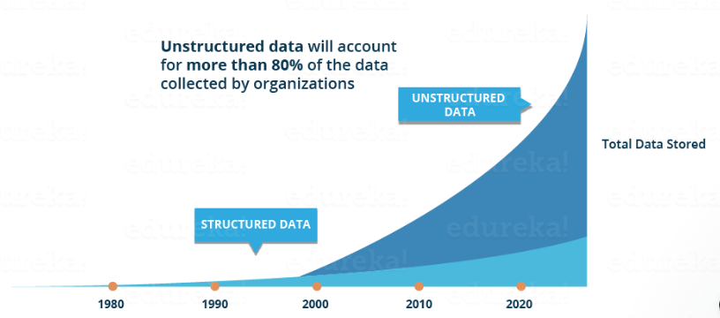
How to handle this unstructured data

Slide 3
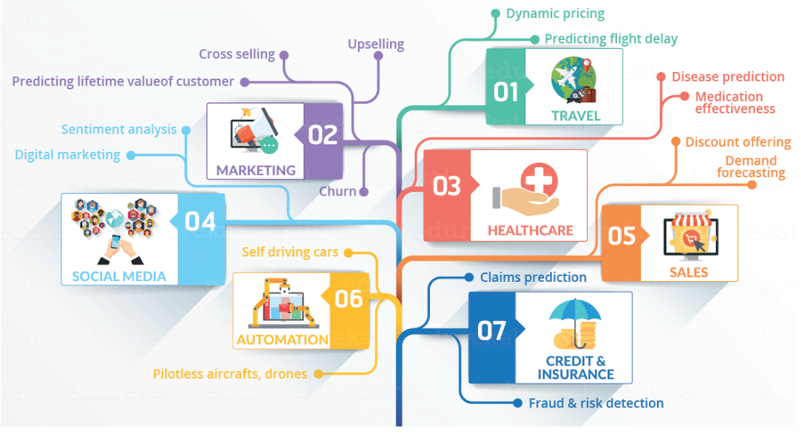
Infographic to see all the domains where Data Science is creating its impression

Slide 4
What IS MACHINE LEARNING?

Slide 5
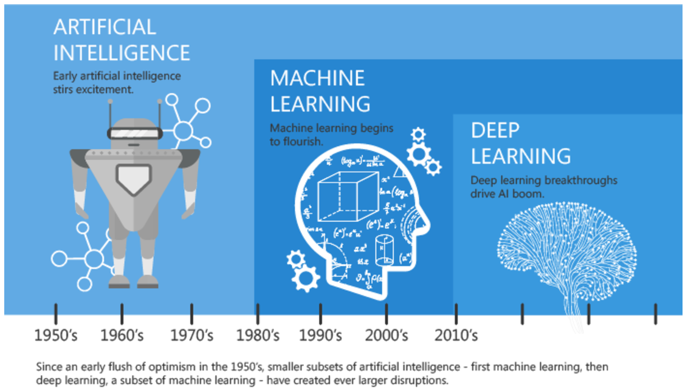
Artificial Intelligence, Machine Learning, and Deep Learning

Slide 6
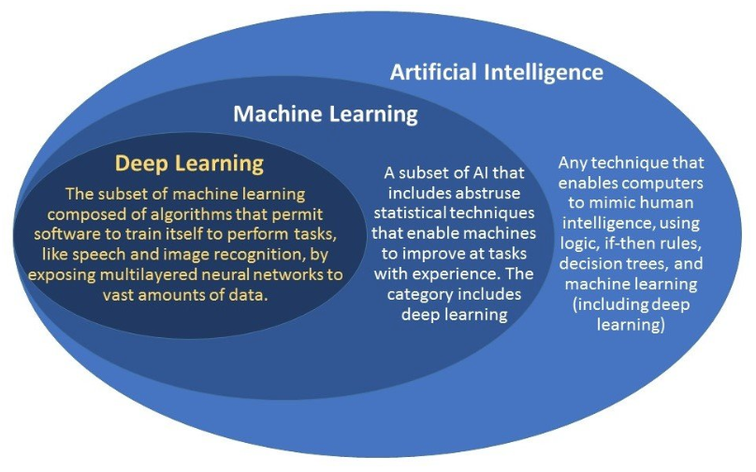

Slide 7
ML/DL: Open Source Platform
H2O.ai
https://www.h2o.ai/download/
https://github.com/h2oai/h2o-3/tree/master/h2o-py/demos
Turi Graphlob
https://github.com/turi-code/tutorials
https://turi.com/

Slide 8
Assignments: Conceptual review
https://www.youtube.com/watch?v=VUrqddjkxok
https://medium.com/machine-learning-for-humans/why-machine-learning-matters-6164faf1df12
https://www.youtube.com/watch?v=Q9Z20HCPnww
https://www.youtube.com/watch?v=FmpDIaiMIeA

