Slide 1
Culinary Technology and Reinvention of Food Recipes
Daniel Lee
danieleewww.yolasite.com

Slide 2
2018 Best Restaurants
https://edition.cnn.com/travel/article/worlds-best-restaurants-2018/index.html
https://edition.cnn.com/travel/article/lonely-planet-500-ultimate-eats/index.html

Slide 3
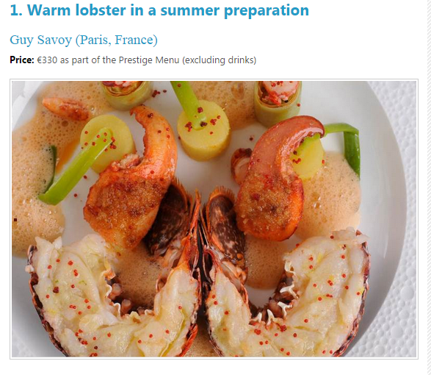
One of the best haute cuisines in the world.
http://financesonline.com/10-most-expensive-meals-from-michelin-starred-restaurants/

Slide 4
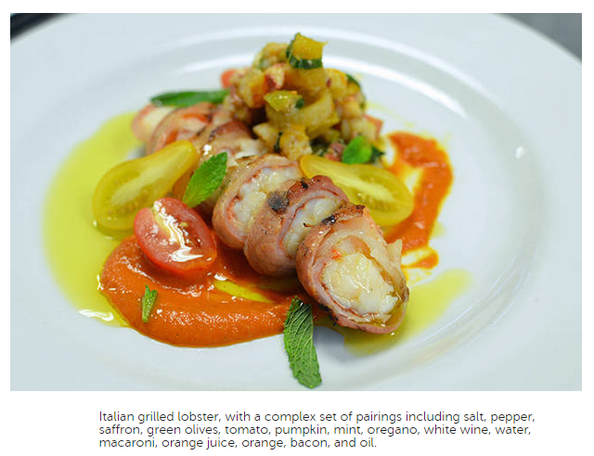
Chefs of ICE. + IBM’s Chef Watson
Computational creativity assisted innovation
http://www.fastcodesign.com/1672444/try-a-recipe-devised-by-ibms-supercomputer-chef

Slide 5
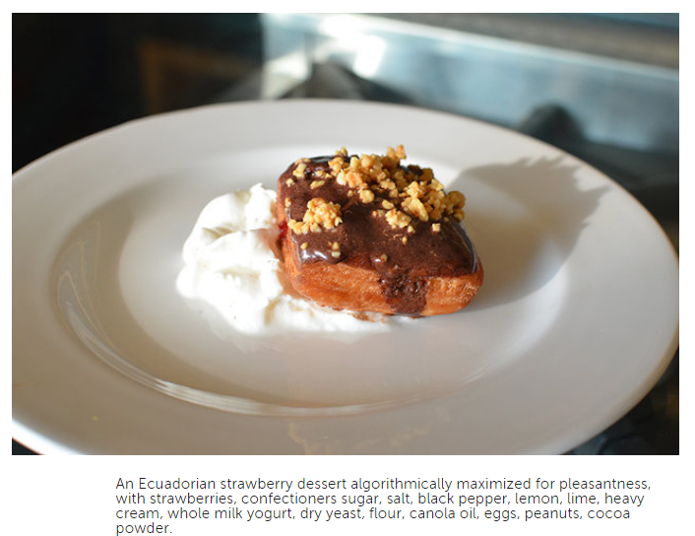
Ecuadorian Strawberry Dessert (recipe created by IBM’s Chef Watson)
http://www.fastcodesign.com/1672444/try-a-recipe-devised-by-ibms-supercomputer-chef

Slide 6
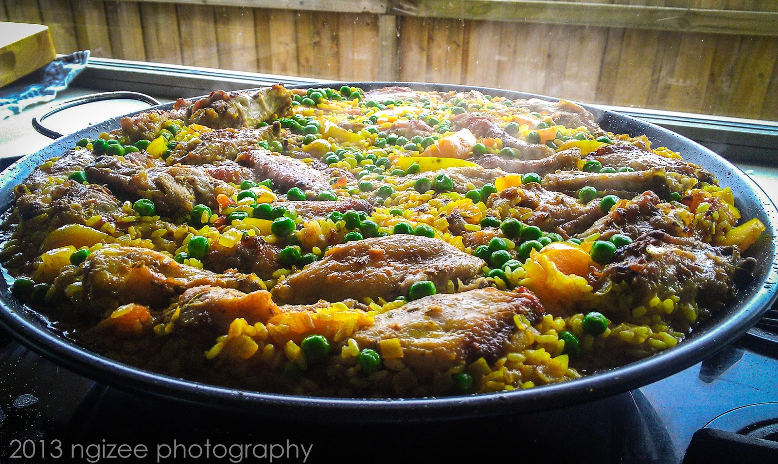
Indian Turmeric Paella

Slide 7
Systematic View
This is how the system presents the recipe for Indian Turmeric Paella. You’ll see that all the big steps are there, but cook times/temperatures are fairly open for human interpretation.

Slide 8
Food and Cooking
An Art?
Human Cognition
Science and Engineering
Massive amount of chemical under neural science – which cognitive computing system may play a big role here.

Slide 9
Science and Cooking (How/Why/What)
https://www.youtube.com/watch?v=Ik1gpTp8OXw (Diffusion)
https://www.youtube.com/watch?v=ix2oG-AGESU (Emulsion)
https://www.youtube.com/watch?v=I9RIS4PZ7EY (Heat)
https://www.youtube.com/watch?v=vqYNVp469HM (Fermentation)
https://courses.edx.org/courses/HarvardX/SPU27x/2013_Oct/courseware/50464c966b36415eae961b2b244ae20f/

Slide 10
Chemistry of Cookies (How/Why/What)
https://www.youtube.com/watch?v=n6wpNhyreDE&noredirect=1

Slide 11
Decode the Science of Food and Then…..
Decode and Establish Database: human flavor preferences, regional recipes, and about the chemistry behind these recipes.
Then: (computational creativity)
Step 1: Define the problem
Step 2: Learn everything you can about the problem
Step 3: Generate ideas to solve the problem
Step 4: Select the best ideas
Step 5: Implement your idea
http://www.wired.com/2013/11/a-new-kind-of-food-science/

Slide 12
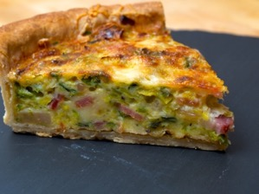
Databases
A recipe index containing tens of thousands of existing dishes that allows the system to infer basics like “what makes a quiche a quiche”
Hedonic psychophysics, which is essentially a quantification of whether people like certain flavor compounds at the molecular level
Chemoinformatics, which sort of marries these two other databases, as it connects molecular flavor compounds to actual foods they’re in

Slide 13
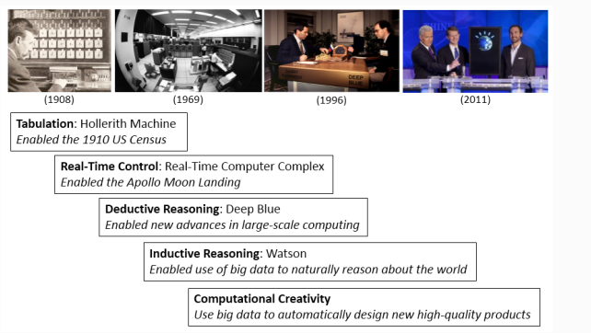
Computational Creativity
http://researcher.watson.ibm.com/researcher/view_group.php?id=5077

Slide 14
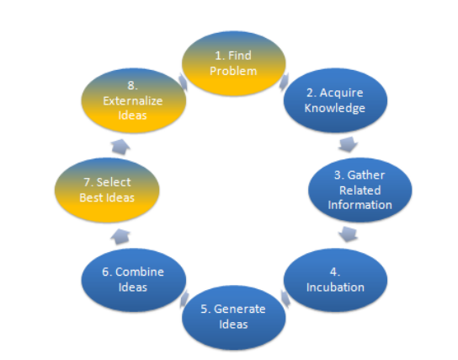
Stages in the cognitive process of creativity . In computational creativity, blue/gold stages may have significant human-computer
interaction whereas blue stages involve autonomous computer operation.

Slide 15
Computational Creativity
https://www.youtube.com/watch?v=mr-1JAnairs#t=30

Slide 16
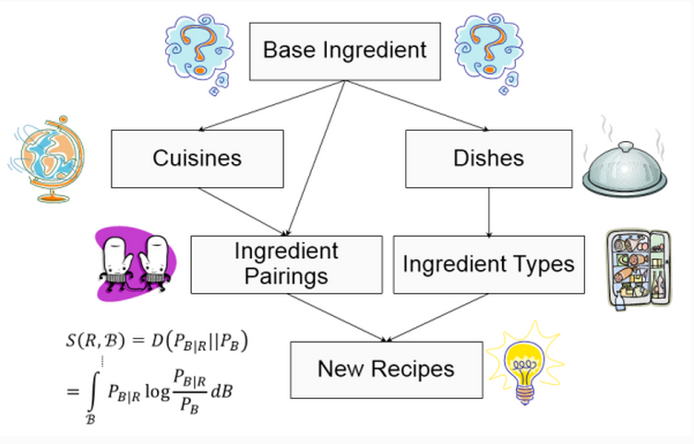
By using large databases of recipes, the flavor compounds in thousands of ingredients, and a great deal of psychological data on human perception, we can build up novel, flavorful, and healthy foods.
http://researcher.watson.ibm.com/researcher/view_group.php?id=5077

Slide 17
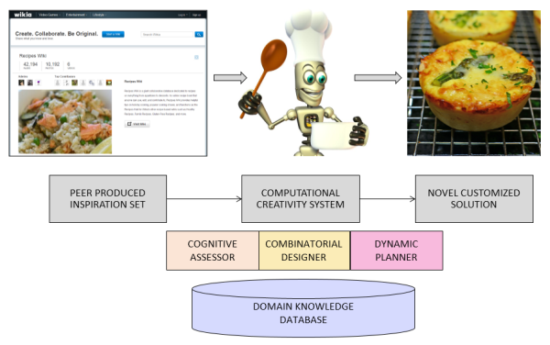

Slide 18
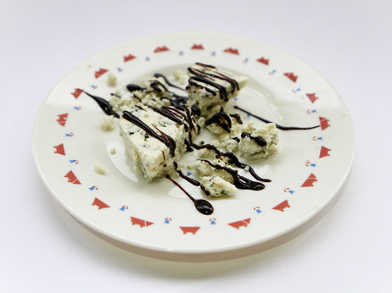
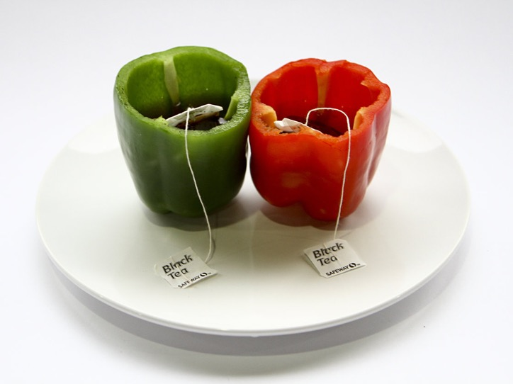
Creating Creativity:
Computers May Someday Beat Chefs At Creating Flavors We Crave
How about some chocolate drizzled over blue cheese?
Does bell pepper and black tea sound appetizing? A computer may think so.

Slide 19
IBM’s Chef Watson
http://www.bonappetit.com/test-kitchen/inside-our-kitchen/article/chef-watson-in-the-ba-test-kitchen

Slide 20
IBM Food Truck
https://www.youtube.com/watch?v=VejjnUDw8o0
https://www.youtube.com/watch?v=yrfMcNE0y9s
https://www.youtube.com/watch?v=jAnJ4kauANc
http://www.ibm.com/smarterplanet/us/en/cognitivecooking/truck.html?cmp=usbrb&cm=s&csr=cognitive_cooking_site&cr=home&ct=usbrb301

Slide 21
Food Truck Revolution
https://www.youtube.com/watch?v=fjDsMg9C9es

Slide 22
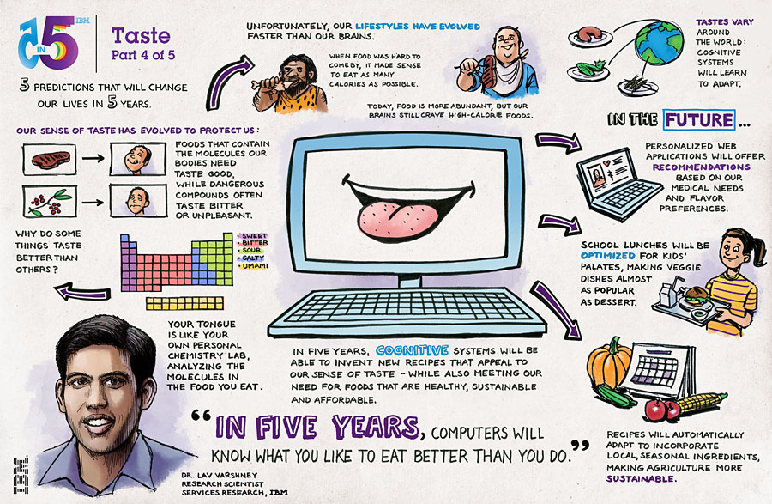

Slide 23
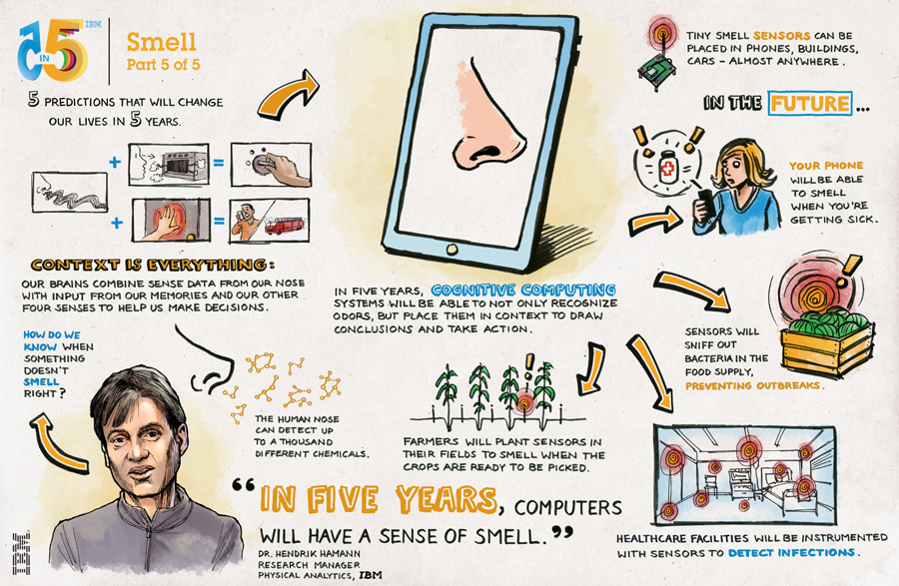

Slide 24
AI Taste+Smell(Sensory) to Create the next Star Chef (Human assisted by Computational Creativity)!

Slide 25
Gastronomy and Modernist Cuisine
Background introduction:
Harvard’s Food and Science Lectures
http://www.youtube.com/watch?v=_Ft0cwxjBKE&feature=youtu.be
http://modernistcuisine.com/

Slide 26
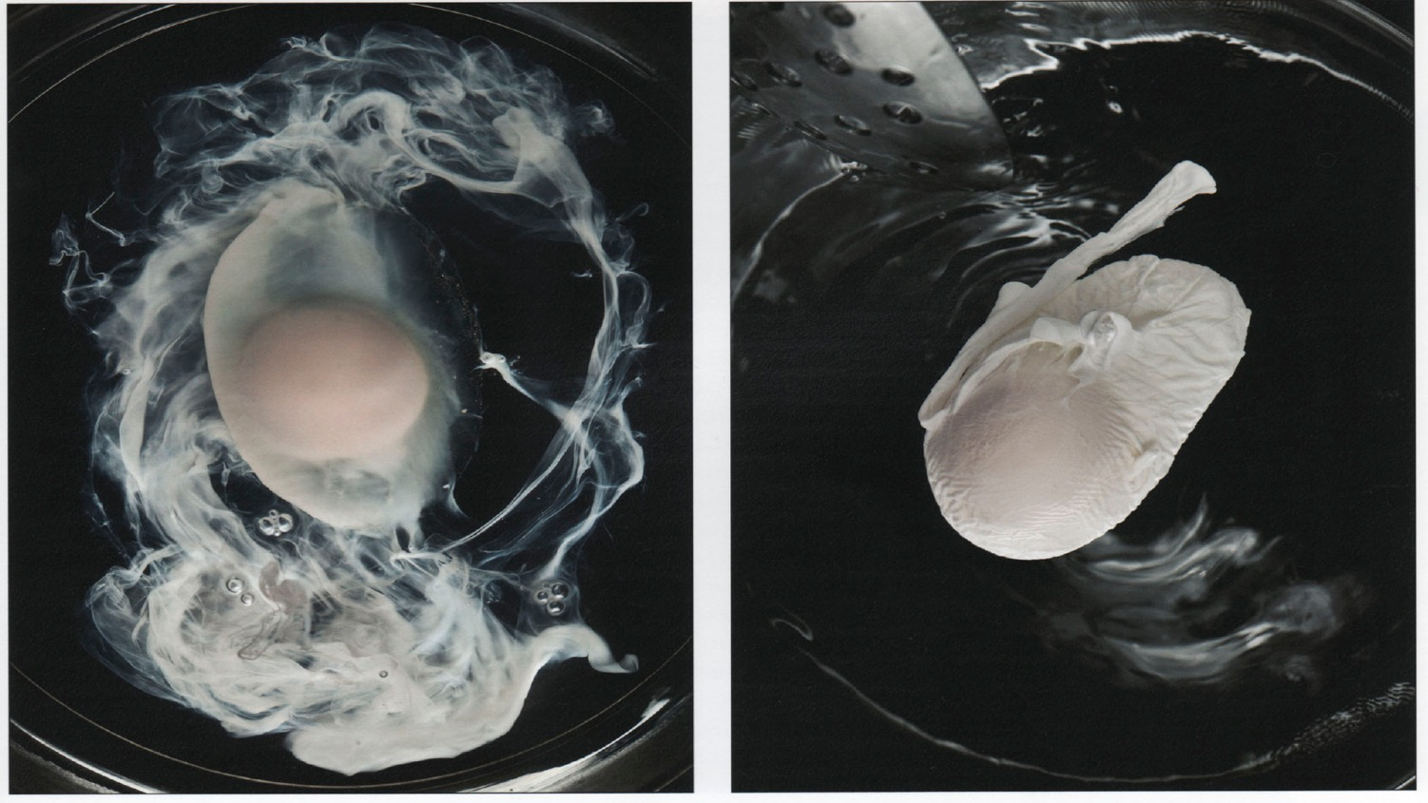
Egg-Drop Soup vs Poached Egg
Drop an egg into a pot of hot, still water, and you 're likely to end up with something closer to egg-drop soup than a poached egg
Stir the pot vigorously before the egg goes in , however, and a phenomenon known as Ekman pumping will gather the egg for you into a nice , compact mass at the center.
Courtesy of Modernist Cuisine by Nathan Myhrvold

Slide 27
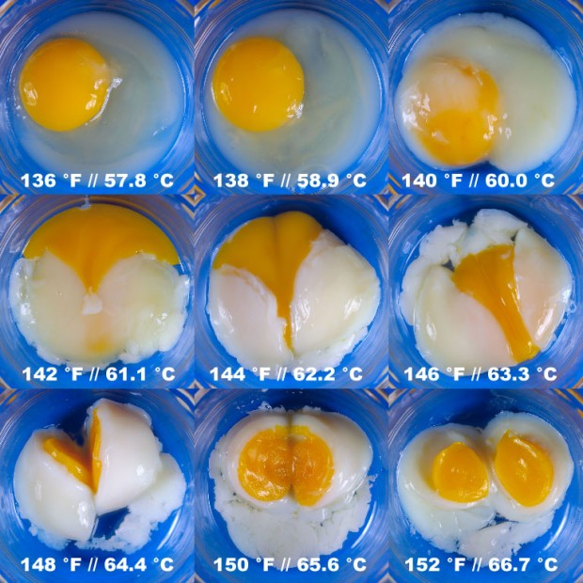
Which one you like!
http://4.bp.blogspot.com/-qqqG8kCeOgc/TqjgkgYJK3I/AAAAAAAAC18/rfooAGsZJpk/s1600/eggchartfull.jpg

Slide 28
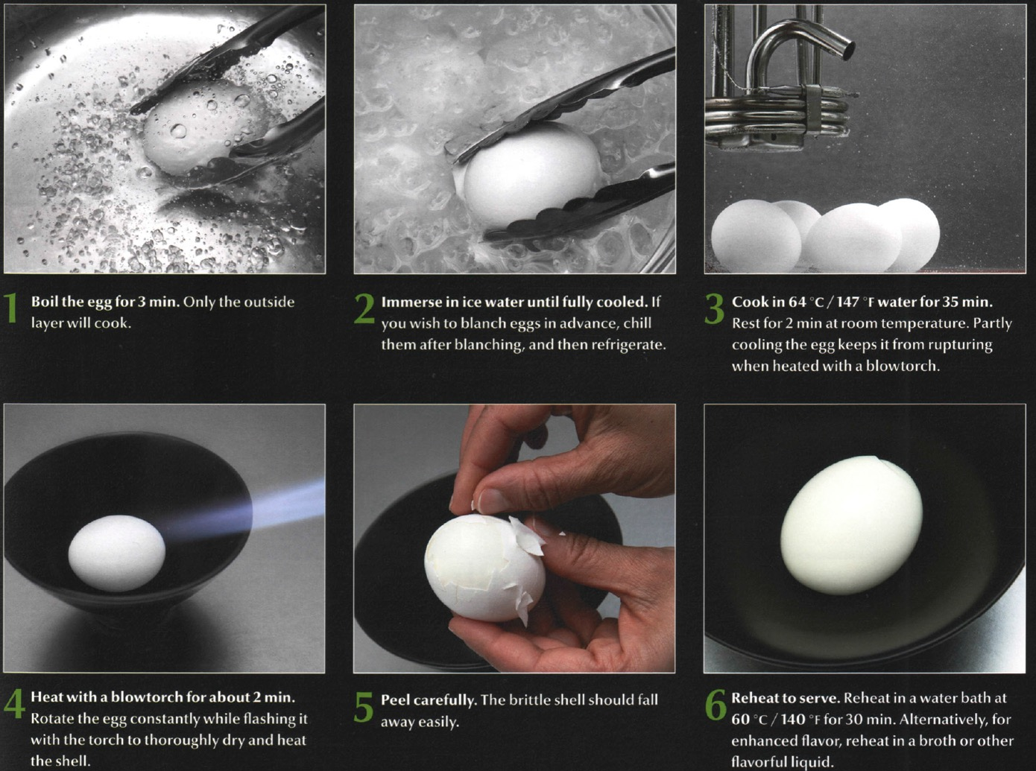
How to Make a Perfect Soft Egg:

Slide 29
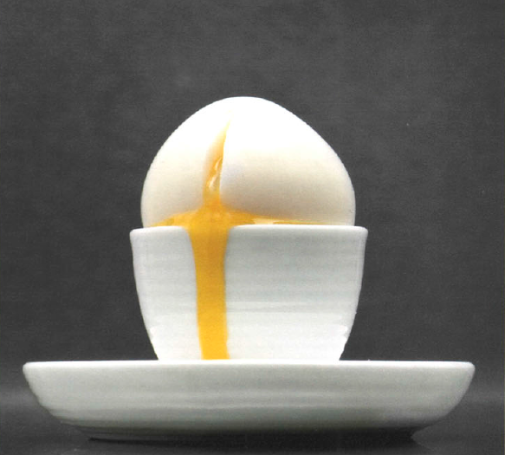
Cont. what you get
Courtesy of Modernist Cuisine vol.4 by Nathan Myhrvold

Slide 30
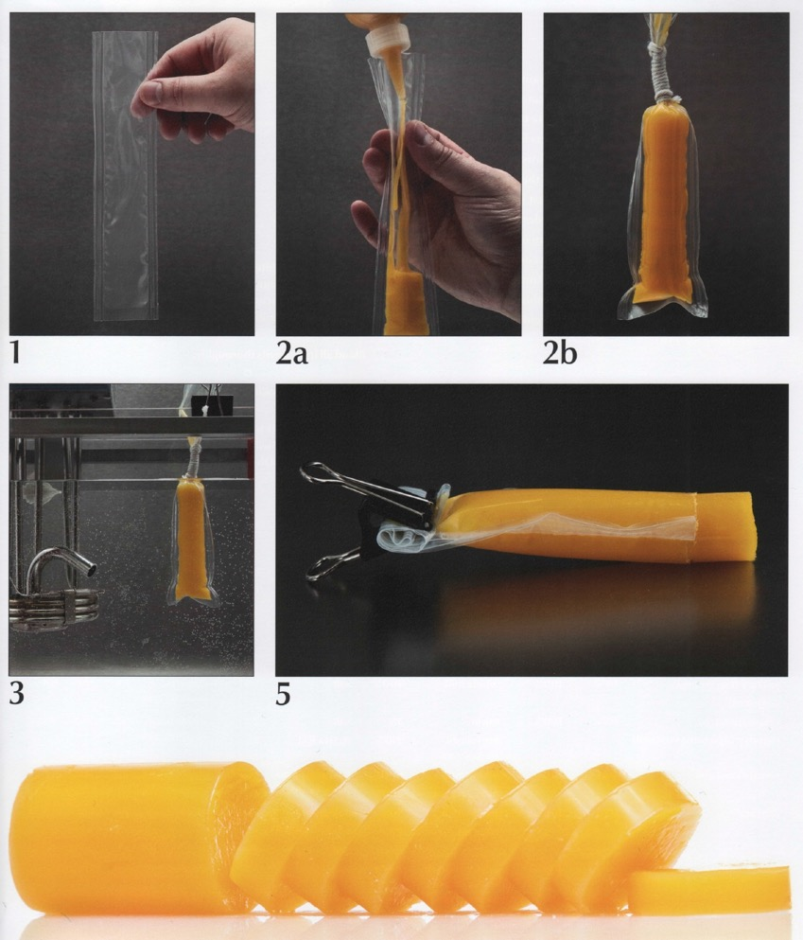
More!

Slide 31
Which one is more likeable!
Courtesy of Modernist Cuisine by Nathan Myhrvold

Slide 32
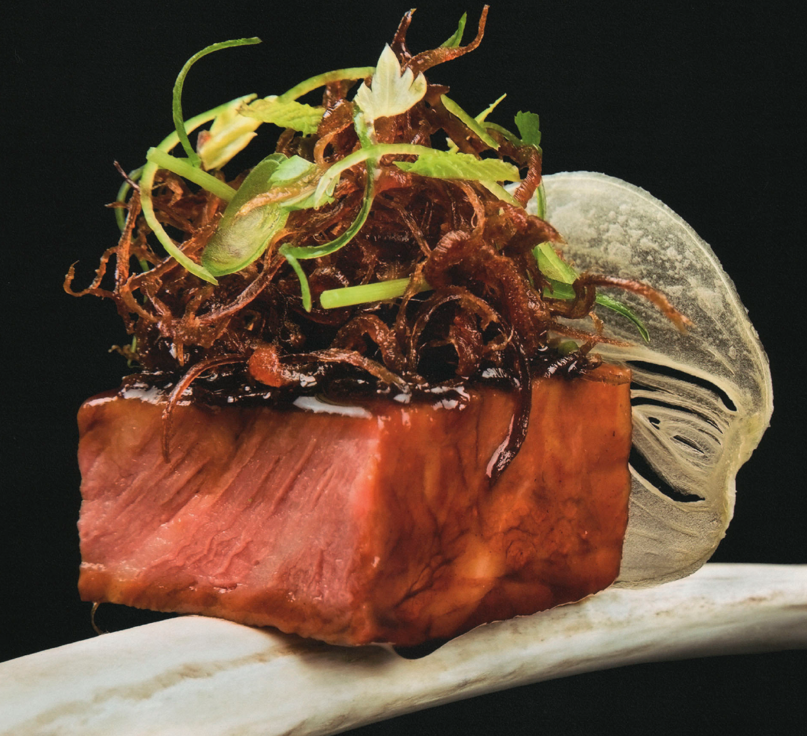
Courtesy of Modernist Cuisine by Nathan Myhrvold

Slide 33
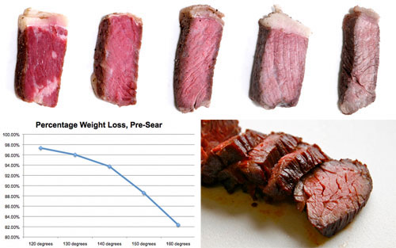

Slide 34
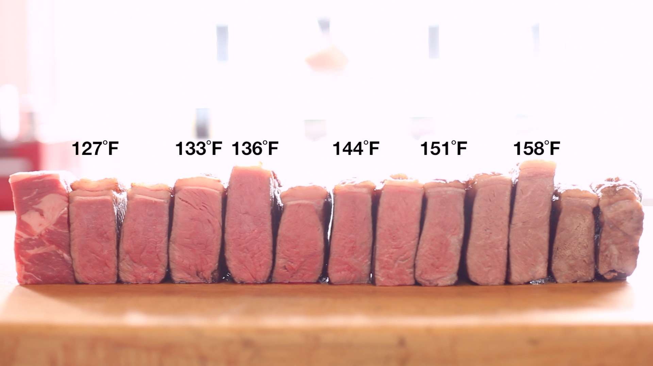

Slide 35
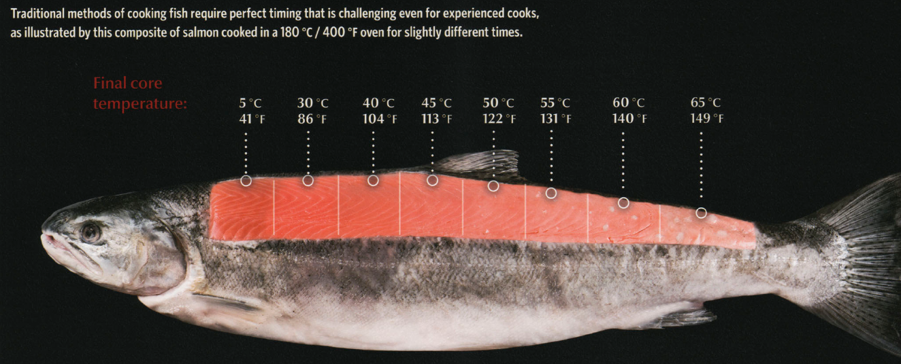
How to cook this fish! (optimum: serving temp. = cooking temp.)

Slide 36
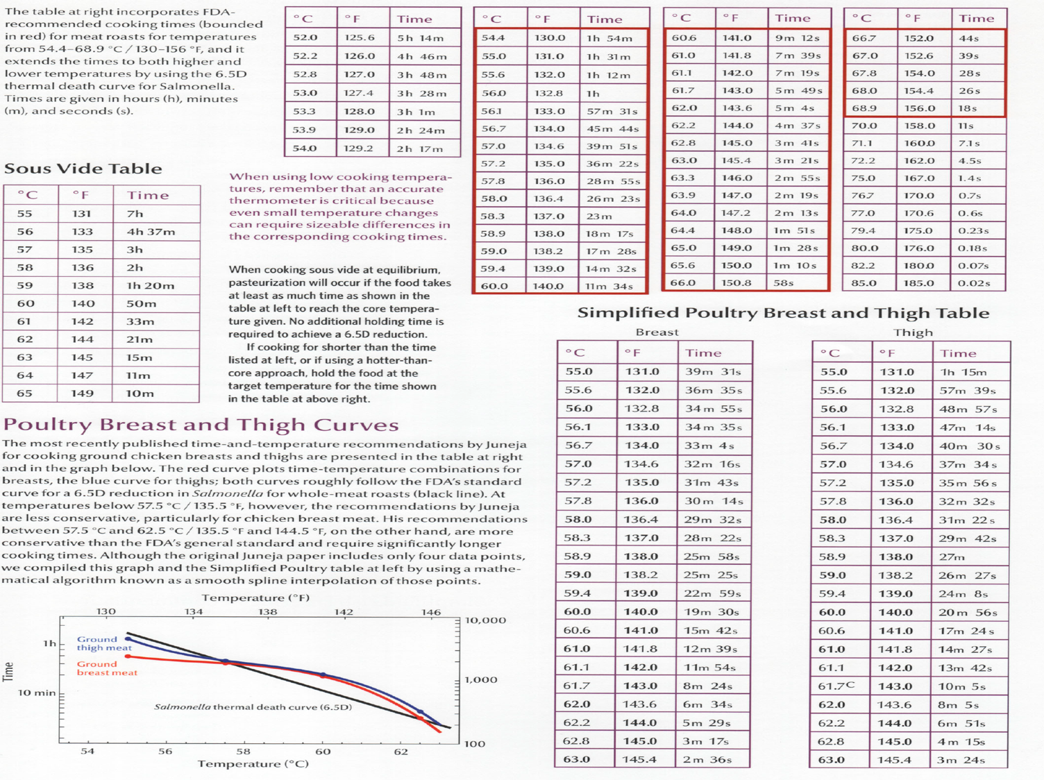

Slide 37
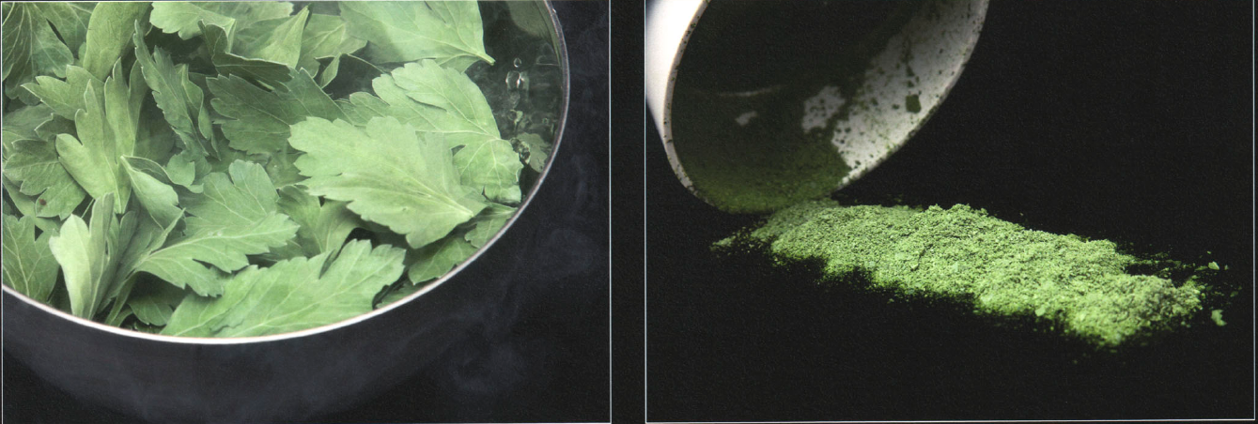
How to grind herbs into powder without mashing them into a paste!
Courtesy of Modernist Cuisine by Nathan Myhrvold

Slide 38
Molecular Gastronomy
The application of scientific methods and tools to cooking
Subdiscipline of food science that seeks to investigate, explain, and make practical use of the physical and chemical transformations of ingredients that occur while cooking
http://www.youtube.com/watch?v=OCBxGwzNhmg

Slide 39
Classical Molecular Gastronomy: Examples
Sous-Vide Cooking
(vacuum sealed, low-controlled temperature in an immersion circulator) http://www.youtube.com/watch?v=WQD3os7OVIs
Chemical/Enzymatic Cooking
Example: Ceviche http://www.youtube.com/watch?v=VJdYIVx_91s

Slide 40
Modern Molecular Gastronomy: Examples
Gelification
Spherification
Emulsification
Transformation
http://www.moleculargastronomynetwork.com/additives.html

Slide 41
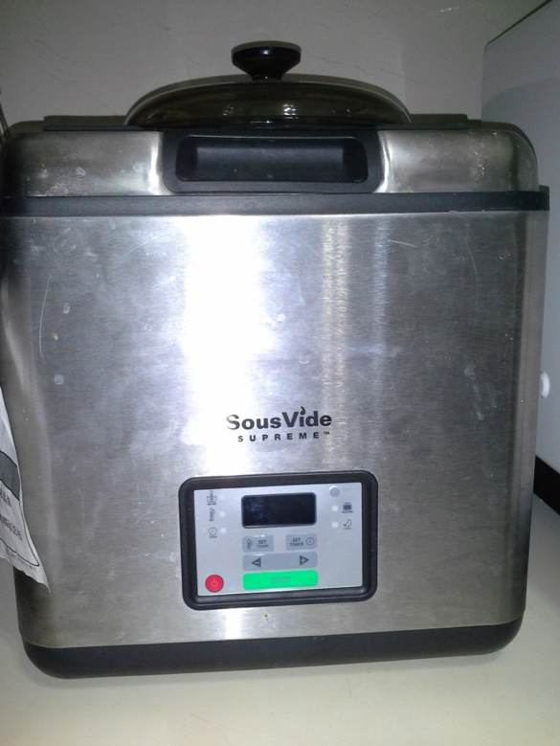
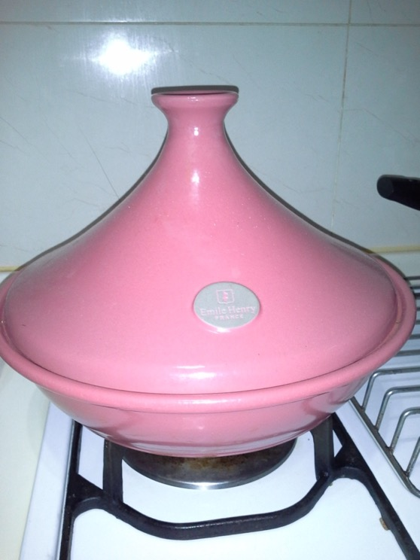
Daniel’s Cooking Gadgets
Tajine Slow Cooking Pod
Sous Vide (Under Vacuum) Low Temperature Cooker

Slide 42
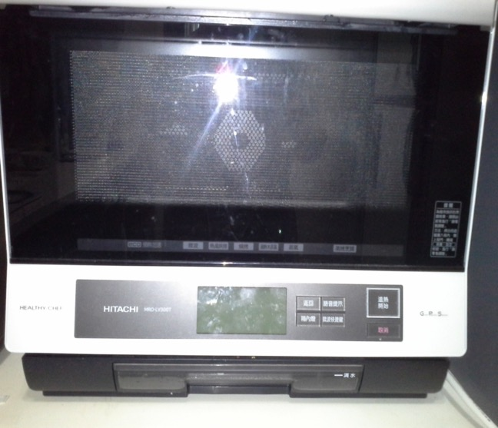
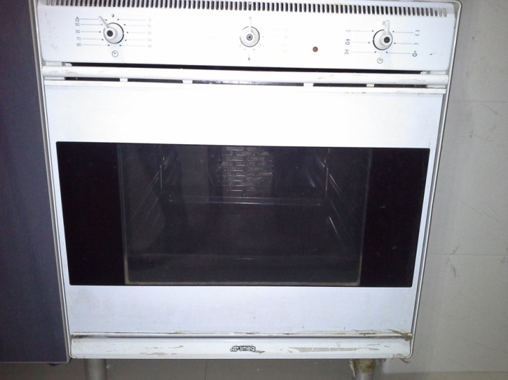
Cont. Daniel’s Cooking Gadgets
Hitachi Automatic Cooker
(Superheated Steam /Oven/Microwave)
SMEG Conventional Oven

