Slide 1
Data Driven Decision Making(DDDM) for Business, Education, and Consumers:

Slide 2
DDDM
“The practice of basing decisions on the analysis of data rather than purely on intuition.” Equally succinctly, data science “as the connective tissue between data-processing technologies (including those for big data) and data-driven decision making.”
http://blogs.wsj.com/cio/2013/09/27/data-driven-decision-making-promises-and-limits/

Slide 3
Data Science 101
Courtesy of Bill Cowe, U. of Washington

Slide 4
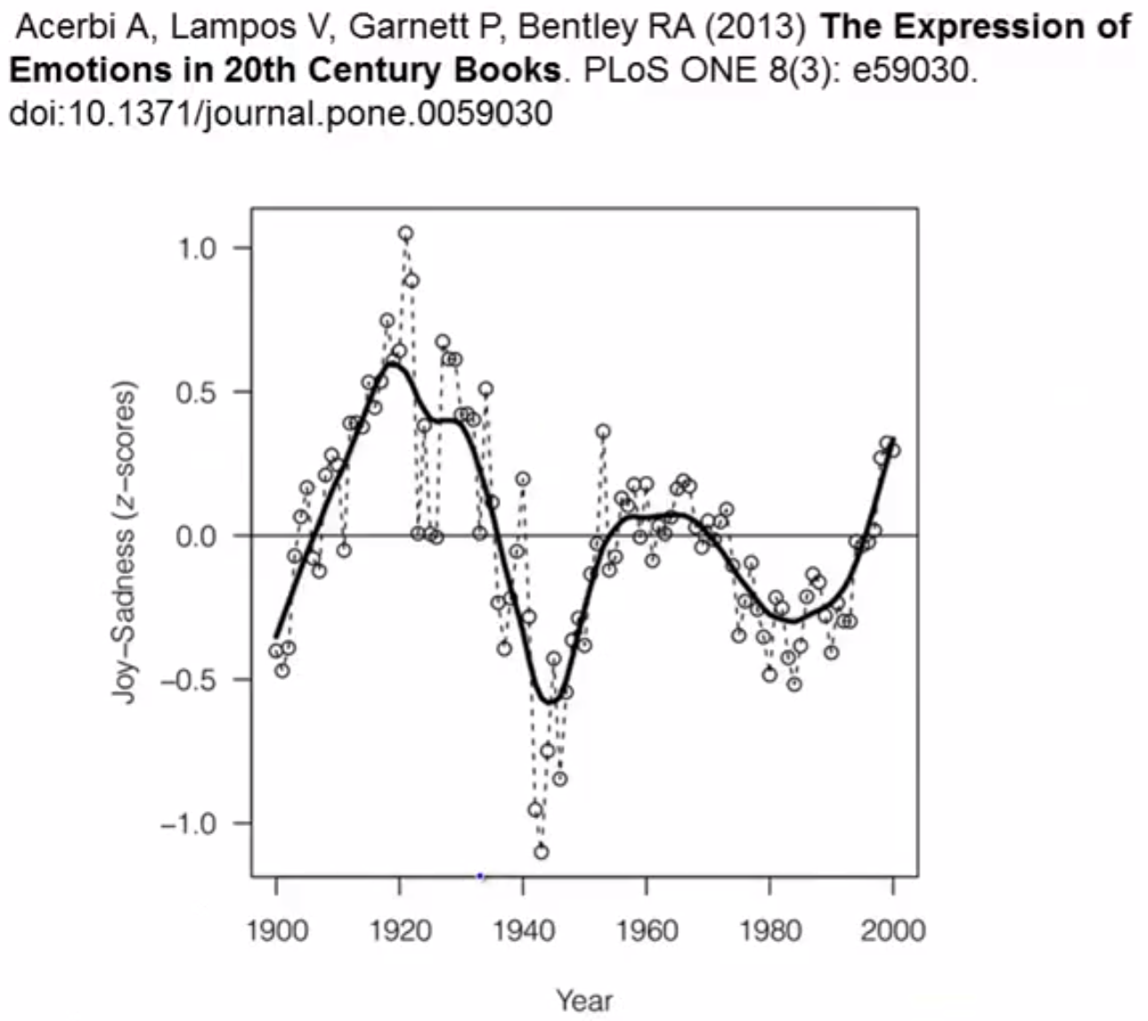

Slide 6
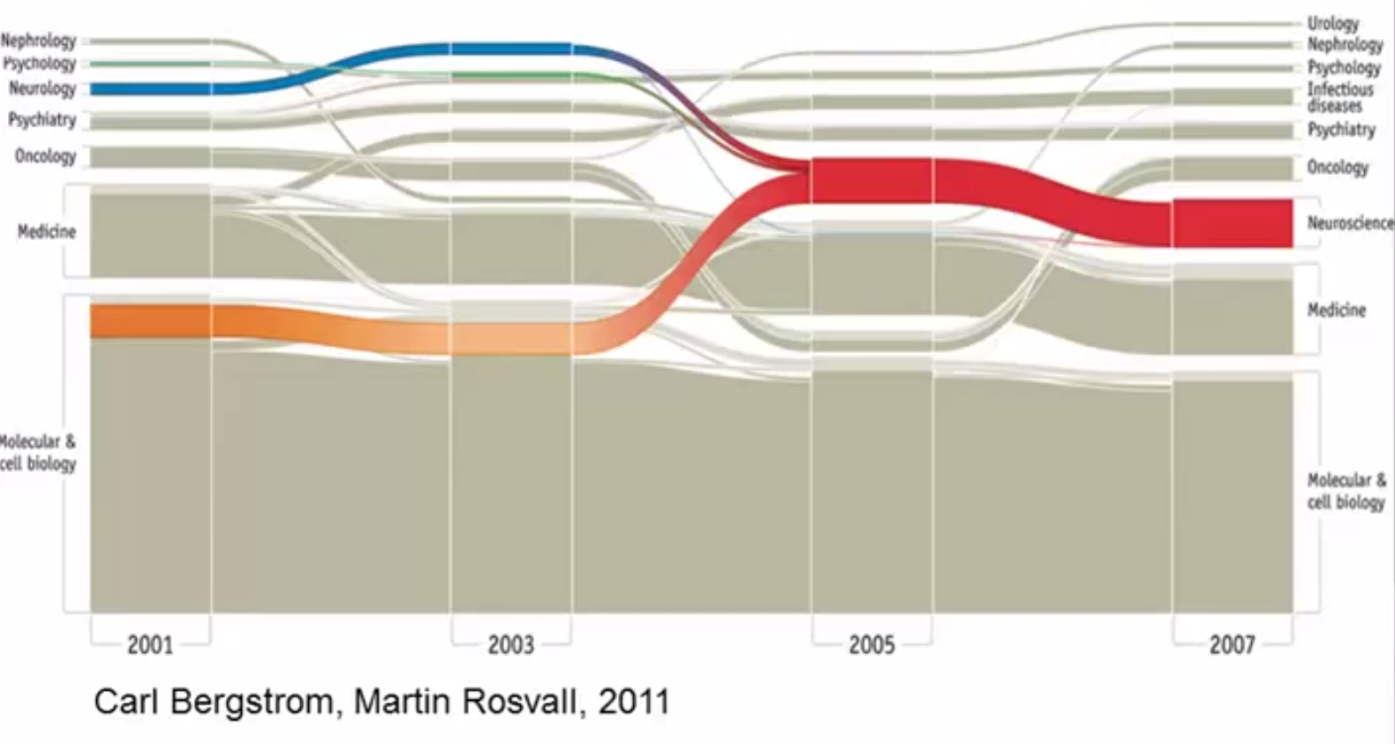

Slide 7
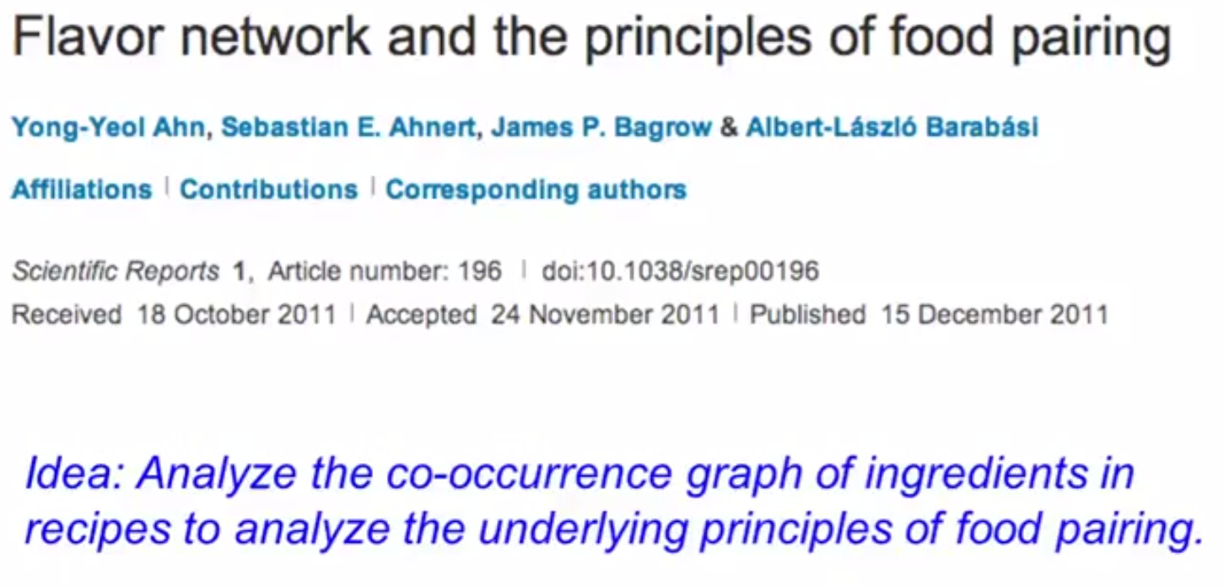

Slide 11
HIPPO Effect
HIPPO: highest paid person’s opinion
HiPPO effect is one of the biggest barriers to more evidence-based and data-driven decision-making
https://www.forbes.com/sites/bernardmarr/2017/10/26/data-driven-decision-making-beware-of-the-hippo-effect/#2855bcc880f9

Slide 12
Cases

Slide 13
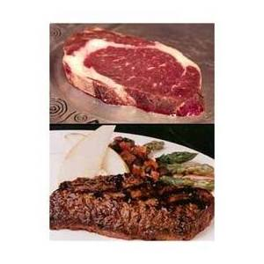
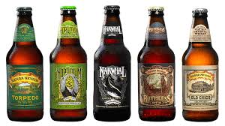
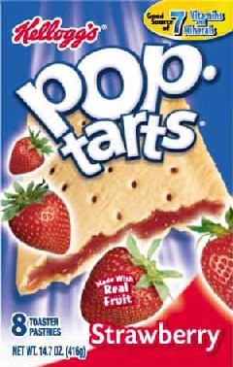
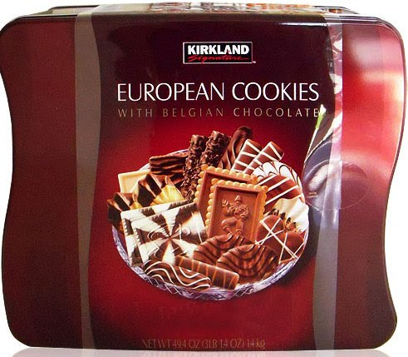
CASE 1: Hurricane Hit; What to be stored heavily in Wal-Mart ?

Slide 14
CASE 1: Scenario and Role Play
Hurricane Frances was on its way, barreling across the Caribbean, threatening a direct hit on Florida's Atlantic coast. Residents made for higher ground, but far away. A week ahead of the storm's landfall, Linda M. Dillman, Wal-Mart's chief information officer, pressed her staff to come up with forecasts based on what had happened when Hurricane Charley struck several weeks earlier.
Assuming you were the planner for this event, what you supposed to put in stock for increasing in sales?

Slide 15
CASE 2: Customer Churn
Assume you just landed a great analytical job with MegaTelCo, one of the largest telecommunication firms in the United States. They are having a major problem with customer retention in their wireless business. In the mid-Atlantic region, 20% of cell-phone customers leave when their contracts expire, and it is getting increasingly difficult to acquire new customers. Since the cell-phone market is now saturated, the huge growth in the wireless market has tapered off. Communications companies are now engaged in battles to attract each other's customers while retaining their own. Customers switching from one company to another is called churn, and it is expensive all around: one company must spend on incentives to attract a customer while another company loses revenue when the customer departs.
You have been called in to help understand the problem and to devise a solution. Attracting new customers is much more expensive than retaining existing ones, so a good deal of marketing budget is allocated to prevent churn. Marketing has already designed a special retention offer.
Your task is to devise a precise, step-by-step plan

Slide 16
CASE 3: Caesars Entertainment and Big Data
Digitally personalizing the customer experience –review http://ebooks.capgemini-consulting.com/dm/Caesars.pdf
Connecting for Citizenship –review http://caesarscorporate.com/wp-content/uploads/2016/07/CCR-Final-Interactive-8-05.pdf

Slide 17
CASE 4: EMI Music’s Data-Driven Marketing
Review http://www.bdvc.nl/images/Rapporten/SAS-Big-data-lessons-from-the-leaders.pdf
Review http://musically.com/wp-content/uploads/2016/12/Sandbox170-eoy-34324324.pdf

