Slide 1
Recent Innovation in Technology, Market, Business, and Financial Systems @ Our Generations

Slide 2
Outline
Recent Innovations in Technology, Business, Market, and New Polymaths
Internet Innovations and Trend
Innovations of Financial Technology
http://www.kurzweilai.net/videos

Slide 3
Amusing things all happened and may expect further
Analog to Digital Device → Rich Digital Life → Personalized Digital Life and Digital Eco-Society
Traditional One-Class Education → Module Based Education
Business Computing to Consumer Computing → Virtualization and Cloud Computing
Real Surfer to Web Surfer →Android and Avatar of 2nd. Life in the Web
Wired to Wireless Narrowband → Wireless Broadband Real-time Communication
Traditional Social Connections to Internet Social Network → Internet Society/Country
Traditional Business Connections to Internet Business Network → Internet Networked Company
B&W to Color and 2D→3D Display; Mechanic User Interface → Natural User Interface
Bicycle to Car, Airplane → Consumer Space Shuttle
Seemingly unlimited resource consumption→ Conservation, Recycle and Reuse
Product and Service Design for Business and Consumer → Design for Green Eco-Society

Slide 4
10 most disruptive technology combinations over last 25 years
Disruption: The whatever/wherever/whenever model of media consumption is turning both Hollywood and the consumer electronics industry on their heads, and forcing advertisers to rethink ways to capture our attention.
10. VOD and TV on demand + broadband service (TiVo, iTune, Slingbox, iPod etc.)
Disruption: Digital video has made mini-Hitchcocks of everyone. YouTube and its many cousins give the masses a place to put their masterworks. Journalism, politics, and entertainment will never be the same.
9. YouTube + Cheap Digital Cameras and Camcorders
Disruption: The Net is seeing a new boom in Web 2.0 companies that are more stable and more interesting than their dot-com-era predecessors. And with phones using Google's Linux-based Android operating system slated to appear this year, open source could disrupt the wireless market as well.
8. Open Source + Web Tools
Disruption: The idea that media should be portable is disruptive. The notion that it should be free--and that some artists can survive, or even thrive, despite a lack of sales revenue--is even more so.
7. MP3 + Napster
Disruption: Blogs give everyone a public voice, while Google gives bloggers a way to fund and market themselves--and the economy of the 21st century is born.
6. Blogs + Google Ads
Disruption: Where would we be today without cheap, capacious, portable storage? No iPods. No YouTube. No Gmail. No cloud computing.
5. Cheap Storage + Portable Memory
Disruption: For enterprises, cloud computing provides the benefits of a data center without the cost and hassle of maintaining one. For consumers, it offers the promise of cheaper, simpler devices that let them access their data and their applications from anywhere.
4. Cloud Computing + Always-On Devices (i-cloud + i-Pad)
Disruption: Broadband has created an explosion of video and music Web sites and VoIP services, while Wi-Fi is bringing the Net to everyday household appliances such as stereos, TVs, and home control systems. Together, they're making the connected home a reality.
3. Broadband + Wireless Networks
Disruption: Media firms, publishing companies, and advertisers now think Web first, and broadcast or print second.
2. The Web + The Graphical Browser
Disruption: The ability to be reachable 24/7 is morphing into the ability to surf the Net from any location. And it's forcing monopolistic wireless companies to open up their networks to new devices and services.
1. Cell Phones + Wireless Internet Access
Source: Dan Tynan, PC World 2008.03

Slide 5
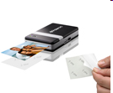
Disruption in business models has been the dominant historical mechanism for making things more affordable and accessible.
Yesterday
Ford
Dept. Stores
Digital Eqpt.
Delta
JP Morgan Chase
Xerox
IBM
Cullinet
AT&T
Dillon, Read
Japan
Sony DiskMan
Today
Toyota
Wal-Mart
Dell
Southwest Airlines
Fidelity
Canon
Microsoft
Oracle
Cingular
Merrill Lynch
Korea, Taiwan
Cellular Phones, iPod
Tomorrow:
Chery
Internet retail
iPhone, RIM etc.
Skywest, Air taxis
ETFs (exchange trade fund)
Zink, Micropojector
Linux, Android, iOS
Salesforce.com
Skype
E-Trade
China, India, Turkish, Brazil
Smart Phones, iPad, ebook
Courtesy of Clayton Christensen, Harvard U. 2008

Slide 6
New Gadgets/Application @2010

Slide 7
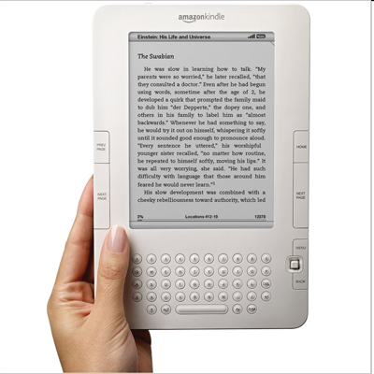
e-book Reader/iPad/Tablet
Amazon, Sony (Leader))
Barnes & Noble, Plastic Logic, BenQ, FoxConn (Follower)
Apple iPad

Slide 8
Smart/Digital Electric Grid
“digital and networked grid will be the last great network we build in our lifetimes.“?
and IEEE2030 Standard!
Today the Internet represents a $1 trillion economy, and there are some 1.2 billion people on the Net. But energy is a $6 trillion economy, 4 billion people use it, and there hasn't been innovation here.
The smart grid will open the door to the broad use of solar, wind and other renewable energy sources while raising energy efficiency.
Smart grid projects are sprouting up in China, India and Africa, where a major wind turbine deployment aims to serve Europe's needs
Video Ref: http://www.eetimes.com/showArticle.jhtml;?articleID=221900476

Slide 9
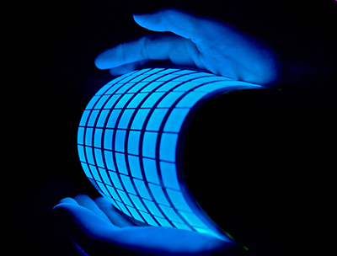
Roll-to-Roll Printing Devices
Promising a new class of paper-thin products—batteries, LEDs, memories, RFID tags, solar cells and more—mass-produced at low cost.
Konica Minolta Holdings Inc. and GE
Video Ref: http://www.eetimes.com/showArticle.jhtml;?articleID=221900476

Slide 10
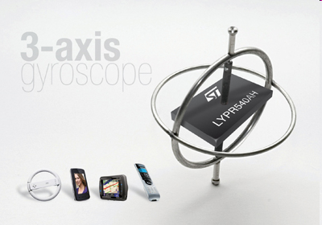
Gyroscope
Today MEMS gyroscopes are used to stabilize digital images taken by cameras and high-end cell phones, but starting in 2010 they will be added to GPS navigational devices (for dead reckoning when the signal is lost indoors) and to a new breed of 3-D peripherals, such as in-air mice.
Courtesy of http://www.eetimes.com/showArticle.jhtml?articleID=222001302&pgno=2

Slide 11
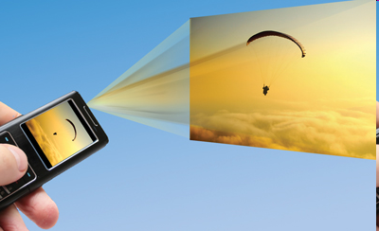
PicoProjector
TI-DLP, Microvision
Micro Technology
Syndiant
3M
Courtesy of http://www.eetimes.com/showArticle.jhtml?articleID=222001302&pgno=2

Slide 12
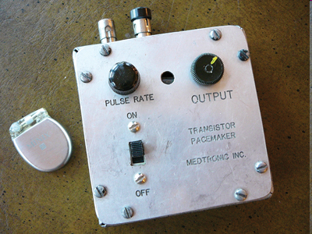
Home-based Health Monitoring
With as much as $2.5 trillion—18 percent of the GDP—spent on health care in the United States alone last year, everyone is looking for ways to lower costs. One promising avenue is to lessen the need for expensive doctor visits and hospital care by enabling home-based health monitoring, especially for chronic conditions and two of their underlying causes: stress and obesity.
Intel, GE, Honeywell
The Continua Health Alliance and IEEE 802.15.6 standard for body area nets
Courtesy of http://www.eetimes.com/showArticle.jhtml?articleID=222001302&pgno=2

Slide 13
Android OS Invasion
This was the year 2009 Android-based handsets hit the mobile phone market. Year 2010, the Google-developed operating system will show up just about everywhere else.
Although some question Google's commitment to spreading Android beyond mobile phones, it might be impossible to prevent the broader consumer electronics community from exploiting the Google brand and Android's momentum, applying the open-source platform to consumer devices ranging from large-screen TVs and set-tops to GPS handhelds and MP3
Open Platform for brands and Shanzhai OEMs
Courtesy of http://www.eetimes.com/showArticle.jhtml?articleID=222001302&pgno=2

Slide 14
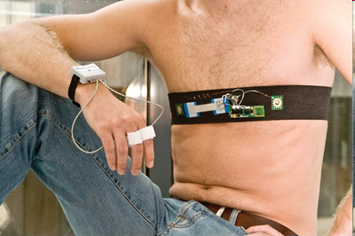
Bionic Human
Monitoring of implanted devices?
Courtesy of http://www.eetimes.com/showArticle.jhtml?articleID=222001302&pgno=2

Slide 15
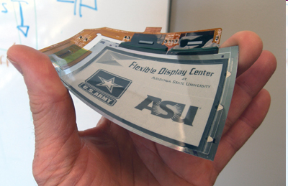
Touch Screen
Old technology
iPhone Story and its followers
Courtesy of http://www.eetimes.com/showArticle.jhtml?articleID=222001302&pgno=2

Slide 16
3D @ Home
Three-D for the home, courtesy of a new-generation Blu-ray players and 3-D TV sets, is coming soon to a store near you. Panasonic, Sony and their content-producing partners are hell-bent on providing it. The question is whether you'll want it.
Courtesy of http://www.eetimes.com/showArticle.jhtml?articleID=222001302&pgno=2

Slide 17
2011 Strategic Technologies Predictions (Gartner’s 2010)
Cloud Computing
Mobile Applications and Media Tablets
Social Communications and Collaboration
Video
Next Generation Analytics
Social Analytics
Context-Aware Computing
Storage Class Memory
Ubiquitous Computing
Fabric-Based Infrastructure and Computers
http://stephenslighthouse.com/2010/11/03/gartner%E2%80%99s-top-10-strategic-technologies-for-2011/

Slide 18
Cloud Computing
Cloud computing services exist along a spectrum from open public to closed private. The next three years will see the delivery of a range of cloud service approaches that fall between these two extremes. Vendors will offer packaged private cloud implementations that deliver the vendor’s public cloud service technologies (software and/or hardware) and methodologies (i.e., best practices to build and run the service) in a form that can be implemented inside the consumer’s enterprise. Many will also offer management services to remotely manage the cloud service implementation. Gartner expects large enterprises to have a dynamic sourcing team in place by 2012 that is responsible for ongoing cloudsourcing decisions and management.

Slide 19
Mobile Applications and Media Tablets
Gartner estimates that by the end of 2010, 1.2 billion people will carry handsets capable of rich, mobile commerce providing an ideal environment for the convergence of mobility and the Web. Mobile devices are becoming computers in their own right, with an astounding amount of processing ability and bandwidth. There are already hundreds of thousands of applications for platforms like the Apple iPhone, in spite of the limited market (only for the one platform) and need for unique coding.
The quality of the experience of applications on these devices, which can apply location, motion and other context in their behavior, is leading customers to interact with companies preferentially through mobile devices. This has lead to a race to push out applications as a competitive tool to improve relationships and gain advantage over competitors whose interfaces are purely browser-based.

Slide 20
Social Communications and Collaboration
Social media can be divided into: (1) Social networking —social profile management products, such as MySpace, Facebook, LinkedIn and Friendster as well as social networking analysis (SNA) technologies that employ algorithms to understand and utilize human relationships for the discovery of people and expertise. (2) Social collaboration —technologies, such as wikis, blogs, instant messaging, collaborative office, and crowdsourcing. (3) Social publishing —technologies that assist communities in pooling individual content into a usable and community accessible content repository such as YouTube and flickr. (4) Social feedback – gaining feedback and opinion from the community on specific items as witnessed on YouTube, flickr, Digg, Del.icio.us, and Amazon. Gartner predicts that by 2016, social technologies will be integrated with most business applications. Companies should bring together their social CRM, internal communications and collaboration, and public social site initiatives into a coordinated strategy.

Slide 21
Video
Video is not a new media form, but its use as a standard media type used in non-media companies is expanding rapidly. Technology trends in digital photography, consumer electronics, the web, social software, unified communications, digital and Internet-based television and mobile computing are all reaching critical tipping points that bring video into the mainstream. Over the next three years Gartner believes that video will become a commonplace content type and interaction model for most users, and by 2013, more than 25 percent of the content that workers see in a day will be dominated by pictures, video or audio.

Slide 22
Next Generation Analytics.
Increasing compute capabilities of computers including mobile devices along with improving connectivity are enabling a shift in how businesses support operational decisions. It is becoming possible to run simulations or models to predict the future outcome, rather than to simply provide backward looking data about past interactions, and to do these predictions in real-time to support each individual business action. While this may require significant changes to existing operational and business intelligence infrastructure, the potential exists to unlock significant improvements in business results and other success rates.

Slide 23
Social Analytics
Social analytics describes the process of measuring, analyzing and interpreting the results of interactions and associations among people, topics and ideas. These interactions may occur on social software applications used in the workplace, in internally or externally facing communities or on the social web. Social analytics is an umbrella term that includes a number of specialized analysis techniques such as social filtering, social-network analysis, sentiment analysis and social-media analytics. Social network analysis tools are useful for examining social structure and interdependencies as well as the work patterns of individuals, groups or organizations. Social network analysis involves collecting data from multiple sources, identifying relationships, and evaluating the impact, quality or effectiveness of a relationship.

Slide 24
Context-Aware Computing.
Context-aware computing centers on the concept of using information about an end user or object’s environment, activities connections and preferences to improve the quality of interaction with that end user. The end user may be a customer, business partner or employee. A contextually aware system anticipates the user’s needs and proactively serves up the most appropriate and customized content, product or service. Gartner predicts that by 2013, more than half of Fortune 500 companies will have context-aware computing initiatives and by 2016, one-third of worldwide mobile consumer marketing will be context-awareness-based.

Slide 25
Storage Class Memory
Gartner sees huge use of flash memory in consumer devices, entertainment equipment and other embedded IT systems. It also offers a new layer of the storage hierarchy in servers and client computers that has key advantages — space, heat, performance and ruggedness among them. Unlike RAM, the main memory in servers and PCs, flash memory is persistent even when power is removed. In that way, it looks more like disk drives where information is placed and must survive power-downs and reboots. Given the cost premium, simply building solid state disk drives from flash will tie up that valuable space on all the data in a file or entire volume, while a new explicitly addressed layer, not part of the file system, permits targeted placement of only the high-leverage items of information that need to experience the mix of performance and persistence available with flash memory.

Slide 26
Ubiquitous Computing
The work of Mark Weiser and other researchers at Xerox’s PARC paints a picture of the coming third wave of computing where computers are invisibly embedded into the world. As computers proliferate and as everyday objects are given the ability to communicate with RFID tags and their successors, networks will approach and surpass the scale that can be managed in traditional centralized ways. This leads to the important trend of imbuing computing systems into operational technology, whether done as calming technology or explicitly managed and integrated with IT. In addition, it gives us important guidance on what to expect with proliferating personal devices, the effect of consumerization on IT decisions, and the necessary capabilities that will be driven by the pressure of rapid inflation in the number of computers for each person.

Slide 27
Fabric-Based Infrastructure and Computers
A fabric-based computer is a modular form of computing where a system can be aggregated from separate building-block modules connected over a fabric or switched backplane. In its basic form, a fabric-based computer comprises a separate processor, memory, I/O, and offload modules (GPU, NPU, etc.) that are connected to a switched interconnect and, importantly, the software required to configure and manage the resulting system(s). The fabric-based infrastructure (FBI) model abstracts physical resources — processor cores, network bandwidth and links and storage — into pools of resources that are managed by the Fabric Resource Pool Manager (FRPM), software functionality. The FRPM in turn is driven by the Real Time Infrastructure (RTI) Service Governor software component. An FBI can be supplied by a single vendor or by a group of vendors working closely together, or by an integrator — internal or external.”

Slide 28
IBM’s Top 5 for 2015 http://www.youtube.com/watch?v=anKiEoxkpxM&feature=player_embedded
You’ll beam up your friends in 3-D
Batteries will breathe air to power our devices
You won’t need to be a scientist to save the planet
Your commute will be personalized
Computers will help energize your city

Slide 29
You’ll beam up your friends in 3-D
In the next five years, 3-D interfaces – like those in the movies – will let you interact with 3-D holograms of your friends in real time. Movies and TVs are already moving to 3-D, and as 3-D and holographic cameras get more sophisticated and miniaturized to fit into cell phones, you will be able to interact with photos, browse the Web and chat with your friends in entirely new ways.
Scientists are working to improve video chat to become holography chat – or “3-D telepresence.” The technique uses light beams scattered from objects and reconstructs them a picture of that object, a similar technique to the one human eyes use to visualize our surroundings.
You’ll be able to see more than your friends in 3-D too. Just as a flat map of the earth has distortion at the poles that makes flight patterns look indirect, there is also distortion of data – which is becoming greater as digital information becomes “smarter” – like your digital photo album. Photos are now geo-tagged, the Web is capable of synching information across devices and computer interfaces are becoming more natural.
Scientists at IBM Research are working on new ways to visualize 3-D data, working on technology that would allow engineers to step inside of a designs of everything from buildings to software programs, running simulations of how diseases spread across an interactive 3-D globes, and visualizing trends happening around the world on Twitter – all in real time and with little to no distortion.

Slide 30
Batteries will breathe air to power our devices
Ever wish you could make your lap top battery last all day without needing a charge? Or what about a cell phone that powers up by being carried in your pocket?
In the next five years, scientific advances in transistors and battery technology will allow your devices last about 10 times longer than they do today. And better yet, in some cases, batteries may disappear altogether in smaller devices.
Instead of the heavy lithium-ion batteries used today, scientists are working on batteries that use the air we breath to react with energy-dense metal, eliminating a key inhibitor to longer lasting batteries. If successful, the result will be a lightweight, powerful and rechargeable battery capable of powering for everything from electric cars to consumer devices.
But what if we could eliminate batteries all together?
By rethinking the basic building block of electronic devices, the transistor, IBM is aiming to reduce the amount of energy per transistor to less than 0.5 volts. With energy demands this low, we might be able to lose the battery altogether in some devices like mobile phones or e-readers.
The result would be battery-free electronic devices that can be charged using a technique called energy scavenging. Some wrist watches use this today – they require no winding and charge based on the movement of your arm. The same concept could be used to charge mobile phones for example – just shake and dial.

Slide 31
You won’t need to be a scientist to save the planet
While you may not be a physicist, you are a walking sensor. In five years, sensors in your phone, your car, your wallet and even your tweets will collect data that will give scientists a real-time picture of your environment. You’ll be able to contribute this data to fight global warming, save endangered species or track invasive plants or animals that threaten ecosystems around the world. In the next five years, a whole class of “citizen scientists” will emerge, using simple sensors that already exist to create massive data sets for research.
Simple observations such as when the first thaw occurs in your town, when the mosquitoes first appear, if there’s no water running where a stream should be – all this is valuable data that scientists don’t have in large sets today. Even your laptop can be used as a sensor to detect seismic activity. If properly employed and connected to a network of other computers, your laptop can help map out the aftermath of earthquake quickly, speeding up the work of emergency responders and potentially saving lives.
IBM recently patented a technique that enables a system to accurately and precisely conduct post-event analysis of seismic events, such as earthquakes, as well as provide early warnings for tsunamis, which can follow earthquakes. The invention also provides the ability to rapidly measure and analyze the damage zone of an earthquake to help prioritize emergency response needed following an earthquake.
The company is also contributing mobile phone “apps” that allow typical citizens to contribute invaluable data to causes, like improving the quality of drinking water or reporting noise pollution. Already, an app called Creek Watch allows citizens to take a snapshot of a creek or stream, answer three simple questions about it and the data is automatically accessible by the local water authority.

Slide 32
Your commute will be personalized
Imagine your commute with no jam-packed highways, no crowded subways, no construction delays and not having to worry about late for work. In the next five years, advanced analytics technologies will provide personalized recommendations that get commuters where they need to go in the fastest time. Adaptive traffic systems will intuitively learn traveler patterns and behavior to provide more dynamic travel safety and route information to travelers than is available today.
IBM researchers are developing new models that will predict the outcomes of varying transportation routes to provide information that goes well beyond traditional traffic reports, after-the fact devices that only indicate where you are already located in a traffic jam, and web-based applications that give estimated travel time in traffic.
Using new mathematical models and IBM’s predictive analytics technologies, the researchers will analyze and combine multiple possible scenarios that can affect commuters to deliver the best routes for daily travel, including many factors, such as traffic accidents, commuter’s location, current and planned road construction, most traveled days of the week, expected work start times, local events that may impact traffic, alternate options of transportation such as rail or ferries, parking availability and weather.
For example, combining predictive analytics with real-time information about current travel congestion from sensors and other data, the system could recommend better ways to get to a destination, such as how to get to a nearby mass transit hub, whether the train is predicted to be on time, and whether parking is predicted to be available at the train station. New systems can learn from regular travel patterns where you are likely to go and then integrate all available data and prediction models to pinpoint the best route.

Slide 33
Computers will help energize your city
Innovations in computers and data centers are enabling the excessive heat and energy that they give off to do things like heat buildings in the winter and power air conditioning in the summer. Can you imagine if the energy poured into the world’s data centers could in turn be recycled for a city’s use.
Up to 50 percent of the energy consumed by a modern data center goes toward air cooling. Most of the heat is then wasted because it is just dumped into the atmosphere. New technologies, such as novel on-chip water-cooling systems developed by IBM, the thermal energy from a cluster of computer processors can be efficiently recycled to provide hot water for an office or houses.
A pilot project in Switzerland involving a computer system fitted with the technology is expected to save up to 30 tons of carbon dioxide emissions per year the equivalent of an 85 percent carbon footprint reduction. A novel network of microfluidic capillaries inside a heat sink is attached to the surface of each chip in the computer cluster, which allows water to be piped to within microns of the semiconductor material itself. By having water flow so close to each chip, heat can be removed more efficiently. Water heated to 60 °C is then passed through a heat exchanger to provide heat that is delivered elsewhere.

Slide 34
5 Technologies That Will Shape the Web
The Mobile Web Will be a Smarter Web
Video Is Poised to Inundate the Web
Everyday Objects Will Join Our Social Networks
Web Data Will Explode, and That’s a Good Thing
Voice and Gestures Will Change Human-Computer Interaction

Slide 35
The Best Companies: Amalgamating distinct strands of technology (New Polymath)
Infortech
Greentech/Cleantech
Healthtech
Nanotech
Biotech
New Polymath(Greek for the Renaissance men and women who excelled at multiple disciplines)
Reference: Vinnie Mirchandani, The New Polymath - Profiles in Compound-
Technology Innovations, 2010

Slide 36
Monomath and Polymath
Exploding knowledge requires monomaths to specialize in each domain
Well-designed enterprises are taking individual monomaths, leveraging a wide array of technologies and becoming the new polymaths. And as during the European Renaissance, there are plenty of polymaths.
Baldesar Castiglione’s Book of the Courtier considered one of the most
comprehensive perspectives of life during the Renaissance in Europe. : What Makes a “Perfect Gentleman/Lady”
In volleying, in running bulls … he should be outstanding among the Spaniards.
Painting, since it is a worthy and beneficial art
The man who does not enjoy music can be sure there is no harmony in his soul.
He should have knowledge of Greek as well as Latin
Well-equipped as to horses, weapons and dress …
Swim, jump, run, cast the stone …
Attractive manners, wisdom, speech, gestures …

Slide 37
The Art of Making the Complex Look Easy (Sprezzatura)
Sprezzatura is a term from the Italian Renaissance that would translate to what we would today call “ being cool ” — a certain nonchalance even when tackling complex assignments
The New Polymath - In an Age of “Wicked Problems” and Technology Abundance
That is a modern polymath at work — integrating multiple modern disciplines. An AND versus an OR mind-set
An AND versus an OR mind-set; Modern-Day Dark Ages: In spite of huge budgets for infotech, cleantech, and healthtech, there is plenty of “nothingness” and “stagnation”
Modern-Day Polymath: Apple, BASF, GE, Google etc.

Slide 38
Cases of Polymath’s AND Mind-Set
i-Phone: Tear down an iPhone 3GS and it shows Bluetooth AND Wi - Fi AND GPS transceivers AND lenses AND chips AND circuits AND batteries — a marvel of miniaturization. It functions as a Web access device, a camera, a music player, a navigation device, a compass, a voice recorder, a modem, and more — and, of course, it is also a phone
BASF: brands itself “ The Chemical Company. ” That moniker is too narrow when you look at the technologies it deploys in its quest for better strains of rice. Its Metanomics unit in Berlin, Germany, studies the changes that occur when an individual gene in a plant’s genetic code is modified. A few hundred miles away, the Ghent, Belgium greenhouse of its Crop Design unit, uses robots, conveyor belts, radio-frequency identification chips, high-resolution cameras, and software algorithms to find the best rice seedlings. The metabolite research from Berlin and the phenotype research from Ghent are combined into “bio-informatics ” knowledge base, one of the largest gene-function databases in the world. What’s impressive is the wide range of infotech and biotech components it leverages. That is the New Polymath — comfortable with a wide range of technologies.

Slide 39
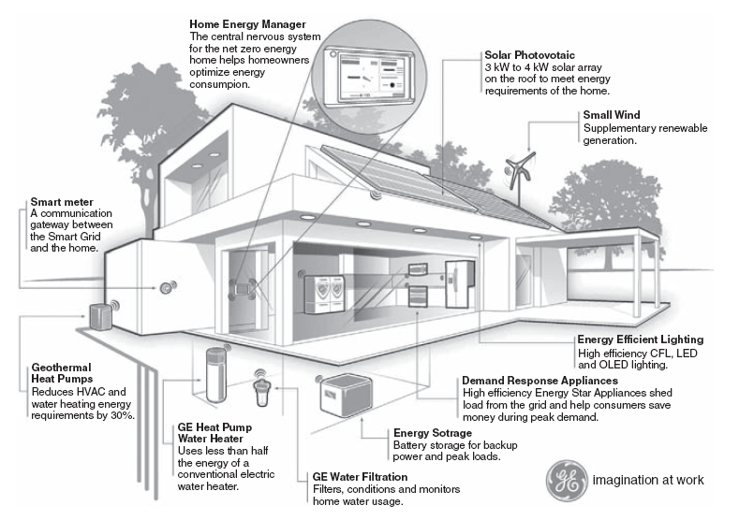
GE Targets Net Zero Homes by 2015

Slide 40
Grand Challenges for Modern Polymaths
Make solar energy economical
Provide energy from fusion
Develop carbon sequestration methods
Manage the nitrogen cycle
Provide access to clean water
Restore and improve urban infrastructure
Advance health informatics
Engineer better medicines
Reverse - engineer the brain
Prevent nuclear terror
Secure cyberspace
Enhance virtual reality
Advance personalized learning
Engineer the tools of scientific discovery
National Academy of Engineering, 2008

Slide 41
U.N. 2015 Eight Millennium Goals@2000: More Motivation upon Polymath
Eradicate extreme poverty and hunger
Achieve universal primary education
Promote gender equality and empower women
Reduce child mortality
Improve maternal health
Combat HIV/AIDS, malaria, and other diseases (http://www.presentationagency.com/great-presentations/best-presentations-of-2010-nathan-myhrvold-on-lasers-zapping-malaria/)
Ensure environmental sustainability
Develop a Global Partnership for Development

Slide 42
Internet Innovation and Trend
The next few are courtesy of Morgan Stanley 2010

Slide 43
Question Focus Areas
1) Globality
2) Mobile
3) Social Ecosystems
4) Advertising
5) Commerce
6) Media
7) Company Leadership Evolution
8) Steve Jobs
9) Ferocious Pace of Change in Tech
10) Closing Thoughts
2

Slide 44
1. Globality
Do you know which players in which countries
do what you do better (or at least differently) than you do?
Do you study / implement it?
3

Slide 45
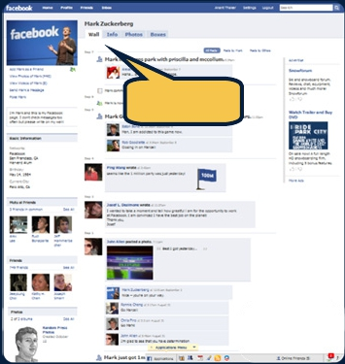
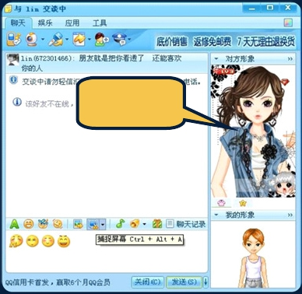
Unusually High Level of Global Innovation –
Facebook & Tencent Learning From Each Other’s Playbooks
Facebook
Tencent
• Largest Social Network in English-Speaking
• Largest Social Network in China – 637MM
Countries – 620MM visitors, +51% Y/Y in 9/10
active IM users, +31% Y/Y in CQ3
• Real Identity – Sharing among real-world
• Virtual Identity – $1.4B virtual goods revenue
friends / pictures / events
(from users customizing their avatars /
purchasing game items…) in 2009, +94% Y/Y
Real pictures
& real names
Virtual identity
& customizable
avatars
Source: Facebook, comScore (global unique visitors for Facebook), Tencent.
6

Slide 46
2. Mobile
Ramping faster than any ‘new new thing’ –
is your business leading or lagging?
7

Slide 47
Mobile Connectivity
Drives New Ways to Do Old Things Faster / Better / Cheaper
• More Connected – Real-time connectivity / 24x7 / in palm of hand…
• More Affordable – Wi-Fi nearly ubiquitous in many developed markets…for
many / 3G tiered pricing lowers adoption barrier…
• Faster – Near-zero latency for boot-up / search / connect / pay...
• Easier to Use – User Interface revolution + location awareness provide
something for nearly everyone…
• Fun to Use – Social / casual gaming / reward-driven marketing…
• Access Nearly Everything – Music / video / documents / ‘stuff’ in cloud...
• Longer Battery Life – Hours of continuous usage…
41

Slide 48
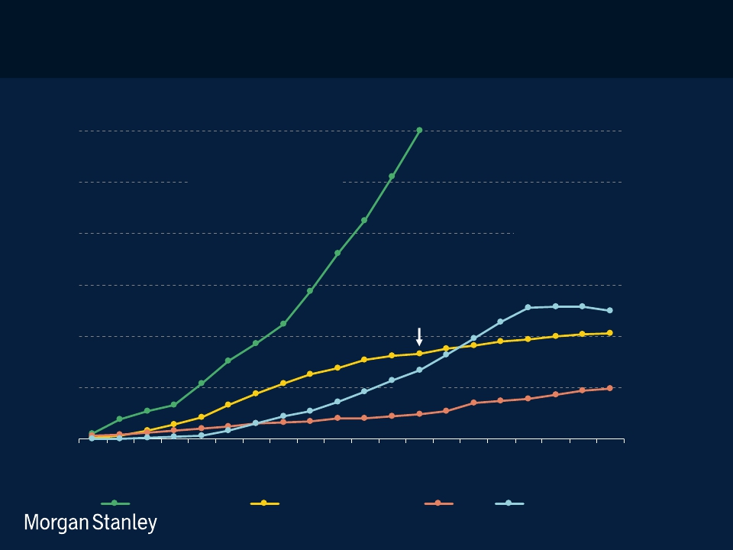
Apple iPhone + iTouch + iPad Ramp –
The Likes of Which We Haven’t Seen Before
iPhone + iTouch vs. NTT docomo i-mode vs. AOL vs. Netscape Users
First 20 Quarters Since Launch
120
~120MM+
Mobile Internet
100
80
iPhone + iTouch + iPad
Launched 6/07
Desktop Internet
Netscape*
Launched 12/94
Subscribers(MM)
60
40
Mobile Internet
NTT docomo i-mode
Launched 6/99
~32MM
20
Desktop Internet
AOL*
v 2.0 Launched 9/94
~27MM
~9MM
Q1
Q3
Q5
Q7
Q9
Q11
Q13
Q15
Q17
Q19
Quarters Since Launch
iPhone + iTouch
NTT docomo i-mode
AOL
Netscape
Note: *AOL subscribers data not available before CQ3:94; Netscape users limited to US only. Morgan Stanley Research estimates
~65MM+ netbooks have shipped in first 11 quarters since launch (10/07). Source: Company Reports , Morgan Stanley Research.
Data as of CQ3:10.
8

Slide 49
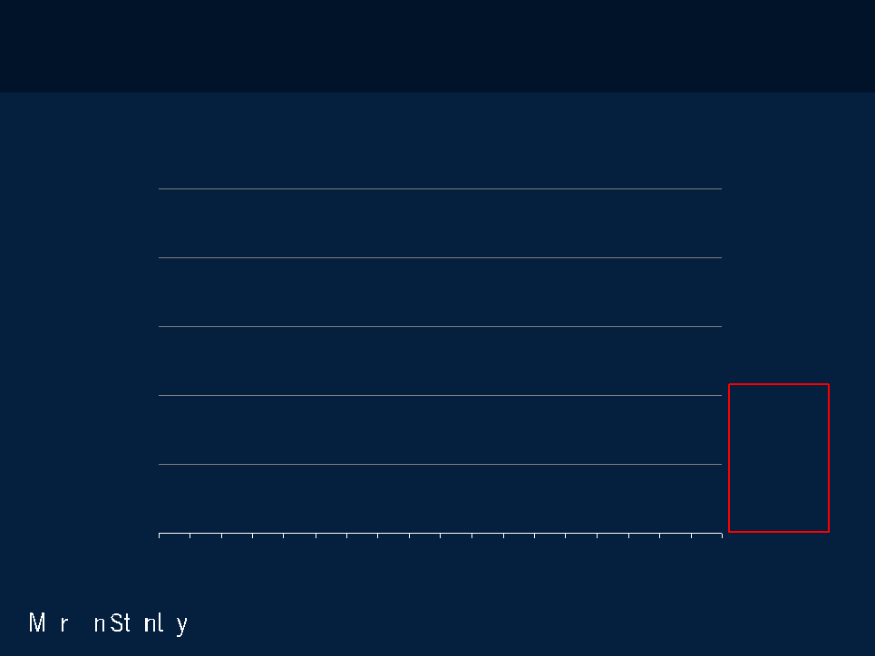
Mobile Operating Systems –
Attackers (Apple & Google) Driving Market Excitement & Momentum
Global Unit Shipment Share of Smartphones by Operating System,
Symbian (Nokia) / BlackBerry (RIM) / iOS (Apple) / Android (Google) / Others, 1Q06 – 3Q10
100%
6%
QuarterlySmartphoneUnitShipmentShare(%)
Others*
31%
15%
80%
BlackBerry
(RIM)
Symbian
7%
60%
37%
(Nokia)
40%
Android
(Google)
iOS
62%
25%
20%
17%
(Apple)
0%
CQ1:06
CQ4:06
CQ3:07
CQ2:08
CQ1:09
CQ4:09
CQ3:10
Note: iOS excludes iPod Touch and iPad shipments as they are not smartphones. *Others include Windows Mobile, Palm OS &
WebOS, Linux and other proprietary smartphone OSes. Call outs on the left side represent market shares in CQ1:06; call outs
on the right side represent market shares in CQ3:10. Source: Gartner.
9

Slide 50
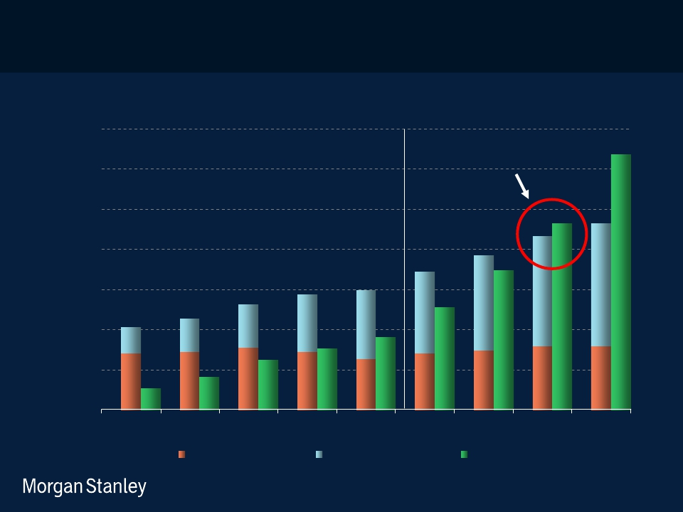
Smartphone > PC Shipments Within 2 Years –
Implies Very Rapid / Land Grab Evolution of Internet Access
Global Unit Shipments of Desktop PCs + Notebook PCs vs. Smartphones, 2005 – 2013E
700
600
500
400
300
200
100
0
2012E: Inflection Point
Smartphones > Total PCs
GlobalUnitShipments(MM)
2005
2006
2007
2008
2009
2010E
2011E
2012E
2013E
Desktop PCs
Notebook PCs
Smartphones
Note: Notebook PCs include Netbooks. Source: Katy Huberty, Ehud Gelblum, Morgan Stanley Research.
Data and Estimates as of 11/10
10

Slide 51
New Computing Cycles – 10x More Devices
New = Reduce Usage Friction Via Better Processing Power + Improved User
Interface + Smaller Form Factor + Lower Prices + Expanded Services
Computing Growth Drivers Over Time, 1960 – 2020E
More than
Just Phones
1,000,000
100,000
Mobile
Internet
iPad
Smartphone
Kindle
Devices/Users(MMinLogScale)
ation
Desktop
Internet
1B+ Units /
Users
Tablet
MP3
Cell phone /
PDA
Car Electronics
GPS, ABS, A/V
Mobile
Video
Home
Entertainment
Games
Wireless Home
Appliances
10,000
1000
100
10
1
gr
e
sing
Minicomputer
10MM+ Units
I
nt
cr
ea
PC
100MM+
Units
10B+
Units???
In
Mainframe
1MM+ Units
1960
1970
1980
1990
2000
2010
2020
Note: PC installed base reached 100MM in 1993, cellphone / Internet users reached 1B in 2002 / 2005 respectively;
Source: ITU, Mark Lipacis, Morgan Stanley Research.
7

Slide 52
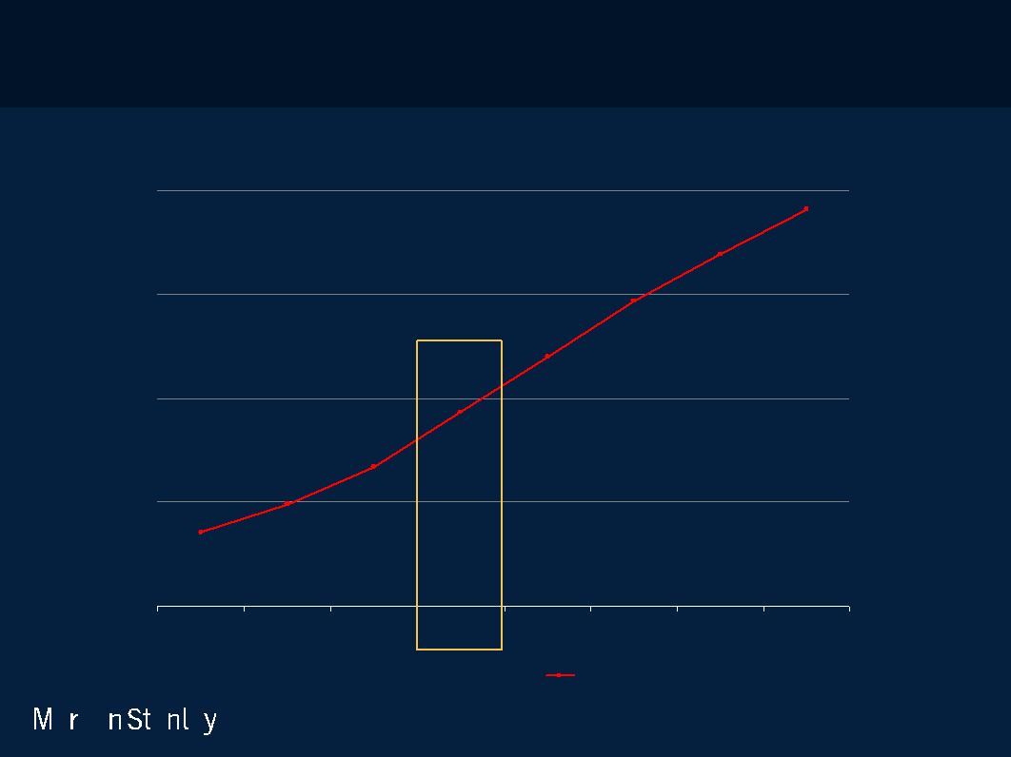
3G = A Key to Success of Mobile Internet –
2010E ‘Mainstream’ Inflection Point, 3G Penetration >20%
Global 3G+ Subscribers & Penetration, 2007 – 2014E
4,000
43%
45%
2010E: Inflection Point
3G+ Penetration Reaches
38%
Sweet Spot
33%
36%
27%
3,000
2,776
27%
3G+Penetration(%)
3G+Users(MM)
2,348
2,000
21%
1,055
1,928
15%
1,503
18%
11%
1,000
8%
688
9%
430
273
0
0%
2007
2008
2009E
2010E
2011E
2012E
2013E
2014E
3G+ Users
3G Penetration
Note: 3G+ technologies include WCDMA, HSPA, TD-SCDMA, 1xEV-DO, LTE and WiMax.
Source: Ovum Estimates, Morgan Stanley Research.
8

Slide 53
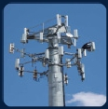
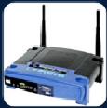
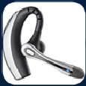
Wireless Options Growing Rapidly –
Creating Broad-Based Wireless Infrastructure
• GPS – 421MM+ chipsets sold in 2008E, +57% Y/Y; Cell Phones /
PDAs = 60% of GPS shipments.
• 3G – 485MM global users, +46% Y/Y in CQ2, >11% mobile user
penetration, rising to 44% by 2013E…Japan / W. Europe / USA
already >30% penetration.
• Wi-Fi – 319MM chipsets sold in 2008E, +42%Y/Y with 862MM
installed base; estimate 60% of iPhone / iTouch usage may be on
Wi-Fi, providing a crucial (and ~10x faster) offload to stressed 3G
networks.
• Bluetooth – 1.3B Bluetooth-enabled units shipped in 2008, +45%
Y/Y; 2B+ Bluetooth devices in use.
Source: 3G subscribers data per Informa, Wi-Fi usage estimates per AdMob, Wi-Fi shipments by Wi-Fi Alliance; installed base
per iSuppli, assuming 4-yr replacement cycle; Bluetooth shipment per iSuppli, installed base per The Bluetooth Special Interest
Group; GPS shipment per Future Horizons. Picture sources: Howstuffworks.com, Boy Genius Report, Cisco, Letsbuy.com.
9

Slide 54
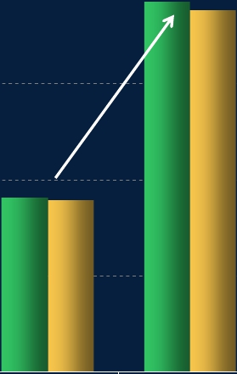
Mobile Apps & Mobile Search –
Users of Both Up 2x Y/Y…Search = Most Used Browser Feature, USA
Number of USA Smartphone App & Browser Users
4/09 vs. 4/10
% of Mobile Browser Users Who Have Done
the Following Activities, 4/10
Mobile App Users
Mobile Browser Users
Search
48%
40
38
38
Social
#ofUSASmartphoneUsersWhoHaveUsed
Networking
MobileApps/MobileBrowsers(MM)
2x
News
30
Sports Info
Movie Info
20
18
18
Bank
Accounts
General
Reference
Classifieds
Online Retail
10
0
4/09
4/10
0%
20%
40%
60%
Source: comScore.
10

Slide 55
Mobile App Usage Ramp =
Unprecedented
50
40
Apps
Downloaded 30
per User
47
22
20
10
12
10
5
0
iPhone / iTouch
Android
iPad
BlackBerry
Nokia
Apps Available
Apps
Downloaded
Installed Base
Launch Date
200K
4B+
86MM
7/08
50K
400MM
10MM+
10/08
3K
12MM+
2MM
4/10
5K
--
20MM*
4/09
7K
--
50-70MM*
5/09
Note: *BlackBerry / Nokia installed base excludes older devices that cannot support app stores.
Nokia apps available / downloaded exclude wallpapers / ringtones / music tracks.
Source: Distimo, Apple, Google, RIM, Nokia, Nielsen. Morgan Stanley Research.
11

Slide 56
Massive / Rapid User Expectation Change
In Just 2 Years, Wireless Consumers Expect…
• Always-On Access with Super-Fast ‘Boot Time’
• Near Zero Latency Access to Nearly All Information
• Day-Long-Plus Battery Life in Elegant Portable Devices
17

Slide 57
3. Social Ecosystems
Would you rather be Apple, Google or…Facebook?
Will their future directions help / hurt your business?
12

Slide 58
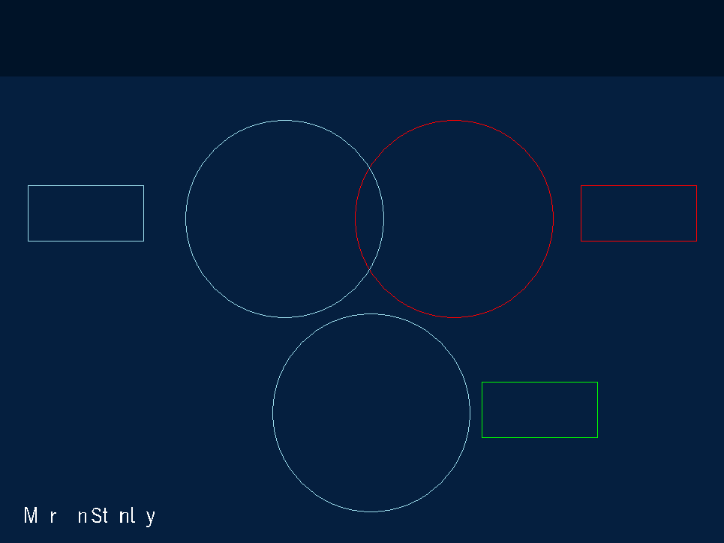
Facebook / Apple / Google =
Platforms of Different Types…Each with Rapid Innovation
Facebook
620MM users
Apple iPhone
/ iTouch / iPad
120MM+ users
Social
Networking
+51% Y/Y
550K+ Apps
+111% Y/Y
300K+ Apps
Mobile
500MM+ Downloads
6.5B+ Downloads
940MM users
+11% Y/Y
Google
Search
CQ3: CPCs +2% Q/Q
Paid Clicks +16% Y/Y
Source: PC World, comScore (global user data for Facebook and Google as of 9/10), Facebook, Apple, Google (as of CQ3).
13

Slide 59
4. Advertising
Ripe for innovation –
will your business benefit?
14

Slide 60
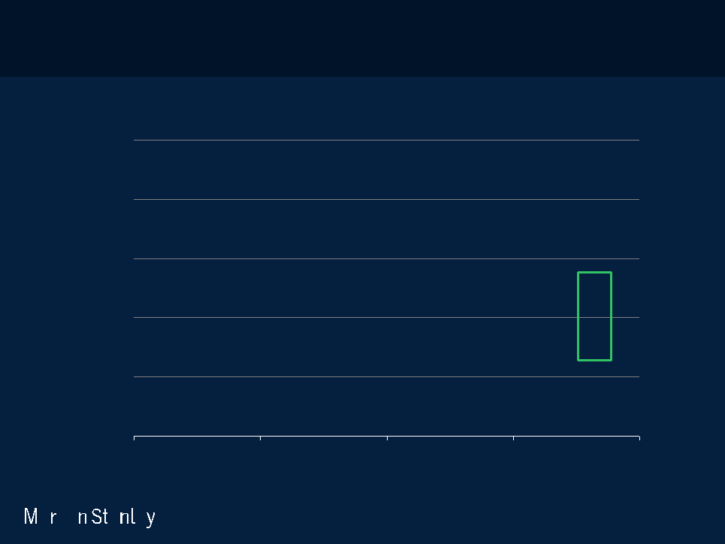
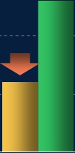
Media Time Spent vs. Ad Spend Still Out of Whack
Internet / Mobile (upside…) vs. Newspaper / Magazine / TV (downside…)
% of Time Spent in Media vs. % of Advertising Spending, USA 2009
50%
Time Spent
Ad Spend
%ofTotalMediaConsumptionTime
40%
39%
orAdvertisingSpending
30%
31%
28%
~$50B
Global
Opportunity
26%
20%
16%
10%
12%
13%
9%
0%
Print
Radio
TV
Internet
Note: Time spent data per NA Technographics (2009), ad spend data per VSS, Internet advertising opportunity assumes online ad
spend share matches time spent share, per Yahoo!. Source: Yahoo! Investor Day, 5/10.
15

Slide 61
Advertising Dollars Follow Eyeballs –
Ad Revenue per User = $46 in 2009E vs. $0 in 1994E
1995E
2009E
Global Internet Ad Revenue
Ad Revenue per User
Global Internet Users
$55MM
$9
6MM
$54B
$46
1.2B
Source: Global online ad revenue per Juniper Communications (1995), ZenithOptimedia (2009). Internet users per
MS estimate (1995) and comScore (2009). We note that comScore reports a lower global Internet user # than
International Telecommunications Union.
16

Slide 62
Facebook’s 620MM Users (+51% Y/Y) + Under-Monetized ‘Like’
Connections Offer Significant New Ad Opportunities
# of People Who Like
Equivalent TV
Rank
Top 20 Brands / Products
This (Millions)
Shows*
TV CPM Range ($)
1
Texas Hold’em Poker (Zynga)
27.2
American Idol
2
Facebook
25.2
NCIS
3
YouTube (Google)
19.6
--
4
Starbucks
16.9
--
~$30
5
Coca-Cola
16.7
--
6
Mafia Wars (Zynga)
14.4
--
7
Oreo (Kraft)
13.2
--
8
Skittles (Mars)
12.4
--
9
Red Bull
11.1
The Good Wife
10
Disney
10.3
Glee
~$25
11
Victoria’s Secret (Limited Brands)
9.1
--
12
Converse All Star
8.8
--
13
iTunes (Apple)
7.9
--
14
Windows Live Messenger (Microsoft)
7.6
Fringe
15
Pringles (P&G)
6.7
--
16
iPod (Apple)
6.6
--
~$20
17
ZARA
6.5
--
18
NBA
6.0
--
19
Starburst (Mars)
5.9
Scrubs
20
Dr Pepper
5.8
Vampire Diaries
Note: Facebook’s user figure reflects global unique visitors in 9/10, per comScore. Top 20 brand / product pages ranked by # of
people who opted in to ‘like’ the page, excludes ‘people’ (like Vin Diesel / Lady Gaga) and ‘activities’ (like ‘I ♥ Sleep’). Data as of 17
11/10/10. *Equivalent TV shows based on # of total viewers during the 2009 – 2010 season.
Source: Facebook, Nielsen Media Research, comScore.

Slide 63
Twitter’s 102MM Users (+74% Y/Y) Increasingly
in Touch with Brands + Media Players
Rank
1
2
3
4
5
6
7
8
9
10
11
12
13
14
15
16
17
18
19
20
Top 20 Brands
Oprah
CNN Breaking News
New York Times
Google
E! Online
The Onion
People Magazine
Time Magazine
NBA
Mashable
Martha Stewart
Whole Foods
NPR
InStyle Magazine
NFL
BBC Click
Zappos!
Good Morning America
Woot
CBS News
# of Twitter Followers
4.5MM
3.6MM
2.7MM
2.6MM
2.5MM
2.4MM
2.2MM
2.2MM
2.1MM
2.1MM
2.0MM
1.8MM
1.8MM
1.8MM
1.8MM
1.8MM
1.8MM
1.7MM
1.6MM
1.6MM
Note: Twitter user figure reflects global unique visitors to Twitter.com in 9/10, per comScore. Top 20 brands ranked by # of
followers, excludes celebrities like Ashton Kutcher and Britney Spears. Data as of 11/05/10.
Source: TwitterCounter.com, comScore.
18

Slide 64
5. Commerce
’Wal-Mart in your pocket’…location-based
services…group buying power…flash sales…
deep discounts…transparent pricing…real-time alerts
/ ratings…virtual goods...immediate gratification…
Products must be fast + easy + fun.
Have you ever seen ‘constant improvement’
in products like we are seeing now?
Is your business keeping pace?
Do humans want everything to be like a game?
21

Slide 65
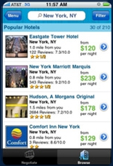
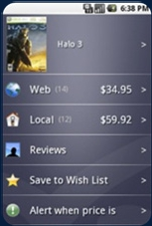
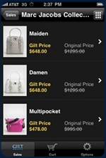
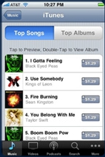
Mobile Revolutionizing Commerce –
With Constant Product Improvements
• Location-Based Services – Enable real-time physical retail / service opportunities
• Transparent Pricing – Instant local + online price comparison could disrupt retailers
• Discounts – Invitation-only time-based selective sales gaining traction
• Immediate Gratification – OTA (over-the-air) instant digital product + content delivery
Location-Based Services
Transparent Pricing
Discounts
Immediate Gratification
Priceline.com iPhone App
ShopSavvy Android App
Gilt iPhone App
iTunes Store on iPhone
Finds hotel deals
in your area
Comparison shopping
among online + local stores
Designer handbags
Up to 70% Off
Music / video / apps
delivered wirelessly
Source: Company Reports, Morgan Stanley Research.
23

Slide 66
6. Media
What does the extraordinary ramp in on-demand
video usage mean for your business?
24

Slide 67
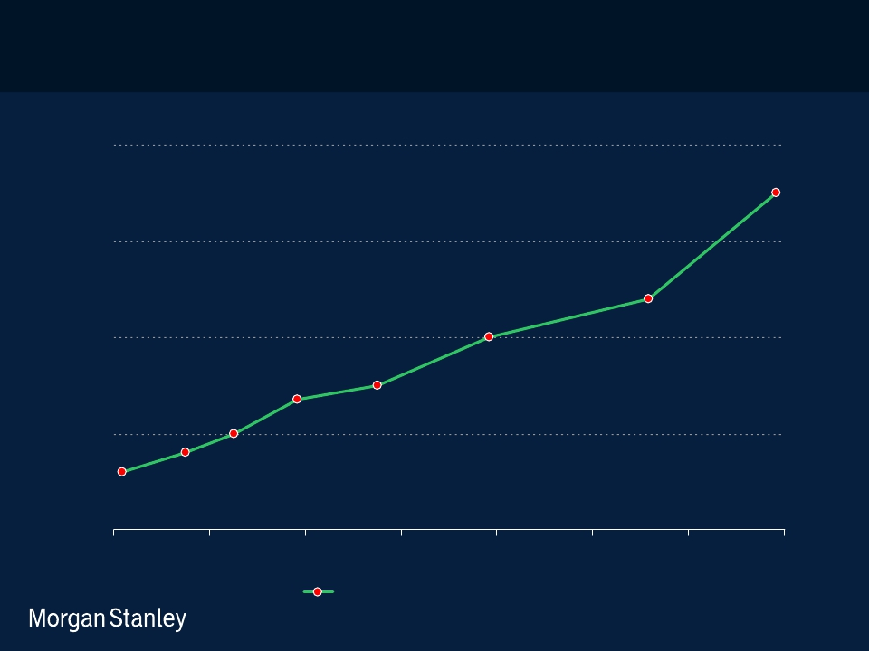
YouTube Content Growth Accelerating (+2x Y/Y) –
35 Hours of Content Added Every Minute
Hours of YouTube Content Uploaded per Minute, 6/07 – 11/10
40
30
20
10
0
HoursofYouTubeContentUploadedperMinute
6/07
12/07
6/08
12/08
6/09
12/09
6/10
Hours Uploaded per Minute
Source: YouTube blog, Morgan Stanley Research.
26

Slide 68
7. Internet Company Leadership Evolution
Shocking changes over just 6 years…
are you prepared for next half decade of change?
27

Slide 69
Global Public Internet Companies –
Significant Changes Over Last 6 Years
Top Global 15 Publicly Traded Internet Companies by Market Value – 2010 vs. 2004
2010
Market Revenue
2004
Market Revenue
Rank Company
Region Value ($B) ($MM)
Rank Company
Region Value ($B) ($MM)
1 Apple
USA $290 $46,709
1
eBay
USA
$71
$3,271
2 Google
USA
197 23,612
2
Google
USA
50
3,189
3 Amazon.com
USA
76 24,508
3
Yahoo!
USA
52
3,575
4 Tencent
CHN
41 1,822
4
IAC/Interactive*
USA
38
4,188
5 eBay
USA
40 8,727
5
Yahoo! Japan
JPN
33
1,101
6 Baidu
CHN
40 641
6
Apple
USA
22
8,279
7 Yahoo!
USA
22 6,460
7
Amazon.com
USA
16
6,921
8 Yahoo! Japan
JPN
21 2,941
8
Rakuten
JPN
9
445
9 Priceline.com
USA
21 2,338
9
Monster
USA
3
846
10 Salesforce.com
USA
15 1,241
10
WebMD
USA
2
134
11 Rakuten
JPN
10 3,204
11
Shanda
CHN
3
157
12 Alibaba.com
CHN
10 568
12
NCSoft
KOR
2
280
13 Akamai
USA
9 860
13
Index
JPN
2
357
14 Netflix
USA
9 1,670
14
NHN
KOR
1
253
15 NHN
KOR
8 1,062
15
For-side.com
JPN
1
85
Total
$809B
$126B
Total
$304B
$33B
2 of 2010 Top 15 Companies (Alibaba, Baidu) Went Public Post 2004
Note: 2010 Market value data as of 11/11/2010; 2004 data as of 11/11/2004. 2010 Revenue is latest calendar year revenue (C2009A)
Source: FactSet. 28

Slide 70
8. Steve Jobs
What’s his ‘secret sauce?’
Does your company have it?
29

Slide 71
Steve Jobs –
‘…mind of an engineer and the heart of an artist…’
Larry Ellison (June 2004): Steve Jobs is the most brilliant person in our industry, and what is
most remarkable about Steve, I think, is his incredible aesthetic sense. He has the
mind of an engineer and the heart of an artist
— that's a very unusual combination, an enormous advantage when you do consumer
products. Look at the iPod...I think the iPod is a beautiful design and I think the iMac is a
brilliant design. He's done a tremendous amount of innovation on the integration of
hardware design and software design.
Bill Gates (May 2007): …We build the products that we want to use ourselves. And so he’s
[Steve Jobs] really pursued that with incredible taste and elegance that has had a huge
impact on the industry. And
his ability to always come around and figure out where that next bet should be has been
phenomenal.
Apple literally was failing when Steve went back and re-infused the innovation and risk-
taking that have been phenomenal.
Note: Ellison quote from interview with Walt Mossberg & Kara Swisher at AllThingsD: D2 Conference, June 2004.
Gates quote from interview with Steve Jobs, Walt Mossberg & Kara Swisher at AllThingsD: D5 Conference, May 2007.
Source: AllThingsDigital, www.peoplesoft-planet.com
30

Slide 72
9. Ferocious Pace of Change - What’s Next in Tech?
When do consumers / enterprises
& incumbents / attackers need you?
31

Slide 73
Mobile Connectivity Drives New Ways to Do LOTS of Things
Faster / Better / Cheaper from Palm of Hand
• More Connected – Real-time connectivity / 24x7 / in palm of hand…
• More Affordable – Wi-Fi nearly ubiquitous in many developed markets…for
many / 3G tiered pricing lowers adoption barrier…
• Faster – Near-zero latency for boot-up / search / connect / pay...
• Easier to Use – User Interface revolution + location awareness provide
something for nearly everyone…
• Fun to Use – Social / casual gaming / reward-driven marketing…
• Access Nearly Everything – Music / video / documents / ‘stuff’ in cloud...
• Longer Battery Life – Hours of continuous usage…
32

Slide 74
Unusually High Level of Innovation -
from Incumbents
• Apple – iPad / iPhone / iTouch / iTunes / Multi-Touch Input /
• Google – Android / Chrome / YouTube / Display Advertising / Web Apps / Instant +
Voice Search
• Amazon.com – Kindle / EGM (Electronics & General Merchandise) Sales / Mobile
Apps / AWS (Amazon Web Services)
• Tencent – Virtual Goods
• Nintendo / Sony / Microsoft – Motion Sensors (natural gaming input)
• PayPal – Mobile + Digital Goods Payments
• Netflix – Streaming Content
• Salesforce.com – Chatter (real-time enterprise collaboration platform)
33

Slide 75
Unusually High Level of Innovation -
from New Attackers
• Facebook – Real-time Communication / Social Graph / Credits
• Zynga – Social Gaming / Virtual Goods / Offers (Reward-Driven Marketing)
• Twitter – One-to-Many Real-Time Broadcast
• OpenTable / Yelp / Foursquare / Shopkick – Location-Aware Mobile Services
• Gilt / One Kings Lane / Rue La La – Time-based ‘Flash’ Sales
• Groupon – Social Group Buying
• Tapulous / Digital Chocolate / Booyah / Ngmoco:) – Social / Mobile Gaming
• Pandora / Spotify – Personalized Music
34

Slide 76
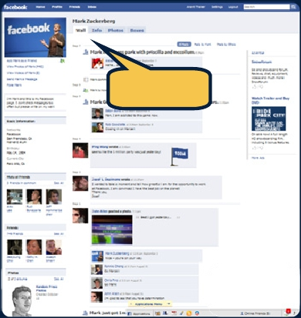
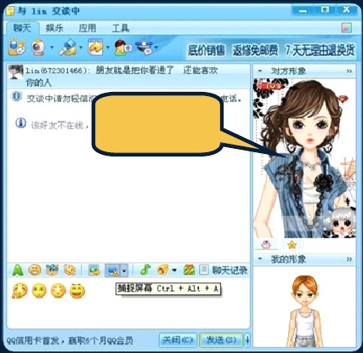
Unusually High Level of Global Innovation –
Facebook & Tencent Learning From Each Other’s Playbooks…
Facebook
• Largest Social Network in English-Speaking
Countries – 519MM visitors, +69% Y/Y in 4/10
• Real Identity – Sharing among real-world
friends / pictures / events
Tencent
• Largest Social Network in China – 523MM
active IM users, +39% Y/Y in CQ1
• Virtual Identity – $1.4B virtual goods revenue
(from users customizing their avatars /
purchasing game items…) in 2009, +94% Y/Y
Real pictures
& real names
Virtual identity
& customizable
avatars
Source: Facebook, comScore, Tencent.
23

Slide 77
User Interface + Device Usage Evolution Over Past 30 Years –
From Input…to Output…to Sharing
Text
Keyboard
Creation
Personal Computing
Graphical
Mouse
Communication
Internet Computing
Touch
Fingers
Consumption + Sharing
Mobile Internet Computing
User
Interface
Input
Device
Device
Usage
Computing
Cycle
16

Slide 78
‘Disruptive Innovation’ – Clayton Christensen
Christensen studied why great companies with smart managements and substantial
resources consistently lost to ‘disruptors,’ companies with simpler, cheaper, and
inferior products. - Michael Mauboussin (7/10)
Two Ways Disruptive Innovation Can Happen
Low-End Segment Strategy
Non-Consumption Strategy
Disruptors introduce a product that is at the low
end of the market and that is neither profitable
for the incumbents nor in demand from the
incumbents customers...
Disruptors introduce a product
that was unavailable to consumers
before, effectively competing with
non-consumption.
This becomes a problem as the disruptors
improve their offering and move up market,
eventually encroaching on the core business of
the incumbent, and doing so with a lower cost
structure.
Amazon.com / Netflix / PayPal…
iPhone / iPad / Facebook…
Source: “Untangling Skill and Luck: How to Think About Outcomes – Past, Present, and Future” (7/15/2010). 35
Michael Mauboussin, Legg Mason Capital Management

Slide 79
‘Cloud Computing’ –
Consumer First, Enterprise Next
38

Slide 80
Consumers Have Been Clouding for Awhile…
Enterprises Moving to the Cloud - Why Now?
• Home Users Ahead of Enterprise Users - Quality of home based computing
has been evolving at faster pace than enterprise computing for years and cloud-
based connectivity has become so pervasive that enterprises are finally being
forced to play catch up.
• Consumers Expect Easy-to-Use 24x7 Connectivity and Want the Same at
Work - Wireless device (smartphone / tablet) adoption has empowered
consumers to expect (and demand) cloud-based high-speed wireless
connectivity 24x7.
• Recession-Spending Delays Helped Underlying Markets Develop -
Recession-related technology spending delays from 2007 to 2009, in effect,
allowed cloud-based services to evolve / develop / mature to levels that are more
‘enterprise-ready.’
• Less Concern about Security Issues - Cloud-based security concerns have
abated somewhat as enterprises realize the difference in risk profile between
internal and external environments is lower than they once believed.
39

Slide 81
10. Closing Thoughts –
Large companies do not typically support rapid growth
rates of the magnitude that follow…
will these trends continue?

Slide 82
Recent Financial Innovation

Slide 83
Outlines
Cutting Edge Trading Technology
Risk Management Innovations of Securization and Derivatives
Bank2.0

Slide 84
Primary Players in Financial Trading Industry
Broker-dealers
Buy-side funds
Global Exchanges
Venues of trade execution

Slide 85
Goals of Financial Trading Innovation
Cut transaction costs
Minimize human error
Boost trading efficiency
Supplement productivity

Slide 86
Innovations of Financial Trading Technology
Electronic Communication Networks (ECNs)
Algorithmic trading(Quantitative trading)
Black box trading
High frequency trading
All together above >70% of Trading today!

Slide 87
Electronic Communication Networks (ECNs)
Off-exchange exchanges
ECN vs exchange
Both
Conduct transactions
Collect fees
Produce and sell market data
Exchanges
Can list stocks
Govern themselves…
ECNs
Governed by the SEC

Slide 88
What are ECNs
Automated limit order books
Open display
Offer anonymity
After-hours trading
Subject to SEC’s Regulations
Order protection rule – best displayed prices
Access rule – fair access, limit on fees
Sub-penny rule

Slide 89
List of ECNs
Instinet (1st)
Archipelago
Island
BATS
Direct Edge
LavaFlow
Bloomberg
Track Data

Slide 90
Algorithmic trading(Quantitative trading)
Quantitative trading, also known as algorithmic trading, is the trading of securities based strictly on the buy/sell decisions of computer algorithms. The computer algorithms are designed and perhaps programmed by the traders themselves, based on the historical performance of the encoded strategy tested against historical financial data
Quantitative trading includes more than just technical analysis. Many quantitative trading systems incorporate fundamental data in their inputs: numbers such as revenue, cash flow, debt-to-equity ratio, and others--- convert information and news event into bits and bytes that the computer can understand, it can be regarded as part of quantitative trading

Slide 91
Black-Box Trading
A computer-based trading system for individual investors that uses a set of fixed, proprietary rules to generate buy and sell signals. Black box systems are named for the secrecy surrounding the methodology employed in the analysis.

Slide 92
High Frequency Trading
In general, high- frequency trading (HFT) refers to the buying or selling of securities wherein success depends on how quickly you act, where a delay of a few thousandths of a second,or milliseconds, can mean the difference between profit and loss.
The high- frequency trader evolved from the ranks of the traditional market-maker, or specialist, whose primary source of profit was the spread between the prices at which he bought and sold.
Unlike the traditional market-maker, however, and owing to developments like decimalization and advances in technology, the high- frequency trader must settle for much narrower spreads—razor-thin margins of a penny or less. As such, high- frequency traders operate in massive scales.

Slide 93
Disruptive Risk Management Innovation
CXO^{N} (1987 Innovation)
a type of structured asset-backed security (ABS) with multiple "tranches" that are issued by special purpose entities and collateralized by debt obligations including bonds and loans. Each tranche offers a varying degree of risk and return so as to meet investor demand. CDOs' value and payments are derived from a portfolio of fixed-income underlying assets. CDO securities are split into different risk classes, or tranches, whereby "senior" tranches are considered the safest securities. Interest and principal payments are made in order of seniority, so that junior tranches offer higher coupon payments (and interest rates) or lower prices to compensate for additional default risk.
CDS (1990 Innovation)
is similar to a traditional insurance policy, in as much as it obliges the seller of the CDS to compensate the buyer in the event of loan default. Generally, the agreement is that in the event of default the buyer of the CDS receives money (usually the face value of the loan), and the seller of the CDS receives the defaulted loan (and with it the right to recover the loan at some later time). However, the difference between a traditional insurance policy and a CDS is that anyone can purchase one, even buyers who do not hold the loan instrument and may have no direct "insurable interest" in the loan.

Slide 94
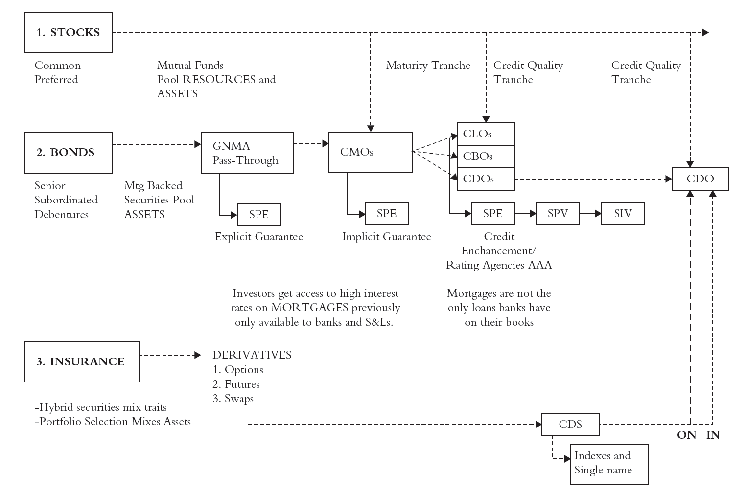
Complete Financial Origami Diagram
L: Loan, B: Bond,
D: Debt, S: Synthetic
SPE(special purpose entity): to ensure that the holders of the mortgage-back securities have the first priority right to receive payments on the loans, these loans need to be legally separated from the other obligations of the bank. This is done by creating an SPE, and then transferring the loans from the bank to the SPE.
SPV(special purpose vehicle)
SPE(special purpose entity)
SPE(special investment vehicle)
Financial Engineering Innovations!

Slide 95
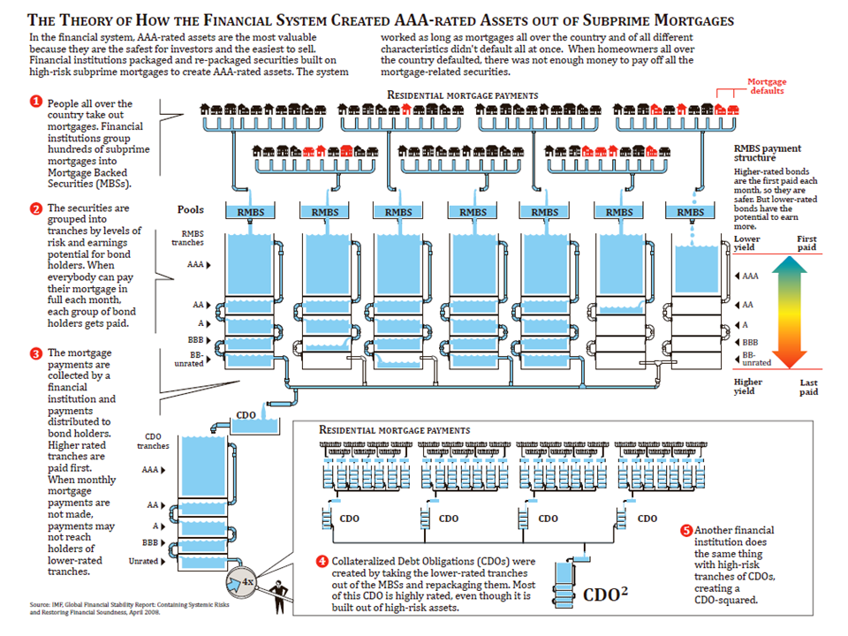
2007: US$ 481.6 Billion
2010: US$ 8 Billion

Slide 96
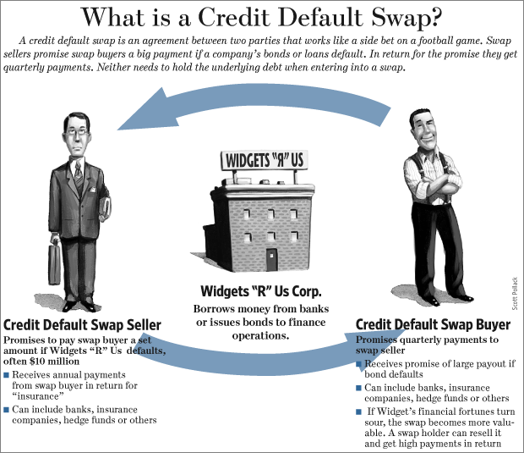
CDS
2007: US$ 62.2 Trillion
2010: US$ 26.3 Trillion
The European Parliament has approved a ban on this kind of CDS, effective starting 1st December 2011.

Slide 97
Risk Management Innovation
Hedge Fund (2008: $1.9 trillion, 2011: $2 trillion)
is a private pool of capital actively managed by an investment adviser. Most hedge fund investment strategies aim to achieve a positive return on investment whether markets are rising or falling.
ETF (2007: $7 billion, 2010: $1.24 trilliion)
An exchange-traded fund (ETF) is an investment fund traded on stock exchanges, much like stocks. An ETF holds assets such as stocks, commodities, or bonds, and trades close to its net asset value over the course of the trading day. Most ETFs track an index, such as the S&P 500 or MSCI EAFE. ETFs may be attractive as investments because of their transparence, low costs, tax efficiency, and stock-like features.

Slide 98
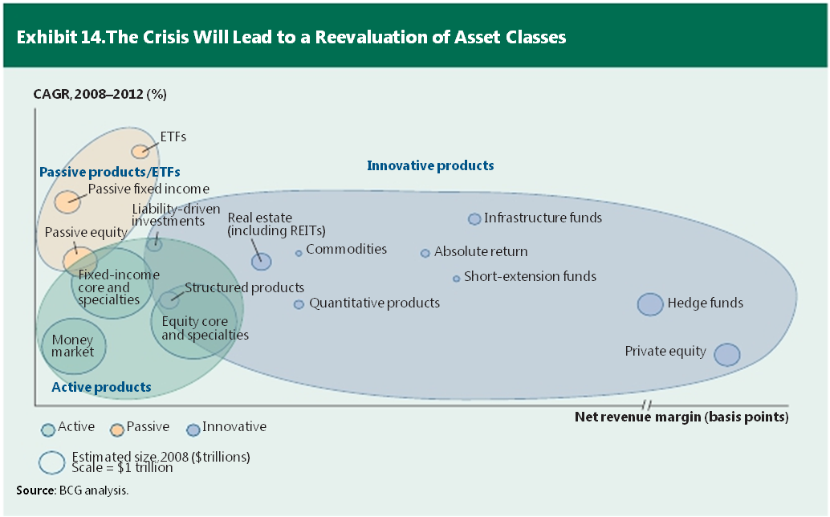
Innovation for Asset Growth and Margin

Slide 99
BANK 2.0
HOW CUSTOMER BEHAVIOUR AND TECHNOLOGY WILL CHANGE THE FUTURE OF FINANCIAL SERVICES

Slide 100
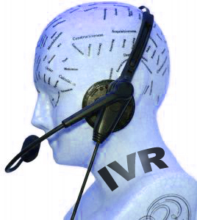
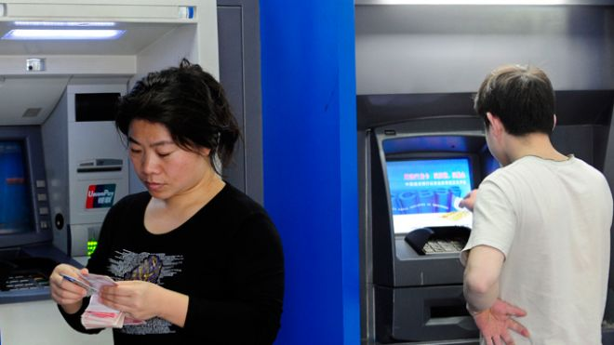
Major Technology Innovation in Banking Before Internet
1970 ATM(customer facing technology)
1990 Phone Banking
1990s IVR(interactive voice response) with Call Center
1990s VBC(video banking center)
Could You Build Relationships Through Technology?

Slide 101
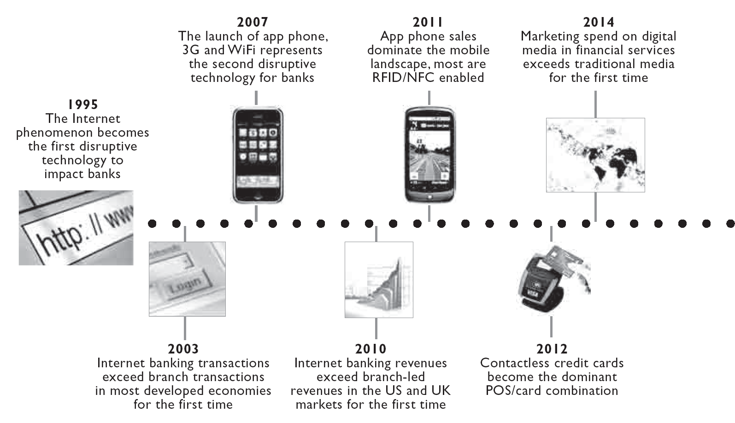
Recent Disruptive Technology on Banking

Slide 102
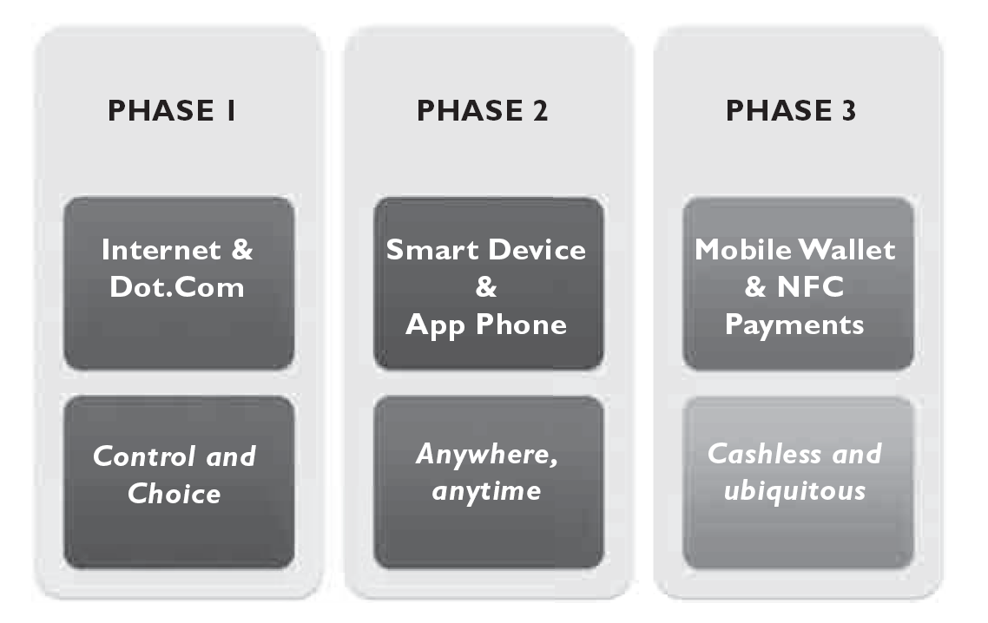
The Three Phases of Customer-Behavioral-Led Disruption

Slide 103
Comparison of Product Application Approval Times

Slide 104
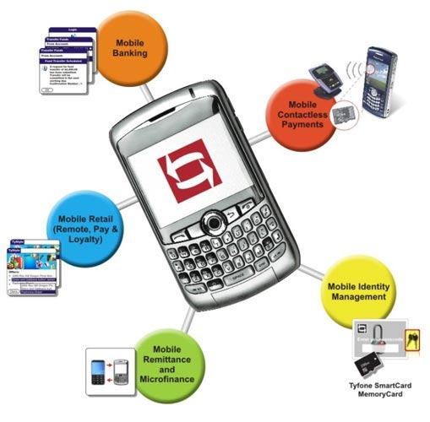
Mobile Banking

Slide 105
Mobile Banking Features
Mobile banking for all, including those who have not subscribed for online banking
Account aggregation that combines multiple accounts with one login
Secured ID management with Tyfone’s Multi Factor Authentication (MFA)
Contactless Payments with NFC and customized digital wallet
Mobile remote deposit capture (mRDC) that lets users to capture a check and deposit it with mobile banking.

Slide 106
Mobile Banking Market
For both banked and non-banked customers
Nearly five billion people worldwide have little or no access to traditional financial services due to a lack of ATMs and bank branches, poor regulation, low levels of financial literacy or other weaknesses in infrastructure
According to the World Bank, 175 million migrant workers each year send billions of dollars’ worth of international remittances to family and friends, many of whom do not have bank accounts, The two most successful of these are M-PESA in Kenya and G-Cash in the Philippines.

Slide 107
Overview of M-PESA

Slide 108
What is G-CASH

Slide 109
G-CASH

Slide 110
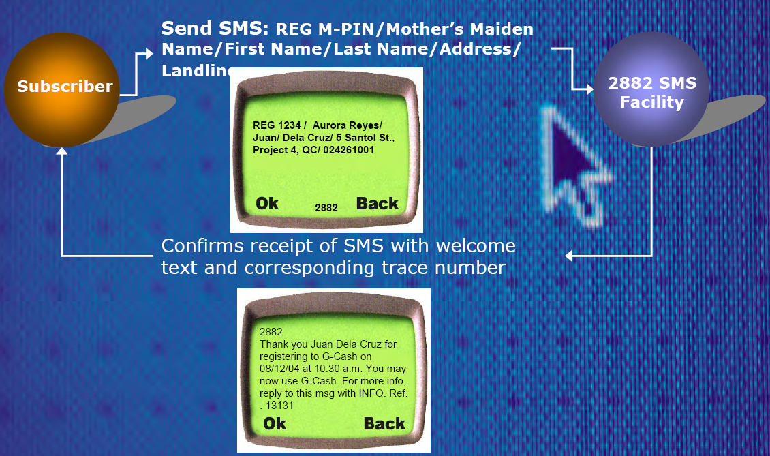
G-Cash: Subscriber Registration

Slide 111
G-Cash: Customer Cash-In

Slide 112
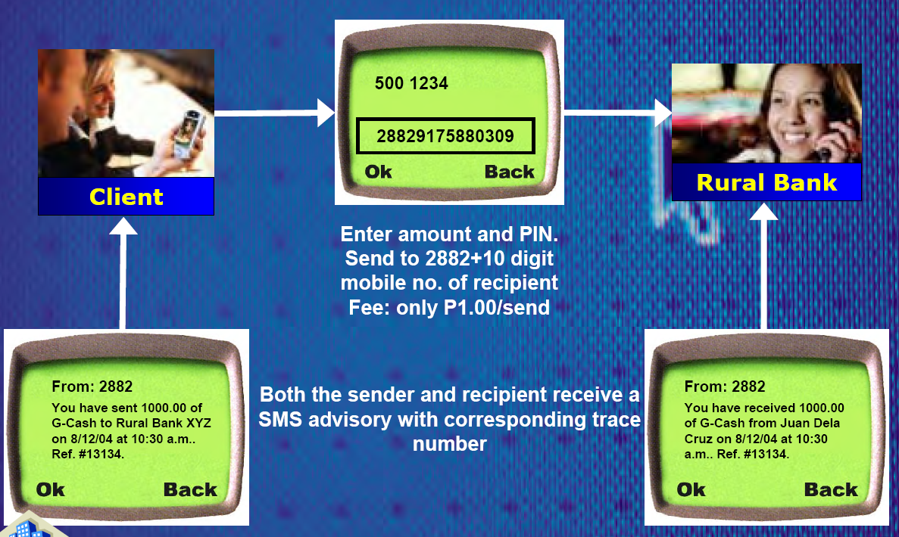
G-Cash: P2P Transfer

