Slide 1
Blockchain Basics
Daniel Hao Tien Lee
http://danieleewww.yolasite.com/2020-mgb070.php
Slide materials: courtesy of Bikramaditya Singhal, “Beginning Blockchain”, Apress 2018

Slide 2
What is Blockchain and its Application
https://www.youtube.com/watch?v=SSo_EIwHSd4
https://www.youtube.com/watch?v=bBC-nXj3Ng4&t=630s
https://www.youtube.com/watch?v=jZ4ZK7SkjCs
https://www.youtube.com/watch?v=Xm5qx2ZG7Z4

Slide 3
What is a blockchain?
A distributed immutable ledger of
transactions
The underlying technology behind
the cryptocurrency known as Bitcoin
What TCP/IP (internet protocol) has been for the exchange of information, blockchain can be for the exchange of value
The following introduction slides are courtesy of Tom Savel, MD, CDC Health Information Innovation Consortium Forum 2018

Slide 4
What is a blockchain?
A set of tools for cryptographic assurance of data integrity, standardized auditing, and formalized contracts for data access
A technology which empowers participating members to exchange items of value through a distributed ledger - that each member owns - and who’s content is always in sync
video

Slide 5
No really, what’s is a blockchain: 5 Principles*
Distributed Database
Peer-to-Peer Transmission
Irreversibility of Records
Computational Logic (automated)
Transparency with a degree of
anonymity (pseudonymity)
* Harvard Business Review – Halamka et al., 2017

Slide 6
Blockchain: Is it of value to me?
“It is most useful when multiple loosely coupled distinct organizations or entities want to confidently share and audit information and automate mutually beneficial processes”

Slide 7
What is a blockchain? One more time…it is…
Distributed
Decentralized, shared, etc.
Affording high availability
Immutable
Write only
Extremely “hacker resistant”
Affording high Integrity
Ledger
Transaction record (e.g., of financial data, contractual data, physical assets)
Uses a validation process (consensus protocol)

Slide 8
Is Blockchain new?
No…but it is now gaining rapid
popularity
Over $4.5 Billion in private funding for Blockchain-related projects in 2017 (Forbes)
Dramatic increase in number of Blockchain patents filed (coindesk.com)
Still in its early stages of development and implementation – similar to the internet itself in the late 1990s

Slide 9
Blockchain development activity
Significant activity in the Corporate, Academic
and Federal spaces:
IBM, Microsoft, MIT, GA Tech, GSA, FDA, DHS, DOD, ONC, OMB, NIST, OPM, Postal Service, State Dept., Treasury Dept., Federal Reserve, and hundreds of blockchain startups.
https://emerging.digital.gov/blockchain-programs
New Magazines / Journals:
Traditional (e.g., Wired): DISTRIBUTED (2017)
Peer-reviewed: Blockchain in Healthcare Today (2018)

Slide 10
Digging a bit deeper into Blockchain: All hype? No.
Leverages and expands existing
capability of the internet
Based on mathematics and cryptography
(not magic):
– (Tech speak: merkle trees, cryptographic hashes, public and private keys, etc.)
Can be used for many different purposes
When used in finance – it finally solves the very challenging “double spend” problem

Slide 11
Why is it called Blockchain?
The power of the technology to be a “trusted source of truth” - is based on its ability to permanently connect groups of validated transactions…
[connection = called a chain]
[group = called a block]
Remember: the blockchain data continues to grow and is automatically replicated to every connected node… to potentially thousands of nodes. Sound inefficient?
It’s the cost of being a “trusted source of truth”

Slide 12
Why does an internet-based “trusted source of truth” matter?
You don’t need a trusted 3rd party with a
blockchain infrastructure
Critical ledgers / databases are ubiquitous in our society – and most always require a trusted 3rd party
Examples:
For financial transactions: Bank
For drivers license, auto tags, etc.: DMV

Slide 13
Why does an internet-based “trusted source of truth” matter?
Blockchain technology can enhance the internet - from an internet of knowledge and information sharing - to an internet of value and value exchange – where trust and security are “baked in”

Slide 14
Blockchain: There isn’t just one
There are 3 general categories of blockchains:
Similar to the idea of internet vs. intranet web sites
Public (full access by anyone)
Permissioned (consortium)
Private (i.e., within an organization)

Slide 15
Blockchain: There isn’t just one
There are many different types / configurations of
blockchains – with more being created every day
Similar to the idea of using different operating
systems (iOS, Android, Windows, Linux, etc.)
Examples:
Bitcoin Blockchain
Ethereum Blockchain, https://consensys.net/
Cardano Blockchain
Hyperledger Fabric
IOTA “Tangle”

Slide 16
Blockchain: A foundation for new ecosystems
Blockchain technology can support a wide variety of
unique use cases
Decentralized file sharing, Digital asset exchange, Real estate transactions, Proof of authorship, Laboratory / pharmaceutical asset tracking, etc.
Examples:
Bitcoin - single purpose - exchange and store value
Ethereum - distributed application platform
i.e., an app store for blockchain-based apps (dApps)
– Offers custom tokens, smart contracts, etc.

Slide 17
Blockchain: A foundation for new ecosystems

Slide 18
The Blockchain Token: Unit of value exchange
Public blockchains (almost always) leverage a token
(not required with private/permissioned blockchains)
A token (i.e., digital asset) can be many things…and have different
purposes:
Digital Currency
To support the creation of a “marketplace”
A unit of value – to be exchanged within distributed app ecosystem
Initial Coin Offering (ICOs) – to be exchanged for fiat currency (e.g., USD)
Proxy for physical asset
Exchangeable for other digital assets / fiat currencies
Coinbase, Kraken, Bitfinex, Bittrex, Binance, etc.

Slide 19
Using the Blockchain: making a transaction
What is involved in a transaction event recorded on
blockchain?
Unique Sender
Wallet (can be explicit or hidden from the user)
– Contains Public Key – to receive & Private Key – send
Transaction Data (i.e., the data packet / metadata)
Financial asset, activating a change in rights to view or
access a digital or real world asset
Receiver
Unique (most often) or multiple (i.e., automated by a “smart contract”)
Wallet (can explicit or hidden….same as sender)

Slide 20
Using the Blockchain: the transaction – a deeper look
Inherent to a standard blockchain- every transaction is stored…every one…forever.
With, for example, the public (Bitcoin) blockchain – transactions are grouped and processed in blocks (thousands of transactions)
Blocks are then tied together with 1-way digital fingerprints (cryptographic hashes)

Slide 21
Using the Blockchain: the transaction – a deeper look
Transactions take time (which varies based on the
blockchain type/platform)
Huge area of development / activity to improve transaction efficiency
There are significant challenges which need to be rapidly
overcome (e.g., projects: plasma, lightning network)
Transactions can have fees (for public blockchains)
to prevent spam, misuse of resources
e.g., Ethereum requires “Gas”
All transactions require validation (consensus protocol)
Many types
Also, a very rapidly evolving area

Slide 22
Blockchain: Validation (have you heard of mining?)
Blockchain technology elegantly leverages computer science, mathematics, cryptography, & game theory
For a public blockchain – the goal is to incentivize unknown, untrusting participants to work with the system and not try to break it

Slide 23
Blockchain: Validation (have you heard of mining?)
There are many types of consensus protocols
Proof of Work – classic but incredibly costly (electricity, etc.)
Mining – Competing to solve a computationally intensive problem to validate transaction
– GPU, ASIC (Application Specific Integrated Circuit),etc.
With the winner of the competition receiving a financial reward
Proof of Stake – Ownership
Proof of Authority
Proof of Space-Time
Proof of Capacity
Proof of Elapsed Time (e.g., Intel)
With more being studied and tested every day

Slide 24
Blockchain: Quick recap and breather….
Blockchain doesn’t solve every problem
Most useful “when loosely coupled distinct organizations / entities
want to confidently share and audit information and automate
mutually beneficial processes”
Removes the need for intermediaries – and thus gives control back
to the users / original data / asset owners
Provides a source of truth / trust between untrusting participants

Slide 25
Blockchain: Where is it ideal?
It excels in 3 general types of activities in a
non-centralized / distributed environment:
Tracking and Tracing of Assets / Value
– i.e., chain of custody (provenance)
Data Exchange
Automation of operational processes

Slide 26
Blockchain: Once last piece – “the data”
Important issue:
Can / should I put all my data on the blockchain?
No, no and no…
You will hear the terms “on chain” and “off chain”
Remember- what you put on the chain is replicated to all the nodes
– It’s important to keep the blockchain light…

Slide 27
Blockchain: Once last piece – “the data”
There are other “on chain/off chain” issues to consider:
Privacy / Transparency
PII, etc.
Storage Capacity Issues (IPFS, Minio, etc.)
Large files: e.g., chest x-rays, etc.
This issue must be carefully evaluated for each unique blockchain implementation
Important Note: It is possible to link off-chain data (encrypted PII, large files, etc.) to the blockchain – and ensure data integrity (via digital fingerprint / cryptographic hashing)

Slide 28
Blockchain: Its impact on the digital global economy
Accounting
Digital Identity
Smart Contracts
Data Provenance
eGov
Supply Chain Management
Internet of Things (IoT)
Trade Finance
Clearing And Settlement

Slide 29
Blockchain Startup Landscape

Slide 30
Blockchain: Challenges
The challenge is that the shift to blockchain is a
fundamental change on many levels
Historically:
Centralized system
Single point of failure
Manual Processes
Sending / Receiving data “messages”

Slide 31
Blockchain: Challenges
The challenge: the shift to blockchain is a fundamental change
Decentralized / Distributed data / value exchange ecosystem Control is given back to the data owner / stakeholder Increased transparency
Increased Security
Post/Link data to blockchain – not to specific stakeholders
Automated Processes
Improved Efficiency
Works well with microservices Enhanced Metrics
Permanent longitudinal record / log

Slide 32
Blockchain: Next steps
Overall Goals:
Reduce costs & Improve efficiencies
Improve transparency and security
Make blockchain-based solutions invisible to the users----
IT JUST WORKS (just like our phones)
“If users see cryptographic hashes- we have failed”

Slide 33
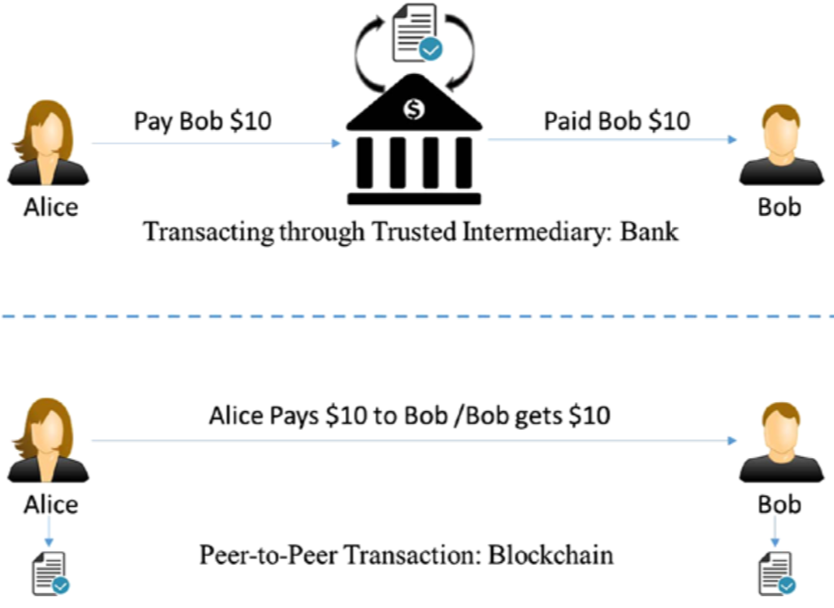
Transaction through an intermediary vs. peer-to-peer transaction

Slide 34
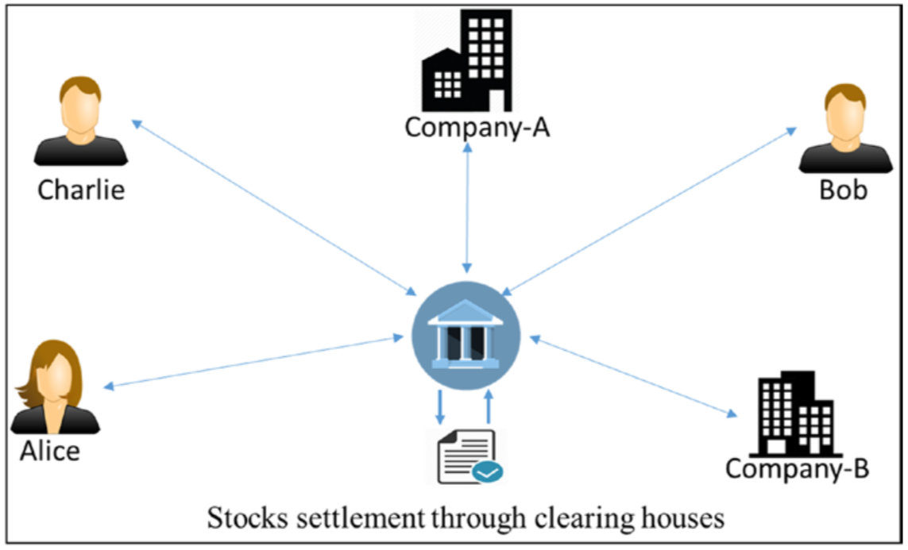
Stocks trading through an intermediary clearing house
A typical stock transaction happens in seconds, but its settlement takes weeks. Is it desirable in this digital age?

Slide 35
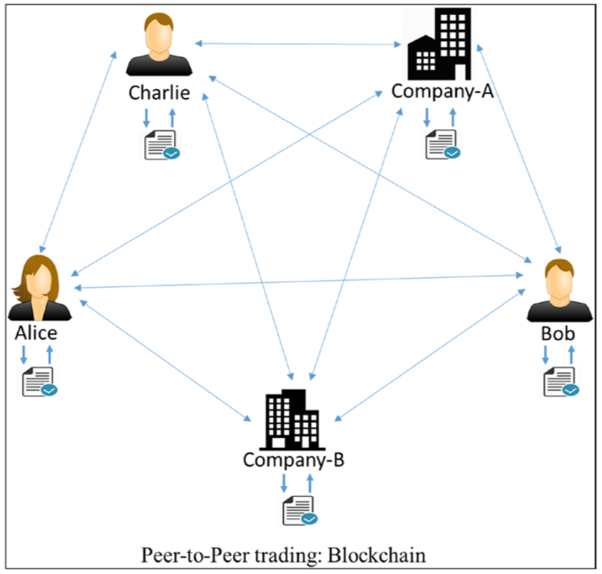
Peer-to-peer stock trading

Slide 36
Concept of Blockchain
Blockchain is a peer-to-peer system of transacting values with no trusted third parties in between.
It is a shared, decentralized, and open ledger of transactions. This ledger database is replicated across a large number of nodes.
This ledger database is an append-only database and cannot be changed or altered. It means that every entry is a permanent entry. Any new entry on it gets reflected on all copies of the databases hosted on different nodes.
There is no need for trusted third parties to serve as intermediaries to verify, secure, and settle the transactions.
It is another layer on top of the Internet and can coexist with other Internet technologies.
Just the way TCP/IP was designed to achieve an open system, blockchain technology was designed to enable true decentralization. In an effort to do so, the creators of Bitcoin open-sourced it so it could inspire many decentralized applications.

Slide 37
The blockchain data structure
Every node on the blockchain network has an identical copy of the blockchain as shown, where every block is a collection of transactions, hence the name. As you can see, there are two major parts in every block. The “header” part links back to the previous block in the chain. What it means is that every block header contains the hash of the previous block so that no one can alter any transaction in the previous block.

Slide 38
Practical Example: Assume that there are three candidates—Alice, Bob, and Charlie—who are doing some monetary transactions among each other on a blockchain network.
Step-1: Let us assume that Alice had $50 with her, which is the genesis of all transactions and every node is aware of it, as shown in Figure (The genesis block).

Slide 39
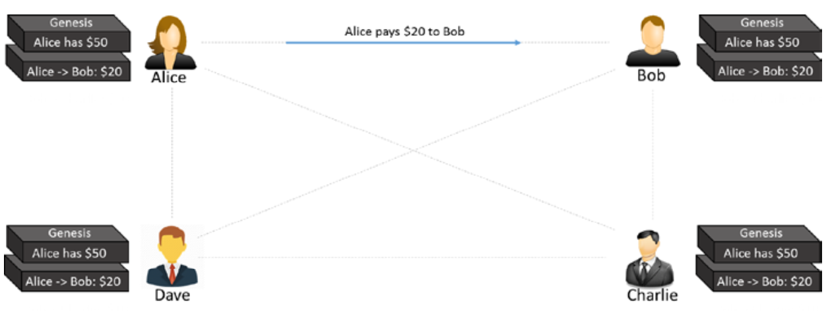
Step-2: Alice makes a transaction by paying $20 to Bob. Observe how the blockchain gets updated at each node, as shown in Figure (The first transaction).

Slide 40
Step-3: Bob makes another transaction by paying $10 to Charlie and the blockchain gets updated as shown in Figure (The second transaction).
Please note that the transaction data in the blocks is immutable. All transactions are fully irreversible. Any change would result in a new transaction, which would get validated by all contributing nodes. Every node has its own copy of blockchain.

Slide 41
cont….
If there are many questions popping up in your mind, such as “What if Alice pays the same amount to Dave to double-spend the same amount, or what if she is making a payment without having enough funds in her account?,” “How is the security ensured?,”

Slide 42
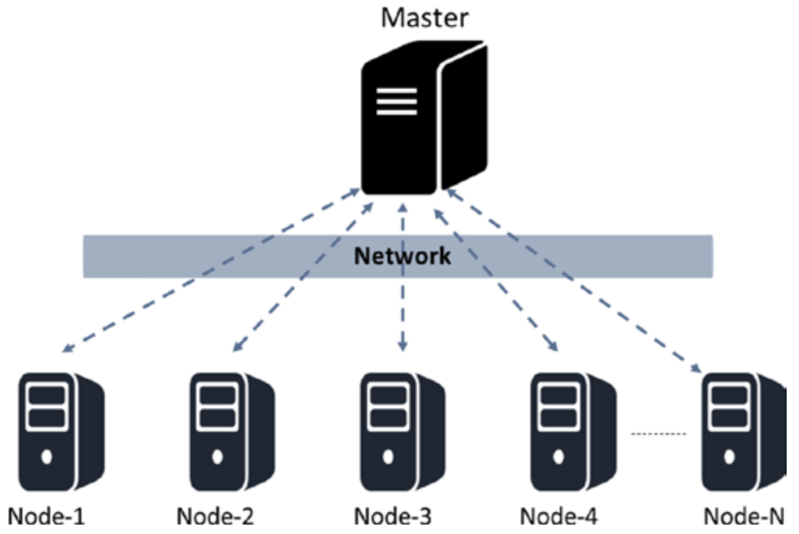
A distributed system with centralized control

Slide 43
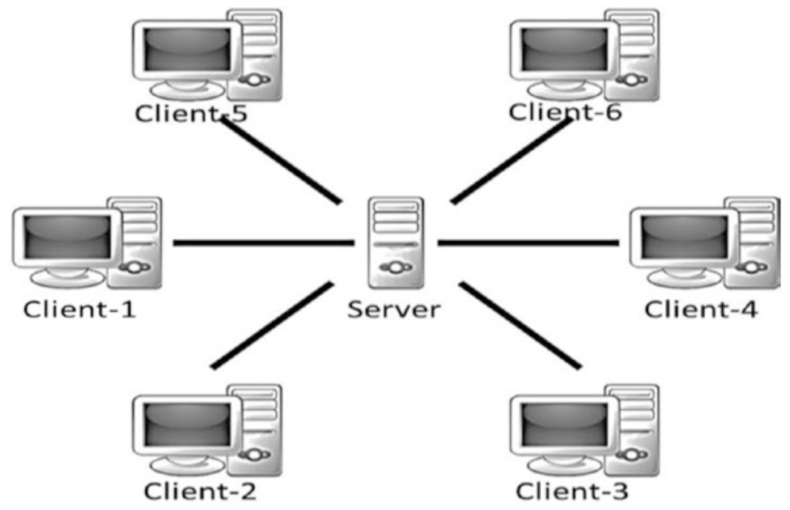
A centralized system
Trust issues
Security issue
Privacy issue—data sale privacy is being undermined
Cost and time factor for transactions

Slide 44
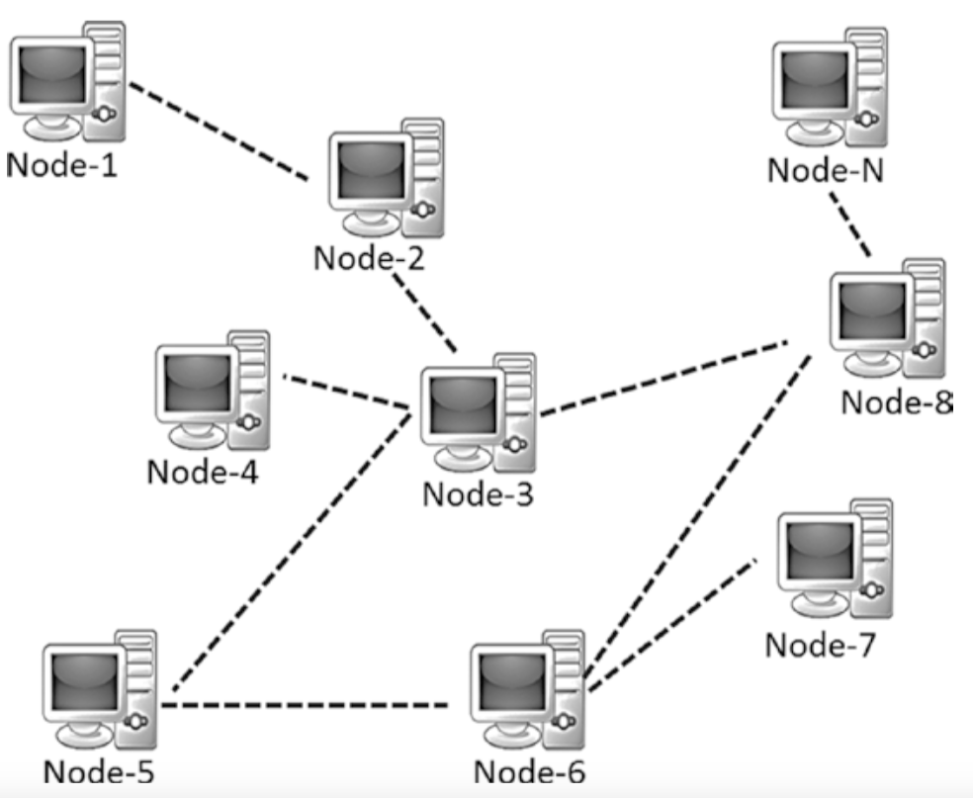
A decentralized system
Elimination of intermediaries
Easier and genuine verification of transactions
Increased security with lower cost
Greater transparency
Decentralized and immutable

Slide 45
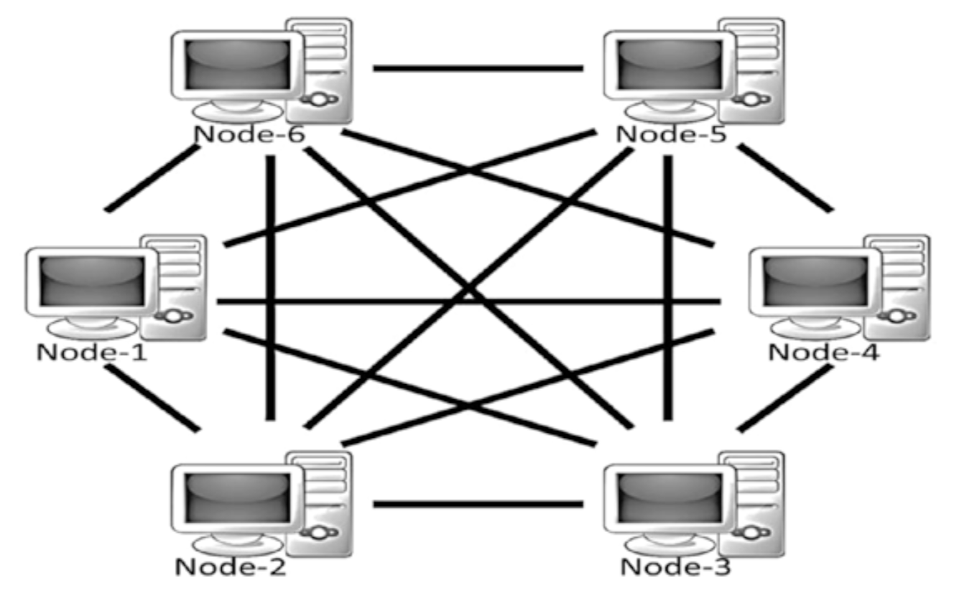
A decentralized and peer-to-peer system

Slide 46
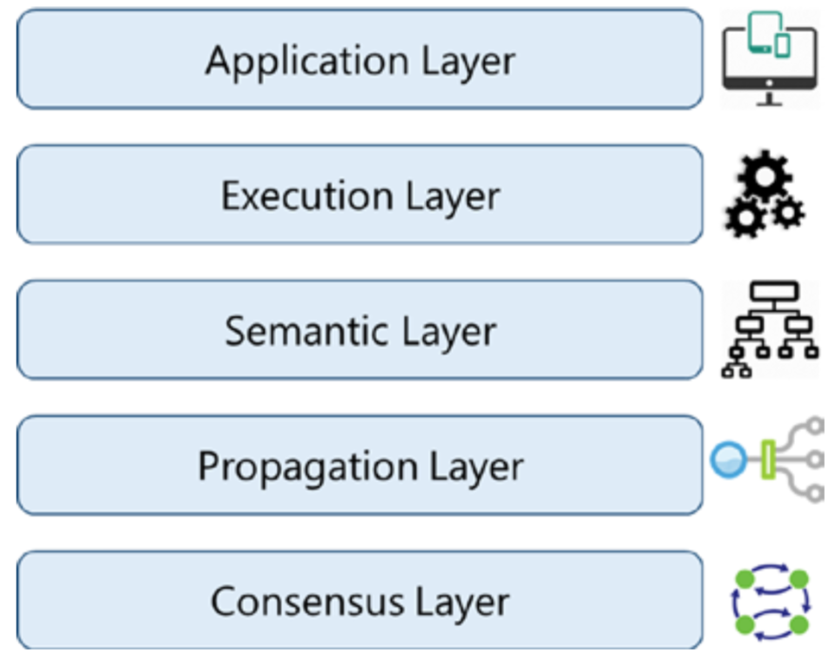
Various layers of blockchain
Application layer is the layer where you code up the desired functionalities and make an application out of it for the end users. It usually involves a traditional tech stack for software development such as client-side programming constructs, scripting, APIs, development frameworks, etc. For the applications that treat blockchain as a backend, those applications might need to be hosted on some web servers and that might require web application development, server-side programming, and APIs, etc.
The Execution Layer is where the executions of instructions ordered by the Application Layer take place on all the nodes in a blockchain network. The instructions could be simple instructions or a set of multiple instructions in the form of a smart contract.
The Semantic Layer is a logical layer because there is an orderliness in the transactions and blocks. A transaction, whether valid or invalid, has a set of instructions that gets through the Execution Layer but gets validated in the Semantic Layer. If it is Bitcoin, then whether one is spending a legitimate transaction, whether it is a double-spend attack, whether one is authorized to make this transaction, etc., are validated in this layer.
The previous layers were more of an individual phenomenon: not much coordination with other nodes in the system. The Propagation Layer is the peer-to-peer communication layer that allows the nodes to discover each other, and talk and sync with each other with respect to the current state of the network.
The Consensus Layer is usually the base layer for most of the blockchain systems. The primary purpose of this layer is to get all the nodes to agree on one consistent state of the ledger. There could be different ways of achieving consensus among the nodes, depending on the use case. Safety and security of the blockchain is accertained in this layer.

Slide 47
Blockchain: friction removal
In the 1990s, mass adoption of the Internet changed the way people did business. It removed friction from creation and distribution of information. This paved the way for new markets, more opportunities, and possibilities. Similarly, blockchain is here today to take the Internet to a whole new level by removing friction along three key areas: Control, Trust, and Value.
Control: Blockchain enabled distribution of the control by making the system decentralized.
Trust: Blockchain is an immutable, tamper-resistant ledger. It gives a single, shared source of truth to all nodes, making the system trustless. What it means is that trust is no longer needed to transact with any unknown person or entity and is inherent by design.
Value: Blockchain enables exchange of value in any form. One can issue and transfer assets without central entities or intermediaries.

Slide 48
How Blockchain Works!

Slide 49
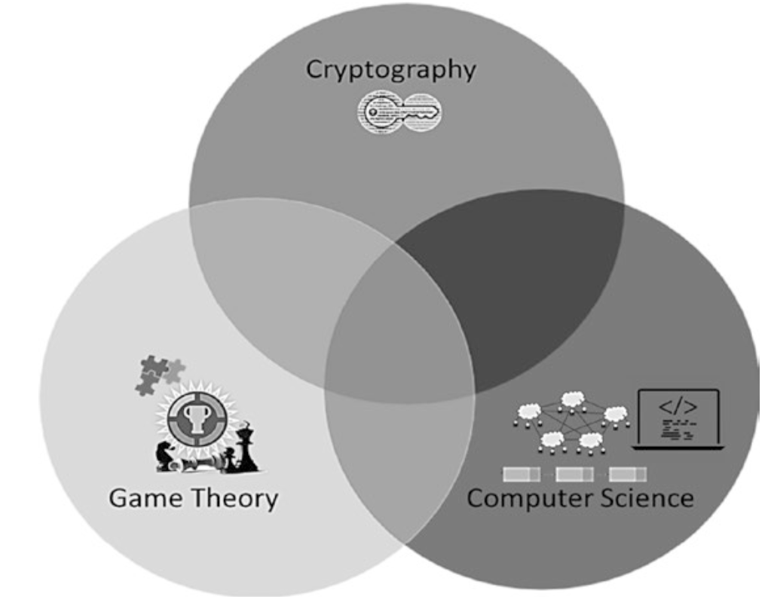
Blockchain at its core

Slide 50
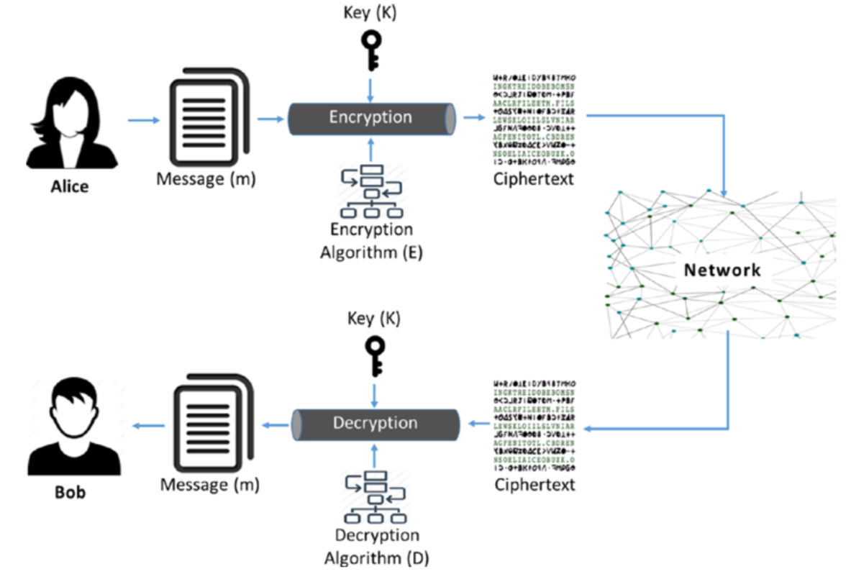
Cryptography
Confidentiality: Only the intended or authorized recipient can understand the message. It can also be referred to as privacy or secrecy.
Data Integrity: Data cannot be forged or modified by an adversary intentionally or by unintended/accidental errors. Though data integrity cannot prevent the alteration of data, it can provide a means of detecting whether the data was modified.
Authentication: The authenticity of the sender is assured and verifiable by the receiver.
Non-repudiation: The sender, after sending a message, cannot deny later that they sent the message. This means that an entity (a person or a system) cannot refuse the ownership of a previous commitment or an action.
Symmetric key cryptography is referred to as private key cryptography
Asymmetric key cryptography is called public key cryptography.

Slide 51
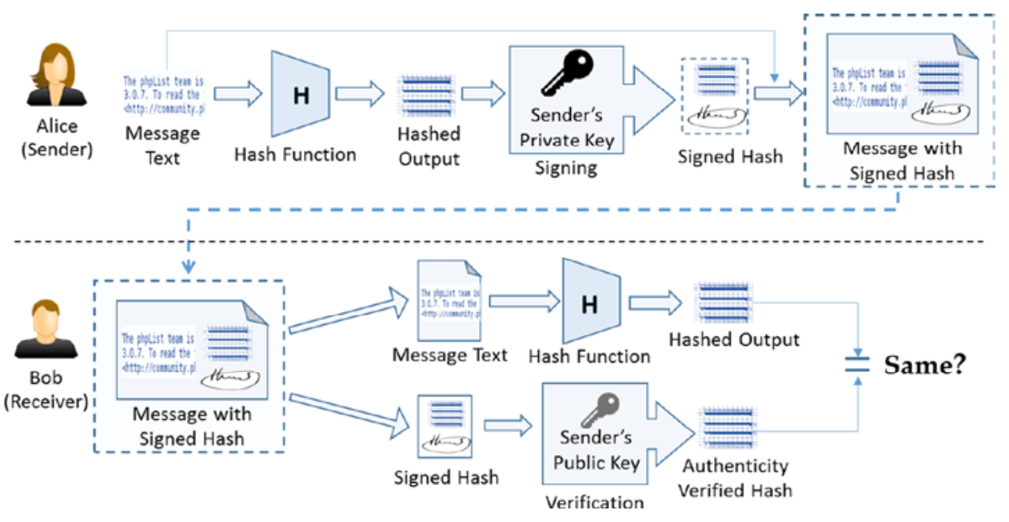
Digital Signature Algorithm (DSA)
DSA provides the following security properties:
Authenticity: Signed by private key and verified by public key
Data integrity: Hashes will not match if the data is altered.
Non-repudiation: Since the sender signed it, they cannot deny later that they did not send the message. Non-repudiation is a property that is most desirable in situations where there are chances of a dispute over the exchange of data. For example, once an order is placed electronically, a purchaser cannot deny the purchase order if non-repudiation is enabled in such a situation.

Slide 52
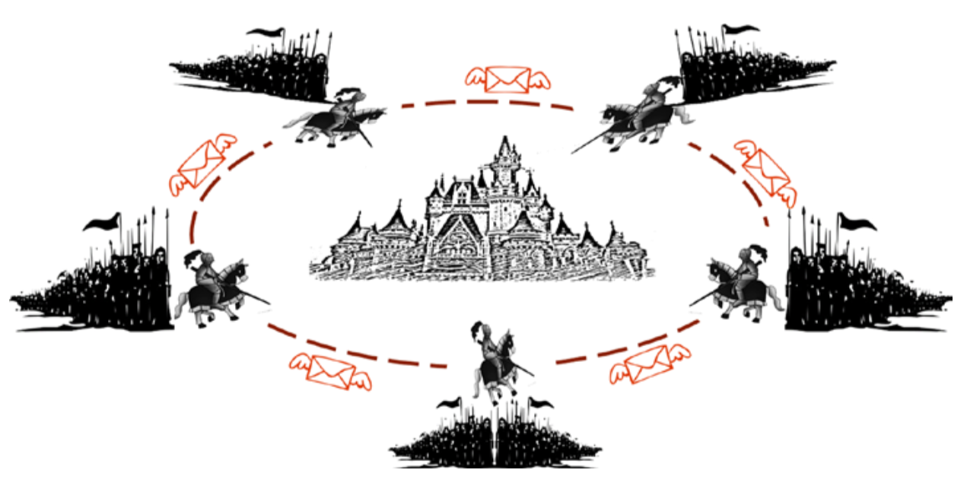
Game Theory: Byzantine army attacking the city
The Byzantine Generals’ Problem is widely used in distributed storage solutions and data centers to maintain data consistency across computing nodes.

Slide 53
Computer Science Engineering
Blockchain: blockchain is actually a blockchain data structure; in the sense that it is a chain of blocks linked together.
Hash pointeris the basic building block of blockchain data structure. Hash pointers point to the previous data block and provide a way to verify that the data has not been tampered with.
The purpose of the hash pointer is to build a tamper resistant blockchain that can be considered as a single source of truth. How does blockchain achieve this objective? The way it works is that the hash of the previous block is stored in the current block header, and the hash of the current block with its block header will be stored in the next block’s header.

Slide 54
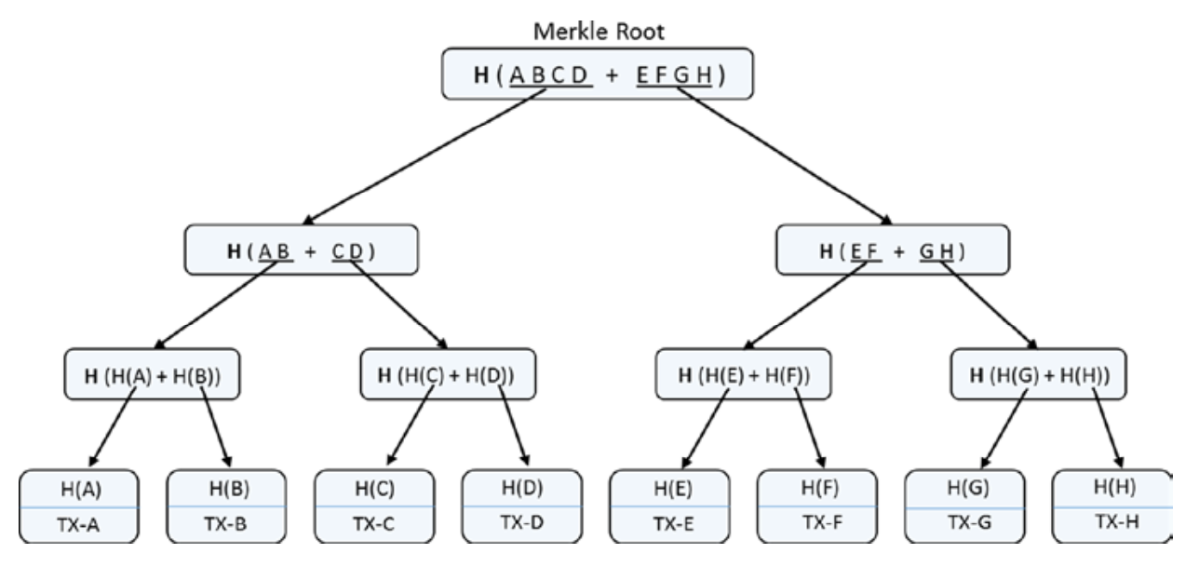
Merkle Binary Tree
Similar to the hash pointer data structure, the Merkle tree is also tamper-proof. Tampering at any level in the tree would not match with the hash stored at one level up in the hierarchy, and also till the root node. It is really difficult for an adversary to change all the hashes in the entire tree. It also ensures the integrity of the order of transactions. If you change just the order of the transactions, then also the hashes in the tree till the Merkle root will change.
As discussed, if we were to find a transaction through its hash, or check if a transaction had happened in the past, how would we get to that transaction? The only way is to keep traversing till you encounter the exact block that matches the hash of the transaction. This is a case where a Merkle tree can help a great deal.

Slide 55
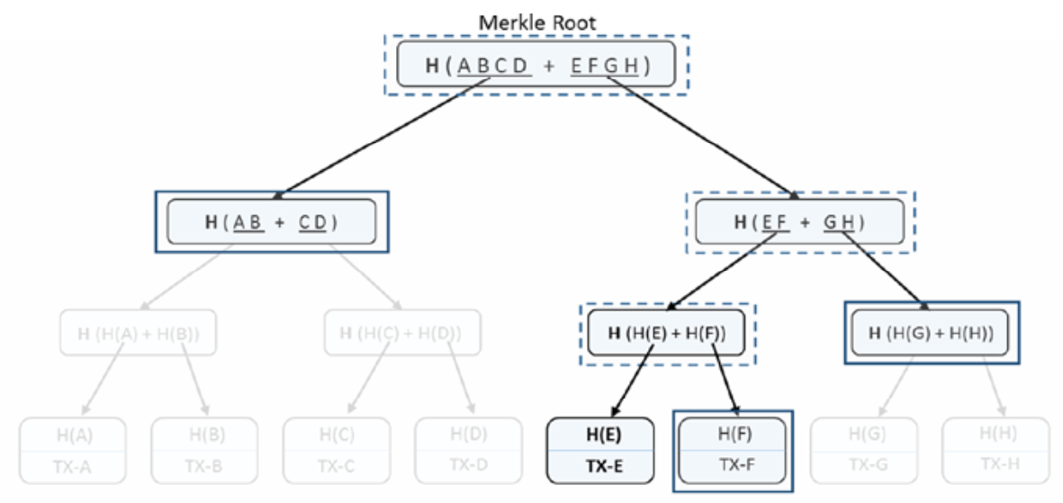
Verification in Merkle tree
Merkle trees provide a very efficient way to verify if a specific transaction belongs to a particular block. If there are “n” transactions in a Merkle tree (leaf items), then this verification takes just Log (n) time.
To verify if a transaction or any other leaf item belongs to a Merkle tree, we do not need all items and the whole tree. Rather, a subset of it is needed as we can see in the diagram in Figure left. One can just start with the transaction to verify along with its sibling (it is a binary tree so there would be one sibling leaf item), calculate the hash of those two, and see if it matches their parent hash. Then continue with that parent hash and its sibling at that level and hash them together to get their parent hash. Continuing this process all the way to the top root hash is the quickest possible way for transaction verification (just Log (n) time for n items). In the figure, only the solid rectangles are required and the dotted rectangles can be just computed, provided the solid rectangle data. Since there are eight transaction elements (n = 8), only three computations (log2 8 = 3) would be required for verification.

Slide 56
Summary of Blockchain Basics
Cryptographic functions are one-way and cannot be inverted. They are deterministic and produce the same output for a given input. Any changes to the input would produce a completely different output when hashed again.
Using public key cryptography, digital signatures are possible. It helps in verifying the authenticity of the person/entity that has signed. Considering the private key is kept confidential, it is not feasible to forge a signature with someone else’s identity. Also, if someone has signed on any document or a transaction, they cannot later deny they did not.
Using game theoretic principles and best practices, robust systems can be designed that can sustain in most of the odd situations. Systems that can face the Byzantine Generals’ Problem need to be handled properly. Our approach to any system design should be such that the participants play by the rules to get the maximum payoff; deviating from the protocol should not really benefit them.
The blockchain data structure, by using the cryptographic hashes, provides a tamper resistant chain of blocks. The usage of Merkle trees makes the transaction verification easier and faster.

Slide 57
Assignment for Debate(10/15)
Resolution of “5G and Technology/Trade Battle between US and China”
Argument # 1: 5G battle between US and China can be better for the free world.
Argument # 2: Technology decoupling from China would be best for the rest of world in the long run.
Argument # 3: US will be better off in the long run to put key manufacturing back to its own territory in stead of relying on China or others
Argument # 4: China will win its own way to dominate technology and trade related conflicts with US and others
Argument # X’s: (to be determined by the teams)
Arrangement: For(teams 1/4), Against(teams 2/3), Moderator(LIAO YENLIN), Commentator(Daniel)

