Slide 1
Blockchain and Distributed Ledger Technology (DLT)
Daniel Hao Tien Lee
http://danieleewww.yolasite.com/2018-mgb070.php
danieleewww@gmail.com

Slide 2
Case Study of Blockchain

Slide 3
What is Blockchain?
A blockchain is a continuously growing list of records
called blocks, which are linked and secured
using cryptography.
It is an open, distributed ledger that can record transactions between two parties efficiently and in a verifiable and permanent way.
https://coincenter.org/entry/what-is-blockchain-anyway

Slide 4
What is Blockchain?
Blockchains can be used in application requiring:
Contracts
Certificate of Ownership
Statement of authenticity
Proof of a bank's financial transaction
https://www.cbinsights.com/research/what-is-blockchain-technology/

Slide 5
Key aspects of Blockchain
Digital Ledgers
Blocks
Decentralized
Consensus Mechanism
Proof-of-work
Cryptography

Slide 6
Use case 0: Blockchain Bitcoin Features

Slide 7
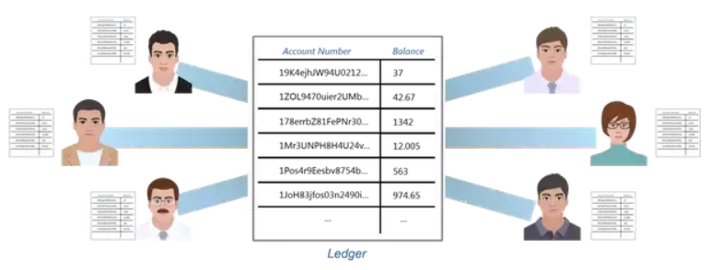
Distributed Public Ledger
Every single person on the network has a copy of the ledger. There is no single centralized original copy. Ledger here means the copy of all the transactions that ever happened. Blockchain is a distributed database that stores all the transactions that have ever happened in the history of specific application, i.e. Bitcoin. This ensures that no one person can make changes to the ledger because everyone else will immediately flag it as corrupt.

Slide 8
Hash Encryption
Everything stored on the Blockchain is encrypted. This way, everyone is able to see all the transactions but at the same time no one will know which of those accounts belongs to you. Isn’t this exactly what we expect a banking system to be?

Slide 9
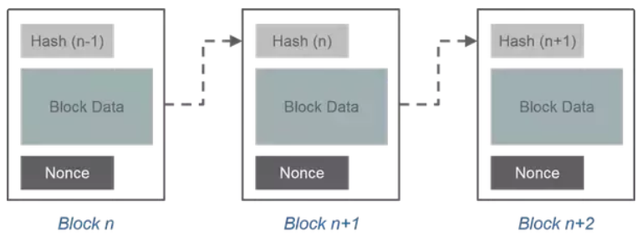
Proof of Work
Proof of Work is a concept invented in Bitcoin Blockchain where in the miners (special users of Bitcoin) will validate transactions by solving a complex mathematical puzzle called Proof of Work. Technically, there is a hash target value designated to every block before time.
Miners club together a set of unverified Bitcoin transactions (around 250) into one block, compute its hash and then begin a race to find a specific set of characters called Nonce.
The total hash obtained from the hash of the previous block, transaction data and the nonce has to match the final pre-assigned target hash value. It is this Nonce which is computationally extensive. Only people with huge computational computing power and electricity are able to solve it in 10 minutes on average.

Slide 10
Incentive Validation
The most interesting part of Bitcoin is Bitcoin Mining. It is the concept in which certain users do a piece of work and are rewarded 12.5 BTC per block. Each block takes on average about 10 minutes to mine. Thus a successful miner earns $ 34,380. You could in theory buy an Audi A4 every 10 minutes given you can successfully mine the block. It takes on average about 12 billion laptops working in parallel to achieve this feat.
https://www.coindesk.com/information/how-bitcoin-mining-works/
“The Rise and Fall of Bitcoin” https://www.wired.com/2011/11/mf-bitcoin/

Slide 11
Case study 1: Global food supply chain
Identify where a food product came from in about 2.5 seconds - down from six days before its history was tracked on a blockchain
https://www.coindesk.com/ibm-wants-know-ways-blockchain-can-go-wrong

Slide 12
Why Blockchain for Food Supply Chain
Because the data provided by the supply chain participants must be unmodifiable. Due to the significant distrust and suspiciousness among consumers, supply chain companies, and authorities (caused by several food frauds and corruption), only technically unalterable logistics and food quality data can provide credibility.
Because the data in the system is a common property of all participants. It must be stored in a shared, distributed ledger to provide transparency.
Because the food safety related data all over the world is a property of all us, and data accessibility must be public and democratic.
Because the economic inequality is one of the largest social problems and we need a technology which helps to create a fair access to data, know-how, and income.
Because corruption is a global economic problem, and the food sector in emerging countries is one of the most affected sectors. Incorruptible food history information leads to transparent food supply chains, which can make a difference in public health, and literally save lives.

Slide 13
Cost Saving by Adoption of Blockchain in Food Supply Chain
The cost of human health and life
The cost of recalling tainted food
The cost of food wasted due to consumer fears
“A blockchain food safety program is tremendously good because it provides transparency into the food system, which means that in the event that there is a problem like a recall, you’re able to quickly, effectively, and surgically deal with that problem.” —Brigid McDermott, IBM

Slide 14
Tracing Mexican mangoes in the US
Developed using the hyperledger blockchain technology, the pilots were designed to accurately record the following:
Farm origin data
Batch number
Factory and processing data
Expiration dates
Storage temperatures
Shipping details
How food tracking that would usually take seven days could be done in 2.2 seconds with blockchain. Once the blockchain projects scale to include 10 or more nodes, IBM believes it can save the industry “billions of dollars.”
Walmart also uses IBM Watson to predict patterns in retail by analyzing policies and variables that influence the supply chain.
In addition to speeding up how food is traced, Walmart can also speed up deliveries by predicting road traffic.

Slide 15
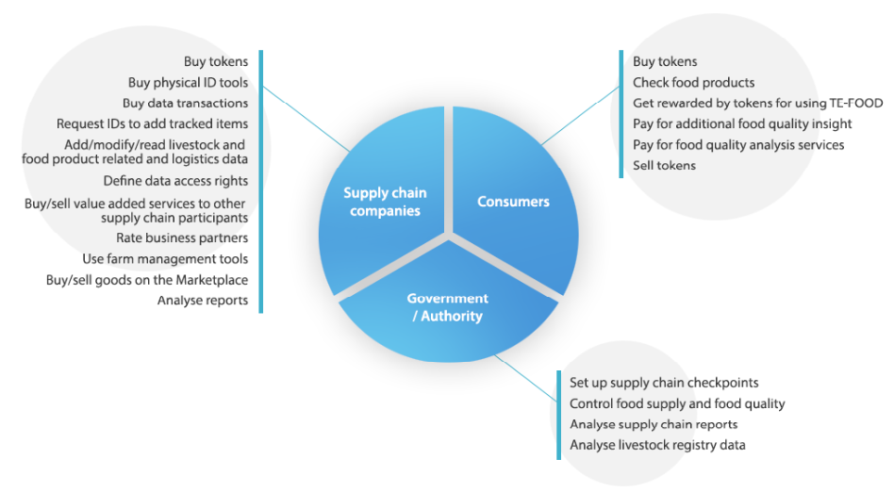
Tokenized financial transactions will enable us to equally integrate supply chain participants, authorities, and consumers into the process.
https://ico.tefoodint.com/te-food-white-paper.pdf

Slide 16
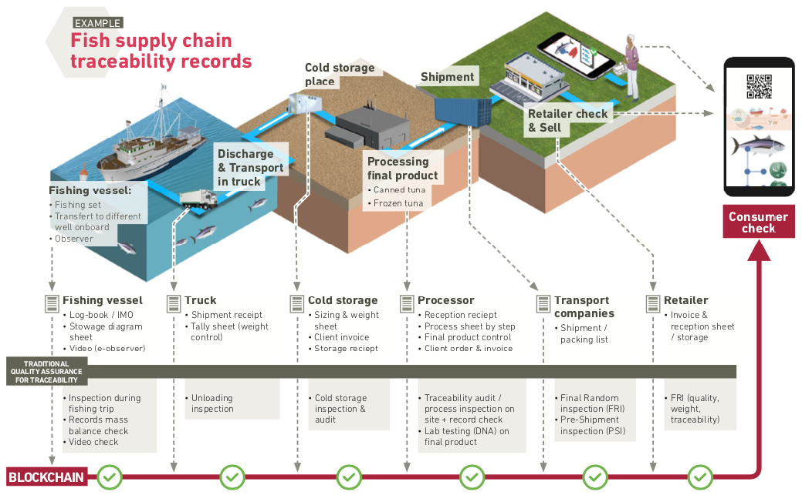
http://origin.bureauveritas.com/assets/vendor/white_paper_food_blockain.pdf

Slide 17
Food Supply Chain
https://www.forbes.com/sites/rachelwolfson/2018/07/11/understanding-how-ibm-and-others-use-blockchain-technology-to-track-global-food-supply-chain/#5690c2e62d1e
https://www.altoros.com/blog/blockchain-at-walmart-tracking-food-from-farm-to-fork/
https://www.coindesk.com/ibm-wants-know-ways-blockchain-can-go-wrong
https://cointelegraph.com/news/walmart-is-ready-to-use-blockchain-for-its-live-food-business
https://cointelegraph.com/news/walmart-experiments-with-blockchain-to-safely-store-food
https://www.ibm.com/blockchain/solutions/food-trust
https://www.slideshare.net/MattLucas3/blockchain-solutions-v209
https://www.slideshare.net/ibmsverige/blockchain-explained-87917702

Slide 18
Food Supply Chain: Startup ICO
https://genuineway.io/
https://vegannation.io/
https://www.bext360.com/
http://nif.vc/about/
https://www.forbes.com/sites/rachelwolfson/2018/07/11/understanding-how-ibm-and-others-use-blockchain-technology-to-track-global-food-supply-chain/#5690c2e62d1e

Slide 19
Case study 2 : Trucking industry
https://www.freightwaves.com/blockchain/

Slide 20
Why need blockchain for trucking industry?
Because trucking is an inefficient industry: in U.S. truckers drive more than 29 billion miles with partial or empty truckloads.
American Trucking Association: there are roughly 1.5 million trucking companies employing approximately 3.5 million truck drivers. But 90 percent of these companies have six trucks or fewer. This enormously fragmented industry struggles to match shippers (the demand) with carriers (the supply).
Blockchain could be the Holy Grail that makes the entire trucking supply chain more efficient. Imagine a cadre of shippers, carriers and brokers collaborating on a secure, frictionless network.

Slide 21
Prerequisite
Everyone must trust the blockchain as the single source of truth: For example, some manufacturers require their carriers to have $250,000 of cargo insurance before they hand-off their goods to be transported. If a carrier enters “yes, we have the insurance” in the blockchain, their customer must trust that to be true. Similarly, carriers must trust the shippers that hire them through the blockchain to pay them for their services.
All shippers, carriers and brokers will be vetted, and relationships need to be built through contracts and agreements with a level of interconnectivity of trustable data sources. For example, to ensure that a carrier has satisfied insurance requirements, the blockchain should connect directly with insurance companies.
Small carriers and shippers must participate en masse: This task will prove to be difficult.
The entire industry must embrace data standardization: Data standardization is not easy. https://bita.studio/

Slide 22
Case study 3: Flight insurance
Blockchain technology could run a flight- insurance business without any employees
28
https://spectrum.ieee.org/computing/networks/how-smart-contracts-work

Slide 23
All-Blockchain Insurer: for insurance-only and ecosystem blockchains
https://www.bcg.com/en-sea/publications/2018/first-all-blockchain-insurer.aspx

Slide 24
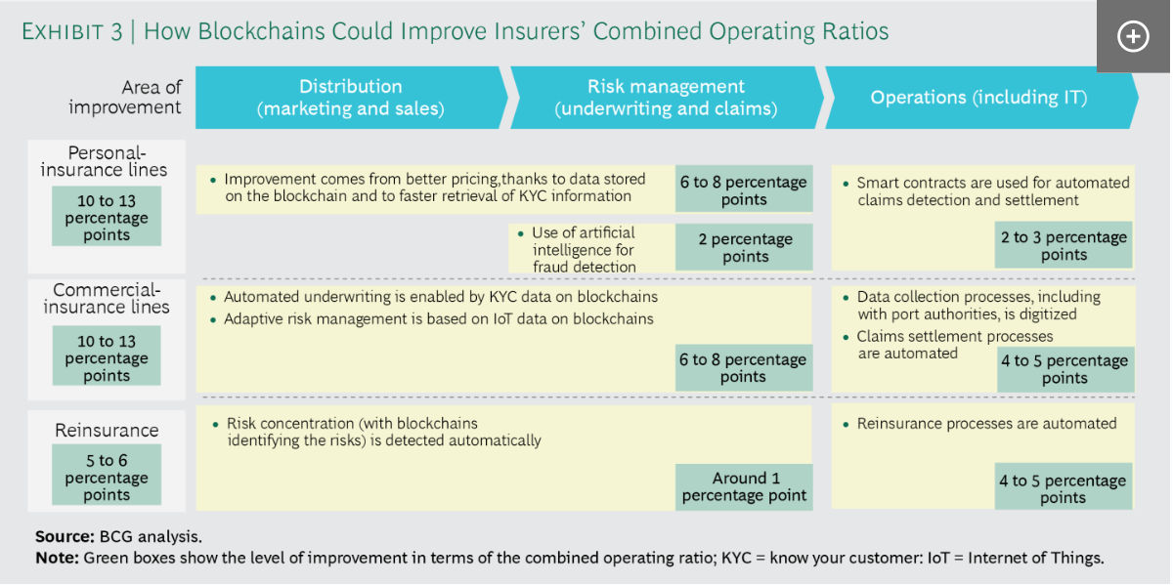

Slide 25
Customer Onboarding Process
The current customer onboarding process for the insurance companies is a key requirement to completing the underwriting process. The current As-Is process flow requires customer providing KYC details which is then further validated by the insurance company using various manual process. KYC details which is then further validated by the insurance company using various manual process. In a case were the customer medical information is required, the insurance company would inform the customer to visit some hospitals and click to recapture medical information such as blood pressure, HIV status, eye test, body mass index (BMI) etc. Figure 6 below shows the typical process flow when registering a customer for a new business (NB), completing a policy endorsement (EN) or policy renewal (RN) which can occur monthly, quarterly, semi-annually or yearly. The repetitive process of completing customer KYC form at each stage of these types of transactions means increased operational cost and undue delay in KYC process.
For the following slides of various insurance processes are courtesy of :
https://comserv.cs.ut.ee/home/files/Akande_Software_Engineering_2018.pdf?study=ATILoputoo&reference=7F88D5D6D854E63009585350EBAB8B0EBEFCAA3D

Slide 26
Underwriting Process
Policy underwriting typically takes an average of five days to 3 months for cases like aviation and marine insurance. There are different processes involving risk assessments, medical assessment etc. to ensure that the cost of insurance cover provided in proportionate to the risk being absolved by the insurance company. The process flow shown in Figure indicates the need for accurate data from the customer to before a cover can be provided by the insurance company.

Slide 27
Claim Process
Once a risk occurs, the claims unit swing into action to enable timely payment of the client. This process involves lots of investigation and due diligence to potentially identify fraudulent claims and ensure the organization is not paying more than expected. Both internal and external expertise are required including loss adjusters, surveyors and superintendent. A widespread problem of multiple claims request made by the insured is also one challenge the insurance industry face as there is little or no collaboration in sharing information amongst them.

Slide 28
Reinsurance Policy
Various parties are involved during reinsurance process and payment. Huge risk amounting to billions of dollars cannot be covered by a single insurance company. In every country/ region, regulators set the capacity and level of risk each company can hold to help lower their risk and exposure level. This way risk can be spread globally involving reinsurance companies located across the globe.

Slide 29
Customer Onboarding Process (using Blockchain)
With the use of blockchain, the customer would only need to update their KYC details on a blockchain platform and approve access to specific data needed by the insurance company using the customer’s wallet address. This way, the customer’s identity is stored on the distributed ledger which is encrypted and safe. The customer has full control of what to share and all historical changes are immutable likewise hence making the customer identity data accurate, trustworthy and reliable. As shown in Figure, all internal redundancy and repetitive process in capturing the customers details is reduced or eliminated using the blockchain.

Slide 30
Underwritting Process (using Blockchain)
Underwriting process is core operation to providing an insurance cover. This process is supervised by insurance specialist including actuaries, surveyors, superintendents etc. As in seen in previous Figure, most of the underwriting process currently involves lots of paper work and in most cases, this takes an average of about 5 - 10days to get a policy underwriting process completed. With the redefined process flow shown below in Figure left, an estimated period of 2 days to complete an underwriting process including complex process involved in marine insurance, aviation, Oil & Gas etc.

Slide 31
Claim Process (using Blockchain)
The combination of IoT devices and the use of smart contract on blockchain implementation would allow for connected cars and smart homes to provide in real-time more accurate data for analysis and automatic claims payments. These smart devices would serve as oracles and be able to communicate and update smart contract providing information in real time such as brake pressure, airbag status, tire pressure etc. Insurance companies would be able to compensate for a safer driving habits as it would reduce claims payout thereby evolving from providing insurance cover to becoming valued partners that help their customers monitor, mitigate and avoid risk.
In Figure, we can see that with the implementation of blockchain, a greater percentage of the process flow would rely on oracle data sources and less on human.

Slide 32
Reinsurance Process (using Blockchain)
Information sharing amongst all relevant parties involved in a reinsurance transaction has in the past been of much burden. Since all parties involves in the risk sharing using different systems, there are cases of wrong interpretation of contract terms or undue delays from third party like the broker. With blockchain, this process can be done in real time thereby reducing transaction cost that arise for both the insurance and reinsurers in placing and managing a reinsurance contract. This would also fast track apportion payment when there is a claim. Once negotiations are completed, digital copies can be signed and can be accessible to all including regulators. Smart contract then ensures payment and reconciliation is seamless when a claim occurs. In Figure left, all parties involved are able view the apportionment and agreement signed. Since reinsurance involves huge risk and premium payment, a permissioned blockchain would be most suitable for information sharing.

Slide 33
Concern for the adoption of blockchain adoption in the insurance industry
Security vulnerabilities
Data privacy
Lack of skilled personnel
Regulatory uncertainty - improve technical standard would create a “tipping point” for widespread adoption
Scalability – computing power

Slide 34
Startup
https://www.ey.com/en_gl/news/2018/05/world-s-first-blockchain-platform-for-marine-insurance-now-in-co

Slide 35
Case study 4: Trading and Settlement
https://www2.deloitte.com/ch/en/pages/innovation/articles/the-blockchain-revolution.html

Slide 36
What is Clearing and Settlement?
Executing an order, “the trade,” declares the intention to buy or sell a security
“Clearing and settlement” refers to everything that happens after that initial declaration to cause the actual transfer of assets and ownership
Instructions and trade-related information must flow between broker/dealers, the securities exchange, central clearing parties, custodial banks, and security depositories, so that each takes the necessary action at the right time
How well the process works depends upon how well information flows between all of the players
Source: Harvard Research Group

Slide 37
Simple Settlement and Clearing

Slide 38
Credit Card Transaction
Source: www.futurepaytech.com

Slide 39
Securities Clearing and Settlement
Exchange
1. Trade ( T ) 2. Reporting
2. Notified Trade (T)
2. Notified Trade ( T )
Clearing Participant (Brokers)
Clearing House
Novates the trades and acts
as central counterparty
Clearing Participant (Brokers)
3. Net Batch Instructions (T+1)
3. Net Batch Instructions (T+1)
4. Batch Instructions (non-novated)
Clearing Service
4. Batch Instructions (non-novated)
Settlement Participant (Custodians)
Settlement Participant (Custodians)
Settlement House
Settles novated and non- novated trades and conducts multilateral netting
6. Confirmation of DvP Transfer (T+3)
6. Confirmation of DvP Transfer (T+3)
5. Instructions to effect transfer of funds (T+3)
7. End of Day Reporting (T+3)
Registry
Central Bank
Source: ASX

Slide 40
Fundamentals
In order to sell a security/product you need to prove that you have it
In order to buy the security/product you need to prove you have the funds
When it is bought/sold, the ownership is transferred
How well the process works depends upon how well information flows between all of the players

Slide 41
Financial Application of Blockchain
Smart Contracts
Smart Assets
Clearing and Settlement
Payments
Digital Identity

Slide 42
Smart Contracts
The Contract needs to have:
What the asset is
How much/size/weight
Value (currency)
Ownership
Terms and conditions
Actions

Slide 43
How Smart Contracts Work
Match Buyer with Seller
Exchange Contract receives assets Contract distributes assets
A
Sell House
Buy House
B
Buy House
Get Token
Registry
Clearing and settlement is automated
Ownership is undisputed
Digitise the Land Deed
Digitise Currency

Slide 44
Stock/Securities Exchange

Slide 45
Case study 5: Blockchain in Healthcare
https://www.hyperledger.org/wp-content/uploads/2016/10/ey-blockchain-in-health.pdf

Slide 46
Status of Blockchain in Healthcare
There is a growing trend towards personalized medicine, with people tracking and gaining more information about their health than ever before. Federal legislation (Medicare Access and CHIP Reauthorization Act) has also dramatically sped up digitization of medical records. However issues arise when all this data need to be stored securely and transferred across healthcare practitioners to foster collaboration. Blockchain can help with these.
Blockchain in healthcare is still very early stage requiring education around use-cases that can benefit from it, unlike in finance where it is a worldwide phenomenon. However it has moved past the theoretical stages and has spurred activity from major companies and venture capitalists.
According to Founder of Factom, a healthcare startup that has received over $1B in funding, Blockchain can enable for the first time the long sought longitudinal health record that contains every episode of care from childhood to old age in every location healthcare was delivered. This capability would radically reduce medical errors and improve care quality as well as empower individuals to have full control over their own health records
An initial adoption barrier was that Healthcare providers – historically locked in competition and often resistant to sharing health data within their systems – would need to agree to use Blockchain. With recent developments in the United States, Federal Legislation is incentivizing data sharing with new pay-for-value payment models.
The United Kingdom, Australia and Estonia have seen considerable government adoption of the technology, with Estonia for example
signing a deal with GuardTime to secure 1 million patient records on the Blockchain in 2016

Slide 47
Blockchain Value Propositions for Healthcare
“One of the pretty obvious use cases for Blockchain is its ability to identify when there's been data manipulation and when there's been a disruption in that flow” – Peter Nichol, former IT chief of the Connecticut state health insurance exchange
 | Health Information Exchange (HIE) Pain Points | Blockchain Opportunities
 | Establishing a Trust Network depends on the HIE as an intermediary to establish point-to-point sharing and “book-keeping” of what data was exchanged. | Disintermediation of Trust likely would not require an HIE operator because all participants would have access to the distributed ledger to maintain a secure exchange without complex brokered trust.
 | Cost Per Transaction, given low transaction volumes, reduces the business case for central systems or new edge networks for participating groups. | Reduced Transaction Costs due to disintermediation, as well as near-real time processing, would make the system more efficient.
 | Master Patient Index (MPI) challenges arise from the need to synchronize multiple patient identifiers between systems while securing patient privacy. | Distributed framework for patient digital identities, which uses private and public identifiers secured through cryptography, creates a singular, more secure method of protecting patient identity.
 | Varying Data Standards reduce interoperability because records are not compatible between systems. | Shared data enables near real-time updates across the network to all parties.
 | Limited Access to Population Health Data, as HIE is one of the few sources of integrated records. | Distributed, secure access to patient longitudinal health data across the distributed ledger.
 | Inconsistent Rules and Permissions inhibit the right health organization from accessing the right patient data at the right time. | Smart Contracts create a consistent, rule-based method for accessing patient data that can be permissioned to selected health organizations.

Slide 48
10 Notable Healthcare Companies Built on Blockchain
Blockchain application platform for enterprises. For example, its first partner is Philips Blockchain Lab, a research center on Blockchain who is exploring the uses of Blockchain technology in clinical trials.
Gem
Blockchain security company, seeking to register every update and access to healthcare records in the Blockchain. They signed a deal with the Estonian e-Health Authority to secure the country’s health records, and created a network that can be used by patients, providers, private companies or the government to access information in a safe way.
Guardtime
Australian Blockchain company that built a platform CyphMD’s to improve and facilitate data sharing using smart contracts on the Ethereum Blockchain. Improved data sharing will influence the accuracy of the diagnosis and reduce the potential for common clinical errors.
Brontech
Platform that helps manage medical records using Ethereum Blockchain. It was created by MIT graduates with the goal to give patients the control over their health data. Their prototype gives patients one-stop-shop access to their medical history across multiple providers.
MedRec
Blockchain Health Co.
Blockchain application company operating out of San Francisco seeking to revolutionize the relationship between medical researchers and users, so users can share their medical data while maintaining control.

Slide 49
10 Notable Healthcare Companies Built on Blockchain
Platform company offering 5 types of solutions: clearinghouse (X12), private label marketplace, scheduling, identity management and payment optimization to improve communication among the medical community and reduce the inefficiency of the healthcare system.
Pokitdok
Help insurance companies use the Blockchain for their record keeping, so that all parties involved are able to easily verify the accuracy of the claims and further increase efficiency in medical billing processes. They signed a deal with US health data software provider to imprint their documents on the Blockchain to guarantee authenticity of sequence of events.
Factom
French startup looking to improve the major issue of lack of transparency and trust panning from data falsification in pharmaceutical clinical trials. For example of 137 clinical trials it
investigated during a study, 67 found outcomes they weren’t expecting, and only 9 reported
their results properly.
Stratumn
Global Blockchain platform company looking to solve problems in several industries. The startup partnered with Philips Healthcare to work on the possible applications of Blockchain technology to improve the healthcare industry.
Tierion
French startup using blockchain-based technologies to fight drug counterfeiting. Blockchain can improve drug traceability, allow participants in the supply chain interact easily and alert the labs of fake drugs.
Blockpharma

Slide 50
Classifying Companies by Value
Companies
Description Value Proposition
Supporting Trends
Brontech
MedRec
Patient Data Management
These companies perform a service similar to putting healthcare data on the cloud, except that they put it on the Blockchain and unlock the additional benefits that come with the system.
Foster interoperability to reduce
Secure health records for patients and
care providers.
Foster ancestral analysis over time
Enable automation that can come
The typical primary care physician has to coordinate care with
229 other physicians
working in 117 practices
Lack of interoperability costs 150,000 lives and $18.6 billion per year
Guardtime
Gem
Stratumn
Research and Clinical Trials
These companies protect the identity of people involved in trials, reduce falsification of results, and manages the thousands of micro-processes and documentation involved.
Reduce falsification of results
Scale number of people who can and are willing to contribute to studies
Speed up the process
Secure identity of participants
In 2015, publisher Springer had to retract 64 articles from its journals for fraudulent findings
.
Blockchain Health Co.
Drug Provenance
These companies prevent patients from consuming counterfeit drugs, by increasing visibility and transparency thus reducing probability of misinformation and data inaccuracy in the supply chain.
Track drug integrity all the way to the final patient
Reduce complexity of the supply chain
Automate processes using smart
contracts
800,000 deaths due to consumption of falsified medicines in the world every year
$100s of billions are spent tackling counterfeit drugs in developing nations annually
Stratumn
Blockpharma
Factom
Pokitdok
Payments, Claims & Other Services
These companies provide other value-added services like payment optimization, scheduling, document management and insurance claims to improve efficiencies in managing operations at hospitals.
Reduce inefficiencies in hospital operations
Reduce complexity around processing payments to and from different insurance agencies
Provide immutable storage/ history of transactions
Highmark for example, the biggest health insurer in Pennsylvania lost $222 Million selling coverage under the Affordable care Act in 2015
.
Tierion

Slide 51
Business Models
Software as a Service - Companies charge a fee for using their API and infrastructure. Example: Tierion
Professional Services - Some companies build custom projects for enterprise clients. Many existing firms have Blockchain practice areas. Examples: Gem.
Flat Fees & Transaction Fees - Some companies build and maintain networks between a consortium of partners. They make money by
charging a subscription fee or a transaction fee on activity in the network. Often times, they are a part owner of the network.
Examples: Chain, R3Cev
Service Level Agreements - Some businesses build platforms and host infrastructure for enterprise customers. They offer a SLA for uptime and maintenance. Examples: Bloq, Microsoft
Cryptocurrency Speculation - Some Blockchain companies either issue their own token or the management holds large amounts of a cryptocurrency such as Ethereum. These companies do work that makes the market value of their token increase. They then sell the token to speculators. Examples: Factom

Slide 52
Niche Considerations for Evaluating Healthcare Blockchain
Opportunities
Feasibility of use-case/ Partnership with healthcare professionals – Few notable healthcare professionals have cautioned that many proposed Blockchain use-cases are not operationally practical for industry, or overlook that hospitals can get bankrupted by fines relating to careless exposure of patient data. This mandates that startups in this space work very closely with existing healthcare partners to develop feasible solutions.
Ecosystem – Although now is not the time to worry about which Blockchain technologies or standards will dominate, solutions should include abstractions around protocols and platform features to allow portability should it eventually become necessary to switch to a different standard.
Compute resources –The computational requirements to run the blockchain’s consensus algorithms consume time and resources. The very features that protect Blockchain against theft and fraud could also drive overhead if not correctly implemented.
Incentive for Miners –With bitcoin, miners earn bitcoins for carrying out mining tasks. Be clear on the economic incentives in place to entice miners to perform the mining and recording tasks. For example with MedRec, the miners are medical researchers who are rewarded with access to census-level data of the medical records.
Governance and Standards – There is an eventual need for governance and standards to prevent recklessness, chaos and calamity. For example there is a huge debate about what the block-size should be, and how this will affect volume of transactions. W3C Consortium does this for the web, while Internet Engineering Task Force does this for the net.

Slide 53
Blockchain: Its impact to Healthcare
Identity Management – Patients, Providers
Medical Record Management
Medicaid Management Information Systems
Benefits Administration
Data Security
Reimbursement
Clinical Trial Management
Pharmaceutical Supply

Slide 54
Blockchain: Its impact in Healthcare
▪ Identity Management – Patients, Providers
▪ Medial Record Management
▪ Medicaid Management Information Systems
▪ Benefits Administration
▪ Data Security
▪ Reimbursement
▪ Clinical Trial Management
▪ Pharmaceutical Supply
Created by Andrea Coravos 2017
Healthcare Blockchain Startup Landscape

Slide 55
Blockchain: What about public health?
Blockchain technology can impact public health
at many levels:
CDC
Within & between programs
Examples: laboratory, countermeasure tracking, surveillance and other data…
Prototypes…
Between programs and partners
The entire Public Health Community (as a consortium)
Federal, State, Local, etc.

Slide 56
Blockchain & Public health: The vision hasn’t changed…
…but the technology has dramatically matured
2008 – 2010: PHGrid
Savel, et al. Int J Med Inform. 2010 Jul;79(7):523-9

Slide 57
Blockchain: What about public health?
Blockchain technology can impact public health at
even more levels (in time):
Public Health / Clinical Healthcare Exchange
Health research data
Connections to other health and non-health related blockchains:
Financial, pharmaceutical, food supply blockchains

Slide 58
Blockchain: What about public health?
Many use cases to consider (with varying levels of
effort & numbers of stakeholders)
Surveillance / Monitoring
Event detection, situational awareness, notifiable condition reporting, surveillance / vital statistics, specimen tracking / results reporting, outbreak management
Interventions
Response management, inventory allocation and distro., resource utilization (hosp. beds, etc.)

Slide 59
Blockchain: What about public health?
Many use cases to consider (with varying levels of
effort & numbers of stakeholders)
Prevention
Vaccination campaigns, wellness programs, health awareness campaigns
Communication / Alerting
Health alerting, decision support, public communications,
health training and communications

Slide 60
Case Study 6: Blockchain in Automotive
Blockchains could be used to:
Share data on vehicles and their owners, manufacturers and dealers in a secure way
Monetise that data and derive more value from vehicles by increasing utilisation and selling unused space through car sharing
Link data held by different businesses across the industry including manufacturers, dealers, auto finance providers and insurers
Enable consumerstosavemoneythrough ‘pay as you go’ access to mobility and cheaper insurance based on usage and accurate data.

Slide 61
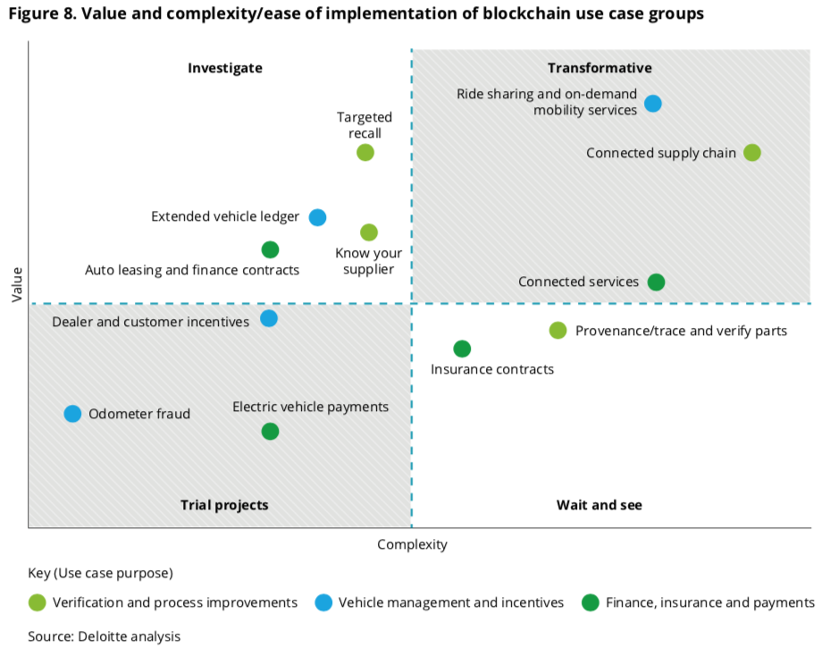
https://www2.deloitte.com/content/dam/Deloitte/cn/Documents/consumer-business/deloitte-cn-consumer-blockchain-in-the-automotive-industry-en-180809.pdf

Slide 62
What would you do with Blockchain?

Slide 63
Predictive maintenance and tracking parts
https://blogs.sap.com/2017/09/09/digital-twin-implementation/

Slide 64
Data reconciliation and settlements
https://www.bis.org/cpmi/publ/d157.pdf

Slide 65
Fund raising
https://www.forbes.com/sites/eidoo/2017/11/17/crypto-startups-managing-icos-and-fundraising-on-the-blockchain/#79cd5b046025

Slide 66
Digital Asset Management & Software Piracy
http://europa.eu/rapid/press-release_MEMO-17-4943_en.htm

Slide 68
Many Blockchain initiatives
https://techcrunch.com/2017/10/16/mapping-the-blockchain-project-ecosystem/

Slide 69
Future
www.bloomberg.com/news/features/2015-09-01/blythe-masters-tells-banks-the-blockchain-changes-everything

Slide 70
Whitepaper
https://www.slideshare.net/QuantUniversity/blockchain-for-business-a-quantuniversity-briefing

