Slide 1
Blockchain and Distributed Ledger Technology (DLT)
Daniel Hao Tien Lee
http://danieleewww.yolasite.com/2018-mgb070.php
danieleewww@gmail.com

Slide 2
Headline of Blockchain 2018 (Internet of Value)
Blockchain was a priority topic at Davos 2018; a World Economic Forum survey suggested that 10 percent of global GDP will be stored on blockchain by 2027. Multiple governments have published reports on the potential implications of blockchain, and the past two years alone have seen more than half a million new publications on and 3.7 million Google search results for blockchain.
Most tellingly, large investments in blockchain are being made. Venture-capital funding for blockchain start-ups consistently grew and were up to $1 billion in 2017. The blockchain-specific investment model of initial coin offerings (ICOs), the sale of cryptocurrency tokens in a new venture, has skyrocketed to $5 billion. Leading technology players are also heavily investing in blockchain: IBM has more than 1,000 staff and $200 million invested in the blockchain-powered Internet of Things (IoT).
Despite the hype, blockchain is still an immature technology
https://www.mckinsey.com/business-functions/digital-mckinsey/our-insights/blockchain-beyond-the-hype-what-is-the-strategic-business-value

Slide 3
Blockchain opportunities by industrial sector

Slide 4
Strategic Value of Blockchain
Blockchain does not have to be a disintermediator to generate value, a fact that encourages permissioned commercial applications.
Blockchain’s short-term value will be predominantly in reducing cost before creating transformative business models.
Blockchain is still three to five years away from feasibility at scale, primarily because of the difficulty of resolving the “coopetition” paradox to establish common standards.
https://www.mckinsey.com/business-functions/digital-mckinsey/our-insights/blockchain-beyond-the-hype-what-is-the-strategic-business-value

Slide 5
Nuts and Bolts of Blockchain
Blockchain is a distributed ledger, or database, shared across a public or private computing network. Each computer node in the network holds a copy of the ledger, so there is no single point of failure. Every piece of information is mathematically encrypted and added as a new “block” to the chain of historical records. Various consensus protocols are used to validate a new block with other participants before it can be added to the chain. This prevents fraud or double spending without requiring a central authority. The ledger can also be programmed with “smart contracts,” a set of conditions recorded on the blockchain, so that transactions automatically trigger when the conditions are met. For example, smart contracts could be used to automate insurance-claim payouts.

Slide 6
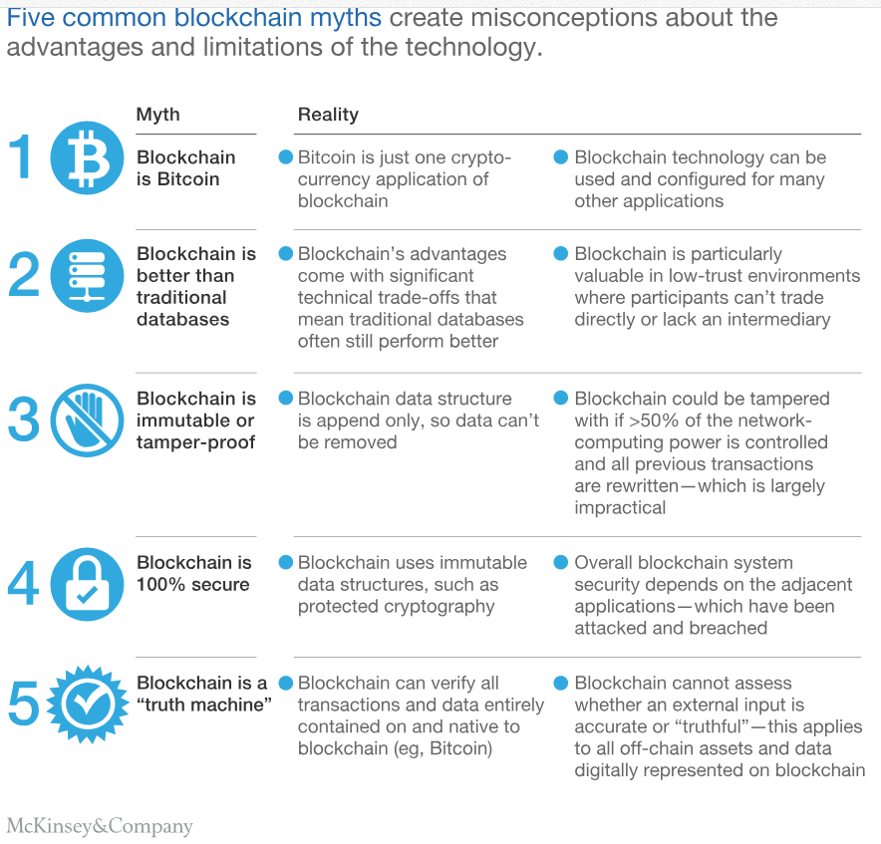

Slide 7
Two Fundamental Functions of Blockchain
Record Keeping
Transacting

Slide 8
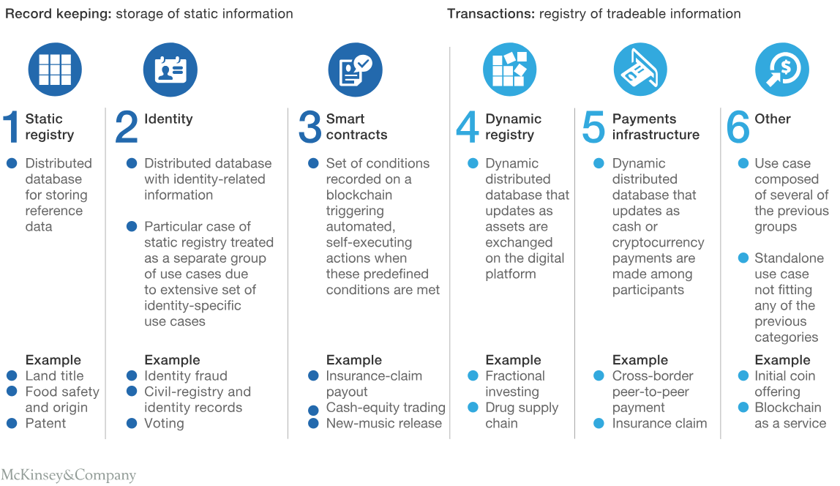

Slide 9
Blockchain does not need to be a disintermediator to generate value
Benefits from reductions in transaction complexity and cost, as well as improvements in transparency and fraud controls can be captured by existing institutions and multiparty transactions using appropriate blockchain architecture. The economic incentives to capture value opportunities are driving incumbents to harness blockchain rather than be overtaken by it. Therefore, the commercial model that is most likely to succeed in the short term is permissioned rather than public blockchain. Public blockchains, like Bitcoin, have no central authority and are regarded as enablers of total disruptive disintermediation. Permissioned blockchains are hosted on private computing networks, with controlled access and editing rights.
The degree to which incumbents adapt and integrate blockchain technology will be the determining factor on the scale of disintermediation in the long term.

Slide 10
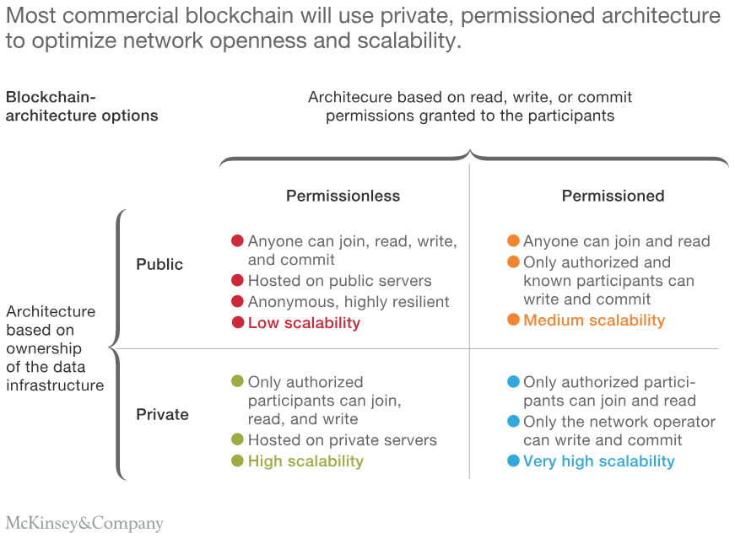

Slide 11
Uses Case of Permissioned Blockchain
Australian Securities Exchange, for which a blockchain system is being deployed for equities clearing to reduce back-office reconciliation work for its member brokers.
IBM and Maersk Line, the world’s largest shipping company, are establishing a joint venture to bring to market a blockchain trade platform. The platform’s aim is to provide the users and actors involved in global shipping transactions with a secure, real-time exchange of supply-chain data and paperwork.

Slide 12
In the short term, blockchain’s strategic value is mainly in cost reduction
Blockchain might have the disruptive potential to be the basis of new operating models, but its initial impact will be to drive operational efficiencies. Cost can be taken out of existing processes by removing intermediaries or the administrative effort of record keeping and transaction reconciliation. This can shift the flow of value by capturing lost revenues and creating new revenues for blockchain-service providers.

Slide 13
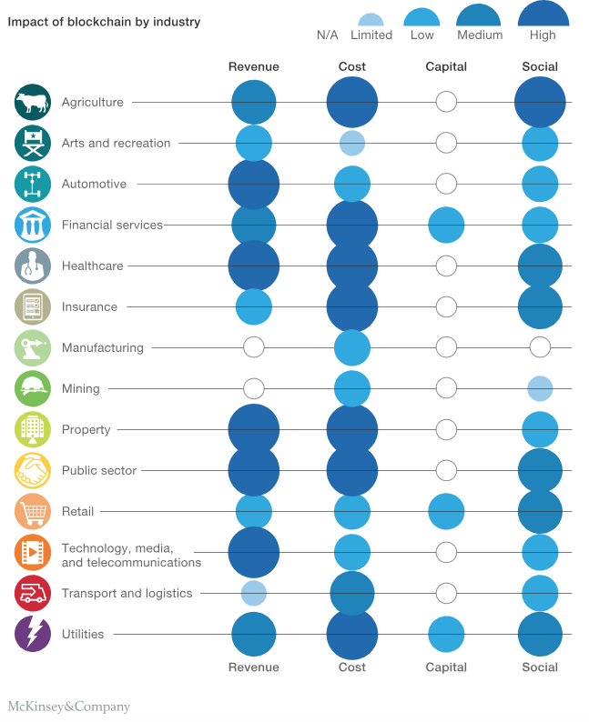
Strategic Business Value
https://www.mckinsey.com/business-functions/digital-mckinsey/our-insights/blockchain-beyond-the-hype-what-is-the-strategic-business-value

Slide 14
More…
Certain industries’ fundamental functions are inherently more suited to blockchain solutions, with the following sectors capturing the greatest value: financial services, government, and healthcare. Financial services’ core functions of verifying and transferring financial information and assets very closely align with blockchain’s core transformative impact. Major current pain points, particularly in cross-border payments and trade finance, can be solved by blockchain-based solutions, which reduce the number of necessary intermediaries and are geographically agnostic. Further savings can be realized in capital markets post-trade settlement and in regulatory reporting.
As with banks, governments’ key record-keeping and verifying functions can be enabled by blockchain infrastructure to achieve large administrative savings.
Public data is often siloed as well as opaque among government agencies and across businesses, citizens, and watchdogs. In dealing with data from birth certificates to taxes, blockchain-based records and smart contracts can simplify interactions with citizens while increasing data security.
Within healthcare, blockchain could be the key to unlocking the value of data availability and exchange across providers, patients, insurers, and researchers.
Blockchain-based healthcare records can not only facilitate increased administrative efficiency, but also give researchers access to the historical, non–patient-identifiable data sets crucial for advancements in medical research. Smart contracts could give patients more control over their data and even the ability to commercialize data access. For example, patients could charge pharmaceutical companies to access or use their data in drug research.

Slide 15
Over time, the value of blockchain will shift from driving cost reduction to enabling entirely new business models and revenue streams. One of the most promising and transformative use cases is the creation of a distributed, secure digital identity—for both consumer identity and the commercial know-your-customer process—and the services associated with it. However, the new business models this would create are a longer-term possibility due to current feasibility constraints.

Slide 16
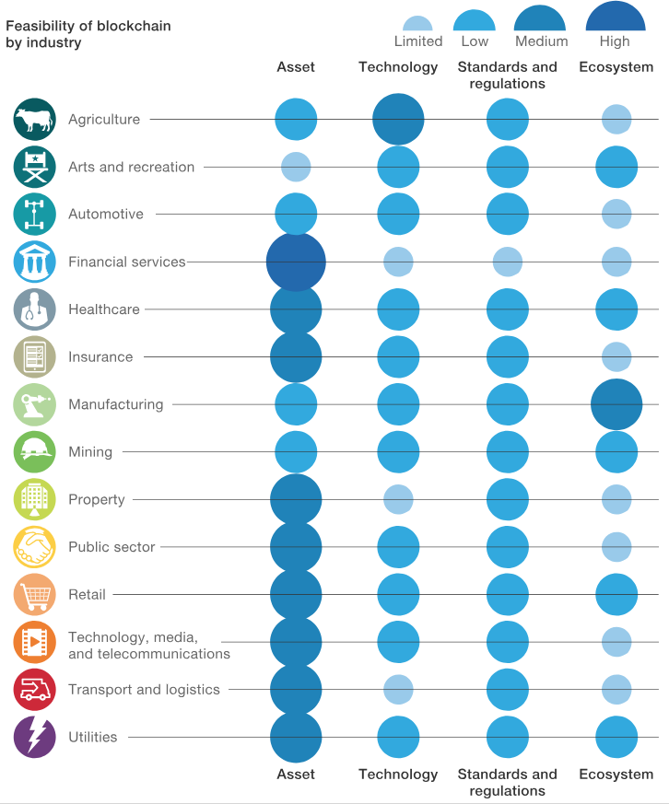

Slide 17
Feasibility at scale is likely to be three to five years away
Common standards are essential for examples
R3 consortium for global bank
US Securities and Exchange Commission’s recognition of ICOs as securities brought ICOs under the agency’s regulation and into the mainstream.
Technology must advance
Power consumption
Transaction speed
Assets must be able to be digitized
Digitized asset and equity
Secure tagging system with IoT and Biometrics
The coopetition paradox must be resolved
Blockchain’s major advantage is the network effect, but while the potential benefits increase with the size of the network, so does the coordination complexity. For example, a blockchain solution for digital media, licenses, and royalty payments would require a massive amount of coordination across the various producers and consumers of digital content.
Natural competitors need to cooperate, and it is resolving this coopetition paradox that is proving the hardest element to solve in the path to adoption at scale.

Slide 18
Blockchain: Basics
Slide materials: courtesy of Bikramaditya Singhal, “Beginning Blockchain”, Apress 2018

Slide 19
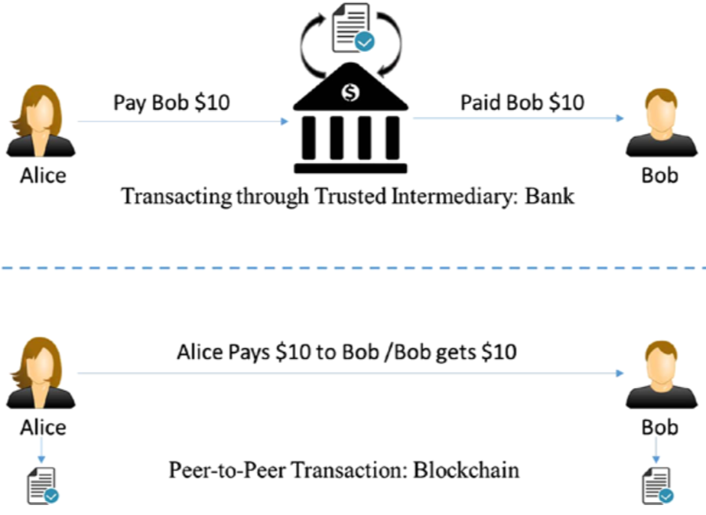
Transaction through an intermediary vs. peer-to-peer transaction

Slide 20
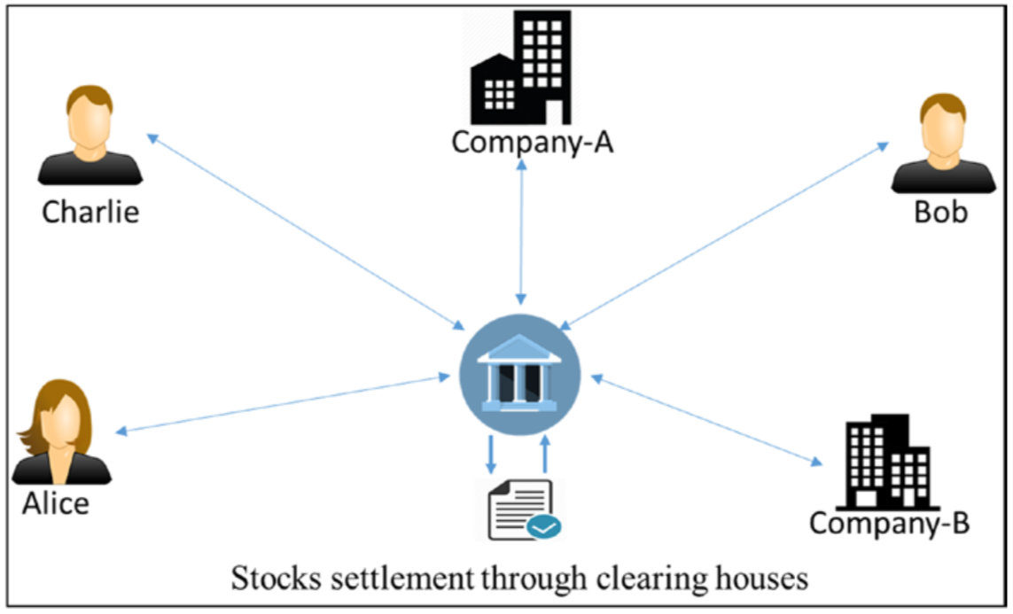
Stocks trading through an intermediary clearing house
A typical stock transaction happens in seconds, but its settlement takes weeks. Is it desirable in this digital age?

Slide 21
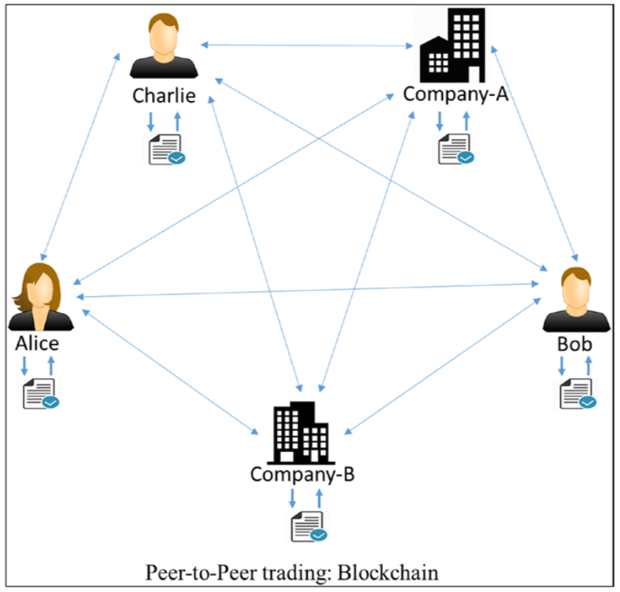
Peer-to-peer stock trading

Slide 22
Concept of Blockchain
Blockchain is a peer-to-peer system of transacting values with no trusted third parties in between.
It is a shared, decentralized, and open ledger of transactions. This ledger database is replicated across a large number of nodes.
This ledger database is an append-only database and cannot be changed or altered. It means that every entry is a permanent entry. Any new entry on it gets reflected on all copies of the databases hosted on different nodes.
There is no need for trusted third parties to serve as intermediaries to verify, secure, and settle the transactions.
It is another layer on top of the Internet and can coexist with other Internet technologies.
Just the way TCP/IP was designed to achieve an open system, blockchain technology was designed to enable true decentralization. In an effort to do so, the creators of Bitcoin open-sourced it so it could inspire many decentralized applications.

Slide 23
The blockchain data structure
Every node on the blockchain network has an identical copy of the blockchain as shown, where every block is a collection of transactions, hence the name. As you can see, there are two major parts in every block. The “header” part links back to the previous block in the chain. What it means is that every block header contains the hash of the previous block so that no one can alter any transaction in the previous block.

Slide 24
Practical Example: Assume that there are three candidates—Alice, Bob, and Charlie—who are doing some monetary transactions among each other on a blockchain network.
Step-1: Let us assume that Alice had $50 with her, which is the genesis of all transactions and every node is aware of it, as shown in Figure (The genesis block).

Slide 25
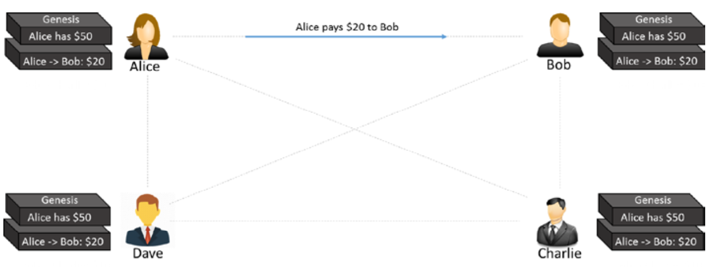
Step-2: Alice makes a transaction by paying $20 to Bob. Observe how the blockchain gets updated at each node, as shown in Figure (The first transaction).

Slide 26
Step-3: Bob makes another transaction by paying $10 to Charlie and the blockchain gets updated as shown in Figure (The second transaction).
Please note that the transaction data in the blocks is immutable. All transactions are fully irreversible. Any change would result in a new transaction, which would get validated by all contributing nodes. Every node has its own copy of blockchain.

Slide 27
cont….
If there are many questions popping up in your mind, such as “What if Alice pays the same amount to Dave to double-spend the same amount, or what if she is making a payment without having enough funds in her account?,” “How is the security ensured?,”

Slide 28
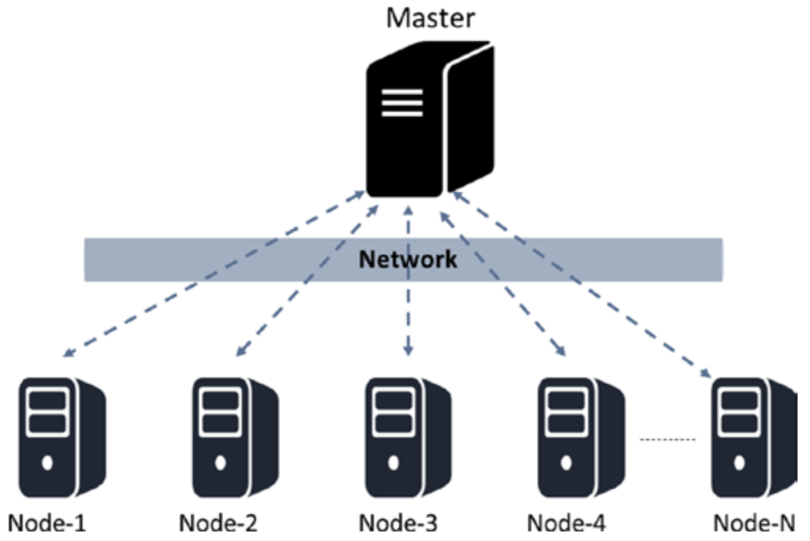
A distributed system with centralized control

Slide 29
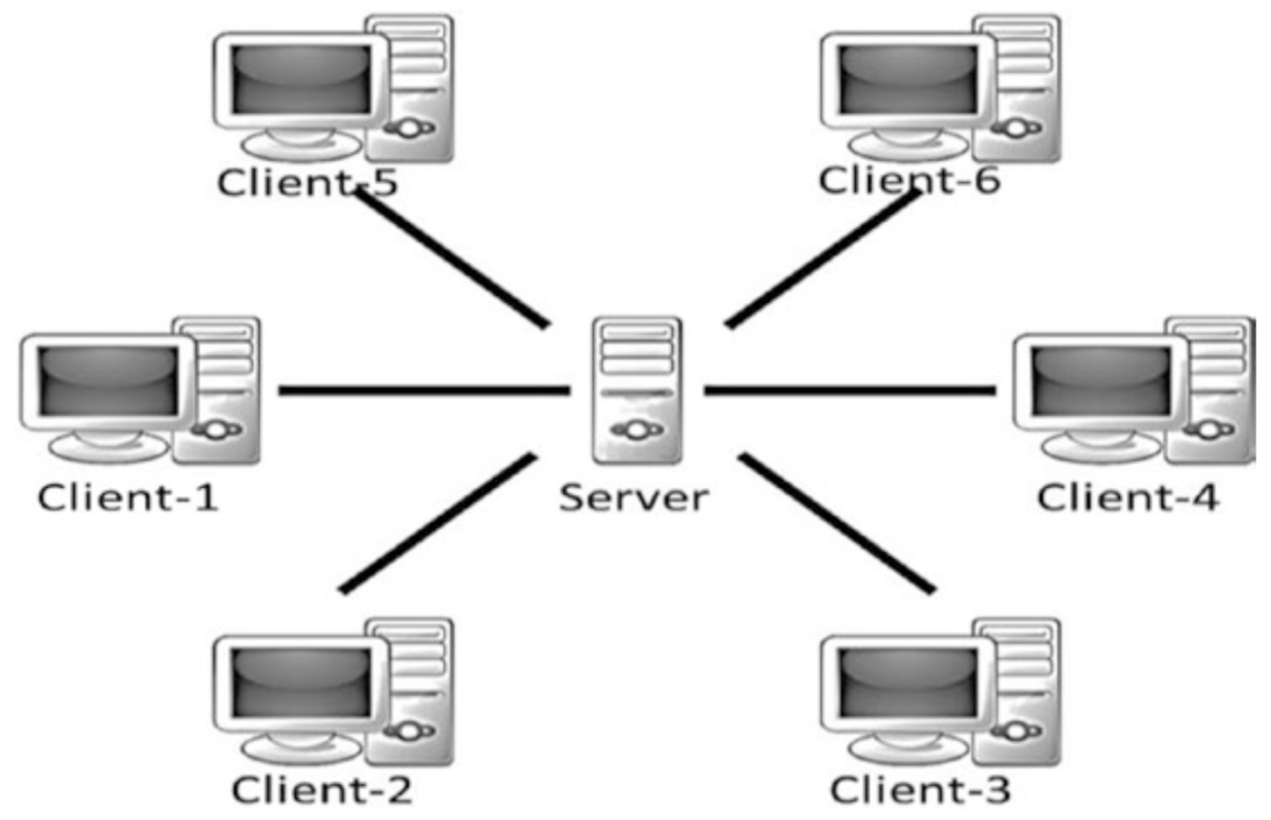
A centralized system
Trust issues
Security issue
Privacy issue—data sale privacy is being undermined
Cost and time factor for transactions

Slide 30
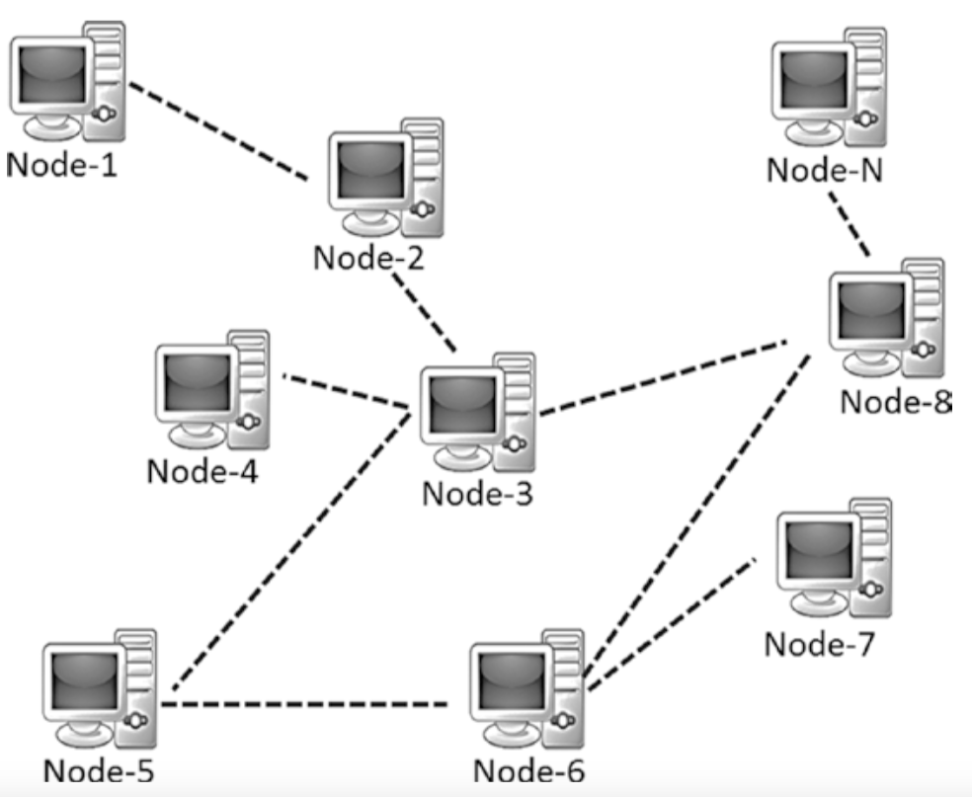
A decentralized system
Elimination of intermediaries
Easier and genuine verification of transactions
Increased security with lower cost
Greater transparency
Decentralized and immutable

Slide 31
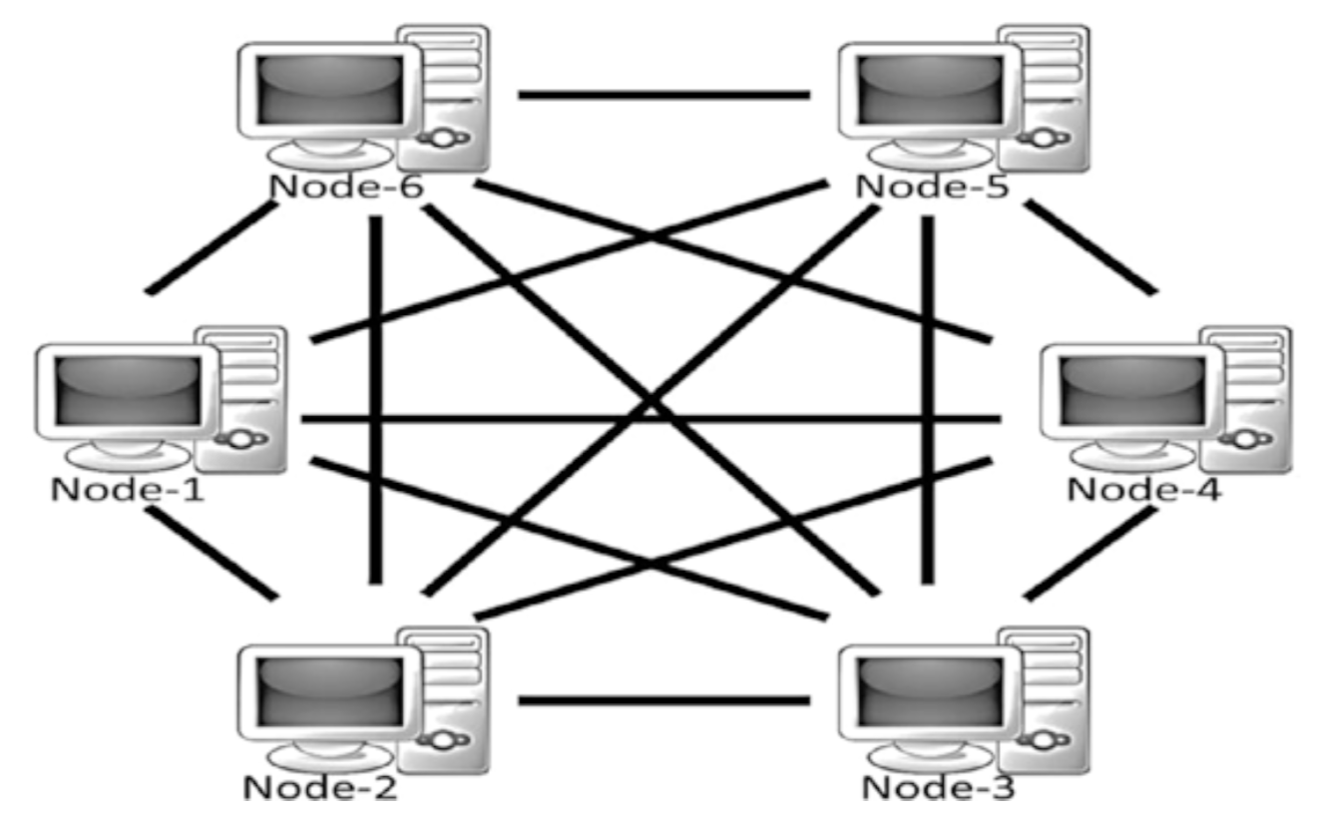
A decentralized and peer-to-peer system

Slide 32
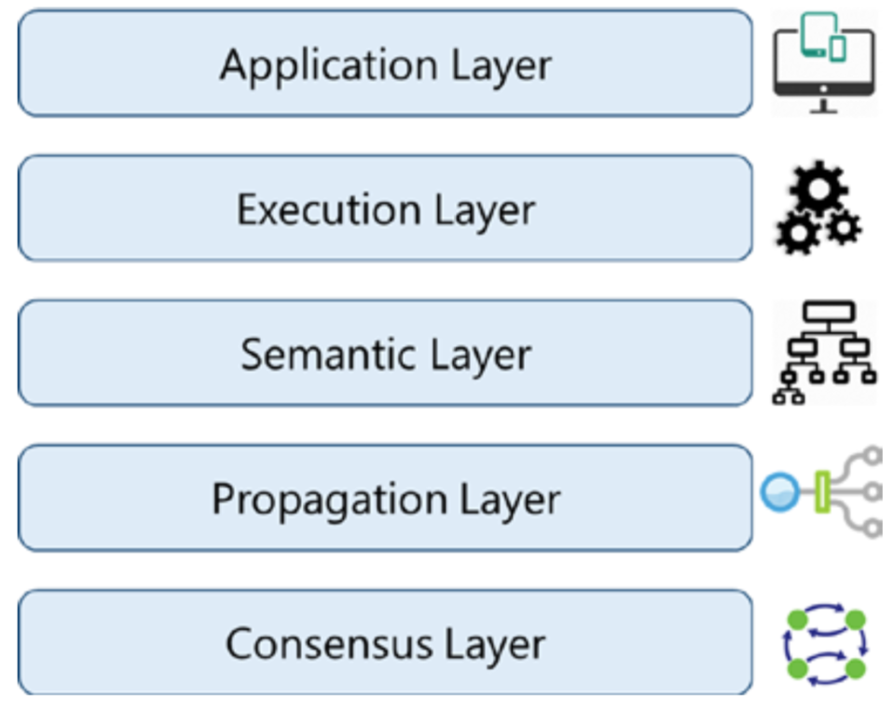
Various layers of blockchain
Application layer is the layer where you code up the desired functionalities and make an application out of it for the end users. It usually involves a traditional tech stack for software development such as client-side programming constructs, scripting, APIs, development frameworks, etc. For the applications that treat blockchain as a backend, those applications might need to be hosted on some web servers and that might require web application development, server-side programming, and APIs, etc.
The Execution Layer is where the executions of instructions ordered by the Application Layer take place on all the nodes in a blockchain network. The instructions could be simple instructions or a set of multiple instructions in the form of a smart contract.
The Semantic Layer is a logical layer because there is an orderliness in the transactions and blocks. A transaction, whether valid or invalid, has a set of instructions that gets through the Execution Layer but gets validated in the Semantic Layer. If it is Bitcoin, then whether one is spending a legitimate transaction, whether it is a double-spend attack, whether one is authorized to make this transaction, etc., are validated in this layer.
The previous layers were more of an individual phenomenon: not much coordination with other nodes in the system. The Propagation Layer is the peer-to-peer communication layer that allows the nodes to discover each other, and talk and sync with each other with respect to the current state of the network.
The Consensus Layer is usually the base layer for most of the blockchain systems. The primary purpose of this layer is to get all the nodes to agree on one consistent state of the ledger. There could be different ways of achieving consensus among the nodes, depending on the use case. Safety and security of the blockchain is accertained in this layer.

Slide 33
Blockchain: friction removal
In the 1990s, mass adoption of the Internet changed the way people did business. It removed friction from creation and distribution of information. This paved the way for new markets, more opportunities, and possibilities. Similarly, blockchain is here today to take the Internet to a whole new level by removing friction along three key areas: Control, Trust, and Value.
Control: Blockchain enabled distribution of the control by making the system decentralized.
Trust: Blockchain is an immutable, tamper-resistant ledger. It gives a single, shared source of truth to all nodes, making the system trustless. What it means is that trust is no longer needed to transact with any unknown person or entity and is inherent by design.
Value: Blockchain enables exchange of value in any form. One can issue and transfer assets without central entities or intermediaries.

Slide 34
How Blockchain Works!

Slide 35
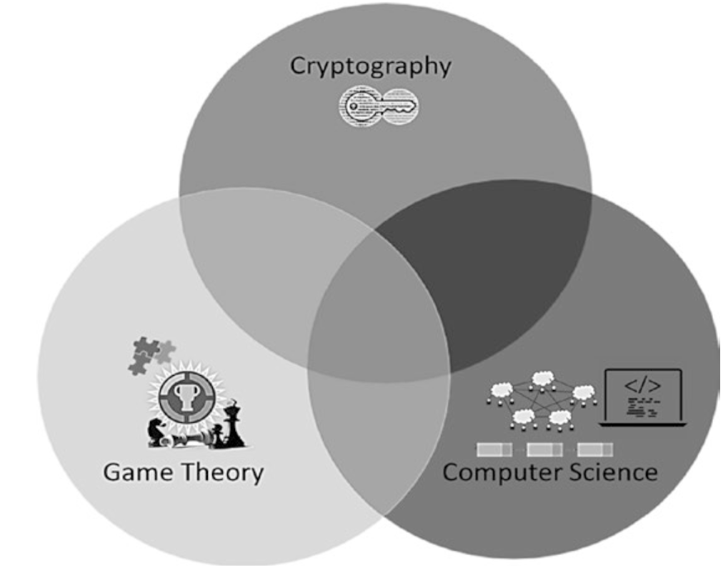
Blockchain at its core

Slide 36
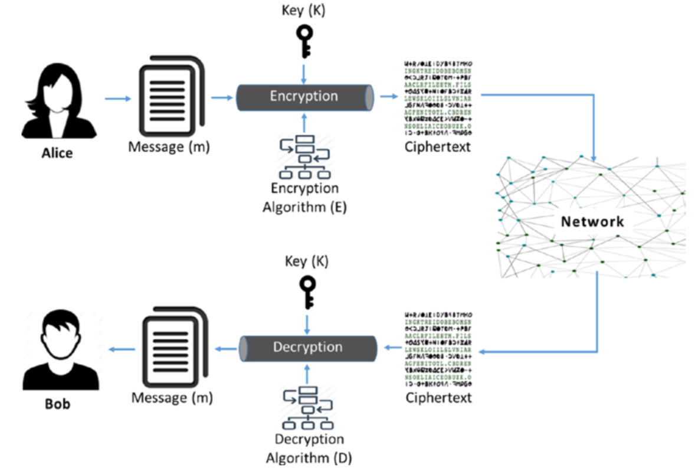
Cryptography
Confidentiality: Only the intended or authorized recipient can understand the message. It can also be referred to as privacy or secrecy.
Data Integrity: Data cannot be forged or modified by an adversary intentionally or by unintended/accidental errors. Though data integrity cannot prevent the alteration of data, it can provide a means of detecting whether the data was modified.
Authentication: The authenticity of the sender is assured and verifiable by the receiver.
Non-repudiation: The sender, after sending a message, cannot deny later that they sent the message. This means that an entity (a person or a system) cannot refuse the ownership of a previous commitment or an action.
Symmetric key cryptography is referred to as private key cryptography
Asymmetric key cryptography is called public key cryptography.

Slide 37
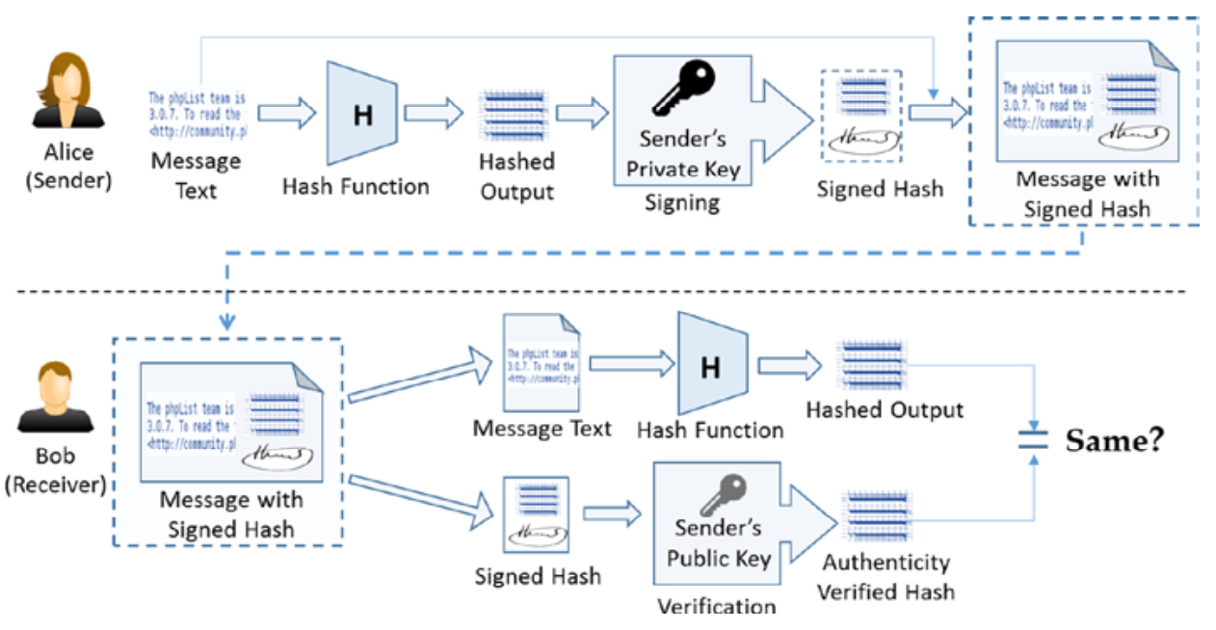
Digital Signature Algorithm (DSA)
DSA provides the following security properties:
Authenticity: Signed by private key and verified by public key
Data integrity: Hashes will not match if the data is altered.
Non-repudiation: Since the sender signed it, they cannot deny later that they did not send the message. Non-repudiation is a property that is most desirable in situations where there are chances of a dispute over the exchange of data. For example, once an order is placed electronically, a purchaser cannot deny the purchase order if non-repudiation is enabled in such a situation.

Slide 38
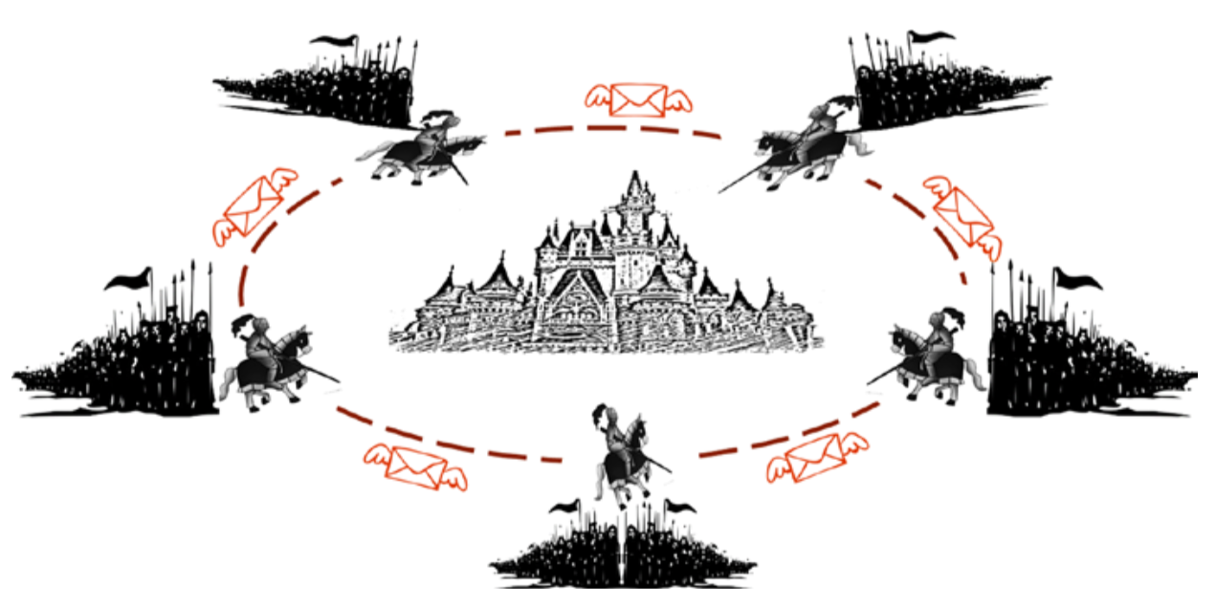
Game Theory: Byzantine army attacking the city
The Byzantine Generals’ Problem is widely used in distributed storage solutions and data centers to maintain data consistency across computing nodes.

Slide 39
Computer Science Engineering
Blockchain: blockchain is actually a blockchain data structure; in the sense that it is a chain of blocks linked together.
Hash pointeris the basic building block of blockchain data structure. Hash pointers point to the previous data block and provide a way to verify that the data has not been tampered with.
The purpose of the hash pointer is to build a tamper resistant blockchain that can be considered as a single source of truth. How does blockchain achieve this objective? The way it works is that the hash of the previous block is stored in the current block header, and the hash of the current block with its block header will be stored in the next block’s header.

Slide 40
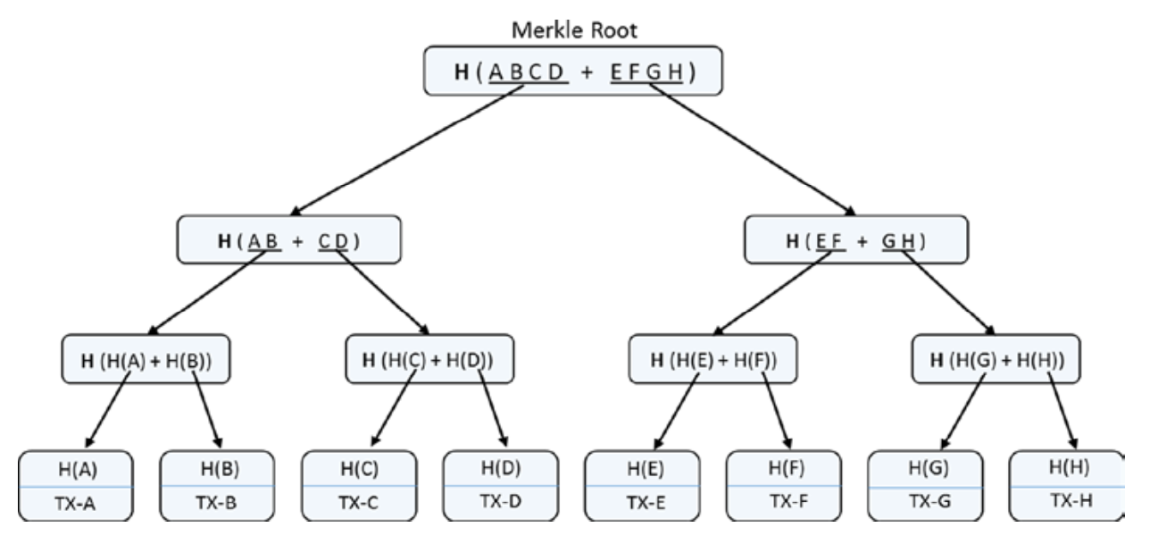
Merkle Binary Tree
Similar to the hash pointer data structure, the Merkle tree is also tamper-proof. Tampering at any level in the tree would not match with the hash stored at one level up in the hierarchy, and also till the root node. It is really difficult for an adversary to change all the hashes in the entire tree. It also ensures the integrity of the order of transactions. If you change just the order of the transactions, then also the hashes in the tree till the Merkle root will change.
As discussed, if we were to find a transaction through its hash, or check if a transaction had happened in the past, how would we get to that transaction? The only way is to keep traversing till you encounter the exact block that matches the hash of the transaction. This is a case where a Merkle tree can help a great deal.

Slide 41
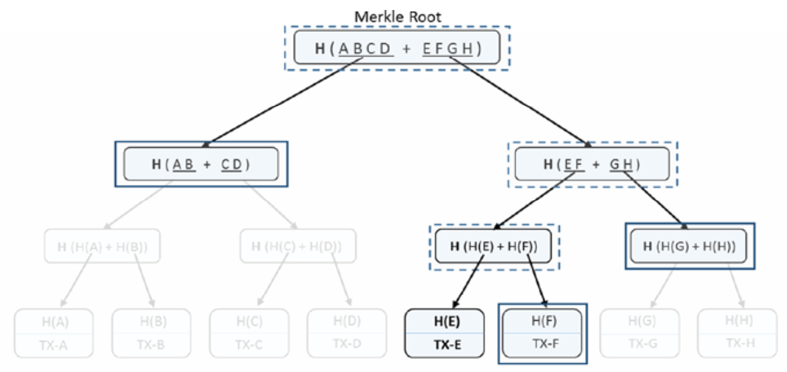
Verification in Merkle tree
Merkle trees provide a very efficient way to verify if a specific transaction belongs to a particular block. If there are “n” transactions in a Merkle tree (leaf items), then this verification takes just Log (n) time.
To verify if a transaction or any other leaf item belongs to a Merkle tree, we do not need all items and the whole tree. Rather, a subset of it is needed as we can see in the diagram in Figure left. One can just start with the transaction to verify along with its sibling (it is a binary tree so there would be one sibling leaf item), calculate the hash of those two, and see if it matches their parent hash. Then continue with that parent hash and its sibling at that level and hash them together to get their parent hash. Continuing this process all the way to the top root hash is the quickest possible way for transaction verification (just Log (n) time for n items). In the figure, only the solid rectangles are required and the dotted rectangles can be just computed, provided the solid rectangle data. Since there are eight transaction elements (n = 8), only three computations (log2 8 = 3) would be required for verification.

Slide 42
Summary of Blockchain Basics
Cryptographic functions are one-way and cannot be inverted. They are deterministic and produce the same output for a given input. Any changes to the input would produce a completely different output when hashed again.
Using public key cryptography, digital signatures are possible. It helps in verifying the authenticity of the person/entity that has signed. Considering the private key is kept confidential, it is not feasible to forge a signature with someone else’s identity. Also, if someone has signed on any document or a transaction, they cannot later deny they did not.
Using game theoretic principles and best practices, robust systems can be designed that can sustain in most of the odd situations. Systems that can face the Byzantine Generals’ Problem need to be handled properly. Our approach to any system design should be such that the participants play by the rules to get the maximum payoff; deviating from the protocol should not really benefit them.
The blockchain data structure, by using the cryptographic hashes, provides a tamper resistant chain of blocks. The usage of Merkle trees makes the transaction verification easier and faster.

Slide 43
Overview of Blockchain

Slide 44
Next Level of Information Transfer Evolution: Blockchain
Productivity
Firms who adopted IT became more efficient at accomplishing normal business tasks, leading to linear improvement on productivity.
Firms that fully embraced the internet era drove down distribution cost, and fundamentally changed the way business was conducted, allowing them reach exponential scale and drive out other competition. Facebook, Amazon, Netflix, Google – companies are examples of successful firms here.
Pre-IT
IT
Internet
Blockchain

Slide 45
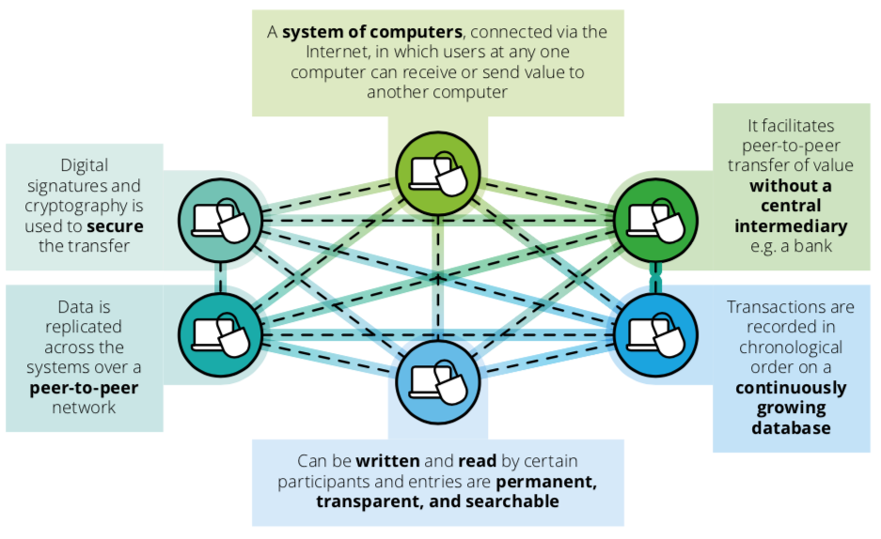
Understanding Blockchain

Slide 46
Blockchain Cost Saving Laws
Blockchain solution is expected to be cost effective and reduce operational cost generally on the long run including for the insurance industry when compared to centralized solution as it supports three downward sloping exponential cost curves
Moore’s law (cost of processing digital information, i.e. speed, halves every 18 months)
Kryder’s Law (cost of storing digital information, i.e. memory, halves every 12 months)
Nielsen’s Law (cost of shipping digital information, i.e. bandwidth, halves every 24 months)

Slide 47
WHAT IS THE BLOCKCHAIN?
2.1
The blockchain is a global distributed ledger, which facilitates the movement of assets across the world in seconds, with only a minimal transaction fee. These assets can be any type of value, as long as they can be represented digitally.
Up until Bitcoin and its distributed ledger was invented, digital currencies were seen as unfeasible due to the relative ease of which digital information can be copied. This is know as the “double-spend” problem where each transaction carries a risk of the holder sending a copy of the digital coin to the merchant while retaining the original. The traditional way of mitigating this risk has been to have a trusted third party, such as a bank, to act as a centralised authority keeping track of all transactions.
Bitcoin has shifted this responsibility to a whole network. To exchange ownership of a digital coin, a centralised database is no longer required. Instead, a distributed ledger keeps a history of all transactions, and requires validation from its users to verify each change of ownership.
LABS
PAGE 8

Slide 48
Recent block
Simplified blockchain
network diagram
transactions
Blockchain
Figure 2: Simplified illustration of a distributed ledger network. Each member of the network, called a node, holds a chain of blocks which constitutes a total history of transactions performed on the network.
Each block holds a set of transactions, which size depends on how many transactions were completed in a given time interval.
Transaction
Encryption code:
PAGE 9
LABS

Slide 49
HOW DOES IT WORK?
2.2
1
Transaction definition
2
Transaction authentication
3
Block creation
Encryption code:
5
Block chaining
Validated block:
4 Block validation
Figure 3: Generalized overview of a blockchain transaction.
LABS
PAGE 10

Slide 50
1
Transaction definition
The “Sender” creates a transaction and transmits it to the network. The transaction message includes details of the Receiver’s public address, the value of the transaction, and a cryptographic digital signature that proves the authenticity of the transaction.
4
Block validation
The validator nodes of the network receive the proposed block and work to validate it through an iterative process which requires consensus from a majority of the network. Different blockchain networks use different validation techniques. Bitcoin’s Block chain uses a technique called “proof-of-work”, Ripple uses “Distributed Consensus”, and Ethereum uses “proof-of-stake”. The various techniques have different pros and cons. The common denominator is that they ensure that every transaction is valid, and make fraudulent transactions impossible.
2
Transaction authentication
The nodes (computers/users) of the network receive the message and authenticate the validity of the message by decrypting the digital signature. The authenticated transaction is placed in a ‘pool’ of pending transactions.
3
Block creation
These pending transactions are put together in an updated version of the ledger, called a block, by one of the nodes in the network. At a specific time interval, the node broadcasts the block to the network for validation.
5
Block chaining
If all transactions are validated, the new block is “chained” into the blockchain, and the new current state of the ledger is broadcast to the network. This whole process can be completed in 3-10 seconds.
PAGE 11
LABS

Slide 51
TWO REVOLUTIONS FOR THE PRICE OF ONE
2.3
The blockchain revolution is so fascinating because it could actually be TWO completely different revolutions both
profound in their implications: 1) Industry-level systems of record providing massive efficiency gain for incumbents.
2) Censorship-resistant digital cash providing a new platform for open, permissionless innovation.²
Bitcoin and its Block chain was successful because it did not ask for permission. It was built upon the idea of a system where a central authority and oversight is to be avoided, and that the network itself should be resistant to all forms of censorship. At the same, time the network should be open to all, and all members should be able to transact anonymously.
inefficiencies being removed and a prime system of record being introduced to the financial world.
This led to the development of what is now commonly called permissioned ledgers. In contrast to the permissionless ledger of Bitcoin, the nodes doing block validation (see p. 11) are known and trusted, meaning that they can be held accountable according to laws and regulations. Another difference is that normal member nodes, meaning those who can only initiate and receive transactions, are also required to identify themselves when they join the network, similar to how a bank account is opened today. (More details are presented on page 14 and 15.)
This meant that the idea of Bitcoin was initially scorned and avoided by financial institutions, and its Blockchain technology was seen as too slow and too risky for traditional finance ³. As the technology matured, however, more and more people began to see the potential of a distributed ledger technology, just in a more controlled setting. If the distributed ledger technology could be adapted to fit into existing laws and regulations, this could lead to a lot of costly
LABS
PAGE 12
2: http://gendal.me/2015/07/23/bitcoin-and-blockchain-two-revolutions-for-the-price-of-one/
3: https://www.eba.europa.eu/documents/10180/657547/EBA-Op-2014-08+Opinion+on+Virtual+Currencies.pdf

Slide 52
Validator node
(Can both initiate/receive and validate transactions)
Member node
(Can only initiate/receive
transactions)
 | Permissioned Blockchain (Private) | Permissionless Blockchain (public)
How do you get access to the network? | Authorized access | Open access
How are their approach to laws and regulations? | Aims to follow financial regulations such as AML/ KYC | Aims to create censorship resistant, anonymous transactions, outside current legal framework
Who are the validators? | Pre-selected, trusted validators | Anonymous, fully decentralized validators
What can it be used for? | Enterprise-level systems | Permissionless innovation, open- access applications
PAGE 13
LABS

Slide 53
Permissioned Ledgers: Industry-Level Systems of Record
In a permissioned ledger, also commonly called a private or consortium ledger, the validation process is controlled by a pre-selected set of nodes. One can here imagine a system run by a consortium of financial institutions, where a certain majority have to sign every block in order for it to be valid. The access rights to read the blockchain might be public or restricted to just a certain number of participants, such as government- approved auditors.
after all, that they are required to take on a great deal of responsibility. Banks are given an important task to fulfil, and they are heavily regulated and scrutinized and will be held responsible for their actions. The population of the entire country, as represented by the government, stands behind bank deposits and promises to honour them even if the bank goes bust.
The main benefits offered by employing a permissioned ledger approach over a permissionless have been suggested to be: cheaper energy cost for transactions, greater privacy, and a faster validation process ⁴.
This is an example of how an industry-level system might be implemented, and as of the time of writing the main development focus for companies backed by financial institutions seems to lean towards such an approach.
Permissioned ledgers replicate the high degree of transparency and accountability in traditional banking systems. It is because we place so much trust in banks,
LABS
PAGE 14
4: https://blog.ethereum.org/2015/08/07/on-public-and-private-blockchains/

Slide 54
Permissionless Ledgers: Censorship resistant
What characterizes the permissionless ledgers is that there is no gating or authorizing process to enroll into the transactions scheme, they are in theory a public ledger. Everyone is free to download a copy of the blockchain ledger, and they are able to join as anonymous validators by performing computationally intensive proof-of-works.
Although a strong argument is presented for the drive towards permissioned ledgers, financial institutions would be remiss to ignore the ideas and concepts adopted by the permissionless ledgers. Their openness means they are likely to be used by various people and gain unforeseen network effects.
It has also been argued that these public ledgers are practical for primarily on-chain assets, meaning assets that are endogenous and created on the ledger (e.g Bitcoin). This argument is based on the fact that
off-chain assets are not controllable by the validators in the same way as the native assets, and any conflicts in a transaction would need to be solved by an outside party or legal entity.
Disruptive innovations usually find their first customers at the bottom of the market, as their unproven and unpolished products cannot command a high price. But as iterative improvements allow them to gain new grounds and attract new customers, they may end up reshaping entire industries.
PAGE 15
LABS

Slide 55
What is a blockchain?
A distributed immutable ledger of
transactions
The underlying technology behind
the cryptocurrency known as Bitcoin
What TCP/IP (internet protocol) has been for the exchange of information, blockchain can be for the exchange of value
The following introduction slides are courtesy of Tom Savel, MD, CDC Health Information Innovation Consortium Forum 2018

Slide 56
What is a blockchain?
A set of tools for cryptographic assurance of data integrity, standardized auditing, and formalized contracts for data access
A technology which empowers participating members to exchange items of value through a distributed ledger - that each member owns - and who’s content is always in sync
video

Slide 57
No really, what’s is a blockchain: 5 Principles*
Distributed Database
Peer-to-Peer Transmission
Irreversibility of Records
Computational Logic (automated)
Transparency with a degree of
anonymity (pseudonymity)
* Harvard Business Review – Halamka et al., 2017

Slide 58
Blockchain: Is it of value to me?
“It is most useful when multiple loosely coupled distinct organizations or entities want to confidently share and audit information and automate mutually beneficial processes”

Slide 59
What is a blockchain? One more time…it is…
Distributed
Decentralized, shared, etc.
Affording high availability
Immutable
Write only
Extremely “hacker resistant”
Affording high Integrity
Ledger
Transaction record (e.g., of financial data, contractual data, physical assets)
Uses a validation process (consensus protocol)

Slide 60
Is Blockchain new?
No…but it is now gaining rapid
popularity
Over $4.5 Billion in private funding for Blockchain-related projects in 2017 (Forbes)
Dramatic increase in number of Blockchain patents filed (coindesk.com)
Still in its early stages of development and implementation – similar to the internet itself in the late 1990s

Slide 61
Blockchain development activity
Significant activity in the Corporate, Academic
and Federal spaces:
IBM, Microsoft, MIT, GA Tech, GSA, FDA, DHS, DOD, ONC, OMB, NIST, OPM, Postal Service, State Dept., Treasury Dept., Federal Reserve, and hundreds of blockchain startups.
https://emerging.digital.gov/blockchain-programs
New Magazines / Journals:
Traditional (e.g., Wired): DISTRIBUTED (2017)
Peer-reviewed: Blockchain in Healthcare Today (2018)

Slide 62
Digging a bit deeper into Blockchain: All hype? No.
Leverages and expands existing
capability of the internet
Based on mathematics and cryptography
(not magic):
– (Tech speak: merkle trees, cryptographic hashes, public and private keys, etc.)
Can be used for many different purposes
When used in finance – it finally solves the very challenging “double spend” problem

Slide 63
Why is it called Blockchain?
The power of the technology to be a “trusted source of truth” - is based on its ability to permanently connect groups of validated transactions…
[connection = called a chain]
[group = called a block]
Remember: the blockchain data continues to grow and is automatically replicated to every connected node… to potentially thousands of nodes. Sound inefficient?
It’s the cost of being a “trusted source of truth”

Slide 64
Why does an internet-based “trusted source of truth” matter?
You don’t need a trusted 3rd party with a
blockchain infrastructure
Critical ledgers / databases are ubiquitous in our society – and most always require a trusted 3rd party
Examples:
For financial transactions: Bank
For drivers license, auto tags, etc.: DMV

Slide 65
Why does an internet-based “trusted source of truth” matter?
Blockchain technology can enhance the internet - from an internet of knowledge and information sharing - to an internet of value and value exchange – where trust and security are “baked in”

Slide 66
Blockchain: There isn’t just one
There are 3 general categories of blockchains:
Similar to the idea of internet vs. intranet web sites
Public (full access by anyone)
Permissioned (consortium)
Private (i.e., within an organization)

Slide 67
Blockchain: There isn’t just one
There are many different types / configurations of
blockchains – with more being created every day
Similar to the idea of using different operating
systems (iOS, Android, Windows, Linux, etc.)
Examples:
Bitcoin Blockchain
Ethereum Blockchain
Hyperledger Fabric
IOTA “Tangle”

Slide 68
Blockchain: A foundation for new ecosystems
Blockchain technology can support a wide variety of
unique use cases
Decentralized file sharing, Digital asset exchange, Real estate transactions, Proof of authorship, Laboratory / pharmaceutical asset tracking, etc.
Examples:
Bitcoin - single purpose - exchange and store value
Ethereum - distributed application platform
i.e., an app store for blockchain-based apps (dApps)
– Offers custom tokens, smart contracts, etc.

Slide 69
Blockchain: A foundation for new ecosystems

Slide 70
The Blockchain Token: Unit of value exchange
Public blockchains (almost always) leverage a token
(not required with private/permissioned blockchains)
A token (i.e., digital asset) can be many things…and have different
purposes:
Digital Currency
To support the creation of a “marketplace”
A unit of value – to be exchanged within distributed app ecosystem
Initial Coin Offering (ICOs) – to be exchanged for fiat currency (e.g., USD)
Proxy for physical asset
Exchangeable for other digital assets / fiat currencies
Coinbase, Kraken, Bitfinex, Bittrex, Binance, etc.

Slide 71
Using the Blockchain: making a transaction
What is involved in a transaction event recorded on
blockchain?
Unique Sender
Wallet (can be explicit or hidden from the user)
– Contains Public Key – to receive & Private Key – send
Transaction Data (i.e., the data packet / metadata)
Financial asset, activating a change in rights to view or
access a digital or real world asset
Receiver
Unique (most often) or multiple (i.e., automated by a “smart contract”)
Wallet (can explicit or hidden….same as sender)

Slide 72
Using the Blockchain: the transaction – a deeper look
Inherent to a standard blockchain- every transaction is stored…every one…forever.
With, for example, the public (Bitcoin) blockchain – transactions are grouped and processed in blocks (thousands of transactions)
Blocks are then tied together with 1-way digital fingerprints (cryptographic hashes)

Slide 73
Using the Blockchain: the transaction – a deeper look
Transactions take time (which varies based on the
blockchain type/platform)
Huge area of development / activity to improve transaction efficiency
There are significant challenges which need to be rapidly
overcome (e.g., projects: plasma, lightning network)
Transactions can have fees (for public blockchains)
to prevent spam, misuse of resources
e.g., Ethereum requires “Gas”
All transactions require validation (consensus protocol)
Many types
Also, a very rapidly evolving area

Slide 74
Blockchain: Validation (have you heard of mining?)
Blockchain technology elegantly leverages computer science, mathematics, cryptography, & game theory
For a public blockchain – the goal is to incentivize unknown, untrusting participants to work with the system and not try to break it

Slide 75
Blockchain: Validation (have you heard of mining?)
There are many types of consensus protocols
Proof of Work – classic but incredibly costly (electricity, etc.)
Mining – Competing to solve a computationally intensive problem to validate transaction
– GPU, ASIC (Application Specific Integrated Circuit),etc.
With the winner of the competition receiving a financial reward
Proof of Stake – Ownership
Proof of Authority
Proof of Space-Time
Proof of Capacity
Proof of Elapsed Time (e.g., Intel)
With more being studied and tested every day

Slide 76
Blockchain: Quick recap and breather….
Blockchain doesn’t solve every problem
Most useful “when loosely coupled distinct organizations / entities
want to confidently share and audit information and automate
mutually beneficial processes”
Removes the need for intermediaries – and thus gives control back
to the users / original data / asset owners
Provides a source of truth / trust between untrusting participants

Slide 77
Blockchain: Where is it ideal?
It excels in 3 general types of activities in a
non-centralized / distributed environment:
Tracking and Tracing of Assets / Value
– i.e., chain of custody (provenance)
Data Exchange
Automation of operational processes

Slide 78
Blockchain: Once last piece – “the data”
Important issue:
Can / should I put all my data on the blockchain?
No, no and no…
You will hear the terms “on chain” and “off chain”
Remember- what you put on the chain is replicated to all the nodes
– It’s important to keep the blockchain light…

Slide 79
Blockchain: Once last piece – “the data”
There are other “on chain/off chain” issues to consider:
Privacy / Transparency
PII, etc.
Storage Capacity Issues (IPFS, Minio, etc.)
Large files: e.g., chest x-rays, etc.
This issue must be carefully evaluated for each unique blockchain implementation
Important Note: It is possible to link off-chain data (encrypted PII, large files, etc.) to the blockchain – and ensure data integrity (via digital fingerprint / cryptographic hashing)

Slide 80
Blockchain: Its impact on the digital global economy
Accounting
Digital Identity
Smart Contracts
Data Provenance
eGov
Supply Chain Management
Internet of Things (IoT)
Trade Finance
Clearing And Settlement

Slide 81
Blockchain Startup Landscape

Slide 82
Blockchain: Challenges
The challenge is that the shift to blockchain is a
fundamental change on many levels
Historically:
Centralized system
Single point of failure
Manual Processes
Sending / Receiving data “messages”

Slide 83
Blockchain: Challenges
The challenge: the shift to blockchain is a fundamental change
Decentralized / Distributed data / value exchange ecosystem Control is given back to the data owner / stakeholder Increased transparency
Increased Security
Post/Link data to blockchain – not to specific stakeholders
Automated Processes
Improved Efficiency
Works well with microservices Enhanced Metrics
Permanent longitudinal record / log

Slide 84
Blockchain: Next steps
Overall Goals:
Reduce costs & Improve efficiencies
Improve transparency and security
Make blockchain-based solutions invisible to the users----
IT JUST WORKS (just like our phones)
“If users see cryptographic hashes- we have failed”

Slide 85
How Blockchain Works: Closer Look At A Transaction
The transaction is configured into a block
The transaction is broadcast across the entire network which validates it
The block is then added to the chain which records the entire non-reversible history of transactions in a public ledger
User A sends funds to User B
User B receives funds from User A
There needs to be an application or platform where the users create their own entity, and initiate their asset.
For example with bitcoins, a user can join a mobile or web app called Coinbase where they create an account, convert currency like US Dollars to Bitcoin and then send out those funds.
The app compiles relevant data for the transfer into a transaction. The transaction contains the owner address, the sender address, a private key or password to verify rightful ownership, and the hash of the previous block.
Each block has several transactions.
There’s a requirement to solve the block’s hash function or simply or guess the inputs of the block before the block gets added to the chain. This check keeps the system secure.
Several computers around the world spend their processing power trying to solve the hash for a reward, mostly monetary. This is called Mining.
After one computer solves the hash, it broadcasts its solution to thousands of other computers to validate the result. Validation is a much simpler problem. Once validated by greater than 50% of the network, the block gets added to the chain.
The universal chain is updated so user B’s account is credited with the fund, which he/ she can do whatever she pleases with.

Slide 86
Why Blockchain: 7 Driving Key Principles
Transparency & Visibility - No one should be able to cover their tracks.
Accountability - Every action should be attributable to it’s owner.
Privacy - Security should be afforded without giving up confidential information.
Scalability - Must be able to scale to trillions of digital assets.
Portability - Security must move with the data, wherever the data goes.
Permanence - Security must not be ephemeral – it must exist as long as the data exists, and ideally longer.
Open - It must not rely on traditional closed trust anchors.

Slide 87
Blockchain Benefits to Industries
TECHNICAL
MARKET/BUSINESS
LEGAL/ REGULATORY
Secure Transaction
Ledger Database
Eliminates Error Handling and Reconciliation
Automation of Execution and Settlement
Cost Reduction in Infrastructure and Transaction
Smart Controls i.e. Self Enforcing Contracts
Trusted Third Party Elimination

Slide 88
Common Complaints about Blockchain
MARKET/BUSINESS
BEHAVIORAL/ EDUCATIONAL
Lack of understanding of potential value
Limited executive vision
Change management
Trusting a network
Few best practices
Low usability factor
LEGAL/ REGULATORY
TECHNICAL
Moving assets to the Blockchain
Quality of project ideas
Critical mass of users
Volatility of cryptocurrency
Onboarding new users
Few poster companies
Not enough qualified individuals
Infrastructure Cost issues
Innovator’s dilemma
Unclear regulations
Government interferences
Compliance requirements
Hype
Taxation and reporting
Underdeveloped ecosystem infrastructure
Lack of mature applications
Immature middleware and tools
Scalability of transactions
Legacy system migration
Tradeoffs with databases
Privacy of public data
New security threat
Lack of Standards

Slide 89
Levels Companies Operate in: Value Chain
Applications designed for the end user to solve particular use-cases
Brokerage services
Cryptocurrency exchanges
Software wallets
Hardware wallets
Merchant and retail services
Financial data providers
Compliance and identity
Payments integrations
Trading platforms
Brokerage services
Payroll
Insurance
Investments & Loans
Global/ Local money services
Capital markets solutions
Entry point APIs for developers who want to build applications and innovate on top of the underlying protocols
Technology services providers
Blockchain platforms
Software development environments
General purpose APIs
Special purpose API
Smart contracts tools
For core developers well versed into cryptology-based software technologies
Public consensus blockchains
Private consensus blockchains
Microtransactions infrastructure
Miners

Slide 90
Fact 1: Bitcoin is not equal to Blockchain! Blockchain is technology behind Bitcoin.

Slide 91
Fact 2: Internet of the 1990’s
Blockchain discussions today are like talking about the internet in the early 1990s.
Everyone’s talking about bitcoin. But the killer applications are yet to see the light of day.

Slide 92
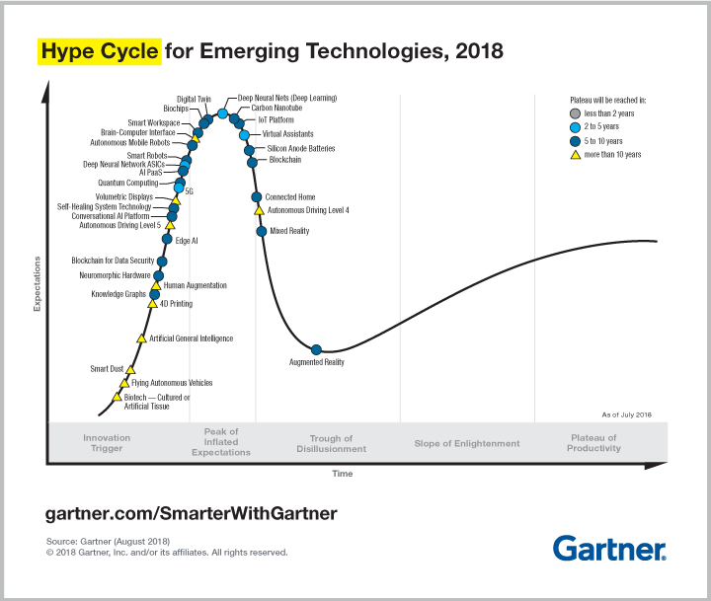
Fact 3: In a hype cycle
A recent study by Deloitte, 92% of the 26,000 blockchain-based projects that have been created over the last two years are now dead.
https://www2.deloitte.com/insights/us/en/industry/financial-services/evolution-of-blockchain-github-platform.html

Slide 93
Fact 4: Web 3.0
Blockchain can bring us true P2P transactions without a middleman.
Blockchain-based networks, decentralized apps (DApps), and distributed ledgers are becoming the foundation of much of your digital life.
https://blockchainhub.net/web3-decentralized-web/ https://www.pcmag.com/article/351486/blockchain-the-invisible-technology-thats-changing-the-wor

Slide 94
Distributed Ledger Technology (DLT)

Slide 95
What’s a Ledger
Ledgers are the foundations of accounting — a system by which people establish who owns what, who has what, and who owes what to whom. While the concept has remained the same, the medium used to record transactions has varied over time and through technological advances. From cowry shells to papyrus, books to computers — the goal has always been to keep records as efficiently and effectively as possible.
Humans have been maintaining ledgers for thousands of years, and while the medium and methods have changed over time, one element of ledger-keeping has not. From Mesopotamia to McGladrey, a third party party has always had to register and oversee transactions and maintain accounts. This makes sense as it provides a basis for validation, and allows people conducting a trade of value to trust one another.
The growth of global trade and commerce has led to the creation of a vast network of ledger systems, which are vulnerable to downtime, misinterpretation and fraud, the repercussions of which can be catastrophic and far-reaching — just think back to the 2008 Financial Crisis.
https://medium.com/nakamo-to/what-is-dlt-5554cd5bd5ac

Slide 96
Distributed Ledger Technology (DLT)
Distributed Ledger Technology is the first form of ledger to eliminate the need for a third party. It makes it possible for a ledger to be distributed among all those using it, putting the responsibility to maintain and validate it in the hands of those using it. The result is a decentralized system of data registry where transactions are instant, transparent, reliable and incorruptible.
DLT is the first system to bypass the need to trust one another when conducting transactions of value — the implications of which will be profound and far-reaching.
Note: DLT do not have to be decentralized or public, they are malleable systems and can exist in many states, including centralized and private. This article focused more on the decentralized aspect as achieving digital decentralization is a huge breakthrough in itself.
https://medium.com/nakamo-to/what-is-dlt-5554cd5bd5ac

Slide 97
Distributed Ledger Technology vs Blockchain
Blockchain is a type of DLT, a subcategory of a more broad definition, much like how the word ‘car’ falls under the umbrella term ‘vehicles’.
https://medium.com/nakamo-to/what-is-dlt-5554cd5bd5ac

Slide 98
DLT and The Autonomous Cars

Slide 99
DAG for Internet of Thing (IoT)
The distributed ledger technology-directed acyclic graph (DAG) has the potential to eliminate the drawbacks of Blockchain.
In DAG system, there are no blocks and miners. Users can confirm each other’s transactions through a process that involves confirmation of previous transactions with each new transaction. As there are no blocks, block size is no more an issue and hence, the block scaling debate seen in cryptocurrencies such as Bitcoin no more exist.

Slide 100
DAG: Peer-Confirming System
Instead of having mining firms confirming transactions via proof of work, DAG exercises the transactions made by users to confirm each other’s transactions. As DAG is a peer-confirming system, it can address some limitations of blockchain technology, for example:
Improved Reliability – The DAG system provides multiple confirmations of transactions. This leads to an improved level of security and decreased possibility of double-spending, compared to transactions made on the blockchain.
Simplified Mining – Blockchain cryptocurrency (Bitcoin) mining has led to an oligopoly issue. Much of mining power is sent to mining pools and by joining it, miners considerably increase their chance of profitability. This leads to a centralization which directly breaks the main principle of cryptocurrencies. --- Disrupt centralization of mining issue!
Blockchain-free solutions such as DAG solve this issue. DAG presents less power in a technological sense to miners as individual transactions are coupled with the speed at which transactions are processed.
Increased Speed – low speed challenges are said to be solved by DAG by confirming transactions on a transaction to transaction basis instead of a block to block basis.

Slide 101
DAG as Blockless Distributed Ledgers for IoT
IOAT: use a mechanism called “Tangle” whose mission is to be the backbone of IoT and to accelerate the proliferation of “The Economy of Things” concept in the market. – offer zero transaction fees https://www.iota.org/
ByteBall: non-blockchain smart payments network
DagCoin: fastest and scalable network with very low transaction fees

Slide 102
DAG as Blockless Distributed Ledgers for IoT
IOAT: use a mechanism called “Tangle” whose mission is to be the backbone of IoT and to accelerate the proliferation of “The Economy of Things” concept in the market. – offer zero transaction fees https://www.iota.org/
ByteBall: non-blockchain smart payments network
DagCoin: fastest and scalable network with very low transaction fees

Slide 103
What is Blockchain
https://www.youtube.com/watch?v=3xGLc-zz9cA
https://www.youtube.com/watch?v=3xGLc-zz9cA
https://www.youtube.com/watch?v=SSo_EIwHSd4
https://www.youtube.com/watch?v=qOVAbKKSH10&t=277s

Slide 104
Learning Blockchain by Doing
https://www.youtube.com/watch?v=zVqczFZr124
https://www.ethereum.org/
https://github.com/blockchain

Slide 105
Reference
https://cyber.stanford.edu/bpase18

