Slide 1
Technology and Industry/Business
Daniel Hao Tien Lee
http://danieleewww.yolasite.com/2020-mgb070.php
danieleewww@gmail.com

Slide 2
State of Mind
BCI (Brain-Computer Interface) https://www.youtube.com/watch?v=9uRK8Delzvk https://www.youtube.com/watch?v=6eA_JIDzza0
Non-Invasive Mind/Body/Machine Interface (MBMI) https://www.youtube.com/watch?v=NtiapP8XYSg https://www.kernel.co/kernel-raises-series-c
Cognitive Training Technology https://www.brainco.tech/

Slide 3
AI and Humanity
https://www.youtube.com/watch?v=Pls_q2aQzHg

Slide 4
Technology
The Merriam-Webster Dictionary offers a definition of the term: "the practical application of knowledge especially in a particular area" and "a capability given by the practical application of knowledge".
Technology can be most broadly defined as the entities, both material and immaterial, created by the application of mental and physical effort in order to achieve some value.

Slide 5
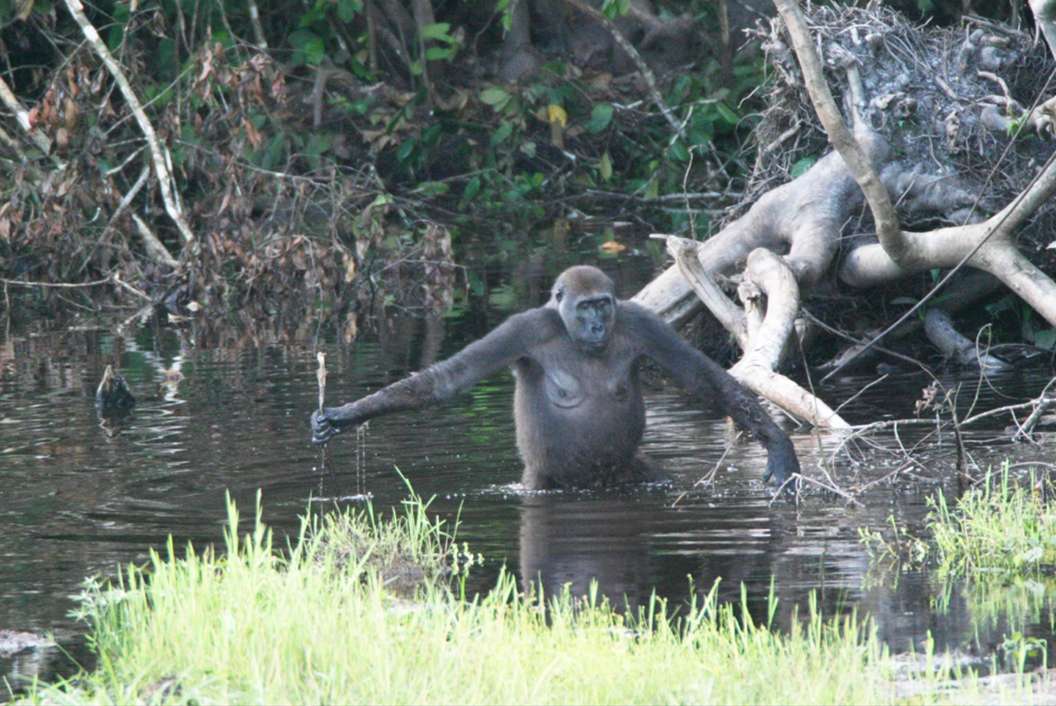
Wild Gorillas Handy with a Stick. PLoS Biology Vol. 3/11/2005, e385 doi:10.1371/journal.pbio.0030385

Slide 6
Technology and Industry/Business
Why this!
Interests….
Philosophy
Romantic understanding
Classic understanding

Slide 7
Romantic Understanding

Slide 8
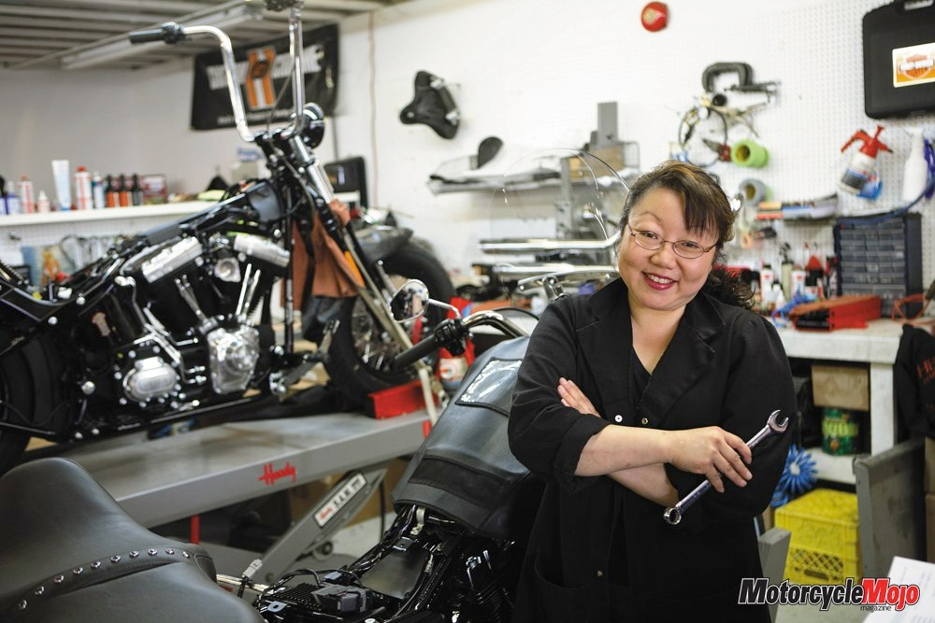
Classical Understanding

Slide 9
Romantic + Classical Understandings

Slide 10
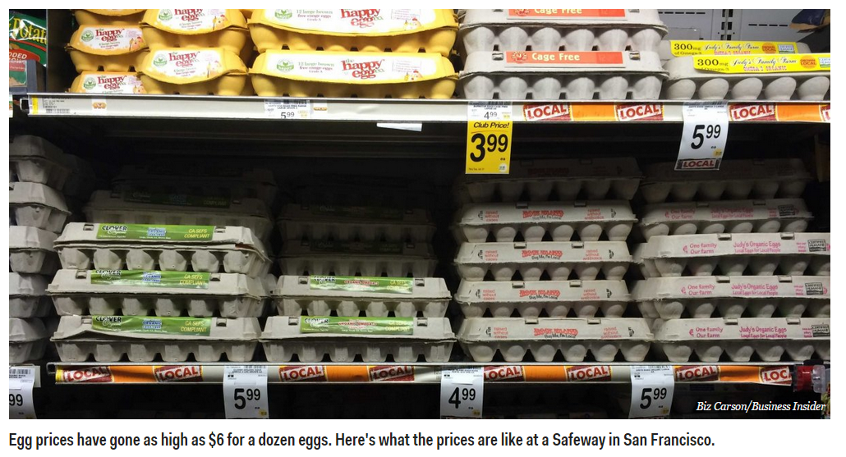
Project example: “Egg Replacement” mission is making the egg without dependency on animals.

Slide 11
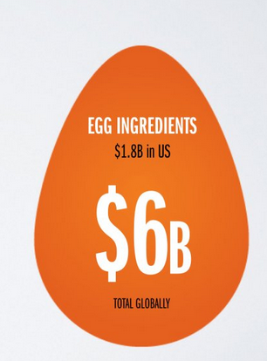
---cont. “What’s your takes on this”
Romantic
Classical
Massive Opportunity
google “Just Mayo, Just Cookies, Just Cookie Dough”
of Hampton Creek Inc. for reference

Slide 12
Six Years Ago
Social media struggling to integrate with consumerism
Mobile phones primarily being used for “casual” pursuits by the general public rather than “business,” “work” or “commerce” applications
The relative non-existence of cloud-based solutions for small to mid-sized businesses
The birth of the App Generation (again, primarily concerned with games and trivialities like “poking”)
The bumbling incompetence of early attempts at omni-channel marketing

Slide 13
Forecast
– How we think the future will be
Vision
– How we want the future to be
Scenarios
– What the future can be
–“Alternative memories” from the future
? ?
? ?
ref. https://www.slideshare.net/eteigland

Slide 14
ref. https://www.slideshare.net/eteigland

Slide 15
Thx to R. Wieselfors, Ericsson for photos
ref. https://www.slideshare.net/eteigland

Slide 16
Smart Robots
2015
ref. https://www.slideshare.net/eteigland

Slide 17
H.I.S. Co. has Hotels run
2017
“entirely” by robots and plans to open 100 hotels.
Food
deliveries
Check-in
Other Automated Tasks
Concierge Porters Cleaning Lawnmowing Room Service Robot Trashcan Robot fish
ref. https://www.slideshare.net/eteigland

Slide 19
Technology is Changing Business
Citizen AI (responsibility) Sophia
Extended Reality (the end of distance) XR
Data Veracity (the importance of trust (accuracy)) 5Vs
Frictionless Business (digital technology-based partnerships)
Internet of Thinking (intelligence everywhere)
FINTECH (technology centric financial service)
https://www.forbes.com/sites/steveolenski/2018/03/12/the-5-technology-trends-that-may-disrupt-business-over-the-next-3-years/#a2594c4b18cf

Slide 20
FINTECH Evolution (Financial Technology)
Cryptocurrency
Bitcoin
Blockchain
Ethereum
Regetech
Insurtech
Initial Coin Offering (ICO)
Initial Token Offering (ITO)
Open Banking
Robo-advisor
Unbanked/Underbanked
Financial Inclusion
Smart Contracts
Accelerators
https://www.cnbc.com/2017/10/02/fintech-everything-youve-always-wanted-to-know-about-financial-technology.html

Slide 21
Convergence for a “true” Collaborative Economy?
AI/ML
IoT/Sensors
Blockchains/Tokens
P2P/M2M payments
3D printing
Renewables
MR=VR/AR/MR
Sharing/ Collaborative Economy
ref. https://www.slideshare.net/eteigland

Slide 22
2045 – What it might be!
https://www.youtube.com/watch?v=01hbkh4hXEk http://2045.com/
Singularity - hypothetical point in time at which technological growth becomes uncontrollable and irreversible, resulting in unforeseeable changes to human civilization.
Consciousness – uploadable

Slide 23
So, What’s education for
Create and Improve the Future!
Predict the Future or Close Loop of Future with Less Error!
Uplift the Purpose of Life!!!

Slide 24
Class Activity
Special Topic Presentation by team: prepare 30 min. presentation and 10 min. Q&A (team to organize questionnaires in advance for this)
Special Topic Debate by team:
Final Project Task: team effort or individual (optional)
Prepare 45min. Presentation and 15min. Q/A
Real-World Scenario
Supporting Data and Documents
Open-Ended Problem and Discussion
Write a Comprehensive Research Project Report or Business Plan
Topic for Final Project
New business plan: ideas for startup, product, technology, and business etc…
Research projects (TBD)
O2O (online-to-offline) and OMO (online-merge-offline) Businesses
Why cashless mobile payment is so popular in China
What is Wechat: the SuperApp
The Four Waves of A.I.: Internet AI, Business AI, Perception AI, and Autonomous AI
A.I. Superpowers: the New World Order
Quantum Computing: What’s up to!
TBD…..
Hand-on real-life projects
Becoming citizen data scientist by using Kaggle platform
Develop your 1st blockchain Apps (no programming experience needed)
Learn something about A.I. https://www.elementsofai.com/

Slide 25
Course Topics
Course Introduction
Emerging Technology Trend
Blockchain Technology and Application
5G Technology, Application, and Technology War!
Cryptocurrency
FINTECH (Financial Technology)
Digital Enterprise and Industry 4.0: Enterprise Virtualization
Culinary Technology and Reinvention of Food Recipes; Case Study and Discussion: "Digitized Your Favorite Recipe”
Hand-On Project: Machine Learning (ML) and Deep Learning (DL), or Blockchain Hand-On Project, or Research Project Report

Slide 26
Assignment for next week (9/24)
Case Study and Discussion: "Which Technology Pioneer Companies (chose one from each field) will be your Favorite and Why!“ → prepare for 25min. presentation and 5min. Q&A
Company Review Assignment: https://twitter.com/hashtag/techpioneers20?src=hashtag_click
Team 1: http://widgets.weforum.org/techpioneers-2020/ Energy
Team 2: http://widgets.weforum.org/techpioneers-2020/ Health
Team 3: http://widgets.weforum.org/techpioneers-2020/ AI
Team 4: http://widgets.weforum.org/techpioneers-2020/ Financial
References:
Technology Pioneer Company: https://www.weforum.org/communities/technology-pioneer.
Handout: Emerging Technology Trend http://danieleewww.yolasite.com/2020-mgb070.php
Recommend to use Prezi style of presentation https://prezi.com/signup/public/

Slide 27
Presentation and Q&A Guideline
Review the selection criteria here https://www.weforum.org/about/technology-pioneers-programme-faq and identify the selection criteria and takeaways.
Review the website of your favorite company including its technology advancing and business progress.
Google the company information see any information on its technology/business competitor or positive/negative business reviews
Review the handout material : Emerging Technology Trend http://danieleewww.yolasite.com/2020-mgb070.php to get familiar with the information about the tipping point and predict if your favorite company could squeeze into the “Chasm” stage.
Prepare questionnaires in advance for Q&A session
Presentation Arrangement (recommended): arrange a group leader to moderate the presentation and Q & A session, and each team member should carry certain part of presentation, if possible.

Slide 28
Informal Debate Guidelines
Conducting:
The first speaker on the For (affirmative) team presents arguments in support of the resolution. (5-10 minutes)
The first speaker on the Against (opposing) team presents arguments opposing the resolution. (5-10 minutes)
The second speaker on the For team presents further arguments in support of the resolution, identifies areas of conflict, and answers questions that may have been raised by the opposition speaker. (5-10 minutes)
The second speaker on the Against team presents further arguments against the resolution, identifies further areas of conflict, and answers questions that may have been raised by the previous affirmative speaker. (5 – 10 minutes)
The rules may include a short recess for teams to prepare their rebuttals. (5 minutes)
The Against team begins with the rebuttal, attempting to defend the opposing arguments and to defeat the supporting arguments without adding any new information. (3 – 5 minutes)
First rebuttal of the affirmative team (3 – 5 minutes)
Each team gets a second rebuttal for closing statements with the For team having the last opportunity to speak. (3 – 5 minutes each)
Each team must type up a general script/outline of their arguments.
Each team must have prepared one page of hypothetical counterarguments.
Each person in the group must speak at least once.

