Slide 1
Technology and Industry/Business
Daniel Hao Tien Lee
http://danieleewww.yolasite.com/2016-mgb070.php
danieleewww@gmail.com

Slide 2
What you want from this course!
Given and Take!
or Take Lead and Explore!
or Take Action and Do Problem Solving with User-Friendly Technology Tool!

Slide 3
How Do You Define Technology!
Your Definition
The Merriam-Webster Dictionary offers a definition of the term: "the practical application of knowledge especially in a particular area" and "a capability given by the practical application of knowledge".
Technology can be most broadly defined as the entities, both material and immaterial, created by the application of mental and physical effort in order to achieve some value.

Slide 4
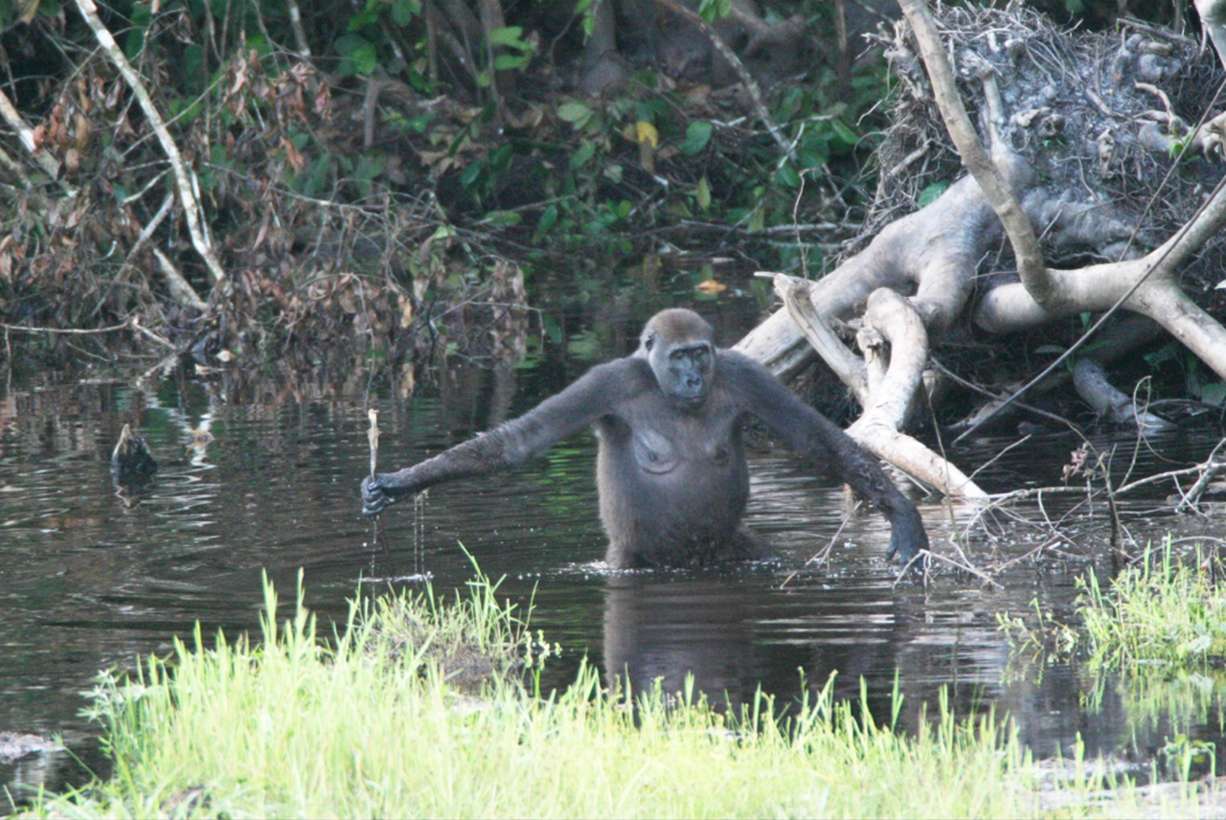
Wild Gorillas Handy with a Stick. PLoS Biology Vol. 3/11/2005, e385 doi:10.1371/journal.pbio.0030385

Slide 5
Technology and Industry/Business
Why this!
Interests….
Philosophy
Romantic understanding
Classic understanding

Slide 6
Romantic Understanding

Slide 7
Classical Understanding

Slide 8
Romantic + Classical Understandings

Slide 9
Mirror for Conventional Toilet Cleaning

Slide 10
Camera for Toilet Cleaning

Slide 11
From sticks, motorbikes, mirror, camera….. What lead to us?

Slide 12
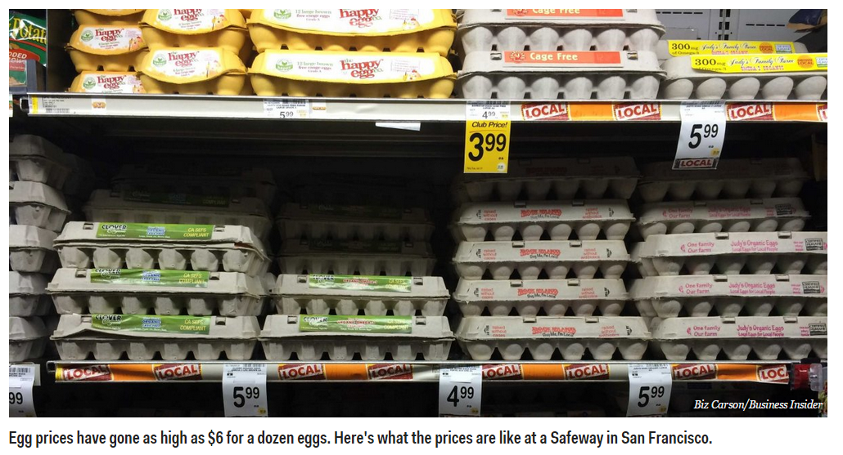
Project example: “Egg Replacement” mission is making the egg without dependency on animals.

Slide 13
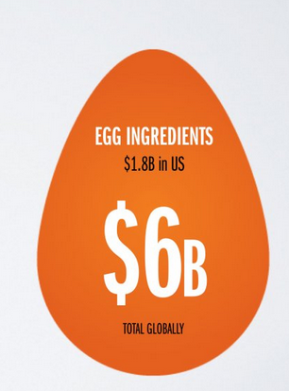
---cont. “What’s your takes on this”
Romantic
Classical
Massive Opportunity
google “Just Mayo, Just Cookies, Just Cookie Dough”
of Hampton Creek Inc. for reference

Slide 14
Automated Society
Repetitive Job
Cognitive Job
Whatelse!
Last Job on Earth http://www.theguardian.com/sustainable-business/video/2016/feb/17/last-job-on-earth-automation-robots-unemployment-animation-video?CMP=embed_video

Slide 15
Seamless Interactive Society
Human-to-Human
Twitter
Facebook
Human-to-Machine
Apple Siri
Google Now
Amazon Alexa
Machine-to-Human
Robot@Home/Service
Machine-to-Machine
Driverless Vehicle
Automated Factory

Slide 16
How we are going to proceed!
Your thinking and feedback
Fun Project: team effort or individual(option)
Ideas for startup, product, and business etc…
Hand-on projects on analytics by using machine learning or deep learning tools ! (no programming experience needed)
https://webcache.googleusercontent.com/search?q=cache:2KjIwDuvLLEJ:https://turi.com/learn/gallery+&cd=1&hl=zh-TW&ct=clnk&gl=tw
http://www.h2o.ai/download/h2o/desktop
https://gallery.cortanaintelligence.com/

Slide 17
Assignment for next week
Case Study and Discussion: "Which Company and/or which Technology will be on your Top List for the next 10-year“ → refer to course website link and prepare for 15min. presentation and 5min. Q&A(as a host)
Recommend using Prezi style of presentation https://prezi.com/signup/public/ (for free and open)

