Slide 1
Technology and Industry/Business
Daniel Hao Tien Lee
http://danieleewww.yolasite.com/2014-mgb070-soochow-u.php
danieleewww@gmail.com

Slide 2
How Do You Define Technology!
Your Definition
The Merriam-Webster Dictionary offers a definition of the term: "the practical application of knowledge especially in a particular area" and "a capability given by the practical application of knowledge".
Technology can be most broadly defined as the entities, both material and immaterial, created by the application of mental and physical effort in order to achieve some value.

Slide 3

Wild Gorillas Handy with a Stick. PLoS Biology Vol. 3/11/2005, e385 doi:10.1371/journal.pbio.0030385

Slide 4
Technology and Industry/Business
Why this!
Interests….
Philosophy
  Romantic understanding
  Classic understanding

Slide 5

  Romantic Understanding

Slide 6

  Classical Understanding

Slide 7

  Romantic + Classical Understandings

Slide 8
How we are going to proceed!
Your thinking and feedback

Slide 9
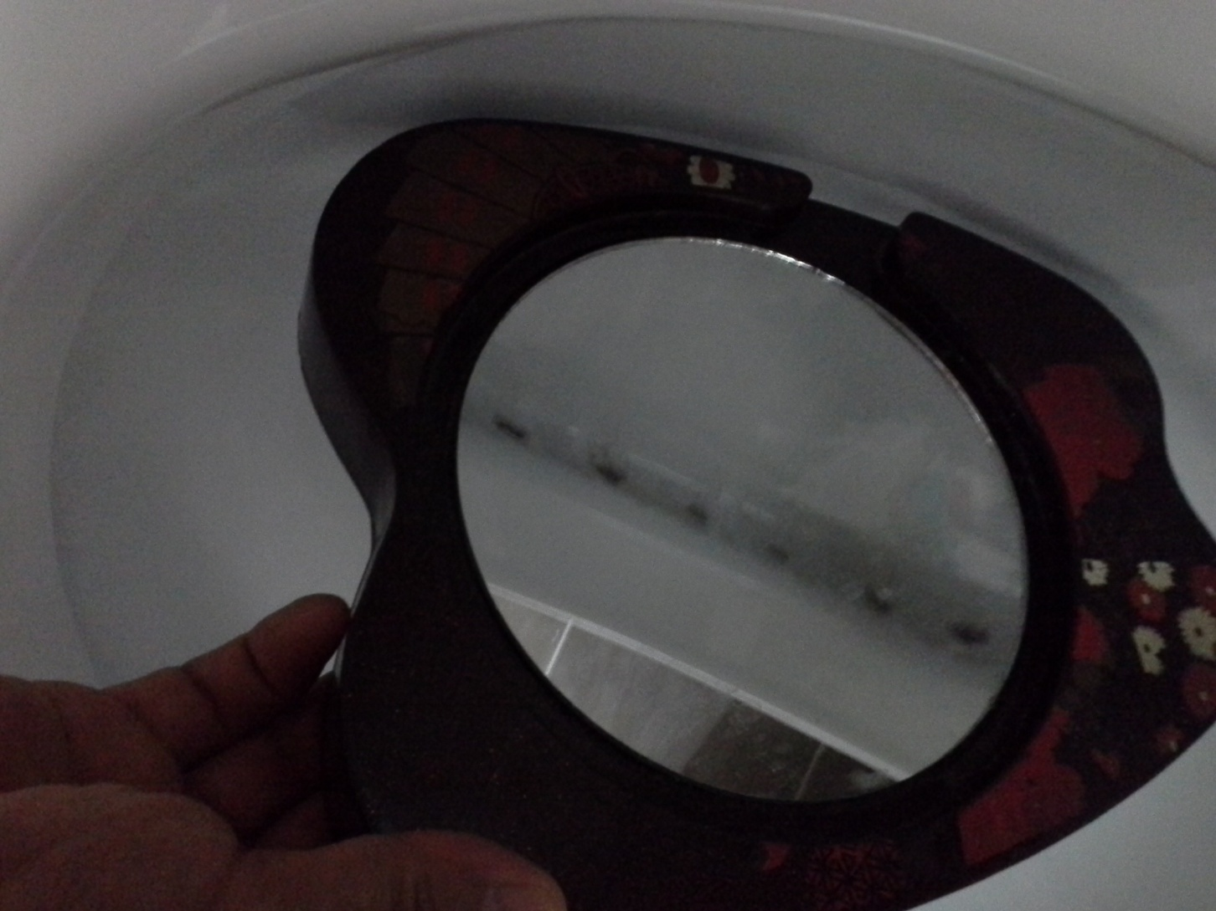
Mirror for Conventional Toilet Cleaning

Slide 10

Camera for Toilet Cleaning

Slide 11
From sticks, motorbikes, mirror, camera…..
What lead to us?

