Slide 1
Technology Trend 2030
Daniel Hao Tien Lee
http://danieleewww.yolasite.com/2017-mgb070.php
danieleewww@gmail.com

Slide 2
Outlines
Consumers in 2030
http://www.forumforthefuture.org/sites/default/files/project/downloads/future2030-finalreport.pdf
http://www.mckinsey.com/industries/consumer-packaged-goods/our-insights/the-consumer-sector-in-2030-trends-and-questions-to-consider
Technology Trend for 2030
http://www.businessinsider.com/technology-tipping-points-we-will-reach-by-2030-2016-11/#a-government-will-collect-taxes-for-the-first-time-via-blockchain-2023-10
http://www.businessinsider.com/technologies-future-2030-world-economic-forum-tech-video-2017-2
http://www.futuretimeline.net/21stcentury/2030.htm#.WSgc-BOGO_E
http://www.quantumrun.com/future-timeline/2030/future-timeline-subpost-technology#article0
https://www.forbes.com/sites/gregsatell/2016/08/12/5-technologies-for-2031/#89d05a5334f0
http://unctad.org/meetings/en/Presentation/ecn162016p02_McBean_en.pdf

Slide 3
Key Technology in 2030
Ambient Computing
https://shanewallcto.com/2016/11/07/challenges-and-opportunities-of-ambient-computing/
Smart(er) Devices
http://smarter2030.gesi.org/
Cybersecurity and Ethics
Robot and Ethics
AI and Risk Management
Information and Analytics
www.mckinsey.com/~/media/mckinsey/.../mgi-the-age-of-analytics-full-report.ashx
http://www.gartner.com/smarterwithgartner/technology-and-business-in-2030/

Slide 4
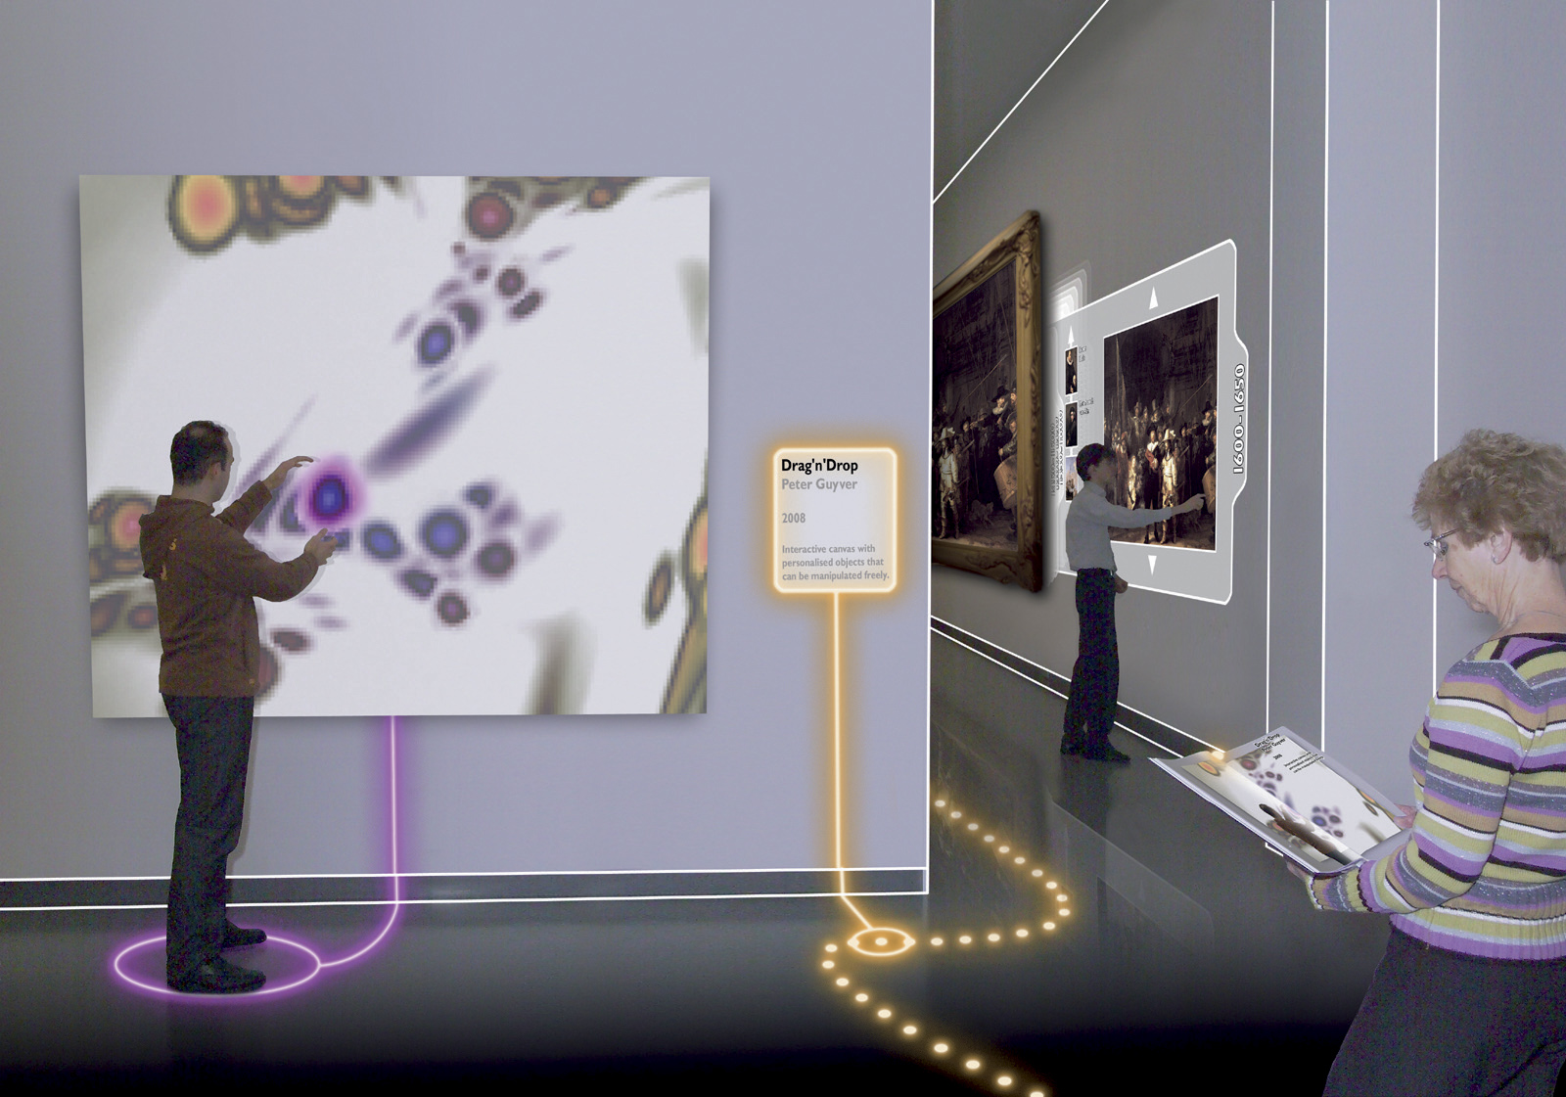
Ambient Intelligence
Dr. Mazlan Abbas

Slide 5
Ambient Intelligence (AmI)
Ambient Intelligence builds on three recent key technologies:
Ubiquitous Computing, Ubiquitous Communication and Intelligent User Interfaces
Ubiquitous Computing means integration of microprocessors into everyday objects like furniture, clothing, white goods, toys, even paint.
Ubiquitous Communication enables these objects to communicate with each other and the user by means of ad-hoc and wireless networking.
An Intelligent User Interface enables the inhabitants of the AmI environment to control and interact with the environment in a natural (voice, gestures) and personalized way (preferences, context).

Slide 6
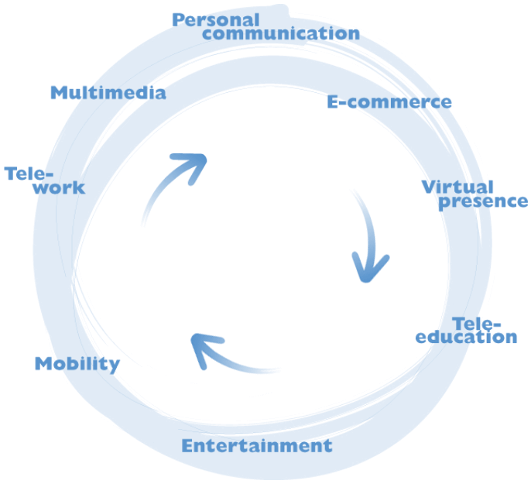
Photonics enabling Ambient Intelligence
AmI puts PEOPLE in the CENTER
Making technology invisible, embedded in natural surroundings, present whenever we need it and making interaction with technology simple effortless
PEOPLE
Notes:
In the future environment people will be surrounded and supported by a network structure which will support all their communication needs. This structure can be considered as offering an Ambient Intelligence linking people and services. Ambient intelligence requires the embedding of technology in natural surroundings such as buildings etc providing constant access to a variety of services, such as entertainment, personal communications, tele-education etc
Realisation of an ambient intelligence requires a fixed network providing large capacity links, which can only be supplied at low cost through the use of photonic networks, subsystems and components.

Slide 7
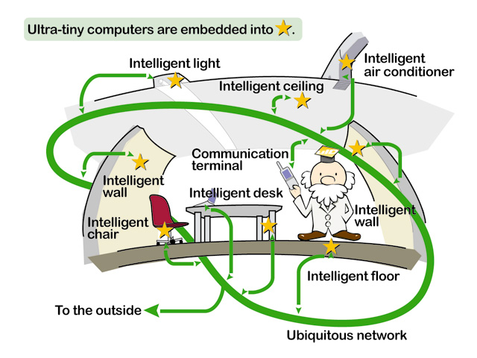
Imagine in the future…. Intelligence Are Embedded
Providing:-
Information
Communications
Entertainment
[Source: http://www.uidcenter.org ]

Slide 8
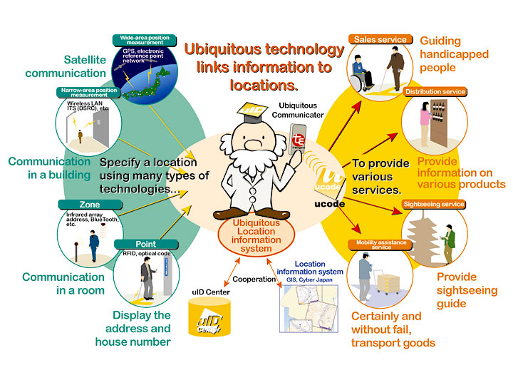
Information can be Access Anywhere & Anytime…
[Source: http://www.uidcenter.org ]

Slide 9
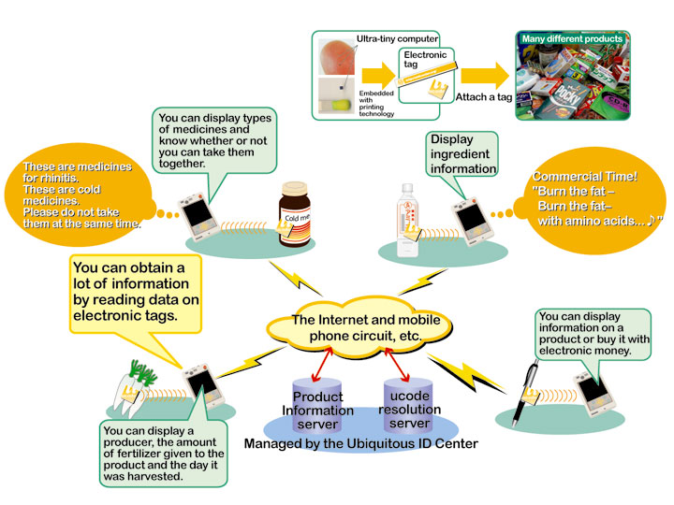
Links Devices with Different Networks...
[Source: http://www.uidcenter.org ]

Slide 10
Characteristics of Ambient Intelligence
Distribution
Non-central systems control and computation
Ubiquity
Surrounded by a multitude of interconnected embedded systems
Intelligence
Recognize the people that live in it, adapt themselves to them, learn from their behavior, and possibly show emotion.
Ambient
Intelligence

Slide 11
Ambient Intelligence
Significant work in the areas of:-
Device
Network
Software
R&D in preliminary stage
Would take at least another decade to see the light of commercialization
Critical factors
Interoperability
Security
Reliability
Predictablity
Devices need to become more autonomous in nature
Reduce arduous task of system management and administration
Biggest adopters
Healthcare
Home automation
Key enabling technologies
Wireless communications
Multi-disciplinary Research
Technologists
Designers
Human behavior sceintists
Adaptive
Ambient
Intelligence
Anticipatory
Personalized

Slide 12
Convergence of 3 Areas
Ubiquitous
Communications
Ambient
Intelligence
Ubiquitous
Computing
Ubiquitous
Interfaces
“The vision is to embed intelligence into different devices, to make them smart and capable to attend to the user’s need and lifestyle”

Slide 13
Requirements of Ambience Intelligence
Unobtrusive hardware
Nano-electronics & Nano-devices
Dependability and security
One global network of devices
Safe to use
Ambient
Intelligence
Seamless communications infrastructure
Heterogeneous networks
Convergence networks
Advanced human interface
Universal access to existing devices
Unified interface
Dynamic and distributed device network
Portable
Plug-and-play

Slide 14
Architecture
Daily
Lifestyle
Solutions
Applications
Convergence
Ambient Intelligence
Technologies
Ubiquitous
Computing
Ubiquitous
Communications
Ubiquitous
Interfaces

Slide 15
Six Forces Shaping Business and Technology in 2030
Global to personal
Hierarchies to meshes
Fixed to interchangeable assets
Devices to connected humans and things
Big data to algorithmic business
Resources to smart materials
https://pages.upwork.com/gartner-report-six-forces-that-will-shape-business-and-technology-in-2030.html

