Slide 1
Strategic Technology Trend 2017
Daniel Hao Tien Lee
http://danieleewww.yolasite.com/2017-mgb070.php
danieleewww@gmail.com

Slide 3
Top 10 Strategic Technology for 2017
Artificial Intelligence and Advanced Machine
https://www.facebook.com/kaifulee/videos/1671936116167033/
Intelligent Apps
Intelligent Things
Virtual Reality and Augmented Reality
Digital Twins
Blockchains and Distributed Ledgers
Conversational Systems
Mesh App and Service Architecture
Digital Technology Platforms
Adaptive Security Architecture
References:
http://www2.caict.ac.cn/zscp/qqzkgz/qqzkgz_zdzsq/201611/P020161111584956755544.pdf

Slide 4
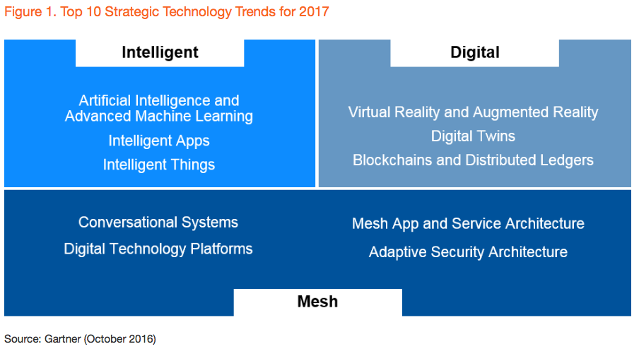

Slide 6
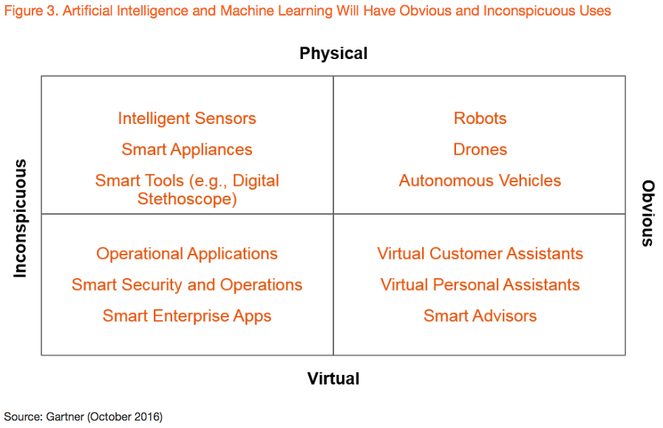

Slide 7
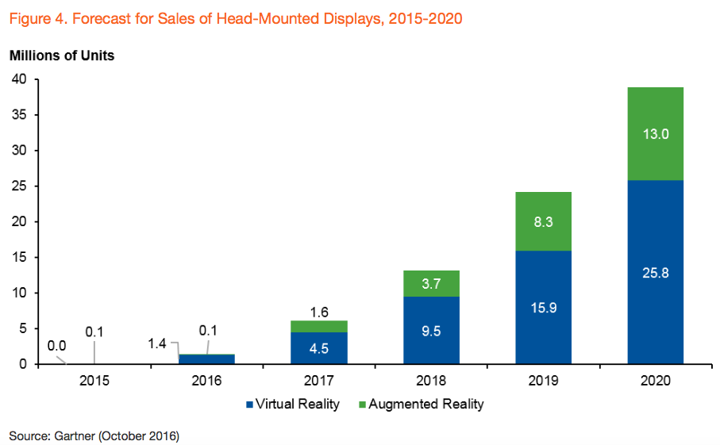

Slide 8
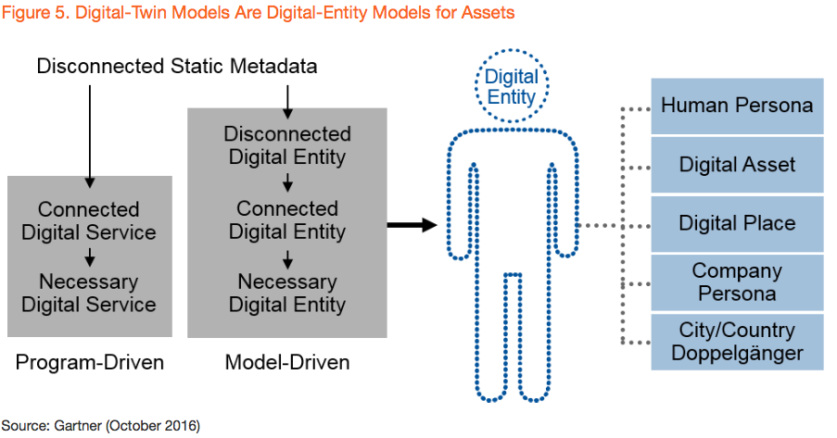

Slide 9
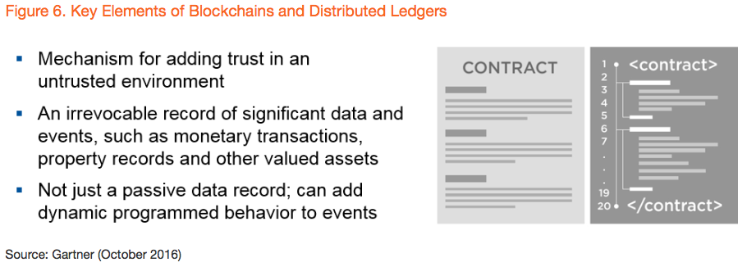

Slide 10
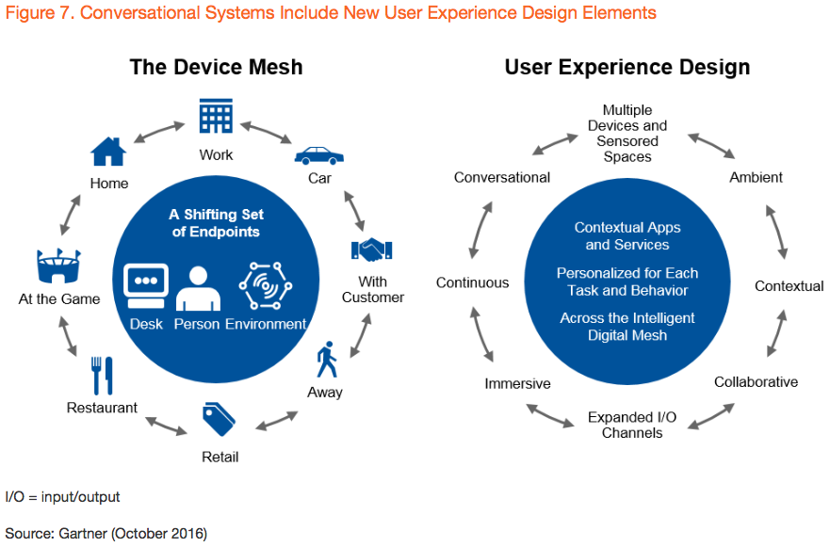

Slide 11
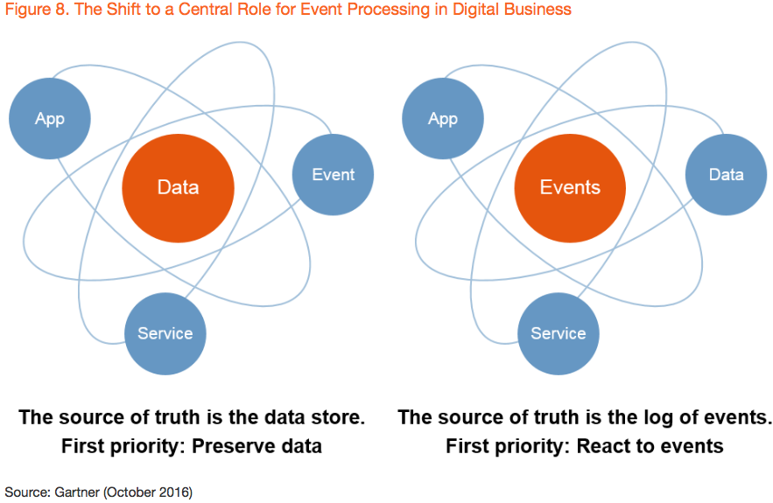

Slide 12
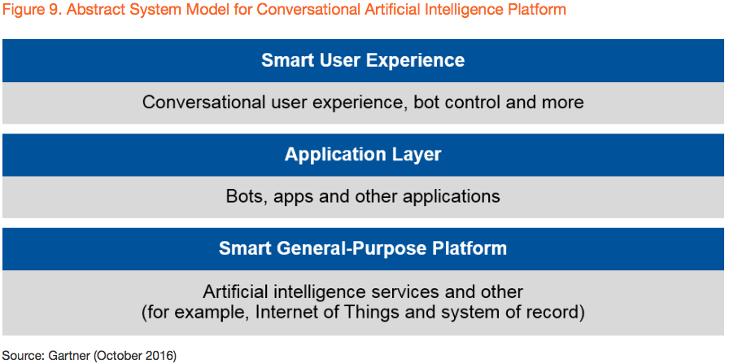

Slide 13
