Slide 1
Data Science
Future of J
Notes:
1

Slide 2
What is Data Science
http://datascience.nyu.edu/what-is-data-science/
https://www.youtube.com/watch?v=40riCqvRoMs

Slide 3
How to Learn Data Science
https://www.youtube.com/watch?v=Ura_ioOcpQI&t=76s
https://www.youtube.com/watch?v=z1kPKBdYks4
https://www.youtube.com/watch?v=N4mEzFDjqtA
https://www.dataquest.io/home

Slide 4
ML Introduction
https://www.youtube.com/watch?v=cKxRvEZd3Mw
https://www.youtube.com/watch?v=tNa99PG8hR8&t=1s
https://www.youtube.com/watch?v=N9fDIAflCMY&t=126s
https://www.youtube.com/watch?v=84gqSbLcBFE
https://www.youtube.com/watch?v=AoeEHqVSNOw
https://www.youtube.com/watch?v=cSKfRcEDGUs
https://www.youtube.com/watch?v=Gj0iyo265bc
https://www.youtube.com/watch?v=IpGxLWOIZy4
https://www.youtube.com/watch?v=VUrqddjkxok

Slide 5
DL Introduction
https://www.youtube.com/watch?v=He4t7Zekob0
https://www.youtube.com/watch?v=Q9Z20HCPnww
https://www.youtube.com/watch?v=FmpDIaiMIeA

Slide 6
ML in Everyday Life
https://www.youtube.com/watch?v=dcZvhP-IqY4
https://www.youtube.com/watch?v=w1xNTLH1zlA

Slide 7
DL in Everyday Life
https://www.youtube.com/watch?v=aKSILzbAqJs

Slide 8
ML/DL in Future

Slide 9
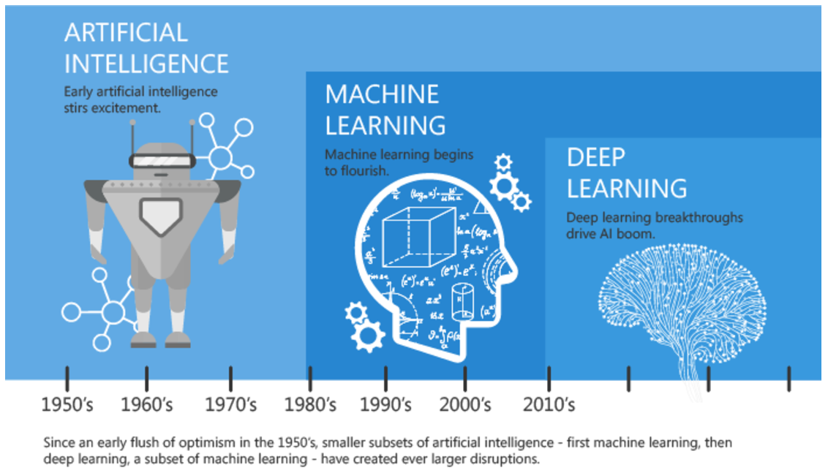
Artificial Intelligence, Machine Learning, and Deep Learning

Slide 10
What IS MACHINE LEARNING?
Machine learning explores the study and construction of algorithms that can learn from and make predictions on data. Such algorithms operate by building a model from example inputs in order to make data-driven predictions or decisions, rather than following strictly static program instructions.
Machine learning is closely related to and often overlaps with computational statistics; a discipline that also specializes in prediction-making. It has strong ties to mathematical optimization, which delivers methods, theory and application domains to the field.
https://en.wikipedia.org/wiki/Machine_learning

Slide 11
What IS MACHINE LEARNING?

Slide 12
ML|Data Mining|Data Science|AI|Big DATA
Statistics
Artificial Intelligence
Data Science
Big Data
“The study and design of intelligent agents” and the creation of machines that learn
Predictive Analytics
Massive volumes of structured and unstructured data.
Machine Learning
Data Mining

Slide 13
ML/DL: Open Source Platform
H2O.ai
https://www.h2o.ai/download/
https://github.com/h2oai/h2o-3/tree/master/h2o-py/demos
Turi Graphlob
https://github.com/turi-code/tutorials
https://turi.com/

Slide 14
How to become a data scientist
https://www.quora.com/How-can-I-become-a-data-scientist-1
http://insighthealthdata.com/
https://www.youtube.com/watch?v=tKa0zDDDaQk
https://www.youtube.com/watch?v=ccCblUZFM0w

Slide 15
Assignments: Conceptual review
https://medium.com/machine-learning-for-humans/why-machine-learning-matters-6164faf1df12 prepare a brief on the review
Part 1: for all
Part 2.1: Jonas
Part 2.2: Ellen
Part 2.3: Johan
Part 3: Anna
Part 4: Sami
Part 5: Richard

