Slide 1
Behavioral Science and Persuasive Technology
Future of J
Notes:
1

Slide 2
What is Behavioral Science
Why floss daily
Why ware fitness tracker
Why most people’s expensive home treadmills turn into overpriced coat racks
Why motivating humans is more complicated than ever before
https://www.datanami.com/2017/02/20/data-science-meets-behavioral-science/
https://www.princeton.edu/news/2017/01/19/better-living-through-behavioral-science

Slide 3
Behavioral Science
https://www.youtube.com/watch?v=6Fu4tfQWGm8
https://www.youtube.com/watch?v=NNnIGh9g6fA

Slide 4
“Whatever else it produces, an organization is a factory that produces judgments and decisions.” by Thinking, Fast and Slow, Daniel Kahneman

Slide 5
Judgments and decisions are at the core of two of the most significant intellectual trends of our time – Moneyball and Nudge

Slide 6
“Moneyball” is shorthand for applying data analytics to make more economically efficient decisions in business, health care, the public sector, and beyond. “Nudge” connotes the application of findings from psychology and behavioral economics to prompt people to make decisions that are consistent with their long-term goals.

Slide 7
Other than the connection with decisions, the two domains might seem to have little in common. After all, analytics is typically discussed in terms of computer technology, machine learning algorithms, and (of course) big data. Behavioral nudges, on the other hand, concern human psychology. What do they have in common?

Slide 8
When the ultimate goal is behavior change, predictive analytics and the science of behavioral nudges can serve as two parts of a greater, more effective whole. – The last-mile problem “If we want to act on data to get fit or reduce heating bills, we need to understand not just the analytics of the data, but how we make decisions.”
https://dupress.deloitte.com/dup-us-en/deloitte-review/issue-16/behavioral-economics-predictive-analytics.html

Slide 9
Data Science + Behavioral Analytics = Behavior Change → Force Multiplier ! Data Science = Seeing the unseen ( Surface actionable signals previously undetected to bake into a data product ) Behavioral Science = Making it relevant ( Making data product relevant to the daily context of tasks a person does to accomplish concrete business outcomes )

Slide 10
Behaviroal Scientist
Behavioral scientists know all about the human brain. They are specialized in cognitive psychology. How do people perceive? How do they reach a decision? This kind of knowledge is crucial if you want to influence your visitors’ behavior. This sounds very simple, but if you do not know what moves your customer, you cannot change his or her movements. Maybe you can strike lucky once or twice but for continuous customer experience optimization you cannot go without behavioral scientists. Preferably, you should use the expertise of a neurological psychologist or someone that has completed a study like Human Technology Interaction. Otherwise, you will never be able to unify your goals with those of your customers.

Slide 11
Behavioral Analytics
Intention-Action Gap

Slide 12
The Smart City and Behavioral Science
The vision of the smart city, with its ability to monitor public behaviours and habits at larger scale, could change the geographical scope of these developments further.

Slide 13
Captology
Captology is the study of computers as persuasive technologies. This includes the design, research, and analysis of interactive computing products (computers, mobile phones, websites, wireless technologies, mobile applications, video games, etc.) created for the purpose of changing people’s attitudes or behaviors. BJ Fogg derived the term captology in 1996 from an acronym: Computers As Persuasive Technologies = CAPT.

Slide 14
https://www.youtube.com/watch?v=GcyUVOuSBrw

Slide 16
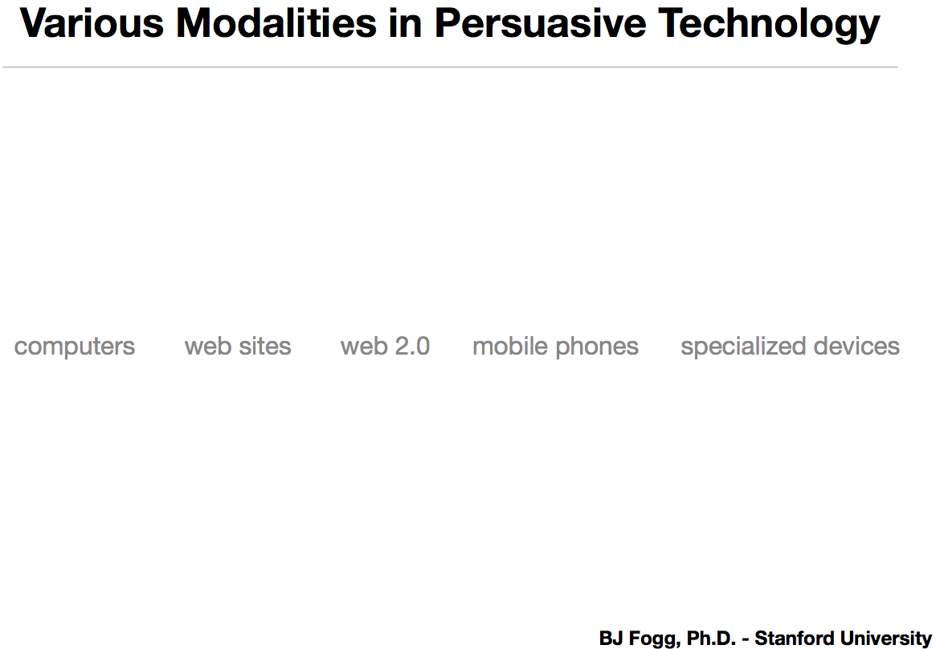

Slide 17
file:///Users/haotienlee/Desktop/scu2017/persuasivetechnology/s23whalen-final-100505084040-phpapp01.pdf

Slide 18
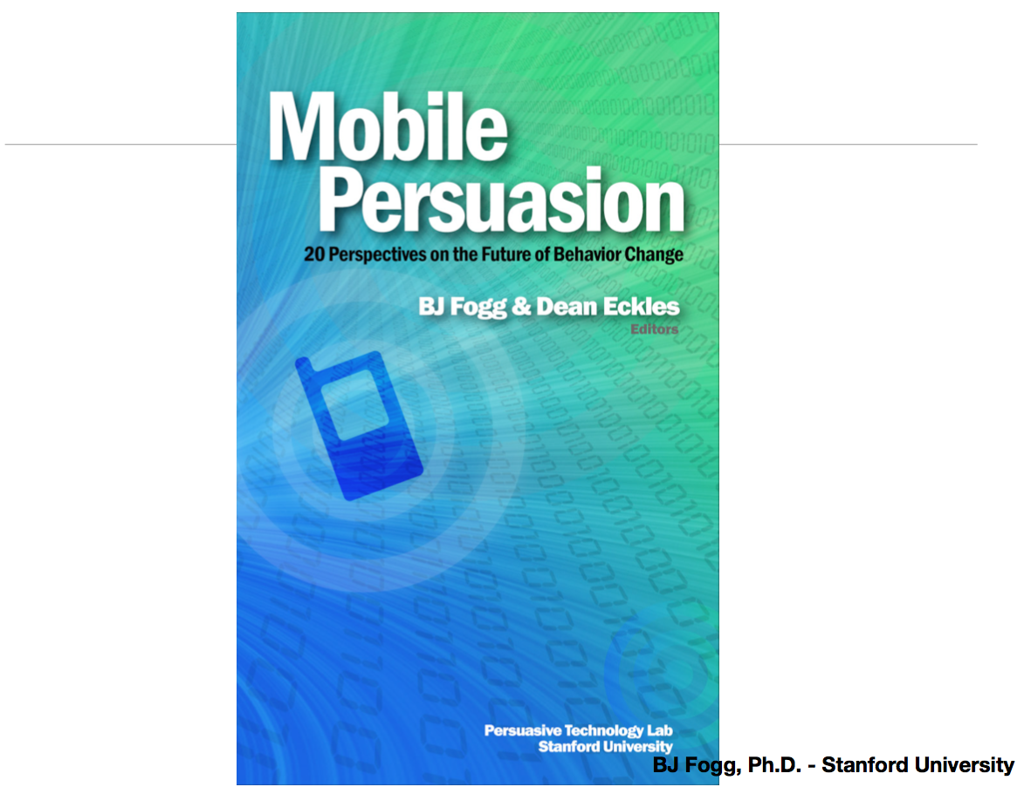

Slide 20
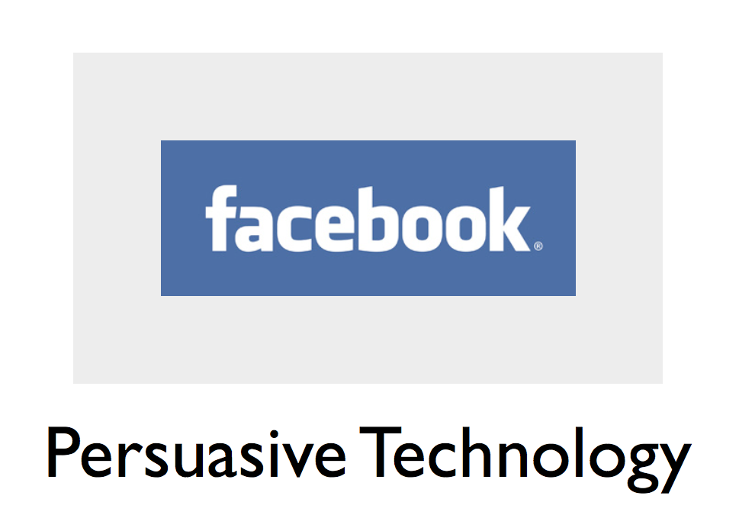

Slide 22
Psychology of Facebook
https://www.slideshare.net/EnriqueAllen/auto-sensing-context

Slide 23
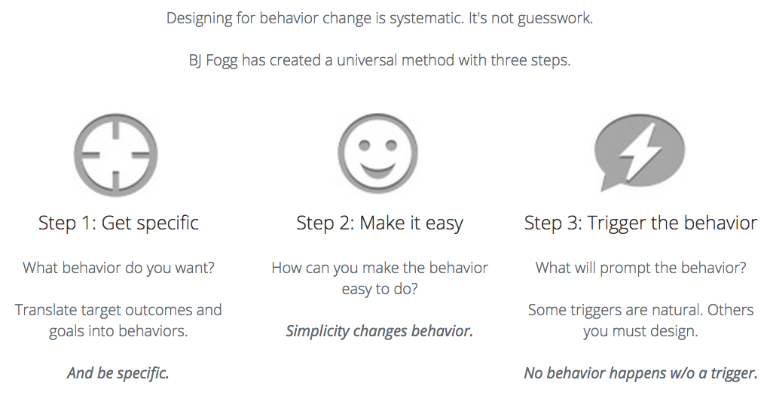

Slide 24
RealLife Project
https://www.brookings.edu/blog/brown-center-chalkboard/2016/03/10/big-data-meet-behavioral-science

Slide 25
Persuasion Cases
https://www.brookings.edu/blog/brown-center-chalkboard/2016/03/10/big-data-meet-behavioral-science
http://www.tweetpsych.com/
http://vistriai.com/gaydartest/

Slide 26
Nudge Theory
https://www.youtube.com/watch?v=jsy1E3ckxlM
http://nudges.org/
http://www.businessballs.com/nudge-theory.htm
http://www.behaviouralinsights.co.uk/
https://www.slideshare.net/joebarnes/nudge-35334187

Slide 27
Design to Nudge and Change Behviour
https://www.youtube.com/watch?v=EsUzI9lZMak
https://www.youtube.com/watch?v=l5d8GW6GdR0
https://www.youtube.com/watch?v=Lp7E973zozc

Slide 28
Pretrial Technology
DecisionQuest http://www.decisionquest.com/

Slide 29
Habit-forming technology
DecisionQuest http://www.decisionquest.com/

Slide 30
Assignment
Topic to address:
??? Your choices

