Slide 1
Lifestyle Addiction and Technology/Business Co-Evolution
Daniel Hao Tien Lee
http://danieleewww.yolasite.com/2015-mgb070.php
danieleewww@gmail.com

Slide 2
???!!!
Any lifestyle addiction you have now!
Your dream of lifestyle

Slide 3
Typical Q’s for Lifestyle Survey
In what types of stores do consumers shop for food and drink?
Do commuters drive cars to work or take public transport?
How do ethnic groups influence consumer preferences and expenditure trends?
How many households own microwave ovens? Personal computers? Refrigerators?
On the whole, are the consumers spenders or savers?
Where do consumers go on holiday and how much do they spend?
How well are consumers served by the healthcare system?

Slide 4
Ingredients of Lifestyle
Hobby
Entertainment
Gaming
Internet Surfing
Social Network
Travel
Work
Wealth
Health
Others……

Slide 5
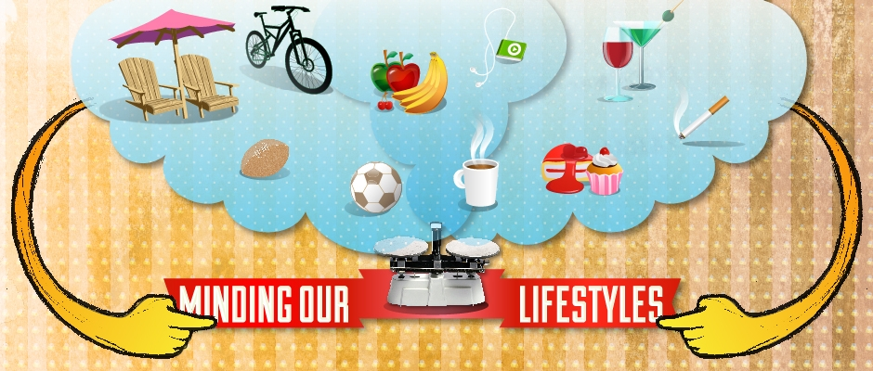
Hobby and Casual Lifestyle

Slide 6
Daily Lifestyle

Slide 7
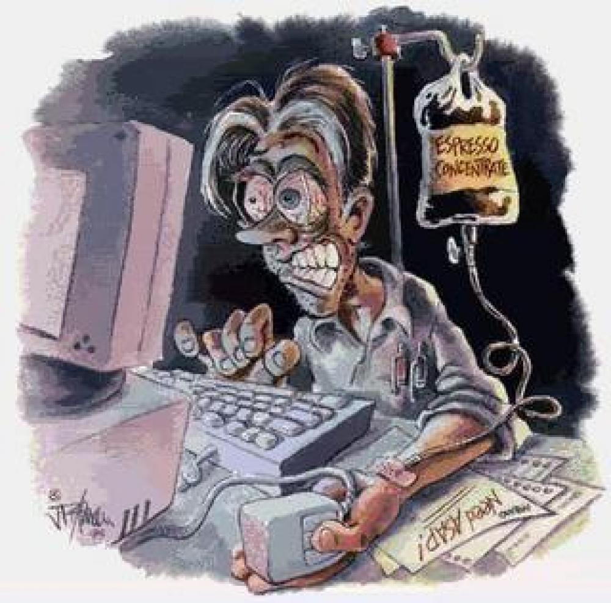
Internet Lifestyle
http://kris-sariy.tumblr.com/post/20283789740/cyberchondriac

Slide 8
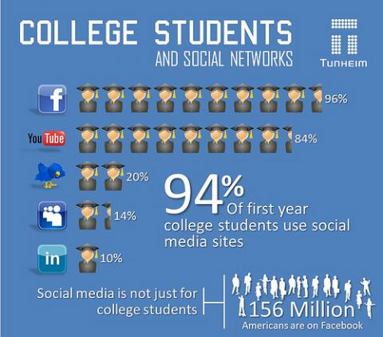
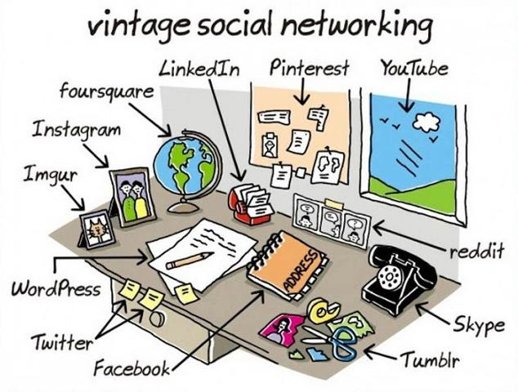
Internet Social Network Lifestyle

Slide 9
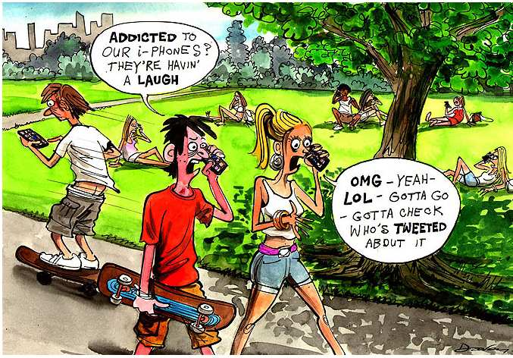
Mobile Internet Addiction
http://www.michellehenry.fr/tel.htm

Slide 11
Or Computing is Speeding Up our Life!

Slide 12
Examples
Software Defined Data Center https://www.vmware.com/products/nsx/
SW to Unify Sales, Marketing , and Services http://www.usermind.com/
Music Genome Project: Music– Feeling and Sensibility
Human Genome Project: DNA Sequencing and Proactive Health Care for Life Time
Brain Genome Project: AI (machine learning)
Dating and Social Activity
Others….

Slide 13
Lifestyle Changing to accord with Changing Pace of SW Eating the World

Slide 14
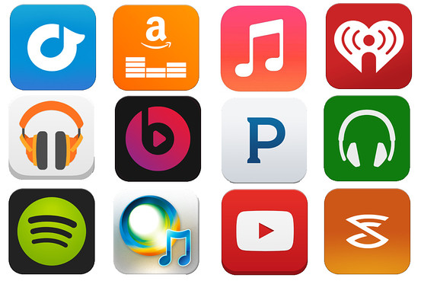

Slide 15
Music and Technology
http://echonest.com/
http://www.pandora.com/about/mgp
http://spotibot.com/
http://www.soundhound.com/
http://www.shazam.com/
https://www.gracenote.com/music/
http://www.last.fm/
http://musicbrainz.org/
All based on what?

Slide 16
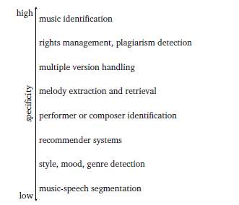
Music information retrieval (MIR)
http://www.nyu.edu/classes/bello/MIR_files/1-Introduction.pdf

Slide 18
Streaming Service for Emotion
Netflix: the new phrase is "It's not TV. It's Netflix." Everything that makes Netflix's programming distinctive--surrendering control to creators, releasing all episodes of a season at once, keeping its viewership data private rather than participate in the ratings game--is a modern twist on the original, universally admired HBO game plan. http://www.fastcompany.com/3024158/netflix-the-red-menace
Pandora
Spotify
KKBox
Beatsmusic : understands users' emotions, offering the best of human curation and computer algorithm http://www.fastcompany.com/3024765/beats-music-launches-to-take-on-spotify-google-and-apple
http://www.usatoday.com/story/tech/personal/2014/01/20/beats-music-service-review/4575521/

Slide 19
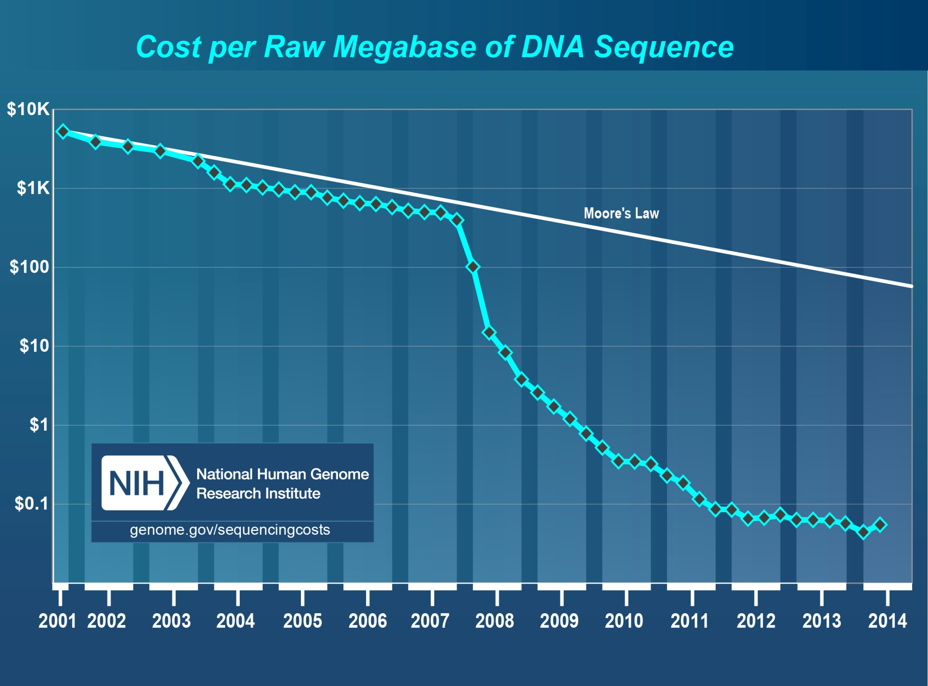
DNA Sequencing Cost Down Beating Megabit Cost Down of
Moore’s Law--- But computing power facilitated by Moore’s
Law is key to DNA sequencing
Human (23 chromosomes) is estimated to be about 3.2 billion base pairs long

Slide 20
Takeaways on DNA Sequencing
DNA sequencer raises doctors' hopes for personalized medicine
The Supreme Court on Thursday issued a ruling that bans the patenting of naturally occurring genes but allows edited or artificially created DNA to be patented. http://news.nationalgeographic.com/news/2013/06/130614-supreme-court-gene-patent-ruling-human-genome-science/
DNA sequencing: how much do you want to know about your health future?
Will My Son Develop Cancer? The Promise (and Pitfalls) of Sequencing Children’s Genomes http://www.cancer.org/acs/groups/cid/documents/webcontent/002548-pdf.pdf
Living Longer, Living Better – DNA And Your Future
https://www.23andme.com/ $99 offer!

Slide 21
AI: Machine Learning and Deep Learning
Algorithm to create/generate intelligence out of recognition and learning
are the name of game.
https://www.youtube.com/watch?v=exhdfIPzj24

Slide 22
Takeway: AI of ML and DL
Skype will soon get real-time speech translation based on deep learning http://blogs.microsoft.com/blog/2014/05/27/microsoft-demos-breakthrough-in-real-time-translated-conversations/
Google, Baidu, Facebook are on the run as well.

Slide 23
Dating Decision by Math.
https://www.okcupid.com/about/okcupid
Math. Based Dating System inside Okcupid http://www.youtube.com/watch?v=m9PiPlRuy6Ehttp://www.sonichu.com/cwcki/List_of_OkCupid_Answers
What’s Next!

Slide 24
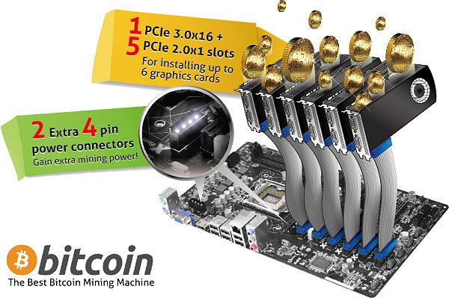
BitCoin: Digging gold mine out of nowhere!
https://www.youtube.com/watch?v=Gc2en3nHxA4#t=50
https://bitcoin.org/

Slide 25
BitCoin
No more monopolize in the currency by FED, BE, or other central banks in the world.
http://singularityhub.com/2014/09/30/how-long-would-it-take-to-mine-bitcoin-by-hand/

Slide 26
Bitcloud
"If you're interested in privacy, security, ending Internet censorship, decentralizing the Internet, and creating a new mesh network to replace the Internet, then you should join or support this project,"
http://singularityhub.com/2014/09/30/how-long-would-it-take-to-mine-bitcoin-by-hand/

Slide 27
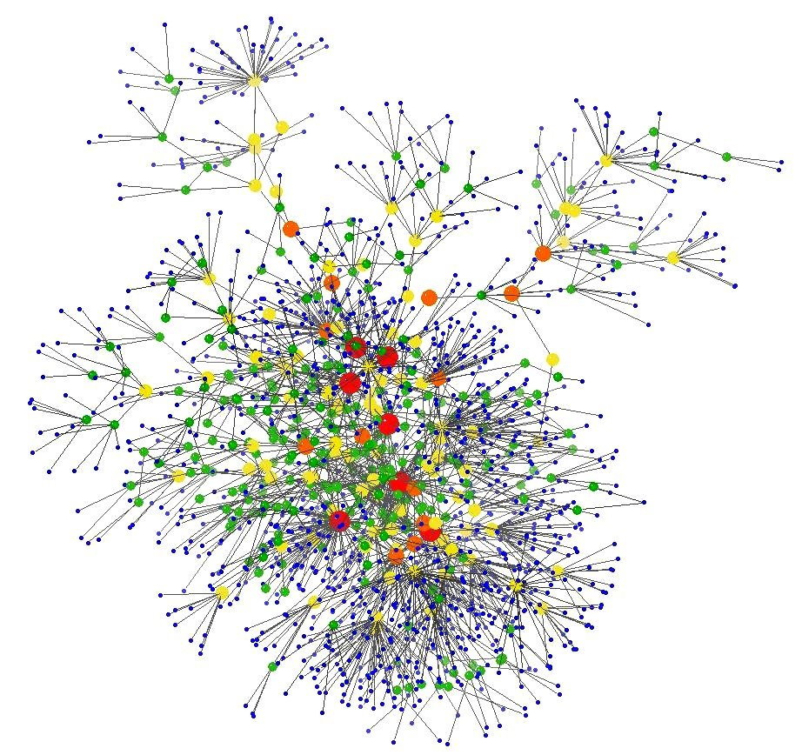
Two Projects Aim To Decentralize The Internet
Bitcloud
Maidsaft

Slide 28
Lifestyle Addiction: Its Impact on the Industry Ecosystem and Technology

Slide 29
Coffee Industry and Business
Ecosystem and Value Chain
Brewing Ecosystem
Single-Serve-Coffee

Slide 30
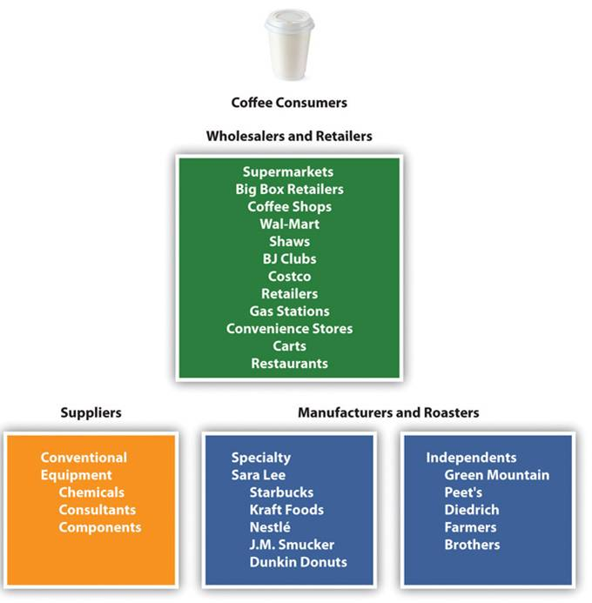
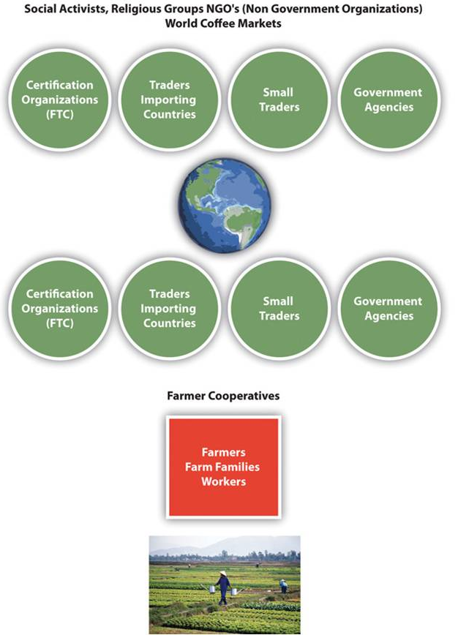
Coffee Ecosystem
http://catalog.flatworldknowledge.com/bookhub/reader/3157?e=gittell_1.0-ch07_s02

Slide 31
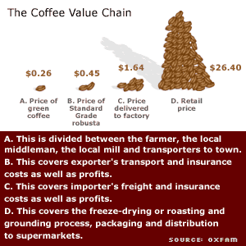
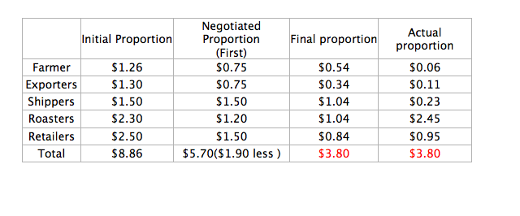
Is this fair?
Fair Trade Term
Results of our exercise on the profit share of a 100 gram bag of branded instant coffee sold at $3.80 (do euros if you like)

Slide 32
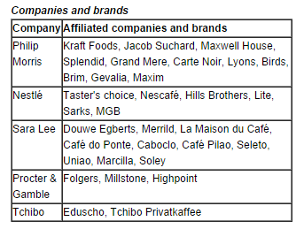
Coffee statistics show that coffee is the most popular beverage worldwide with over 500 billion cups consumed each year.
Coffee is the 2nd. largest commodity next to crude oil; a retail sales value in excess of $100 billion in the world market.
http://www.teacoffeecocoa.org/tcc/Commodities/Coffee/Industry

Slide 33
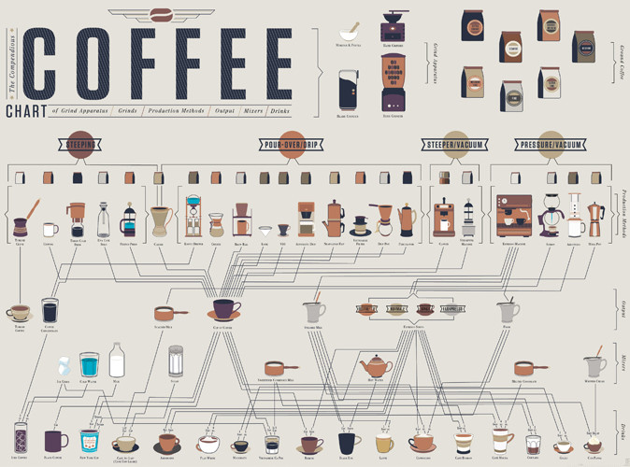
Coffee brewing ecosystem and its taxonomy-- sustainability
Consumption: >23 billions cup-of-coffee per day
http://www.fastcodesign.com/1670599/infographic-how-to-make-every-coffee-drink-you-ever-wanted#7

Slide 34
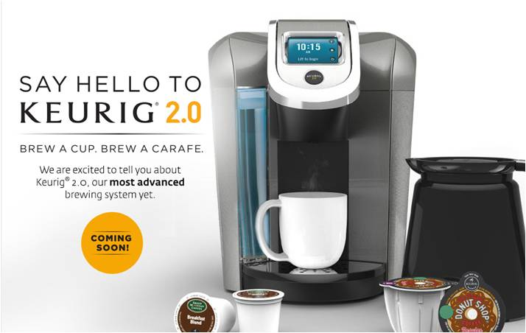
Keurig 2.0 Brewer
Single-Serve-Coffee
Brews a Cup or a Carafe

Slide 35
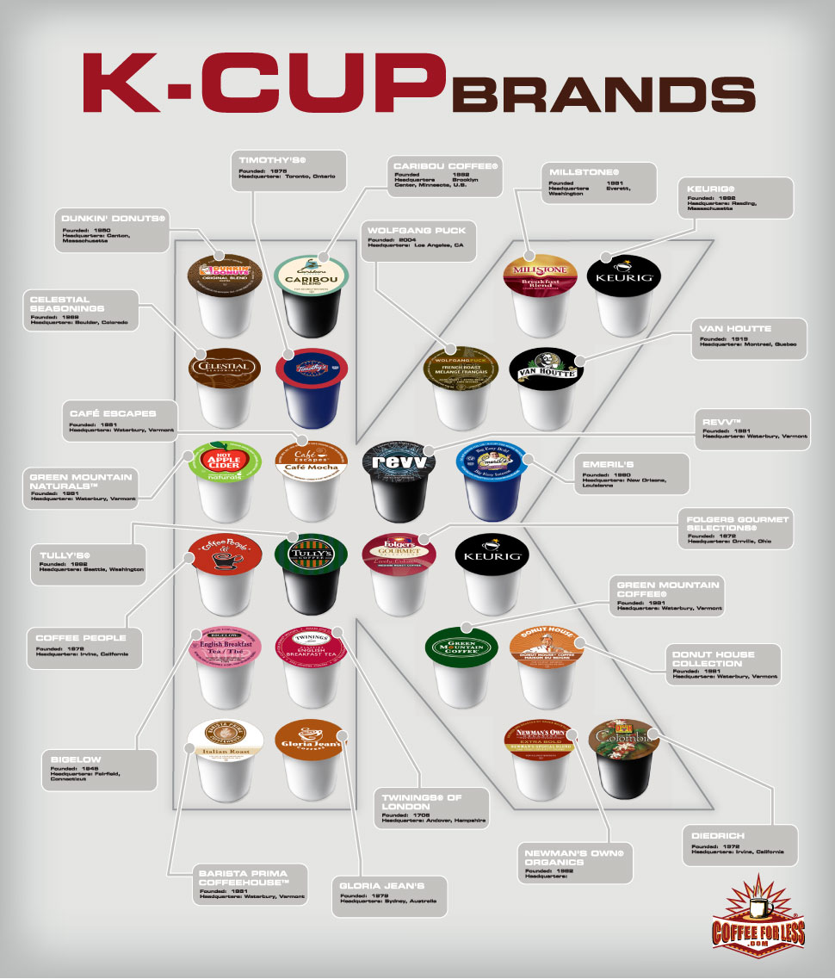
Single-Serve-Coffee

Slide 36
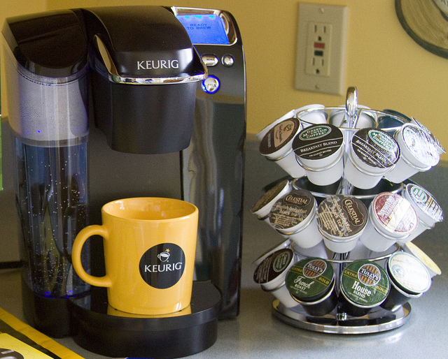
As K-cups have demonstrated, people are willing to pay handsomely US$1-0.35/cup for convenience and control over their coffee experience.

Slide 37
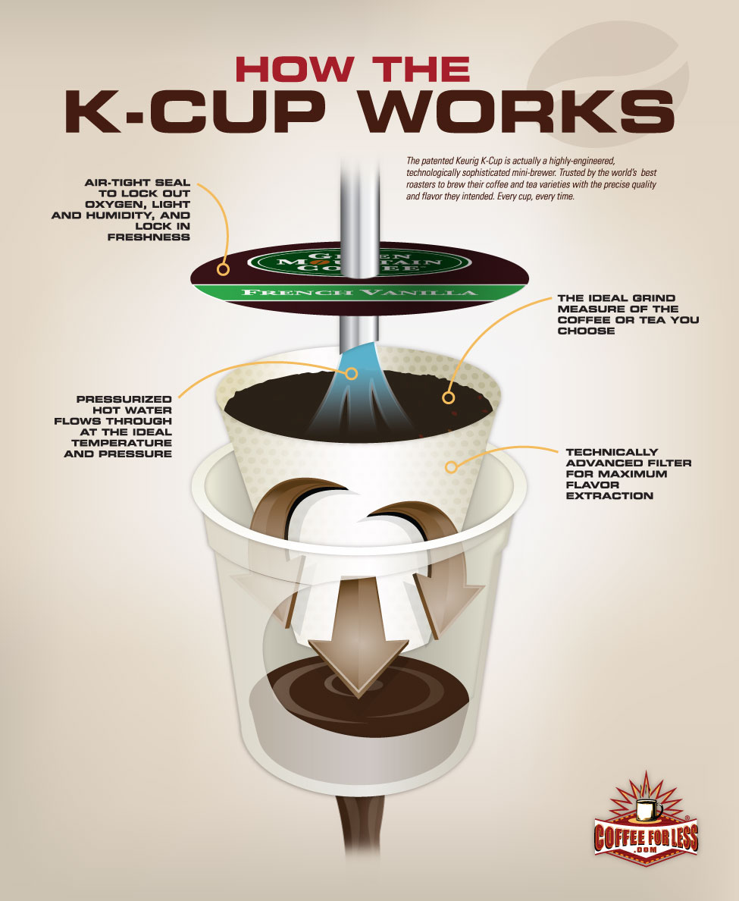

Slide 38
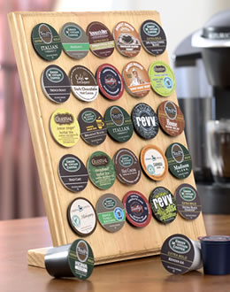

Slide 39
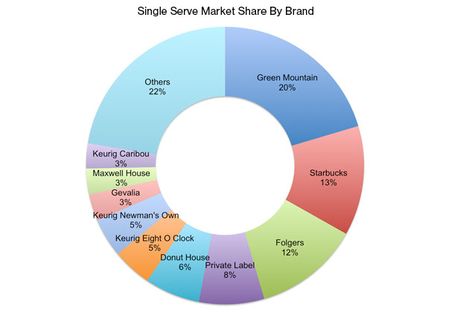
The company(Green Mountain) began moving into the home market in 2004, and sales took off. K-Cups now come in more than 200 flavors and sell for about 35 cents apiece. That’s 7 times the cost per cup of coffee brewed by traditional methods, but consumers are willing to pay for the speed and convenience: In 2013 U.S. sales of Keurig coffeemakers and pods exceeded $4.25 billion, and the coffeemakers had a dollar market share of more than 40%.

Slide 40
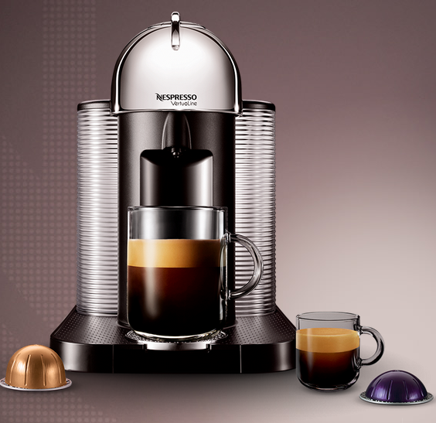
Nestle’s Nespresso
For both small and big cup

Slide 41
Nespresso VertuoLine and Nespresso OriginalLine
Two distinct technologies

Slide 42
What’s Next

Slide 43
Analogy: Coffee vs Smart Phone

Slide 44
Coffee vs Mobile Device Industries: Commons (Similarities)
Very Low Value of Maker’s (1% vs 1.5%)
2nd. biggest commodity vs the most popular electronics devices ever
Ubiquitous(home/office/business/travel)
Affordable to everyone!
Easy use and entertained
A variety of choices for both
Brand is the “King”
Customer Experience: End-user’s addiction is critical
Social drinks vs social networking
Globalization

Slide 45
Coffee vs Mobile Device Industries: Dissimilarities
Customer Experience
Competitive Landscape
Regional vs Worldwide
Oligopoly vs Perfect Competition
Sustaining Innovation (incumbents near always win) vs Disruptive Innovation (entrantants near always win)
Business Model
Vertical Integration vs Horizontal Integration vs Mixes
Value Chain Integration
Supply Chain Configuration
Knowledge Management

Slide 46
Open-Ended Question/Problem
Decode the value chain of coffee industry, including incumbents/winners, entrants, startups etc.; explain why/how this value chain and its sustainability issues
Decode the value chain of mobile phone industry………

Slide 47
Assignment for Next Week
Case Study and Discussion: "GMO Food and Technology“ search and prepare for 15min presentation and 10min Q&A

