Slide 1
Financial Bubble and Crisis ,and Financial Engineering Innovation

Slide 2
Recent Reminders (1)
Iraq was where once a civilization had started.
In 1840, when the Industrial Revolution just started, China and India had 40% share of the world trades.
In 1935, GDP per capita of Japan did not differ much with those of Mexico and Brazil.
In 1938, Philippines had highest GDP per capita in Asia.
In 1944, the first computer was 200 times more expensive than present computer. The modern computer is 50,000 times more powerful.
In 1948, Taiwanese GDP per capita was less than a half of Mexico’s. Now it is more than four times bigger.
In 1954, according to World Bank, Miyama (once Burma) had brightest economic prospect in Asia
Courtesy of Byeongwon Park, 2007 KIST of Korea

Slide 3
Recent Reminders (2)
Until 1960, ‘Switzerland of Middle East’ was Lebanon and ‘Switzerland of Africa’ was Uganda.
In 1960, ‘‘Made in Japan’ meant low-quality cheap product. However, nowadays one Japanese people produces five times larger wealth than Latin American does.
In year 1999, total assets of Bill Gates was larger than annual production of Israel, Malaysia and Chile . It was even bigger than those of 141 countries in the world.
Courtesy of Byeongwon Park, KIST of Korea

Slide 4
Recent Reminders (3)
In 1954, a man had to work 563 hours to buy a TV. In 1971, it was 174 hours and was less than 24 hours in 1997
The dominant alphabet nowadays has no more 26 characters. It has only two, 0 and 1
Human kind has lived for 1.8 million years on Earth. However it was just 18,000 years ago that human started planned economy..
Among 200 thousands plants, just 12 are occupying 80 % of whole production
The generic difference between humans is less than 0.0003%
In 1974, Monsanto predicted that it would cost 0.15 billion$ to decipher one genome sequence. However, it decreased to just less than 150 US$ and 50 US$ in 2000.
Courtesy of Byeongwon Park, KIST of Korea

Slide 5
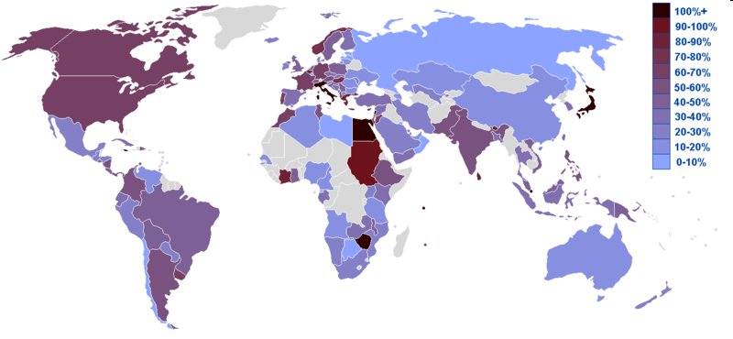
Map of countries by public debt from CIA 2007 estimates

Slide 6
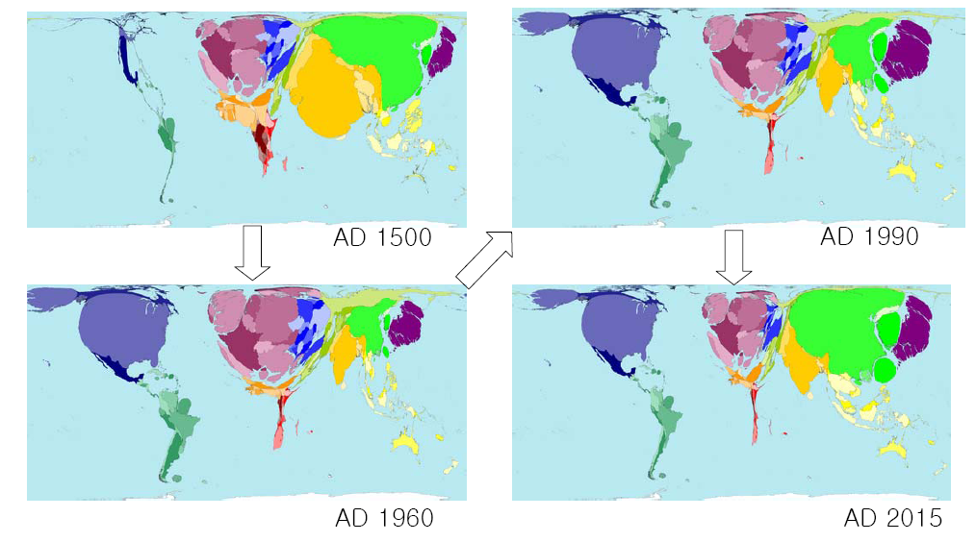
World Wealth Change
AD1500-AD2015
Courtesy of http://www.sasi.group.shef.ac.uk/worldmapper/index.html

Slide 7
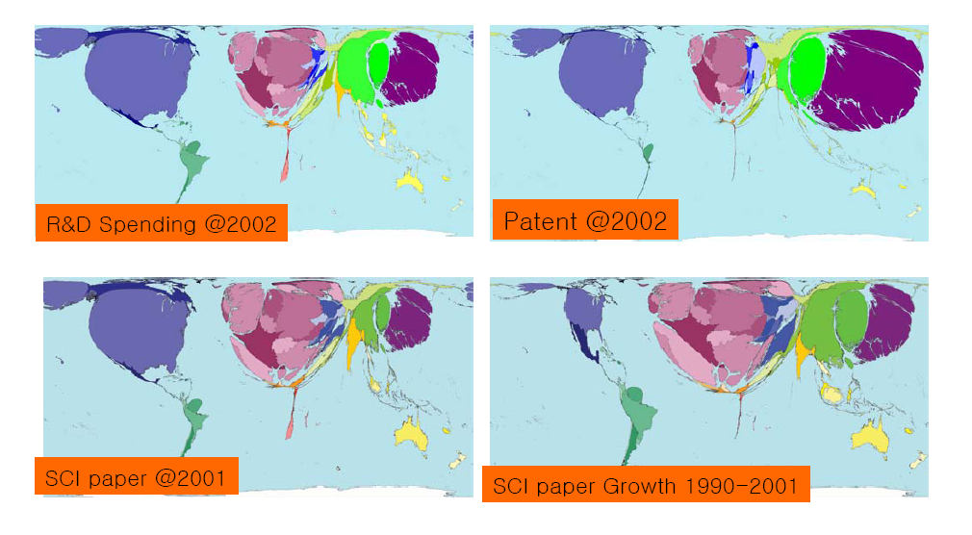
Scientific Activities
Courtesy of http://www.sasi.group.shef.ac.uk/worldmapper/index.html

Slide 8
Outline
Technology Revolution and Financial Crisis
Financial and production bubbles
Financial Crisis
“American Way of Life” – Bubble Economy
Debt Economy – Solutions to resolve ?
What’s Lie Ahead

Slide 9
Risk Capital for Technological Revolution
By definition a technological revolution implies risk – products are new, processes are being tested, markets are unknown, consumers are unaccustomed, and supplies are not guaranteed
Many of the initiating innovations of the microelectronics revolution were made in garages with personal funds and with help of family and friends. The same happened in the Industrial Revolution in England. Carnegie’s new Bessemer steel plant, the big-bang of that surge, was still funded by fellow capitalists as independent investors. Three years later, in 1878, Edison was already getting financial backing for his early projects from young Morgan’s bank. Only when industry became heavy (with electricity, chemistry and the like) and as capital hungry as infrastructure did financial capital really organize to fund it. By the end of nineteenth century, in German and the USA, it was even taking control of it.
Venture capital became a well-known feature since the 1970, especially for the opportunities of microelectronics, computers and software explosion
  Allow the emergence of new entrepreneurs, a few of whom might later become the giants of their industry
  Open a window of opportunity for catching-up countries and regions – the outspreading of capital to distant places from the maturity phase incorporates them into the range of action of financial capital and makes various ventures possible, including those related to the new industries and products
Government’s support capital and policy
  State involvement in Japan in the 1960s and 1970s are recent fresh examples
  Belgium in 1840s and Germany from 1870s to the 1890s while in the United States as much as 40 per cent of the funding for the railways was put up by the state governments
  Policy: immigration of skilled personnel and technical education and training, and in decidedly protectionist policies, Korea’s latecomer catch-up by putting financial innovations and their promotion by the state

Slide 10
Technological Revolution Stimulate Innovation in Finance
Provision of 90-day revolving and open credit – aided the cotton industry and trade in the early of the Industrial Revolution.
In the beginning of the third surge, the swiftness of ocean travel with faster steamships and the Suez Canal made it possible for small entrepreneurs to trade in small quantities of goods for which much smaller, shorter-term, credit instruments wer made available, as happened some time later in that same surge when the German producers of small electric motors needed adequate – medium-sized, medium-term – export funding.
For consumers, after the First World War, when the fourth technological revolution was diffusing with increasing force, hire-purchase credit systems were developed so that masses of home durable equipment, such as refrigerators, vacuum cleaner and automobiles could be paid for from monthly salaries.
With the information revolution, since the early 1970s there has been an explosion of international plastic money, which is gradually becoming even more ‘virtual’ through Internet trade.

Slide 11
Adoption of New Technologies by the Financial World
The most demanding test bed of the technological revolution is the financial world itself, always ready to increase the speed of transactions and to expand their range
  The early adoption accelerates the formation of larger and larger networks of banks and financial nets. Branch banks developed into national networks in England as soon as the railway and telegraph lines made it possible; the same occurred later worldwide when long-distance telegraph permitted British national bank networks to connect with international branches.
  Since the 1970s and 1980s, instant global money and finance movements as well as universal credit cards began giving shape to world-scale financial service super-markets and other globalized networks. These organizational models appear earlier and prefigure what will gradually become the scale and the structure of the largest production and commercial enterprises under each new paradigm
Financial capital propels each technological revolution in an indirect but extremely important way

Slide 12
Tentative Typology of
Financial Innovations
A | Instruments to provide capital for new products or services | For radical innovations (bank loans, venture capital and others) To enable large investments and/or spread risks (joint stocks, bank syndicates and so on) To accommodate the financial requirements of new infrastructures (for both construction and operation) To facilitate investment or trade in novel goods or services
B | Instruments to help growth or expansion | For incremental innovations or production expansion (like bonds) To facilitate government funding in different circumstances (war, colonial conquest, infrastructural investment, welfare spending) For moving (or creating) production capacity abroad
C | Modernization of the financial services themselves | Incorporation of new technologies (communications, transport, security, printing and so on) Development of better forms of organization and service to clients (from telegraph transfers, through personal checking accounts and high street banking to automatic tells and E-banking) Introduction of new financial instruments or methods (from checks to virtual money, local, national and international services and various types of loans and mortgages)
D | Profit-taking and spreading investment and risk | Instruments to attract small investors (various forms of mutual funds, certificates of deposit, bonds, IPOs, ‘junk bonds’) New instruments to encourage and facilitate big risk taking (derivatives, hedge funds and similar)

Slide 13
Tentative Typology of
Financial Innovations _ cont.
E | Instruments to refinance obligations or mobilize assets | To reschedule debts or restructure existing obligations (re-engineering, Brady Bonds, swaps and others) To buy active production assets (acquisitions, incorporations, mergers, takeovers, junk bonds) To acquire and mobilize ‘rent’-type assets (real estate, valuables, futures and similar)
F | Questionable innovations | Discovering and taking advantage of legal loopholes (fiscal havens, off-the-record deals and so on) Discovering and taking advantage of incomplete information; ‘making money from money’ (foreign exchange arbitrage, leads and lags and similar) Making money without money (from pyramid schemes to insider trading and outright swindles)

Slide 14
The shifting behavior of financial capital from phase to phase of each surge
Phase | Prevalent types of innovation A B C D E F | Prevalent characteristics of finance during the phase
Irruption | □ □ □ □ □ □ | Maximum intensity of real financial innovation
Frenzy | □ □ □ | Escape control, attract funds, speculate, inflate assets
Synergy | □ □ □ | Adaptive innovations to accompany growth
Maturity | □ □ □ | Accompany outspreading, escape control and manipulate

Slide 15
Five successive surges, recurrent parallel periods and major financial crises
?

Slide 16
Momentum behind Financial Bubble
Paper Economy > Real Economy
Money Make Money → Loans and Stocks
Greed over Fear → Take Risk

Slide 17
Financial Crisis
Paper Economy >> Real Economy
Money Make Money → Loans and Stocks → Derivatives etc.
Greed over Fear → Take Risk → Casino Syndrome
Idle Money Leads to Bad Loans, Low Interest Rate Make this Even Worse

Slide 18
Frenzy: Self-Sufficient Financial Capital Governing the Casino
Decoupling and Widening Social Gaps
Speculating with Old Wealth: Asset Inflation
Crises in the Weaker Nodes of the World Economy
Windows of Opportunity for Catching Up
Over-Funding the Revolutionary Industries: Manias and Frantic Competition
Mergers and the Creation of Oligopolies
Ethical Softening and Opacity
Increasing Tensions between the Money and Real Economies

Slide 19
Speculating with Old Wealth:
Asset Inflation
The leveraged buy-outs of the late 1980s and 1990s and some forms of mutual and hedge funds (e.g. $4.7B capital borrowed $120B in 1998 and it went bad and which had to be rescued)
Derivatives, ‘junk bonds’ and other instruments serve as rakes to bring in capital for a wider than usual range of investment in productive assets and to make ‘everybody into an investor’, which is part of how the financial agents and the larger players increase their margins.
The other route for imagination is diverting finance from wealth creation and simply finding whatever objects of speculation are at hand. Investment in real estate, gold and other precious metals, futures markets, art, ‘pyramids’ of loans, hedge funds and many other instruments of financial manipulation can serve the purposed of using the money that cannot find profitable use in productive activities.
Real estate if one of the preferred targets for speculation. In Tokyo, in the 1980s, real estate climbed to such absurd heights that the grounds of the Imperial Palace had the same nominal value as all the land in the state of California (or in all of Canada). In the Chicago of the late 1880s it was clear the prices had reached equally impossible levels.

Slide 20
Crises in the Weaker Nodes of the World Economy
Several American states defaulted during the frenzy phases of the second and third surges in the nineteenth century. In the first case, in the 1830s they had built canals and turnpikes when Britain was already about to enter the first railway boom; in the second case, in the 1860s they built the railways with the old iron technologies when Besemer steel ones were about to replace them.
In the 1930s depression, there were massive defaults of several countries on bonds and loans for building railways and ports or for mining and agricultural exports, when already the industries manufacturing mass-consumption products had become the new dynamic sectors. As regards the present fifth surge, the debt crisis – which exploded in the 1980s and is far from overcome in the new century – is the tail end of the loans taken to set up mature mass-production industries or, worse still, to massively finance imports for luxury consumption without investing. As a result, the economies of most debtor countries are stretched to their limits in a situation that makes the debts structurally unpayable in most cases.

Slide 21
Windows of Opportunity for Catching Up
Belgium, France and the USA caught up in the installation period fo the second surge; Germany and the USA forged ahead in that of the third, Most of Europe, Japan and the Soviet Union, caught up in the forth. The forging forward of Japan in the fifth, overtaking several more advanced countries, was clear until the collapse of its early casino bubble plunged it into a recession that lasted through the 1990s
There are areas of the world that happen to be in a position, for national, international, historical and geographic reasons, to make a catching-up leap with the new paradigm. Examples of this are Argentina with the third great surge in the last quarter of the nineteenth century and the Asian Tigers a hundred years later, in the installation period of the fifth.
In the case of the Asian Tigers, paradigm construction plus the geopolitical forces of the Cold War came together from the 1960s to facilitate a wave of foreign investment in the area, which happened to have the mass-production electronics industry as one of the most active. Both factors also opened the US markets to manufactured exports from those countries. The success of Japan in forging ahead and riding a high wave in the 1980s, when the Western economies were riddled with stagflation, created a sort of oasis for the neighboring countries to attempt catching up from behind. The similar case can be made to the USA in the 1820s and 1830s, the United States, then a peripheral country, also had a booming economy with internal dynamics and intense foreign investment coming from Britain during the installation period of the second great surge.
But latecomers economies are naturally more fragile than the already developed economies and thus probably more vulnerable to a sudden retrieval of funds. They can also be severely affected by the shrinking of markets.

Slide 22
Over-Funding the Revolutionary Industries: Manias and Frantic Competition
The canal mania leading to the panic of 1798
The railway mania panic of 1847
The real estate and stock market mania before the crash of 1929
Internet mania of 1990 to the crash of 2000
The intense concentration of capital, local and international, furthering the infrastructure of the new economy can be seen as the dynamic roles of financial capital in furthering technological advance– but its wasteful and likely to overshoot; it can be painful for many, but it does the job for creating the fundamental externalities and facilitating intense social learning for the full unfolding of the revolution later on.

Slide 23
Mergers and the Creation of Oligopolies
Whether a single-purpose mania develops or not, other types of problem are likely to follow from excess investment flowing into the core industries. If there is a time and a place in the evolution of capitalism when ‘free competition’ actually develops, it is during the installation period. Many, truly many, enter the fray; only a few are destined to become the giants of each of the new industries. But, as late-Frenzy is reached, not only overinvestment but also other perverse mechanisms begin to operate.
The velocity of technical change, typical of the early phases of technological revolutions ends up creating the problem of premature obsolescence. Since the mid-1990s, for instance, the speed of increase in computer power, in new generations of software or cellular phones and in dot.com companies on the Internet, hardly allowed users the time for learning or for amortizing investment. But no producer could afford to stay behind in the innovation race.
With accelerated technical change, price competition can be excessive. Given that each paradigm provides the potential for a quantum jump in productivity through successive innovative improvements, lower and lower prices become a possibility and are typically brandished as weapons in the competition for market power. So, movements toward oligopoly or cartel-type agreements are likely to take place as some of the firms involved become strong enough.
The aggregation process is one of the changes brought about by each technological revolution and its enabling infrastructure:
  In the 3rd. surge, vertical integration from raw materials to final clients in a core product became the ‘ideal’ form of the most powerful firms of the period
  In the 4th. surge, horizontal integration was more typical, so that final product manufacturers widened their range of similar products, rather than integrate backwards into raw materials
  In the present 5th. surge, transcontinental networks encompassing the whole range of segments both horizontally and vertically – or ‘diagonally’ – in several related markets for goods and/or services are emerging as the strongest organizations

Slide 24
Ethical Softening and Opacity
Frenzy phase: Being rich is being ‘good’; anything else is failure. The ethics of success at any price are the only valid norms. This is the attitude driving the ample diffusion of the doubtfully legitimate financial practices developing in the gambling context of the frenzy phase. That permissive atmosphere generates an opacity that is highly convenient for corruption and for the flourishing of outright illegal activities.
  In Britain @ 2nd. surge, government officials took commissions for helping get railway ‘rights’
  The Japan of the 1980s was riddled with tax evasion and corruption, unfortunately facilitated by a general relaxing of state regulation and supervision of financial practices.
  The vast money-laundering networks for the trafficking in drugs in the 1990s are similar to those of ‘bootleggers’ in the USA in the 1920s or those of weapons dealers and of corruption money in various similar periods
  Ponzi scheme in mid-1920s, 1980s, 1990s, and latest 2009 were repeating incidences

Slide 25
Increasing Tensions between the Money and Real Economies
Too much of idle money and ease of money makes money, i.e. US stock index vs US GDP
  From 1971-1999 stock index rose 9 folds (below 1000 to over 9000) and GDP rose only 2.5 folds
  In 1995, volume of derivative economy reached US$64B which was equivalent to the combined value of all bonds, equity and bank assets in the G17(G7 plus all the smaller European countries)
Tension becomes very high between financial and product capital; Structural coherence needs to be reestablished by some means and these can often be violent and painful. It could occur through a truly great crash, as in 1929. or through what seemed to be a series of partial collapses letting off steam, as at the end of nineteenth century of dot.com bubble

Slide 26
Fundamental Causes of the After-Frenzy Recession
The speed at which capital gains are being ‘created’ by the collective faith of the paper investors can not be matched by the speed at which the economy can produce real wealth, in spite of the continued dynamism of the revolutionary industries
The whole frenzy phenomenon is, at bottom, a huge process of income redistribution in favor of those directly or indirectly involved in the casino, which funds the massive process of creative destruction in the economy
The regressive distribution generates a double vicious cycle; one is economic, expressed in the market; the other is social, expressed in political terms. Both get worse as the bubble increases

Slide 27
Collapse of Bubble
Inevitable at late-frenzy stage, repeatedly happened in previous surges
The party is over: Crashes as the door to regulation each time
Historical experience seems to show that big crashes teach big lessons, but such lessons are short lived
Recession is certainly a high price to pay, but it is typical of the contradictory nature of capitalism

Slide 28
Recurrence of Loan Fever and Default:
Latin American Case
Idle money for loans
in maturity phase
Technological
Revolution
Core Country
Debt difficulties
and defaults
INSTALLATION
PERIOD
Turning
Point
DEPLOYMENT
PERIOD
GREAT
SURGE
1st
The Industrial
Revolution
Britain
1771
1820-25
Independence
LOANS
182625
DEFAULT
2nd
Age of Steam and
Railways Britain
(spreading to
continent and USA)
DEBT MORATORIUM
(Default since 1826-28)
1860-73
Refinancing old debts,
LOANS for military
and public wroks
1829
Age of Steel, Electricity
and Engineering
USA and Germany
Overtaking Britain
1874-80
DEFAULTS
1880-90 Rio de la Plata LOANS for
railways/ports
1904-14
Investment
LOANS
3rd
1875
1890
Argentina
4th
Age of Oil, Automotives
and Mass Production
USA (spreading to
Europe)
1925-28
Development
LOANS
Depression
DEBT CRISIS
WWII
1960-70s
Development
LOANS
1908
5th
Age of Information and
Telecommunications
USA (spreading to
Europeand Asia)
1980
DEBT
CRISIS
Mexico
1971
Argentina
Crash
Source: Marichal 1988 and
Carlota Perez 2002
Big-bang
Institutional recompostion
(in the core countries)

Slide 29
“American Way of Life”
-- Consumption
-- Bubble Economy
-- Debt Society

Slide 30
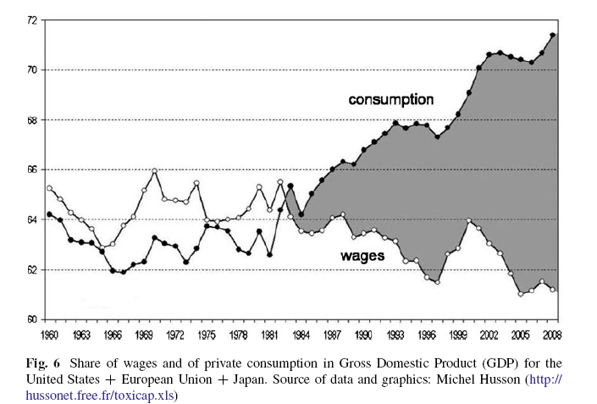
Consumption vs Saving!

Slide 31
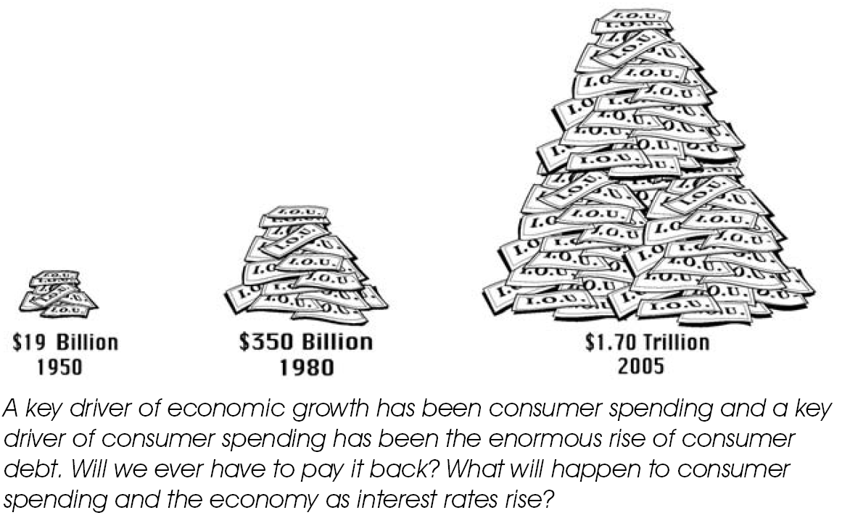
Consumer Spending

Slide 32

Income Growth vs. Housing Prices Growth

Slide 33
Debt Economy –
Solutions to resolve ?

Slide 34
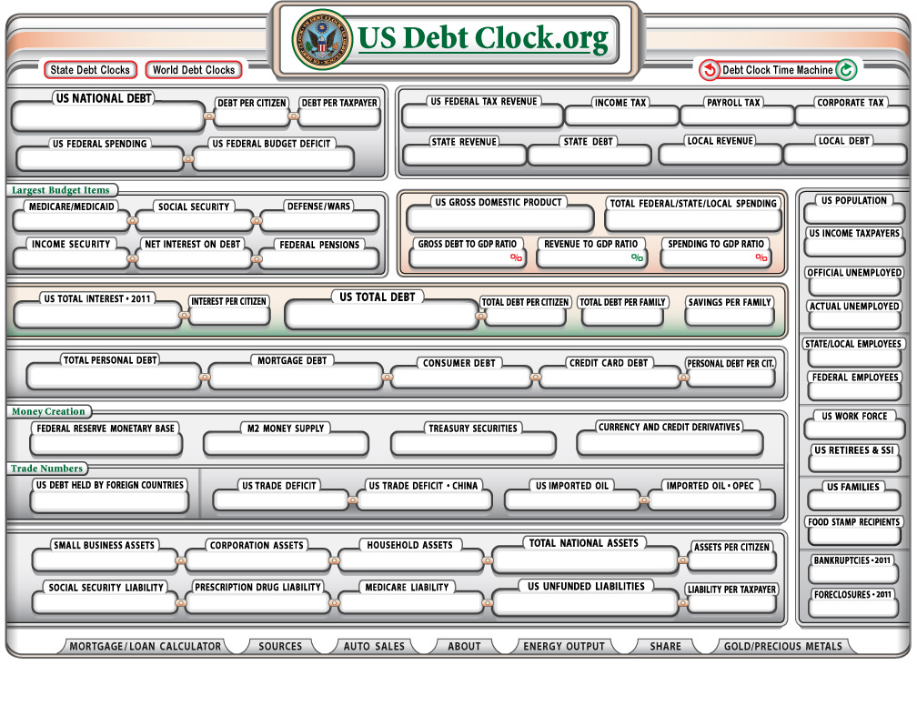
US Debt Clock: Reminder?

Slide 35
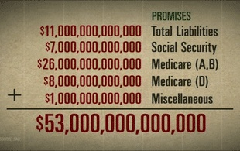
US Government’s 53 Trillion US$ Long Term Liability Equation (2008)
That was the sum of public debt; accrued civilian and military retirement benefits; unfunded, promised Social Security and Medicare benefits; and other financial obligations

Slide 36
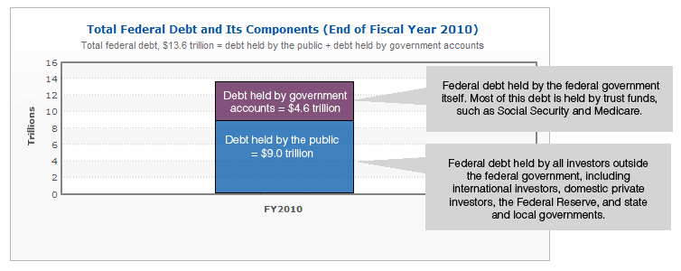
U.S. Federal Debt

Slide 37
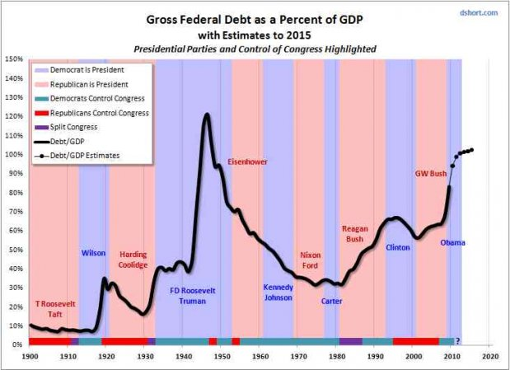
Debt as Percent of GDP

Slide 38
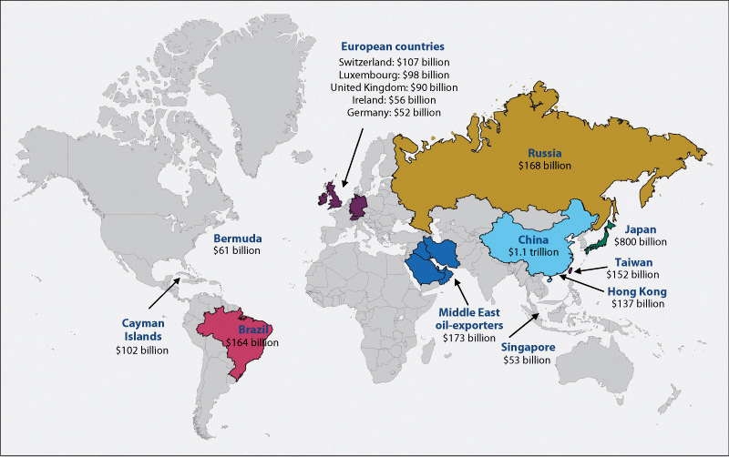
Countries with Largest Holdings of U.S. Treasury Securities (As of June 2010)

Slide 39
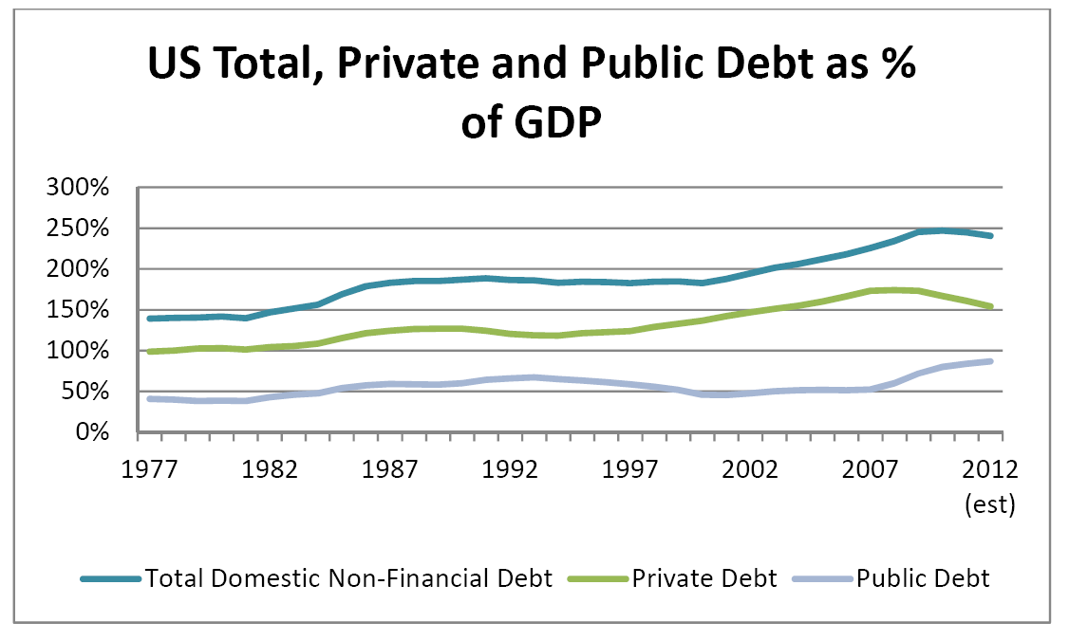
Private Debt and Public Debt

Slide 40
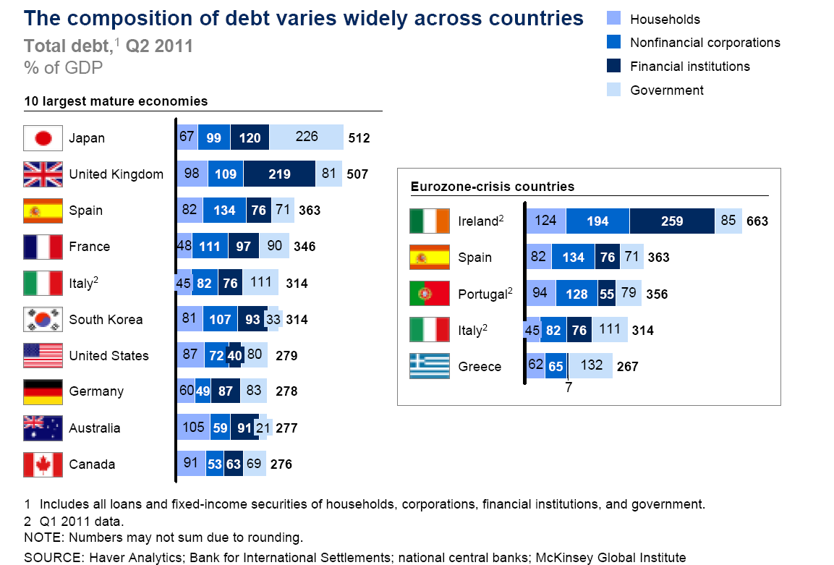

Slide 41
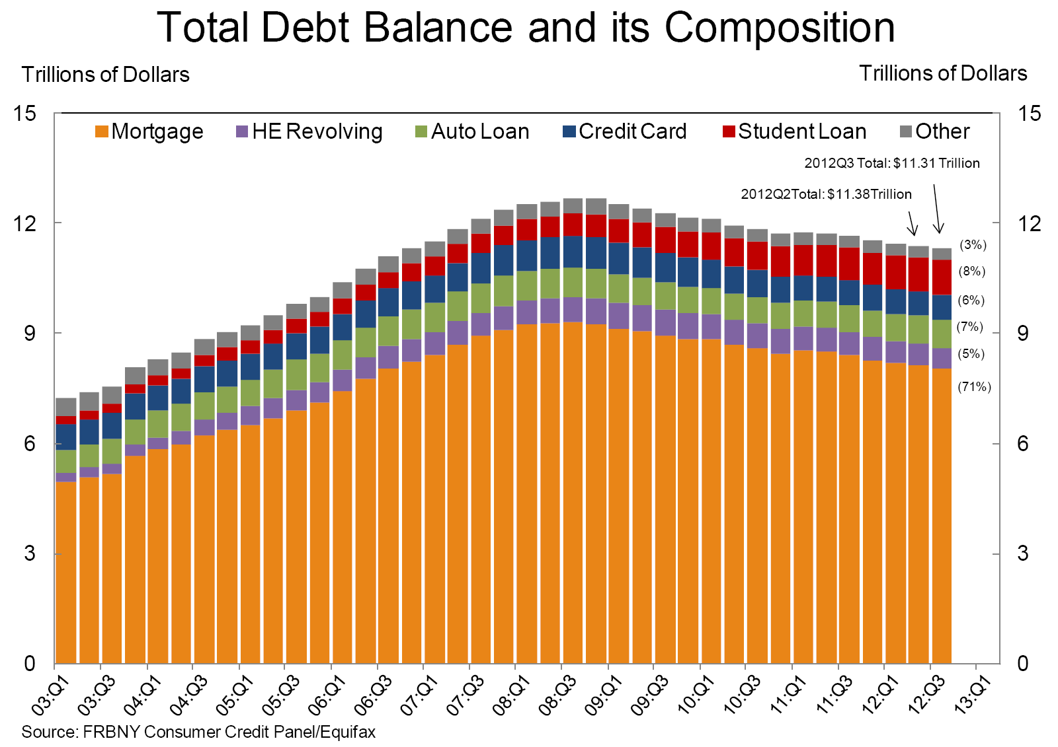

Slide 42
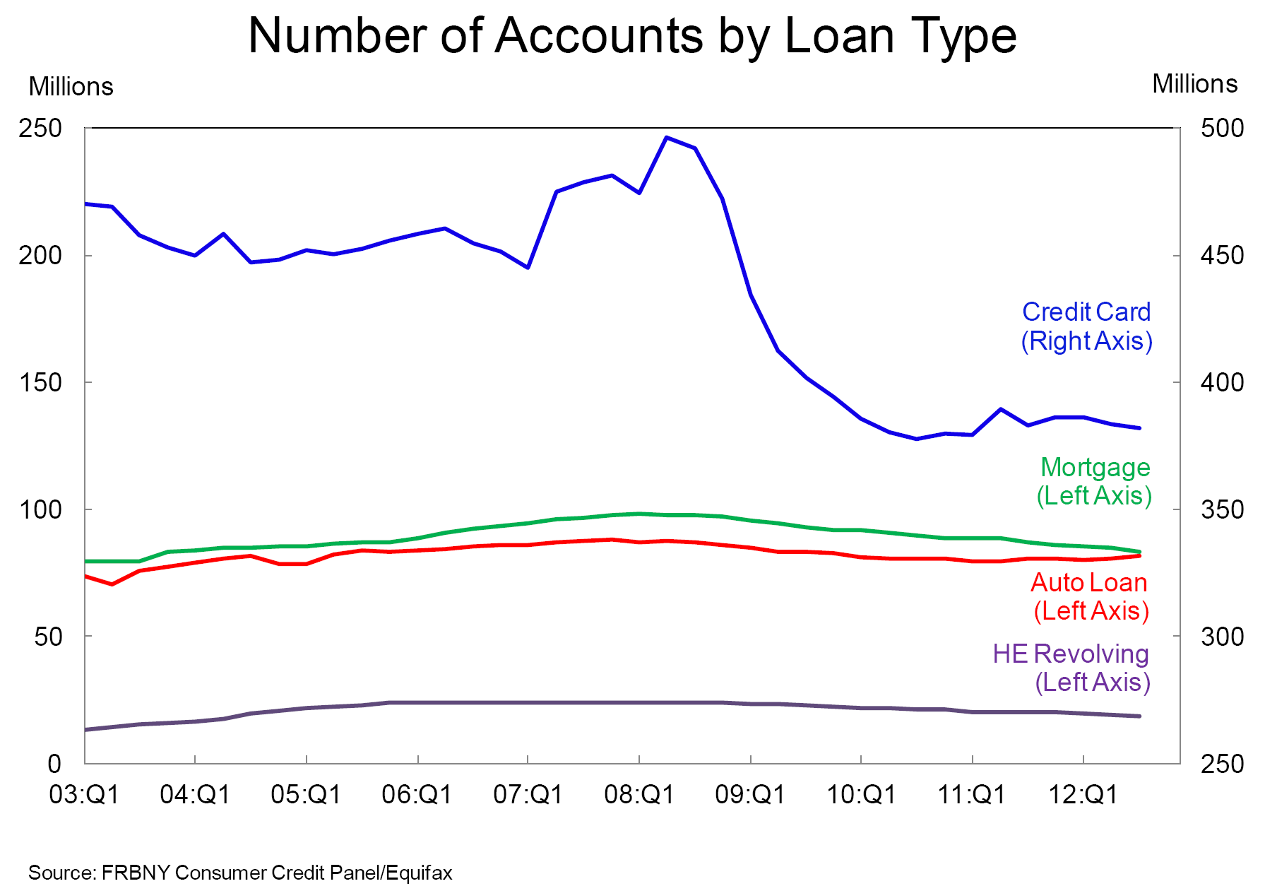

Slide 43
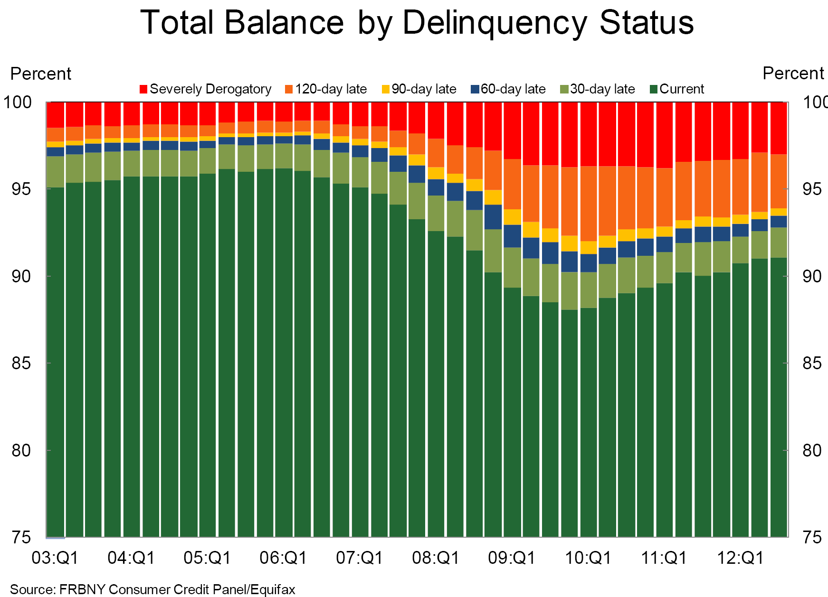

Slide 44
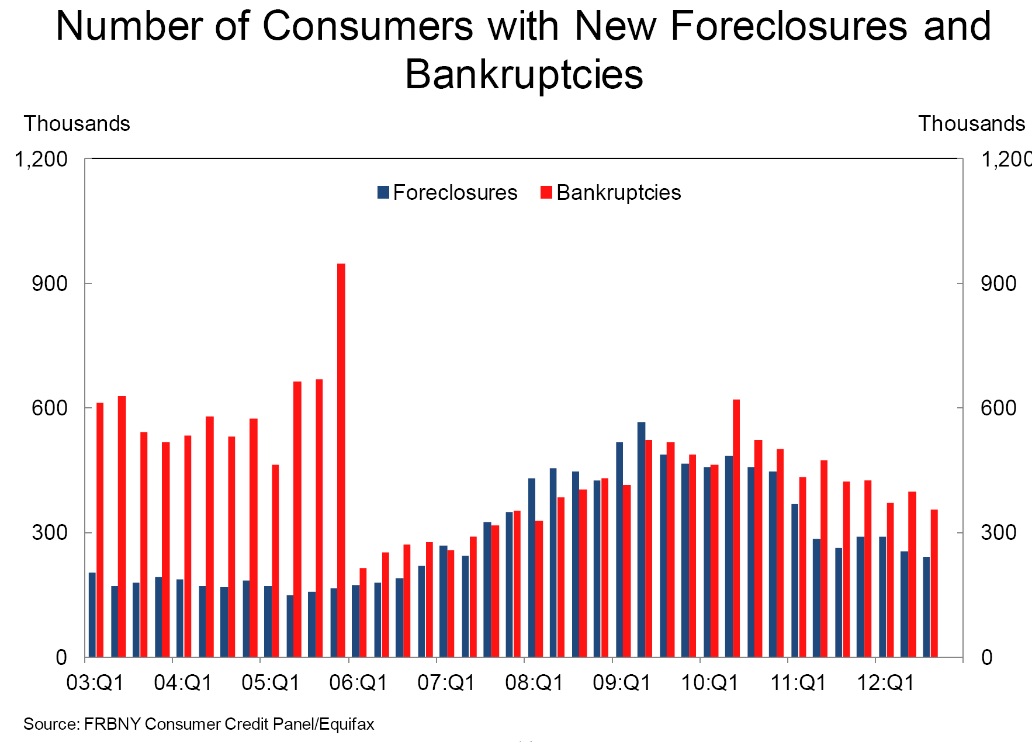

Slide 45
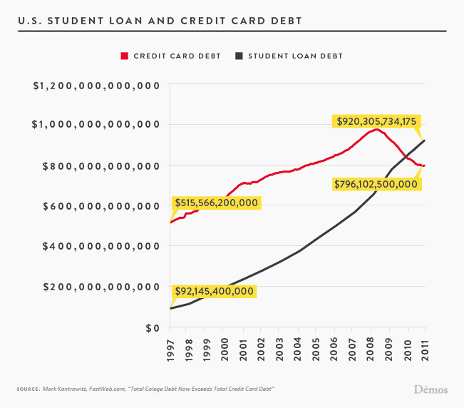
about 22 millions (20%) of household have student loans

Slide 46
The Global Financial Crisis:
American Chapter
(Subprime + Sovereign Debt)

Slide 47
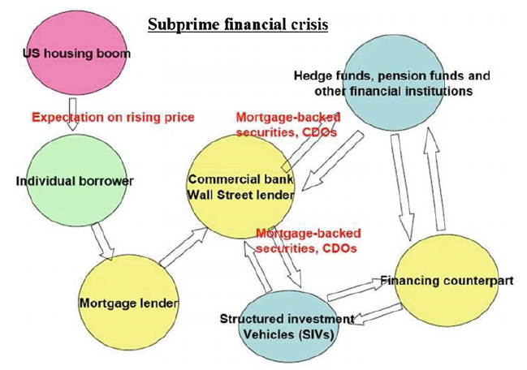
Subprime Net

Slide 48


Slide 49
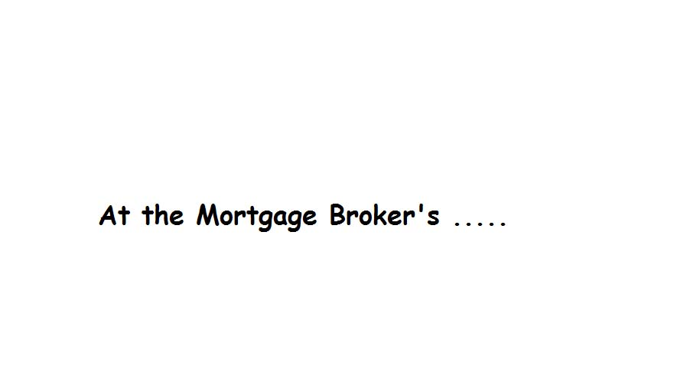

Slide 50


Slide 51


Slide 52


Slide 53


Slide 54
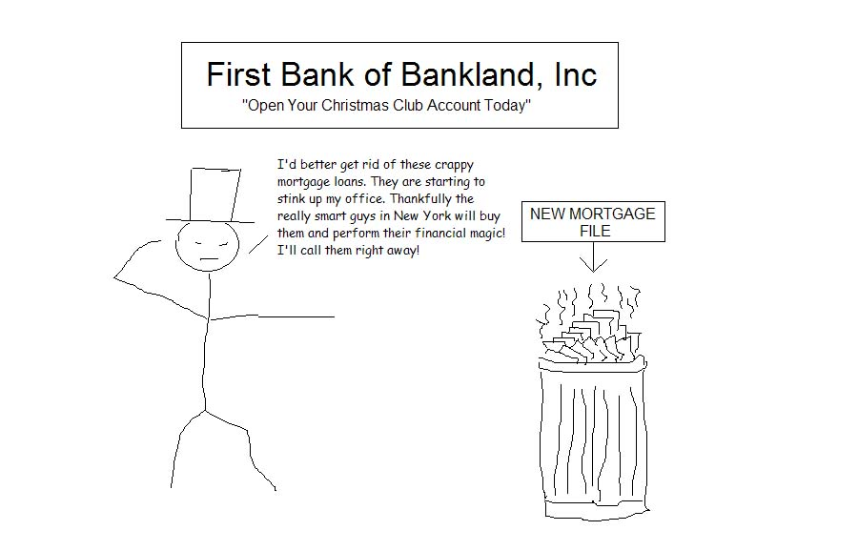

Slide 55


Slide 56
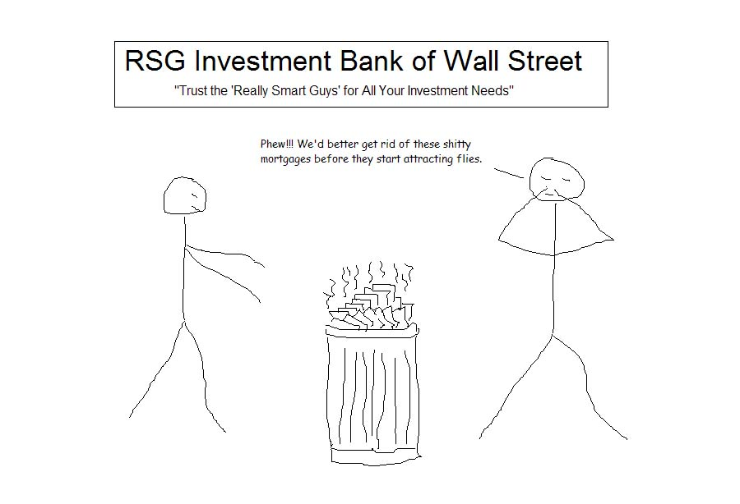

Slide 57
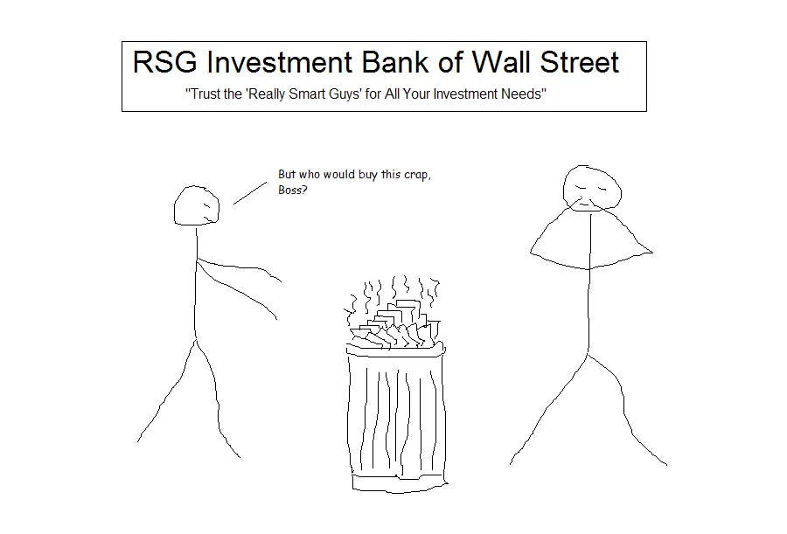

Slide 58
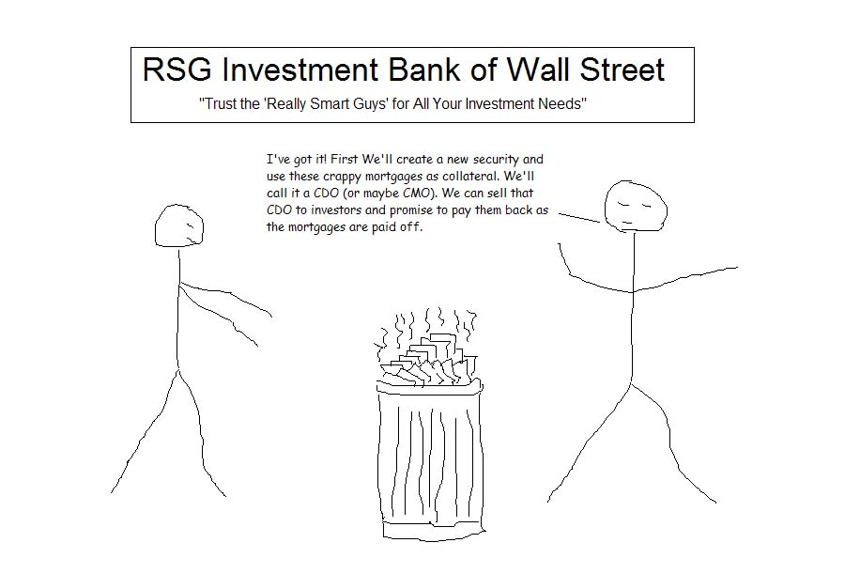

Slide 59
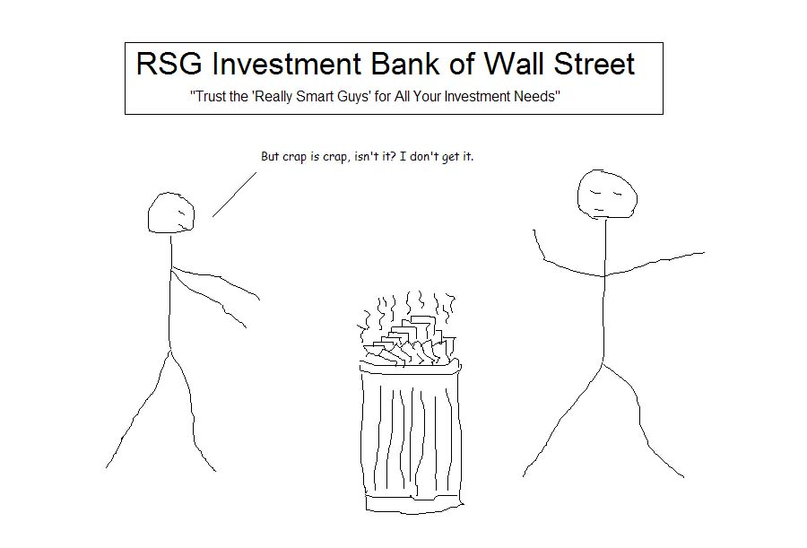

Slide 60
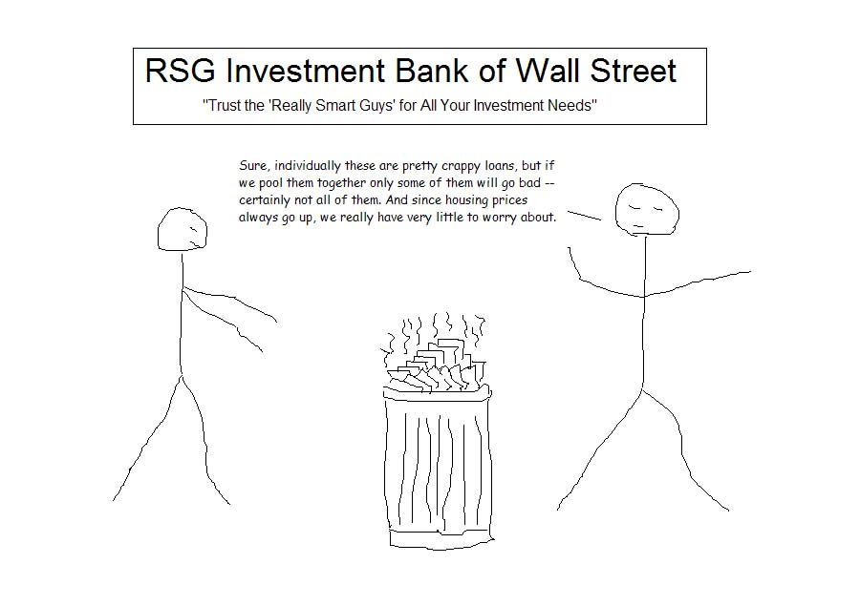

Slide 61
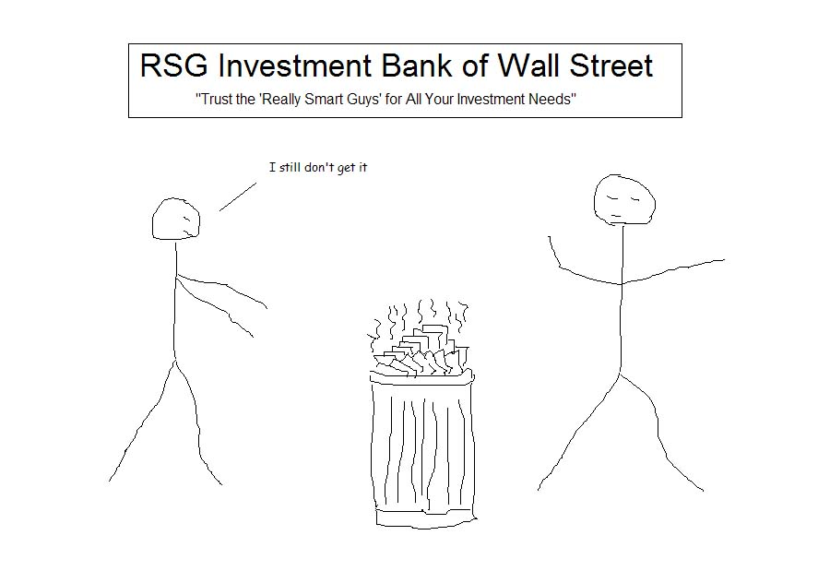

Slide 62
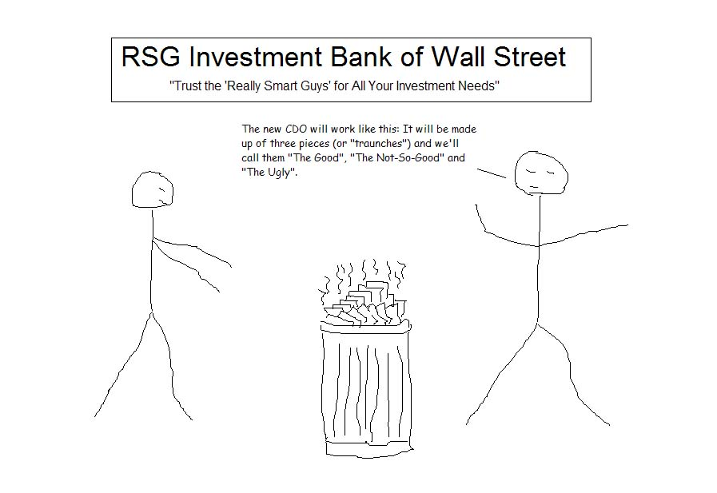

Slide 63
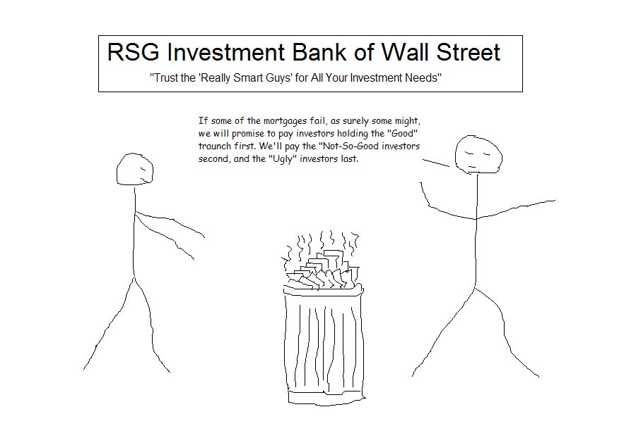

Slide 64
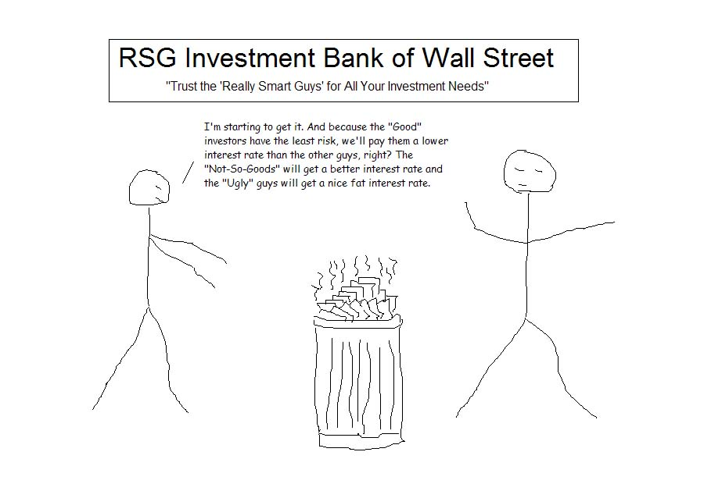

Slide 65
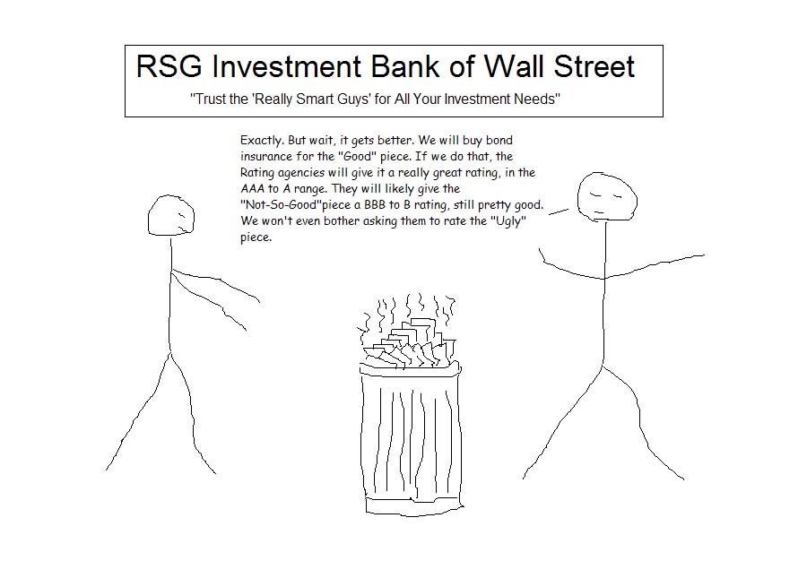

Slide 66
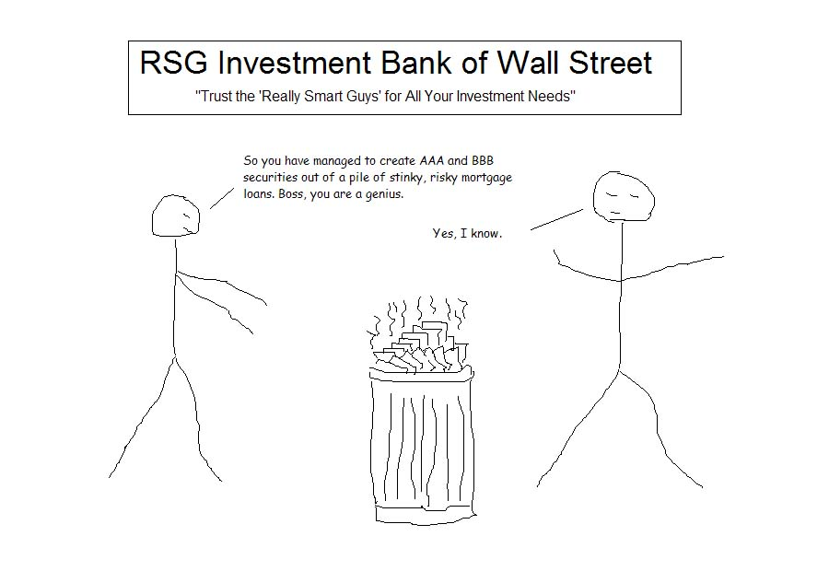

Slide 67
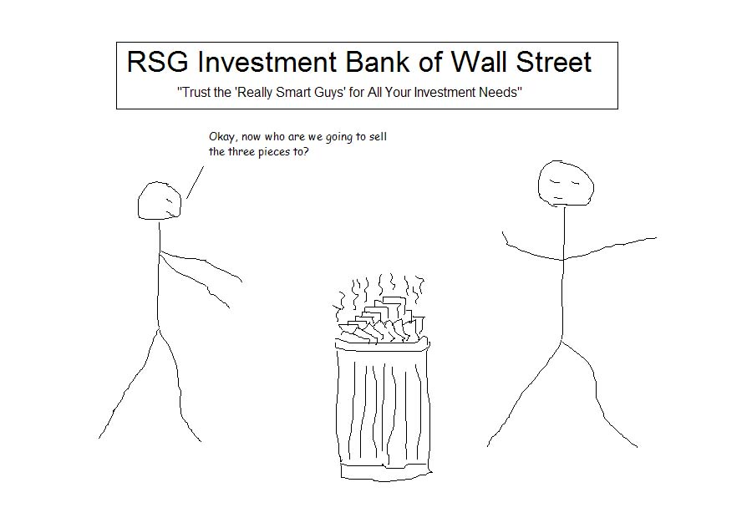

Slide 68
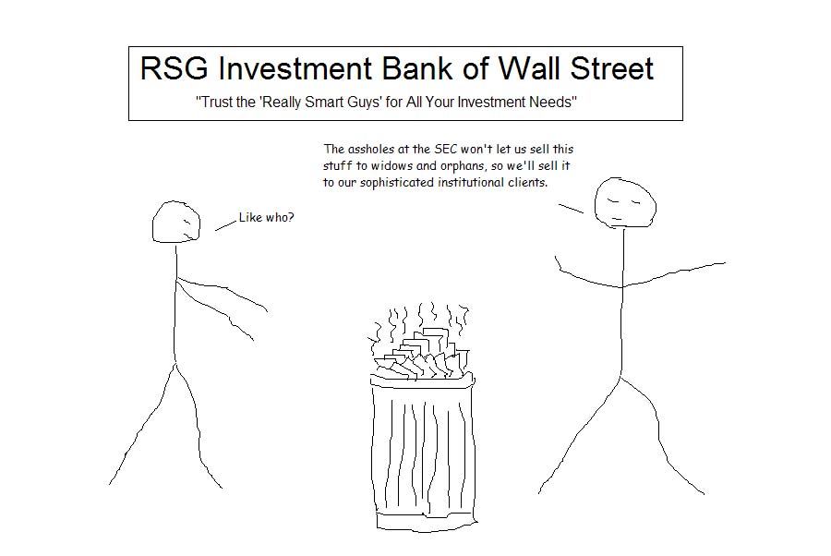

Slide 69
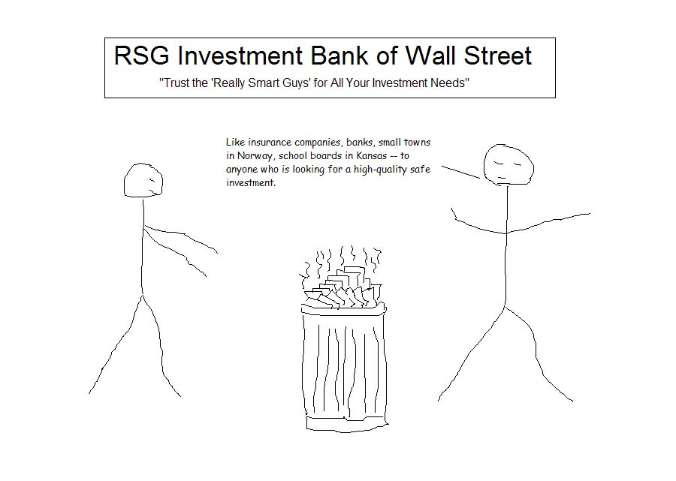

Slide 70
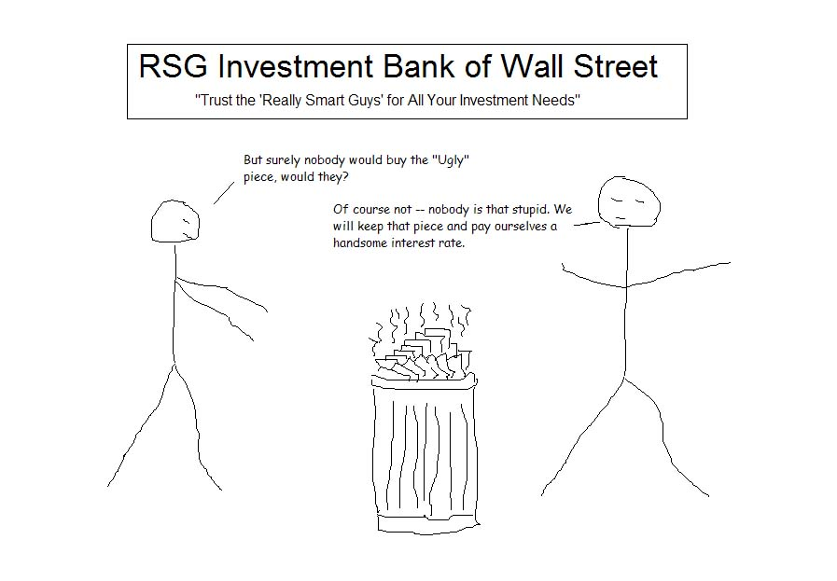

Slide 71
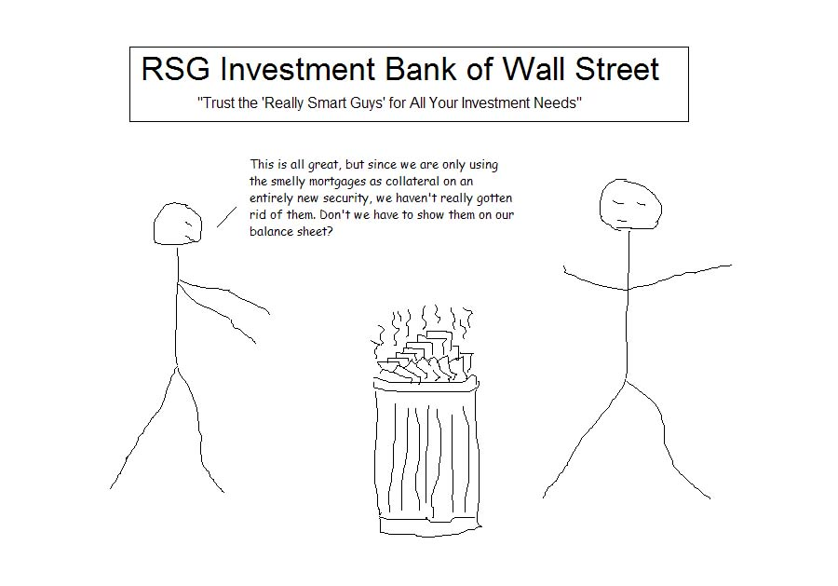

Slide 72
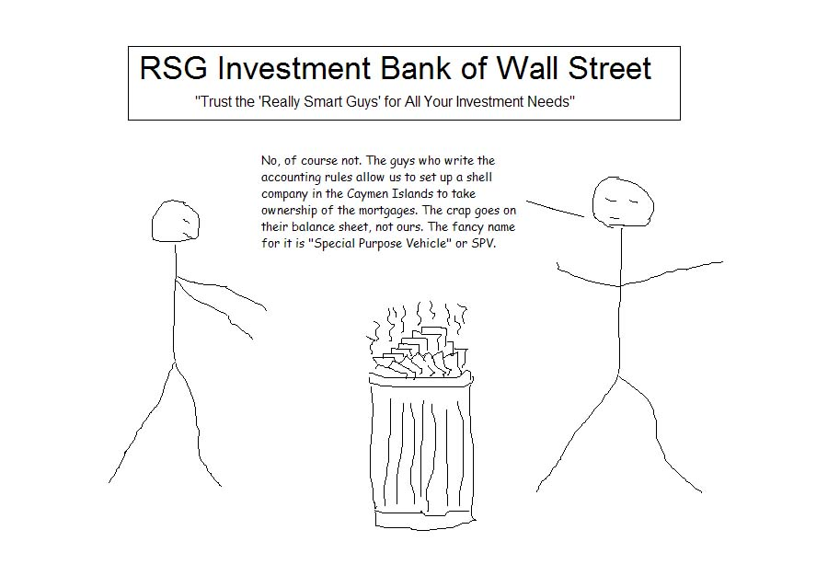

Slide 73
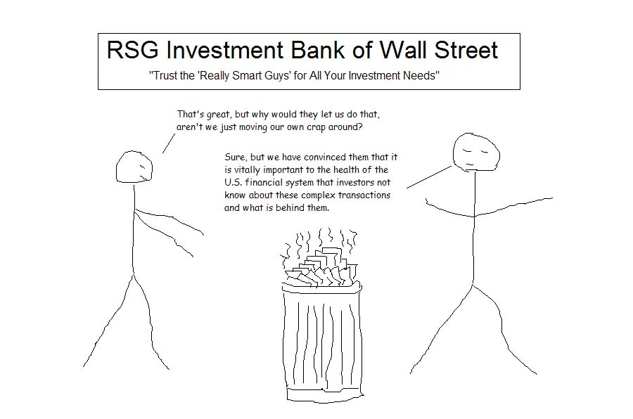

Slide 74


Slide 75
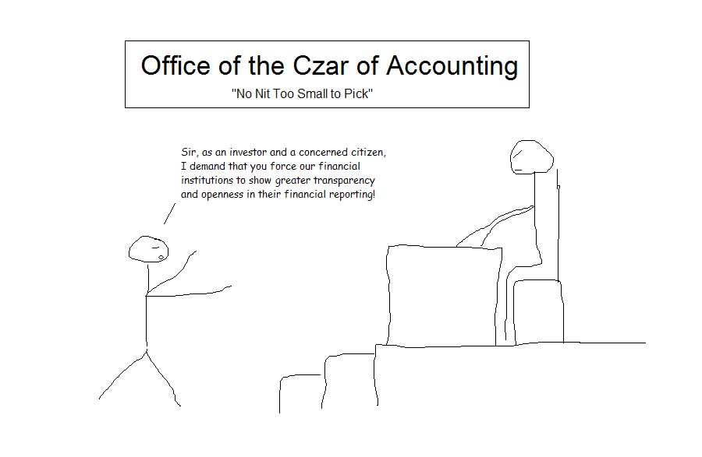

Slide 76
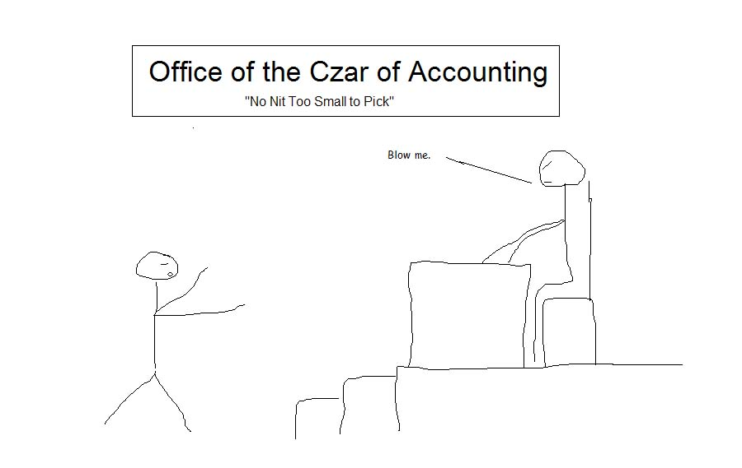

Slide 77


Slide 78
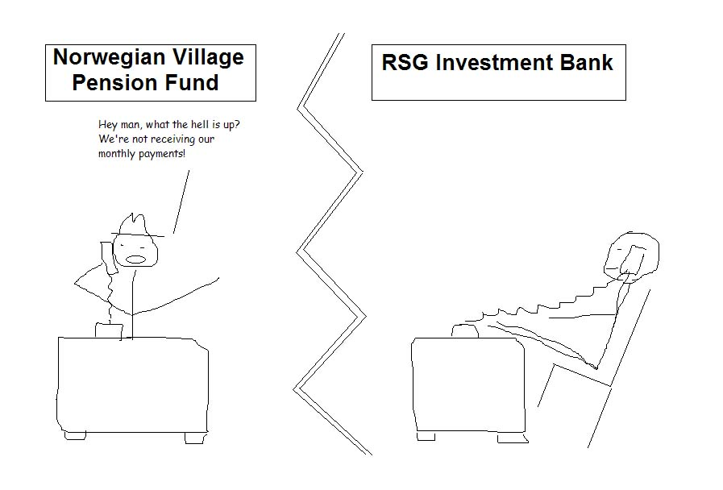

Slide 79
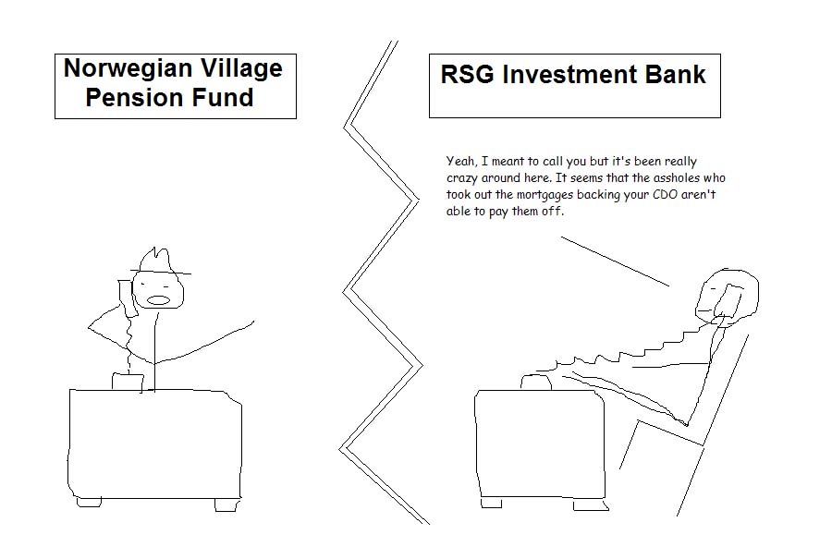

Slide 80
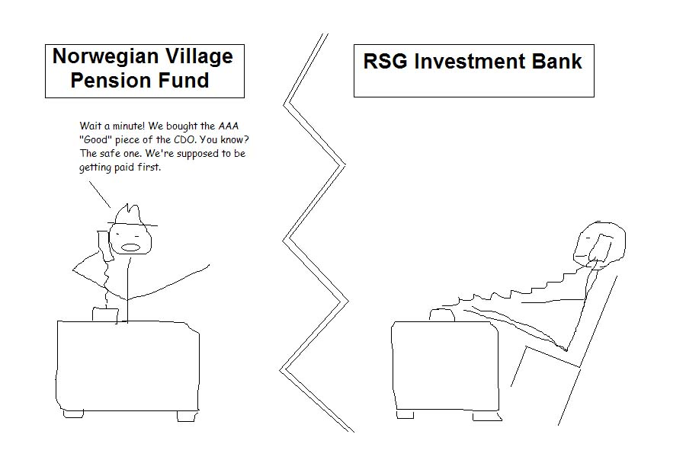

Slide 81
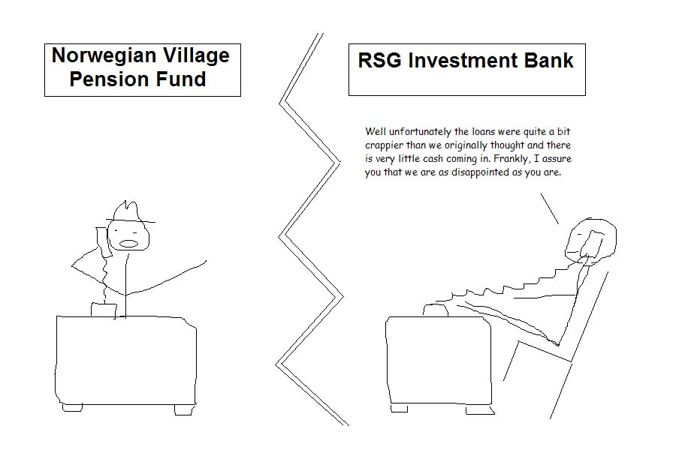

Slide 82
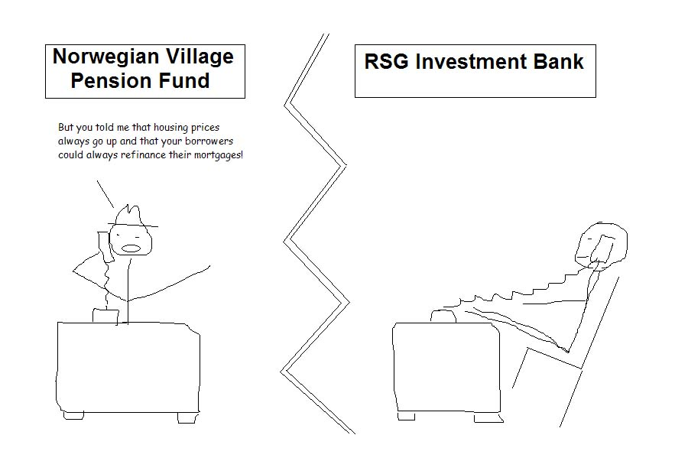

Slide 83
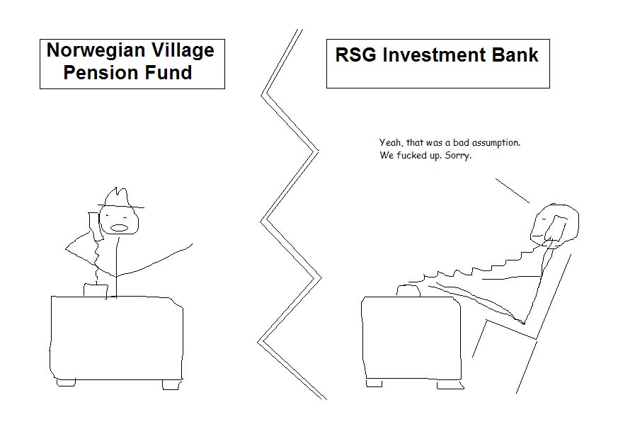

Slide 84
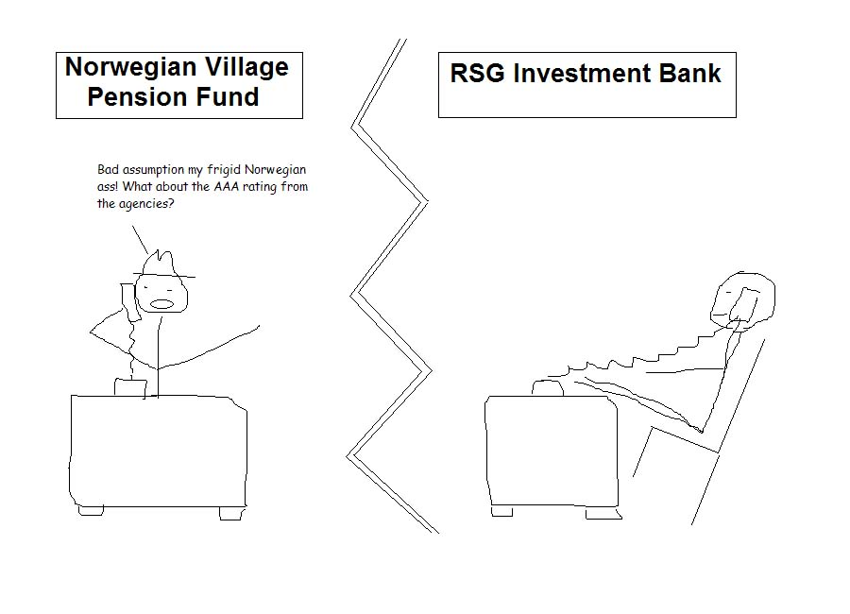

Slide 85
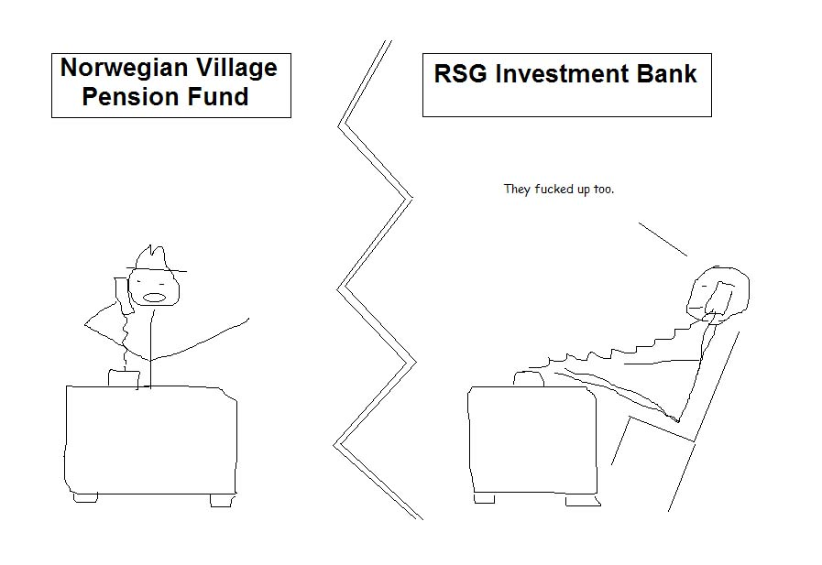

Slide 86
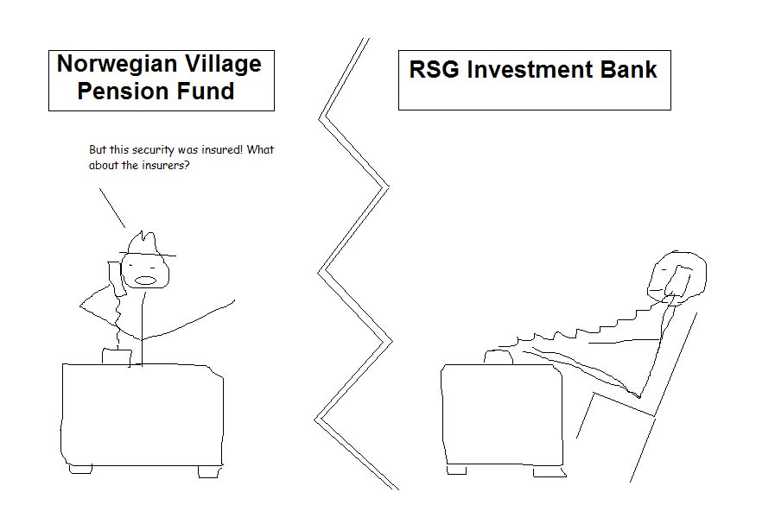

Slide 87
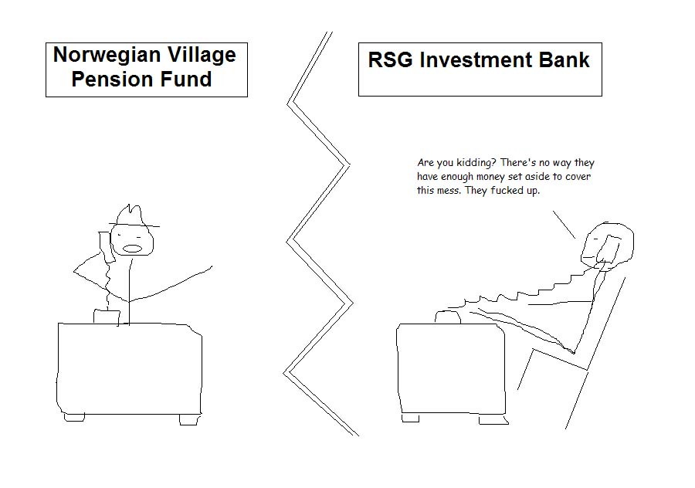

Slide 88


Slide 89


Slide 90


Slide 91


Slide 92


Slide 93
Financial Engineering Innovation

Slide 94

Financial System:
Wall Street and Main Street

Slide 95

Macroeconomic Stages of Capital Mobility and Capital Controls

Slide 96

1960s Wall Street Primary Market
Wall Street’s business is to transfer risk from those who
don’t want it to those who do.
Selling stock to investors in an initial public offering is risk-transfer; so is underwriting
the company’s bonds. The mix of a company’s stock and bonds is the simplest example of
what is called creating tranches, which rank investors’ claims on the company’s
earnings and assets, as well as the risk characteristics according to security type.
The document chartering the firm is folded in such a way that bondholders precede stockholders
in a claim on the firm’s income, with interest being paid before dividends.

Slide 97

1960s Wall Street Secondary Market
Broking shares and bonds previously brought to market is also an exercise in risk transfer.
Wall Street connects and collects in this risk-transfer business, bridging those with surplus
capital to those with a deficit, exacting a toll for the service. It earns revenue by charging
commissions and fees for transaction and advisory services related to the issuance, purchase,
and sale of stocks, bonds, and insurance products, as well as from extracting bid/ask spreads
and taking proprietary trading positions sometimes against those of its customers.

Slide 98

Wall Street’s Three Pieces of Paper, Which Get Folded into New Securities….
GNMA: Government National Mortgage Association

Slide 99
CDO and CDS
CDO: Collateralized Debt Obligations
  a type of structured asset-backed security (ABS) with multiple "tranches" that are issued by special purpose entities and collateralized by debt obligations including bonds and loans. Each tranche offers a varying degree of risk and return so as to meet investor demand. CDOs' value and payments are derived from a portfolio of fixed-income underlying assets
http://www.youtube.com/watch?v=eb_R1-PqRrw
CDS: Credit Default Swap
  A credit default swap (CDS) is similar to a traditional insurance policy, in as much as it obliges the seller of the CDS to compensate the buyer in the event of loan default.
http://www.youtube.com/watch?v=DdEI6PkGZK8&feature=relmfu

Slide 100

Three Pieces of Paper turned into Complete Financial Origami Diagram and No One Knows What’s Going on
Wall Street’s business is to transfer risk from those who don’t want it to those
who want it, and to those who do not know the risk behind.
L: Loan, B: Bond,
D: Debt, S: Synthetic
SPE(special purpose entity): to ensure that the holders of the mortgage-back securities have the first priority right to receive payments on the loans, these loans need to be legally separated from the other obligations of the bank. This is done by creating an SPE, and then transferring the loans from the bank to the SPE.
SPV(special purpose vehicle)
SPE(special purpose entity)
SPE(special investment vehicle)
Financial Engineering Innovations!

Slide 101



Slide 102
Why Securitization: Historical Review of Mortgage System
Traditional (1930-1970): The system of mortgage finance that was characterized by long-term, fixed-rate, self-amortizing loans (provided mainly by savings and loan associations and mutual savings banks out of funds in their short-term deposit accounts). This was indeed the first mortgage revolution.
S&Ls (also known as thrifts) were therefore locked into using short-term deposits to fund long-term mortgages, a mismatch that plagued the industry through a series of later financial crises (i.e. Savings and Loan Crisis). Without alternative funding sources, a loss of deposits could restrict credit access to new home buyers. Thrifts were restricted from matching what the market was paying through new savings vehicles (such as mutual funds, Treasuries, or money market accounts).
By the 1960s, the ability of depository institutions to fund longterm, fixed-rate mortgages was compromised by inflation, which pushed up nominal interest rates and eroded the balance sheets of those institutions. The maturity mismatch problem came to a head during the late 1970s and 1980s, culminating in the liquidity crises and insolvencies that became collectively known as the savings and loan crisis.
The crisis came about due to poorly designed deposit insurance, faulty supervision, and restrictions on investments to hedge the interest rate and credit risks faced during this period. The sharp rise in interest rates in the late 1970s (caused by the appreciation of the dollar against other currencies) caused a twist in the term structure of interest rates (the yield curve) that generated losses. From 1979 to 1983, unanticipated double-digit inflation coupled with dollar depreciation led to negative real interest rates. As financial institutions extended their lending base and their capital ratios worsened, conditions weakened in the industry. Monetary policy tightened, shortterm rates soared, loans were squeezed, and a crisis was underway.

Slide 103
Why Securitization
Securitization, combined with deep and liquid derivatives markets, eased the spread and trading of risk.--- lessons learned from S&L Crisis; The danger inherent in funding short-term liabilities with long-term assets in markets with interest rate volatility became a lesson well learned.
Historically, lenders had used an “originate to hold” model for home mortgages: Institutions originated loans based on careful due diligence and then serviced and held the loans in their portfolios. But starting in the 1970s, securitization (an “originate to distribute” model) took hold. Under this new model, lenders packaged pools of loans into securities that were sold in the secondary market. Upon getting the loans off their balance sheets, lenders gained liquidity and were able to make additional loans at lower cost to consumers.
In 1970, Ginnie Mae issued the first mortgage pass-through security (granting investors an interest in a pool of mortgages and “passing through” the regular payments of principal and interest, providing a flow of fixed income). By the 1980s, Freddie Mac had introduce collateralized mortgage obligations (CMOs), which separate the payments for a pooled set of mortgages into “strips” with varying maturities and credit risks; these could be sold to institutional investors with specific time horizons in their investment needs and different risk preferences.

Slide 104
Why Securitization__cont.
It became common for firms to slice the risk associated with this type of investment vehicle into different classes, or tranches: senior tranches, mezzanine tranches, and equity tranches, each with a corresponding credit rating. Investors in these different tranches absorb losses in reverse order of seniority; because equity tranches carry a higher risk of default, they offer higher coupons in return.
Local and international institutional investors purchased these mortgage-backed securities (MBS), introducing new and broader sources of funding into the housing market. From 1980 to Q3 2008, the share of home mortgages that were securitized increased dramatically.
The rise of securitization made mortgage credit and homeownership available to millions of Americans. Securitization, combined with deep and liquid derivatives markets, eased the spread and trading of risk.
The momentum created by securitization truly caught fire when new information technology was introduced in the 1990s, vastly improving the ability of mortgage issuers to gather and process information. The costs of loan origination were drastically reduced, with greater accessibility of data on credit quality and the value of collateral. Today lenders share information with credit bureaus, title companies, appraisers and insurers, servicers, and others. It has been estimated that the mortgage industry increased its labor productivity about two and a half times with the proliferation of data processing and Internet services.
Despite the power of the information technology that has been introduced into mortgage markets, it’s worth remembering that old adage “garbage in, garbage out.” These new tools are powerful, but their ultimate effectiveness is totally dependent on the accuracy and quality of the data inputs. During the housing boom, many lenders used information technology solely to increase volume, neglecting its capacity to help them more carefully sift through risk factors.

Slide 105

The mortgage model switches from originate-to-hold to originate-to-distribute
Securitization, combined with deep and liquid derivatives markets, eased the spread and trading of risk. The momentum created by securitization truly caught fire when new information technology was introduced in the 1990s, vastly improving the ability of mortgage issuers to gather and process information. The costs of loan origination were drastically reduced, with greater accessibility of data on credit quality and the value of collateral.
Today lenders share information with credit bureaus, title companies, appraisers and insurers, servicers, and others. It has been estimated that the mortgage industry increased its labor productivity about two and a half times with the proliferation of data processing and Internet services.

Slide 106

Dodging Bill Collectors:
Financial innovations don’t have to be laboriously contrived and
complicated Rube Goldberg contraptions
Courtesy of Rube Goldberg

Slide 107
Global Financial Crisis:
European Chapter
(Sovereign Debt)

Slide 108
Advanced Economies: Gross Debt-to-GDP Ratios, 2010 IMF Projections
Debt-GDP ratios have been rumped up dramatically in many countries
250
Percent (%) of GDP
225
200
Japan
Iceland
Greece
Italy
175
Belgium
USA
150
France
Canada
125
Portugal
Israel
100
UK
Germany
75
Ireland
Austria
50
Netherl
Spain
25
0
Strategies for Fiscal Consolidation in the Post-Crisis World, IMF, February 4, 2010

Slide 109
Debt-to-GDP Ratios: Advanced vs.
Emerging G-20 Nations, 2010
Debt-GDP ratios for advanced countries are bearly triple those of developing countries. Clearly it is the developed world that is facing a sovereign debt crisis
120
100
80
60
40
20
0
Advanced G-20
Emerging G-20
Source: IMF

Slide 110

State Insolvencies, 1980 - 2005

Slide 111

Sovereign Defaults Over Time

Slide 112

Sovereign Debt Restructuring via Brady Bonds

Slide 113
Brady Bonds
Brady bonds were created in March 1989 in order to convert bank loans to mostly Latin America countries into a variety or "menu" of new bonds after many of those countries defaulted on their debt in the 1980s. At that time, the market for Emerging Markets' sovereign debt was small and illiquid, and the standardization of emerging-market debt facilitated risk-spreading and trading. In exchange for commercial bank loans, the countries issued new bonds for the principal sum and, in some cases, unpaid interest. Because they were tradable and came with some guarantees, in some cases they were more valuable to the creditors than the original bonds.
The key innovation behind the introduction of Brady Bonds was to allow the commercial banks to exchange their claims on developing countries into tradable instruments, allowing them to get the debt off their balance sheets. This reduced the concentration risk to these banks.

Slide 114

German and France Stable: other else in Panic Mode
Courtesy of OECD

Slide 115
How Did We Arrive at the Current Mess?
Measures of Growth, External, and Fiscal Balances
 | Change from 2000 to 2007 |  |  |  |  | 2009
 | Domestic Demand (Percent Growth) | Unit Labor Costs (Percent Growth) | Current Account Balance (Percent of GDP) | Exports (Percent of GDP) | Debt (Percent of GDP) | Debt Level (Percent of GDP)
Germany | 1.8 | -2.8 | 9.3 | 13.5 | 5.2 | 74
PIIGS Average | 25 | 25 | -3.8 | 3.3 | -7.0 | 85
Greece | 32 | 24 | -6.7 | -2.1 | -7.9 | 115
Ireland | 43 | 28 | -5.0 | -17.7 | -12.7 | 66
Italy | 9 | 21 | -1.9 | 1.9 | -5.7 | 116
Portugal | 7 | 17 | 0.8 | 3.3 | 14.3 | 76
Spain | 34 | 24 | -6.0 | -2.1 | -23.1 | 53
Source(s): Eurostat and OECD and ECB and IMF and Manufacturers Alliance/MAPI
Notes:
The crisis has been building up for years. Its roots are not uniform. In Greece, there was a reckless accumulation of public debt but also personal consumption growth that went beyond the country’s means. The fact that spending exceeded production is evidenced in persistently high current account deficits. Prior to the sovereign debt crisis, Spain and Ireland were examples of probity in fiscal matters. In fact, government debt levels in these two countries remained below those of Germany as recently as the end of 2009. At the same time, pretty much everywhere in the countries of the periphery unit labor costs climbed while productivity stagnated. Manufacturing performance (proxied here by exports) lagged at the expense of less productive services, such as construction. And Eurozone’s uniform monetary policy turned out to be too loose for the countries of the periphery. As a result of low interest rates, home construction in Ireland and Spain boomed.

Slide 116

Wages Rising Faster then Productivities

Slide 117
What Challenges Do Countries of Peripheral Europe Face?
Taxonomy of the Problems
Country | Main Economic Problems | Policy Challenges
Greece | Public sector debt, deficit, corruption, feeble competition, inefficient markets | Decrease public deficit, secure funding sources, restore economic growth
Ireland | Housing bubble and bust, public sector deficit, banking crisis | Cut public deficit, restructure banking sector, revive housing market
Portugal | External debt (public and private), feeble competition, inefficient markets, slow growth | Increase competitiveness, reduce share of external financing, restore growth
Spain | Housing bubble and bust, banking crisis, external debt | Deregulate markets, keep confidence alive, restructure banking sector
Italy | Slow growth, corruption, inefficient markets, high debt | Revive growth, deregulate economy, raise tax base, pare down public debt
Source(s): Manufacturers Alliance/MAPI
Notes:
Not all countries face the same sorts of problems. Greece, Ireland and Portugal face mounting fiscal woes. Spain and Ireland will need to work off excess supply of housing and repair their banking sectors. All economies would benefit from more product competition, less corruption, and more flexible labor and capital markets. Not surprisingly, southern Europe also suffers from low economic growth, as I show in a recent economic forecast for Europe. In fact, the success of crisis management will ultimately be judged by whether the region can grow fast enough to finance its debt repayments.

Slide 118
Private Sector Imbalances Persist In Greece and Portugal but Not Ireland
Current Account and Sovereign Spreads vs. Germany
Greece
Ireland
Slovenia
Belgium
Spain
Austria
Slovakia
Germany
France
Finland
Source(s): European Central Bank, Eurostat and Manufacturers Alliance/MAPI
Notes:
This graph shows the correlation between a current account deficit and the spread on sovereign borrowing above German benchmark bonds. The relationship show that the higher the shortfall of income over spending, which is the current account deficit, the higher the risk premium that borrowers – in this case governments – have to pay in private markets. For example, Greece faced a severe private sector deficit in addition to a public deficit, resulting in a high current account gap. Meanwhile in Ireland the fiscal deficit skyrocketed only when the country had to bail out its banking sector. In cases, governments faced high borrowing costs.

Slide 119
Three Countries Were Bailed Out to the Tune of $400 Billion - So Far …
Assistance Packages
Country | Package | Amount (€ billion)
Greece | Date granted: May 10, 2010 Creditors: EU + IMF Average interest charged: 5% | 110
Ireland | Date granted: November 28, 2010 Creditors: EFSM + EFSF + IMF + NPRF + UK + DK +SE Average interest charged: 5.8% | 85
Portugal | Date granted: May 16, 2011 Creditors: EFSM + EFSF + IMF Average interest charged: 5.1% | 78
Source(s): Manufacturers Alliance/MAPI; EFSM-European Financial Stabilization Mechanism; EFSF-European Financial Stability Facility; NPRF-National Pensions Reserve Fund ; DK-Denmark; SE-Sweden
Notes:
Let’s have a look at how the European institutions dealt with the crisis so far. Their first line of defense was to throw a financial lifeline to the distressed governments. Three loans have been approved so far, totaling just shy of 280 billion euros or about $400 billion. All originated from a combination of European special purpose vehicles and the IMF. The exception is Ireland which also drew bilateral funds from three countries. These loans shield the borrowing governments from either prohibitive costs of private sector borrowing or from default.

Slide 120
… But Emergency Funding Is Not Reassuring to Lenders
Borrowing Rates on 10-year Government Bonds
Source(s): European Central Bank and Manufacturers Alliance/MAPI
Notes:
Yet there is little evidence that markets remain reassured. Rates on government borrowing continue to climb in the countries of the periphery. Worryingly, risk premia are also beginning to creep up on Italy and even Germany. This could signal investors’ growing unease with the very stability of the monetary union.

Slide 121
Solutions To Overcome Crisis Are Many But None is Perfect
Selected Proposals for Solving the Sovereign Debt Crisis (Primarily Greece)
Option for Countries | Rationale/Advantages | Problems
Accept lender-of-last resort assistance from IMF/EU | Buys time, adds to stock of debt, avoids high market rates | Default more probable and disruptive, debt growing
Exchange voluntarily existing debt for new debt, a credit event | Technical default, future access to private markets impaired | Debt unchanged, less incentive to restructure economy
Roll over voluntarily maturing debt for new debt, no credit event | No default but access to private markets uncertain, may need IMF | Debt unchanged, few creditors may be ready to roll over
Redeem maturing debt at less than par (a “haircut”) | Reduce debt, free economy to grow faster, front-load the pain | Shareholder lawsuits, sovereign shutout of private credit markets
Exit common currency and introduce new currency | Faster economic growth via devaluation, no IMF conditionality | Pre-conversion liabilities settled in euros, new currency weak
Source(s): Manufacturers Alliance/MAPI
Notes:
So what else can be done? There is no shortage of proposals. Some are more far-fetched than the others, politically or technically. For example, the Eurozone could mutualize their public finances through creation of a federal treasury. Or it could introduce dual-currency regimes for a limited period of time for countries in distress. I believe these are outliers and unlikely to be seriously considered, at least in the near term. Of the more pragmatic schemes, four deserve mention here. The status quo of continued public bailouts is one option. It muddles through, buys time, but leaves debt stocks piling up ever higher. A more sensible proposal involves “bailing in” existing creditors through an exchange of existing debt for new issues with similar characteristics but longer maturities. Essentially, it assures continued private-sector financing but would trigger a so called “credit event” which is tantamount to a technical default. A third option, which is similar, would have creditors voluntarily swapping maturing debt proceeds for like new issues, essentially rolling over debt on old terms. The obvious problem is the difficulty in convincing creditors to submit to such an exchange. Finally, a more muscular option would have borrowing governments pay less than par for maturing bonds, thus submitting creditors to a “haircut” of their proceeds. This also would constitute a default.

Slide 122
The ECB Has Over €400 Billion Exposure to Countries of Periphery
ECB Holding of Government Debt
EDB Lending to Banks
Source(s): Open Europe and Manufacturers Alliance/MAPI
Notes:
Recent purchases of distressed bonds by the European Central Bank have left it with a large portfolio of securities. When properly marked to market, its value is now substantially below the purchase cost because bond prices have fallen. This presents a problem if the bank were to realize this loss. The ECB might then need to be recapitalized by member governments who own it. Such a cash call would be politically destabilizing for many governments, particularly those from the continent’s northern periphery. The resulting political paralysis would adversely impact investor sentiment, worsening the economic outlook for Europe.

Slide 123
Foreign Exposure to Greek Sovereign Debt is Heavily Concentrated
Holdings of Greek Sovereign Debt
Holdings of Greek Bank Debt
Source(s): Bank for International Settlements and Manufacturers Alliance/MAPI
Note: Figures as of December 31, 2010
Notes:
Another concern is the exposure of continental banks to distressed sovereign debt. French and German investors stand out as the largest creditors of the Greek government. Their losses, if realized, would certainly impair the banking sectors of the two countries. By contrast, Greek bank debt is widely held and the amounts are relatively small. In either case, U.S. investor exposure is insignificant. However, if continental banks were to suffer losses, these would cascade to the American banking sector through counterparty exposure risk. Large American banks with international links would then come under pressure by investors. The likely outcome would be less financing available to domestic U.S. borrowers.

Slide 124
So What Does It All Mean For the U.S. and Economy?
Sovereign Default, Restructuring, Credit Event
  Credibility of European Central Bank Impaired
  Investment sentiment depressed
Collapse of Selected Large European Banks
  Large international banks under stress
  More difficult access to credit
Political Crisis in the European Union (Change-hands in the political arena)
  Serious problem for U.S. policy, economic management
  Surge in value of the dollar
Recession in Europe
  Slower U.S. growth (double-dip?)
  U.S./China/Japan political support uncertain (swap operations, IMF programs)
Notes:
So what does all this mean for the U.S. economy? First, any type of sovereign default would shake markets worldwide, depress global investment sentiment, and move the European economy closer to another recession. Second, a large haircut suffered by investors might tip some European banks into cash calls. Rippling through to American shores, the direct hit to U.S. banks would be small but it could still impact earnings and asset quality at some institutions. Emergency lending by the Fed to its European counterparts would be politically divisive at home. Finally, a political crisis in Europe would also buffet policy making in the United States. For example, a European disarray might make coordinating policy responses with the U.S. difficult. Overall, the risks of a double-dip recession in the U.S. as a result of a major European crisis are probably small. Still, the extent of the crisis itself is highly unpredictable. What is certain is that none of the policy choices are either easy or clear-cut.

Slide 125
What’s Ahead!

Slide 126
Global Ahead
Golden Age of ICT Revolution
Balance of Economy, Social Equity, and Environment
  Disrupting Elite-Dominated Era?
  Global Political/Economic Integration?
  99% vs 1%?
  Social equity and sustained environment in par with globalization(economy integration)
  Democracy Dilemma and Capitalism
Dreaming into the onset of next revolution

