Slide 1
Disruptive Technology Evolution in the Past 50 Years and Its Impact on the Industry and Business
Daniel HaoTien Lee (李浩典)
danieleewww@gmail.com
http://danieleewww.yolasite.com/2015-mgb070.php

Slide 2
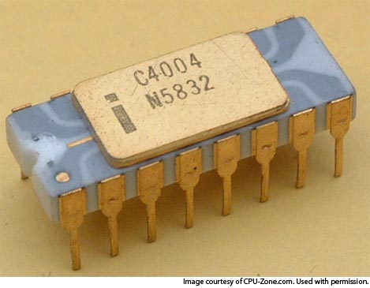
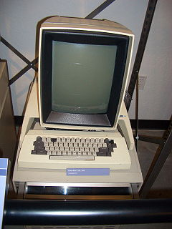
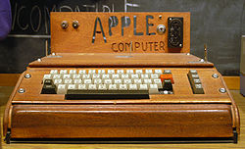
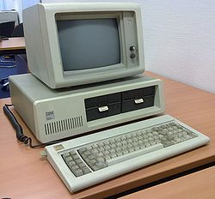

Age of ICT Revolution
1951: Stanford University started the world’s first science park (aka. Silicon Valley)
1965: Uncanny Moor’s Law “The number of transistors that can be fit on a computer chip will double every 1-2 years” published
1971: 1st. CPU announced by Intel
1972: 1st. PC Xerox Alto
1976: Apple I (The Apple I was Apple's first product, and to finance its creation, Jobs sold his only means of transportation, a VW van and Wozniak sold his HP-65 calculator for $500)
1980: Hsinchu Science Park
1981: 1st. IBM PC Launched
1981: MS-DOS 1.0. This was Microsoft's first operating system, and it also became the first widely used operating system for the IBM PC and its clones.
Stories and Dramas abundant here!

Slide 3
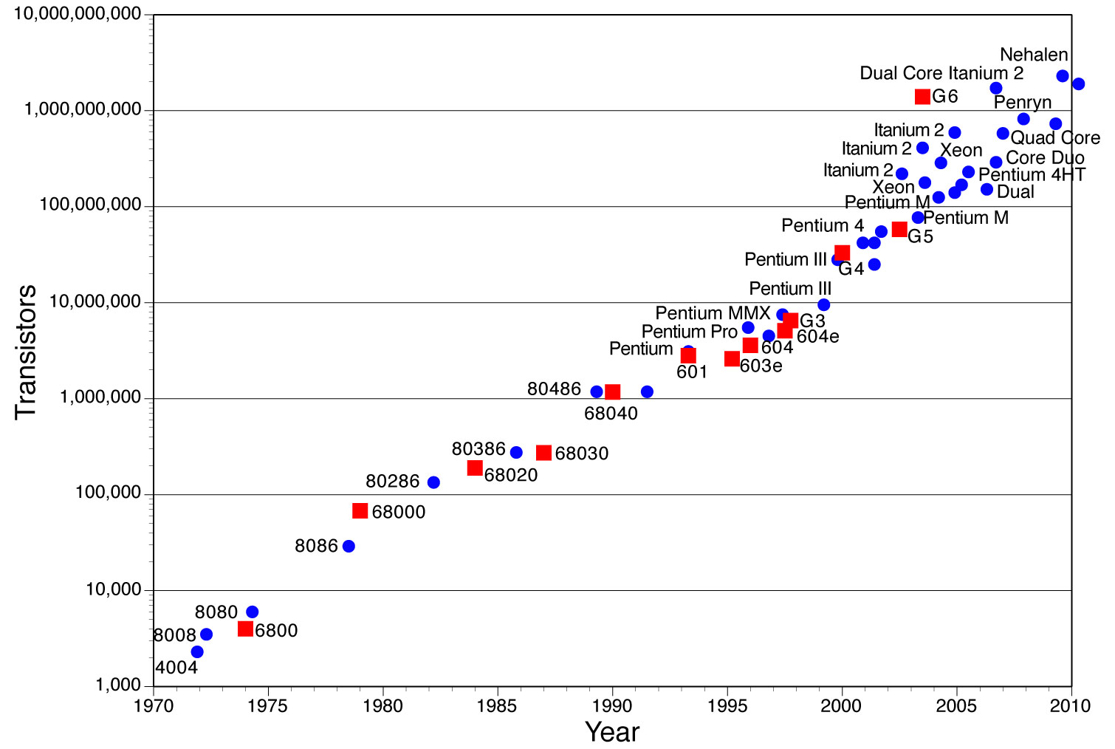
Moor’s Law and CPU Transistor Counts

Slide 4
Moor’s Law not only Dictate the Transistor Technology Roadmap;
But more importantly, Facilitate the Ecosystem Formation of ICT Industry (from US to EU/Japan/Taiwan/Korea, China)

Slide 5
The Industries, Infrastructures and Paradigms of Each Technological Revolution (2)
Courtesy of Carlota Perez, Technological Revolutions and Financial Capital: The Dynamics of Bubbles and Golden Ages 2003

Slide 6
Grand Map of ICT
Technology Revolution/Evolution

Slide 7
 | Components | Device | Network | Software | Applications
1980s & before | Semiconductors Memory Storage | Computers | TCP/IP
1990s | Semiconductor Foundry Service | Cellular Phones Personal Computers | Private Networks / LAN Telecoms / PSTN | Operating systems / GUI
Early 2000s | IC Fabless | Mobile computing / Laptops Mobile phones Consumer Electronics | Public Networks / Internet Cellular | Browsers Enterprise software Open-source / GPL(general public license) | BPO(business process outsourcing) Internet Search E-commerce
Late 2000s | SOC(system-on -chip) | SmartPhones 3D | Mobile Internet 3G Wi-Fi | SaaS(software as a service) Cloud Computing | Web 2.0 / Social media Virtual Reality
Notes:
7

Slide 8
 | Components | Device | Network | AI Robot | Software | Applications
Emerging @ 2010 & before | Memrister, SCM (storage class memory; RRAM, PCM etc.), | Tablet Computing Device, Soft Display, Light Field Camera(handheld) | IPV6 and 4G |  | Cloud Computing , Cloud Service | Machine Learning,
2010s | 3DIC, Biochip, LoC, Open Hardware (OpenPower, Open Compute Project) | iPad, Kindle, Smart Phone, 3D-TV glasses-less, 3D Printer, Google Glass | Ubiquitous 4G and IPV6 Devices, IoT, 5G | Siri-iPhone and alikes | Augmented Reality, Data Science, OpenPower for data center | iCloud, Amazon, Blue Cloud, Data Driven Decision Making
2020s | TeraHertz Components, Organic Components, Graphene | Quantum Computing, Analog Computing, Optical Computing | Sensor Networking, | Avatar(web) | Contextual Search, Analytic Search Engine, Virtual Reality | Semantic Web, Real-time Predictive Analytics,
2030s | Nanomachine | BioComputing, |  | Avatar(physical)
Notes:
8

Slide 9
10 most disruptive technology combinations over last 25 years
Disruption: The whatever/wherever/whenever model of media consumption is turning both Hollywood and the consumer electronics industry on their heads, and forcing advertisers to rethink ways to capture our attention.
  10. VOD and TV on demand + broadband service (TiVo, iTune, Slingbox, iPod etc.)
Disruption: Digital video has made mini-Hitchcocks of everyone. YouTube and its many cousins give the masses a place to put their masterworks. Journalism, politics, and entertainment will never be the same.
  9. YouTube + Cheap Digital Cameras and Camcorders
Disruption: The Net is seeing a new boom in Web 2.0 companies that are more stable and more interesting than their dot-com-era predecessors. And with phones using Google's Linux-based Android operating system slated to appear this year, open source could disrupt the wireless market as well.
  8. Open Source + Web Tools
Disruption: The idea that media should be portable is disruptive. The notion that it should be free--and that some artists can survive, or even thrive, despite a lack of sales revenue--is even more so.
  7. MP3 + Napster
Disruption: Blogs give everyone a public voice, while Google gives bloggers a way to fund and market themselves--and the economy of the 21st century is born.
  6. Blogs + Google Ads
Disruption: Where would we be today without cheap, capacious, portable storage? No iPods. No YouTube. No Gmail. No cloud computing.
  5. Cheap Storage + Portable Memory
Disruption: For enterprises, cloud computing provides the benefits of a data center without the cost and hassle of maintaining one. For consumers, it offers the promise of cheaper, simpler devices that let them access their data and their applications from anywhere.
  4. Cloud Computing + Always-On Devices
Disruption: Broadband has created an explosion of video and music Web sites and VoIP services, while Wi-Fi is bringing the Net to everyday household appliances such as stereos, TVs, and home control systems. Together, they're making the connected home a reality.
  3. Broadband + Wireless Networks
Disruption: Media firms, publishing companies, and advertisers now think Web first, and broadcast or print second.
  2. The Web + The Graphical Browser
Disruption: The ability to be reachable 24/7 is morphing into the ability to surf the Net from any location. And it's forcing monopolistic wireless companies to open up their networks to new devices and services.
  1. Cell Phones + Wireless Internet Access
Source: Dan Tynan, PC World 2008.03

Slide 10
Grand Map of ICT
Industry and Business

Slide 11
 | Components | Device | Network | Software | Applications
1980s & before | Semiconductors Memory Storage | Computers | TCP/IP
1990s | Semiconductor Foundry Service | Cellular Phones Personal Computers | Private Networks / LAN Telecoms / PSTN | Operating systems / GUI
Early 2000s | Fabless | Mobile computing / Laptops Mobile phones Consumer electronics | Public Networks / Internet Cellular | Browsers Enterprise software Open-source / GPL(general public license) | BPO(business process outsourcing) Internet Search E-commerce
Late 2000s | SOC(system-on-chip) | SmartPhones 3D | Mobile Internet 3G Wi-Fi | SaaS(software as a service) Cloud Computing | Web 2.0 / Social media Virtual Reality
Competing against better and cheaper: Intel and Samsung Electronics
IBM
Evolution of Microsoft’s Business Model
TSMC, UMC, Chartered, etc.
Competitive Advantage of a Firm within a Country: Finland and Nokia
Outsourcing for the World:
Taiwan, China and India
Mapping out the Global PC Value Chain
WINTEL
Competitive Advantage of High-tech Nations: Taiwan, S. Korea, Singapore and Israel
Rise of Global Internet Giants: Google and Tencent, Alibaba
Consumer Electronics: Then and Now
Sony, Samsung and Apple
GlobalFoundries, Samsung
Web20 Development of Free, No Business Model Service: Skype, Youtube, Facebook Wikipedia, Twitter, Flickr, LinkedIn etc.
Development of the IaaS, PaaS, SaaS Industries
Notes:
11
11

Slide 13
Sentient Computing
http://www.sentient.ai/
http://vicarious.com/

Slide 14
We might describe our world as having retail sanity, but wholesale madness. Details are well understood; the big picture remains unclear. A fundamental challenge—in business as in life—is to integrate the micro and macro such that all things make sense
http://blakemasters.com/post/20400301508/cs183class1

Slide 15
Future ???
Zero-to-One
One-to-N(many) or Bits-to-Atoms or Human-to-AI…
…………………etc

Slide 16
Ups/Downs for the Next

Slide 17
Inspiration Notes
http://www.youtube.com/watch?v=iZM_JmZdqCw
http://www.youtube.com/watch?v=UEmxRBpCoo0

Slide 18
Simplicity and Abstraction
The path from 0 to 1 might start with asking and answering three questions.
  First, what is valuable?
  Second, what can I do?
  And third, what is nobody else doing?

Slide 19
Assignment for Next Week
Case Study and Discussion: “Entertainment and Beverage of your Choices” prepare for 10min. presentation and 10min.

