Slide 1
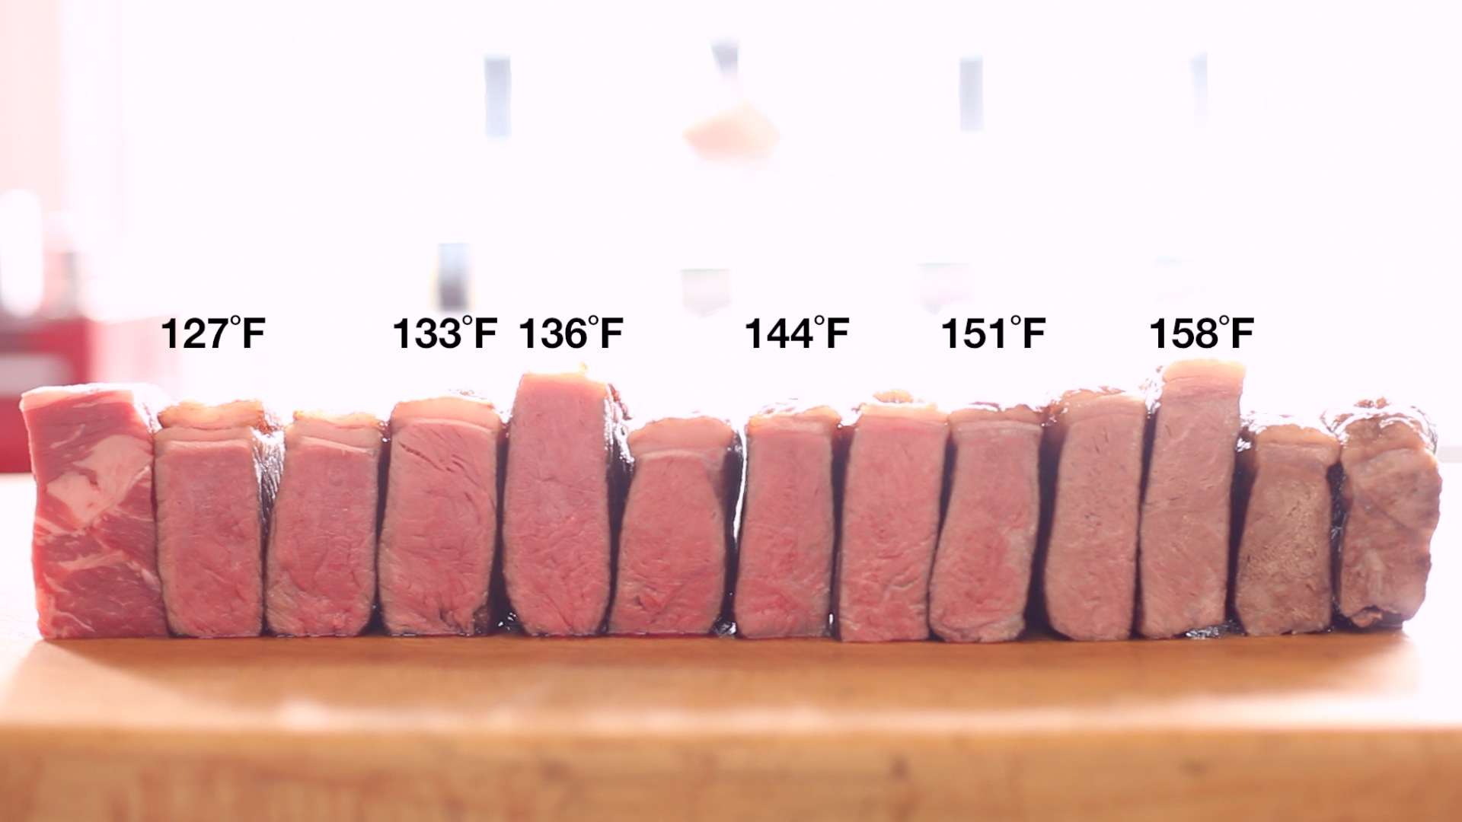
Hi-Tech Barbecue/Grilling @high mountain

Slide 2
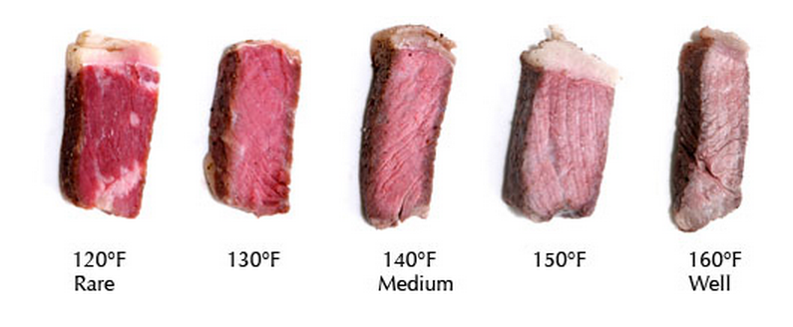
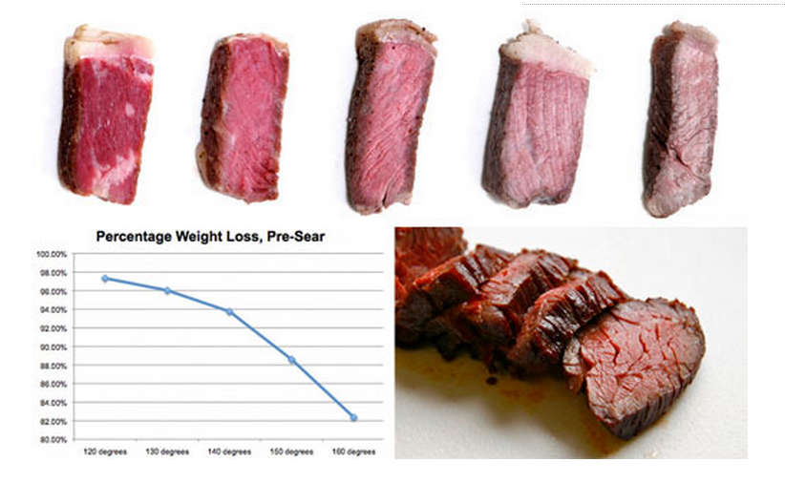

Slide 3
Virtual Singer
https://www.youtube.com/watch?v=NQReOUzN1lI (To be fair, there are actual, live musicians on stage that accompany the virtual singers, The Hatsune Miku)

Slide 4
Datafy Everything: What's Next in Digital Life
Daniel HaoTien Lee (李浩典)
danieleewww@gmail.com
danieleewww.yolasite.com

Slide 5
Datafication: a process of “taking all aspects of life and turning them into data”
Google’s augmented-reality glasses datafy the gaze
Twitter datafies stray thoughts
LinkedIn datafies professional networks
Facebook datafies social activities
Pandora/Spotify datafies music feeling and sensibility
Amazon datafies shopping
Once we datafy things, we can transform their purpose and turn the
information into new forms of value.

Slide 6
What Behind Datafication
Statistically N=small random sampling(carefully curated data) to approaching N=all (some messiness)
Data
from some to all
from clean to messy
from causation to correlation -this represents a move away from always trying to understand the deeper reasons behind how the world works to simply learning about an association among phenomena and using that to get things done.

Slide 7
Eg. UPS Preventive Measures
Take UPS, the delivery company. It places sensors on vehicle parts to identify certain heat or vibrational patterns that in the past have been associated with failures in those parts. In this way, the company can predict a breakdown before it happens and replace the part when it is convenient, instead of on the side of the road. The data do not reveal the exact relationship between the heat or the vibrational patterns and the part’s failure. They do not tell UPS why the part is in trouble. But they reveal enough for the company to know what to do in the near term and guide its investigation into any underlying problem that might exist with the part in question or with the vehicle.
UPS is installing GPS tracking equipment as well as sensors in key areas, such as brakes and engine box, and on the exterior. These devices will help UPS track the location of its delivery trucks as well as identify ways in which drivers can make adjustments and improve their performance based on collected data. Two key areas the company plans to improve are idle time and route efficiency.
"What is new is the proprietary telematic information and sophisticated algorithms we developed to analyze the rich stream of data captured by more than 200 sensors on our delivery trucks." Telematics help UPS determine a truck's performance and condition, as well as identify ways drivers can make small adjustments that yield major results. Together, improved data and driver coaching help reduce fuel consumption, emissions, and maintenance costs, while improving customer service and driver safety.
https://www.youtube.com/watch?v=nMrhuKoE3cI

Slide 8
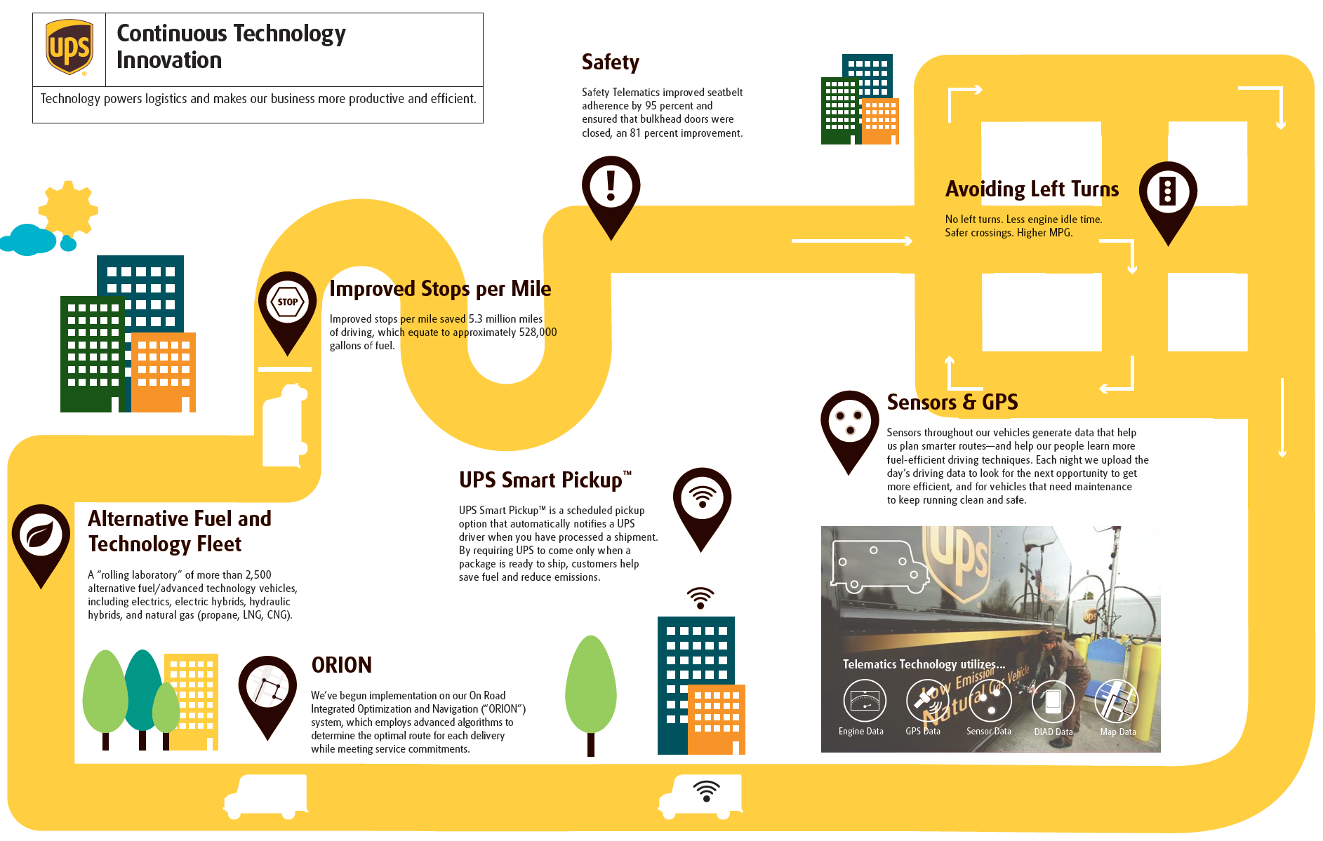

Slide 9
Benefit of Telematics
Greenhouse Gas Reduction
Telematics outputs drive UPS’s planning, training, and maintenance activities.
Mileage Reduction- Multi-million gallons of gasoline saving yearly.
Fuel and Emissions Efficiency
Operational Improvement-- Even tiny operational improvements from telematics data can cut millions of miles from the total.

Slide 10
Saving small per and earning big total amount

Slide 11
Eg. Newborn Risk Management
Researchers in Canada are developing a big-data approach to spot infections in premature babies before overt symptoms appear. By converting 16 vital signs, including heartbeat, blood pressure, respiration, and blood-oxygen levels, into an information flow of more than 1,000 data points per second, they have been able to find correlations between very minor changes and more serious problems. Eventually, this technique will enable doctors to act earlier to save lives. Over time, recording these observations might also allow doctors to understand what actually causes such problems. But when a newborn’s health is at risk, simply knowing that something is likely to occur can be far more important than understanding exactly why.
https://www.youtube.com/watch?v=WNccLBzR_I4
http://www.ibmbigdatahub.com/blog/fusion-big-data-and-little-babies

Slide 12
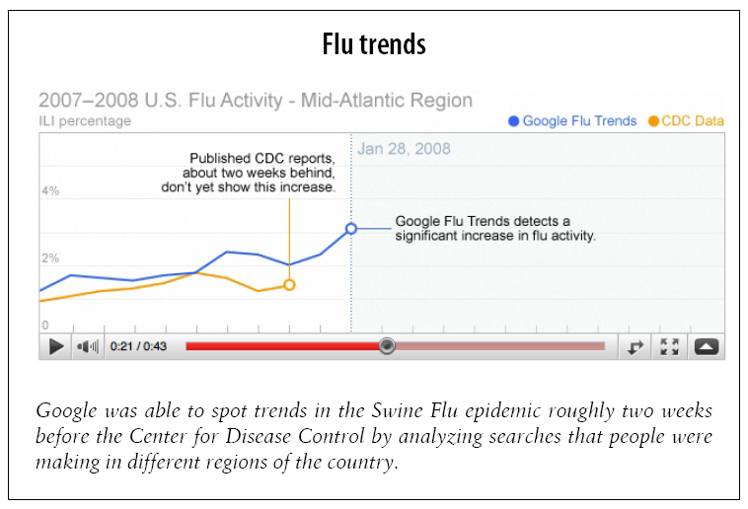
Eg. Outbreak Early Warning
http://www.google.org/

Slide 13
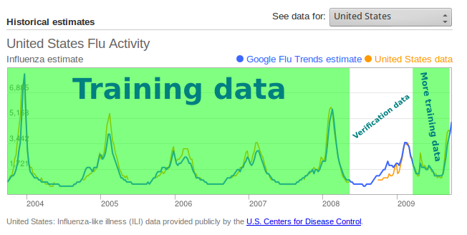
This serves as a reminder that predictions are only probabilities and are not always correct, especially when the basis for the prediction -- Internet searches -- is in a constant state of change and vulnerable to outside influences, such as media reports. Still, big data can hint at the general direction of an ongoing development, and Google’s system did just that.

Slide 14
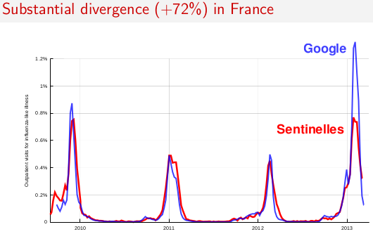

Slide 15
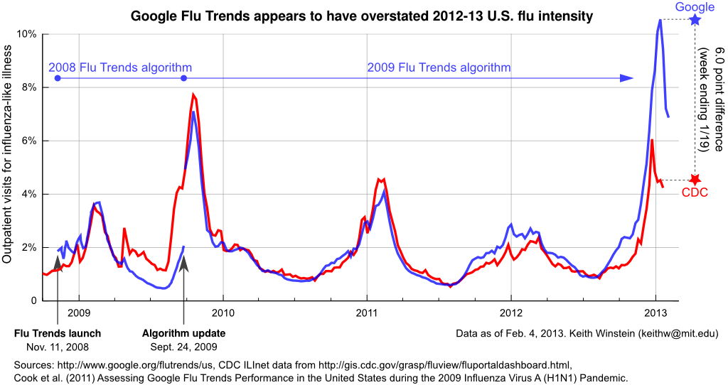
The fact that Google decided not to update the model for 2012-13, and subsequently the model performed poorly in 2012-13, suggests that the procedure for deciding when an update is necessary may need to be reworked.

Slide 16
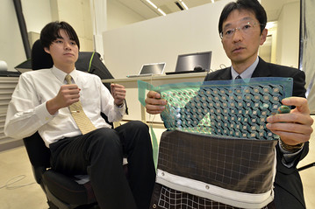
Datafication of Posteriors
When a person is seated, the contours of the body, its posture, and its weight distribution can all be quantified and tabulated.
Car Seat IDs Driver’s Rear End: Mr. Koshimizu, a mechanical engineering associate professor at the Advanced Institute of Industrial Technology in Tokyo, has developed an ultra-sensitive sheet that sometime down the line could make the contours of a driver’s rear end an integral part of a car’s security system.

Slide 17
FAST (Future Attribute Screening Technology)

Slide 18
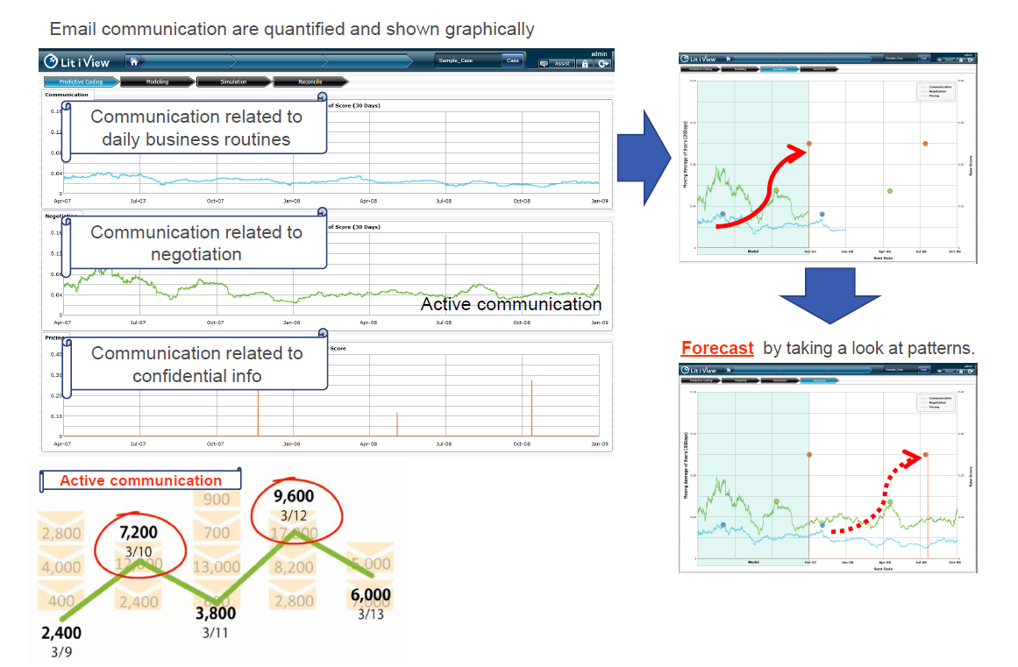
Prediction Technology: Risk Prediction
http://www.ubicna.com/en/technology/

Slide 19
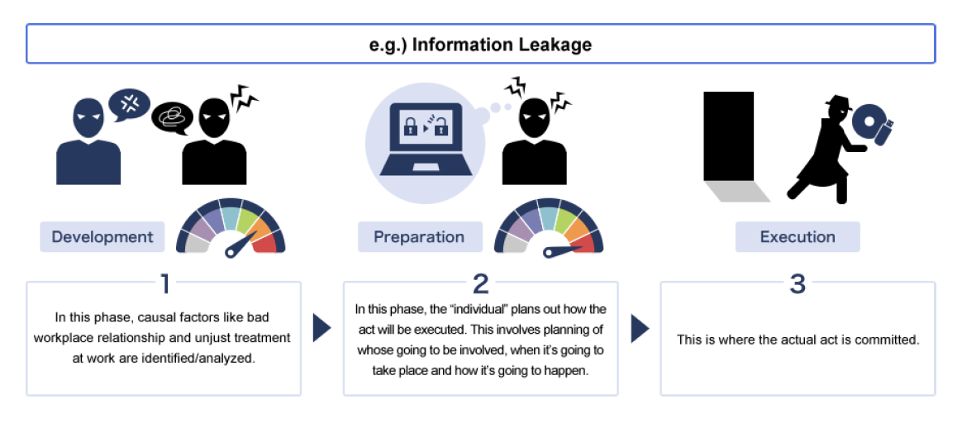
Application of Prediction Technology:
All frauds and misconducts differ, there is similarity in their progression from development to emergence
Risk prediction can be applied to all kinds of misconduct cases. i.e. Cartel, FCPA (bribe), information leakage, research misconduct, etc.

Slide 20
How to get mass amount of data!

Slide 21
Vast Open Data
https://www.data.gov/

Slide 22
Data collected from users provides added value.
Google isn’t the only company that knows how to use data.
Facebook and LinkedIn use patterns of friendship relationships to suggest other people you may know, or should know, with sometimes frightening accuracy.
Amazon saves your searches, correlates what you search for with what other users search for, and uses it to create surprisingly appropriate recommendations. These recommendations are “data products” that help to drive Amazon’s more traditional retail business.
https://www.facebook.com/
http://www.amazon.com/
https://www.linkedin.com/

Slide 23
How Google Collect Data! (free and sharing)
Google’s information-gathering channels
Searches (web, images, news, blogs, etc.)
Web crawling, Website analytics, Ad serving, Email, Twitter
Google Apps (Docs, Spreadsheets, Calendar, etc.)
Google Public Profiles, Orkut, Google Public DNS
The Google Chrome browser,
Google Finance
Youtube
Google Translate, Google Books, Google Reader
Feedburner
Google Maps and Google Earth
Your Contact Networks
Chrome OS
Google TV
Google Glass
http://www.google.com/analytics/apps/results?category=Data%20Collection all free!

Slide 24
Facebook Data Collections
If Facebook were a country, a conceit that founder Mark Zuckerberg has entertained in public, its 1.2 billions members would make it the second largest in the world. It would far outstrip any regime past or present in how intimately it records the lives of its citizens. Private conversations, family photos, and records of road trips, births, marriages, and deaths all stream into the company’s servers and lodge there. Facebook has collected the most extensive data set ever assembled on human social behavior. Some of your personal information is probably part of it.
Facebook information gethering
Data on minute user interactions with its content, such as how long a user’s cursor hovers over a certain part of its website, or whether a user’s newsfeed is visible at a given moment on the screen of his or her mobile phone
Demographic data—such as where a user lives or went to school—documents a user’s life beyond the network
Behavioral data—such as one’s circle of Facebook friends, or “likes”—is captured in real time on the network itself.
Uses your profile to target Ads
Uses your real world shopping to target Ads

Slide 25
How Linkedin Collect Leads: Connect, share ideas, and discover opportunities.
http://www.linkedin.com/static?key=advertising_leads_collection
http://www.linkedin.com/company/launch-leads
https://www.linkedin.com/ads/

Slide 26
Amazon Service and Data Collection
http://www.howstuffworks.com/amazon3.htm
http://aws.amazon.com/big-data/

Slide 27
IBM: Online Retailing Analytics
IBM get analytic data on the 800 retailers' online sales transactions per device and per OS base http://www-03.ibm.com/press/us/en/pressrelease/42617.wss

Slide 28
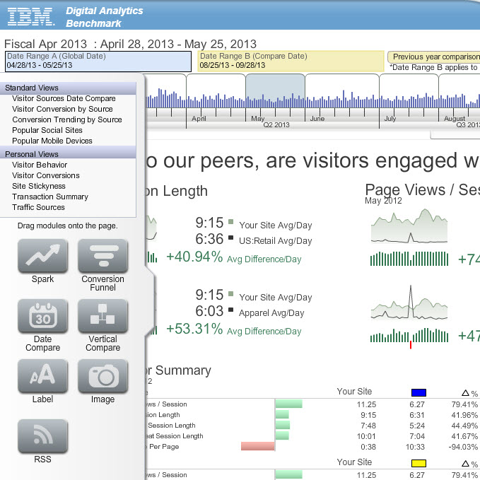

Slide 29
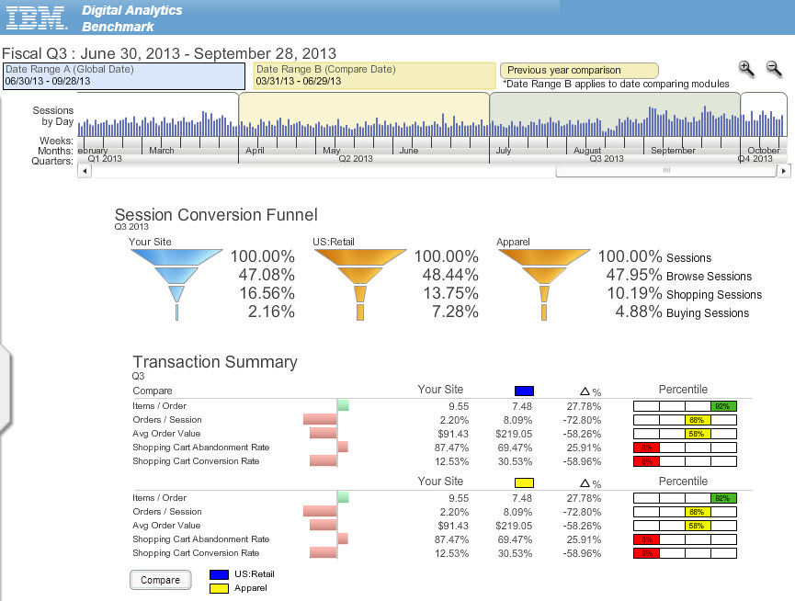

Slide 30
IBM Digital Analytics Benchmark
Industry trends by comparison period: sessions, page views, product views, orders, sales, natural search sessions, paid search sessions, marketing sessions, direct load sessions and referring sites sessions. Note: these metrics reflect only a percent change from a previous period, not absolute figures.
Site trends: product views/session, item abandonment rate, session conversion rate and onsite search session percent.
Visitor summary: page view/session, average session length, average new session length, average repeat session length and average time on page.
Visitor behavior: bounce rate, new session percent, repeat session percent, multi-page session percent and new visitor conversion rate.
Ecommerce funnel: browser session percent, shopping cart session percent and purchasing session percent.
Transactions: average items per order, average orders per session, average order value, shopping cart abandonment rate and shopping cart conversion rate.
On-site search: sessions, conversion rate and average order value where on-site search is used.
Marketing: traffic, sales and conversion rate ratios from direct load, natural search, paid search, referring sites and marketing programs.
Browser types: Internet Explorer, Firefox, Opera, Safari and Google Chrome.
Mobile device: session and conversion rate percentages associated with leading mobile devices.
Social sites: session and conversion rate percentages associated with top social referral sites.

Slide 31
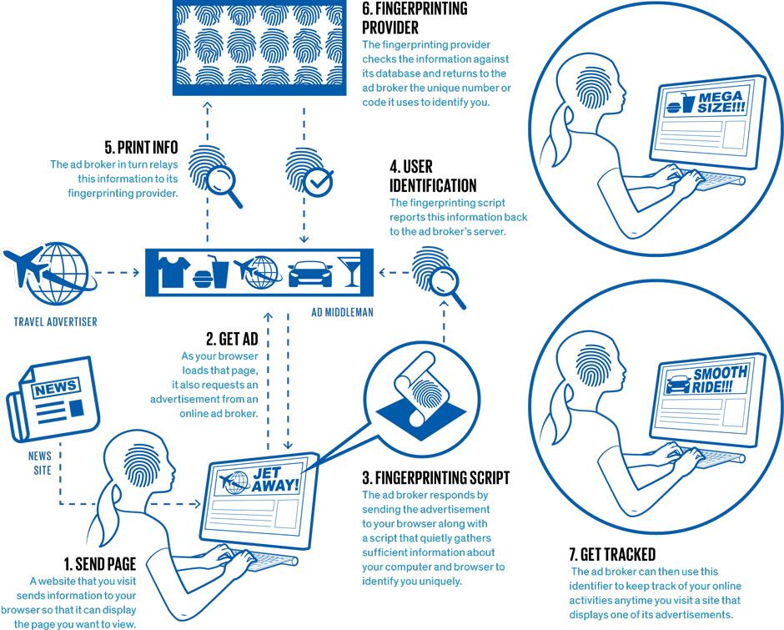
Browser Fingerprinting
In the past, clearing cookies after each session or selecting your browser’s “Do Not Track” setting could prevent third-party tracking. But the advent of browser fingerprinting makes it very difficult to prevent others from monitoring your online activities. The diagram outlines how an online advertising network can track the sites you visit using fingerprinting.

Slide 32
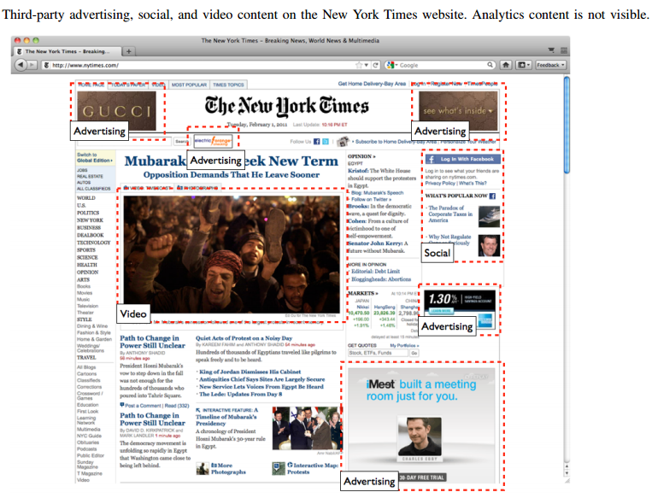

Slide 33
Browser Fingerprinting
Collecting identifying information about unique characteristics of the individual computers people use. Under the assumption that each user operates his or her own hardware, identifying a device is tantamount to identifying the person behind it.
Unique characteristics including user’s screen size, time zone, browser plug-ins, and set of installed system fonts.
Users continue to be fingerprinted even if they have checked “Do Not Track” in their browser’s preferences.
http://spectrum.ieee.org/computing/software/browser-fingerprinting-and-the-onlinetracking-arms-race

Slide 34
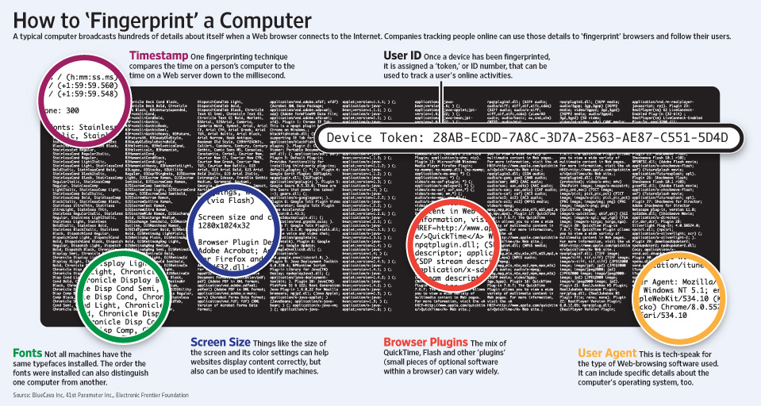

Slide 35
Fingerprinting Providers
BlueCava
Iovation
ThreatMetrix
Coinbase
MaxMind
Perferencement

Slide 36
Canvas Fingerprinting
The fingerprint is primarily based on browser, operating system, and installed graphics hardware, so does not uniquely identify users.
Fingerprint based on browser font and WebGL rendering. To obtain this fingerprint, a website renders text and WebGL scenes to a <canvas> element, then examines the pixels produced. Different systems produce different output, and therefore different fingerprints.

Slide 37
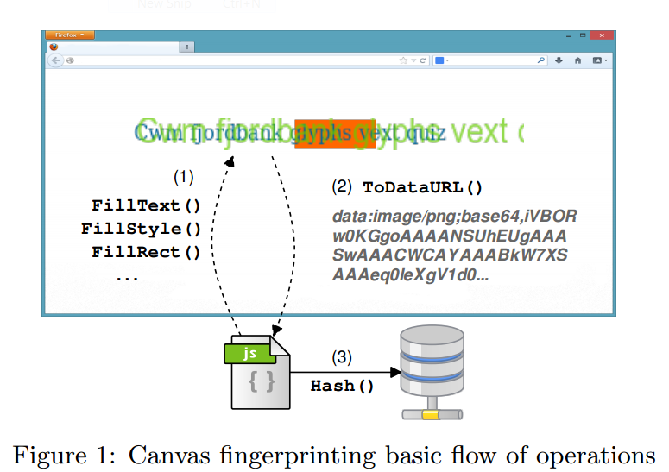
Canvas Fingerprinting
Figure shows the basic flow of operations to fingerprint canvas. When a user visits a page, the fingerprinting script first draws text with the font and size of its choice and adds background colors. Next, the script calls Canvas API’s ToDataURL method to get the canvas pixel data in dataURL format, which is basically a Base64 encoded representation of the binary pixel data. Finally, the script takes the hash of the text-encoded pixel data, which serves as the fingerprint and may be combined with other high-entropy browser properties such as the list of plugins, the list of fonts, or the user agent string

Slide 38
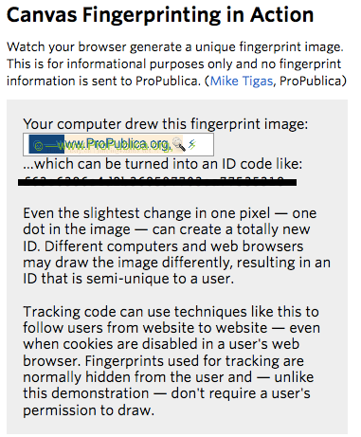

Slide 39
Defense Fingerprinting
https://panopticlick.eff.org/

Slide 40
The future belongs to the companies and people that turn data into products/services

Slide 41
The Historical S, T & A Co-evolution Process Perspective: Age of Data Science
NBIC: Nanotechnology, Biotechnology, Information Technology, Cognitive Science
More stories here!
Courtesy of Byeongwon Park 2007

Slide 42
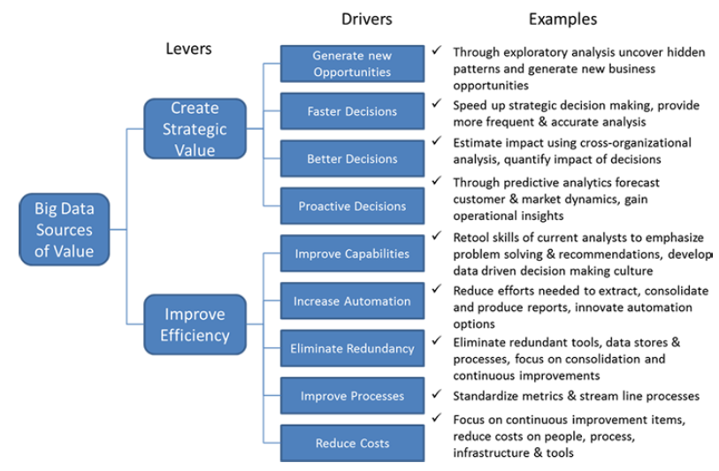
The value drivers of big data for enterprise

Slide 44
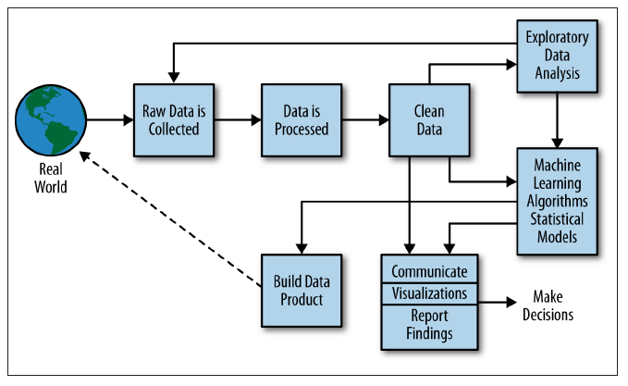
Data Science Process
http://www.youtube.com/watch?v=xbecGJlODPg

Slide 45
Data Scientist
… on any given day, a team member could author a multistage processing pipeline in Python, design a hypothesis test, perform a regression analysis over data samples with R, design and implement an algorithm for some data-intensive product or service in Hadoop, or communicate the results of our analyses to other members of the organization
A data scientist is someone who knows how to extract
meaning from and interpret data, which requires both tools and methods
from statistics and machine learning, as well as being human.

Slide 46
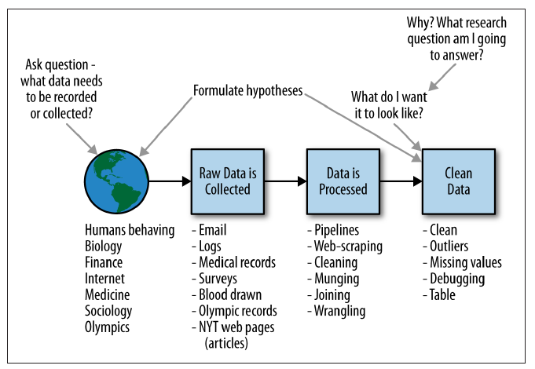
The data scientist is involved in every part of this process

Slide 47
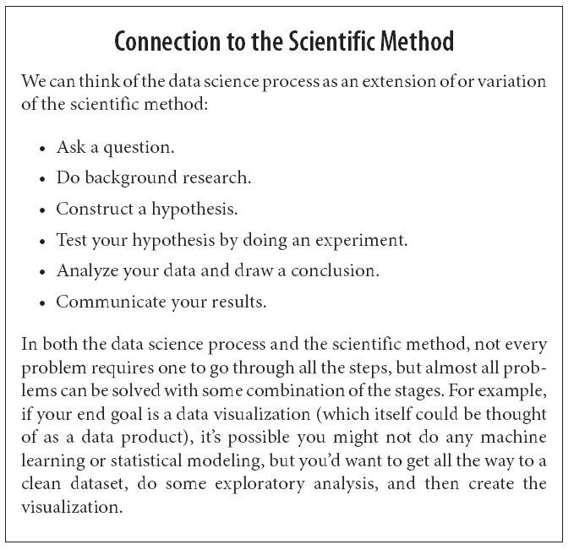
A Data Scientist's Real Job: Storytelling
http://www.bigdatarepublic.com/author.asp?section_id=2642&doc_id=266699&image_number=1

Slide 48
Working with data at scale Making data tell its story
The ability to take data—to be able to understand it, to process it, to extract value from it, to visualize it, to communicate it—that’s going to be……..

Slide 49
Mirror for Conventional Toilet Cleaning

Slide 50
Camera for Toilet Cleaning
Camera for Toilet Cleaning

Slide 51
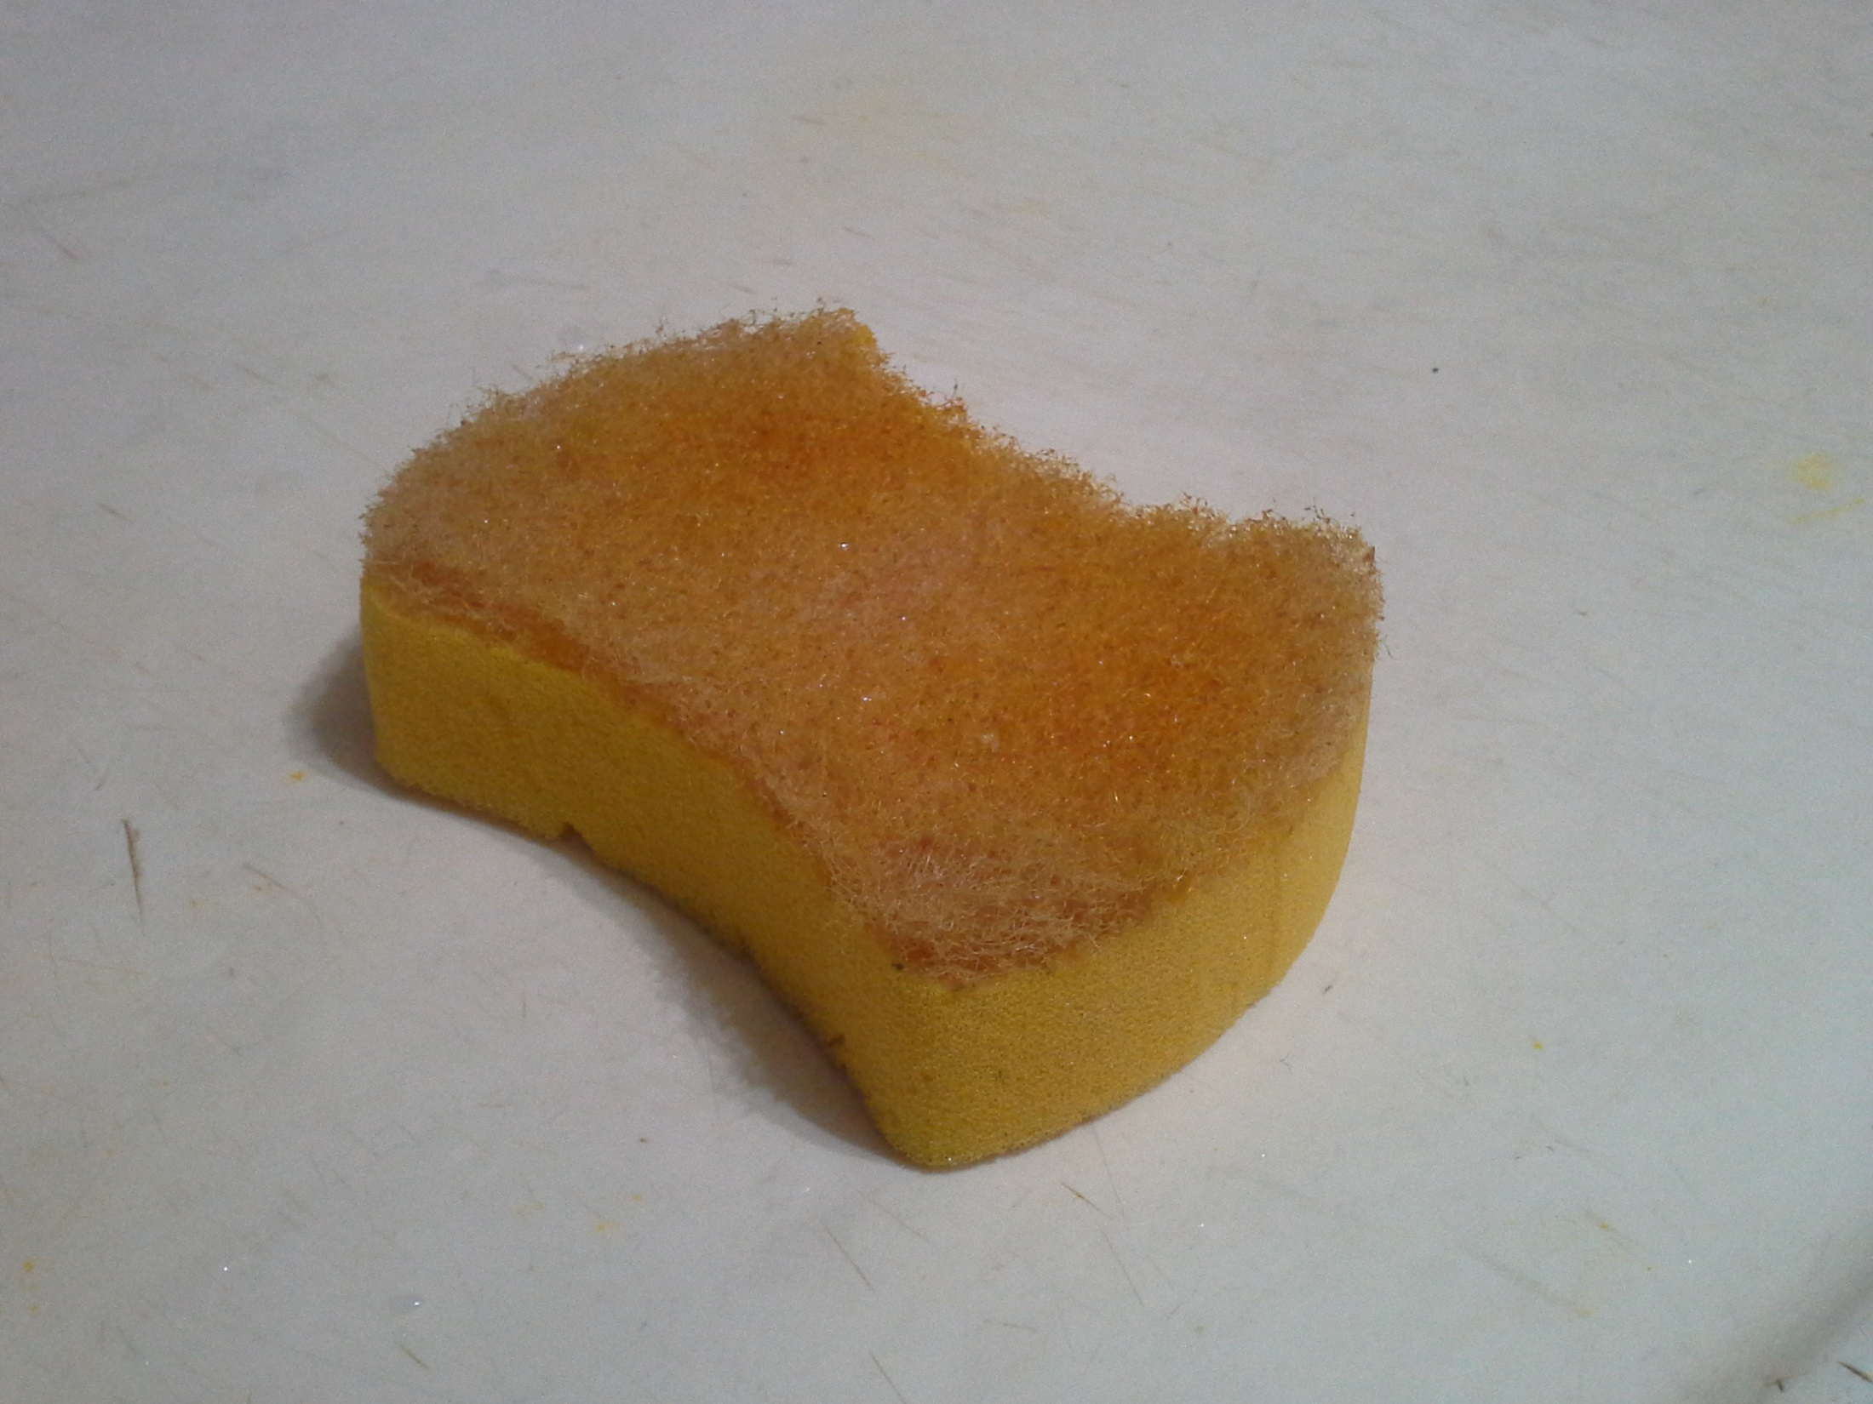
Which Side for Cleaning Dishes!

Slide 52
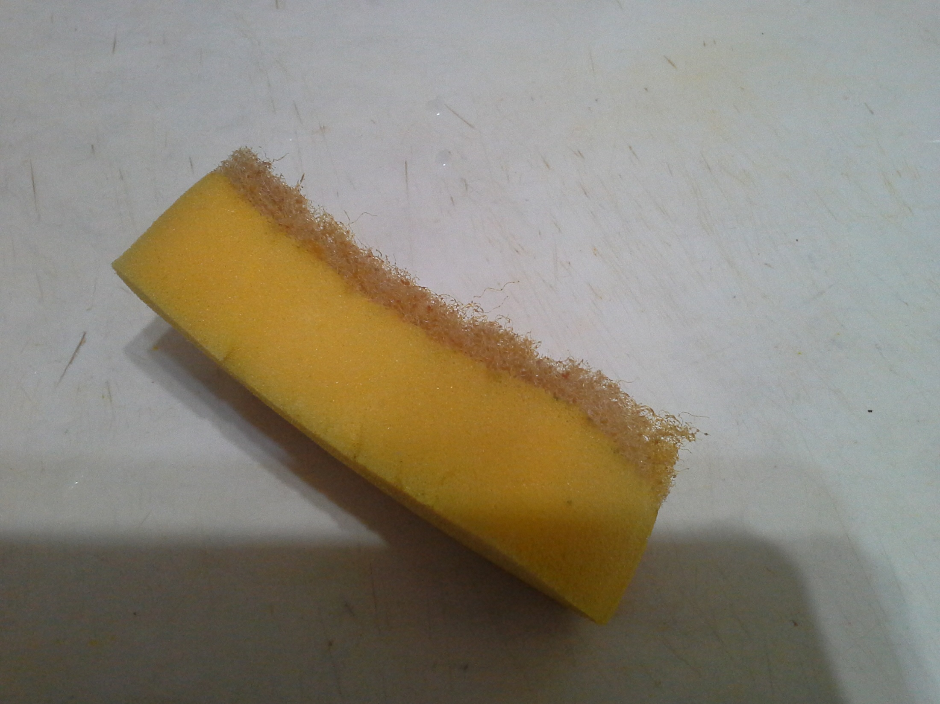
Dish washing scrubber and its impact on detergent and household management!

