Slide 1
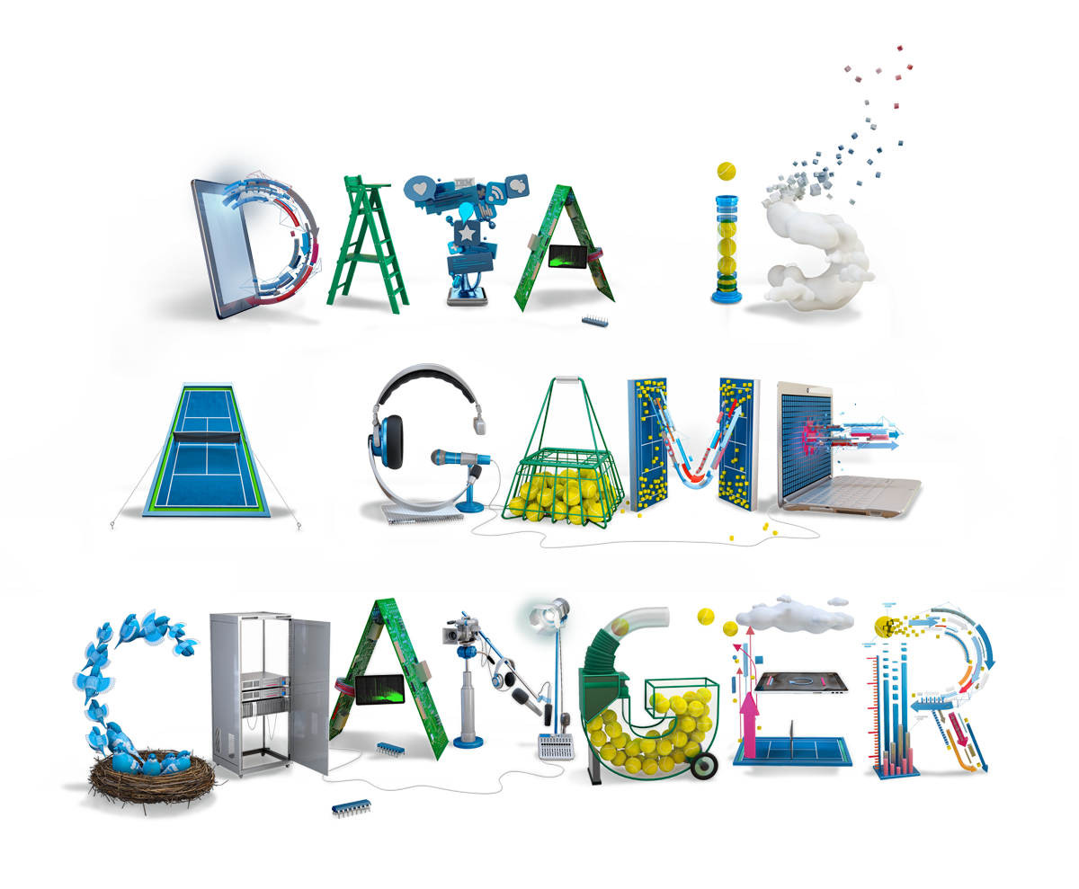
http://www.ibm.com/smarterplanet/us/en/smarter-enterprise/case-studies/us-open.html?cmp=usbrb&cm=j&csr=agus_brspuso-20130808&cr=vanity&ct=usbrb301&cn=usopen_vanity

Slide 2
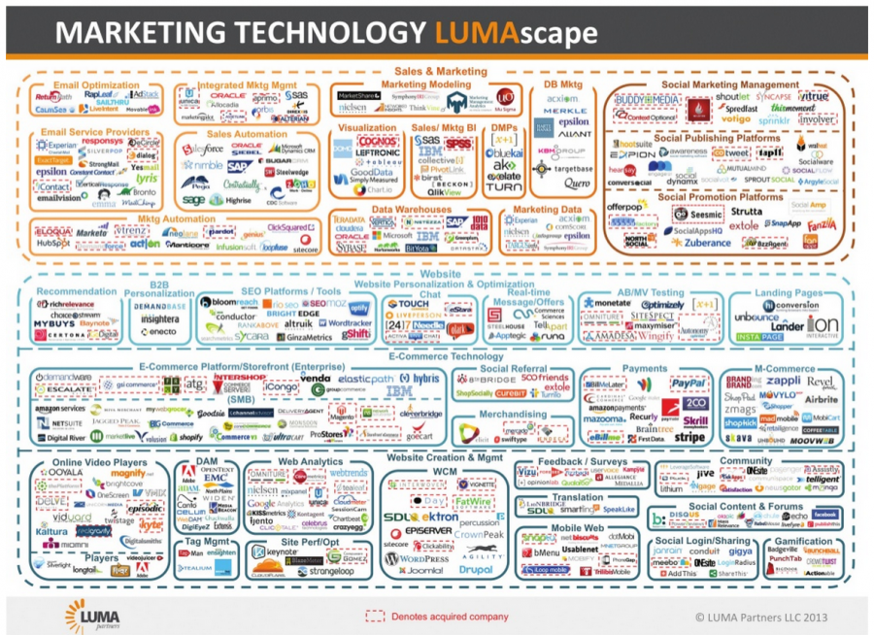

Slide 3
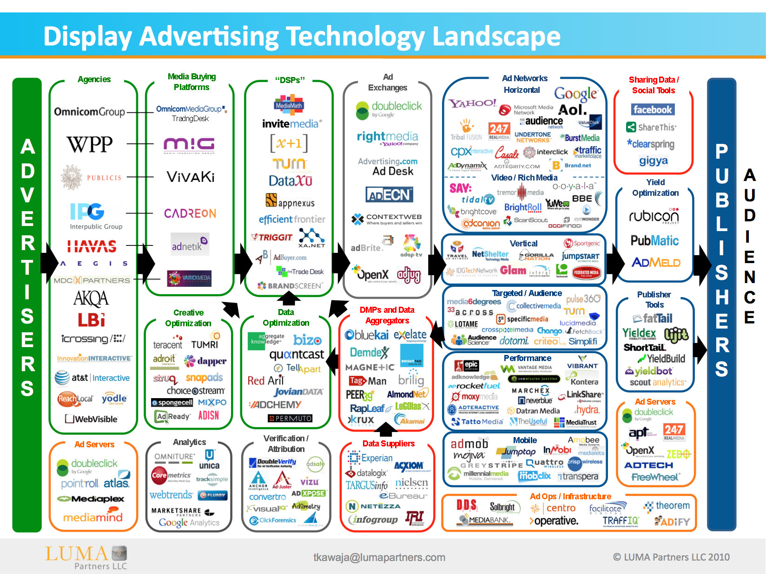

Slide 4
Technology and Complexity
Complexity: individual elements reacting to the collective pattern they create
Evolution is part of this
Q. Does the collective of technology evolve?

Slide 5
An observation
Technologies are constructed from existing
technologies

Slide 6
How a technology is structured
Base concept or principle
“the method of the thing” (i.e. the idea of some effect in use)
E.g. principle of a clock is to count the beats of some stable frequency
A base assembly (a combination that achieves this)
Ancillary systems and parts to make this work

Slide 7
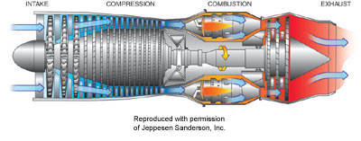
Jet engine (GE J47)

Slide 8
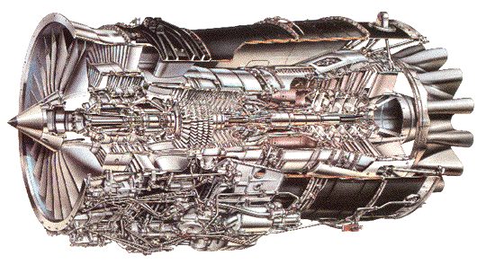
Real powerplant--A Rolls Royce turbofan

Slide 9
The process of invention
Distilled down, it really is seeing a principle, and putting together the ways to make this work from functionalities that already exist
… plus solving the subproblems this creates

Slide 10
We can say …
Novel technologies are constructed from existing technologies
… These offer themselves as components—building blocks for the construction of further technologies

Slide 11
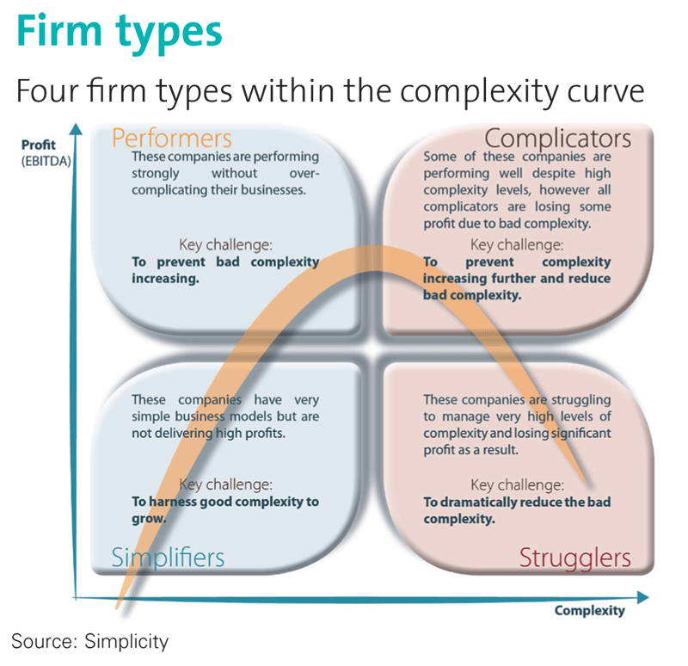

Slide 12
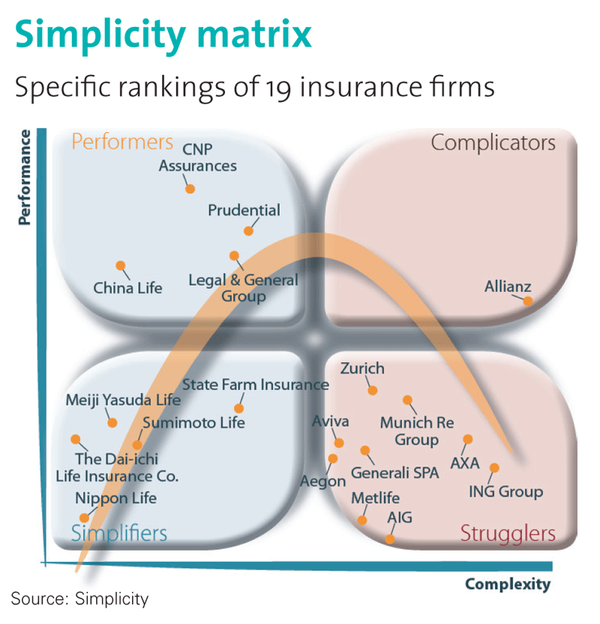

Slide 13
So in real life we may wish simplicity over complexity!
But complexity is growing exponentially
in our modern life!

Slide 14
10 most disruptive technology combinations over last 25 years
Disruption: The whatever/wherever/whenever model of media consumption is turning both Hollywood and the consumer electronics industry on their heads, and forcing advertisers to rethink ways to capture our attention.
10. VOD and TV on demand + broadband service (TiVo, iTune, Slingbox, iPod etc.)
Disruption: Digital video has made mini-Hitchcocks of everyone. YouTube and its many cousins give the masses a place to put their masterworks. Journalism, politics, and entertainment will never be the same.
9. YouTube + Cheap Digital Cameras and Camcorders
Disruption: The Net is seeing a new boom in Web 2.0 companies that are more stable and more interesting than their dot-com-era predecessors. And with phones using Google's Linux-based Android operating system slated to appear this year, open source could disrupt the wireless market as well.
8. Open Source + Web Tools
Disruption: The idea that media should be portable is disruptive. The notion that it should be free--and that some artists can survive, or even thrive, despite a lack of sales revenue--is even more so.
7. MP3 + Napster
Disruption: Blogs give everyone a public voice, while Google gives bloggers a way to fund and market themselves--and the economy of the 21st century is born.
6. Blogs + Google Ads
Disruption: Where would we be today without cheap, capacious, portable storage? No iPods. No YouTube. No Gmail. No cloud computing.
5. Cheap Storage + Portable Memory
Disruption: For enterprises, cloud computing provides the benefits of a data center without the cost and hassle of maintaining one. For consumers, it offers the promise of cheaper, simpler devices that let them access their data and their applications from anywhere.
4. Cloud Computing + Always-On Devices (i-cloud + i-Pad)
Disruption: Broadband has created an explosion of video and music Web sites and VoIP services, while Wi-Fi is bringing the Net to everyday household appliances such as stereos, TVs, and home control systems. Together, they're making the connected home a reality.
3. Broadband + Wireless Networks
Disruption: Media firms, publishing companies, and advertisers now think Web first, and broadcast or print second.
2. The Web + The Graphical Browser
Disruption: The ability to be reachable 24/7 is morphing into the ability to surf the Net from any location. And it's forcing monopolistic wireless companies to open up their networks to new devices and services.
1. Cell Phones + Wireless Internet Access
Source: Dan Tynan, PC World 2008.03

Slide 15
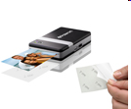
Disruption in business models has been the dominant historical mechanism for making things more affordable and accessible
Yesterday
Ford
Dept. Stores
Digital Eqpt.
Delta
JP Morgan Chase
Xerox
IBM
Cullinet
AT&T
Dillon, Read
Japan
Sony DiskMan
Today
Toyota
Wal-Mart
Dell
Southwest Airlines
Fidelity
Canon
Microsoft
Oracle
Cingular
Merrill Lynch
Korea, Taiwan
Cellular Phones, iPod
Tomorrow:
Chery
Internet retail
iPhone, RIM etc.
Skywest, Air taxis
ETFs (exchange trade fund)
Zink, Micropojector
Linux, Android, iOS
Salesforce.com
Skype
E-Trade
China, India, Turkish, Brazil
Smart Phones, iPad, ebook
But technology advancing are always the main thrust behind these transitions
http://www.christenseninstitute.org/
Courtesy of Clayton Christensen, Harvard U. 2008

Slide 16
Technology complexity actually help life for simplicity or otherwise?

Slide 18
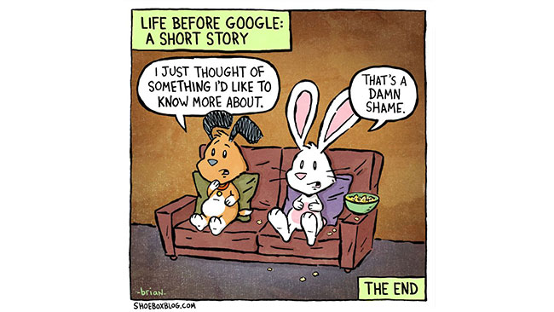
TECHNOLOGY was supposed to save us time and make our lives easier. But….

Slide 19
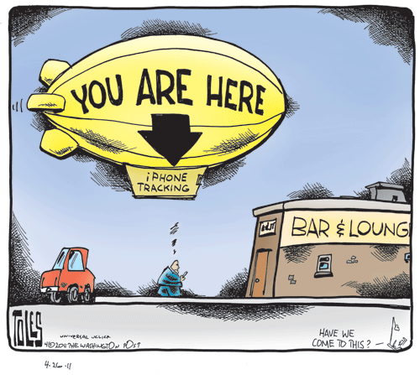
Always connected and location-based service

Slide 20
“To attain knowledge, add things every day. To attain wisdom, subtract things every day. — Lao Tzu”

Slide 21
Subtraction Is the Hardest Math in Product Design

Slide 22
“Simplicity is about subtraction”

Slide 24
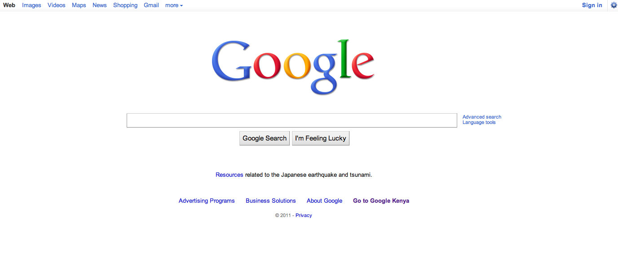

Slide 25
The Laws of Subtraction: How to Innovate in the Age of Excess Everything

Slide 27
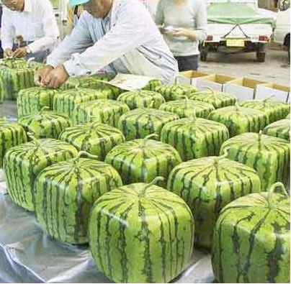
Abstraction is key to creativity– so lead
to technology innovation, evolution,
and revolution….

Slide 28
Abstraction shifts: The concept of new work is based on the fact that in today’s complex and changing world, all fields of work will sooner or later face one or more abstraction shifts. This means that the content, relevance, execution and output of work become redefined and shift to a higher level of development. At the same time, some types of work unavoidably become irrelevant and cease to exist.

Slide 29
In general, companies have two ways of successfully coping with the change: they can either gradually evolve their business model or make a radical move to new business sectors. Car manufacturers have chosen the evolutionary road, combining branding and design to technological progress. In turn, Apple is a prime example of radical change and expansion, now operating not only in hardware manufacturing, but also in the fields of media, content production, and software development.

Slide 30
Figure. The evolution of phenomena. © Juhani Risku 2010.
Every phenomenon has four evolutionary stages: primitive, traditional, modern and futuristic.
http://wikimploi.wordpress.com/key-concepts/abstraction-shifts/

Slide 31
Drinking to Toast:
A mundane story: drinking has evolved from the primitive quenching of thirst to the traditional consumption of liquids to the modern refinement of drinks and finally to the futuristic form of a toast. An abstraction shift happens at each transition point. These evolutionary shifts can be intentionally exploited when drafting new models for work, business and systemic solutions, thus creating a competitive advantage and long term success.

Slide 32
The future belongs to the companies and people that turn data into products/services

Slide 33
The Historical S, T & A Co-evolution Process Perspective: Age of Data Science
NBIC: Nanotechnology, Biotechnology, Information Technology, Cognitive Science
More stories here!
Courtesy of Byeongwon Park 2007

Slide 34
Datafication: a process of “taking all aspects of life and turning them into data”
Google’s augmented-reality glasses datafy the gaze
Twitter datafies stray thoughts
LinkedIn datafies professional networks
Facebook datafies social activities
Once we datafy things, we can transform their purpose and turn the
information into new forms of value.

Slide 36
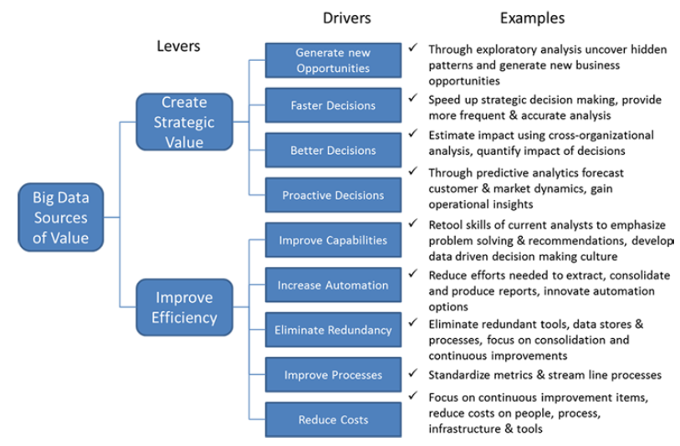
The value drivers of big data for enterprise

Slide 37
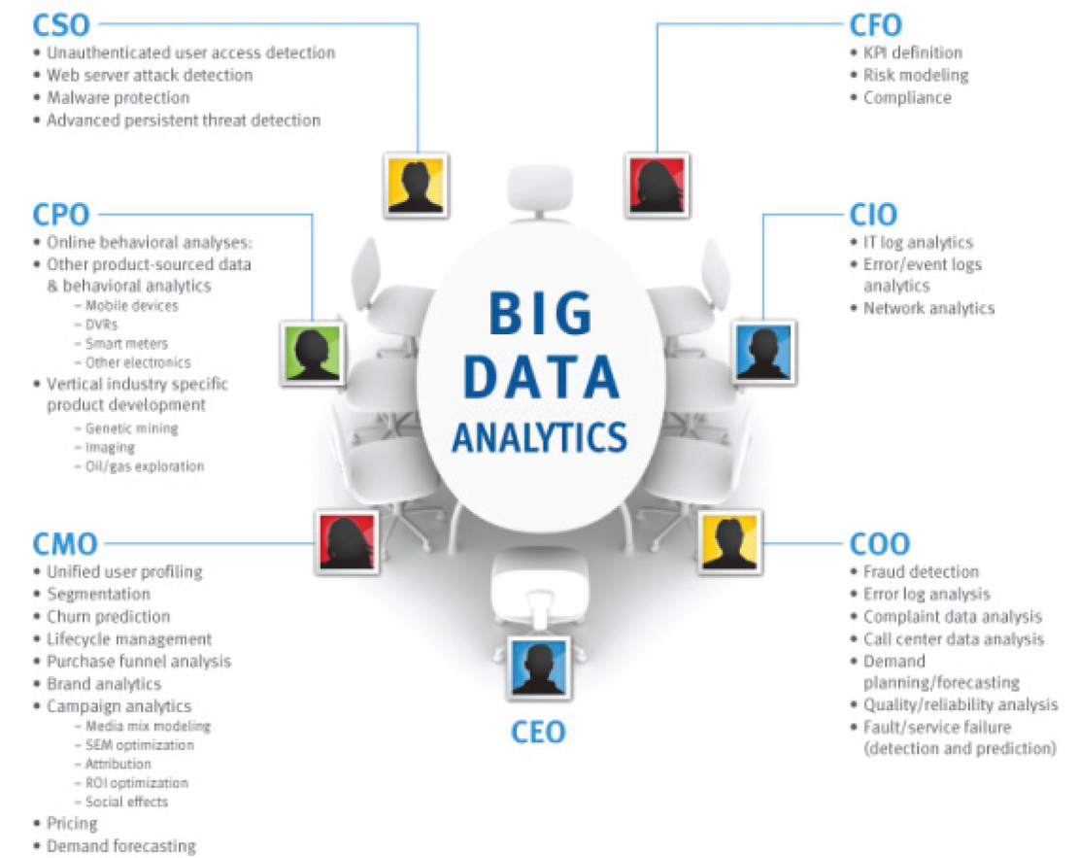

Slide 39
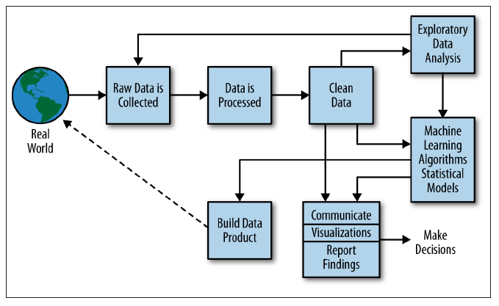
Data Science Process
http://www.youtube.com/watch?v=xbecGJlODPg

Slide 40
Data Scientist
… on any given day, a team member could author a multistage processing pipeline in Python, design a hypothesis test, perform a regression analysis over data samples with R, design and implement an algorithm for some data-intensive product or service in Hadoop, or communicate the results of our analyses to other members of the organization
A data scientist is someone who knows how to extract
meaning from and interpret data, which requires both tools and methods
from statistics and machine learning, as well as being human.

Slide 41
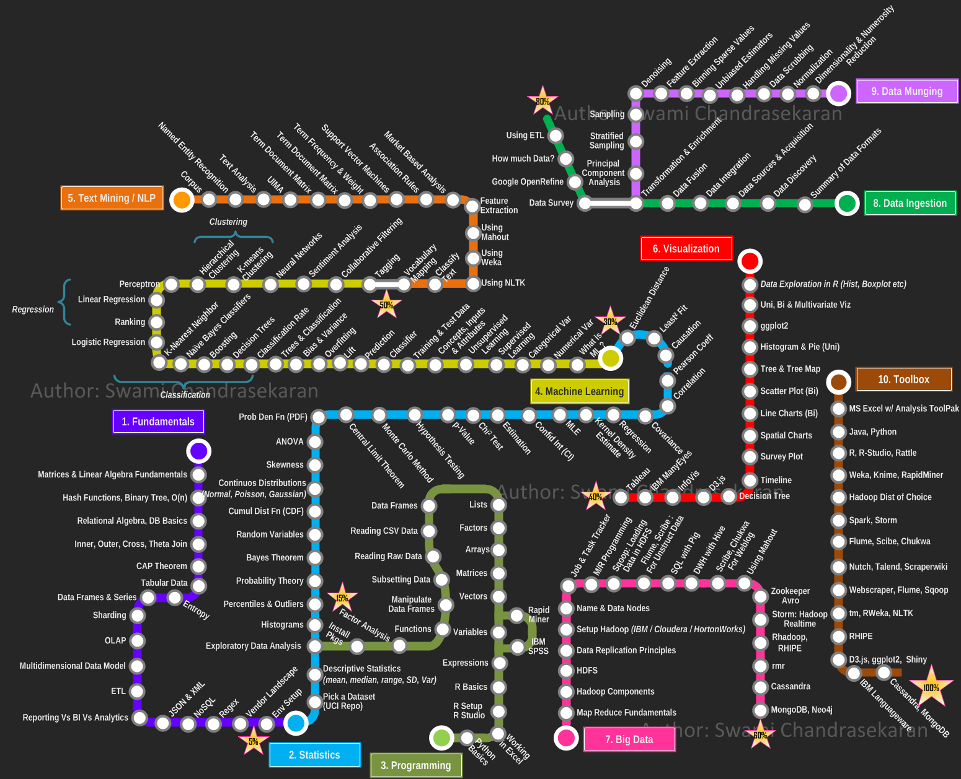
http://nirvacana.com/thoughts/

Slide 42
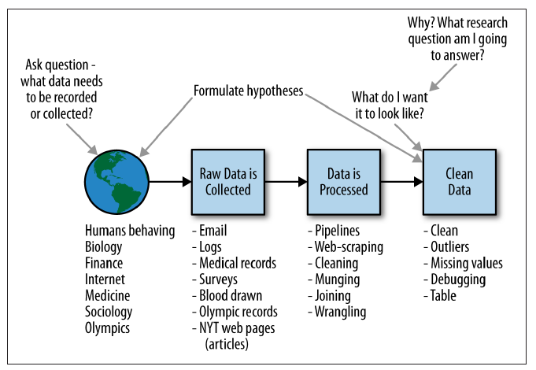
The data scientist is involved in every part of this process

Slide 43
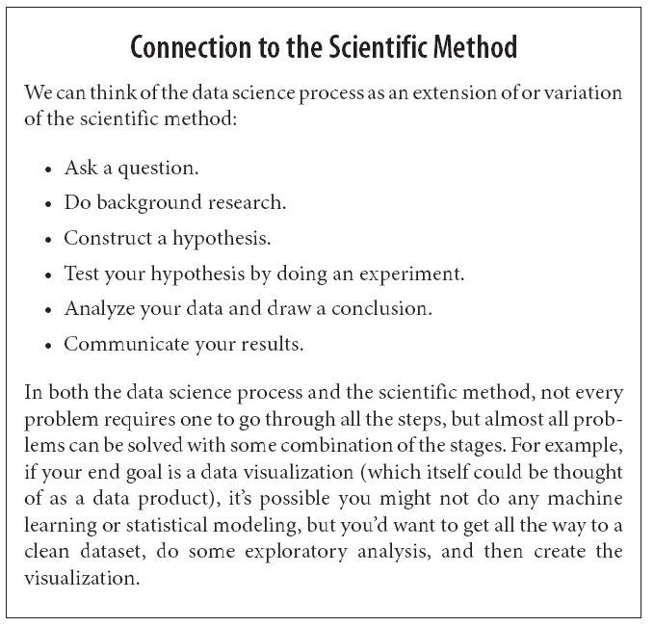
A Data Scientist's Real Job: Storytelling
http://www.bigdatarepublic.com/author.asp?section_id=2642&doc_id=266699&image_number=1

Slide 44
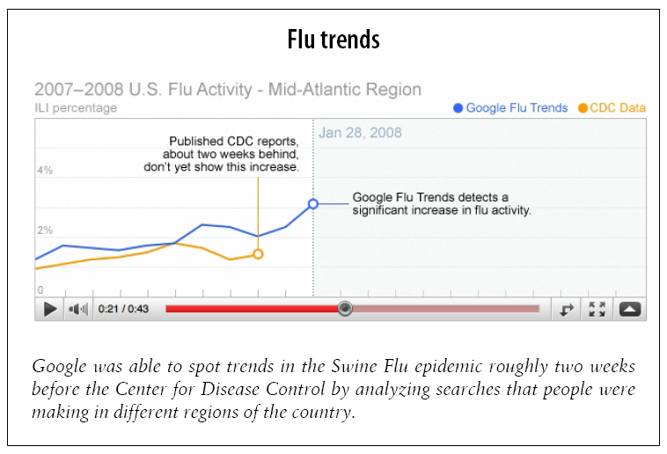
http://www.google.org/

Slide 45
Data collected from users provides added value.
Google isn’t the only company that knows how to use data.
Facebook and LinkedIn use patterns of friendship relationships to suggest other people you may know, or should know, with sometimes frightening accuracy.
Amazon saves your searches, correlates what you search for with what other users search for, and uses it to create surprisingly appropriate recommendations. These recommendations are “data products” that help to drive Amazon’s more traditional retail business.
https://www.facebook.com/
http://www.amazon.com/
https://www.linkedin.com/

Slide 46
How Google Collect Data! (free and sharing)
Google’s information-gathering channels
Searches (web, images, news, blogs, etc.)
Web crawling, Website analytics, Ad serving, Email, Twitter
Google Apps (Docs, Spreadsheets, Calendar, etc.)
Google Public Profiles, Orkut, Google Public DNS
The Google Chrome browser,
Google Finance
Youtube
Google Translate, Google Books, Google Reader
Feedburner
Google Maps and Google Earth
Your Contact Networks
Chrome OS
Google TV
Google Glass
http://www.google.com/analytics/apps/results?category=Data%20Collection all free!

Slide 47
Facebook Data Collections
If Facebook were a country, a conceit that founder Mark Zuckerberg has entertained in public, its 1.2 billions members would make it the second largest in the world. It would far outstrip any regime past or present in how intimately it records the lives of its citizens. Private conversations, family photos, and records of road trips, births, marriages, and deaths all stream into the company’s servers and lodge there. Facebook has collected the most extensive data set ever assembled on human social behavior. Some of your personal information is probably part of it.
Facebook information gethering
Data on minute user interactions with its content, such as how long a user’s cursor hovers over a certain part of its website, or whether a user’s newsfeed is visible at a given moment on the screen of his or her mobile phone
Demographic data—such as where a user lives or went to school—documents a user’s life beyond the network
Behavioral data—such as one’s circle of Facebook friends, or “likes”—is captured in real time on the network itself.
Uses your profile to target Ads
Uses your real world shopping to target Ads

Slide 48
How Linkedin Collect Leads: Connect, share ideas, and discover opportunities.
http://www.linkedin.com/static?key=advertising_leads_collection
http://www.linkedin.com/company/launch-leads
https://www.linkedin.com/ads/

Slide 49
Amazon Service and Data Collection
http://www.howstuffworks.com/amazon3.htm
http://aws.amazon.com/big-data/

Slide 50
Working with data at scale Making data tell its story
The ability to take data—to be able to understand it, to process it, to extract value from it, to visualize it, to communicate it—that’s going to be……..

Slide 51
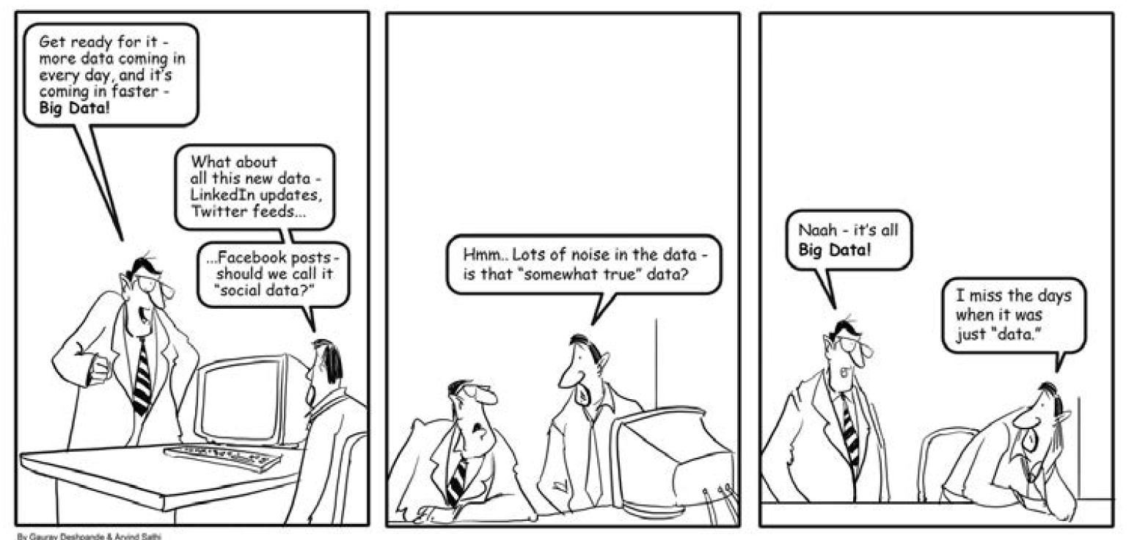

Slide 52
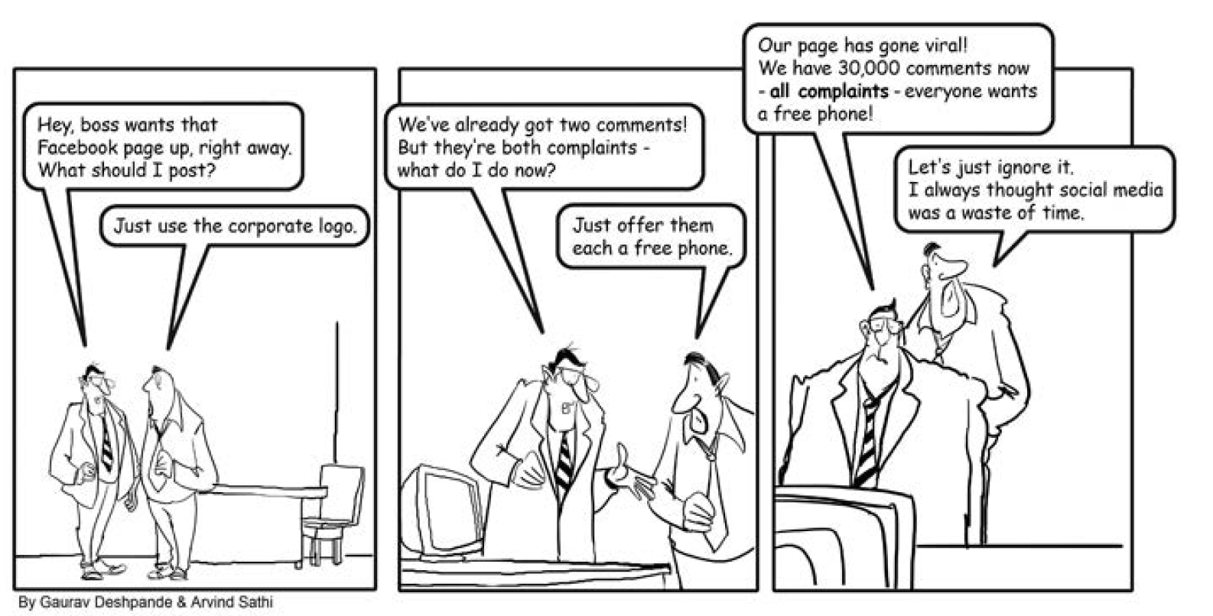

Slide 53
Others
http://www.ibmbigdatahub.com/
http://www.kaggle.com/
http://www.gopivotal.com/pivotal-data-labs
http://musicdatascience.com/
http://datasciencelondon.org/data-science-london/
http://www.data.gov/
https://nycopendata.socrata.com/
http://www.openstreetmap.org/about
http://sunlightfoundation.com/api/
http://getfoodgenius.com/
http://futurecitieshackathon.com/
http://datasciencehackathon.com/the-challenge/
http://www.splunk.com/?r=header

Slide 54
Cases
http://www.ibmbigdatahub.com/presentation/big-data-retail-examples-action
http://www.ibmbigdatahub.com/presentation/big-data-healthcare-case-study-brigham-womens-hospital
http://www.ibmbigdatahub.com/infographic/transforming-us-open-fan-experience

Slide 55
What’s Next in Five Year from Now!

Slide 56
“”
We never had a way to pull together enough data to do a real honest statistical set of predictions about critical issues.

Slide 57
But……
In five years, cities will be sentient. More buses will automatically run when there are more people to fill them. And doctors will use your DNA to tailor medical advice and smart computing to diagnose and plan treatment for big diseases like cancer not in months, but in minutes.
In five years, physical retail stores will understand your preferences and use augmented reality to bring the web to where shoppers can physically touch it. Sophisticated analytics will allow the classroom (not just the teacher) to track your progress in real time and tailor course work. Digital guardians will protect your accounts and identity, proactively flagging fraudulent use, while maintaining the privacy of your personal information.
In five years, we will have analytical models that allow us to actually change the future and prevent the traffic jam that would have happened if 20 minutes from now if we hadn't already rerouted lights to stop it.
http://www.fastcoexist.com/3023514/futurist-forum/do-you-know-what-life-will-be-like-in-5-years-ibms-top-scientist-does

Slide 59
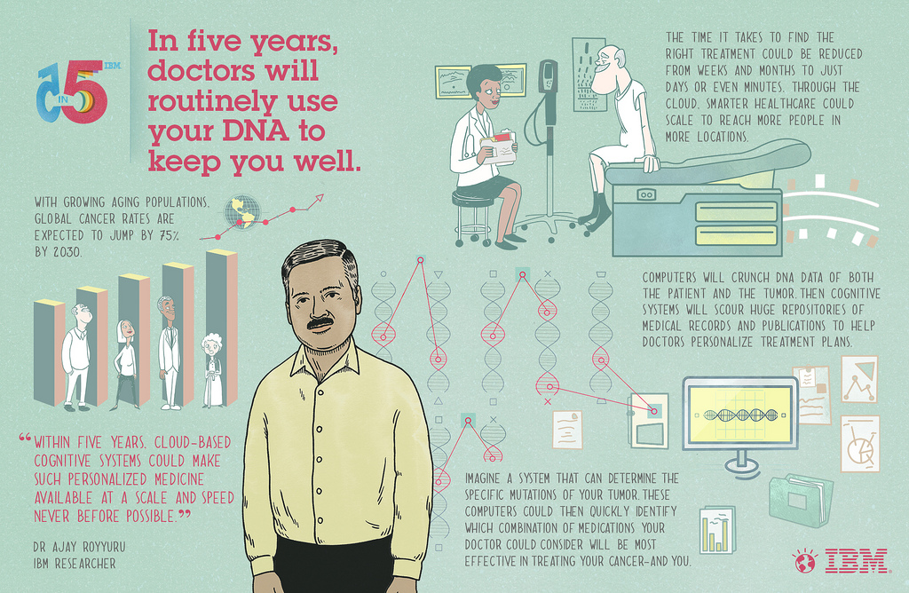

Slide 60
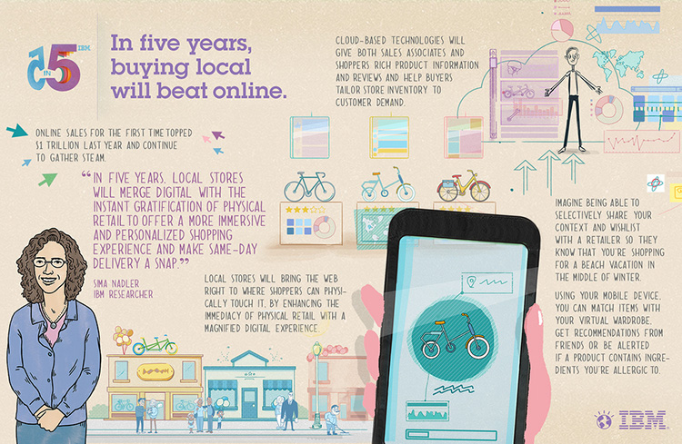

Slide 61
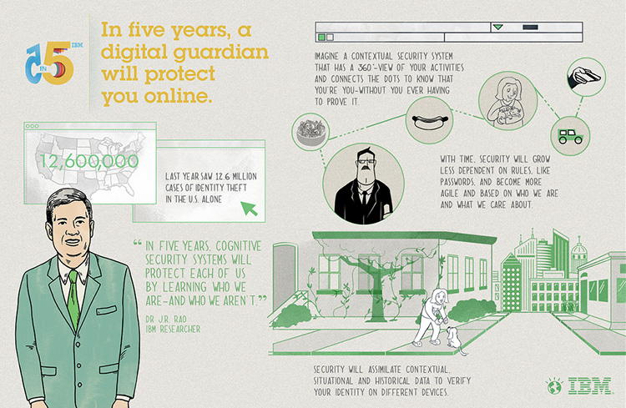

Slide 62
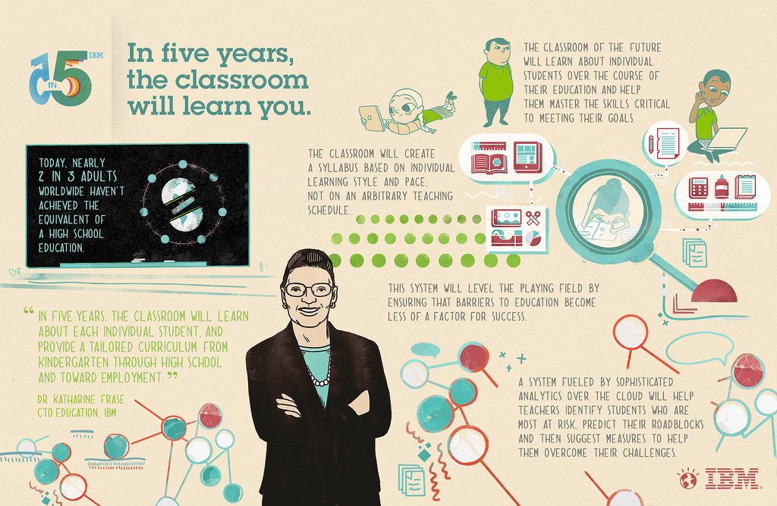

Slide 63
Foresight as a Service (FAAS): Using SmartMachines
http://asmarterplanet.com/blog/2013/10/ibms-accelerated-discovery-lab-where-serendipity-happens.html

Slide 64
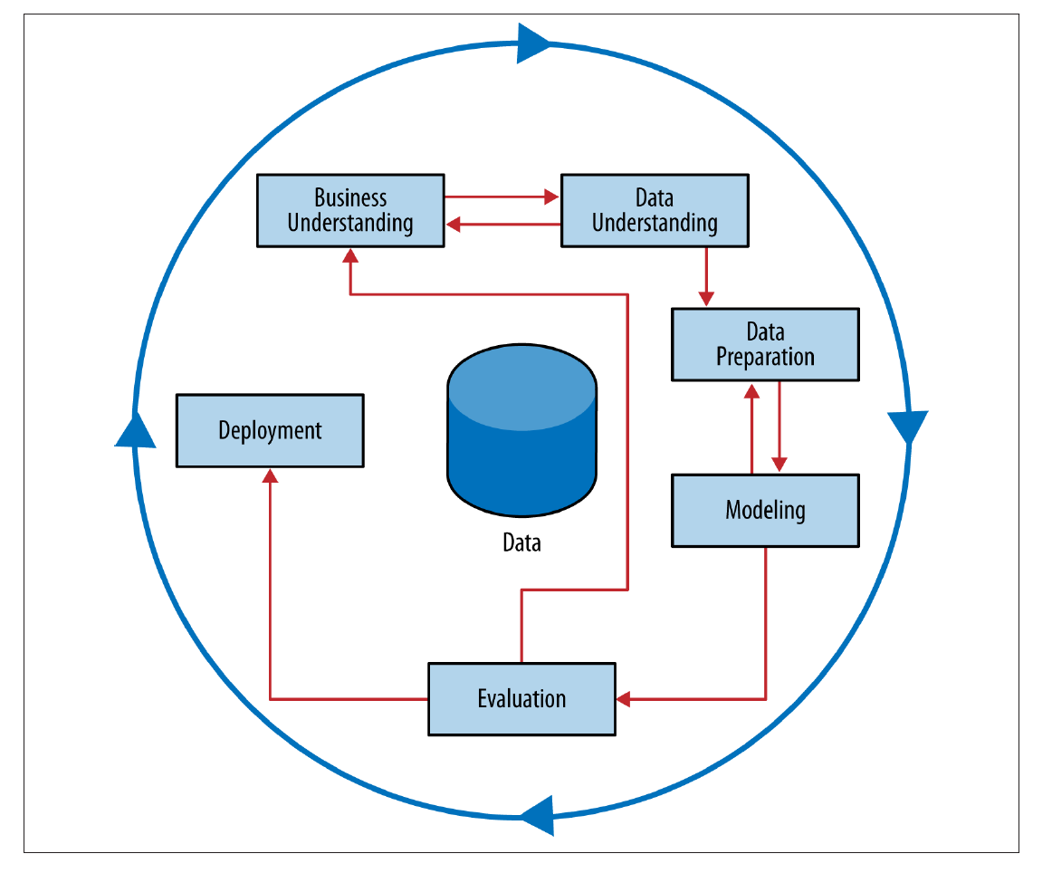
CRISP Data Mining Process

Slide 65
Example 1: Hurricane Frances
Hurricane Frances was on its way, barreling across the Caribbean, threatening a direct hit on Florida’s Atlantic coast. Residents made for higher ground, but far away, in Bentonville, Ark., executives at Wal-Mart Stores decided that the situation offered a great opportunity for one of their newest data-driven weapons … predictive technology.
A week ahead of the storm’s landfall, Linda M. Dillman, Wal-Mart’s chief information officer, pressed her staff to come up with forecasts based on what had happened when Hurricane Charley struck several weeks earlier. Backed by the trillions of bytes’ worth of shopper history that is stored in Wal-Mart’s data warehouse, she felt that the company could ‘start predicting what’s going to happen, instead of waiting for it to happen,’ as she put it. (Hays, 2004)

Slide 66
Example 1_ cont.
The New York Times (Hays, 2004) reported that: “… the experts mined the data and found that the stores would indeed need certain products —and not just the usual flashlights. ‘We didn’t know in the past that strawberry Pop-Tarts increase in sales, like seven times their normal sales rate, ahead of a hurricane,’ Ms. Dillman said in a recent interview. ‘And the pre-hurricane top-selling item was beer.’
Of course! What goes better with strawberry Pop-Tarts than a nice cold beer?

Slide 67
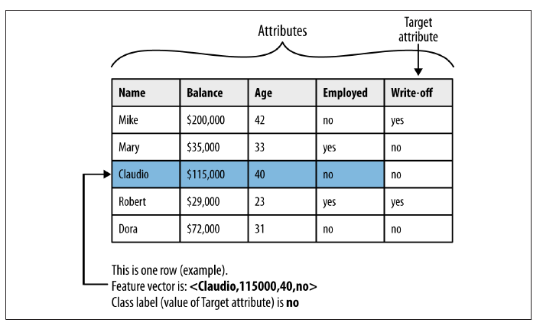
Models, Induction, and Prediction

Slide 68
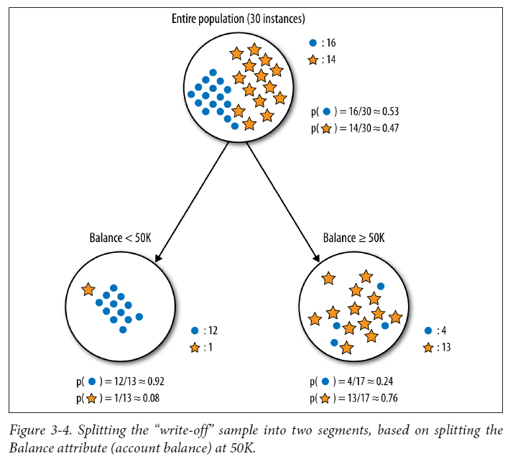
Purity of Sample after Segmentation

Slide 69
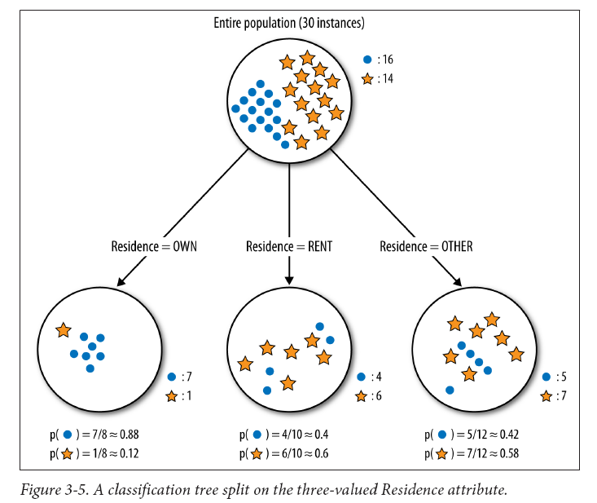
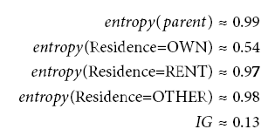
Purity of Sample after Segmentation

Slide 70
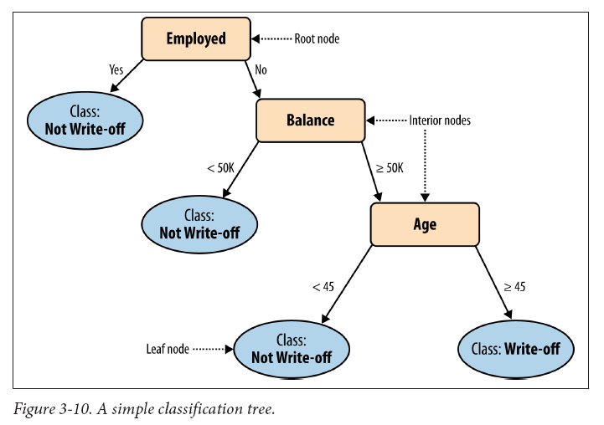

Slide 71
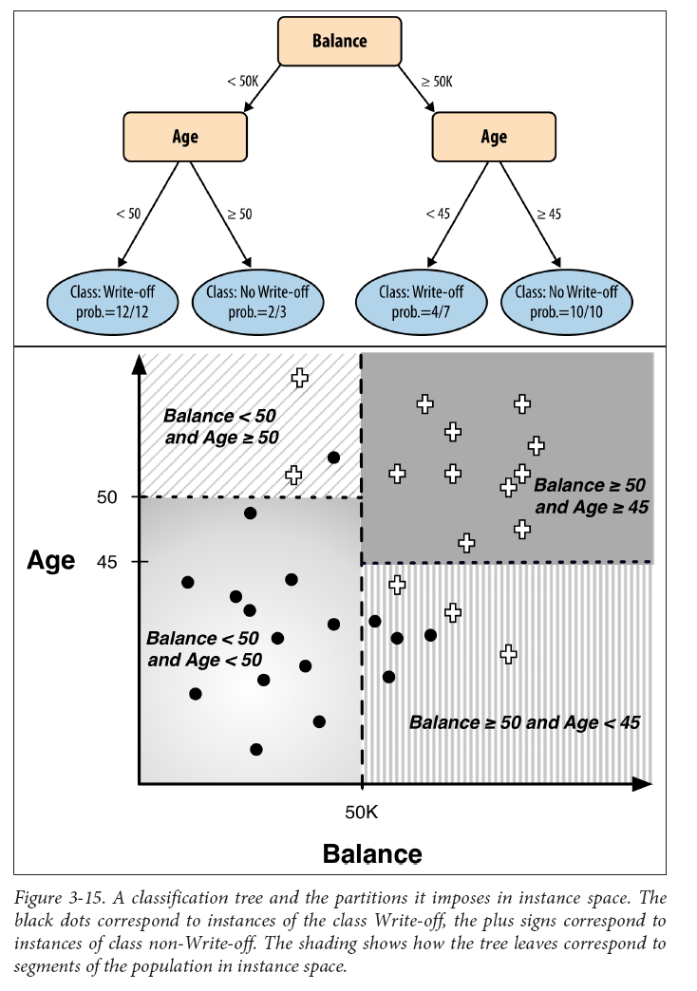
Purity of Sample after Segmentation

Slide 72
Example 2: Predicting Customer Churn
Assume you just landed a great analytical job with MegaTelCo, one of the largest telecommunication firms in the United States. They are having a major problem with customer retention in their wireless business. In the mid-Atlantic region, 20% of cell phone customers leave when their contracts expire, and it is getting increasingly difficult to acquire new customers. Since the cell phone market is now saturated, the huge growth in the wireless market has tapered off. Communications companies are now engaged in battles to attract each other’s customers while retaining their own. Customers switching from one company to another is called churn, and it is expensive all around: one company must spend on incentives to attract a customer while another company loses revenue when the customer departs.
You have been called in to help understand the problem and to devise a solution. Attracting new customers is much more expensive than retaining existing ones, so a good deal of marketing budget is allocated to prevent churn. Marketing has already designed a special retention offer. Your task is to devise a precise, step-by-step plan for how the data science team should use MegaTelCo’s vast data resources to decide which customers should be offered the special retention deal prior to the expiration of their contracts.
Think carefully about what data you might use and how they would be used. Specifically, how should MegaTelCo choose a set of customers to receive their offer in order to best reduce churn for a particular incentive budget?

Slide 73
Example 2_ cont.
What variable gives us the most information about the future churn rate of the population?
Being a professional? Age? Place of residence?
Income? Number of complaints to customer service? Amount of overage charges?

Slide 74
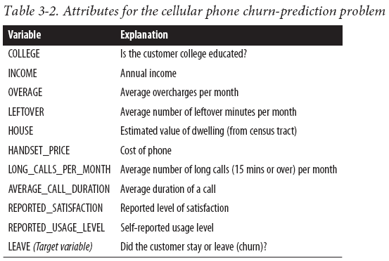
Addressing the Churn Problem with Tree Induction
For this example, we have a historical data set of 20,000 customers. At the point of collecting the data, each customer either had stayed with the company or had left (churned). Each customer is described by the variables listed in Table

Slide 75
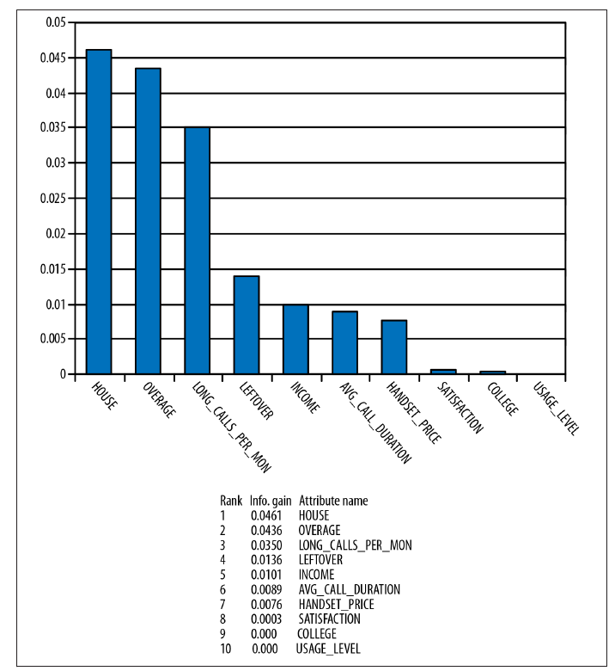
Churn attributes from Table 3-2 ranked by information gain

Slide 76
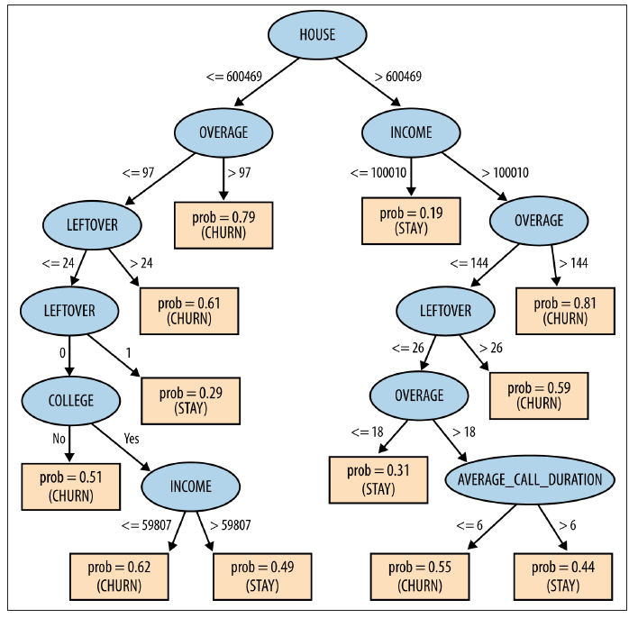
Classification tree learned from the cellular phone churn data

Slide 77
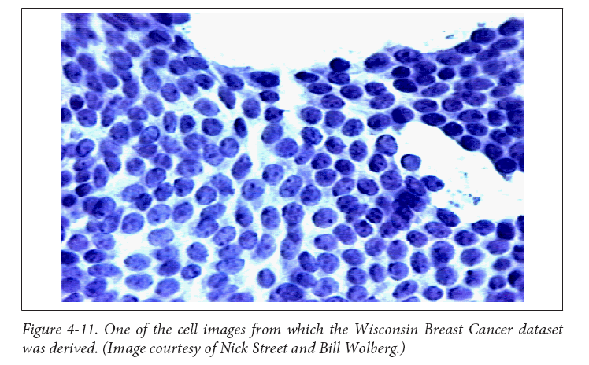
Example 3

Slide 78
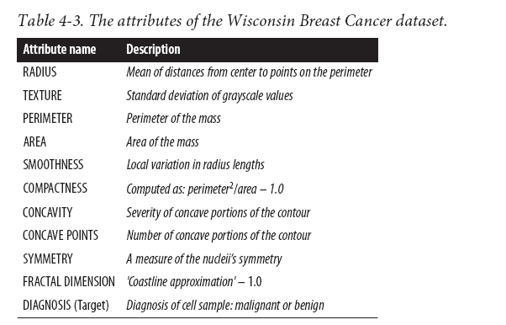
Example 3 _cont.

Slide 79
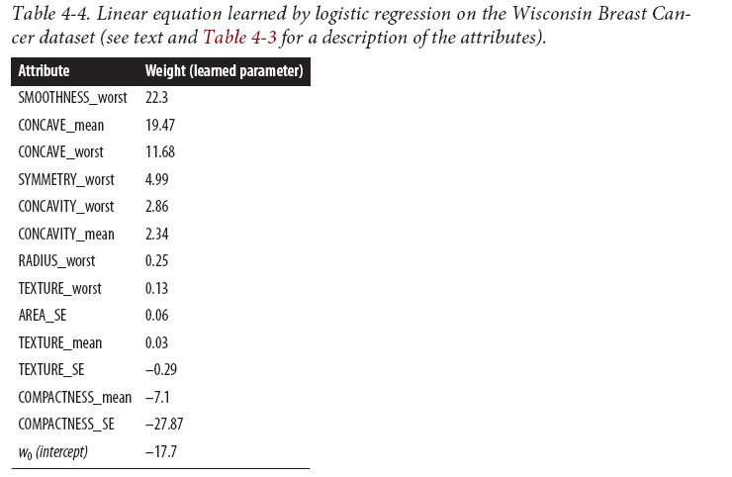
Example 3 _cont.
Table 4-4 shows the linear model learned by logistic regression to predict benign versus malignant for this dataset. Specifically, it shows the nonzero weights ordered from highest to lowest. The performance of this model is quite good—it makes only six mistakes on the entire dataset, yielding an accuracy of about 98.9% (the percentage of the instances that the model classifies correctly).

Slide 80
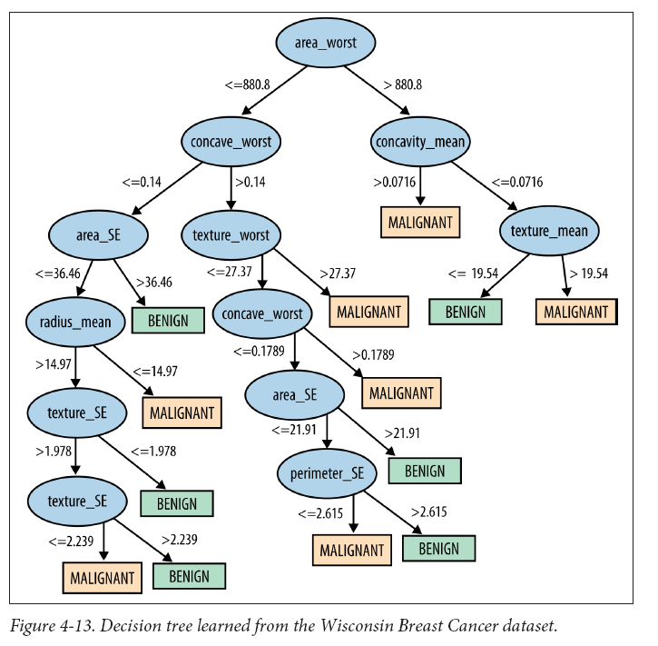
Example 3 _cont.
For comparison, a classification tree was learned from the
same dataset . The resulting tree is shown in Figure 4-13. The tree has 25 nodes altogether, with 13 leaf nodes. Recall that this means that the tree model partitions the instances into 13 segments. The classification tree’s
accuracy is 99.1%, slightly higher than that of logistic regression.

Slide 81
Do you trust these models?

Slide 82
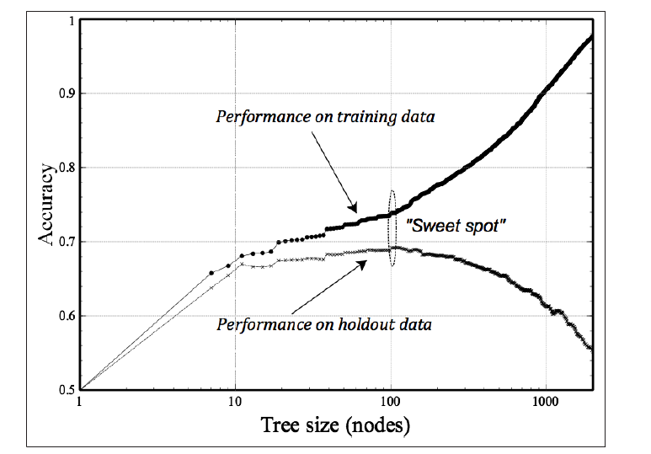
A typical fitting graph for tree induction

Slide 83
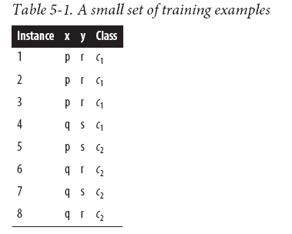

Slide 84
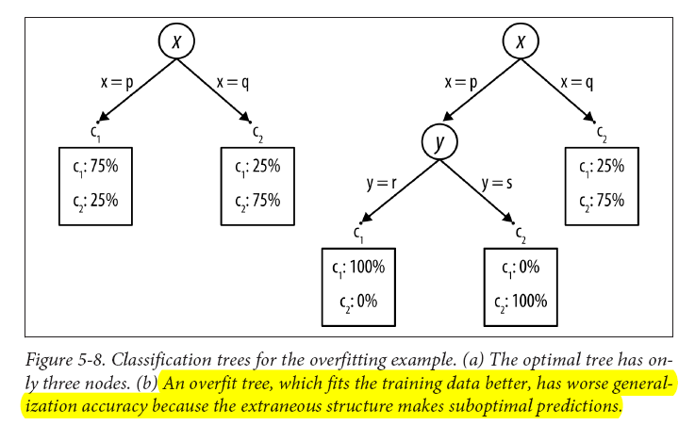
Table 5-1 cont.

Slide 85
Similarity, Neighbors, and Clusters
Modern retailers such as Amazon and Netflix use similarity to provide recommendations of similar products or from similar people. Whenever you see statements like “People who like X also like Y” or “Customers with your browsing history have also looked at …” similarity is being applied.
Advertisers often want to serve online ads to consumers who are similar to their current good customers.
A doctor may reason about a new difficult case by recalling a similar case (either treated personally or documented in a journal) and its diagnosis.
A lawyer often argues cases by citing legal precedents, which are similar historical cases whose dispositions were previously judged and entered into the legal casebook.
http://www.amazon.com/
https://signup.netflix.com/global

Slide 86
Example: Whiskey Analytics
One of us likes single malt Scotch whiskey. If you’ve had more than one or two, you realize that there is a lot of variation among the hundreds of different single malts. When Daniel finds a single malt he really likes, he wants to find other similar ones—both because he likes to explore the “space” of single malts, but also because any given liquor store or restaurant only has a limited selection.
He wants to be able to pick one he’ll really like. For example, the other evening a dining companion recommended trying the single malt “Bunnahabhain.”2 It was unusual and very good. Out of all the many single malts, how could Daniel find other ones like that?

Slide 87
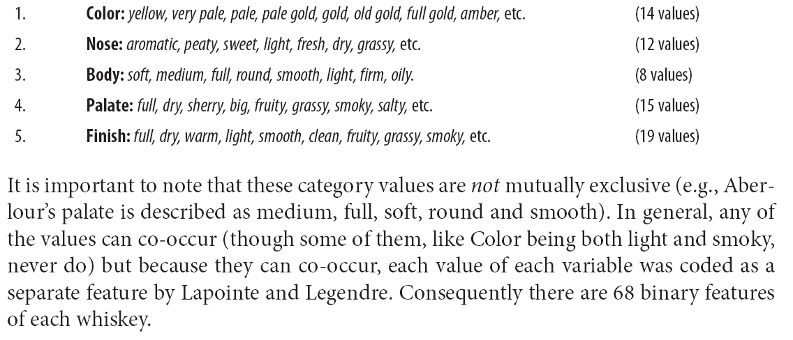
Example: Whiskey Analytics _ cont.
Define five general whiskey attributes, each with many possible values:

Slide 88
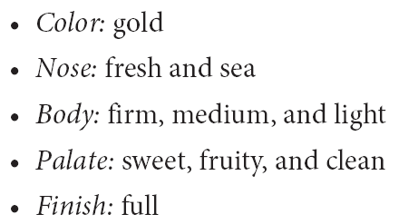
Cont.
Daniel likes Bunnahabhain, so we can use Lapointe and Legendre’s representation of whiskeys with Euclidean distance to find similar ones for him. For reference, here is their description of Bunnahabhain:

Slide 89
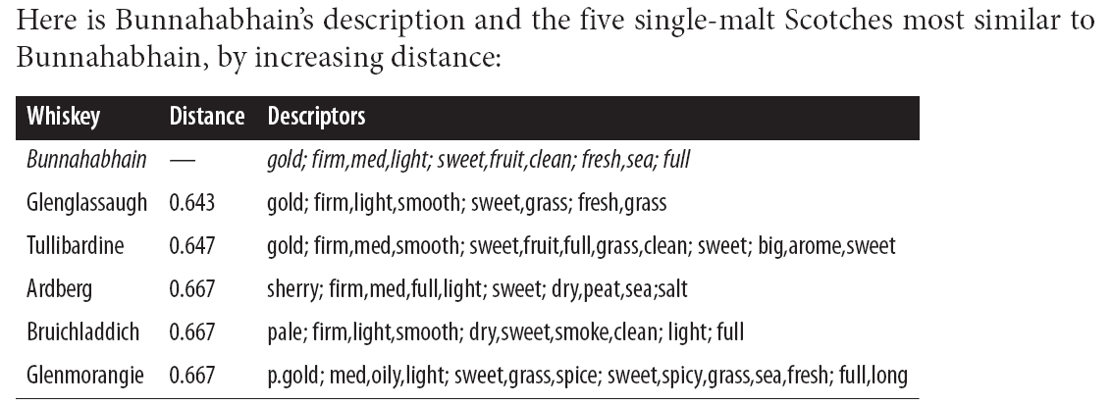
Cont.

Slide 90
Cont. : or using clustering by taste
We may simply want to understand the natural groupings by taste— because we want to understand our “business,” which might lead to a better product or service.
Let’s say that we run a small shop in a well-to-do neighborhood, and as part of our business strategy we want to be known as the place to go for single-malt scotch whiskeys. We may not be able to have the largest selection, given our limited space and ability to invest in inventory, but we might choose a strategy of having a broad and eclectic collection.
If we understood how the single malts grouped by taste, we could (for example) choose from each taste group a popular member and a lesser-known member. Or an expensive member and a more affordable member. Each of these is based on having a good understanding of how the whiskeys group by taste.

Slide 91
Cont. : Hierarchical clustering by taste

Slide 92
Match.com (filter, sort, rank, match)
http://www.businessinsider.com/being-good-at-math-is-not-about-natural-ability-2013-11

Slide 93
Disruptive Risk Management Innovation
CXO^{N} (1987 Innovation)
a type of structured asset-backed security (ABS) with multiple "tranches" that are issued by special purpose entities and collateralized by debt obligations including bonds and loans. Each tranche offers a varying degree of risk and return so as to meet investor demand. CDOs' value and payments are derived from a portfolio of fixed-income underlying assets. CDO securities are split into different risk classes, or tranches, whereby "senior" tranches are considered the safest securities. Interest and principal payments are made in order of seniority, so that junior tranches offer higher coupon payments (and interest rates) or lower prices to compensate for additional default risk.
CDS (1990 Innovation)
is similar to a traditional insurance policy, in as much as it obliges the seller of the CDS to compensate the buyer in the event of loan default. Generally, the agreement is that in the event of default the buyer of the CDS receives money (usually the face value of the loan), and the seller of the CDS receives the defaulted loan (and with it the right to recover the loan at some later time). However, the difference between a traditional insurance policy and a CDS is that anyone can purchase one, even buyers who do not hold the loan instrument and may have no direct "insurable interest" in the loan.

Slide 94
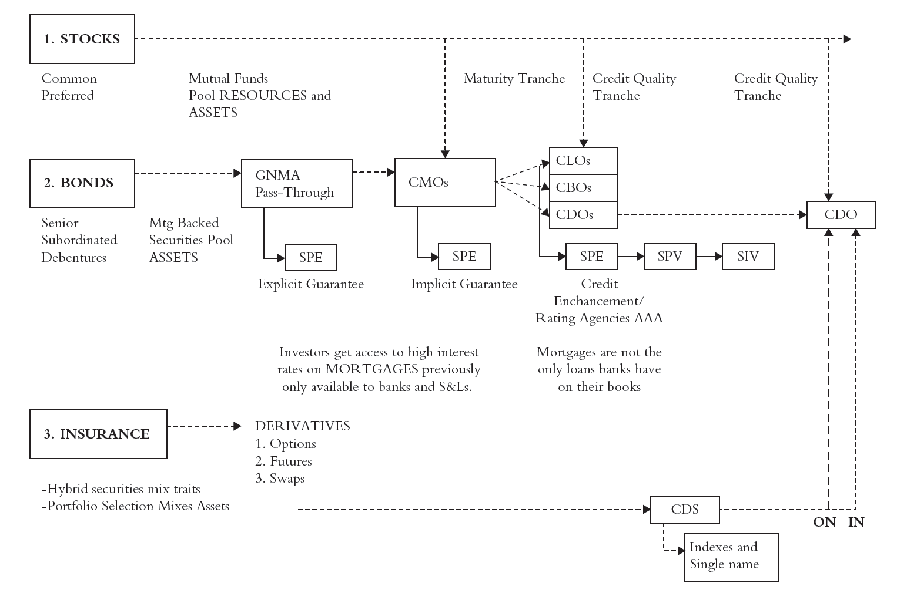
Complete Financial Origami Diagram
L: Loan, B: Bond,
D: Debt, S: Synthetic
SPE(special purpose entity): to ensure that the holders of the mortgage-back securities have the first priority right to receive payments on the loans, these loans need to be legally separated from the other obligations of the bank. This is done by creating an SPE, and then transferring the loans from the bank to the SPE.
SPV(special purpose vehicle)
SPE(special purpose entity)
SPE(special investment vehicle)
Financial Engineering Innovations!
QUANT always win regardless what!

Slide 95
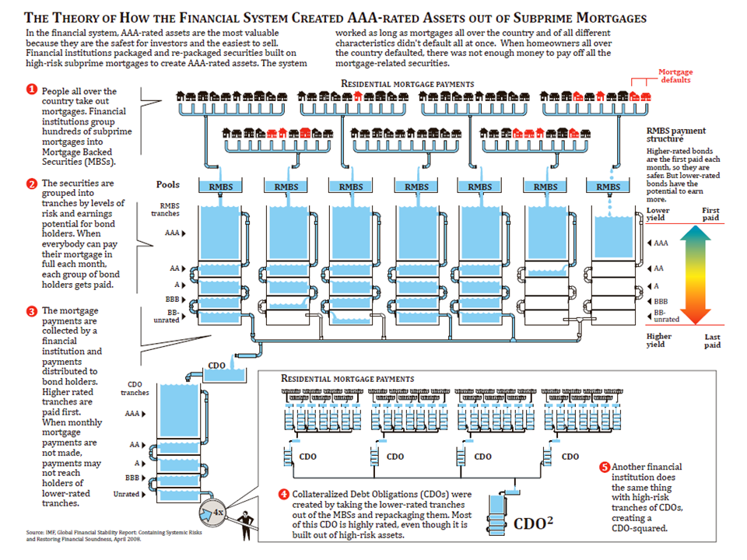
2007: US$ 481.6 Billion
2010: US$ 8 Billion

Slide 96
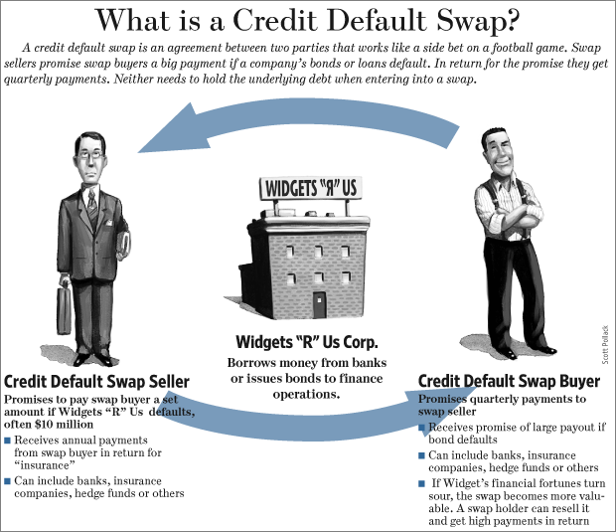
CDS
2007: US$ 62.2 Trillion
2010: US$ 26.3 Trillion
The European Parliament has approved a ban on this kind of CDS, effective starting 1st December 2011.

Slide 97
2007-2008 Financial Crises
CDOs are collections of mortgage debt that are broken into different pools, or “tranches,” some of which are supposed to be quite risky and others of which are rated as almost completely safe
The ratings agencies had given their AAA rating, normally reserved for a handful of the world’s most solvent governments and best-run businesses, to thousands of mortgage-backed securities, financial instruments that allowed investors to bet on the likelihood of someone else defaulting on their home. The ratings issued by these companies are quite explicitly meant to be predictions: estimates of the likelihood that a piece of debt will go into default. Standard & Poor’s told investors, for instance, that when it rated a particularly complex type of security known as a collateralized debt obligation (CDO) at AAA, there was only a 0.12 percent probability—about 1 chance in 850—that it would fail to pay out over the next five years. This supposedly made it as safe as a AAA-rated corporate bond and safer than S&P now assumes U.S. Treasury bonds to be. The ratings agencies do not grade on a curve.
In fact, around 28 percent of the AAA-rated CDOs defaulted, according to S&P’s internal figures. (Some independent estimates are even higher.) That means that the actual default rates for CDOs were more than two hundred times higher than S&P had predicted

Slide 98
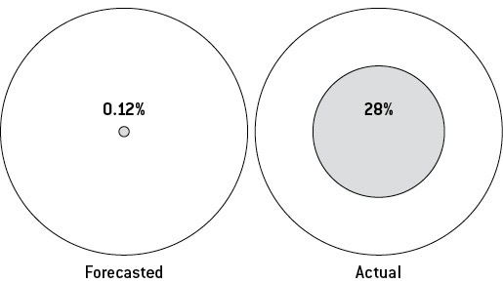
FORECASTED AND ACTUAL 5-YEAR DEFAULT RATES FOR AAA-RATED CDO TRANCHES
2008 Financial Crisis: might just be an failure prediction of CDO default

Slide 99
Machine Learning
https://class.coursera.org/ml-004/lecture/index

Slide 100
Unsupervised Learning
https://class.coursera.org/ml-004/lecture/4

Slide 101
Supervised Learning
https://class.coursera.org/ml-004/lecture/3

