Slide 1
FINTECH: Supply Chain Finance (SCF)
Daniel Hao Tien Lee
http://danieleewww.yolasite.com/2020-mgb070.php
danieleewww@gmail.com

Slide 2
Reference
http://scfacademy.org/

Slide 3
Supply Chain Finance (SCF)
Supply chain finance (also known as supplier finance), is a set of solutions that improves cash flow by allowing large corporate buying businesses to reduce their suppliers payment terms through a banking facility which is based on the large buyer’s balance sheet credit rating- it provides the option for SME suppliers to get paid early. The purpose of the scheme is to borrow the credit rating of the larger buying businesses balance sheet for the benefit of the smaller supplier’s cash flow in order to tackle the issue of protracted payment and improve efficiency of working capital. Large corporates across different sectors have introduced supply chain finance programmes in order to improve suppliers’ cash flow while maintaining their own working funds .

Slide 4
What is the purpose of SCF for SMEs
get paid earlier
secure cash flow
improve stability of working capital
secure the supply chain
improve R&D, protect jobs, boost innovation and increase investment in training

Slide 5
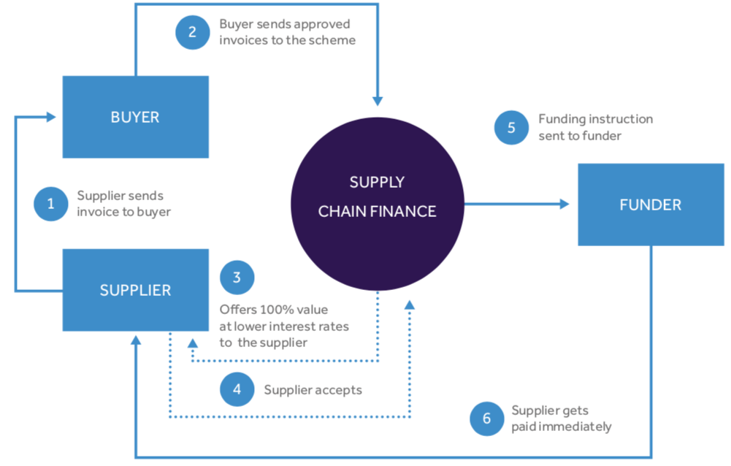
How does SCF work?
http://www.supplierfinancing.org/scf-scheme-uk/

Slide 6
What are the risks?
Product risks – are the risks seller accepts i.e. performance warranties, agreed maintenance, service obligations. The buyer must contemplate the risks of potential external factors for example negligence during production or extreme weather during transport storage an, delivery and installation, which could lead to disputes between the buyer and the supplier. It is therefore crucial for the supplier to word the contract correctly as any plant/equipment/materials changes may have an impact on compensation provisions.
Manufacturing risks – are the risks arising out of custom-made plant/equipment/materials. Usually the supplier covers the costs of alterations to the product until the buyer sees fit, because the product cannot be resold to other buyers. These potential risks should be addressed earlier, which means the buyer has to enter payment commitments at even earlier stage (part-payment and separate guarantees may be offered to off-set these risks in the contract).
Transport risks – risks related to the movement of the plant/equipment/materials from one party to another. An insurance scheme outlining the terms of delivery should be considered, to cover the changes in routes or transportation.
Currency risks – a risk to the fluctuation of the currency value, i.e. party based in another country agrees to purchase plant/equipment/materials should consider currency value and make provisions in their contract accordingly.

Slide 7
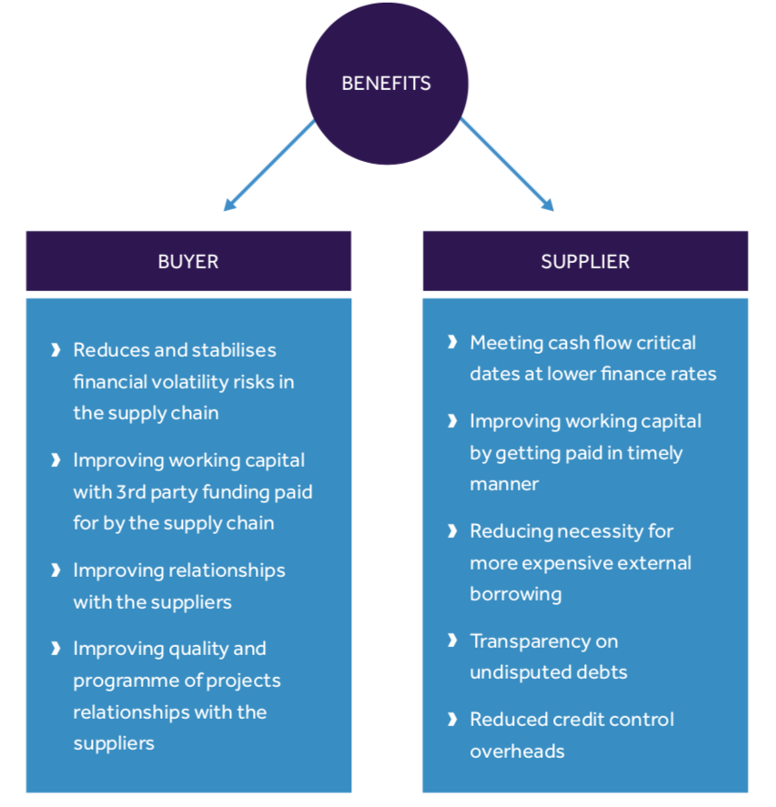
What are benefits?

Slide 8
What SCF is Not!

Slide 9
What SCF is Not!
It is not a loan. Supply chain finance is an extension of the buyer’s accounts payable and is not considered financial debt. For the supplier, it represents a non-recourse, true sale of receivables. There is no lending on either side of the buyer/supplier equation, which means there is no impact to balance sheets.
It is not dynamic discounting or an early payment program. Early payment programs, such as dynamic discounting, are buyer-initiated programs where buyers offer suppliers earlier payments in return for discounts on their invoices. Unlike supply chain finance, buyers are seeking to lower their cost of goods, not to improve their cash flow. Dynamic discounting and early payment programs often turn out to be expensive for both suppliers (who are getting paid less than agreed upon) and buyers who tie up their own cash to fund the programs.
It is not factoring. Factoring enables a supplier to sell its invoices to a factoring agent (in most cases, a financial institution) in return for earlier, but partial, payment. Suppliers initiate the arrangement without the buyer’s involvement. Thus factoring is typically much more expensive than buyer-initiated supply chain finance. Also, suppliers trade “all or nothing” meaning they have no choice to participate from month-to-month to the degree that their cash flow needs dictate. Finally, most factoring programs are recourse loans, meaning if a supplier has received payment against an invoice that the buyer subsequently does not pay, the lender has recourse to claw back the funds.

Slide 10
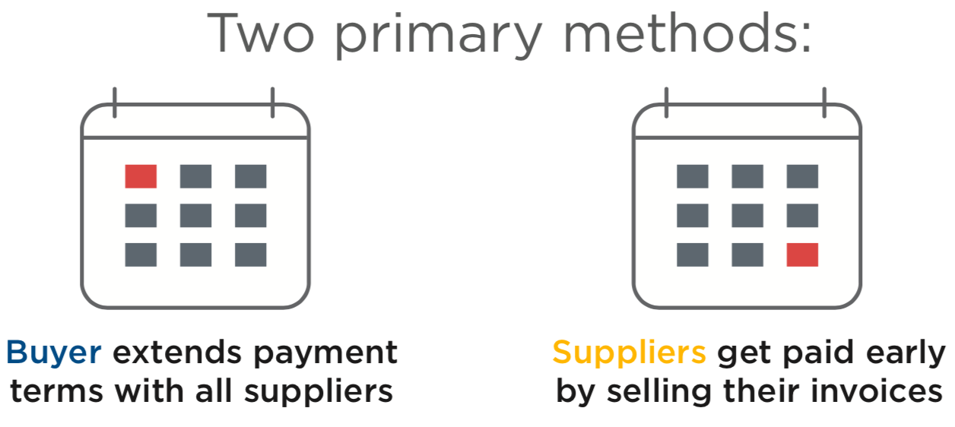
SCF: How it works

Slide 11
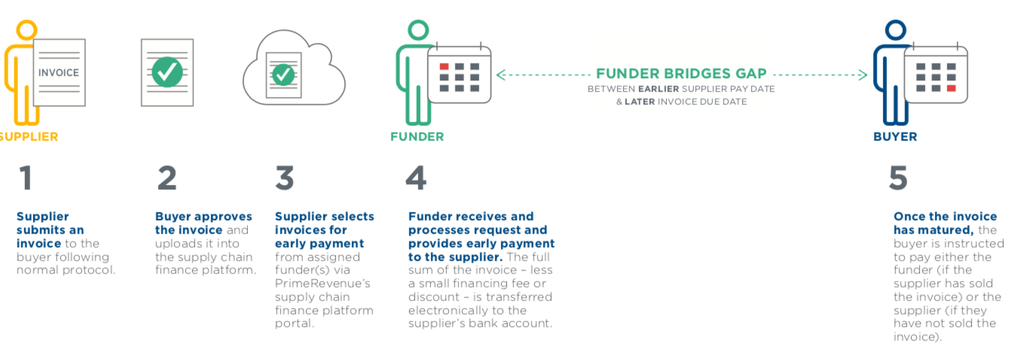
SCF Process-following onboarding, it boils down to these five simple steps:

Slide 12
FinTech in Business-to-Business
Supply Chain Finance (SCF)
Supplier Onboarding
Reverse Factoring and Credit
Blockchain enabling SCF
Dynamic Discounting
Distributed SCF

Slide 13
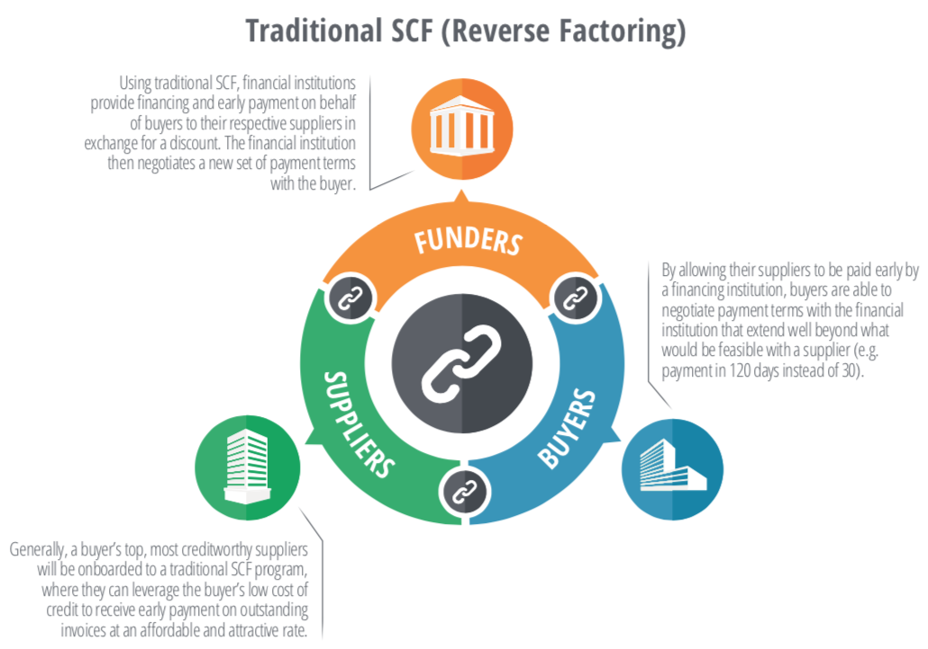
Traditional Reverse Factoring
https://billibfinance.com/wp-content/uploads/2018/01/2017-SCF-FinTech-Analyst-Report-StrategicTreasurer.pdf

Slide 14
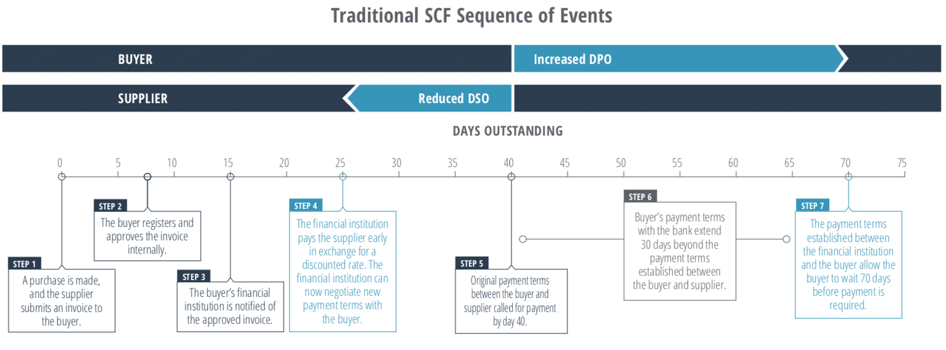
Traditional SCF programs tend to be most successful for large corporate buyers who would prefer to hold onto their cash for longer in order to meet short-term liabilities and cash outflows or to generate greater returns on cash through investments in the market.

Slide 15
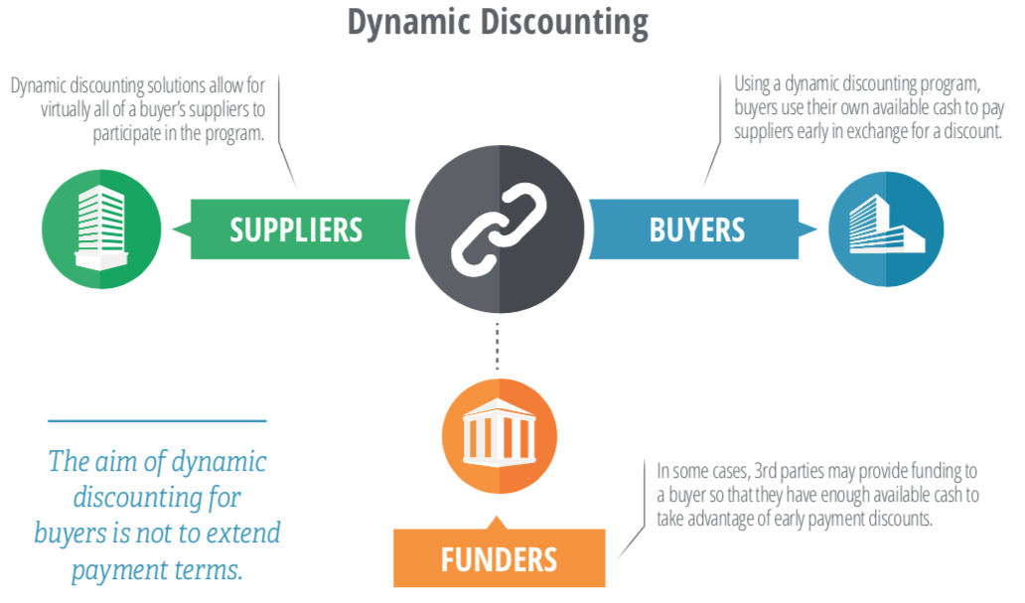
Technology-Driven Dynamic Discounting
https://billibfinance.com/wp-content/uploads/2018/01/2017-SCF-FinTech-Analyst-Report-StrategicTreasurer.pdf

Slide 16
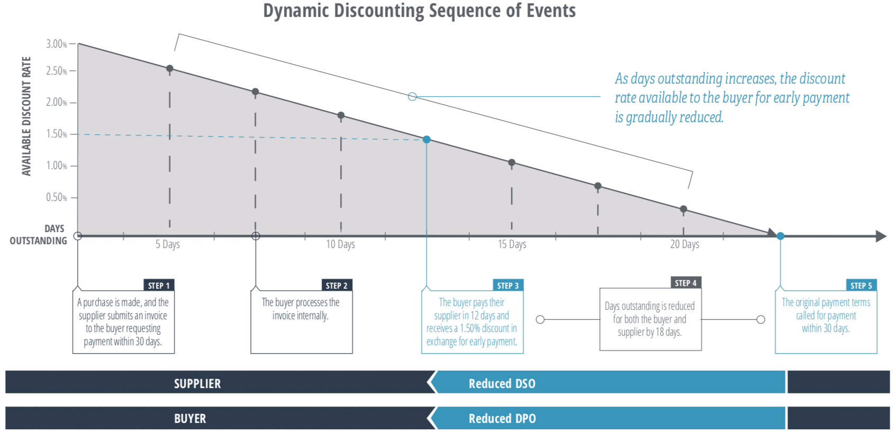
Many of the fintech firms that offer dynamic discounting solutions report invoice discount rates that average anywhere from 4-7% over the course of payment terms. Given that this form of return is practically risk-free, the ability for buyers to inject liquidity into their supply chain and receive high returns is an incredibly valuable opportunity.

Slide 17
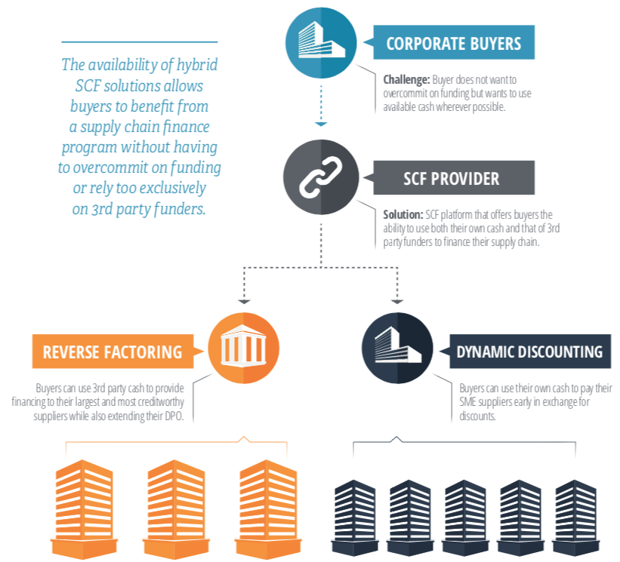
Hybrid SCF

Slide 19
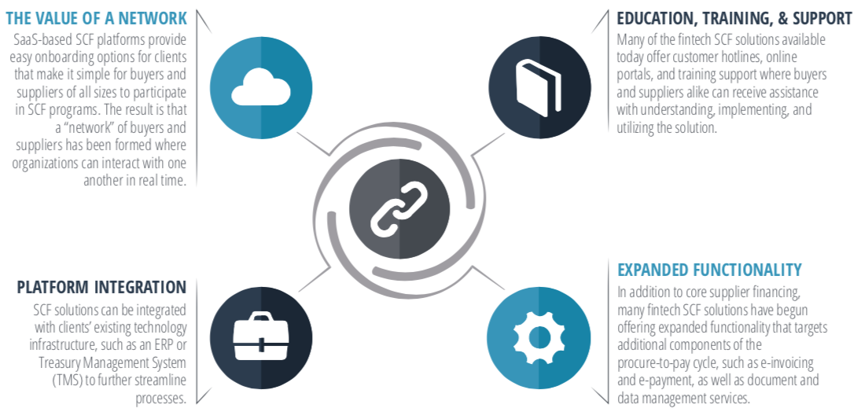
Technological Benefits: SaaS-Based SCF

Slide 20
URICA SCF Example

Slide 21
globally, supply chains face an uphill battle where debt is the Achilles' heal
it’s a structural fault in the global market
large businesses need to define and control their credit terms in line with their business objectives, this often leads to the need for extended credit terms
mid-size businesses are forced to pass through the pressure and remain cash neutral
small businesses are the largest net providers of credit into the system, and are often forced into using debt products, such as invoice factoring to shoulder the supply chain
 The entire European economy is negatively affected by late payment…
Each year across Europe thousands of small and medium-sized enterprises go bankrupt waiting for their invoices to be paid. Jobs are lost and entrepreneurship is stifled…
– The European late payment directive
growth
credit flow
failure ≈ (growth – credit) x debt²
debt

Slide 22
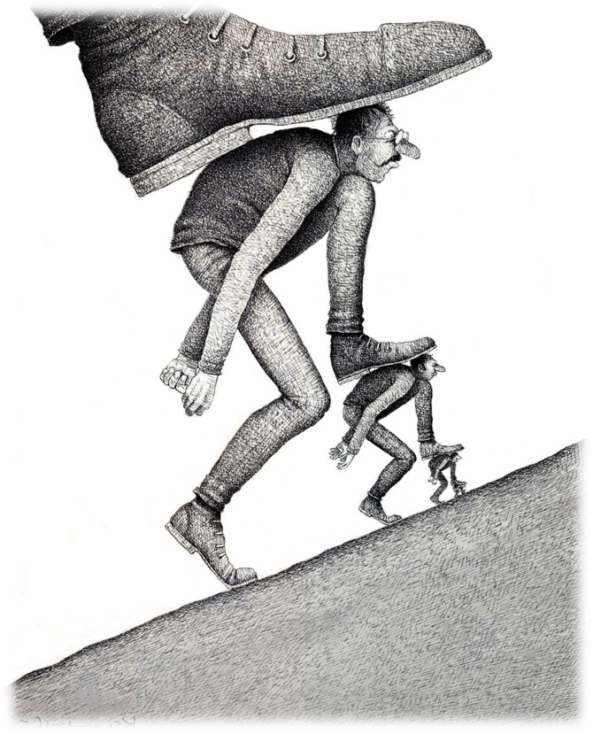
vision – “OEMs flush cash through their supply chains… solving late payment or debt”
tier 1, tier 2 and small businesses would be released from debt and late payments and flourish
supply chains become robust, leading to greater reliability and certainty of supply
entrepreneurs would be fuelled to win
global trade would boom
larger businesses would recognise their corporate social responsibility
and, inequality in society would level
credit flow
growth!
prosperity ≈ fintech x (growth + cash) – debt
where debt ≈ zero
Debt
business on better terms

Slide 23
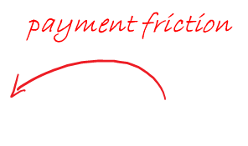
supply chains face pressure when buying and selling
payment friction
y sells
x buys
y buys
z sells
payment friction

Slide 24
URICA is the solution for both
y sells
 the way to pay…
x buys
…and be paid 
y buys
z sells

Slide 25
mission – fintech connectivity & networking, an holistic solution
an intuitu personae collaboration of the best in breed on their “own turf” where the total is greater than the sum of the parts
big data, rating, underwriting
& global collection
UK distribution
& financing
credibility
& finance
global distribution
& underwriting expertise

Slide 26
supply chain finance for smes
the new way
materials
distribution
retail
assembly
components
financing the integral supply chain
Invoice discounting for the masses
Vertical supply chain finance – reserved for investment grade businesses
 a channel of distribution beginning with the supplier of materials or components, extending through a manufacturing process to the distributor and retailer, and ultimately to the consumer
the old way

Slide 27
how it works across your supply chain
YOU
Tier 1 Supplier
Tier 2 Supplier
Tier 2 Supplier
SME Supplier
SME Supplier
SME Supplier
SME Supplier
Tier 1 Supplier
Tier 2 Supplier
SME Supplier
SME Supplier
SME Supplier
Tier 2 Supplier
SME Supplier
URICA provides early payment across the complete supply chain, giving sellers immediate or prompt payment, and buyers extended credit terms
Cash moves through the whole supply chain, removing the need for debt at all levels
Removes the need for SMEs to factor customers outside your supply chain, therefore removing the risk of external problems affecting the strength of your supply chain
We are not lending you the funds, we are using UK Government funds unsecured and risk free, this means your cash is free from commitment
Buyers receive 3% cash back on the URICA funds in use, and up to 90 days credit
Suppliers can be paid as early as day 1
Payments are non-recourse cash, and no security is required from customers or suppliers
Your whole supply chain could sign up in less than 24 hours

