Slide 1
FINTECH: Crowdfunding
Daniel Hao Tien Lee
http://danieleewww.yolasite.com/2020-mgb070.php
danieleewww@gmail.com

Slide 2
Crowdfunding
The New Method of Raising Funds for new businesses & start-ups

Slide 3
Crowdfunding
Do you know how it works?
Know someone who has crowdfunded?
Received a ‘reward’?
Donated to a crowdfunding campaign?
Run a crowdfunding campaign?
Understand the different types of crowdfunding
Are you considering starting a crowdfunding campaign?

Slide 4
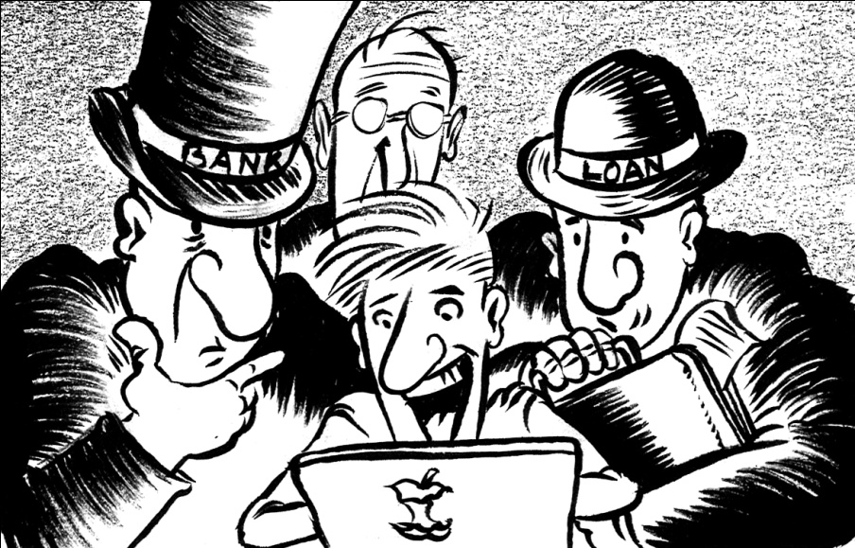
Crowdfunding Models
Donation-based crowdfunding is a way to source money for a project by asking a large number of contributors to donate a small amount to it.

Slide 5
Types of Crowdfunding
Donation-based crowdfunding is a way to source money for a project by asking a large number of contributors to donate a small amount to it.
Reward-based crowdfunding involves setting varying levels of rewards that correspond to pledge amounts. A standard rewards campaign offers at least three levels of pledges/rewards.
Debt-based crowdfunding also called as micro-financing or peer-to-peer (P2P) lending: start-ups borrow money from a number of people online and pay them back after the project is finished.

Slide 6
Lending Crowdfunding: allows entrepreneurs to raise funds in the form of loans that they will pay back to the lenders over a pre-determined timeline with a set interest rate
Equity Crowdfunding is a process in which people invest in an unlisted company in exchange for equitable rights in the form of shares in that company

Slide 7
The rise of the platforms

Slide 8
Kickstarter
Kickstarter is the world’s largest crowdfunding platform
Kickstarter’s mission is to “help bring creative projects to life”
Since Kickstarter’s launch in 2009, 5.1 million people have pledged $861 million, funding 51,000 creative projects
Such as films, music, stage shows, comics, journalism, video games, and food-related projects
People who back Kickstarter projects are offered tangible rewards and unique experiences in exchange for their pledges
Backers of an effort to make a book or film often get a copy of the finished work
A bigger pledge to a film project might get a backer into the premiere
Kickstarter’s model traces its roots to the subscription model of arts patronage, where artists would go directly to their audiences to fund their work

Slide 9
Story Video
Platforms
Make sure to Include:
Project Details
Successful Campaigns
compelling idea or message
Focus on ‘why’ and not on ‘what’
Funded by the general public
25 – 40% is funded by first, second and third degree of connections
Rewards Images
9

Slide 10
Indiegogo
KickStarter
Major CF Platforms
GoFundMe
Kiva
10

Slide 11
Psychological attributes of a crowd
Unconsciousness, impulsivity
Sensitivity and sensuality
Imagination up to hallucinations
Absence of discourse or reasoning
Аccepting or not accepting idea as a whole
Suggestibility
Irresponsibility
Changeability

Slide 12
Psychological laws of crowd life cycle
Circular reaction (mutual emotional
infection)
Common emotional condition and object of attention (event)
Readiness to react and act immediately
Genesis of new object of attention (interpreted event)
Activation (usually by leader)

Slide 13
Why do people bring their money to indefinite projects?
1
They connect to the greater purpose of the campaign, such as being a part of an entrepreneurial community and supporting an innovative idea or product.

Slide 14
Why do people bring their money to indefinite projects?
2
They connect to a physical aspect of the campaign like rewards and gains from investment.

Slide 15
Why do people bring their money to indefinite projects?
₃ They connect to the creative display of the campaign’s
presentation.

Slide 16
Why do people bring their money to indefinite projects?
4
They want to see new products before the public.

Slide 17
Why do people bring their money to indefinite projects?
5
Crowd behavior is heavily influenced by the loss of responsibility of the individual and the impression of universality of behavior, both of which increase with the size of the crowd.

Slide 18
Managing factors, making a crowd to fund!
1
The crucial prerequisite is the use of the open call format and the large network of potential funders.
2
3
4
5
Minimizing perceived risks (AON model, breakdown of spending).
Always securing mutual benefit.
Simplifying the process of contribution.
Communicating charisma and reputation (conveying personal background and regalia, especially education and passed success).

Slide 19
Managing factors, making a crowd to fund!
6
Activating reciprocity.
7
8
9
Intensive crowd marketing.
Stimulating self-awareness (videos with direct look,
second person narratives).
Amplifying feeling of guilt (comparing the price to a cheap hedonic product; disclosing personal info).
Using NLP elements in communication (commands, mindsets, attention control, manipulation).
10

Slide 20
11
Managing factors, making a crowd to fund!
Involving “Angels” (early funders) to contribute at the start.
12
13
14
Managing rumors.
Creating pseudo-panic situations and leading
funders through the necessary way out.
Sharing the result—not necessarily only profit.
15
16
Simplifying the target audience.
Creating great visualization.

Slide 21
What is Crowdcube?
Crowdcube provides a web-based central hub for entrepreneurs to meet micro-investors. It uses the power of Crowdfunding to provide a unique service to two types of people:
for entrepreneurs to source funding more accessibly than conventional routes
for smaller investors to have the opportunity to invest in exciting high-potential businesses
“$100 invested in Microsoft at their IPO would now be worth approximately $35k.”

