Slide 1
FINTECH (Financial Technology)
Daniel Hao Tien Lee
http://danieleewww.yolasite.com/2020-mgb070.php
danieleewww@gmail.com

Slide 2
What’s Fintech
https://www.youtube.com/watch?v=-EoNrg_DR3s
Bank 4.0 (All Digital, Low-Overhead, Mobile-First): Banking everywhere, never at a bank https://www.forbes.com/sites/tomgroenfeldt/2019/04/19/bank-4-0-will-be-all-digital-low-overhead-mobile-first/#342eeef9122a https://www.youtube.com/watch?v=QySt8rt2mPw

Slide 3
What is FinTech?
Financial technologies that create new or improved financial services for both consumers and businesses. It includes everything from personal financial management tools, insurance, payments, asset management, credit, savings, back- end financial platforms, compliance, blockchain solutions, etc.
1

Slide 4
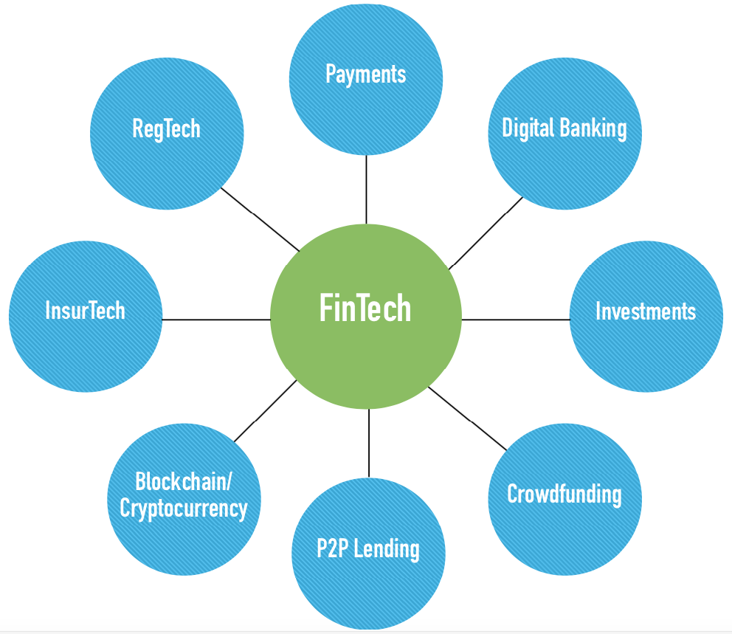
FinTech Universe

Slide 5
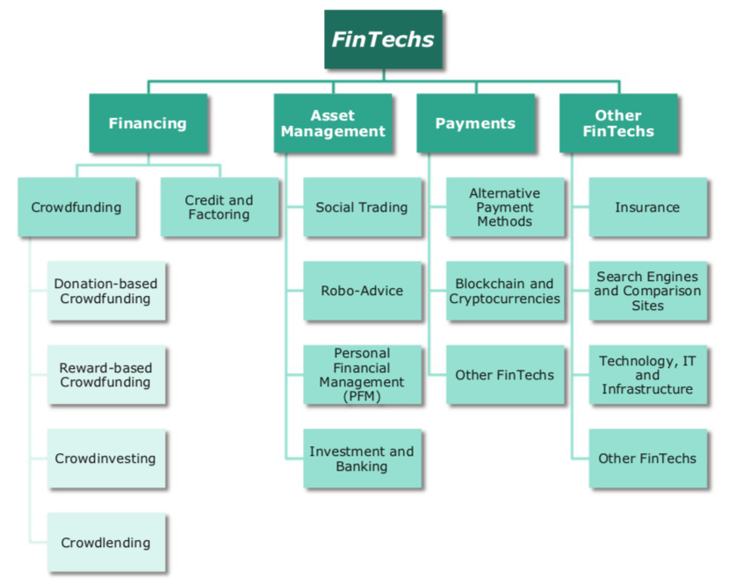
Segments of FinTech Industry

Slide 6
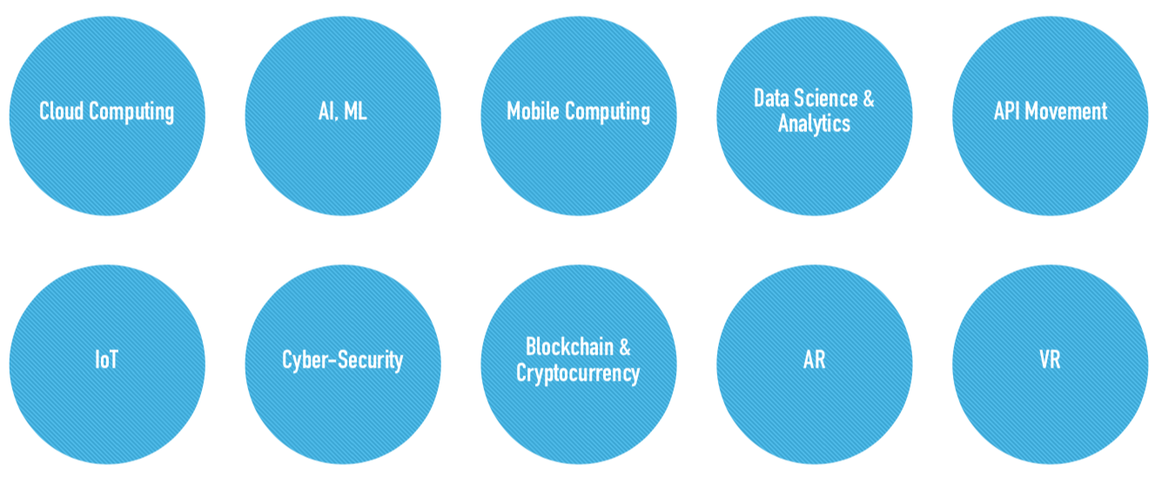
Infrastructure and Key Tech

Slide 7
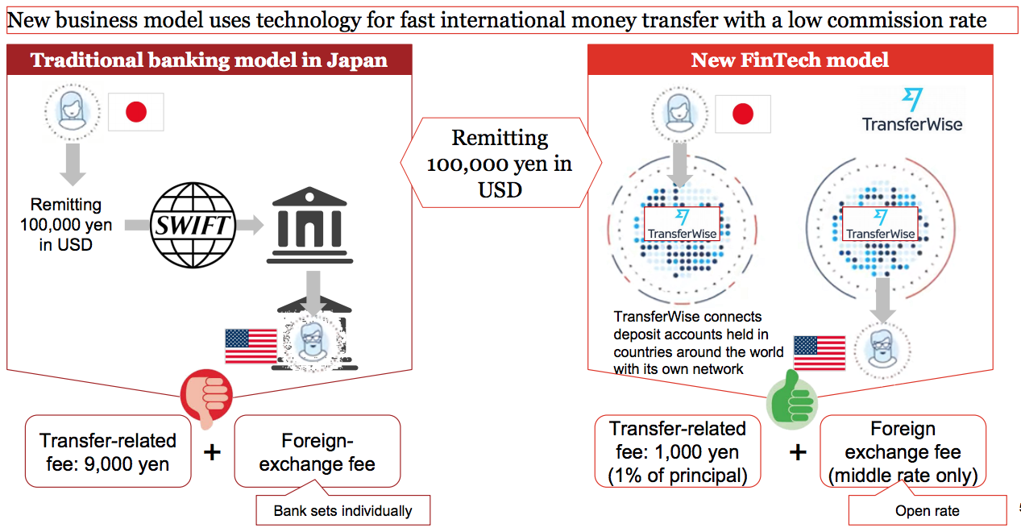
Example: Overseas money transfer – Incumbents vs. FinTech
https://www8.gsb.columbia.edu/cjeb/sites/cjeb/files/Tanaka_Masaaki_CJEB%20FinTech%20presentation%20-%2005.25.17.pdf

Slide 8
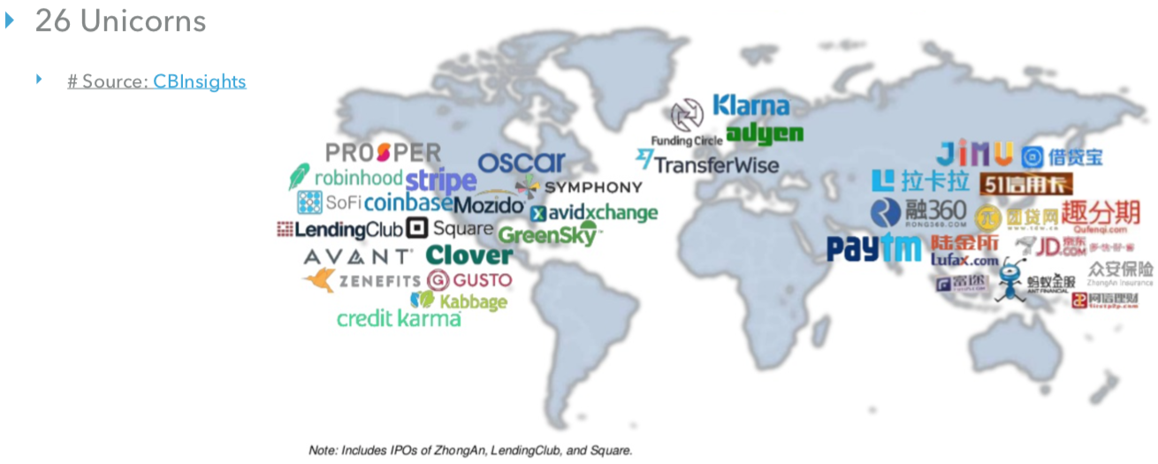
FinTech Unicorns

Slide 9
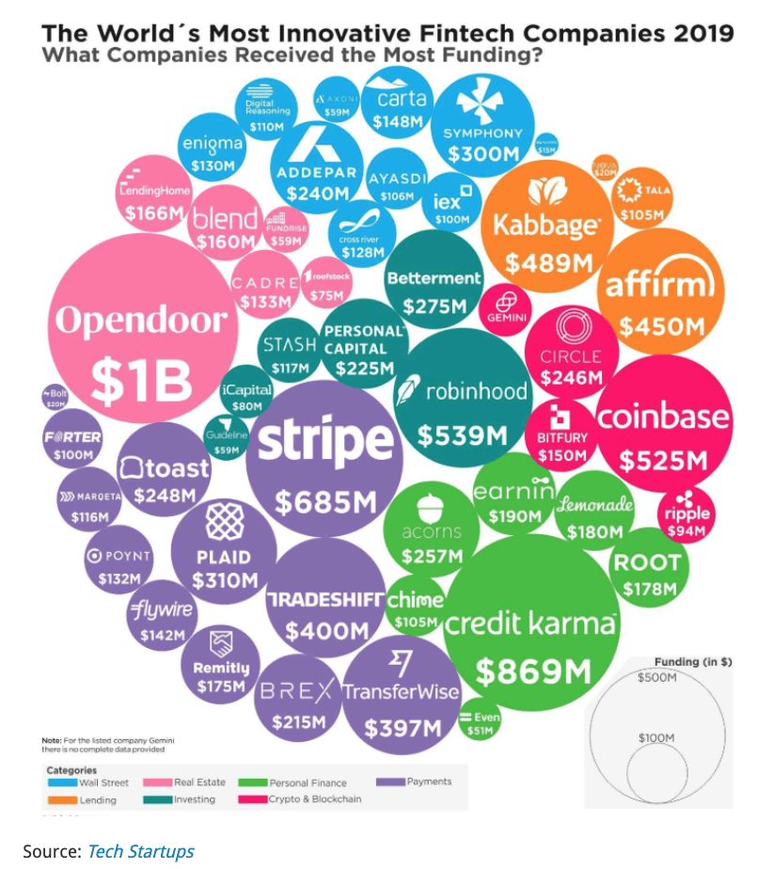

Slide 10
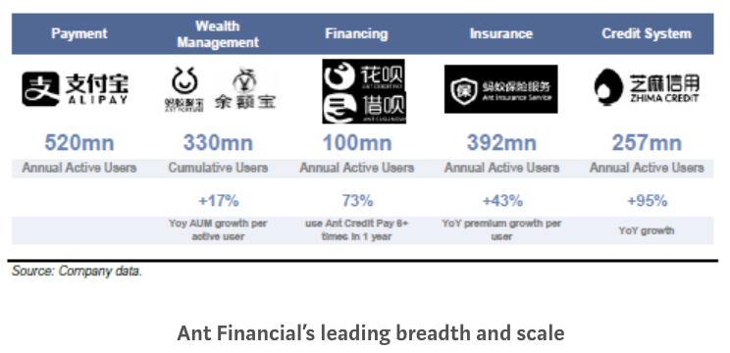
Ant Financial (previous known as Alipay), is the largest unicorn fintech company in the world

Slide 12
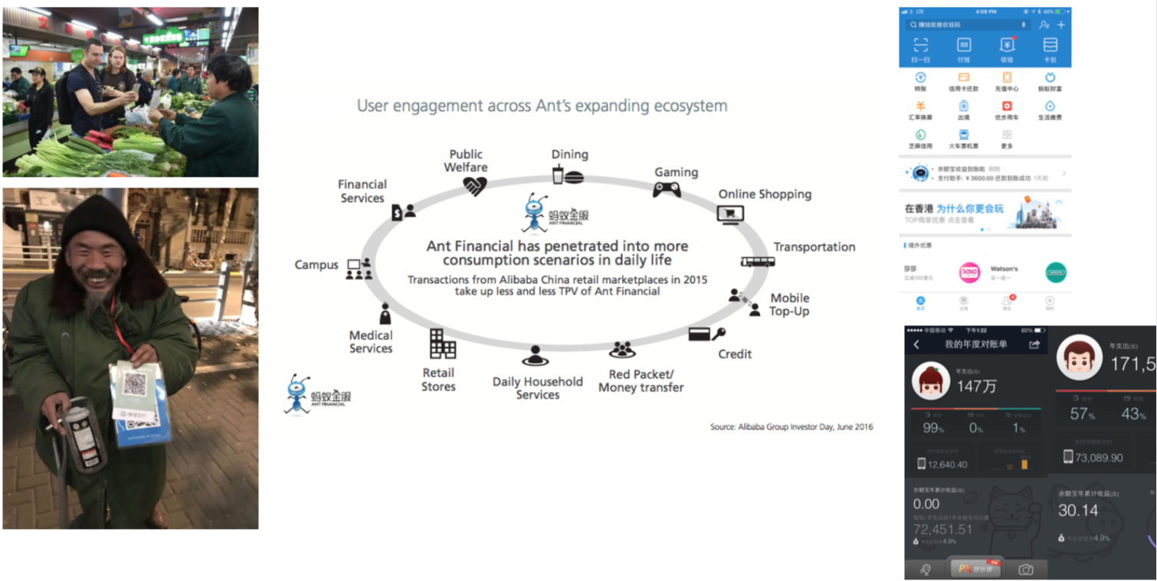
Cashless Payment, and Beyond ….
Ant Financial (previous known as Alipay), is the largest unicorn fintech company in the world

Slide 13
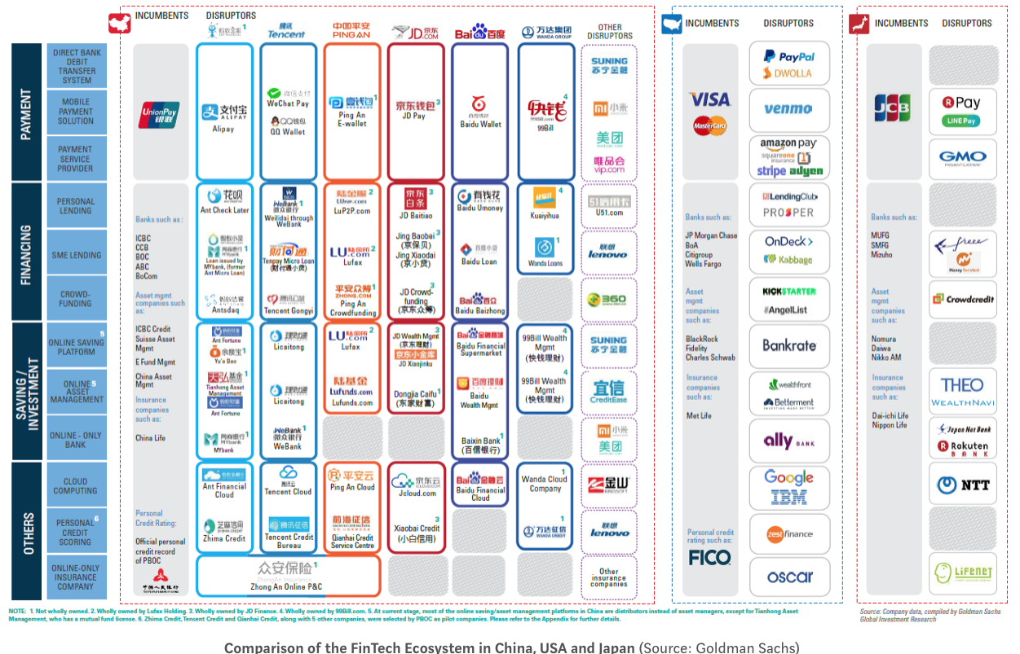

Slide 14
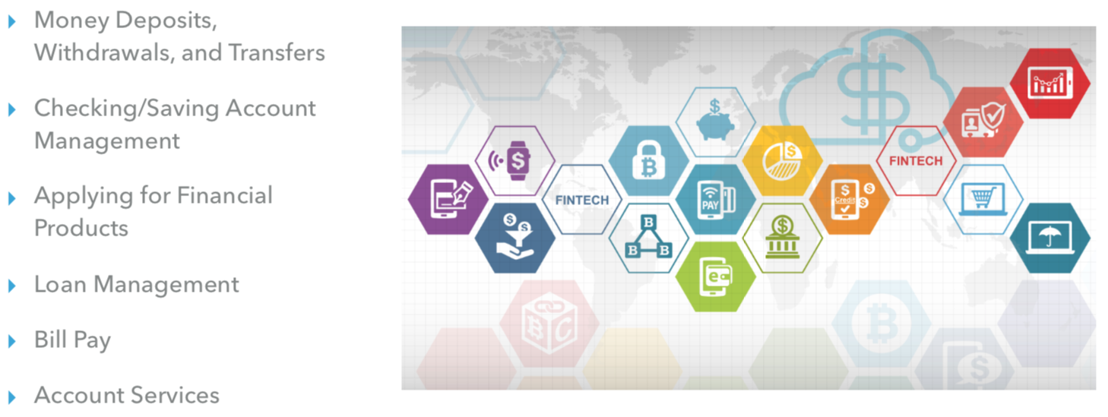
“Banking is necessary, but banks are not”—Bill Gates 1994
Banking is better with FinTech!

Slide 15
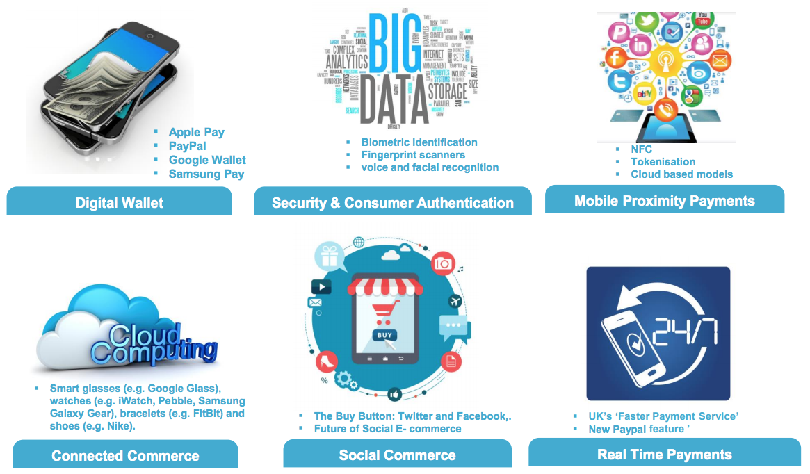
Payment Revolution – New Technologies
https://www.iia.org.uk/media/1560303/digitalisation-of-payments-presentation.pdf

Slide 16
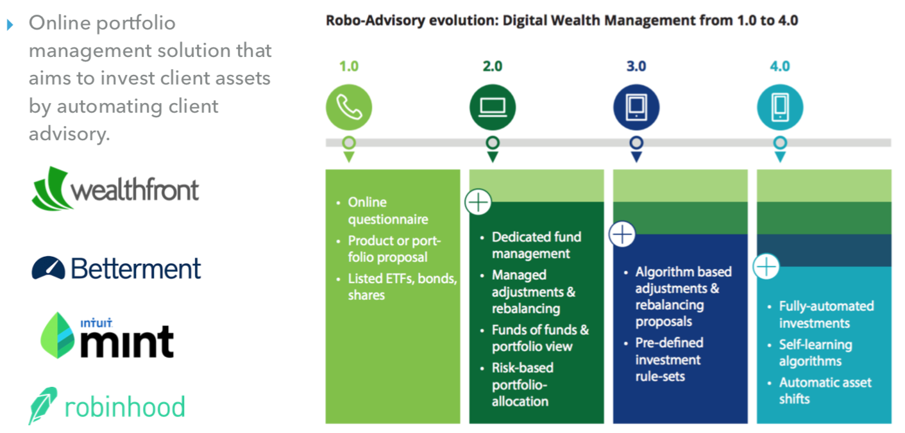
Digital Wealth Management Evolution

Slide 17
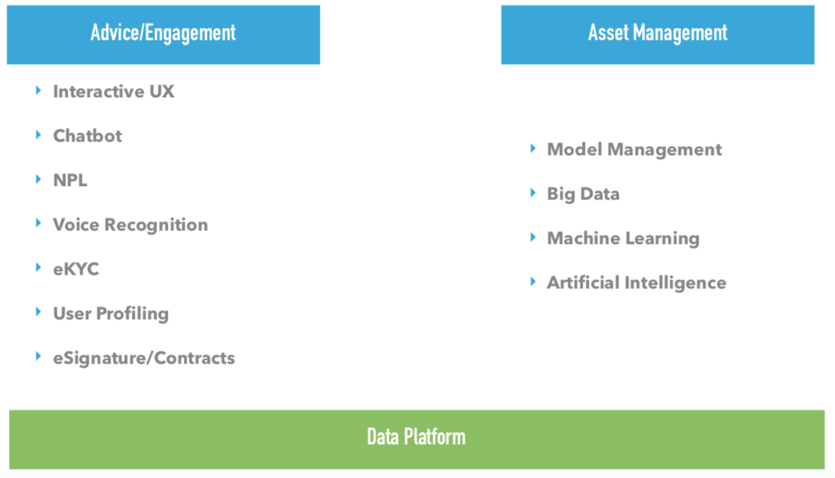
Robo-Advisors: Key Techs

Slide 18
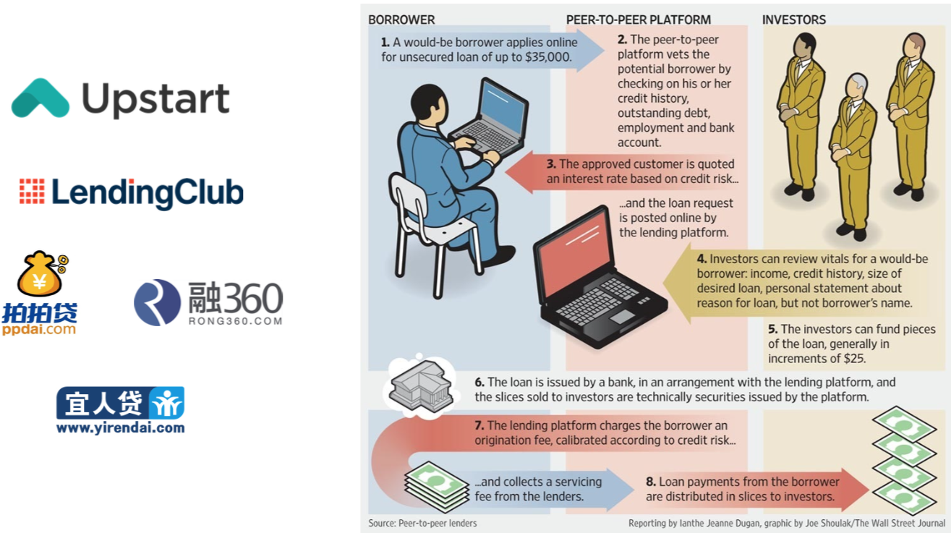
P2P Lending

Slide 19
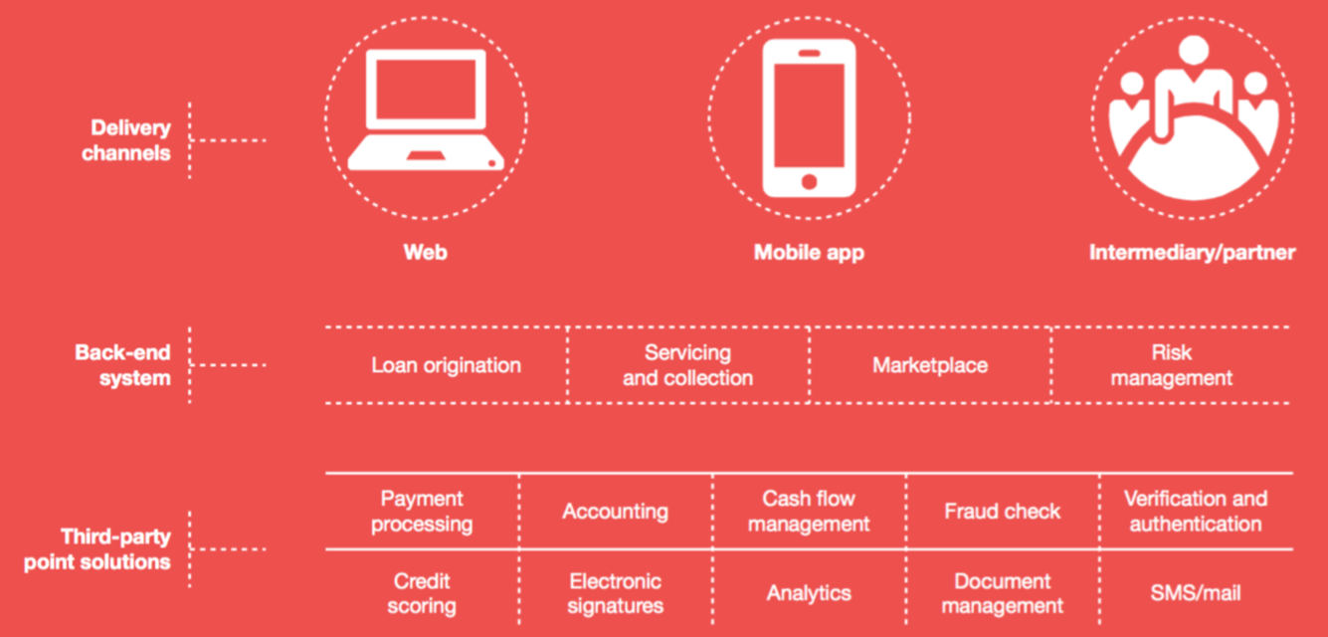
P2P Lending: Key Techs

Slide 20
The Rise of the Marketplace Lenders
A rapidly growing crop of technology-focused lenders are putting customer needs, big data, and advanced
analytics at the center of their business models.
Online Balance
Sheet Lenders
P2P Lenders Supply/Trade Financing
Online Invoice Financing
12

Slide 21
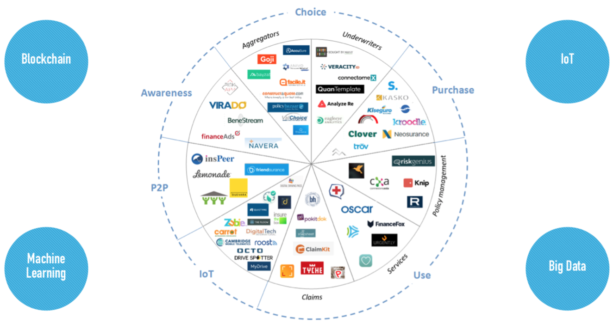
Insurtech Ecosystem

Slide 22
REGTECH STAGES OF DEVELOPMENT
ref. CFA Institute Research Foundation 2016

Slide 23
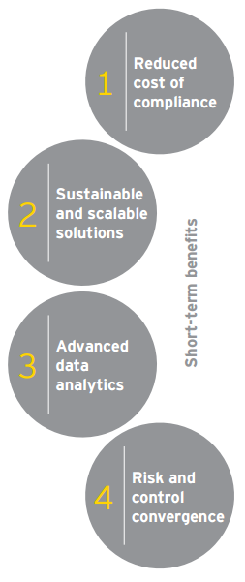
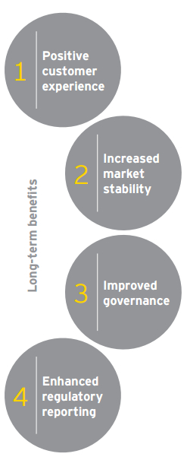
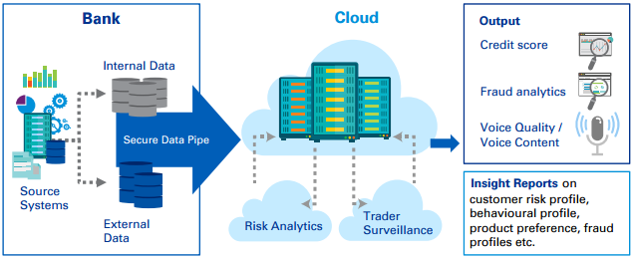
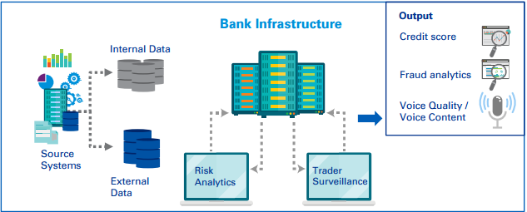
How Regtech help
Regtech Service Model
On-premise Model
ref. Amy Chen, IFG 2017

Slide 24
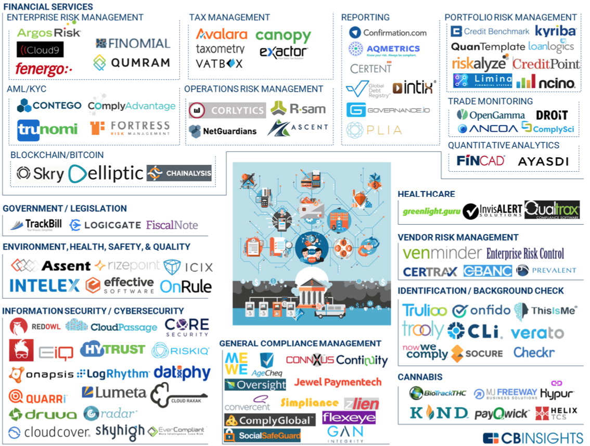
Regulation Tech (Regtech)

