Slide 1
5G Technology and Application, and Technology/Trade War
Daniel HaoTien Lee
http://danieleewww.yolasite.com/2019-mgb070.php
danieleewww@gmail.com

Slide 2
What is 5G!
https://www.youtube.com/watch?v=w0pK7Nemznk
https://www.youtube.com/watch?v=bub2iCRkyLE
https://www.youtube.com/watch?v=MC_Sfkh5-zQ&t=306s
https://spectrum.ieee.org/video/telecom/wireless/everything-you-need-to-know-about-5g

Slide 3
5G Intuitions
Interact with surroundings in real-time – M2M, M2H, H2H
All realities (AR/VR/MR/XR) going mobile
(VR is immersing people into a completely virtual environment ; AR is creating an overlay of virtual content, but can’t interact with the environment; MR is a mixed of virtual reality and the reality, it creates virtual objects that can interact with the actual environment. XR brings all three Reality (AR, VR, MR) together under one term.)
Speed of traditional local storage device (flash disk and hard disk) << 5G based storage system

Slide 4
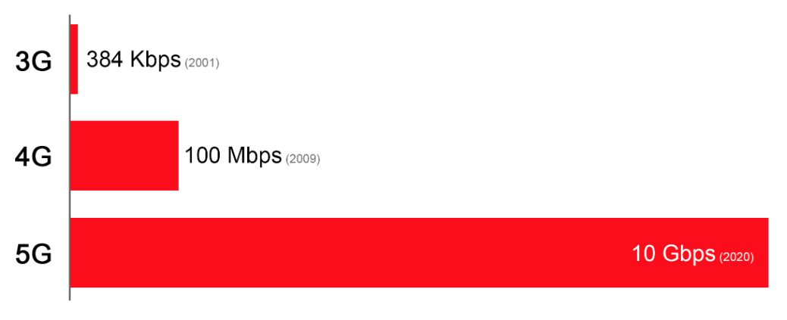
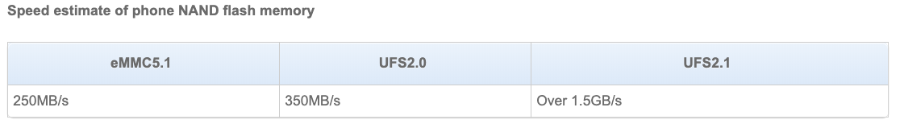
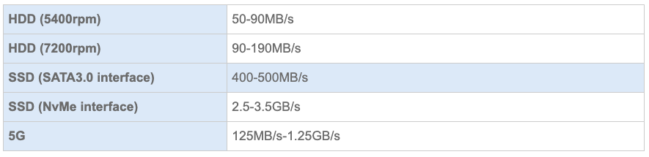

Slide 5
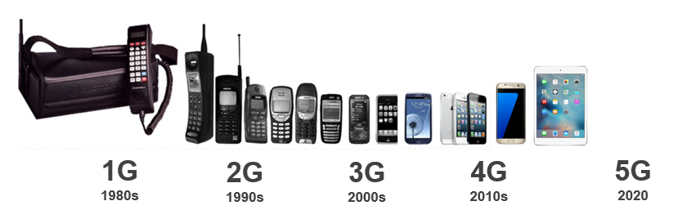
What is 5G?
5G is the 5th generation of mobile networks
Extreme speeds - Gbps
High Capacity – 10x
Low Latency – 1ms
Analogue
Digital
SMS
Multimedia
Video Calling
Mobile internet
Mobile Broadband
Enhanced Video
Mobile Connected World
Enhanced Mobile Broadband
Low latency applications
Internet of Things
Augmented and Virtual Reality (AR & VR)
Courtesy of Mike Wood, ACMA RadComms 2018

Slide 6
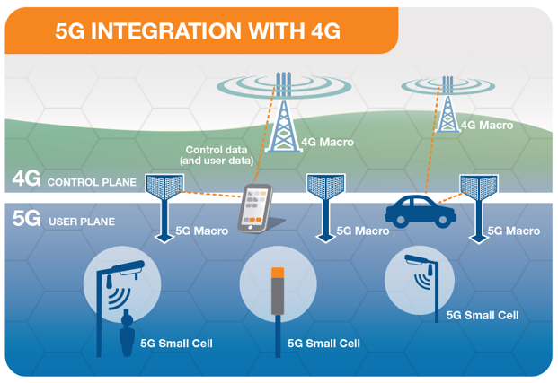
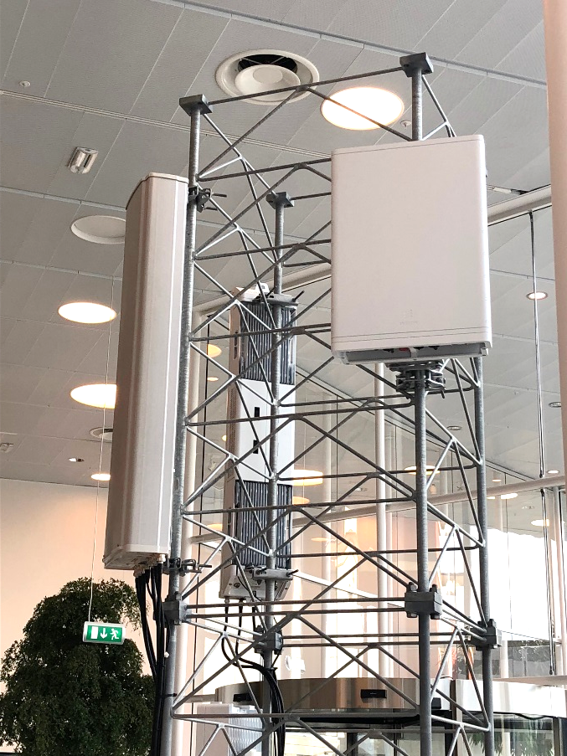
How does 5G work?
5G works together with 4G (initially non standalone NSA)
4G acts as control plane
5G acts as data/user plane
5G will operate stand alone in later releases
5G
5G
4G
4G
5G - 3.5GHz
5G – mmWave 27GHz
Courtesy of Mike Wood, ACMA RadComms 2018

Slide 7
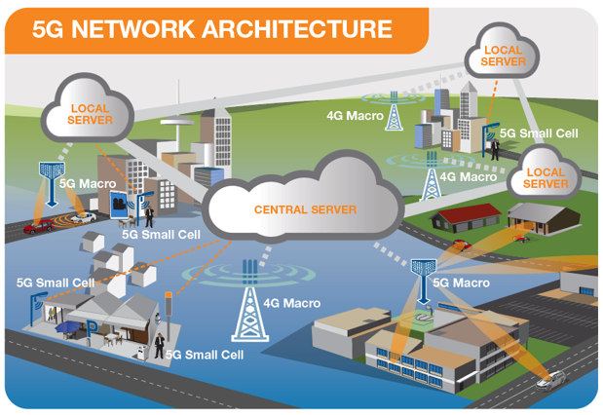
How does 5G work – network architecture
Radio Access Network - small cells, towers, masts dedicated in-building and home systems that connect mobile users and wireless devices to the core network
Core Network - mobile exchange and data network, manages mobile voice, data and internet connections.
Redesigned to integrate with the internet and cloud based services, distributed servers across the network.
Network Slicing – smart way to segment network
for separate applications – e.g. emergency services
5G network architecture - illustrating 5G and 4G working together, with central and local servers providing faster content to users and low latency applications
Courtesy of Mike Wood, ACMA RadComms 2018

Slide 8
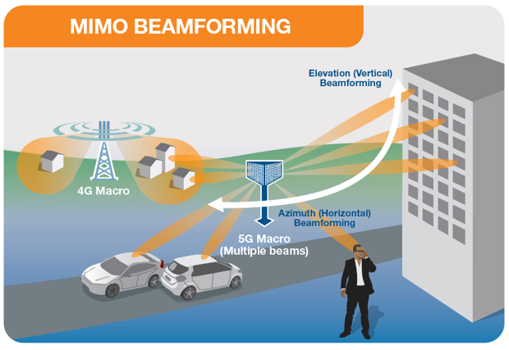
5G Technology - Beamforming
  Dedicated radio signal towards the user
  A 4G signal is typically spread across a wide area
  Enabled by Massive MIMO technology
  Identifies most efficient signal path
  Improves connection reliability
  Reduces interference (unwanted signals)
  Efficient use of spectrum and power
  Allows more simultaneous data streams
Key Point – Beamforming is more efficient and reduces average RF exposure levels

Slide 9
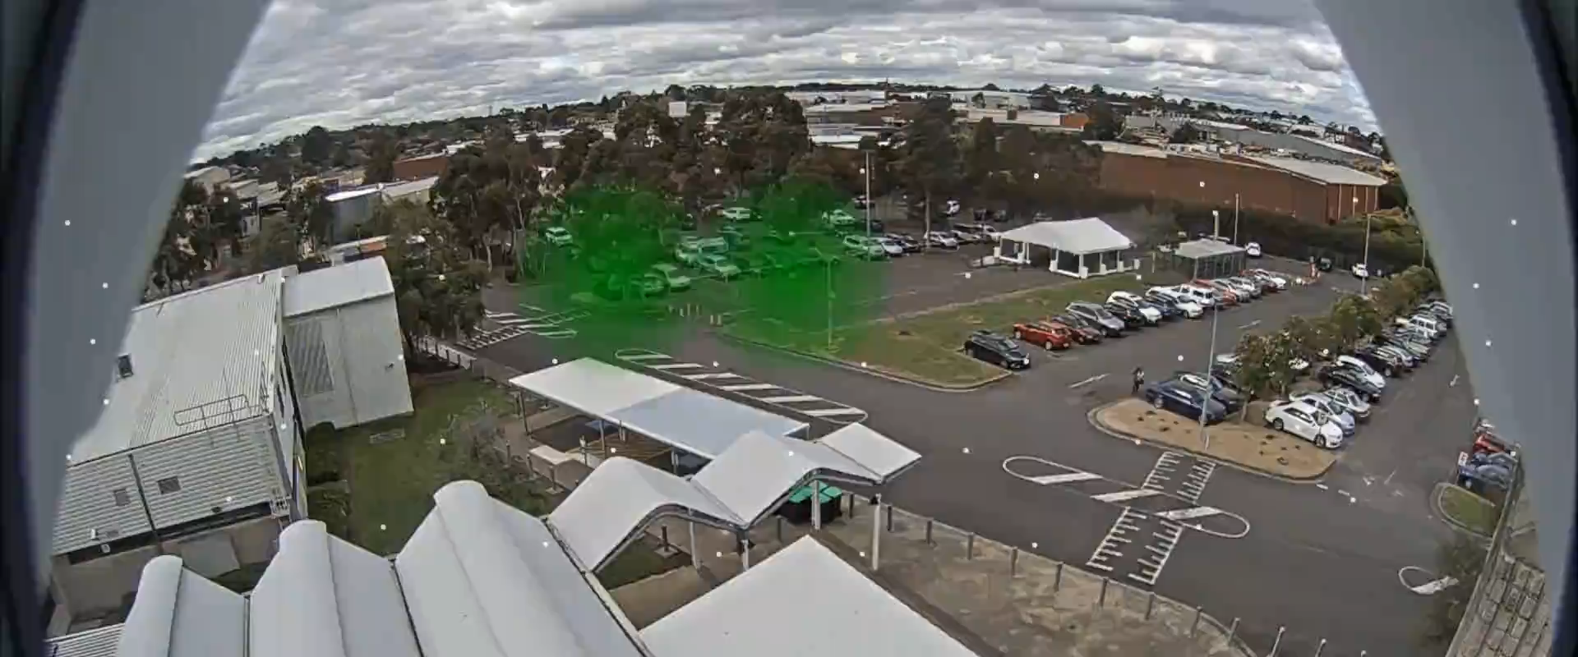
5G Technology – Beamforming live example
Beamforming - Example from Telstra’s 5G Trial in Melbourne 2016
green dots show active beams connected to 5G Van driving in carpark

Slide 10
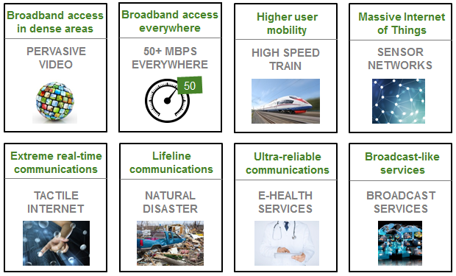
Starting point - ‘5G is different’
Service, application and business case-led definition
Source – NGMN White Paper, 2015 https://www.ngmn.org/de/5g-white-paper/5g-white-paper.html
5G Vision defined around Business Context, and Characterisation based on Use Cases, Business Models and Value Creation
Courtesy of Dan Warren, Samsung 2018

Slide 11






Key Usage Scenarios Drive for 5G
eMBB
Enhanced Mobile Broadband
10 Gbps
4K/8K UHD Video
AR & VR
Cloud Gaming
Enhanced Mobile Media
Home Broadband & TV
In-venue Wireless Broadband
In-car Operations
Ultra-reliable Low Latency Communications
Industrial Automation
Remote Manufacturing/Surgery
Self-driving Vehicles
Ultra-reliable applications
Massive Machine type Communications
mMTC
URLLC
1 million connections/km2
1 ms
Smart Homes/Buildings
Energy & Utilities
Smart Agriculture
Logistics
Smart City
Source: Recommendation ITU-R M.2083
5G connections will go beyond human beings’ communications, and will enable intelligent internet of things in the future. Next generation of telecommunication technologies will be adopted by a wider range of industries and sectors.C
5G connections will go beyond human beings’ communications, and will enable intelligent internet of things in the future. Next generation of telecommunication technologies will be adopted by a wider range of industries and sectors.

Slide 12
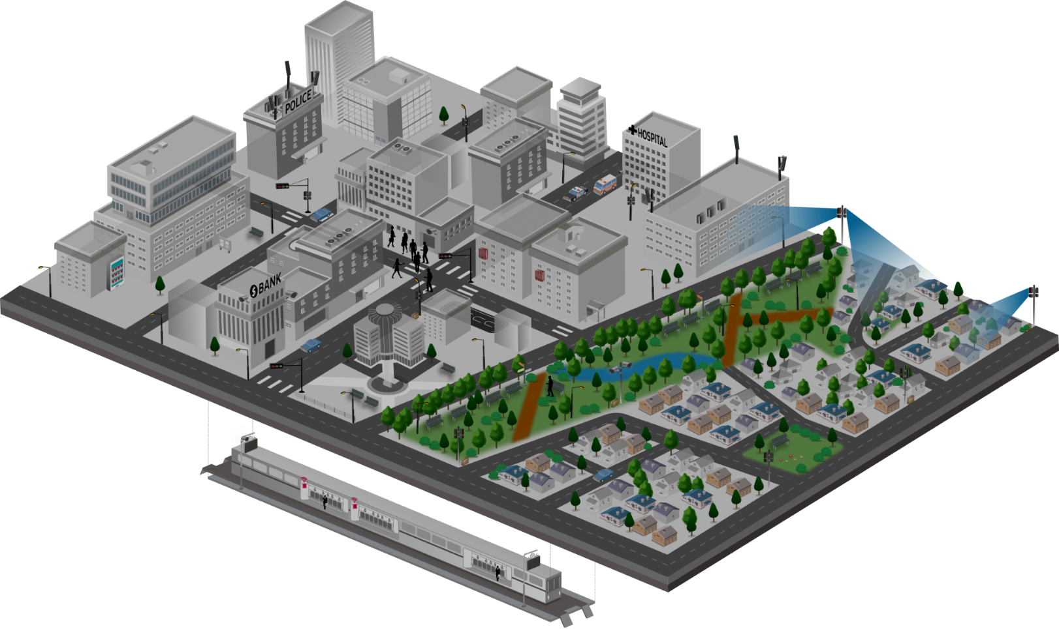












5G Service Scenarios
Key Scenarios to be Addressed throughout the Multiple Stages of 5G Development
1
Mission Critical Service
4
Fixed Broadband
· Full reliability & high availability
· Real-time responsiveness
· On-the-fly coverage scalability
for disaster situations
· Next-generation broadband
· Multi-Gbps peak throughputs
· Alternative to costly fibre
· New VAS possibilities for
fresh revenue generation
Requirements
Ambulance
10x bandwidth per connection
Low-ms latency
Five 9’s reliability
100% coverage
>10x connections
50Mbps per connection everywhere
1000x bandwidth/area
10 year battery life
Reduction in TCO
Autonomous driving
Vending machine
CCTV
CCTV
2
Massive IoT
· Connectivity for a new wave of device types
· High density deployments
· Networks-as-a-Service to meet
each service provider’s needs
· Robust QoE / QoS management
· New revenue opportunities
3
Mobile Broadband
CCTV
· Multi-Gbps peak throughputs
· Universal gigabit connectivity
· Unparalleled mobility support
· New service / application enablement
· Advanced big data analytics
Courtesy of Dan Warren, Samsung 2018

Slide 13
Different contexts of the same environment
Requirements
Applications
Customer segments
MNO biz model
10x bandwidth per connection
Low-ms latency
Five 9’s reliability
100% coverage
>10x connections
50Mbps per connection everywhere
1000x bandwidth/area
10 year battery life
Reduction in TCO
Enhanced Mobile BB
Connected vehicles
AR/VR
S-UHD/3D Video
Haptics/Sensing
Massive IoT
Remote machine control
Mission critical services
Fixed-wireless access
…
Consumer
Auto industry
Health
Industry 4.0
Agriculture
Smart City/Public sector
Smart building
Utilities
Education
Transport
…
B2C
B2B
B2B2C

Slide 14
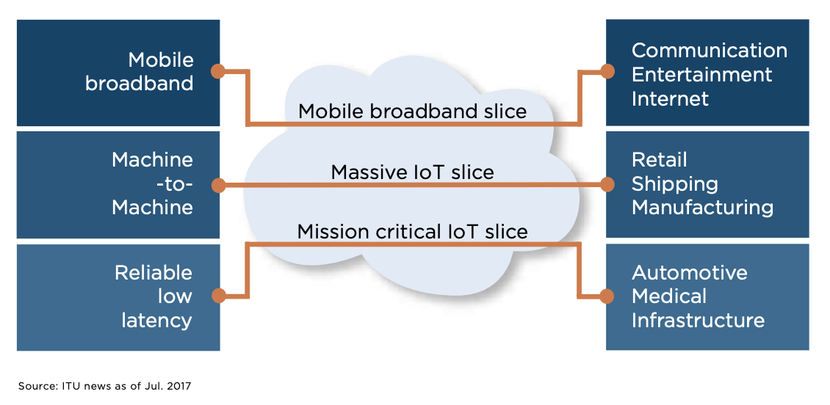
5G Networking Slice

Slide 15
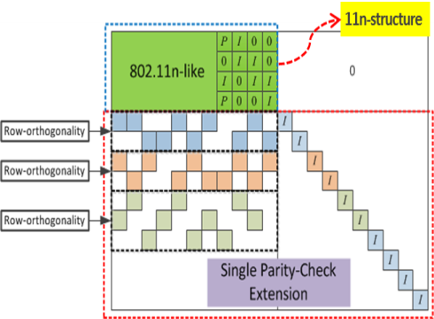
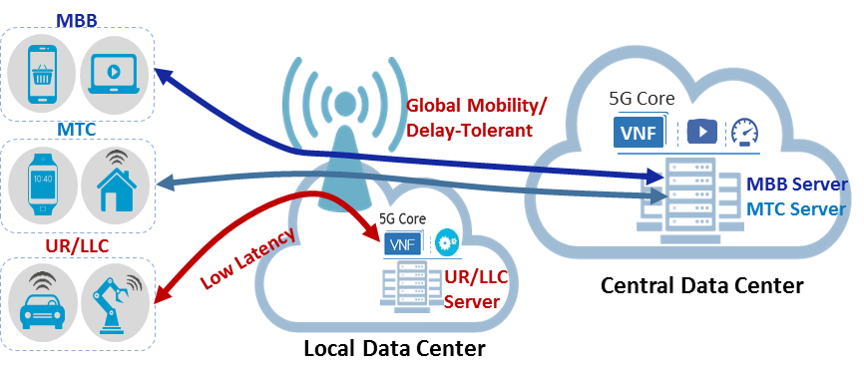
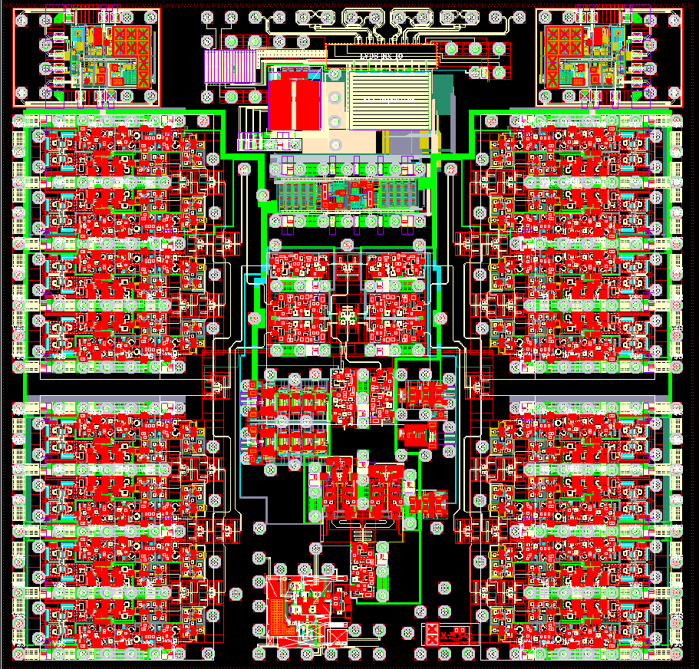


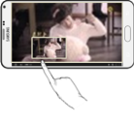




5G Service Enablers – meeting requirements
mmWave System/RFIC/Ant.
New Channel Coding
Network Slicing
700 MHz
3 GHz
18
27
30 GHz
Legacy Bands
New Bands
mmWave
RFIC
Wide
Coverage
Antenna
LDPC (Low-Density Parity-Check )
< 6 GHz Massive MIMO
Massive Connectivity (IoT)
Low Latency NW
Half
-Wavelength
Grant-based
Multiple Access
Grant-Free
Multiple Access
① Radio
Information
② TCP Rate
Control
eNB
3~4 Step
1 Step
eNB
UE
UE
Data
Mobile
BS
Server
Courtesy of Dan Warren, Samsung 2018

Slide 16
Security Perspective
https://www.youtube.com/watch?v=DeTASrRYalE

Slide 17
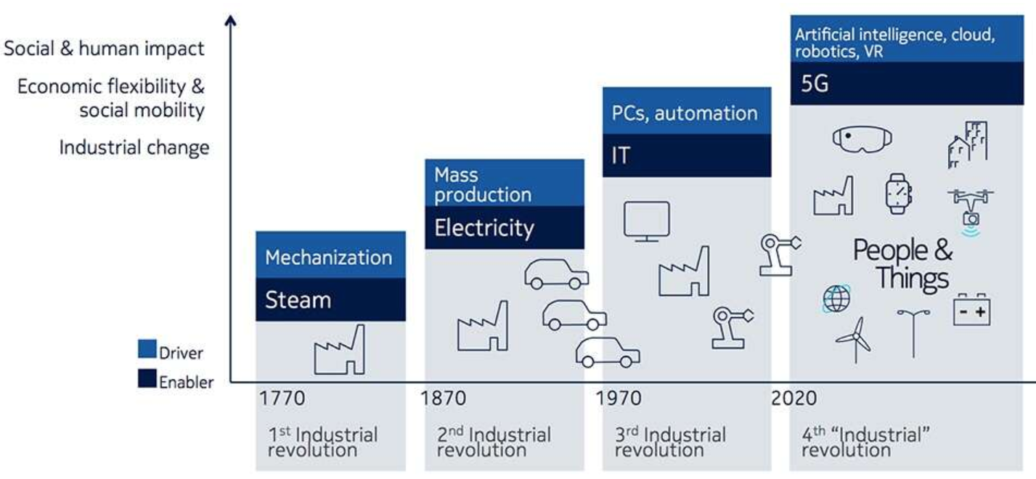
5G Driving Fourth Industrial Revolution
https://www.edn.com/Home/PrintView?contentItemId=4458706

Slide 18
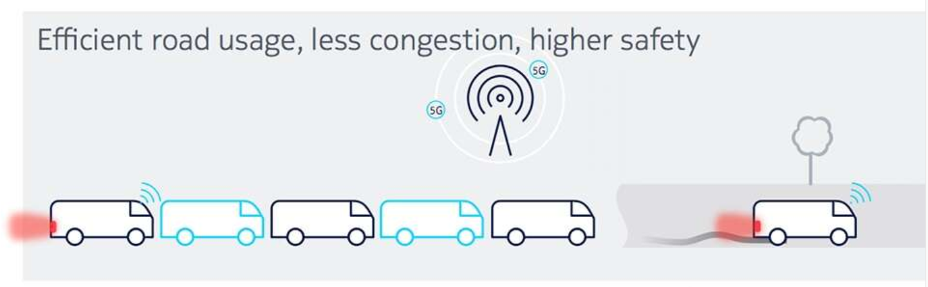
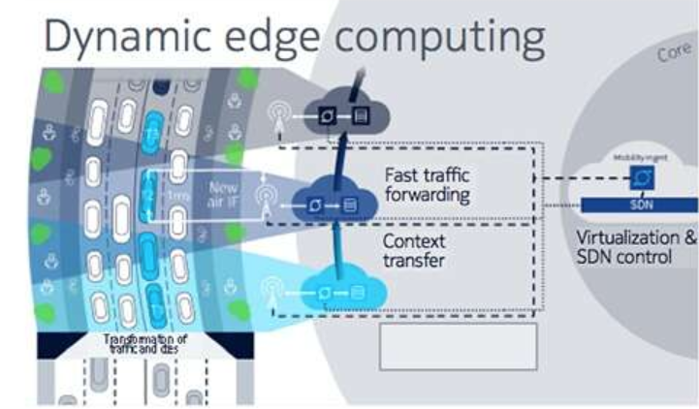
Increasing Safety with AV

Slide 19
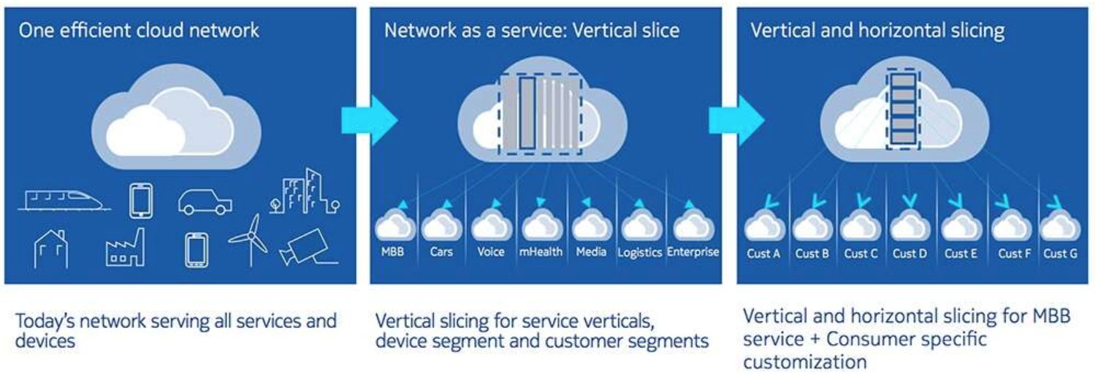
Flexible Network Slicing

Slide 20
Technology/Trade War: 5G initiative
Why US vs China Trade Wars https://www.afk.wiki/video/DxN12jzHrqI/valuetainment.html
5G Technology War? https://www.youtube.com/watch?v=CEQTo9usai4 https://www.youtube.com/watch?v=xnZt1Xd8Vpg
Battle of Nation or Idea!!

Slide 21
References
Handout: http://danieleewww.yolasite.com/2019-mgb070.php
Why US vs China Trade Wars https://www.afk.wiki/video/DxN12jzHrqI/valuetainment.html
5G Technology War? https://www.youtube.com/watch?v=CEQTo9usai4 https://www.youtube.com/watch?v=xnZt1Xd8Vpg
Google and see …..

