Slide 1
Emerging Technology Trend
Daniel Hao Tien Lee
http://danieleewww.yolasite.com/2019-mgb070.php
danieleewww@gmail.com

Slide 2
Top Technology Trend
https://www.weforum.org/agenda/2019/07/these-are-the-top-10-emerging-technologies-of-2019/
http://www3.weforum.org/docs/WEF_Top_10_Emerging_Technologies_2019_Report.pdf
https://www.youtube.com/watch?v=nRTRyfIDp4k&feature=youtu.be
http://www.tadviser.ru/images/6/6b/3891569-top-10-strategic-technology-trends-for-2019.pdf

Slide 3
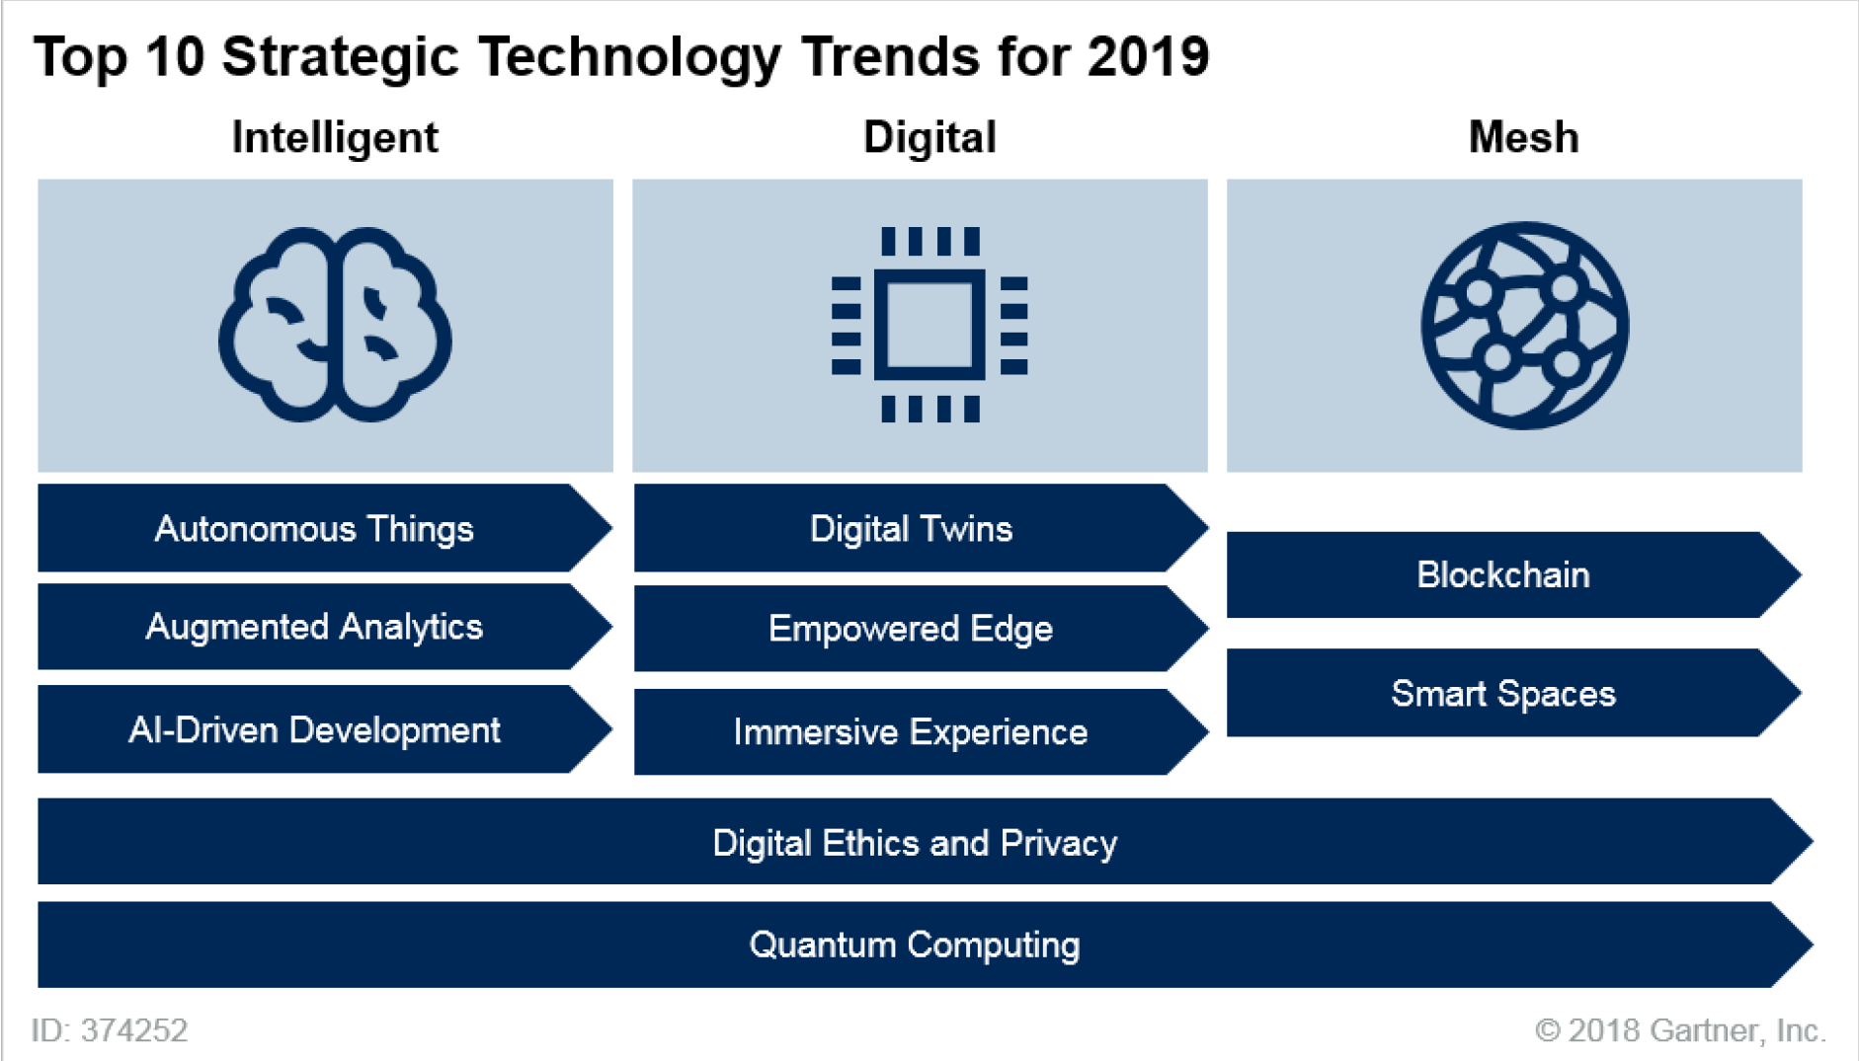

Slide 5
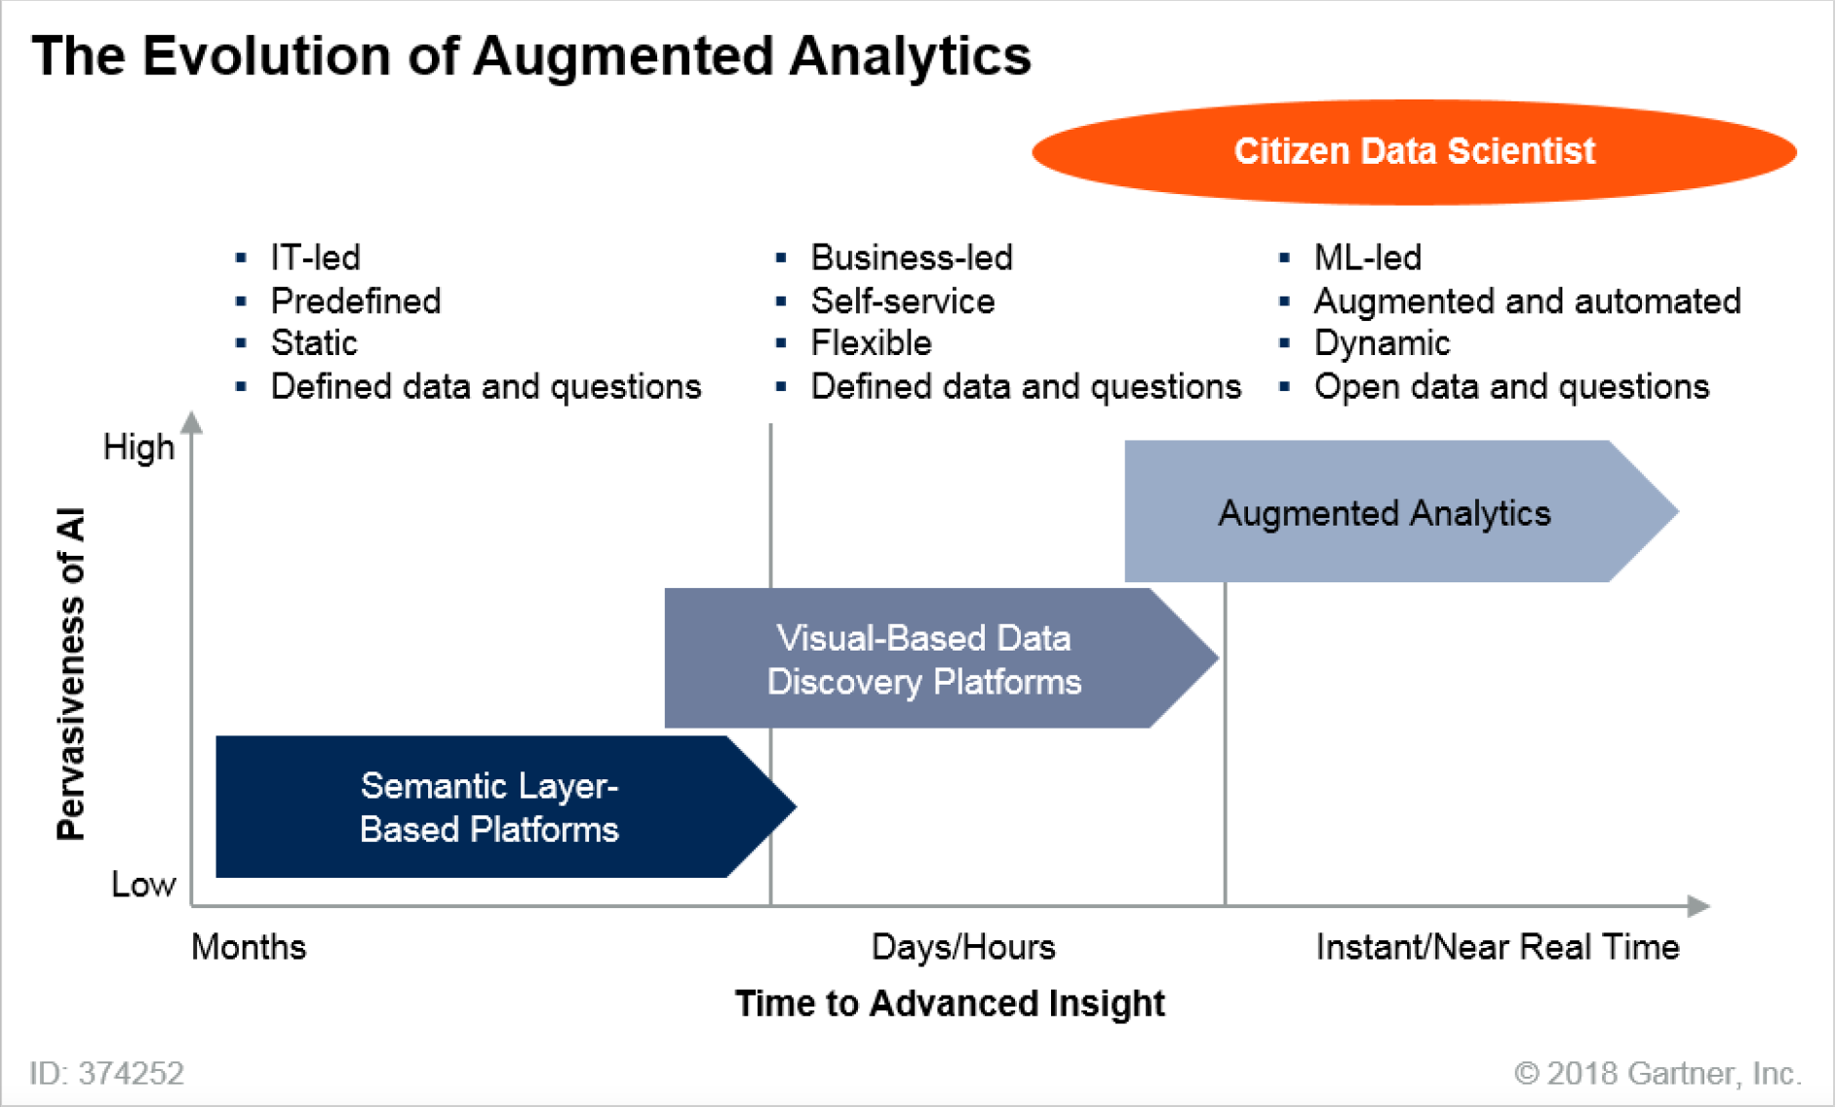
ML = machine learning

Slide 6
Traits of a Citizen Data Scientist
https://blogs.gartner.com/carlie-idoine/files/2018/05/What-Does-a-CDS-Look-Like.jpg

Slide 7
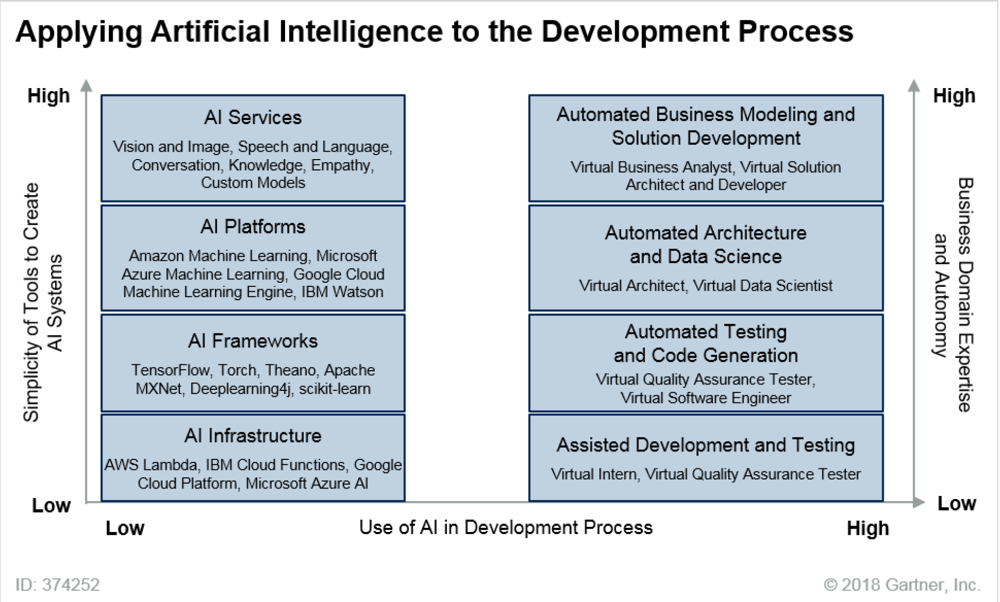

Slide 8
CAD = computer-aided design; FEA = finite element analysis; ML = machine learning

Slide 9
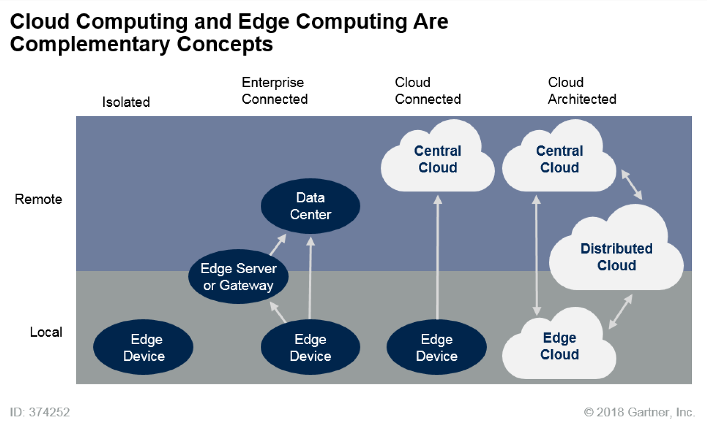

Slide 10
UX = user experience

Slide 12
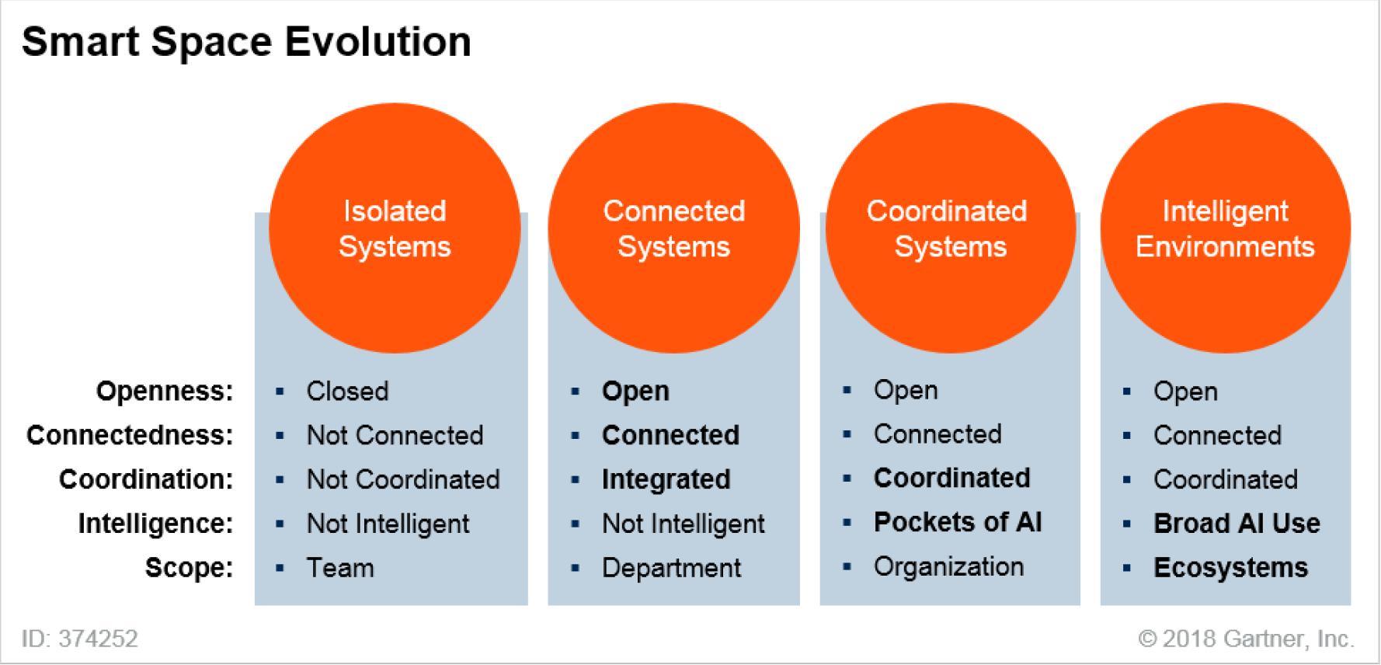

Slide 13
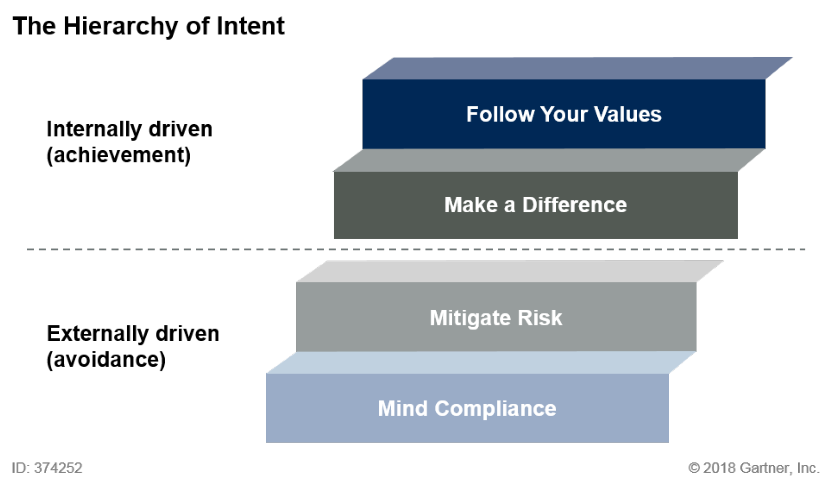
“The move from compliance-driven organizations to ethics-driven organizations can be described as the hierarchy of intent.”

Slide 14
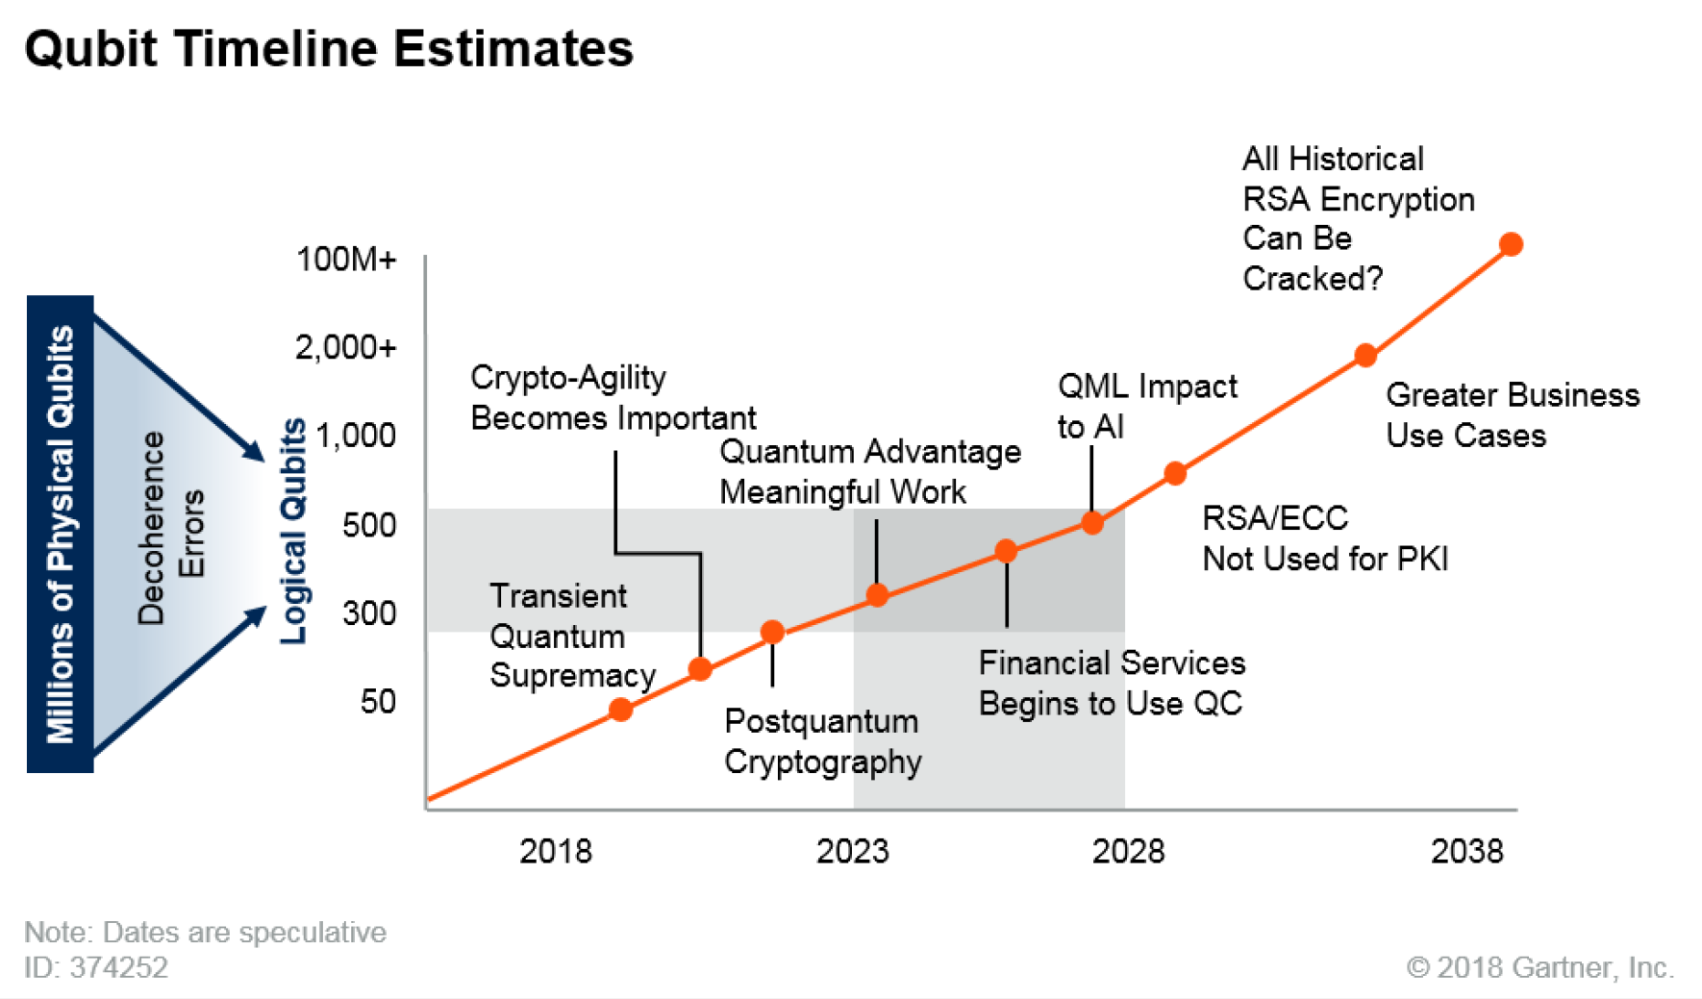
https://www.youtube.com/watch?v=PzL-oXxNGVM
https://www.youtube.com/watch?v=kEJBxotcxRw
https://www.youtube.com/watch?v=JhHMJCUmq28
https://www.youtube.com/watch?v=QuR969uMICM

Slide 15
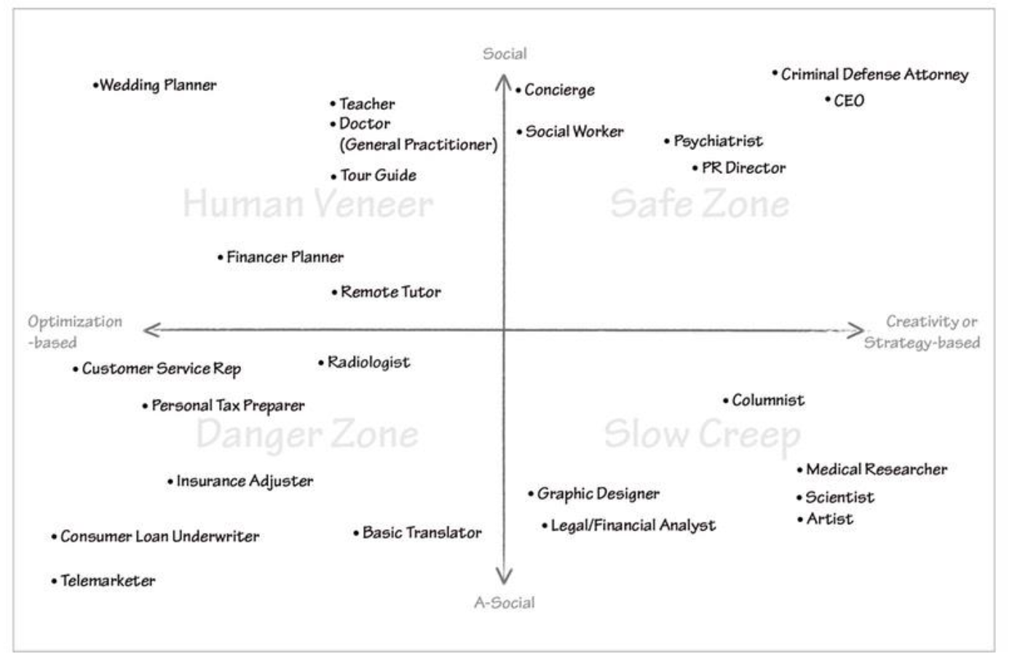
What AI Can and Can’t Do: Replacement of Cognitive Labor
"AI Super-Powers, China, Silicon Valley, and The New World Order", Kai-Fu Lee 2018

Slide 16
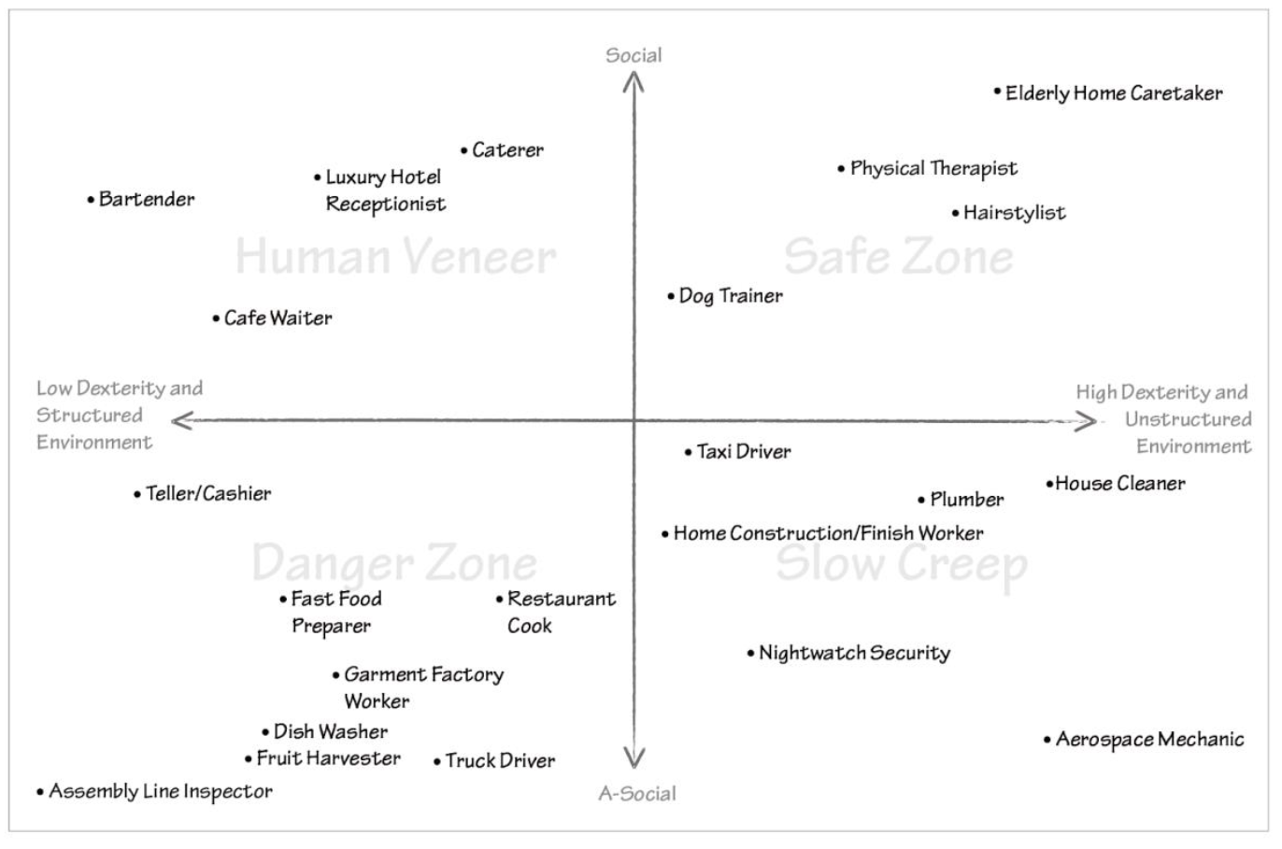
What AI Can and Can’t Do: Replacement of Physical Labor
"AI Super-Powers, China, Silicon Valley, and The New World Order", Kai-Fu Lee 2018

Slide 17
Post AI Era
Symbiosis between Human and AI-Machine!
How
https://medium.com/@kaifulee/10-jobs-that-are-safe-in-an-ai-world-ec4c45523f4f
https://www.inc.com/jessica-stillman/21-future-jobs-robots-are-actually-creating.html
…..

Slide 18
Assignment for next week (9/26)
Resolution of “The population is ready for Artificial Intelligence”
Argument # 1: Taxing both A.I. Robot and A. I. Automation could ease social inequality issues
Argument # 2: Universal Basic Income for digital economy can improve social unstable
Argument # 3: AI/ML(machine learning) in education should close the gap on income inequality
Argument # X: (to be determined by the team)
Arrangement: For(group 1/3), Against(group 2/4), Judging(Daniel)

Slide 19
Informal Debate Guidelines
Conducting:
The first speaker on the For (affirmative) team presents arguments in support of the resolution. (5-10 minutes)
The first speaker on the Against (opposing) team presents arguments opposing the resolution. (5-10 minutes)
The second speaker on the For team presents further arguments in support of the resolution, identifies areas of conflict, and answers questions that may have been raised by the opposition speaker. (5-10 minutes)
The second speaker on the Against team presents further arguments against the resolution, identifies further areas of conflict, and answers questions that may have been raised by the previous affirmative speaker. (5 – 10 minutes)
The rules may include a short recess for teams to prepare their rebuttals. (5 minutes)
The Against team begins with the rebuttal, attempting to defend the opposing arguments and to defeat the supporting arguments without adding any new information. (3 – 5 minutes)
First rebuttal of the affirmative team (3 – 5 minutes)
Each team gets a second rebuttal for closing statements with the For team having the last opportunity to speak. (3 – 5 minutes each)
Each team must type up a general script/outline of their arguments.
Each team must have prepared one page of hypothetical counterarguments.
Each person in the group must speak at least once.

