Slide 1
What is Libra
Daniel Lee

Slide 2
What is Libra
Libra, the new currency what's known as a stablecoin -- a digital currency that's supported by established government-backed currencies and securities. The goal is to avoid massive fluctuations in value so Libra can be used for everyday transactions in a way that more volatile crypotcurrencies, like Bitcoin, haven’t been.
https://www.youtube.com/watch?v=Zmf7Kd64TBo
https://fortune.com/2019/06/18/facebook-project-libra-crypto-coin-cryptocurrency-how-it-works/
https://www.youtube.com/watch?v=u8y3SLfP7TI
https://www.youtube.com/watch?v=BYxH38H7AZQ
https://libra.org/en-US/wp-content/uploads/sites/23/2019/06/LibraWhitePaper_en_US.pdf
https://blockgeeks.com/guides/understanding-facebooks-cryptocurrency-libra/
https://blockgeeks.com/guides/what-is-facebook-libra-cryptocurrency-the-most-comprehensive-guide-part-2/

Slide 3
Libra https://www.bloomberg.com/opinion/articles/2019-06-18/facebook-will-make-the-money-now https://www.theverge.com/2019/6/26/18716326/facebook-libra-cryptocurrency-blockchain-irs-starbucks
Libra will be a “stablecoin,” in the sense that its value will be pinned to conventional financial assets. Unlike most stablecoins, though, it will be pinned to a basket “of low-volatility assets, including bank deposits and government securities” in different currencies, so it won’t consistently be worth one dollar or one euro or anything else. “As the value of Libra will be effectively linked to a basket of fiat currencies, from the point of view of any specific currency, there will be fluctuations in the value of Libra.”
Libra is a permissioned blockchain; transactions on its system are maintained by servers run by members of the Libra Association, i.e. big tech and payments companies. This makes the Libra people nervous:

Slide 4
What is Libra (quoted from its white paper)
According to the white paper, “Libra is a simple global currency and financial infrastructure that empowers billions of people.” Libra has five essential components/features:
Built on a secure, scalable, and reliable blockchain.
It is a stablecoin which is backed by a reserve of assets.
It is governed by the independent Libra Association.
Uses the LibraBFT consensus mechanism.
Smart contract coding is done through “Move” programming language.
Facebook aims to have 100 members in its Libra Association before the launch, which in on first half of 2020. Final decision-making authority lies with the association but Facebook will maintain a leadership role through 2019. However, the whitepaper states that once the network launches, all the members of the Association will have the same commitments, privileges, and financial obligations as any other Founding Member. All the peers will have equal governance power. Facebook has built a digital wallet called “Calibra” which will be used to interact with Libra. Users will be able to send Libra via their smartphones by using Calibra. To send funds to your Calibra wallet, Facebook will allow you to select from a list of partner payment providers, such as MasterCard, Visa, PayPal, and Stripe. People will also be able to turn US dollars into Libra for their Calibra digital wallet, by going to local or online currency exchanges.

Slide 5
The Libra Blockchain
The Libra blockchain is not really a blockchain in the traditional sense. The Facebook team decided to code their chain from scratch for it to fulfill the following requirements:
Must have the ability to scale to billions of accounts. This requires high transaction throughput, low latency, and an efficient, high-capacity storage system.
Must be highly secure, to ensure the safety of funds and financial data.
Should be flexible, so that it can power the Libra ecosystem’s governance as well as future innovation in financial services.

Slide 6
Facebook Libra: Permissioned moving on to permissionless
Blockchain can be widely categorized into the following:
Permissionless
Permissioned.
Bitcoin and Ethereum are both examples of a permissionless chain. Anybody can buy some ASICs and become a miner in either of those ecosystems. However, Ripple is a permissioned network since not just anyone can become a part of its networks. Only banks or financial institutions which have been vetted can become a part of the network.
Permissionless blockchains are highly decentralized but they are much slower since they have a huge number of nodes. Permissioned blockchains are faster but not as decentralized as their permissionless counterparts.
Libra will start as a permissioned blockchain, with the Libra Association taking care of the overall network well-being. Their goal is to become a permissionless chain eventually. However, they acknowledge that there are several hurdles which need to be overcome before they can do so. As of now, there is no proven solution which can handle “the scale, stability, and security needed to support billions of people and transactions across the globe through a permissionless network.” The Libra Association will be working closely with the Libra community to research ways to implement the transition from permissioned to permissionless. This research will begin within five years of Libra’s launch.

Slide 7
Is Libra’s Blockchain Technically a Blockchain?
A blockchain is a series of blocks which contains time-stamped data and each block is linked to the other cryptographically. The data inside the block is kept cryptographically secure. Miners in Bitcoin and Ethereum bunch up transaction data and put them in the blocks and adds them to the blockchain via the proof-of-work consensus mechanism.
Libra completely changes this by not having blocks as the core data structure in its architecture. Instead, their system has been described as a “decentralized, programmable database.” The transactions in Libra will form a sequence (numbered with ever-increasing integers) which will be stored in Merkle Trees.

Slide 8
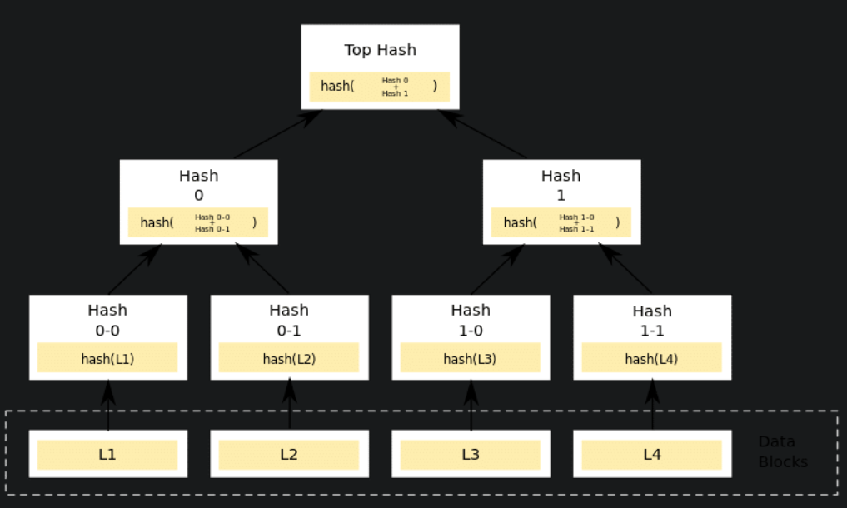

Slide 9
Libra Data Structure
The data structure that you see above is a Merkle tree. In the diagram shown, Hash 0-0 and Hash 0-1 are children of Hash 0, which is known as the parent. You can derive the children from the parent hash. The Top Hash is also known as the Root and you can derive the whole tree through the root.
In Libra, the root of their Merkle Tree will have an authenticator value which is similar to the block hash in a normal blockchain. The authenticator of the transaction will depend on the authenticator of the previous transaction.

Slide 10
Transaction Structure and Fees
A typical Libra transaction has the following components:
The account address of the transaction sender.
The public key that corresponds to the private key used to sign the transaction.
A script coded in Move to execute the transaction along with the arguments (if needed).
The gas price or the fees associated with the transaction.
The gas limit of the transaction. This is the maximum amount of gas that the transaction can consume before it halts.
An unsigned integer that must be equal to the sequence number from the sender’s LibraAccount.T resource. After this transaction executes, the sequence number is incremented by one.
Libra, like Ethereum, works on a gas model. As has been explained above, every single transaction and smart contract operation costs gas. The more complicated the smart contract, the more gas it will consume. The amount of gas consumed will be converted into Libra, based on the gas price which will then have to be paid by the sender. Each smart contract has a gas limit related to it. The contract will run until all the gas associated has been consumed, after which it will halt and revert back to its previous phase.
The model has probably been made similar to Ethereum to boost adoption. Since Ethereum is the most popular smart contract in the world, the developers will be able to use Libra’s system with relative ease because of the similarity. Libra also promises “low fees.”

Slide 11
Stablecoin Properties
Libra is going to be a stablecoin which is backed by the Libra Reserve, which is a reserve of real assets. The assets will be “a collection of low-volatility assets, such as bank deposits and short-term government securities in currencies from stable and reputable central banks.” So, let’s understand why Facebook chose a stablecoin structure and how it works.
A sound currency should fulfill the following three roles:
Medium of exchange.
Unit of account.
Store of value.
While cryptos do a great job as a medium of exchange, it is as a unit of account and store of value where it falters miserably. The reason? It is just not stable enough. If you own something that is extremely volatile, will you trust it as a store of value?
Would you want to safely invest your hard-earned money in an asset which may be worth half of its present valuation in 24 hours?
In fact, let’s do some more research on this.
What are the problems that we face because of the volatility of cryptocurrencies and what are the main advantages of stablecoins?
While traders take advantage of this volatility to make their profits, the reality is that they could quickly lose all their money by taking their eyes off the screen. Most of these crypto-crypto exchanges don’t support fiat funds, which is why it is necessary to have a stablecoin where traders can keep their profits untouched.
Cryptocurrencies are not ideal for time-based contracts. If someone were to bet 1 BTC on an event occurring in a year, then they are exposing themselves to two major risks. Firstly, the event may not occur at all, and secondly, the value of BTC may drop down in that time. This volatility makes it extremely difficult to do a proper risk assessment.
Finally, to have widespread mainstream adoption, stablecoins maybe the best form of the currency to take up that role. This is arguably the most important reason why Facebook wanted Libra to be a stablecoin. To boost adoption and to become a “global currency,” Libra became a stablecoin.
So, where does the stability comes from? For that, we need to understand the idea of “pegs.”

Slide 12
Understanding Pegs
Stablecoins get their stability from pegs. According to Wikipedia:
“A fixed exchange rate, sometimes called a pegged exchange rate, is a type of exchange rate regime where a currency’s value is fixed against either the value of another single currency, to a basket of other currencies, or another measure of value, such as gold.”
A peg is used to keep the value of a currency stable by directly fixing its value in a predetermined ratio to a different more stable or more internationally common currency (or currencies).
This method is beneficial for small economies, economies which borrow primarily in foreign currency, and in which external trade forms a large part of their GDP.

Slide 13
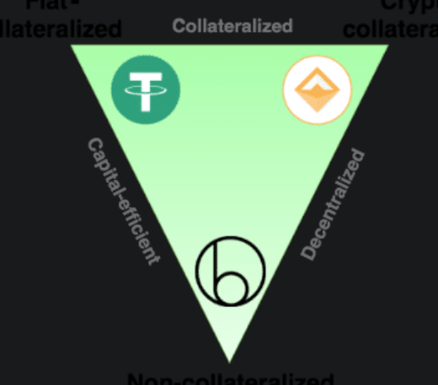
The Three Kinds of Stablecoins
There are three kinds of stablecoins:
Fiat Collateralized.
Crypto Collateralized.
Non-Collateralized.

Slide 14
Stablecoins
#1 Fiat Collateralized
Fiat-collateralization is probably the most simplistic and straightforward execution of stablecoins. The way it works is pretty simple. A certain amount of fiat is locked up as collateral and coins are issued 1:1 against it. Instead of fiat currency, gold, silver, oil etc. can also be kept as collateral.
Tether is probably the best example of this and it also happens to be the most widely used stable coin. Libra is also a fiat collateralized stablecoin.
Unlike Tether, though, Libra’s value will fluctuate in the same manner that the U.S. dollar varies compared with the euro or yen on any given day. A system of exchanges will be established for users to convert fiat for Libra.
#2 Crypto Collateralized
Crypto-collateralized stablecoins are actually pretty similar to fiat-collateralized coins…with one major distinction. Instead of using fiat as a peg, they use another cryptocurrency.
However, we all know that cryptocurrencies are unstable, unlike fiat currency (comparatively), so how does this system work?
The answer to that question is “over-collateralization.” So, if you want $100 worth of stablecoins then you will need to deposit $200 worth of ether. It is not a straightforward 1:1 ratio.
Dai is an example of this kind of stablecoin.
#3 Non-Collateralized
Finally, we have the non-collateralized stablecoins. These are the coins who are not backed by anything. If you think about it, a privately issued, non-collateralized, and stable currency could pose a radical challenge to the dominance of fiat currencies.
But, how does one execute this?
Back in 2014, Robert Sams came up with the concept of Seignorage Shares and it is based on a straightforward idea. Create a smart contract which would act as a central bank with only one policy, issue a currency which will always trade at $1.
So what happens if the coin is trading at $2?
Since the price is high, the smart contract will automatically create more coins to increase the supply and dilute the price. The extra profit that would be left over in the smart contract, as a result, is called seignorage.

